Slide 1
Multi-modal Problems and Spatial Distribution
Chapter 9

Slide 2
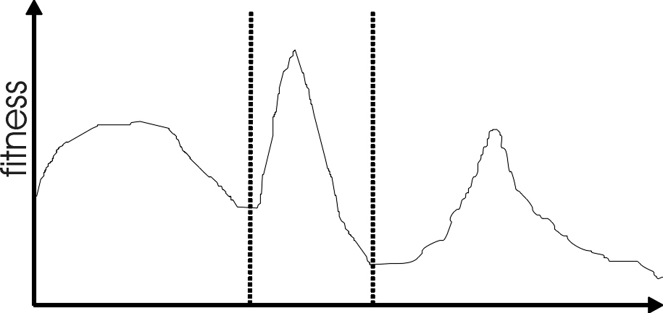
Motivation 1: Multimodality
Most interesting problems have more than one locally optimal solution.
Notes:
There are three local optima in this landscape with different sizes basins of attraction. The global optimum is in the middle, and the leftmost local optimum has a broader peak than the rightmost, despite having a smaller basin of attraction.

Slide 3
Motivation 2: Genetic Drift
Finite population with global mixing and selection eventually converges around one optimum
Often might want to identify several possible peaks
This can aid global optimization when sub-optima have the largest basins of attraction
Notes:
Might want to identify several peaks e.g. for design example where you might want solution from a broad peak as it may be more stable to minor perturbations

Slide 4
Biological Motivation 1: Speciation
In nature different species adapt to occupy different environmental niches, which contain finite resources, so the individuals are in competition with each other
Species only reproduce with other members of the same species (Mating Restriction)
These forces tend to lead to phenotypic homogeneity within species, but differences between species

Slide 5
Biological Motivation 2: Punctuated Equilbria
Theory that periods of stasis are interrupted by rapid growth when main population is “invaded” by individuals from previously spatially isolated group of individuals from the same species
The separated sub-populations (demes) often show local adaptations in response to slight changes in their local environments

Slide 6
Implications for Evolutionary Optimization
Two main approaches to diversity maintenance:
Implicit approaches:
  Impose an equivalent of geographical separation
  Impose an equivalent of speciation
Explicit approaches
  Make similar individuals compete for resources (fitness)
  Make similar individuals compete with each other for survival

Slide 7
Implicit 1: “Island” Model Parallel EAs
EA
EA
EA
EA
EA
Periodic migration of individual solutions between populations

Slide 8
Island Model EAs contd:
Run multiple populations in parallel, in some kind of communication structure (usually a ring or a star).
After a (usually fixed) number of generations (an Epoch), exchange individuals with neighbors
Repeat until stopping criteria met
Partially inspired by parallel/clustered systems

Slide 9
Island Model Parameters 1
Could use different operators in each island
How often to exchange individuals ?
  too quick => all pops converge to same solution
  too slow => waste time
  most authors use range~ 25-150 gens
  can do it adaptively (stop each pop when no improvement for (say) 25 generations)

Slide 10
Island Model Parameters 2
How many, which individuals to exchange ?
  usually ~2-5, but depends on population size.
  more sub populations usually gives better results but there can be a “critical mass” i.e. minimum size of each sub population needed
  it was found that its better to exchange randomly selected individuals than best
  can select random/worst individuals to replace

Slide 11
Implicit 2: Diffusion Model Parallel EAs
Impose spatial structure (usually grid) in 1 pop
Current
individual
Neighbours

Slide 12
Diffusion Model EAs
Consider each individual to exist on a point on a (usually rectangular) grid
Selection (hence recombination) and replacement happen using concept of a neighborhood a.k.a. deme
Leads to different parts of grid searching different parts of space, good solutions diffuse across grid over a number of gens

Slide 13
Diffusion Model Example
Assume rectangular grid so each individual has 8 immediate neighbors
equivalent of 1 generation is:
  pick point in pop at random
  pick one of its neighbors using roulette wheel
  crossover to produce 1 child, mutate
  replace individual if fitter
  circle through population until done

Slide 14
Implicit 3: Automatic Speciation
Either only mate with genotypically/ phenotypically similar members or
Add bits to problem representation
  that are initially randomly set
  subject to recombination and mutation
  when selecting partner for recombination, only pick members with a good match
  can also use tags to perform fitness sharing (see later) to try and distribute members amongst niches

Slide 15
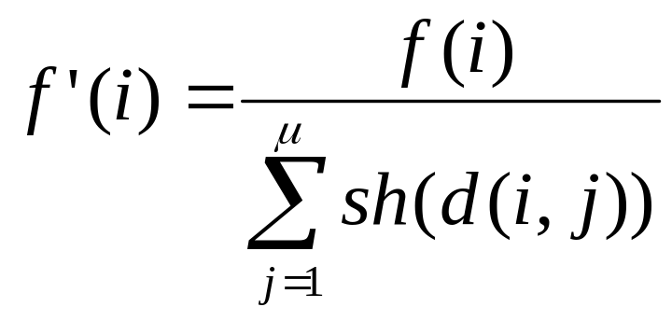
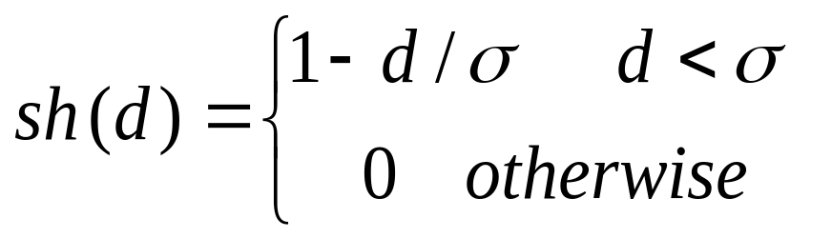
Explicit 1: Fitness Sharing
Restricts the number of individuals within a given niche by “sharing” their fitness, so as to allocate individuals to niches in proportion to the niche fitness
need to set the size of the niche σ_{share} in either genotype or phenotype space
run EA as normal but after each gen set

Slide 16
Explicit 2: Crowding
Attempts to distribute individuals evenly amongst niches
relies on the assumption that offspring will tend to be close to parents
uses a distance metric in ph/g enotype space
randomly shuffle and pair parents, produce 2 offspring
2 parent/offspring tournaments - pair so that d(p1,o1)+d(p2,o2) < d(p1,o2) + d(p2,o1)

Slide 17
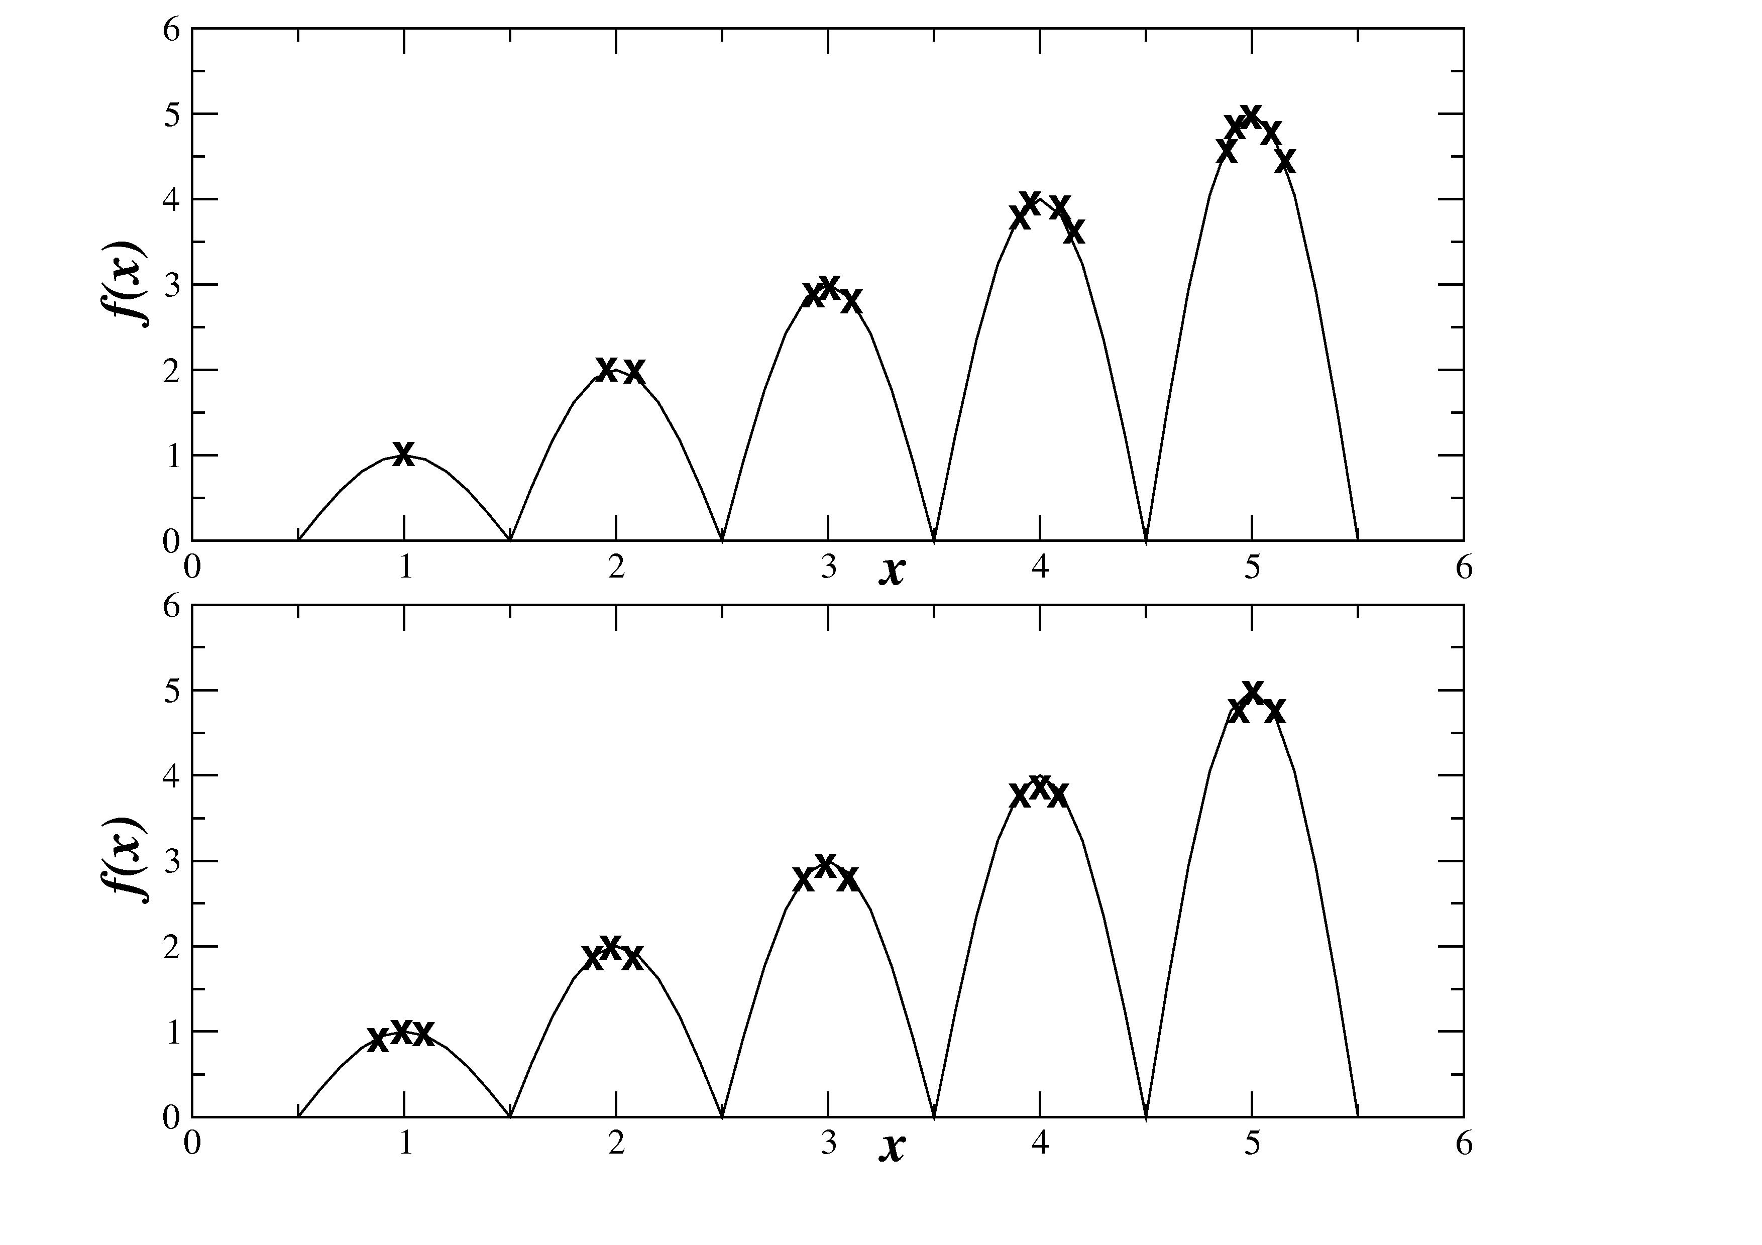
Fitness Sharing vs. Crowding

Slide 18
Multi-Objective Problems (MOPs)
Wide range of problems can be categorized by the presence of a number of n possibly conflicting objectives:
  buying a car: speed vs. price vs. reliability
  engineering design: lightness vs strength
Two part problem:
  finding set of good solutions
  choice of best for particular application

Slide 19
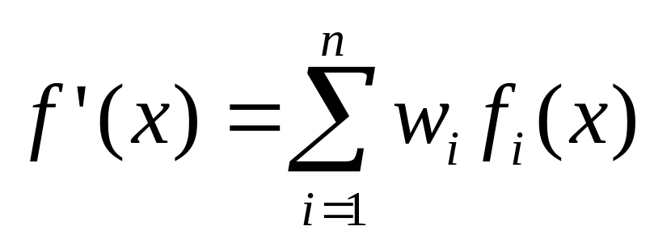
MOPs 1: Conventional approaches
rely on using a weighting of objective function values to give a single scalar objective function which can then be optimized:
to find other solutions have to re-optimize with different w_{i.}

Slide 20
MOPs 2: Dominance
we say x dominates y if it is at least as good on all criteria and better on at least one
f₁
Pareto front
x
Dominated by x
f₂

Slide 21
MOPs 3: Advantages of EC approach
Population-based nature of search means you can simultaneously search for set of points approximating Pareto front
Don’t have to make guesses about which combinations of weights might be useful
Makes no assumptions about shape of Pareto front - can be convex / discontinuous etc

Slide 22
MOPs 4: Requirements of EC approach
Way of assigning fitness,
  usually based on dominance
Preservation of diverse set of points
  similarities to multi-modal problems
Remembering all the non-dominated points you’ve seen
  usually using elitism or an archive

Slide 23
MOPs 5: Fitness Assignment
Could use aggregating approach and change weights during evolution
  no guarantees
Different parts of pop use different criteria
  e.g. VEGA, but no guarantee of diversity
Dominance
  ranking or depth based
  fitness related to whole population

Slide 24
MOPs 6: Diversity Maintenance
Usually done by niching techniques such as:
  fitness sharing
  adding amount to fitness based on inverse distance to nearest neighbor (minimization)
  (adaptively) dividing search space into boxes and counting occupancy
All rely on some distance metric in genotype / phenotype space

Slide 25
MOPs 7: Remembering Good Points
Could just use elitist algorithm
  e.g. ( μ + λ ) replacement
Common to maintain an archive of non-dominated points
  some algorithms use this as second population that can be in recombination etc
  others divide archive into regions too e.g. PAES

