Slide 1
Discrete Mathematics
CSCI/MATH 2610
Boolean Algebra

Slide 2
Reading Assignment
Discrete Mathematics and its Applications ,
by Kenneth H. Rosen.
  Chapter 11, Section 11.1, 11.2, 11.3 and 11.4 (Karnaugh Maps)

Slide 3
Outline
Boolean Algebra
Boolean Functions
Boolean Expression
Boolean Identities
Dual Boolean Functions
DNF and CNF
Circuit Design
Circuit Minimization

Slide 4

Boolean Algebra
Boolean algebra provides the operations and the rules for working with the set {0, 1}.
These are the rules that underlie electronic and optical circuits, and the methods we discuss are fundamental to VLSI design.

Slide 5
Boolean Algebra
An algebra is a mathematical structure satisfying a set of axioms
A Boolean algebra is any set B having elements 0, 1, two binary operators + (adition),• (product), and a unary operator − (complement) that satisfies the following laws:
  Identity laws: x + 0 = x,
  x . 1 = x
  Complement laws: x + x = 1,
  x . x = 0
  Associative laws: (x + y) +z = x + (y +z),
  (x.y).z = x.(y.z)
  Commutative laws: x + y = y + x
  x . y = y . x
  Distributive laws: x + (y.z) = (x + y) .(x + z), x .(y + z)=(x. y) + (x .z).

Slide 6
Boolean Algebra
The minimal Boolean algebra is the algebra formed over the set of truth values {0, 1} by using the operations functions +, •, - (complement).
The minimal Boolean algebra is equivalent to propositional logic where
  O corresponds to False
  1 corresponds to True
  • corresponds logical operator AND
  + corresponds logical operator OR
  - corresponds logical operator NOT

Slide 7
Boolean Algebra
x
0
0
1
1
y
0
1
0
1
x + y
0
1
1
1
xy
0
0
0
1
x
0
1
x
1
0
x,y are Boolean variables that assume value in {0,1)

Slide 8
Boolean Functions
Let B = {0, 1}, the set of Boolean values.
Let B ^{n} = { (x₁,x₂,…x_{n}) | x_{i} ∈ B, i=1,..,n}
.
B ¹⁼ { (x₁) | x₁ ∈ B }
B ²⁼ { (x₁, x₂), | x_{i} ∈ B, i=1,2}
B ^{n=} { (x₁,x₂,…x_{n}) | x_{i} ∈ B, i=1,..,n}
For all n∈Z⁺, any function f:B^{n}→B is called a Boolean function of degree n.

Slide 9
Boolean Functions
F(x₁,x₂,x₃) =B³→B
x₁
x₂
x₃
F(x₁,x₂,x₃)
0
0
0
1
0
0
1
0
0
1
0
1
0
1
1
1
1
0
0
0
1
0
1
0
1
1
0
0
1
1
1
1
B³ has 8 triplets

Slide 10
Boolean Functions
How many different functions of degree n are there ?
Degree 0’s and 1’s tuples How many
1 2 2x2= 2²⁼4
2 4 2⁴= 16
3 8 2⁸= 256
4 16 2¹⁶=65,536
5 32 2³²=4,294,967,296
6 64 2⁶⁴=18,446,744,073,709,551,616
There are 2^{2ⁿ} distinct Boolean functions of degree n.

Slide 11
Boolean Functions
Two Boolean functions F and G of degree n are equal iff for all (x₁,..x_{n}) ∈ B^{n}, F (x₁,..x_{n}) = G (x₁,..x_{n})
Example: F(x,y,z)= x(y+z), G(x,y,z)=xy + zx
x
0
0
0
0
1
1
1
1
y
0
0
1
1
0
0
1
1
z
0
1
0
1
0
1
0
1
F(x,y,z)=x(y+z)
0
0
0
0
1
0
1
1
G(x,y,z)=xy+xz
0
0
0
0
1
0
1
1

Slide 12
Boolean Functions
Let F and G be two Boolean functions of degree n.
  Complement of F: F (x₁,..x_{n})=F (x₁,..x_{n})
  Boolean Sum : (F + G) (x₁,..x_{n})=F (x₁,..x_{n}) + G (x₁,..x_{n})
  Boolean Product: (F G) (x₁,..x_{n})=F (x₁,..x_{n}) G (x₁,..x_{n})
x
0
0
1
1
y
0
1
0
1
F
1
1
0
1
F
0
0
1
0
x
0
0
1
1
y
0
1
0
1
F
1
1
0
1
G
1
0
1
1
F+G
1
1
1
1
FG
1
0
0
1

Slide 13
Boolean Expressions
Let x₁, …, x_{n} be n different Boolean variables.
A Boolean expression (recursive definition) is a string of one of the following forms:
  0, 1, x₁, …, or x_{n}. are Boolean Expressions
  If E₁ and E₂ are Boolean expressions, then -E₁, (E₁E₂), or (E₁+E₂) are Boolean expressions.
Example:
E₁ = x
E₂ = y
E₃ = z
E₄ = E₁ + E₂= x + y
E₅ = E₁E₂= x y
E₆ = -E₃ = -z
E₇ = E₆ + E₄ = -z + x + y
E₈ = E₆ E₄ = -z ( x + y)

Slide 14
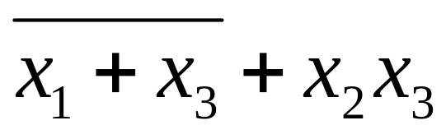
Boolean Functions
A Boolean expression represents a Boolean function.
  Furthermore, every Boolean function (of a given degree) can be represented by a Boolean expression with n variables.
x₁
x₂
x₃
F(x₁,x₂,x₃)
0
0
0
1
0
0
1
0
0
1
0
1
0
1
1
1
1
0
0
0
1
0
1
0
1
1
0
0
1
1
1
1

Slide 15
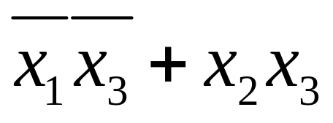
Boolean Functions
Two Boolean expressions e₁ and e₂ that represent the exact same function F are called equivalent
x₁
x₂
x₃
F(x₁,x₂,x₃)
0
0
0
1
e₁=
0
0
1
0
0
1
0
1
e₂=
0
1
1
1
1
0
0
0
1
0
1
0
The two expressions have the same value for all values of the variables appearing in e₁ and e₂.
1
1
0
0
1
1
1
1

Slide 16
Boolean Identities
Double complement:
  x = x
Idempotent laws:
  x + x = x, x · x = x
Identity laws:
  x + 0 = x, x · 1 = x
Domination laws:
  x + 1 = 1, x · 0 = 0
Commutative laws:
  x + y = y + x, x · y = y · x
Associative laws:
  x + (y + z) = (x + y) + z
  x · (y · z) = (x · y) · z
Distributive laws:
  x + y·z = (x + y)·(x + z)
  x · (y + z) = x·y + x·z
De Morgan’s laws:
  (x · y) = x + y, (x + y) = x · y
Absorption laws:
  x + x·y = x, x · (x + y) = x
the Unit Property: x + x = 1 and Zero Property: x · x = 0

Slide 17
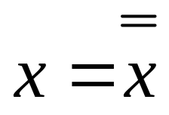
Boolean Identities
  Prove:

Slide 18
Boolean Identities
Boolean Identities can be used to prove other identities
Example: x · (x + y) = x · y

Slide 19
Dual Expression
The dual e^{d} of a Boolean expression e is obtained by exchanging + with •, and 0 with 1 in e.
Example:
e=xy + zw
e=x + y + 0
e^{d}=(x+y)(z +w)
e^{d}=xy1
Parenthesize an expression fully before taking its dual.
(x+y)(z +w) is not the same as x+yz +w

Slide 20
Dual Expression
Duality principle: e1⇔e2 iff e1^{d}⇔e2^{d}
If a property P is proved, each step in that proof can be replaced by its dual to obtain the proof of the dual of P
x(x+y) = x iff x +(xy) = x

Slide 21
Dual Function
The dual of a Boolean function F represented by a Boolean expression e is the function represented by the dual of this expression e^{d}.
The dual function of F is denoted by F^{d}
The dual function, denoted by F^{d}, does not depend on the particular Boolean expression used to represent F.

Slide 22
Representing Boolean Functions
How to construct a Boolean expression that represents a Boolean Function ?
x
y
z
F
F(x, y, z) = 1 if and only if:
0
0
0
1
0
0
1
0
x y z
+ x y z
+ x y z
+ x y z
0
1
0
1
0
1
1
1
1
0
0
0
Sum of products (SOP)
1
0
1
0
1
1
0
0
1
1
1
1

Slide 23
DNF: Disjunctive Normal Form
A literal is a Boolean variable or its complement.
A minterm of Boolean variables x₁,…,x_{n} is a Boolean product of n literals y₁…y_{n}, where y_{i} is either x_{i} or its complement -x_{i}.
Example:
x y z
+ x y z
+ x y z
minterms
Disjunctive Normal Form: sum of products

Slide 24
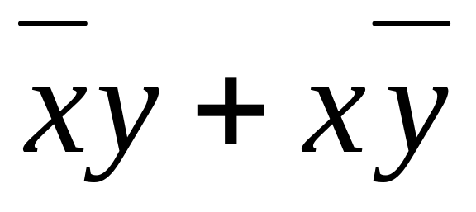
DNF: Disjunctive Normal Form
F
x
y
0
0
0
0
1
1
1
0
1
1
1
0
XOR

Slide 25
Representing Boolean Functions
How to construct a Boolean expression that represents a Boolean Function ?
Theorem: Any Boolean function can be represented as a DNF of variables and their complements.
  Proof:
  By construction from the function’s table.
  For each row that is 1, include a minterm in the sum that is a product representing the condition that the variables have the values given for that row.

Slide 26
Conjunctive Normal Form
A literal is a Boolean variable or its complement.
A maxterm of Boolean variables x₁,…,x_{n} is a Boolean sum of n literals y₁…y_{n}, where y_{i} is either x_{i} or its complement x_{i}.
Example:
(x +y + z)
• (x + y + z)
• (x + y +z)
maxterms
Conjuctive Normal Form: product of sums

Slide 27
Conjunctive Normal Form
To find the CNF representation of a Boolean function F
  Find the DNF representation of its complement F
  Then complement the DNF representation and apply DeMorgan’s laws to get F:
x
y
z
F
F
0
0
0
1
0
1.
x y z + x y z + x y z + xyz
0
0
1
0
1
0
1
0
1
0
2.
x y z + x y z + x y z + xyz
0
1
1
1
0
3.
(x+y+z) (x+y+z) (x+y+z )(x +y +z)
1
0
0
0
1
1
0
1
0
1
How do you build the CNF directly from the table ?
1
1
0
0
1
1
1
1
1
0

Slide 28
Functional Completeness
Since every Boolean function can be expressed in terms of •,+,¯, we say that the set of operators {•,+,¯} is functionally complete.
{•, ¯} are functionally complete
  x+y = x + y (law of double complement)
  = x y (DeMorgan’s law II)
{+, ¯} are functionally complete
NAND | and NOR ↓ are also functionally complete, each by itself (as a singleton set).
x
0
0
1
1
y
0
1
0
1
NAND
1
1
1
0
NOR
1
0
0
0
  x | y = xy
  x↓y = x + y

Slide 29
Functional Completeness
*
x = x|x
Can you prove xy = (x|y)|(x|y).?
x
0
0
1
1
y
0
1
0
1
NAND
1
1
1
0
NOR
1
0
0
0
Proof:
x =
x + x Idempotent laws
= xx De Morgan’s I
= x|x By def. of NAND

Slide 30
Logic Gates
Electronic circuits consist of so-called gates connected by wires
_{x}
x
inverter
x
x+y
OR gate
y
x
xy
AND gate
y

Slide 31
Multiway Logical Gates
Multiple Input AND, OR Gates
x₁
x₁+x₂ +… + x_{n}
x₂
x_{n}
x₁
x₁•x₂ •… • x_{n}
x₂
x_{n}

Slide 32
Combinational Circuits
Combinational Circuits are circuits in which the logical gates outputs depends on their current inputs only
  No memory capabilities
  No loops
  Assumptions:
    All gates incur a non-zero delay between when their inputs are seen and when their outputs are ready.
    No wiring timing delay

Slide 33
Circuit Design
Design a circuit for xy + xy
x
xy
y
xy + xy
x
x
xy
y

Slide 34
Circuit Design: XOR
Design a circuit that implements the XOR
x
y
F
0
0
0
xy +xy
0
1
1
1
0
1
x
1
1
0
xy
y
y
XOR
xy + xy
x
xy
5 Gates!!
y

Slide 35
Circuit Design: XOR
Design a circuit that implements the XOR (CNF)
x
y
F
0
0
0
(x + y )(x+y)
0
1
1
1
0
1
xy(x+y) De Morgan’s I
1
1
0
x
xy
XOR
xy
y
xy(x+ y)
4 Gates!!
x
x +y
y

Slide 36
Circuit Design-Majority Voting Circuit
F
Design a circuit that returns 1 when
two or more variables are 1 and 0
otherwise
x
y
z
0
0
0
0
0
0
1
0
0
1
0
0
xyz +xyz + xyz + xyz
0
1
1
1
1
0
0
0
1
0
1
1
1
1
0
1
1
1
1
1

Slide 37
Majority Circuit
xyz +xyz + xyz + xyz
x
y
z
x
y
z
x
y
z
x
8 Gates!!
y
z

Slide 38
Majority Circuit
Design a circuit for xy + xz + yz
x
y
x
z
y
4 Gates!!
z

Slide 39
Circuit-Adders
Adding two binary numbers
1
1
1
1
1
1
Carry
0 1 0 1 1
0 1 0 0 1
0 0 1 0 1
0 1 1 0 1
1
0
0
0
0
1
0
1
1
0

Slide 40
Circuits- Half Adder
s
c
Add the first two binary bits
x
y
0
0
0
0
s=xy(x+y)=x⊕y
0
1
1
0
c=xy
1
0
1
0
1
1
0
1
c=xy
x
XOR
AND
y
xy
xy
s=xy(x+ y)
x
x + y
y

Slide 41
Circuits- Half Adder
s
c
Add the first two binary bits
x
y
0
0
0
0
s=xy(x+y)=x⊕y
0
1
1
0
c=xy
1
0
1
0
1
1
0
1
XOR
AND
Half
Adder
s=x⊕ y
x
c=xy
y

Slide 42
Circuits- Full Adder
Adding two bits and a carry
s=c_{in}(x⊕y)
+ c_{in}(x⊕y) = c_{in} ⊕(x ⊕ y)
c_{in}
s
c_{out}
x
y
0
0
0
0
1
1
1
1
0
0
1
1
0
0
1
1
0
1
0
1
0
1
0
1
0
0
c_{out}= c_{in}xy
+c_{in}(x+y) = = xy + c_{in}(x⊕y)
1
0
1
0
0
1
1
0
0
1
0
1
1
1

Slide 43
Circuits- Full Adder
Half
Adder
s=x⊕ y
x
c=xy
Adding two bits and a carry
s=c_{in}(x⊕y) + c_{in}(x⊕y)= c_{in} ⊕(x⊕y)
c_{out}= xy +c_{in}(x ⊕ y)
y
Full-adder
C_{in} ⊕ (x⊕ y)
s
c_{in}
Half
Adder
C_{in} (x⊕ y)
x
x⊕ y
C_{in} (x⊕ y) + xy
Half
Adder
c_{out}
y
x y

Slide 44
Circuits- Full Adder
Adding two bits and a carry
c_{in}
Full
Adder
c_{in} ⊕(x⊕y)
x
xy + c_{in}(x⊕y)
y

Slide 45
Circuits-Adding Two 4-bit Integers
Adding Two 4-bits integers
s₀
x₀
Half
Adder
c₀
Full
Adder
s₁
y₀
x₁
c₁
s₂
y₁
Full
Adder
x₂
c₂
s₃
y₂
Full
Adder
x₃
c₃=s₄
y₃

Slide 46
Circuit Minimization
Goal : obtaining a sum of products with the smallest number of literals
Steps:
  Obtain a standard sum of products
  Use one of these heuristics
    Karnaugh Maps
    Quine - McClusky

Slide 47
Circuit Minimization
Karnaugh Maps and Quine - McClusky are based on combining adjacent terms
  Distributive Laws
  Unit property
  Idempotent
Def.: Two minterms are adjacent when they differ in only one literal
  Both minterms have the same variables, but one variable appear negated in one and not negated in the other
      xyz + xyz = xz

Slide 48
Karnaugh Maps
The K-map is a graphical method
It is easy and straightforward for circuits with a small number of variables
A K-map for a function of n variables
  consists of 2^{n} cells, and,
  in every row and column, two adjacent cells should differ in the value of only one of the variables.
y
y
x
x y
x y
x
x y
x y

Slide 49
Karnaugh Maps
xy + xy + xy =x + y
y
y
x
1
1
x
0
1

Slide 50
K-Maps
yz
yz
yz
yz
x
1
1
1
1
1
x
2 adjacent cells : remove 1 variable from minterm
4 adjacent cells: remove 2 variables

Slide 51
K-Maps
yz
yz
yz
yz
OR Group adjacent cells in this way
x
1
1
1
1
1
x
2 adjacent cells : remove 1 variable from minterm
4 adjacent cells: remove 2 variables

Slide 52
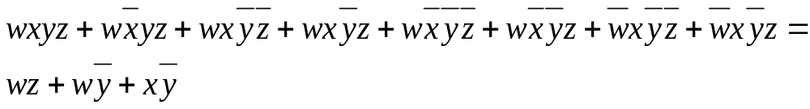
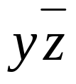
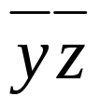
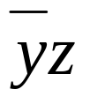


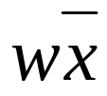
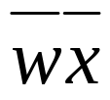
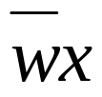
1
1
1
1
1
1
1
1
2 adjacent cells : remove 1 variable from minterm
4 adjacent cells: remove 2 variables
8 adjacent cells: remove 3 variables

Slide 53
Reading Assignment
Discrete Mathematics and its Applications ,
by Kenneth H. Rosen.
  Chapter 11, Section 11.1, 11.2, 11.3 and 11.4 (Karnaugh Maps)

