Slide 1

Khaled Rasheed
Computer Science Dept.
University of Georgia
http://www.cs.uga.edu/~khaled

Slide 2

Genetic algorithms
Genetic programming
Classifier systems
Evolution programming

Slide 3

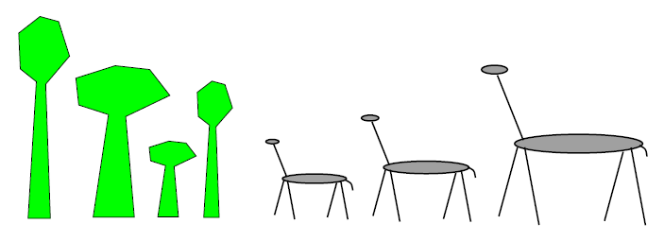
Fitness = Height
Survival of the fittest

Slide 4

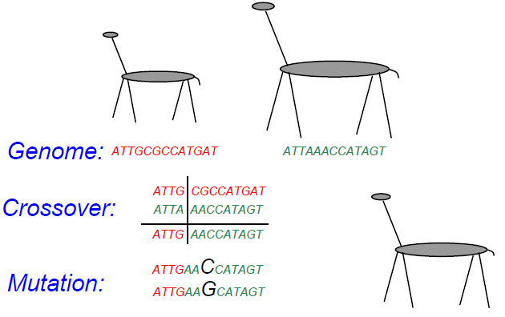

Slide 5

Maintain a population of potential solutions
New solutions are generated by selecting, combining and modifying existing solutions
  Crossover
  Mutation
Objective function = Fitness function
  Better solutions favored for parenthood
  Worse solutions favored for replacement

Slide 6

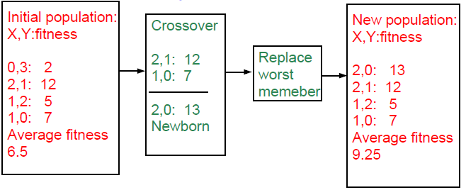
maximize 2X^2-y+5 where X:[0,3],Y:[0,3]

Slide 7

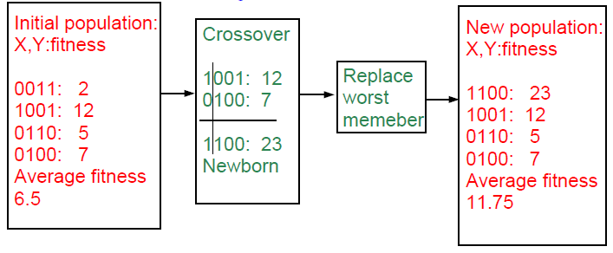
maximize 2X^2-y+5 where X:[0,3],Y:[0,3]

Slide 8

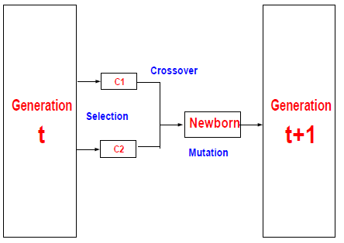
Representation
Fitness function
Initialization strategy
Selection strategy
Crossover operators
Mutation operators

Slide 9

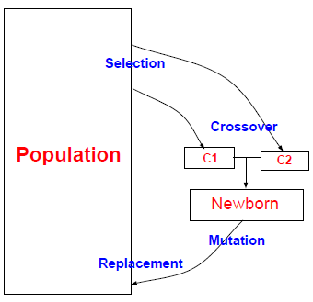
Representation
Fitness function
Initialization strategy
Selection strategy
Crossover operators
Mutation operators
Replacement strategy

Slide 10

Proportional selection (roulette wheel)
  selection probability of individual=fitness/sum of fitnesses
Rank based selection
  Example: decreasing arithmetic/geometric series
  better when fitness range is very large
Tournament selection
  Virtual tournament between randomly selected individuals using fitness

Slide 11

Point crossover (classical)
  Parent1=x1,x2,x3,x4,x5,x6
  Parent2=y1,y2,y3,y4,y5,y6
  Child =x1,x2,x3,x4,y5,y6
Uniform (random) crossover
  Parent1=x1,x2,x3,x4,x5,x6
  Parent2=y1,y2,y3,y4,y5,y6
  Child =x1,x2,y3,x4,y5,y6
Arithmetic crossover
  Parent1=x1,x2,x3
  Parent2=y1,y2,y3
  Child =(x1+y1)/2,(x2+y2)/2,(x3+y3)/2

Slide 12

change one or more components
Let Child=x1,x2,P,x3,x4...
Gaussian mutation:
  P ¬ P ± ∆p
  ∆ p: (small) random normal value
Uniform mutation:
  P ¬ P new
  p new : random uniform value
boundary mutation:
  P ¬ Pmin OR Pmax
Binary mutation=bit flip

Slide 13
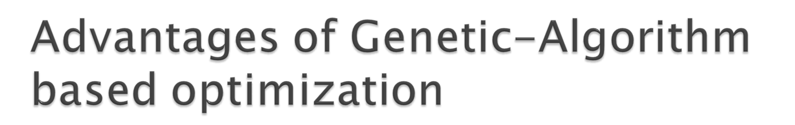
Finds global optima
Can handle discrete, continuous and mixed variable spaces
Easy to use (short programs)
Robust (less sensitive to noise, ill conditions)

Slide 14

Relatively slower than other methods (not suitable for easy problems)
Theory lags behind applications

Slide 15

Introduced (officially) by John Koza in his book (genetic programming, 1992)
Early attempts date back to the 50s (evolving populations of binary object codes)
Idea is to evolve computer programs
Declarative programming languages usually used (Lisp)
Programs are represented as trees

Slide 16

A population of trees representing programs
The programs are composed of elements from the FUNCTION SET and the TERMINAL SET
These sets are usually fixed sets of symbols
The function set forms "non-leaf" nodes. (e.g. +,-,*,sin,cos)
The terminal set forms leaf nodes. (e.g. x,3.7, random())

Slide 17

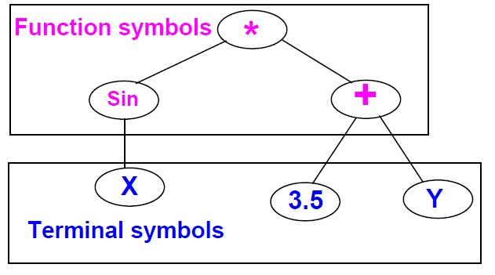

Slide 18

Fitness is usually based on I/O traces
Crossover is implemented by randomly swapping subtrees between individuals
GP usually does not extensively rely on mutation (random nodes or subtrees)
GPs are usually generational (sometimes with a generation gap)
GP usually uses huge populations (1M individuals)

Slide 19

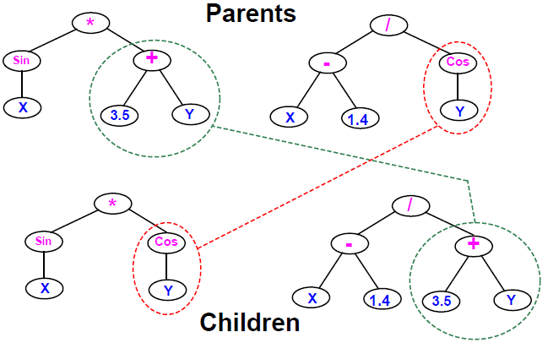

Slide 20

More flexible representation
Greater application spectrum
If tractable, evolving a way to make “things” is more useful than evolving the “things”.
Example: evolving a learning rule for neural networks (Amr Radi, GP98) vs. evolving the weights of a particular NN.

Slide 21

Extremely slow
Very poor handling of numbers
Very large populations needed
Criticism from classical GA community: no schema theory or any theory!

Slide 22

Genetic programming with linear genomes (Wolfgang Banzaf)
  Kind of going back to the evolution of binary program codes
Hybrids of GP and other methods that better handle numbers:
  Least squares methods
  Gradient based optimizers
  Genetic algorithms, other evolutionary computation methods
Evolving things other than programs
  Example: electric circuits represented as trees (Koza, AI in design 1996)

Slide 23

In machine learning we seek a good hypothesis
The hypothesis may be a rule, a neural network, a program ... etc.
GAs and other EC methods can evolve rules, NNs, programs ...etc.
Classifier systems (CFS) are the most explicit GA based machine learning tool.

Slide 24

Rule and message system
  if <condition> then <action>
Apportionment of credit system
  Based on a set of training examples
  Credit (fitness) given to rules that match the example
  Example: Bucket brigade (auctions for examples, winner takes all, existence taxes)
Genetic algorithm
  evolves a population of rules or a population of entire rule systems

Slide 25

Evolves a population of rules, the final population is used as the rule and message system
Diversity maintenance among rules is hard
If done well converges faster
Need to specify how to use the rules to classify
  what if multiple rules match example?
  exact matching only or inexact matching allowed?

Slide 26

Each individual is a complete set of rules or complete solution
Avoids the hard credit assignment problem
Slow because of complexity of space

Slide 27

Evolves finite state machines (or similar structures)
Relies on mutation (no crossover)
Fitness based on training sequence(s)
Uses rank based selection
Good for sequence problems (DNA) and prediction in time series

Slide 28

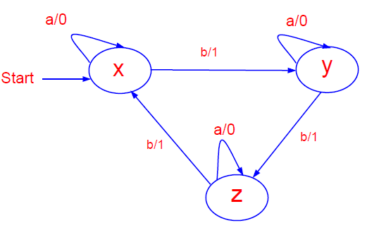

Slide 29

Add a state (with random transitions)
Delete a state (reassign state transitions)
Change an output symbol
Change a state transition
Change the start state

Slide 30

Artificial life
  An individual’s fitness depends on genes + lifetime experience
  An individual can pass the experience to offspring
Co-evolution
  Several populations of different types of individuals co-evolve
  Interaction between populations changes fitness measures

Slide 31

Evolutionary Computation
IEEE transactions on evolutionary computation
Genetic programming
other: AIEDAM, AIENG ...

Slide 32

Genetic and evolutionary computation conference (GECCO)
Congress on evolutionary computation (CEC)
evolutionary programming (EP)
Parallel problem solving from nature (PPSN)
other: AI in design, IJCAI, AAAI ...

