Slide 1
Data Mining
Practical Machine Learning Tools and Techniques
Slides for Chapter 6 of Data Mining by I. H. Witten, E. Frank and
M. A. Hall
Part 1

Slide 2
Implementation:
Real machine learning schemes
6.1 Decision trees
  From ID3 to C4.5 (pruning, numeric attributes, ...)
6.3 Association Rules
  Frequent-pattern trees
6.4 Extending linear models
  Support vector machines and neural networks
6.6 Numeric prediction
  Regression/model trees, locally weighted regression

Slide 3
Industrial-strength algorithms
For an algorithm to be useful in a wide range of real-world applications it must:
  Permit numeric attributes
  Allow missing values
  Be robust in the presence of noise
  Be able to approximate arbitrary concept descriptions (at least in principle)
Basic schemes need to be extended to fulfill these requirements

Slide 4
Decision trees
Extending ID3:
  to permit numeric attributes: straightforward
  to deal sensibly with missing values: trickier
  stability for noisy data:
  requires pruning mechanism
End result: C4.5 (Quinlan)
  Best-known and (probably) most widely-used learning algorithm
  Commercial successor: C5.0

Slide 5
Numeric attributes
Standard method: binary splits
  E.g. temp < 45
Unlike nominal attributes,
every attribute has many possible split points
Solution is straightforward extension:
  Evaluate info gain (or other measure)
  for every possible split point of attribute
  Choose “best” split point
  Info gain for best split point is info gain for attribute
Computationally more demanding

Slide 6
Weather data (again!)
Outlook
Outlook
Outlook
Temperature
Temperature
Temperature
Humidity
Humidity
Humidity
Windy
Windy
Windy
Play
Play
Play
Sunny
Sunny
Sunny
Hot
Hot
Hot
High
High
High
False
False
False
No
No
No
Sunny
Sunny
Sunny
Hot
Hot
Hot
High
High
High
True
True
True
No
No
No
Overcast
Overcast
Overcast
Hot
Hot
Hot
High
High
High
False
False
False
Yes
Yes
Yes
Rainy
Rainy
Rainy
Mild
Mild
Mild
Normal
Normal
High
False
False
False
Yes
Yes
Yes
…
…
…
…
…
…
…
…
…
…
…
…
…
…
…
…
…
Rainy
…
…
Cool
…
…
Normal
…
…
False
…
…
Yes
…
…
Rainy
…
…
Cool
…
…
Normal
…
…
True
…
…
No
…
…
…
…
…
…
…
…
…
…
…
…
…
…
…
If outlook = sunny and humidity = high then play = no
If outlook = rainy and windy = true then play = no
If outlook = overcast then play = yes
If humidity = normal then play = yes
If none of the above then play = yes

Slide 7
Weather data (again!)
Outlook
Outlook
Outlook
Temperature
Temperature
Temperature
Humidity
Humidity
Humidity
Windy
Windy
Windy
Play
Play
Play
Sunny
Sunny
Sunny
Hot
Hot
Hot
High
High
High
False
False
False
No
No
No
Sunny
Sunny
Sunny
Hot
Hot
Hot
Outlook
Outlook
Outlook
High
High
High
Temperature
Temperature
Temperature
True
True
True
Humidity
Humidity
Humidity
No
No
No
Windy
Windy
Windy
Play
Play
Play
Overcast
Overcast
Overcast
Hot
Hot
Hot
Sunny
Sunny
Sunny
High
High
High
Hot
Hot
85
False
False
False
High
High
85
Yes
Yes
Yes
False
False
False
No
No
No
Sunny
Sunny
Sunny
Hot
Hot
80
High
High
90
True
True
True
No
No
Rainy
No
Rainy
Rainy
Mild
Mild
Mild
Normal
Normal
High
False
False
False
Yes
Yes
Yes
…
…
…
…
…
…
Overcast
Overcast
Overcast
…
…
…
Hot
Hot
83
…
…
…
High
High
86
…
…
…
False
False
False
Yes
Yes
…
Yes
…
Rainy
…
…
Cool
…
…
Normal
…
…
False
…
…
Yes
…
…
Rainy
…
…
Cool
Rainy
Rainy
Rainy
…
…
Normal
Mild
Mild
70
…
…
True
Normal
Normal
96
…
…
No
False
False
False
Yes
Yes
Yes
…
…
…
…
…
…
…
…
…
…
…
…
…
…
…
…
…
…
…
…
…
…
…
Rainy
…
…
…
…
…
68
…
…
…
…
…
80
…
…
…
…
…
False
…
…
Yes
…
…
Rainy
…
…
65
…
…
70
…
…
True
…
…
No
…
…
…
…
…
…
…
…
…
…
…
…
…
…
…
If outlook = sunny and humidity = high then play = no
If outlook = rainy and windy = true then play = no
If outlook = overcast then play = yes
If humidity = normal then play = yes
If none of the above then play = yes
If outlook = sunny and humidity > 83 then play = no
If outlook = rainy and windy = true then play = no
If outlook = overcast then play = yes
If humidity < 85 then play = no
If none of the above then play = yes

Slide 8
Example
Split on temperature attribute:
  E.g. temperature < 71.5: yes/4, no/2
  temperature ≥ 71.5: yes/5, no/3
  Info([4,2],[5,3])
  = 6/14 info([4,2]) + 8/14 info([5,3])
  = 0.939 bits
Place split points halfway between values
Can evaluate all split points in one pass!
64 65 68 69 70 71 72 72 75 75 80 81 83 85
Yes No Yes Yes Yes No No Yes Yes Yes No Yes Yes No

Slide 9
Can avoid repeated sorting
Sort instances by the values of the numeric attribute
  Time complexity for sorting: O (n log n)
Does this have to be repeated at each node of the tree?
No! Sort order for children can be derived from sort order for parent
  Time complexity of derivation: O (n)
  Drawback: need to create and store an array of sorted indices for each numeric attribute

Slide 10
Binary vs multiway splits
Splitting (multi-way) on a nominal attribute exhausts all information in that attribute
  Nominal attribute is tested (at most) once on any path in the tree
Not so for binary splits on numeric attributes!
  Numeric attribute may be tested several times along a path in the tree
Disadvantage: tree is hard to read
Remedy:
  pre-discretize numeric attributes, or
  use multi-way splits instead of binary ones

Slide 11
Missing values
Split instances with missing values into pieces
  A piece going down a branch receives a weight proportional to the popularity of the branch
  weights sum to 1
Info gain works with fractional instances
  use sums of weights instead of counts
During classification, split the instance into pieces in the same way
  Merge probability distribution using weights

Slide 12
Pruning
Prevent overfitting to noise in the data
“Prune” the decision tree
Two strategies:
  Postpruning
  take a fully-grown decision tree and discard unreliable parts
  Prepruning
  stop growing a branch when information becomes unreliable
Postpruning preferred in practice—prepruning can “stop early”

Slide 13
Prepruning
Based on statistical significance test
  Stop growing the tree when there is no statistically significant association between any attribute and the class at a particular node
Most popular test: chi-squared test
ID3 used chi-squared test in addition to information gain
  Only statistically significant attributes were allowed to be selected by information gain procedure

Slide 14
Early stopping
a
b
class
1
0
0
0
2
0
1
1
3
1
0
1
Pre-pruning may stop the growth
process prematurely: early stopping
Classic example: XOR/Parity-problem
  No individual attribute exhibits any significant association to the class
  Structure is only visible in fully expanded tree
  Prepruning won’t expand the root node
But: XOR-type problems rare in practice
And: prepruning faster than postpruning
4
1
1
0

Slide 15
Postpruning
First, build full tree
Then, prune it
  Fully-grown tree shows all attribute interactions
Problem: some subtrees might be due to chance effects
Two pruning operations:
  Subtree replacement
  Subtree raising
Possible strategies:
  error estimation
  significance testing
  MDL principle

Slide 16
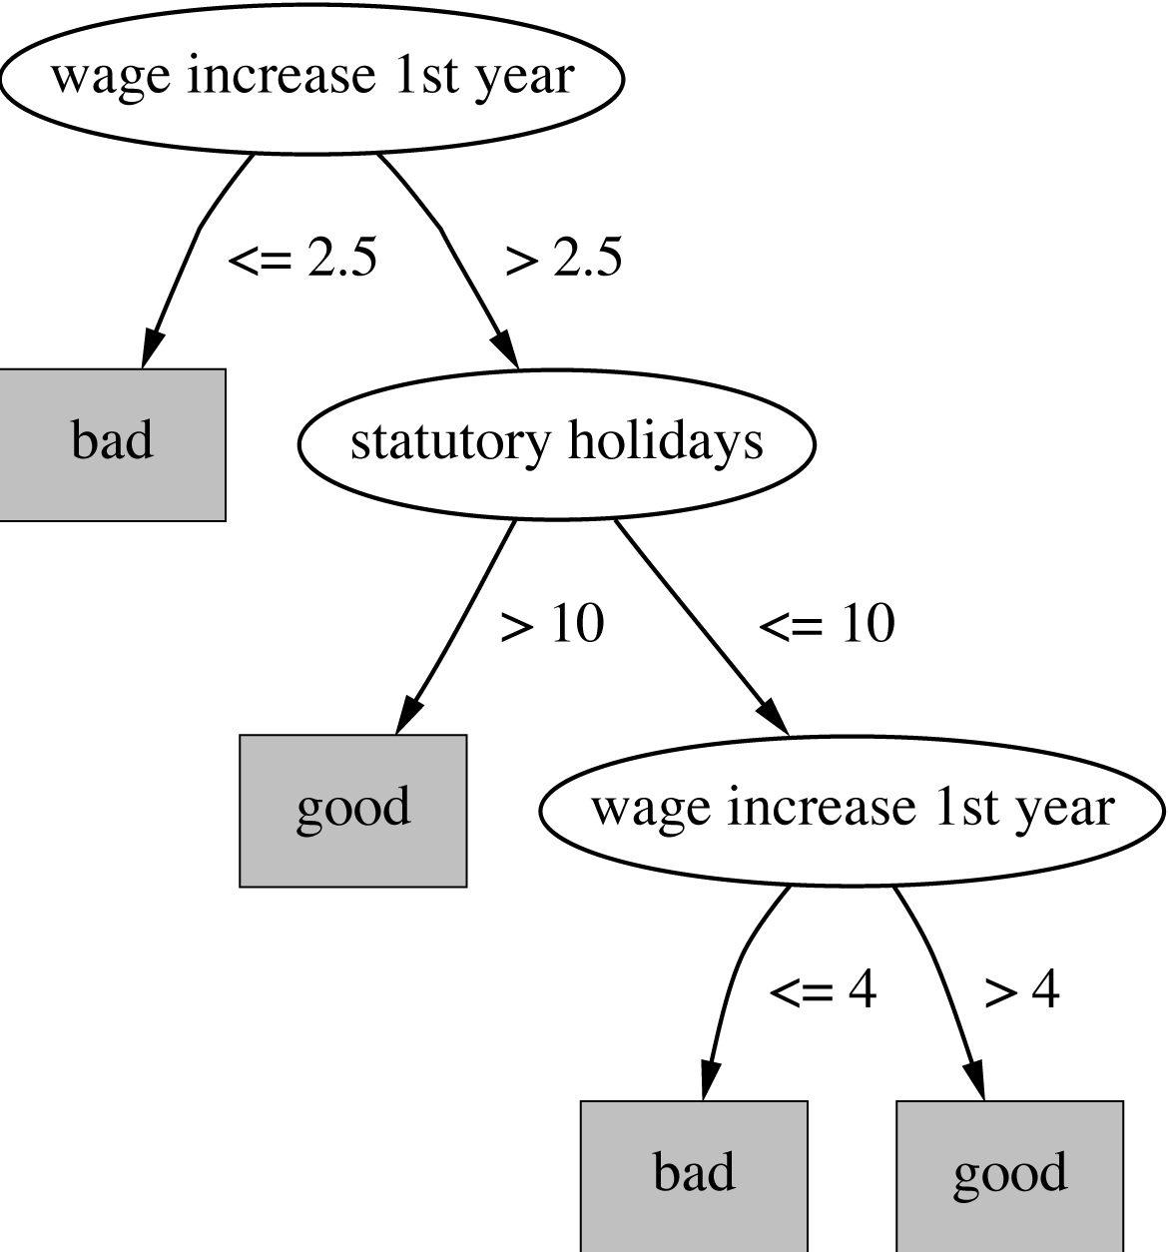
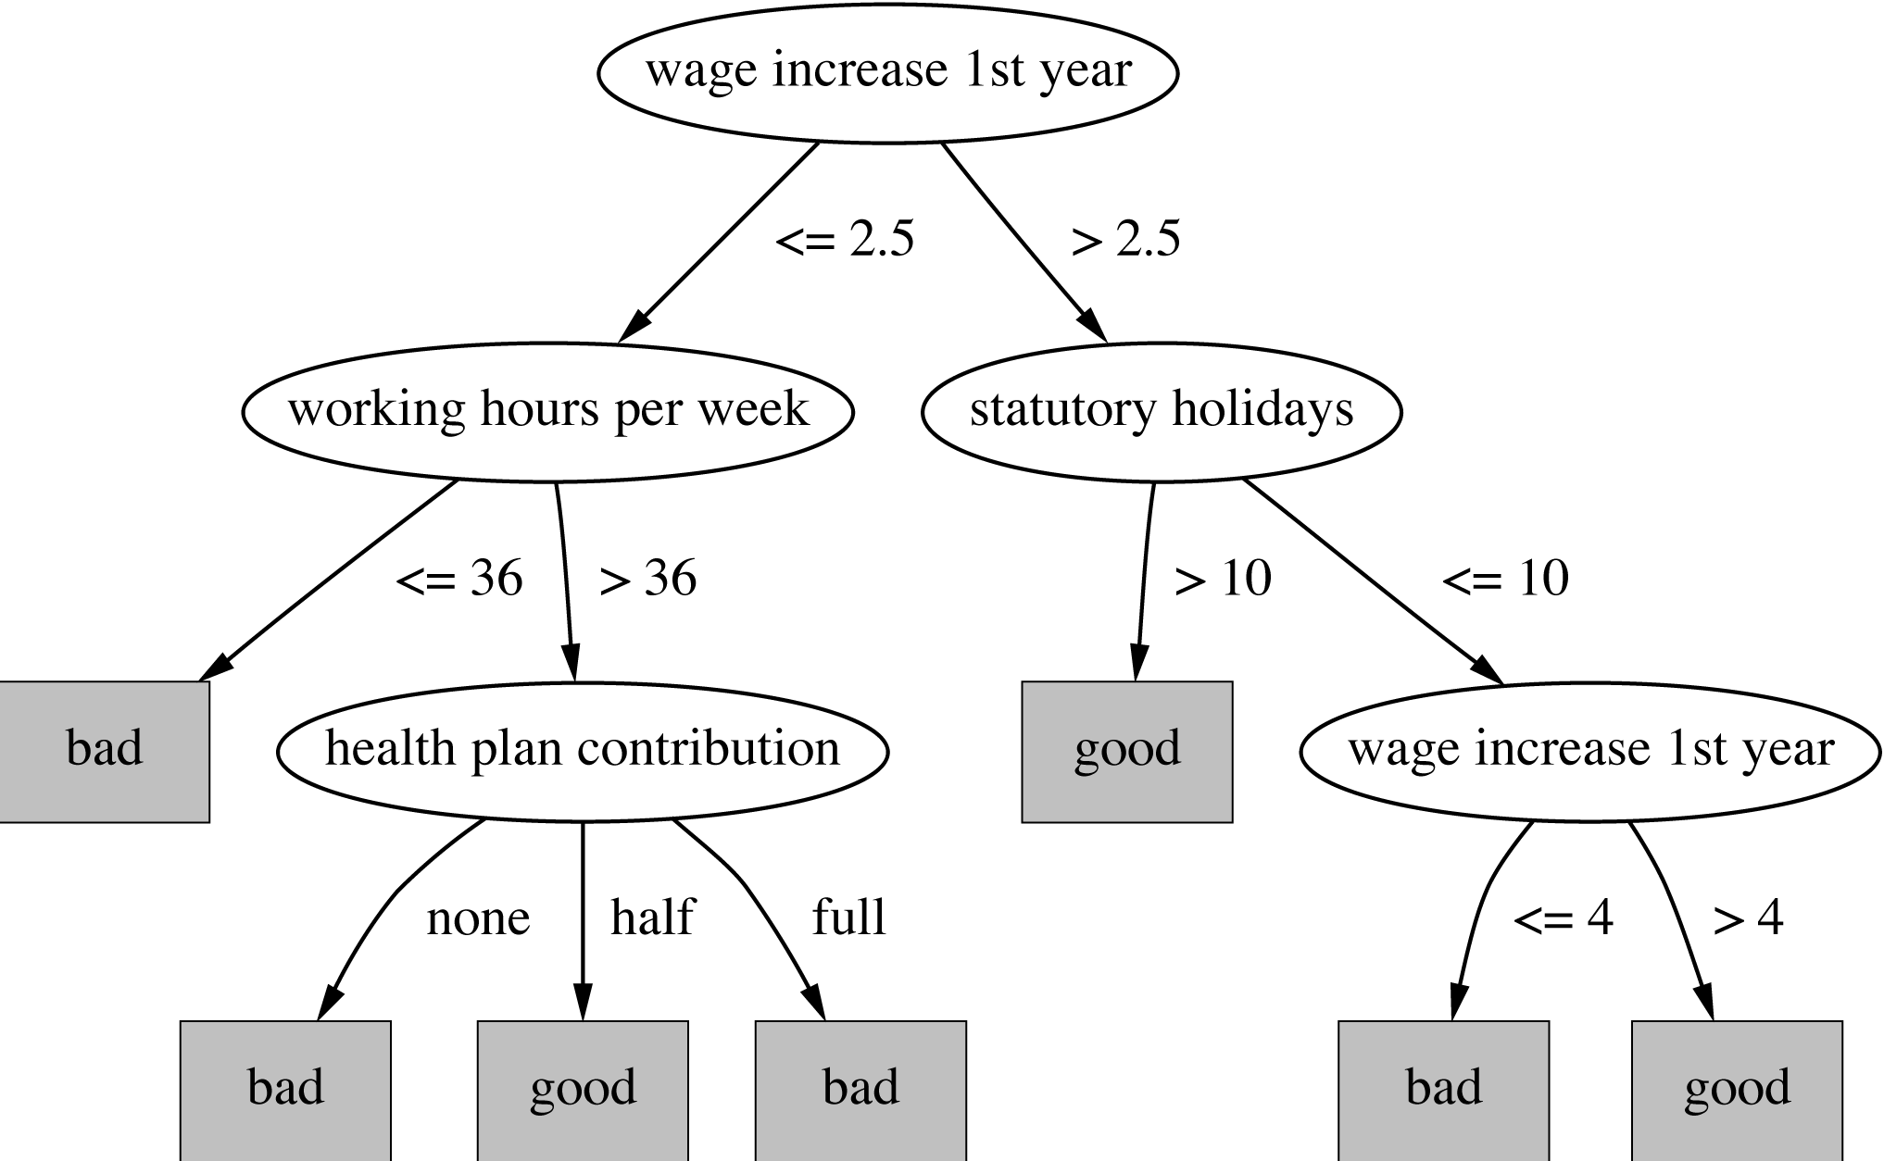
Subtree replacement
Bottom-up
Consider replacing a tree only after considering all its subtrees

Slide 17
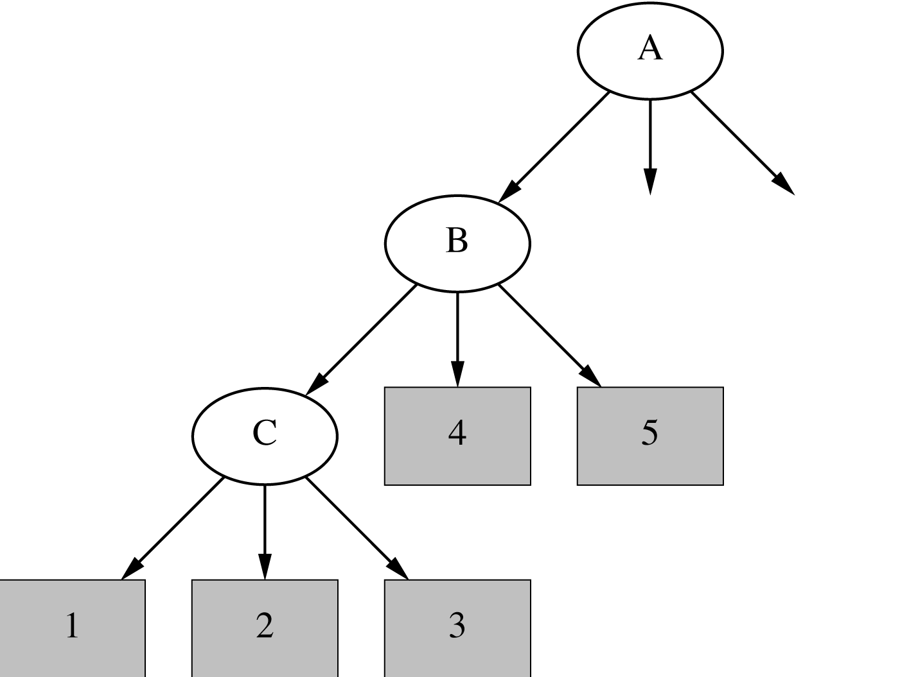
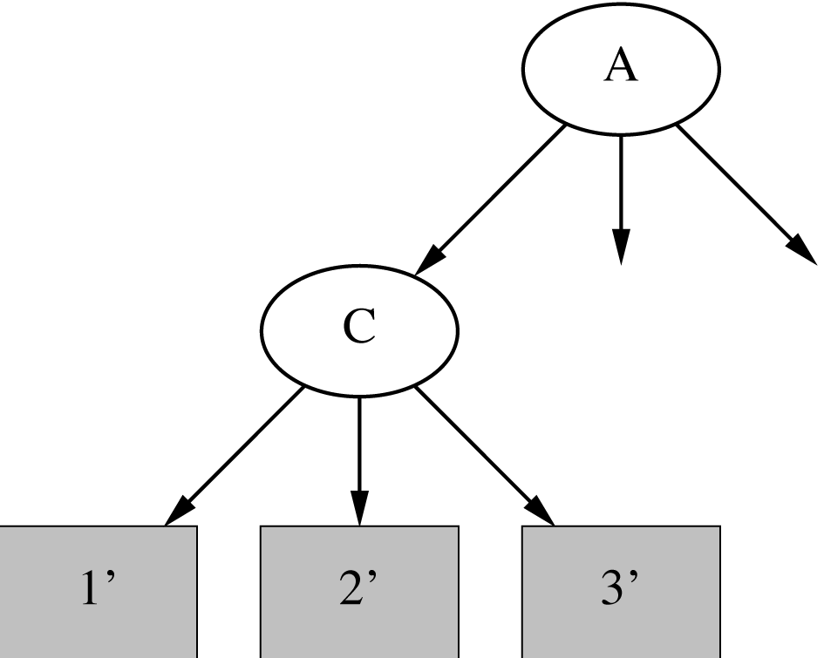
Subtree raising
Delete node
Redistribute instances
Slower than subtree replacement
(Worthwhile?)

Slide 18
Estimating error rates
Prune only if it does not increase the estimated error
Error on the training data is NOT a useful estimator
(would result in almost no pruning)
Use hold-out set for pruning
(“reduced-error pruning”)
C4.5’s method
  Derive confidence interval from training data
  Use a heuristic limit, derived from this, for pruning
  Standard Bernoulli-process-based method
  Shaky statistical assumptions (based on training data)

Slide 19
C4.5’s method
Error estimate for subtree is weighted sum of error estimates for all its leaves
Error estimate for a node:
If c = 25% then z = 0.69 (from normal distribution)
f is the error on the training data
N is the number of instances covered by the leaf

Slide 20
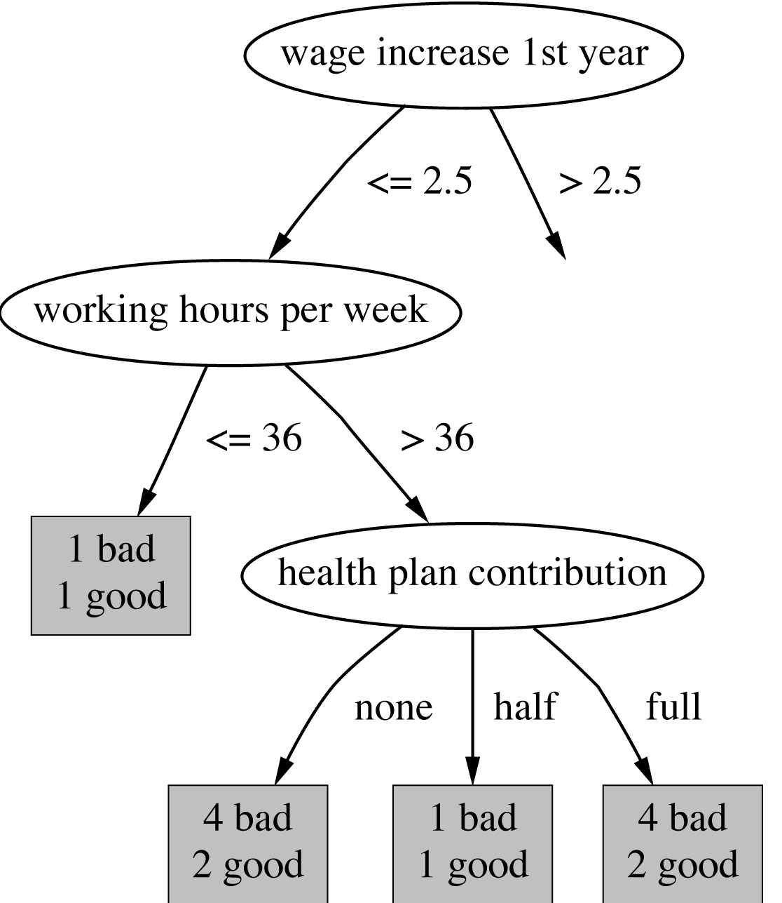
Example
f = 5/14
e = 0.46
e < 0.51
so prune!
f=0.33 e=0.47
f=0.5 e=0.72
f=0.33 e=0.47
Combined using ratios 6:2:6 gives 0.51

Slide 21
Complexity of tree induction
Assume
  m attributes
  n training instances
  tree depth O (log n)
Building a tree O (m n log n)
Subtree replacement O (n)
Subtree raising O (n (log n)²)
  Every instance may have to be redistributed at every node between its leaf and the root
  Cost for redistribution (on average): O (log n)
Total cost: O (m n log n) + O (n (log n)²)

Slide 22
From trees to rules
Simple way: one rule for each leaf
C4.5rules: greedily prune conditions from each rule if this reduces its estimated error
  Can produce duplicate rules
  Check for this at the end
Then
  look at each class in turn
  consider the rules for that class
  find a “good” subset (guided by MDL)
Then rank the subsets to avoid conflicts
Finally, remove rules (greedily) if this decreases error on the training data

Slide 23
C4.5: choices and options
C4.5rules slow for large and noisy datasets
Commercial version C5.0rules uses a different technique
  Much faster and a bit more accurate
C4.5 has two parameters
  Confidence value (default 25%):
  lower values incur heavier pruning
  Minimum number of instances in the two most popular branches (default 2)

Slide 24
Cost-complexity pruning
C4.5's postpruning often does not prune enough
  Tree size continues to grow when more instances are added even if performance on independent data does not improve
  Very fast and popular in practice
Can be worthwhile in some cases to strive for a more compact tree
  At the expense of more computational effort
  Cost-complexity pruning method from the CART (Classification and Regression Trees) learning system

Slide 25
Cost-complexity pruning
Basic idea:
  First prune subtrees that, relative to their size, lead to the smallest increase in error on the training data
  Increase in error (α) – average error increase per leaf of subtree
  Pruning generates a sequence of successively smaller trees
    Each candidate tree in the sequence corresponds to one particular threshold value, αi
  Which tree to chose as the final model?
    Use either a hold-out set or cross-validation to estimate the error of each

Slide 26
Discussion
TDIDT: Top-Down Induction of Decision Trees
The most extensively studied method of machine learning used in data mining
Different criteria for attribute/test selection rarely make a large difference
Different pruning methods mainly change the size of the resulting pruned tree
C4.5 builds univariate decision trees
Some TDITDT systems can build multivariate trees (e.g. CART)

Slide 27
Association rules
Apriori algorithm finds frequent item sets via a generate-and-test methodology
  Successively longer item sets are formed from shorter ones
  Each different size of candidate item set requires a full scan of the data
  Combinatorial nature of generation process is costly – particularly if there are many item sets, or item sets are large
Appropriate data structures can help
FP-growth employs an extended prefix tree (FP-tree)

Slide 28
FP-growth
FP-growth uses a Frequent Pattern Tree (FP-tree) to store a compressed version of the data
Only two passes are required to map the data into an FP-tree
The tree is then processed recursively to “grow” large item sets directly
  Avoids generating and testing candidate item sets against the entire database

Slide 29
Building a frequent pattern tree
First pass over the data – count the number times individual items occur
Second pass over the data – before inserting each instance into the FP-tree, sort its items in descending order of their frequency of occurrence, as found in step 1
  Individual items that do not meet the minimum support are not inserted into the tree
  Hopefully many instances will share items that occur frequently individually, resulting in a high degree of compression close to the root of the tree

Slide 30
An example using the weather data
Frequency of individual items (minimum support = 6)
play = yes 9
windy = false 8
humidity = normal 7
humidity = high 7
windy = true 6
temperature = mild 6
play = no 5
outlook = sunny 5
outlook = rainy 5
temperature = hot 4
temperature = cool 4
outlook = overcast 4

Slide 31
An example using the weather data
Instances with items sorted
1 windy=false, humidity=high, play=no, outlook=sunny, temperature=hot
2 humidity=high, windy=true, play=no, outlook=sunny, temperature=hot
3 play=yes, windy=false, humidity=high, temperature=hot, outlook=overcast
4 play=yes, windy=false, humidity=high, temperature=mild, outlook=rainy
.
.
.
14 humidity=high, windy=true, temperature=mild, play=no, outlook=rainy
Final answer: six single-item sets (previous slide) plus two multiple-item sets that meet minimum support
play=yes and windy=false 6
play=yes and humidity=normal 6

Slide 32
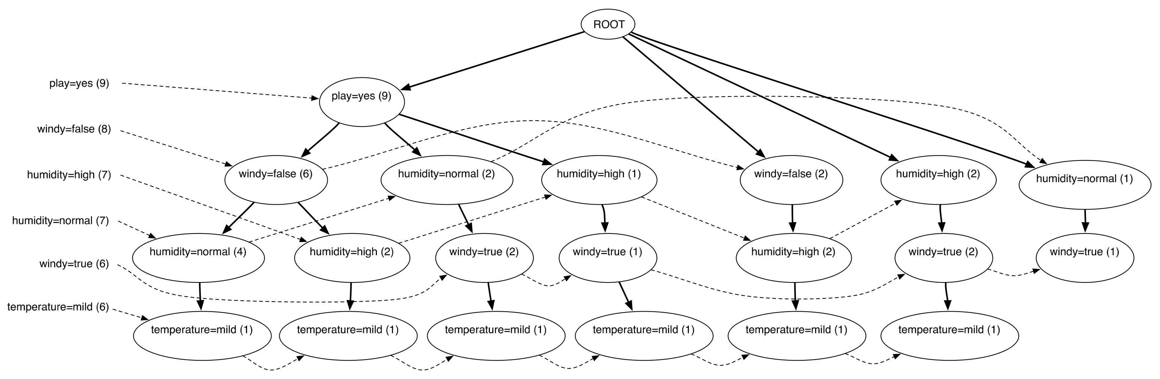
Finding large item sets
FP-tree for the weather data (min support 6)
Process header table from bottom
  Add temperature=mild to the list of large item sets
  Are there any item sets containing temperature=mild that meet min support?

Slide 33
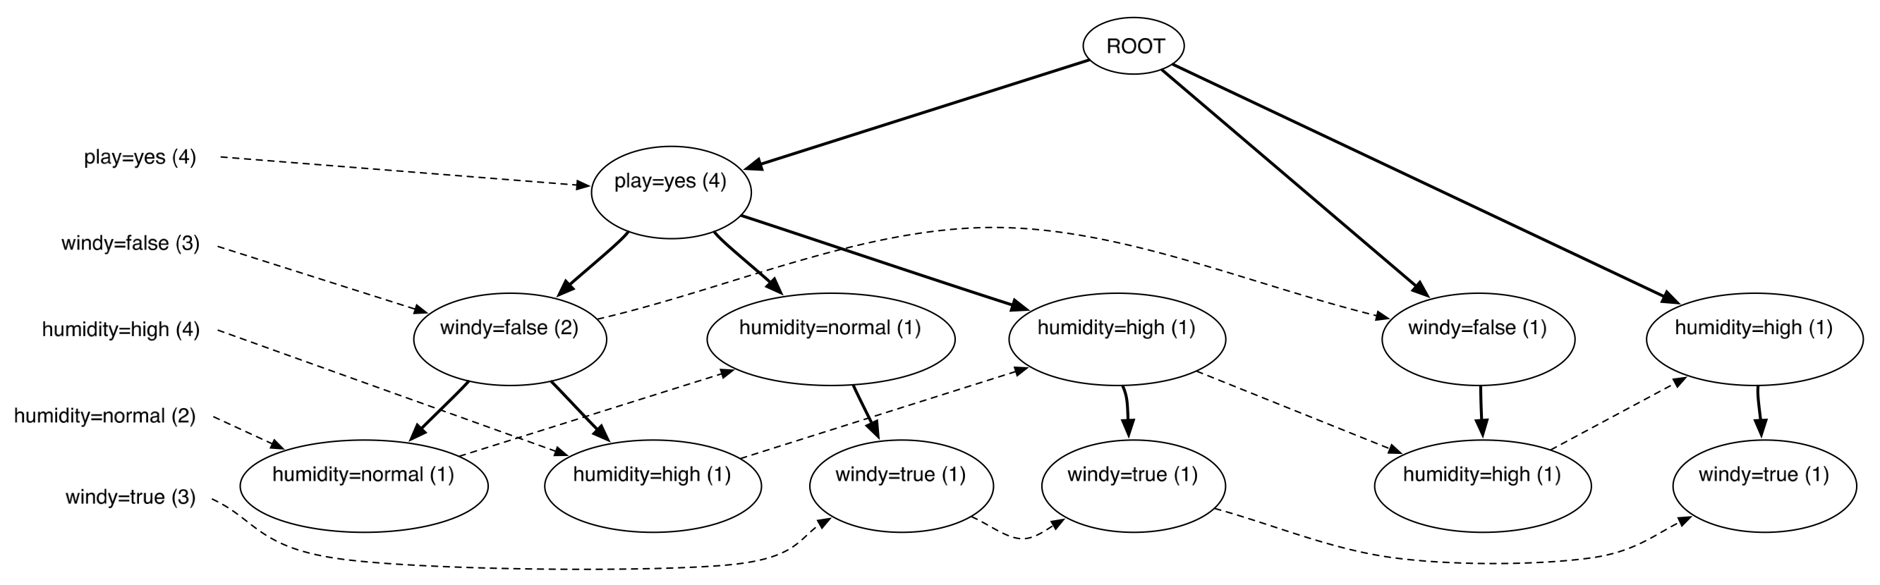
Finding large item sets cont.
FP-tree for the data conditioned on temperature=mild
Created by scanning the first (original) tree
  Follow temperature=mild link from header table to find all instances that contain temperature=mild
  Project counts from original tree
Header table shows that temperature=mild can't be grown any longer

Slide 34
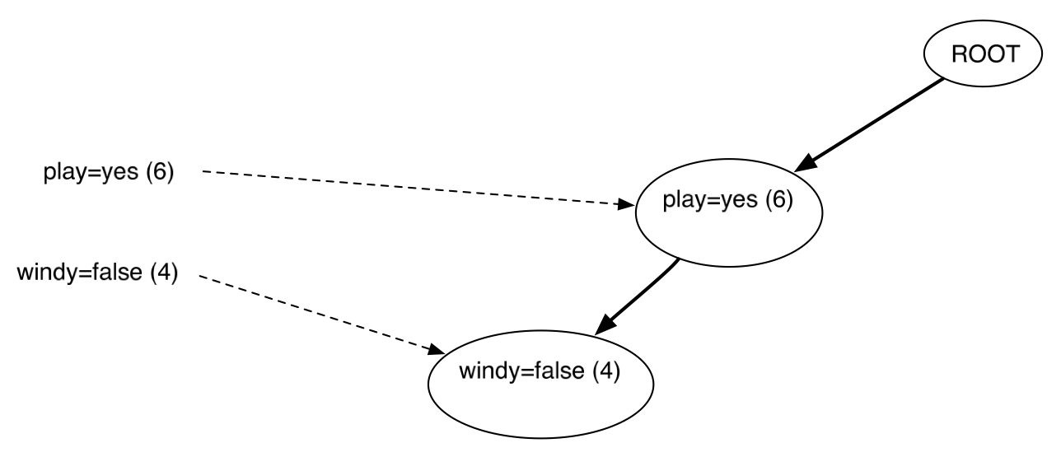
Finding large item sets cont.
FP-tree for the data conditioned on humidity=normal
Created by scanning the first (original) tree
  Follow humidity=normal link from header table to find all instances that contain humidity=normal
  Project counts from original tree
Header table shows that humidty=normal can be grown to include play=yes

Slide 35
Finding large item sets cont.
All large item sets have now been found
However, in order to be sure it is necessary to process the entire header link table from the original tree
Association rules are formed from large item sets in the same way as for Apriori
FP-growth can be up to an order of magnitude faster than Apriori for finding large item sets

Slide 36
Extending linear classification
Linear classifiers can’t model nonlinear class boundaries
Simple trick:
  Map attributes into new space consisting of combinations of attribute values
  E.g.: all products of n factors that can be constructed from the attributes
Example with two attributes and n = 3:

Slide 37
Problems with this approach
1st problem: speed
  10 attributes, and n = 5 ⇒ >2000 coefficients
  Use linear regression with attribute selection
  Run time is cubic in number of attributes
2nd problem: overfitting
  Number of coefficients is large relative to the number of training instances
  Curse of dimensionality kicks in

Slide 38
Support vector machines
Support vector machines are algorithms for learning linear classifiers
Resilient to overfitting because they learn a particular linear decision boundary:
  The maximum margin hyperplane
Fast in the nonlinear case
  Use a mathematical trick to avoid creating “pseudo-attributes”
  The nonlinear space is created implicitly

Slide 39
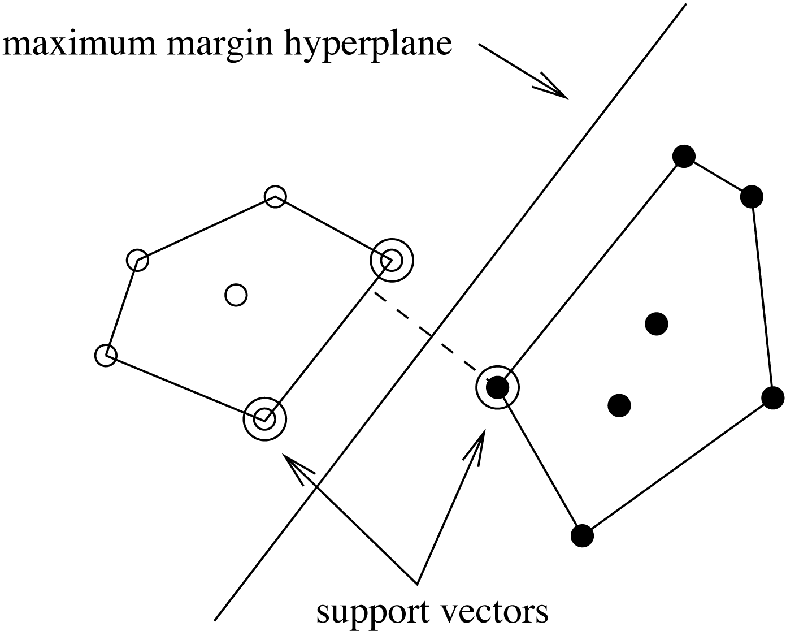
The maximum margin hyperplane
The instances closest to the maximum margin hyperplane are called support vectors

Slide 40
Support vectors
The support vectors define the maximum margin hyperplane
  All other instances can be deleted without changing its position and orientation
This means the hyperplane
can be written as

Slide 41
Finding support vectors
Support vector: training instance for which α_{i} > 0
Determine α_{i} and b ?—
A constrained quadratic optimization problem
  Off-the-shelf tools for solving these problems
  However, special-purpose algorithms are faster
  Example: Platt’s sequential minimal optimization algorithm (implemented in WEKA)
Note: all this assumes separable data!

Slide 42
Nonlinear SVMs
“Pseudo attributes” represent attribute combinations
Overfitting not a problem because the maximum margin hyperplane is stable
  There are usually few support vectors relative to the size of the training set
Computation time still an issue
  Each time the dot product is computed, all the “pseudo attributes” must be included

Slide 43
A mathematical trick
Avoid computing the “pseudo attributes”
Compute the dot product before doing the nonlinear mapping
Example:
Corresponds to a map into the instance space spanned by all products of n attributes

Slide 44
Other kernel functions
Mapping is called a “kernel function”
Polynomial kernel
We can use others:
Only requirement:
Examples:

Slide 45
Noise
Have assumed that the data is separable (in original or transformed space)
Can apply SVMs to noisy data by introducing a “noise” parameter C
C bounds the influence of any one training instance on the decision boundary
  Corresponding constraint: 0 ≤ α_{i} ≤ C
Still a quadratic optimization problem
Have to determine C by experimentation

Slide 46
Sparse data
SVM algorithms speed up dramatically if the data is sparse (i.e. many values are 0)
Why? Because they compute lots and lots of dot products
Sparse data ⇒
compute dot products very efficiently
  Iterate only over non-zero values
SVMs can process sparse datasets with 10,000s of attributes

Slide 47
Applications
Machine vision: e.g face identification
  Outperforms alternative approaches (1.5% error)
Handwritten digit recognition: USPS data
  Comparable to best alternative (0.8% error)
Bioinformatics: e.g. prediction of protein secondary structure
Text classifiation
Can modify SVM technique for numeric prediction problems

Slide 48
Support vector regression
Maximum margin hyperplane only applies to classification
However, idea of support vectors and kernel functions can be used for regression
Basic method same as in linear regression: want to minimize error
  Difference A: ignore errors smaller than ε and use absolute error instead of squared error
  Difference B: simultaneously aim to maximize flatness of function
User-specified parameter ε defines “tube”

Slide 49
More on SVM regression
If there are tubes that enclose all the training points, the flattest of them is used
  Eg.: mean is used if 2ε > range of target values
Model can be written as:
  Support vectors: points on or outside tube
  Dot product can be replaced by kernel function
  Note: coefficients αimay be negative
No tube that encloses all training points?
  Requires trade-off between error and flatness
  Controlled by upper limit C on absolute value of coefficients αi

Slide 50
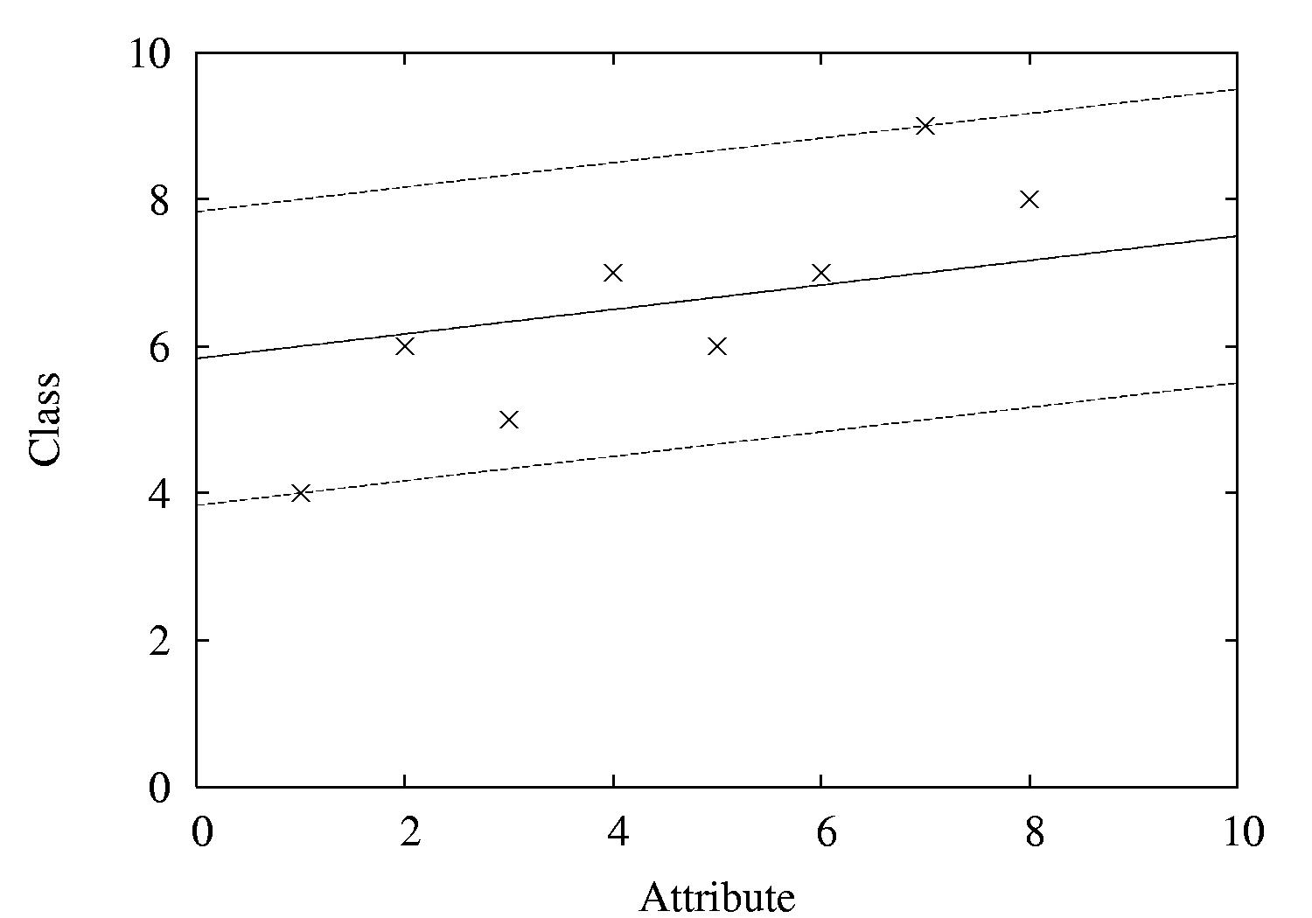
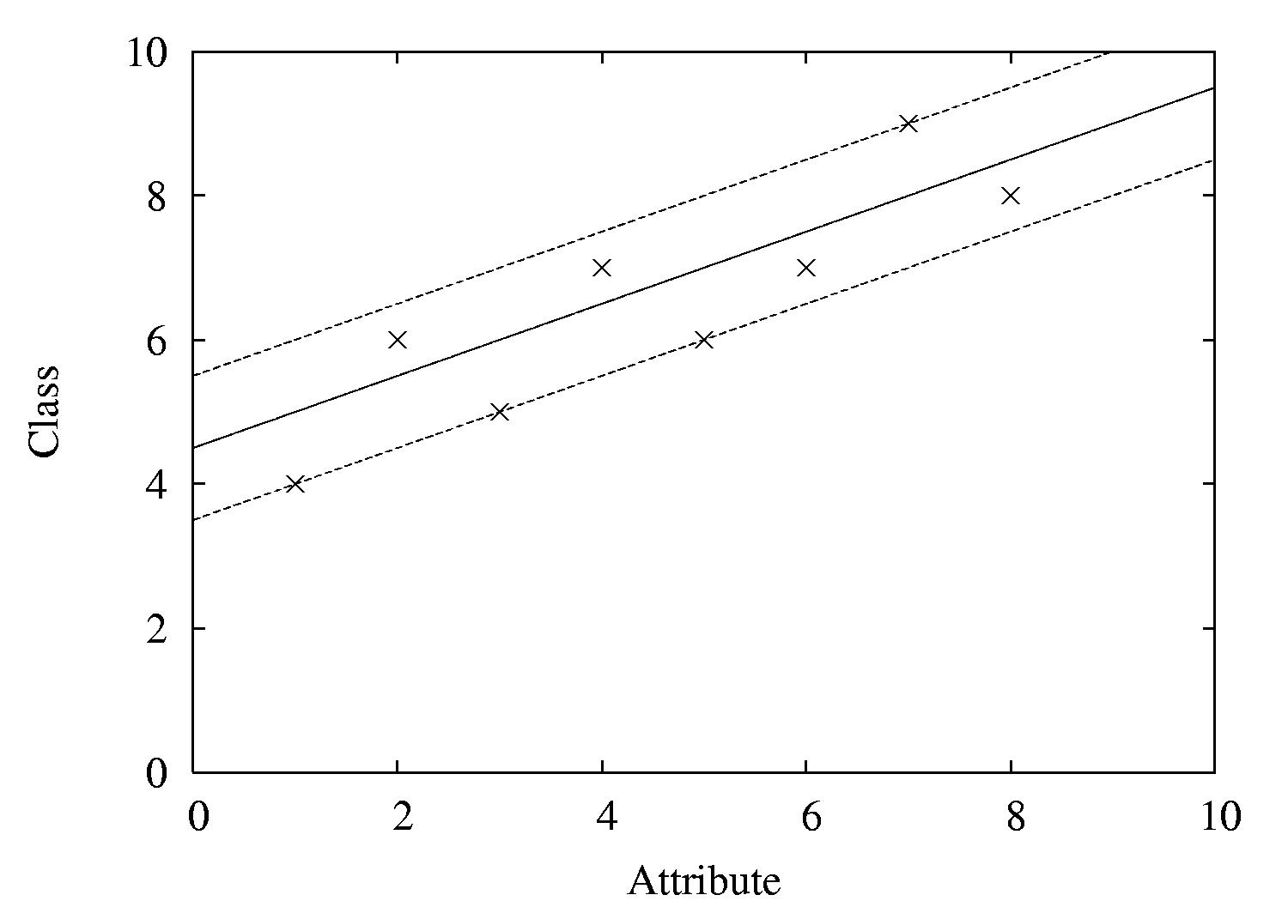
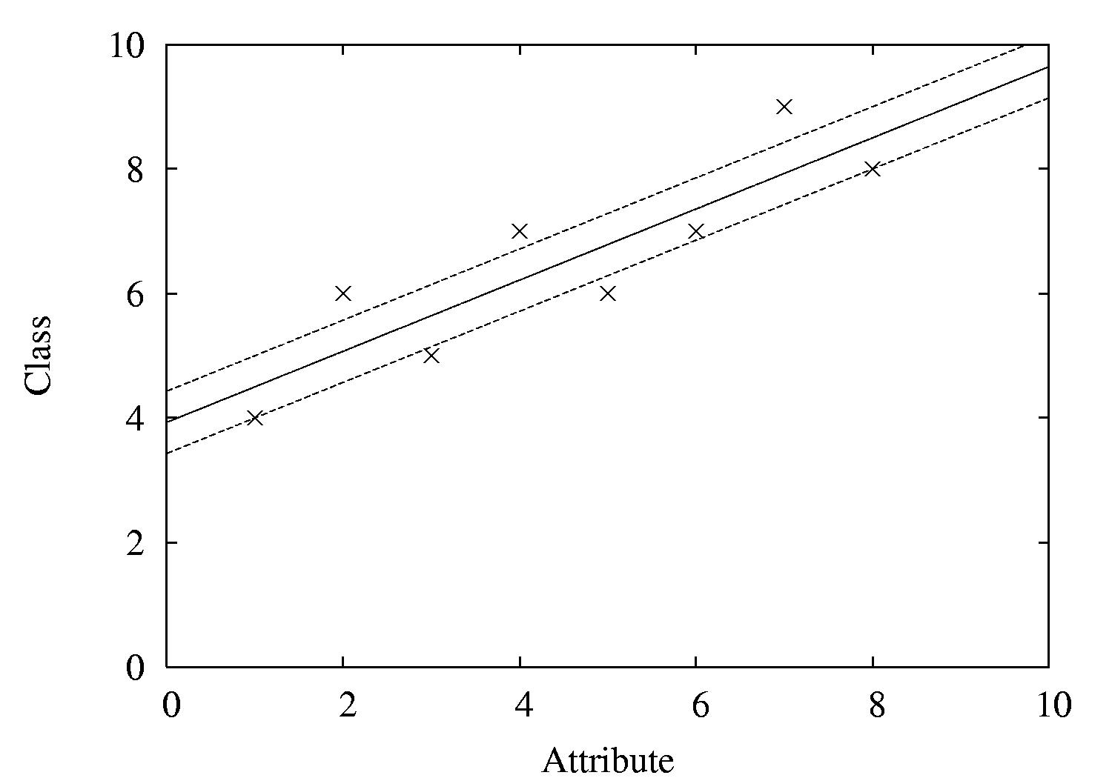
Examples
ε = 2
ε = 1
ε = 0.5

Slide 51
Kernel Ridge Regression
For classic linear regression using squared loss, only simple matrix operations are need to find the model
  Not the case for support vector regression with user-specified loss ε
Combine the power of the kernel trick with simplicity of standard least-squares regression?
  Yes! Kernel ridge regression

Slide 52
Kernel Ridge Regression
Like SVM, predicted class value for a test instance a is expressed as a weighted sum over the dot product of the test instance with training instances
Unlike SVM, all training instances participate – not just support vectors
  No sparseness in solution (no support vectors)
Does not ignore errors smaller than ε
Uses squared error instead of absolute error

Slide 53
Kernel Ridge Regression
More computationally expensive than standard linear regresion when #instances > #attributes
  Standard regression – invert an m × m matrix (O(m³)), m = #attributes
  Kernel ridge regression – invert an n × n matrix (O(n³)), n = #instances
Has an advantage if
  A non-linear fit is desired
  There are more attributes than training instances

Slide 54
The kernel perceptron
Can use “kernel trick” to make non-linear classifier using perceptron rule
Observation: weight vector is modified by adding or subtracting training instances
Can represent weight vector using all instances that have been misclassified:
  Can use
  instead of
  ( where y is either -1 or +1)
Now swap summation signs:
  Can be expressed as:
Can replace dot product by kernel:

Slide 55
Comments on kernel perceptron
Finds separating hyperplane in space created by kernel function (if it exists)
  But: doesn't find maximum-margin hyperplane
Easy to implement, supports incremental learning
Linear and logistic regression can also be upgraded using the kernel trick
  But: solution is not “sparse”: every training instance contributes to solution
Perceptron can be made more stable by using all weight vectors encountered during learning, not just last one (voted perceptron)
  Weight vectors vote on prediction (vote based on number of successful classifications since inception)

Slide 56
Multilayer perceptrons
Using kernels is only one way to build nonlinear classifier based on perceptrons
Can create network of perceptrons to approximate arbitrary target concepts
Multilayer perceptron is an example of an artificial neural network
  Consists of: input layer, hidden layer(s), and output layer
Structure of MLP is usually found by experimentation
Parameters can be found using backpropagation

Slide 57
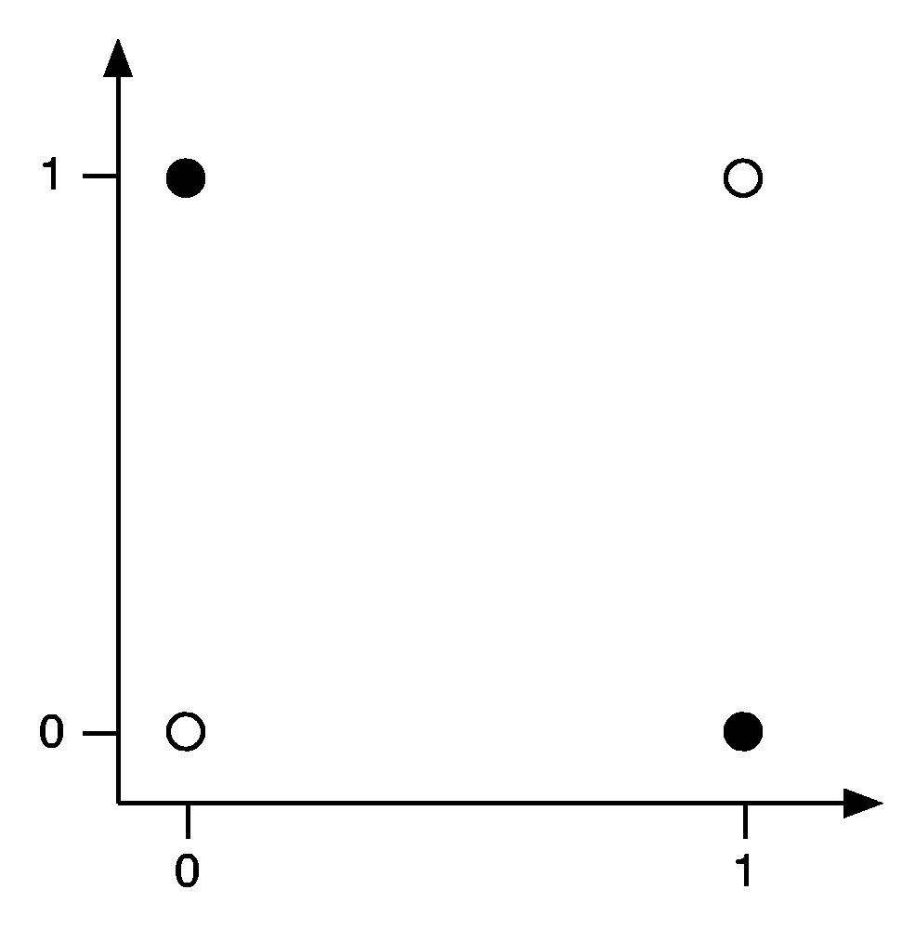
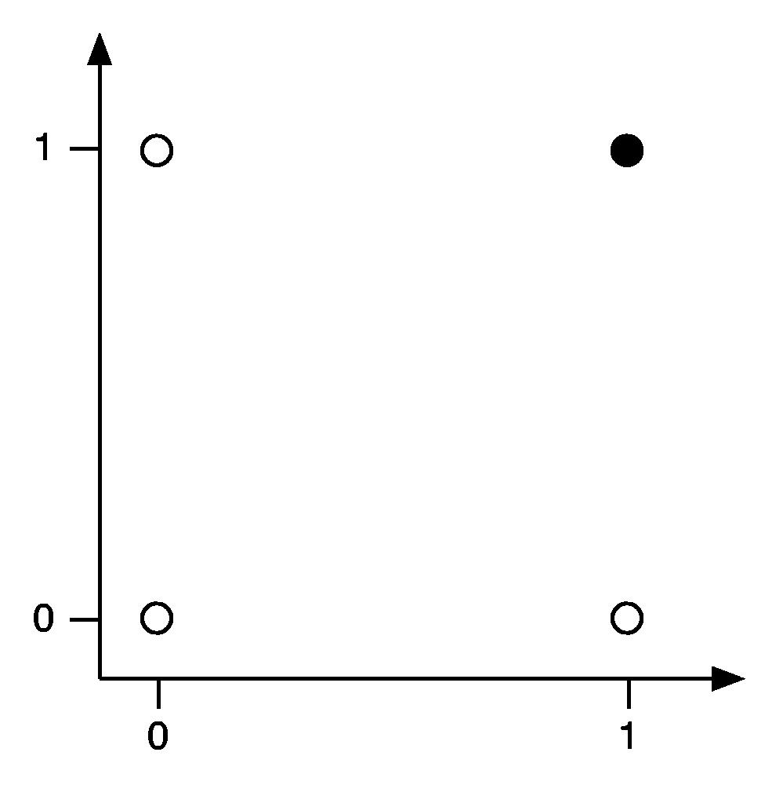
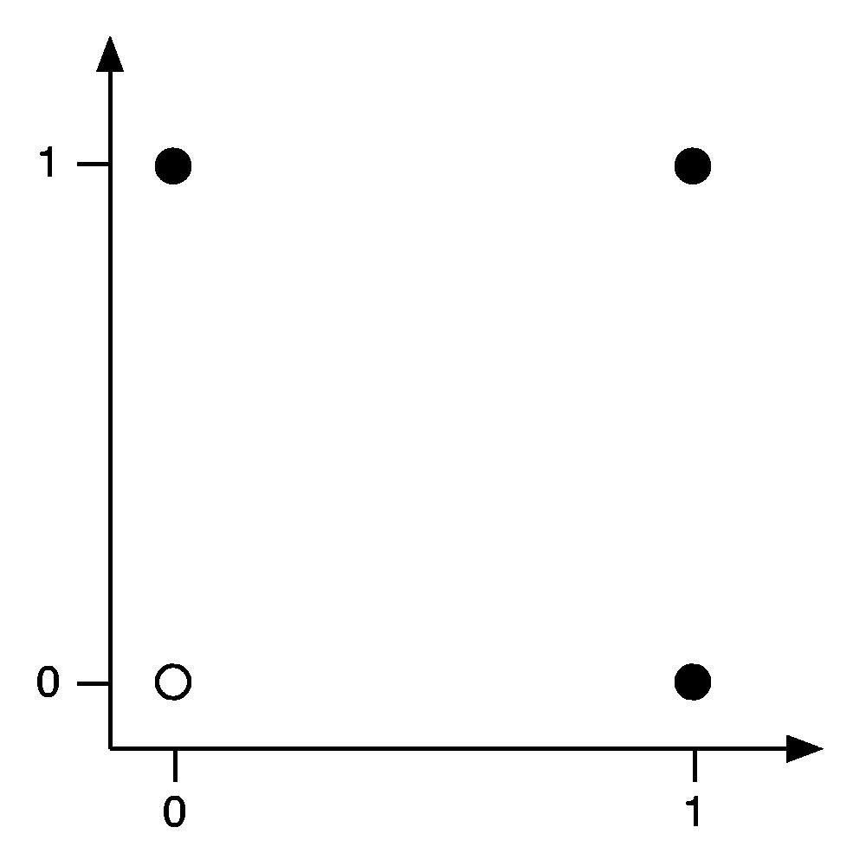
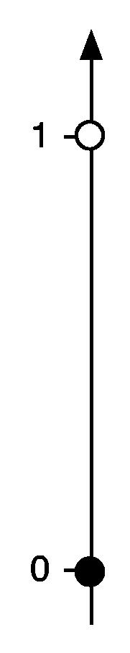
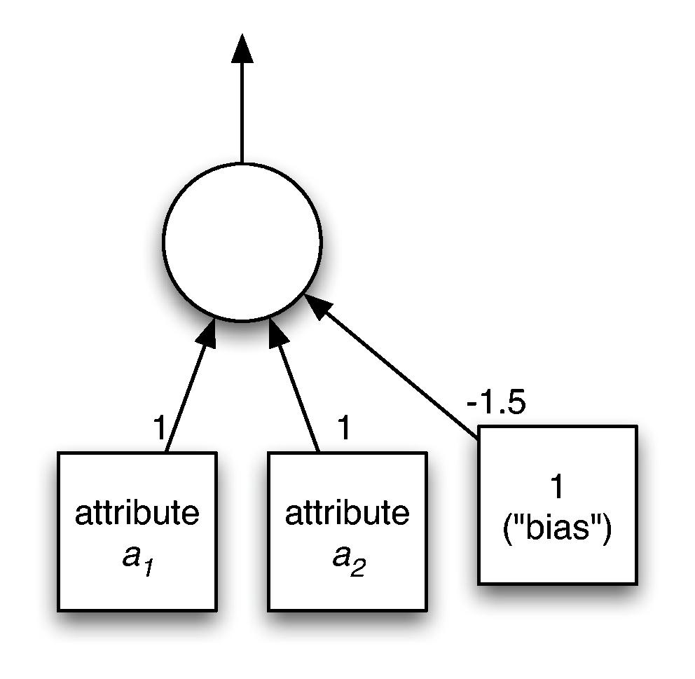
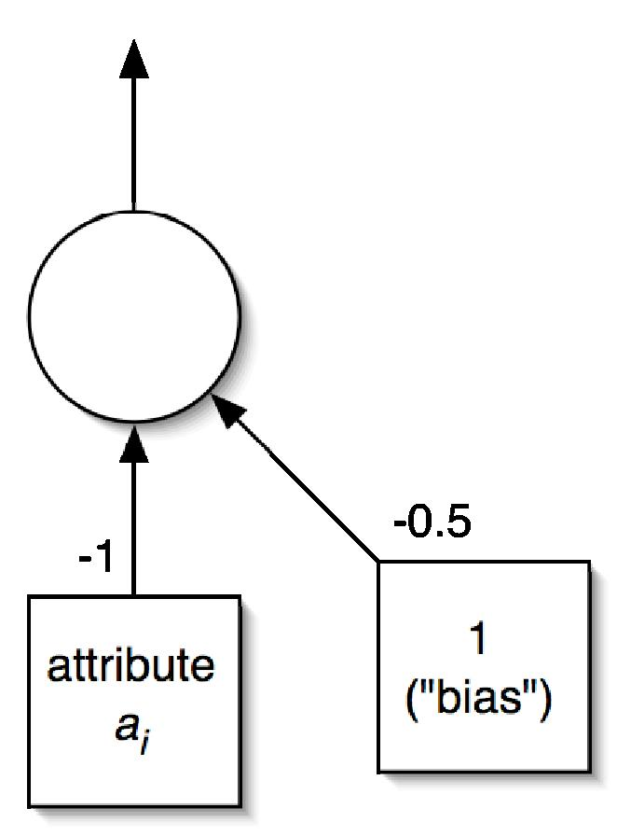
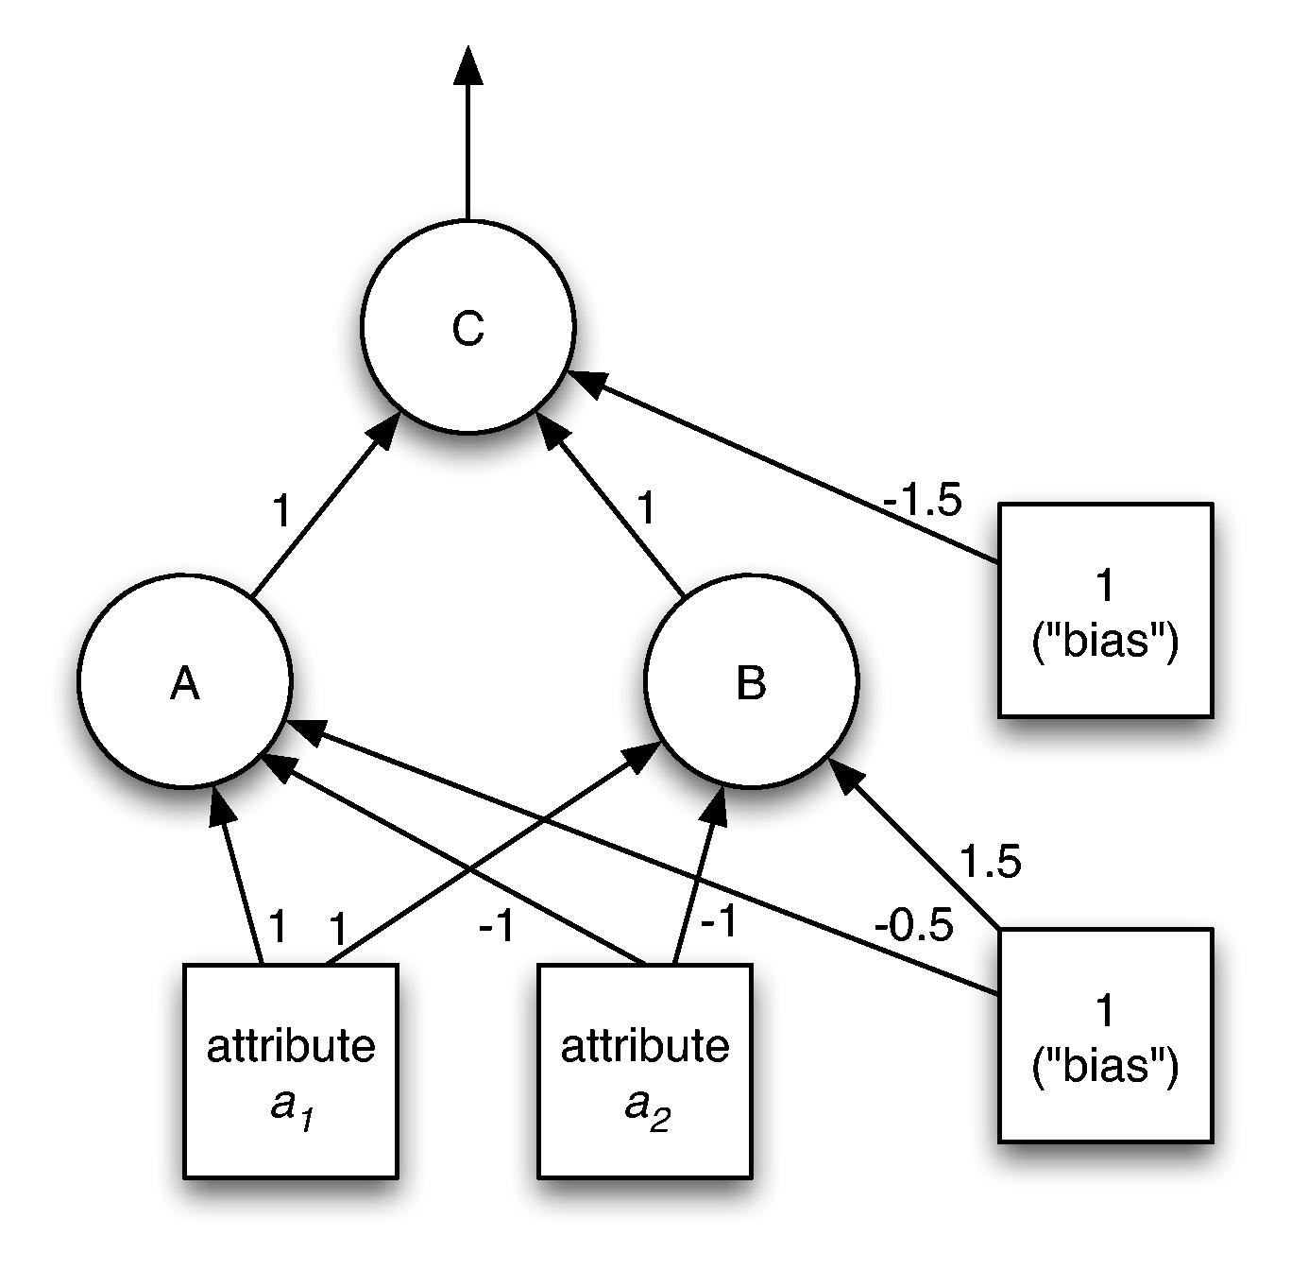

Examples

Slide 58
Backpropagation
How to learn weights given network structure?
  Cannot simply use perceptron learning rule because we have hidden layer(s)
  Function we are trying to minimize: error
  Can use a general function minimization technique called gradient descent
    Need differentiable activation function: use sigmoid function instead of threshold function
    Need differentiable error function: can't use zero-one loss, but can use squared error

Slide 59
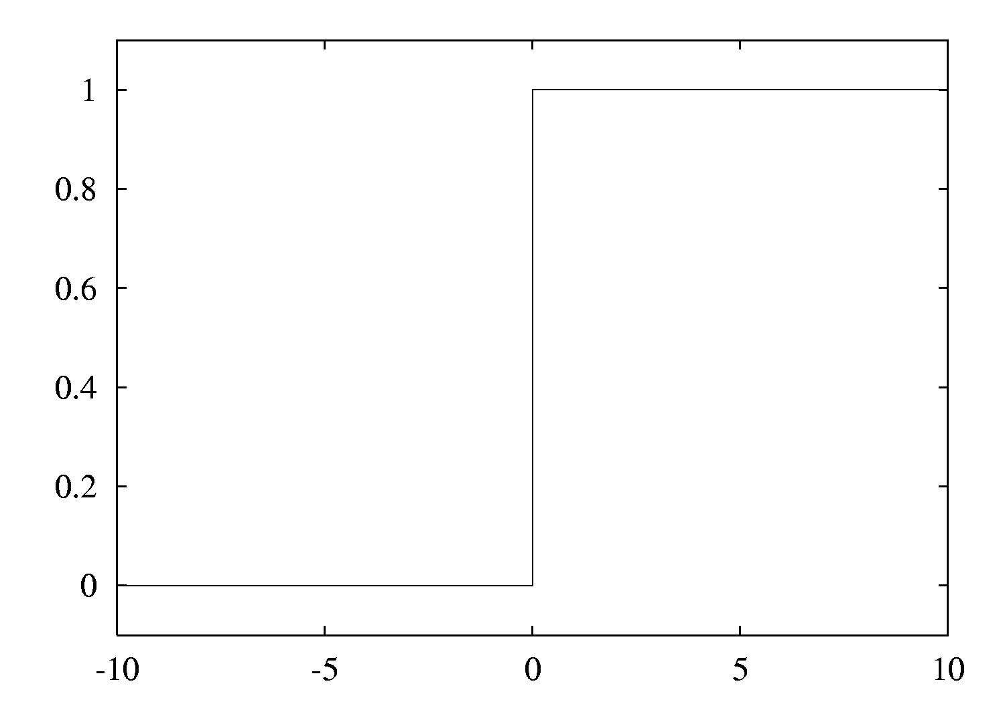
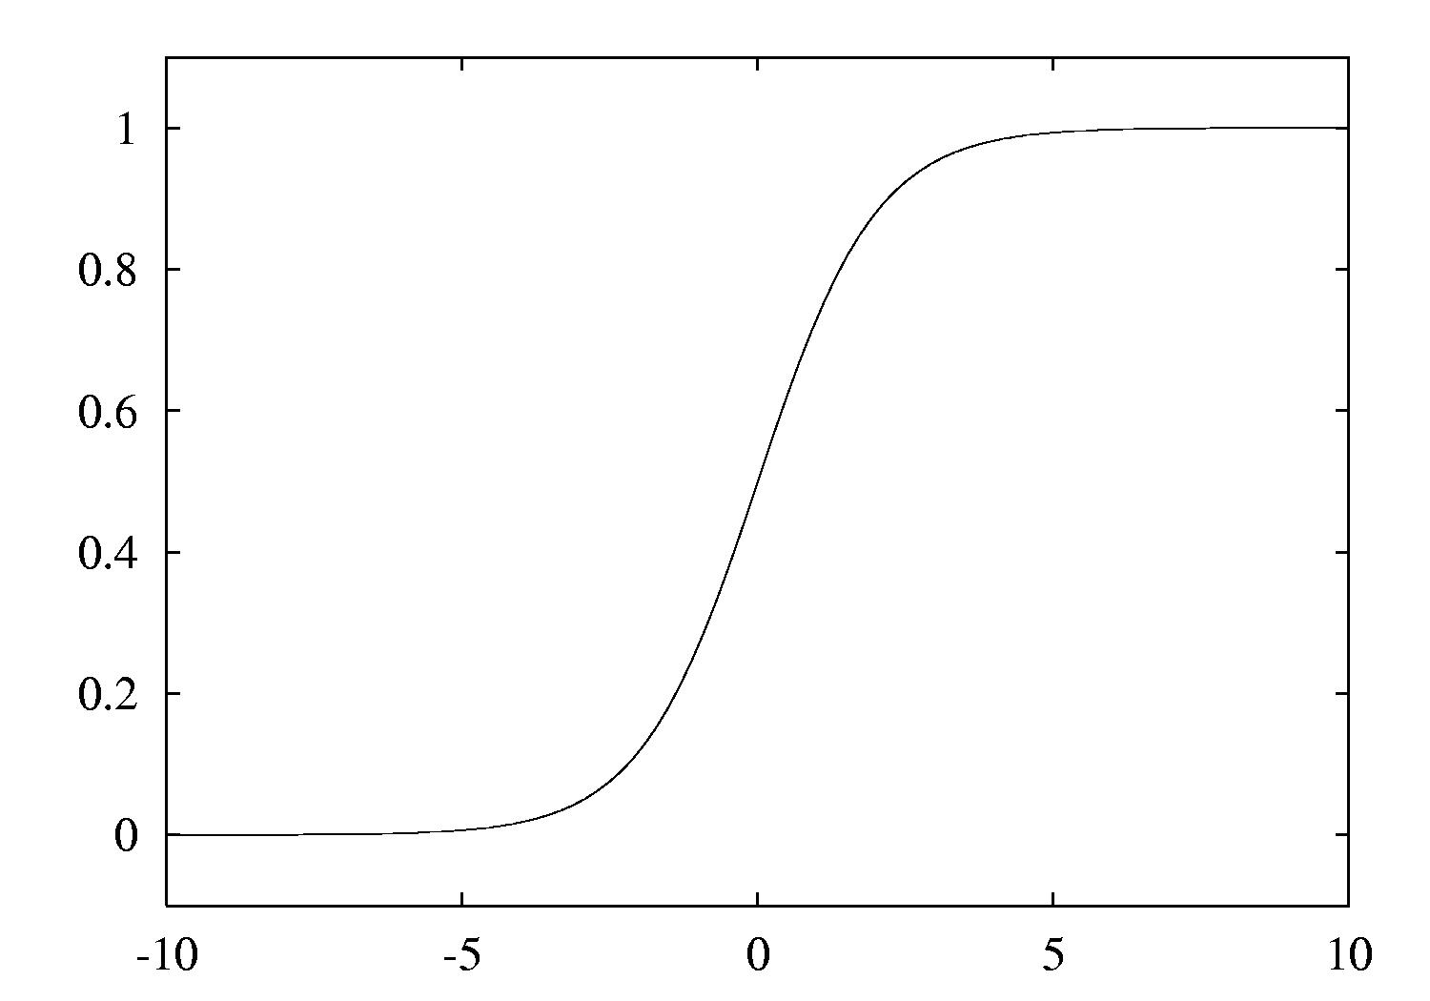
The two activation functions

Slide 60
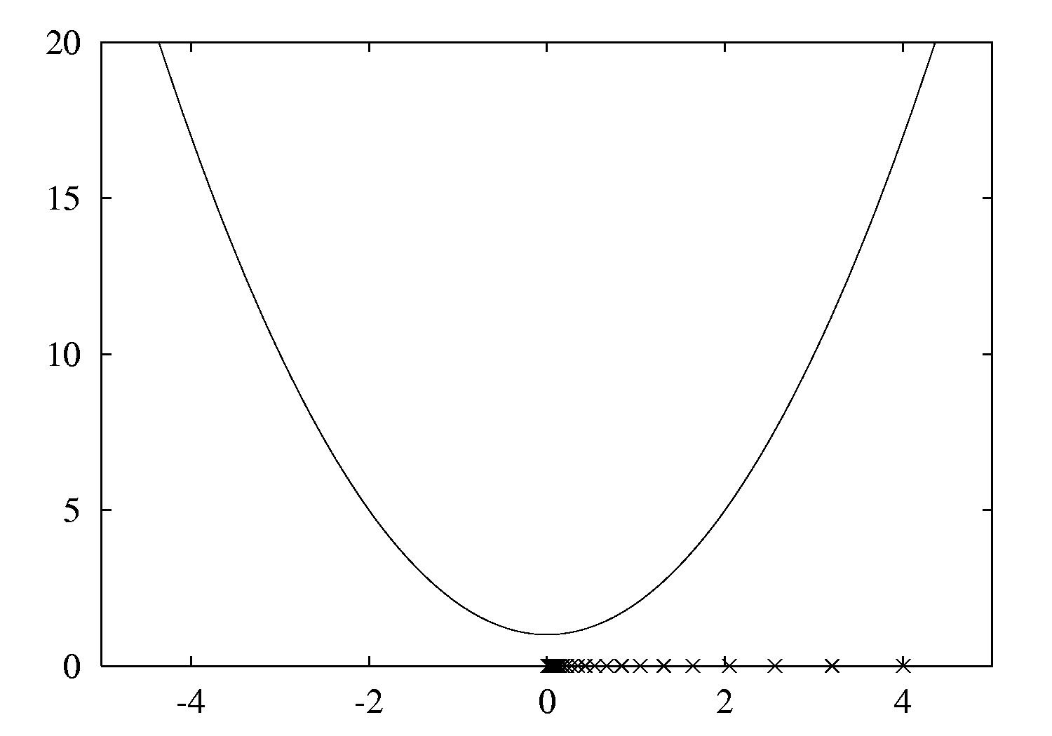
Gradient descent example
Function: x²+1
Derivative: 2x
Learning rate: 0.1
Start value: 4
Can only find a local minimum!

Slide 61
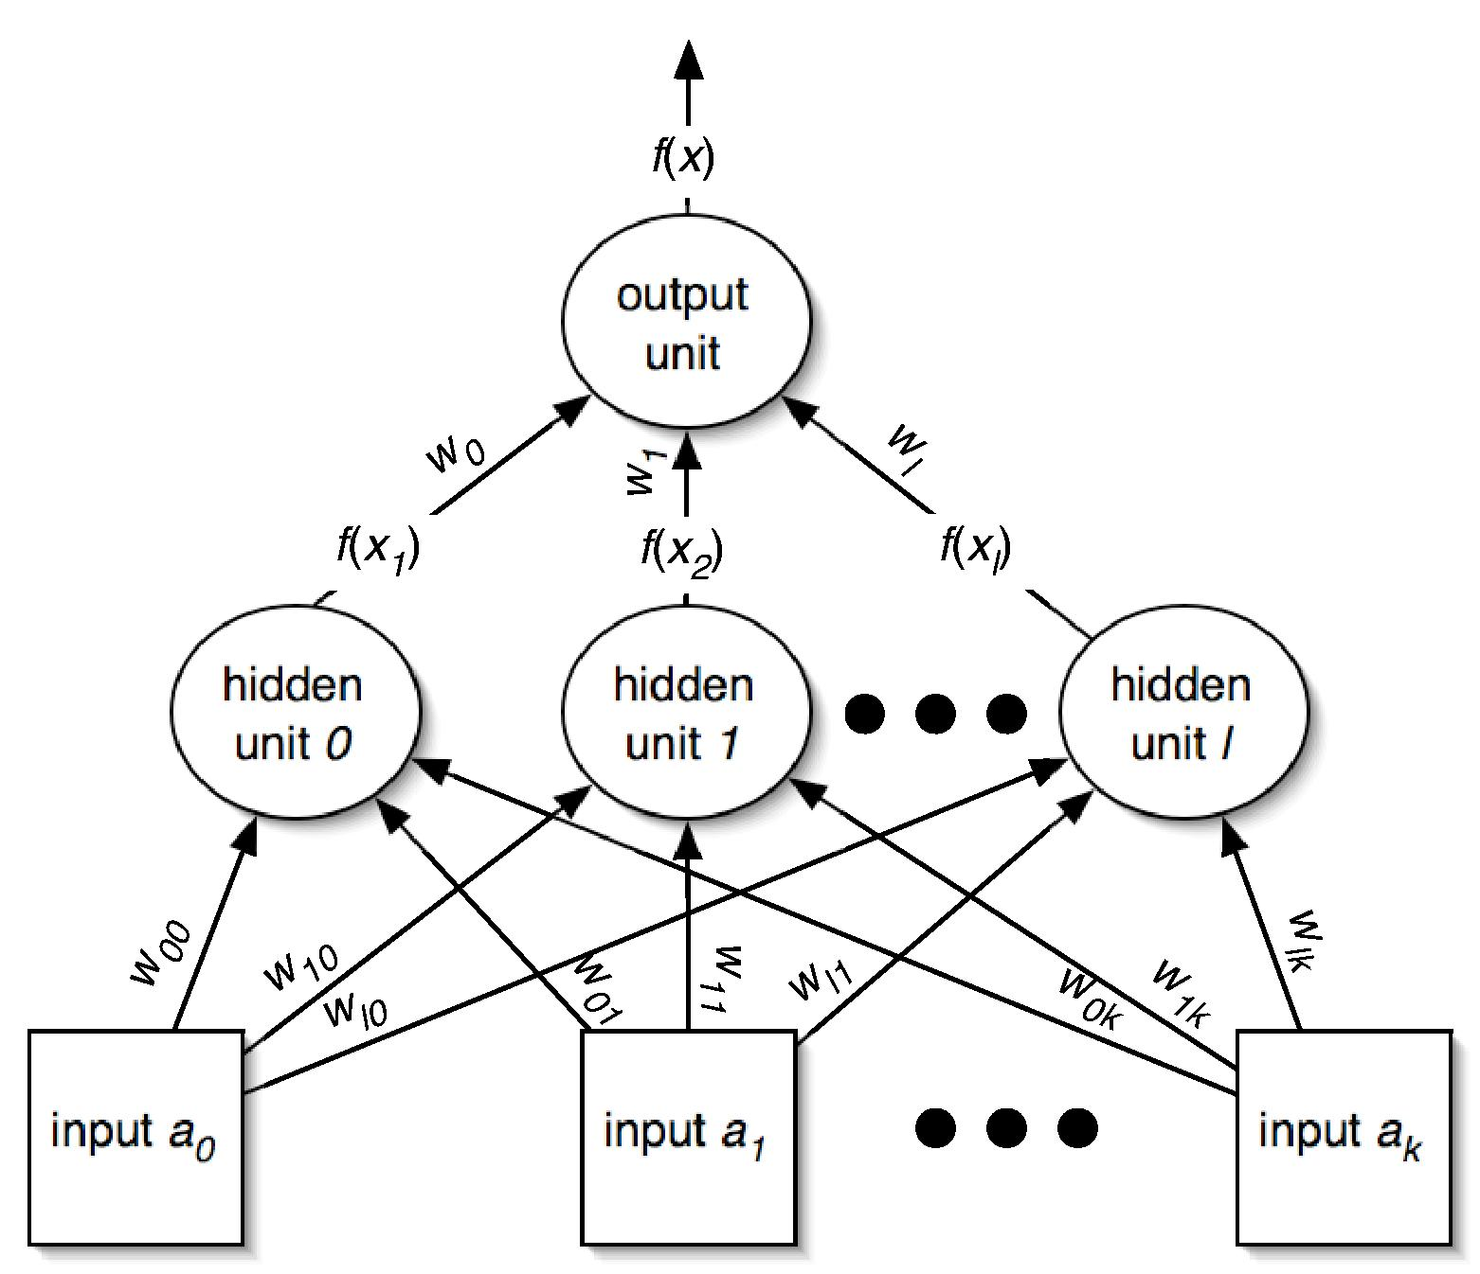
Minimizing the error I
Need to find partial derivative of error function for each parameter (i.e. weight)

Slide 62
Minimizing the error II
What about the weights for the connections from the input to the hidden layer?

Slide 63
Remarks
Same process works for multiple hidden layers and multiple output units (eg. for multiple classes)
Can update weights after all training instances have been processed or incrementally:
  batch learning vs. stochastic backpropagation
  Weights are initialized to small random values
How to avoid overfitting?
  Early stopping: use validation set to check when to stop
  Weight decay: add penalty term to error function
How to speed up learning?
  Momentum: re-use proportion of old weight change
  Use optimization method that employs 2nd derivative

Slide 64
Radial basis function networks
Another type of feedforward network with two layers (plus the input layer)
Hidden units represent points in instance space and activation depends on distance
  To this end, distance is converted into similarity: Gaussian activation function
    Width may be different for each hidden unit
  Points of equal activation form hypersphere (or hyperellipsoid) as opposed to hyperplane
Output layer same as in MLP

Slide 65
Learning RBF networks
Parameters: centers and widths of the RBFs + weights in output layer
Can learn two sets of parameters independently and still get accurate models
  Eg.: clusters from k-means can be used to form basis functions
  Linear model can be used based on fixed RBFs
  Makes learning RBFs very efficient
Disadvantage: no built-in attribute weighting based on relevance
RBF networks are related to RBF SVMs

Slide 66
Stochastic gradient descent
Have seen gradient descent + stochastic backpropagation for learning weights in a neural network
Gradient descent is a general-purpose optimization technique
  Can be applied whenever the objective function is differentiable
  Actually, can be used even when the objective function is not completely differentiable!
    Subgradients
One application: learn linear models – e.g. linear SVMs or logistic regression

Slide 67
Stochastic gradient descent cont.
Learning linear models using gradient descent is easier than optimizing non-linear NN
  Objective function has global minimum rather than many local minima
Stochastic gradient descent is fast, uses little memory and is suitable for incremental online learning

Slide 68
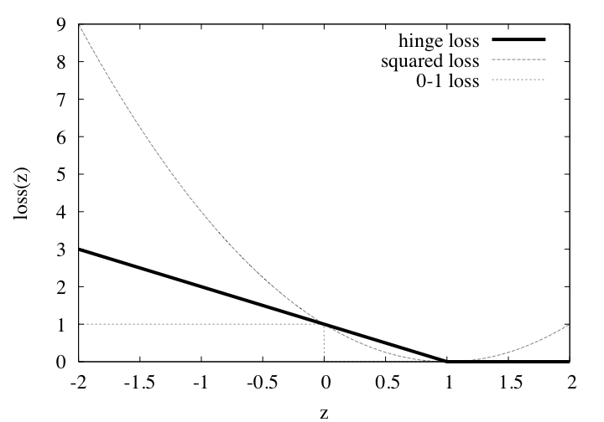
Stochastic gradient descent cont.
For SVMs, the error function (to be minimized) is called the hinge loss

Slide 69
Stochastic gradient descent cont.
In the linearly separable case, the hinge loss is 0 for a function that successfully separates the data
  The maximum margin hyperplane is given by the smallest weight vector that achieves 0 hinge loss
Hinge loss is not differentiable at z = 1; cant compute gradient!
  Subgradient – something that resembles a gradient
  Use 0 at z = 1
  In fact, loss is 0 for z ≥ 1, so can focus on z < 1 and proceed as usual

Slide 70
Numeric prediction
Counterparts exist for all schemes previously discussed
  Decision trees, rule learners, SVMs, etc.
(Almost) all classification schemes can be applied to regression problems using discretization
  Discretize the class into intervals
  Predict weighted average of interval midpoints
  Weight according to class probabilities

Slide 71
Regression trees
Like decision trees, but:
  Splitting criterion: minimize intra-subset variation
  Termination criterion: std dev becomes small
  Pruning criterion: based on numeric error measure
  Prediction: Leaf predicts average class values of instances
Piecewise constant functions
Easy to interpret
More sophisticated version: model trees

Slide 72
Model trees
Build a regression tree
Each leaf ⇒ linear regression function
Smoothing: factor in ancestor’s predictions
  Smoothing formula:
  Same effect can be achieved by incorporating ancestor models into the leaves
Need linear regression function at each node
At each node, use only a subset of attributes
  Those occurring in subtree
  (+maybe those occurring in path to the root)
Fast: tree usually uses only a small subset of the attributes

Slide 73
Building the tree
Splitting: standard deviation reduction
Termination:
  Standard deviation < 5% of its value on full training set
  Too few instances remain (e.g. < 4)
Pruning:
  Heuristic estimate of absolute error of LR models:
  Greedily remove terms from LR models to minimize estimated error
  Heavy pruning: single model may replace whole subtree
  Proceed bottom up: compare error of LR model at internal node to error of subtree

Slide 74
Nominal attributes
Convert nominal attributes to binary ones
  Sort attribute by average class value
  If attribute has k values,
  generate k – 1 binary attributes
    i th is 0 if value lies within the first i , otherwise 1
Treat binary attributes as numeric
Can prove: best split on one of the new attributes is the best (binary) split on original

Slide 75
Missing values
Modify splitting criterion:
To determine which subset an instance goes into, use surrogate splitting
  Split on the attribute whose correlation with original is greatest
  Problem: complex and time-consuming
  Simple solution: always use the class
Test set: replace missing value with average

Slide 76
Surrogate splitting based on class
Choose split point based on instances with known values
Split point divides instances into 2 subsets
  L (smaller class average)
  R (larger)
m is the average of the two averages
For an instance with a missing value:
  Choose L if class value < m
  Otherwise R
Once full tree is built, replace missing values with averages of corresponding leaf nodes

Slide 77
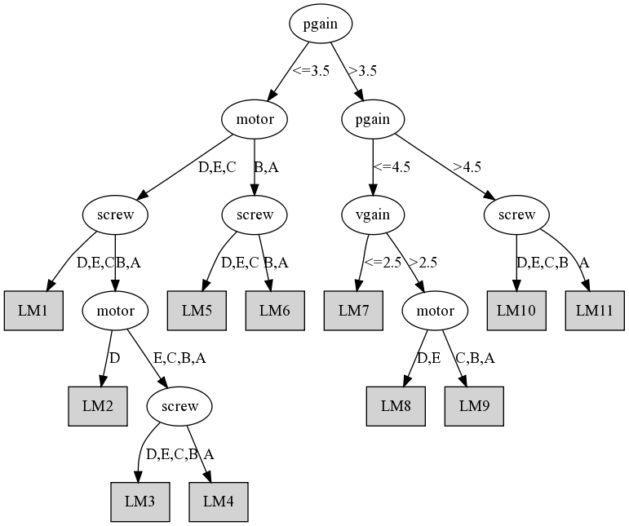
Model tree for servo data

Slide 78
Design decisions
Weighting function:
  Inverse Euclidean distance
  Gaussian kernel applied to Euclidean distance
  Triangular kernel used the same way
  etc.
Smoothing parameter is used to scale the distance function
  Multiply distance by inverse of this parameter
  Possible choice: distance of k th nearest training instance (makes it data dependent)

