Slide 1

Web Usage Mining
Sara Vahid

Slide 2
Agenda
Introduction
Web Usage Mining Procedure
Preprocessing Stage
Pattern Discovery Stage
Data Mining Approaches
Sample Methods
Conclusions
References

Slide 3

Introduction
World Wide Web grows rapidly.
The number of users increases every day.
Web search engines should
extract accurate information.
Web Usage Mining is the application of data mining techniques to discover interesting usage patterns from Web data

Slide 4
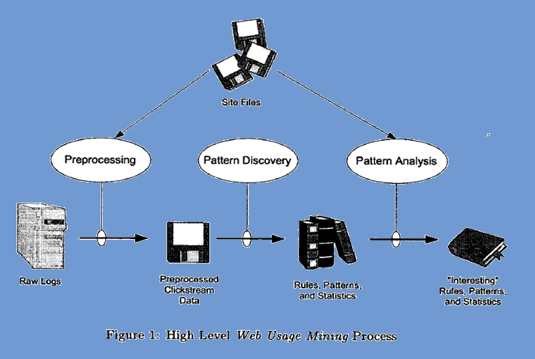
Web Usage Mining Procedure

Slide 5
Preprocessing Stage

Slide 6
Raw Data (Transaction Logs)
Communications between user and system. (W3C is an organization that defines transaction log formats)
Preprocessing of Transaction Logs include (Data Cleaning, User Identification (can be assigned by search engine), Session Identification (set of pages visited by a user within the duration of a particular visit), Transactions Construction
(subset of user session having homogenous pages)

Slide 7
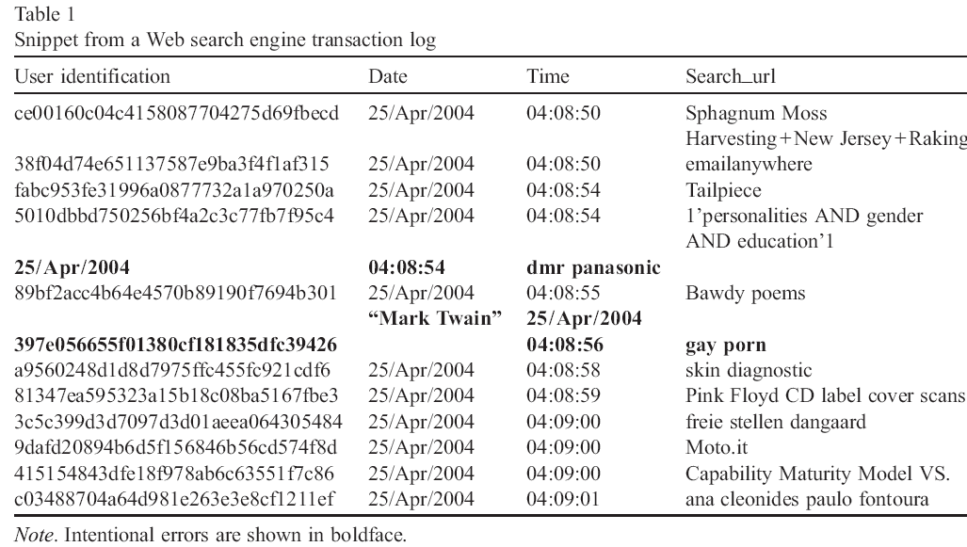
Transaction Log Sample

Slide 8
Data Preparation
Cleaning the data
Session Identification
User Identification
Importing transaction logs data into database and normalizing the data

Slide 9
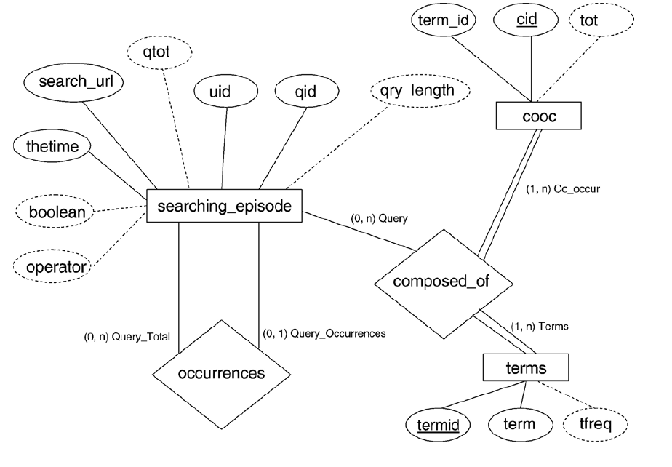
Data Preparation Sample

Slide 10
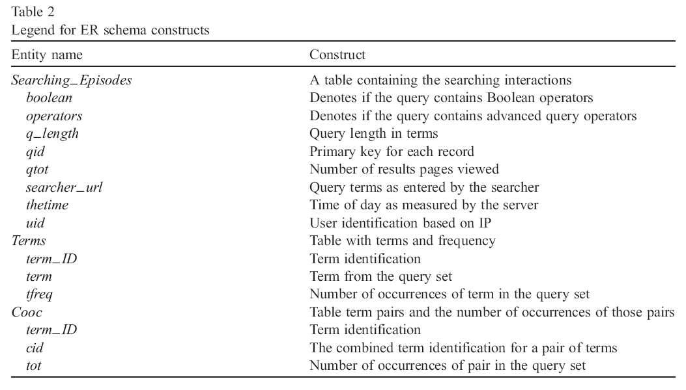
Data Preparation Sample

Slide 11
Pattern Discovery Stage

Slide 12
Data Mining Approaches
Based on Bari and Chawan (2013), quite effective method in web usage mining mainly is classifying and clustering at the present time.
Clustering
Categorization of pages and products
Classification
“The Fool and his Money Video Game”, “Pokemon Video Game” and “Kineck Party Video Game” product pages are all part of Video Games product group.

Slide 13
Sample Methods
Poongothai et al. (2011), used enhanced fuzzy C means clustering algorithm.
Chitraa and Thanamani (2012), used enhanced clustering algorithm. K-mean algorithm suffers from two serious drawback, first one is that the number of the clusters is unknown, and the second is initial seed problem. Solution: first, dataset is divided into subsets and initial cluster points are calculated. Second, k-means algorithm is applied to find clusters. City Block Measures is used for calculating the similarity.

Slide 14
Sample Method (Cont’)
Langhnoja et al. (2013), used association rule mining on clustered data.
Kansara and Patel (2013), used combination of clustering and classification algorithm (classification process that identifies potential users from web log data and a clustering process that groups potential users with similar interest).

Slide 15
Conclusions
Web Usage Mining approaches try to find useful pattern among server log data mostly use clustering techniques. In this review, authors worked more on enhancing the existing algorithm.
However, preprocessing step is one of the most significant part in order to discover better pattern that should be more discussed in future.

Slide 16
References
Ajiferuke, I., Wolfram, D., and Famoye, F. 2006, ‘Sample size and informetric model goodness-of-fit outcomes: A search engine log case study’, Journal of Information Science, vol. 32, no. 3, pp. 212–222.
Bari, P., and Chawan, P., M. 2013, ‘Web Usage Mining’, Journal of Engineering, Computers and Applied Sciences, vol. 2, no. 6, pp. 34-38
Chitraa, V., and Thanamani, S., Antony, 2012, ‘An Enhanced Clustering Method for Web Usage Mining’, International Journal of Engineering Research and Technology, vol.1, no.4, pp. 1-5.
Chu, M., Fang, X., Olivia, R., and Liu, S. 2005, ‘Analysis of the query logs of a Website search engine’, Journal of the American Society for Information Science and Technology, pp. 1363–1376.
Jansen, B. J., Booth, D.L., and Spink, A. 2008, ‘Determining the informational, navigational, and transactional intent of Web queries’, Elsevier, vol. 44, pp. 1251-1266.

Slide 17
Jansen, B. J. 2006, ‘Search log analysis: What it is, what's been done, how to do it’, Elsevier, vol. 28, pp. 407-432.
Kansara, Akshay, and Patel, Swati, 2013, ‘Improved Approach to Predict user Future Sessions using Classification and Clustering’, International Journal of Science and Research, vol. 2, no. 5, pp. 199-202.
Langhnoja, G., Shaily, Barot, P., Mehul, and Mehta, B., Darshak, 2013, ‘Web Usage Mining Using Association Rule Mining on Clustered Data for Pattern Discovery’, International Journal of Data Mining Techniques and Applications, vol. 02, no. 01, pp. 141-150.
Poongothai, K., Parimala, M., and Sathiyabama, S., 2011, ‘Efficient Web Usage Mining with Clustering’, ‘IJCSI International Journal of Computer Science Issues’, vol. 8, no. 3, pp. 203-209.

Slide 18
Thank You

Slide 19
Q & A

