Slide 1
Data Mining
Practical Machine Learning Tools and Techniques
Slides for Chapter 5 of Data Mining by I. H. Witten, E. Frank and
M. A. Hall

Slide 2
Credibility: Evaluating what’s been learned
Issues: training, testing, tuning
Predicting performance: confidence limits
Holdout, cross-validation, bootstrap
Comparing schemes: the t-test
Predicting probabilities: loss functions
Cost-sensitive measures
Evaluating numeric prediction
The Minimum Description Length principle

Slide 3
Evaluation: the key to success
How predictive is the model we learned?
Error on the training data is not a good indicator of performance on future data
  Otherwise 1-NN would be the optimum classifier!
Simple solution that can be used if lots of (labeled) data is available:
  Split data into training and test set
However: (labeled) data is usually limited
  More sophisticated techniques need to be used

Slide 4
Issues in evaluation
Statistical reliability of estimated differences in performance (→ significance tests)
Choice of performance measure:
  Number of correct classifications
  Accuracy of probability estimates
  Error in numeric predictions
Costs assigned to different types of errors
  Many practical applications involve costs

Slide 5
Training and testing I
Natural performance measure for classification problems: error rate
  Success: instance’s class is predicted correctly
  Error: instance’s class is predicted incorrectly
  Error rate: proportion of errors made over the whole set of instances
Resubstitution error: error rate obtained from training data
Resubstitution error is (hopelessly) optimistic!

Slide 6
Training and testing II
Test set: independent instances that have played no part in formation of classifier
  Assumption: both training data and test data are representative samples of the underlying problem
Test and training data may differ in nature
  Example: classifiers built using customer data from two different towns A and B
    To estimate performance of classifier from town A in completely new town, test it on data from B

Slide 7
Note on parameter tuning
It is important that the test data is not used in any way to create the classifier
Some learning schemes operate in two stages:
  Stage 1: build the basic structure
  Stage 2: optimize parameter settings
The test data can’t be used for parameter tuning!
Proper procedure uses three sets: training data, validation data, and test data
  Validation data is used to optimize parameters

Slide 8
Making the most of the data
Once evaluation is complete, all the data can be used to build the final classifier
Generally, the larger the training data the better the classifier (but returns diminish)
The larger the test data the more accurate the error estimate
Holdout procedure: method of splitting original data into training and test set
  Dilemma: ideally both training set and test set should be large!

Slide 9
Predicting performance
Assume the estimated error rate is 25%. How close is this to the true error rate?
  Depends on the amount of test data
Prediction is just like tossing a (biased!) coin
  “Head” is a “success”, “tail” is an “error”
In statistics, a succession of independent events like this is called a Bernoulli process
  Statistical theory provides us with confidence intervals for the true underlying proportion

Slide 10
Confidence intervals
We can say: p lies within a certain specified interval with a certain specified confidence
Example: S=750 successes in N=1000 trials
  Estimated success rate: 75%
  How close is this to true success rate p?
    Answer: with 80% confidence p in [73.2,76.7]
Another example: S=75 and N=100
  Estimated success rate: 75%
  With 80% confidence p in [69.1,80.1]

Slide 11
Mean and variance
Mean and variance for a Bernoulli trial:
p, p (1–p)
Expected success rate f=S/N
Mean and variance for f : p, p (1–p)/N
For large enough N, f follows a Normal distribution
c% confidence interval [–z ≤ X ≤ z] for random variable with 0 mean is given by:
With a symmetric distribution:

Slide 12
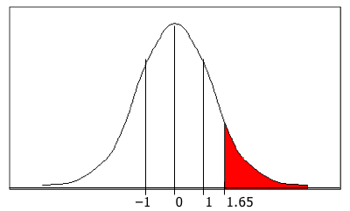
Confidence limits
Confidence limits for the normal distribution with 0 mean and a variance of 1:
Thus:
To use this we have to reduce our random variable f to have 0 mean and unit variance
Pr[X ≥ z]
z
0.1%
3.09
0.5%
2.58
1%
2.33
5%
1.65
10%
1.28
20%
0.84
–1 0 1 1.65
40%
0.25

Slide 13
Transforming f
Transformed value for f :
(i.e. subtract the mean and divide by the standard deviation)
Resulting equation:
Solving for p :

Slide 14
Examples
f = 75%, N = 1000, c = 80% (so that z = 1.28):
f = 75%, N = 100, c = 80% (so that z = 1.28):
Note that normal distribution assumption is only valid for large N (i.e. N > 100)
f = 75%, N = 10, c = 80% (so that z = 1.28):
(should be taken with a grain of salt)

Slide 15
Holdout estimation
What to do if the amount of data is limited?
The holdout method reserves a certain amount for testing and uses the remainder for training
  Usually: one third for testing, the rest for training
Problem: the samples might not be representative
  Example: a class might be missing in the test data
Advanced version uses stratification
  Ensures that each class is represented with approximately equal proportions in both subsets

Slide 16
Repeated holdout method
Holdout estimate can be made more reliable by repeating the process with different subsamples
  In each iteration, a certain proportion is randomly selected for training (possibly with stratificiation)
  The error rates on the different iterations are averaged to yield an overall error rate
This is called the repeated holdout method
Still not optimum: the different test sets overlap
  Can we prevent overlapping?

Slide 17
Cross-validation
Cross-validation avoids overlapping test sets
  First step: split data into k subsets of equal size
  Second step: use each subset in turn for testing, the remainder for training
Called k-fold cross-validation
Often the subsets are stratified before the cross-validation is performed
The error estimates are averaged to yield an overall error estimate

Slide 18
More on cross-validation
Standard method for evaluation: stratified ten-fold cross-validation
Why ten?
  Extensive experiments have shown that this is the best choice to get an accurate estimate
  There is also some theoretical evidence for this
Stratification reduces the estimate’s variance
Even better: repeated stratified cross-validation
  E.g. ten-fold cross-validation is repeated ten times and results are averaged (reduces the variance)

Slide 19
Leave-One-Out cross-validation
Leave-One-Out:
a particular form of cross-validation:
  Set number of folds to number of training instances
  I.e., for n training instances, build classifier n times
Makes best use of the data
Involves no random subsampling
Very computationally expensive
  (exception: NN)

Slide 20
Leave-One-Out-CV and stratification
Disadvantage of Leave-One-Out-CV: stratification is not possible
  It guarantees a non-stratified sample because there is only one instance in the test set!
Extreme example: random dataset split equally into two classes
  Best inducer predicts majority class
  50% accuracy on fresh data
  Leave-One-Out-CV estimate is 100% error!

Slide 21
The bootstrap
CV uses sampling without replacement
  The same instance, once selected, can not be selected again for a particular training/test set
The bootstrap uses sampling with replacement to form the training set
  Sample a dataset of n instances n times with replacement to form a new dataset of n instances
  Use this data as the training set
  Use the instances from the original
  dataset that don’t occur in the new
  training set for testing

Slide 22
The 0.632 bootstrap
Also called the 0.632 bootstrap
  A particular instance has a probability of 1–1/n of not being picked
  Thus its probability of ending up in the test data is:
  This means the training data will contain approximately 63.2% of the instances

Slide 23
Estimating error with the bootstrap
The error estimate on the test data will be very pessimistic
  Trained on just ~63% of the instances
Therefore, combine it with the resubstitution error:
The resubstitution error gets less weight than the error on the test data
Repeat process several times with different replacement samples; average the results

Slide 24
More on the bootstrap
Probably the best way of estimating performance for very small datasets
However, it has some problems
  Consider the random dataset from above
  A perfect memorizer will achieve
  0% resubstitution error and
  ~50% error on test data
  Bootstrap estimate for this classifier:
  True expected error: 50%

Slide 25
Comparing data mining schemes
Frequent question: which of two learning schemes performs better?
Note: this is domain dependent!
Obvious way: compare 10-fold CV estimates
Generally sufficient in applications (we don't loose if the chosen method is not truly better)
However, what about machine learning research?
  Need to show convincingly that a particular method works better

Slide 26
Comparing schemes II
Want to show that scheme A is better than scheme B in a particular domain
  For a given amount of training data
  On average, across all possible training sets
Let's assume we have an infinite amount of data from the domain:
  Sample infinitely many dataset of specified size
  Obtain cross-validation estimate on each dataset for each scheme
  Check if mean accuracy for scheme A is better than mean accuracy for scheme B

Slide 27
Paired t-test
In practice we have limited data and a limited number of estimates for computing the mean
Student’s t-test tells whether the means of two samples are significantly different
In our case the samples are cross-validation estimates for different datasets from the domain
Use a paired t-test because the individual samples are paired
  The same CV is applied twice

Slide 28
Distribution of the means
x₁ x₂ … x_{k} and y₁ y₂ … y_{k} are the 2k samples for the k different datasets
m_{x} and m_{y} are the means
With enough samples, the mean of a set of independent samples is normally distributed
Estimated variances of the means are
σ_{x}²/k and σ_{y}²/k
If μ_{x} and μ_{y} are the true means then
are approximately normally distributed with
mean 0, variance 1

Slide 29
Student’s distribution
With small samples (k < 100) the mean follows Student’s distribution with k–1 degrees of freedom
Confidence limits:
9 degrees of freedom normal distribution
Pr[X ≥ z]
z
Pr[X ≥ z]
z
0.1%
4.30
0.1%
3.09
Assuming
we have
10 estimates
0.5%
3.25
0.5%
2.58
1%
2.82
1%
2.33
5%
1.83
5%
1.65
10%
1.38
10%
1.28
20%
0.88
20%
0.84

Slide 30
Distribution of the differences
Let m_{d} = m_{x} – m_{y}
The difference of the means (m_{d}) also has a Student’s distribution with k–1 degrees of freedom
Let σ_{d}² be the variance of the difference
The standardized version of m_{d} is called the t-statistic:
We use t to perform the t-test

Slide 31
Performing the test
Fix a significance level
  If a difference is significant at the α% level,
  there is a (100-α)% chance that the true means differ
Divide the significance level by two because the test is two-tailed
  I.e. the true difference can be +ve or – ve
Look up the value for z that corresponds to α/2
If t ≤ –z or t ≥z then the difference is significant
  I.e. the null hypothesis (that the difference is zero) can be rejected

Slide 32
Unpaired observations
If the CV estimates are from different datasets, they are no longer paired
(or maybe we have k estimates for one scheme, and j estimates for the other one)
Then we have to use an un paired t-test with min(k , j) – 1 degrees of freedom
The estimate of the variance of the difference of the means becomes:

Slide 33
Dependent estimates
We assumed that we have enough data to create several datasets of the desired size
Need to re-use data if that's not the case
  E.g. running cross-validations with different randomizations on the same data
Samples become dependent ⇒ insignificant differences can become significant
A heuristic test is the corrected resampled t-test:
  Assume we use the repeated hold-out method, with n1 instances for training and n2 for testing
  New test statistic is:

Slide 34
Predicting probabilities
Performance measure so far: success rate
Also called 0-1 loss function:
Most classifiers produce class probabilities
Depending on the application, we might want to check the accuracy of the probability estimates
0-1 loss is not the right thing to use in those cases

Slide 35
Quadratic loss function
p₁ … p_{k} are probability estimates for an instance
c is the index of the instance’s actual class
a₁ … a_{k} = 0, except for a_{c} which is 1
Quadratic loss is:
Want to minimize
Can show that this is minimized when p_{j} = p_{j}*, the true probabilities

Slide 36
Informational loss function
The informational loss function is –log(p_{c}),
where c is the index of the instance’s actual class
Number of bits required to communicate the actual class
Let p₁* … p_{k}* be the true class probabilities
Then the expected value for the loss function is:
Justification: minimized when p_{j} = p_{j}*
Difficulty: zero-frequency problem

Slide 37
Discussion
Which loss function to choose?
  Both encourage honesty
  Quadratic loss function takes into account all class probability estimates for an instance
  Informational loss focuses only on the probability estimate for the actual class
  Quadratic loss is bounded:
  it can never exceed 2
  Informational loss can be infinite
Informational loss is related to MDL principle [later]

Slide 38
Counting the cost
In practice, different types of classification errors often incur different costs
Examples:
  Spam filtering
  Loan decisions
  Oil-slick detection
  Fault diagnosis

Slide 39
Counting the cost
The confusion matrix:
There are many other types of cost!
  E.g.: cost of collecting training data
Predicted class
Yes
No
Actual class
Yes
True positive
False negative
No
False positive
True negative

Slide 40
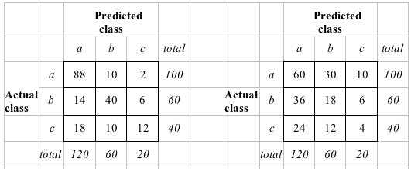
Aside: the kappa statistic
Two confusion matrices for a 3-class problem:
actual predictor (left) vs. random predictor (right)
Number of successes: sum of entries in diagonal (D)
Kappa statistic:
measures relative improvement over random predictor

Slide 41
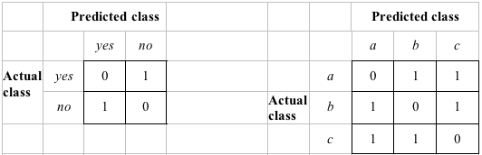
Classification with costs
Two cost matrices:
Success rate is replaced by average cost per prediction
  Cost is given by appropriate entry in the cost matrix

Slide 42
Cost-sensitive classification
Can take costs into account when making predictions
  Basic idea: only predict high-cost class when very confident about prediction
Given: predicted class probabilities
  Normally we just predict the most likely class
  Here, we should make the prediction that minimizes the expected cost
    Expected cost: dot product of vector of class probabilities and appropriate column in cost matrix
    Choose column (class) that minimizes expected cost

Slide 43
Cost-sensitive learning
So far we haven't taken costs into account at training time
Most learning schemes do not perform cost-sensitive learning
  They generate the same classifier no matter what costs are assigned to the different classes
  Example: standard decision tree learner
Simple methods for cost-sensitive learning:
  Resampling of instances according to costs
  Weighting of instances according to costs
Some schemes can take costs into account by varying a parameter, e.g. naïve Bayes

Slide 44
Lift charts
In practice, costs are rarely known
Decisions are usually made by comparing possible scenarios
Example: promotional mailout to 1,000,000 households
  Mail to all; 0.1% respond (1000)
  Data mining tool identifies subset of 100,000 most promising, 0.4% of these respond (400)
  40% of responses for 10% of cost may pay off
  Identify subset of 400,000 most promising, 0.2% respond (800)
A lift chart allows a visual comparison

Slide 45
Generating a lift chart
Sort instances according to predicted probability of being positive:
x axis is sample size
y axis is number of true positives
Predicted probability
Actual class
1
0.95
Yes
2
0.93
Yes
3
0.93
No
4
0.88
Yes
…
…
…

Slide 46
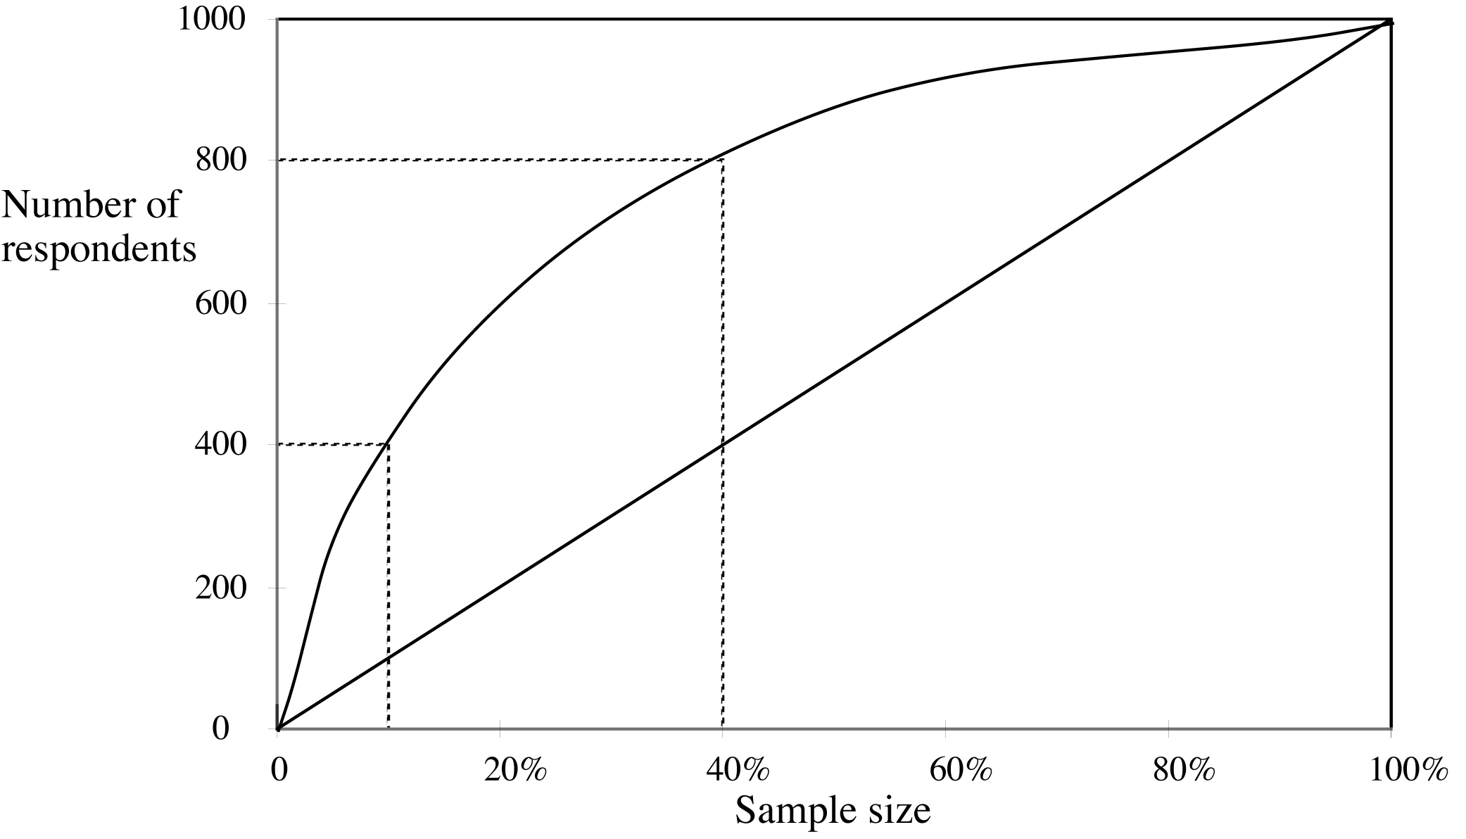
A hypothetical lift chart
40% of responses
for 10% of cost
80% of responses
for 40% of cost

Slide 47
ROC curves
ROC curves are similar to lift charts
  Stands for “receiver operating characteristic”
  Used in signal detection to show tradeoff between hit rate and false alarm rate over noisy channel
Differences to lift chart:
  y axis shows percentage of true positives in sample rather than absolute number
  x axis shows percentage of false positives in sample rather than sample size

Slide 48
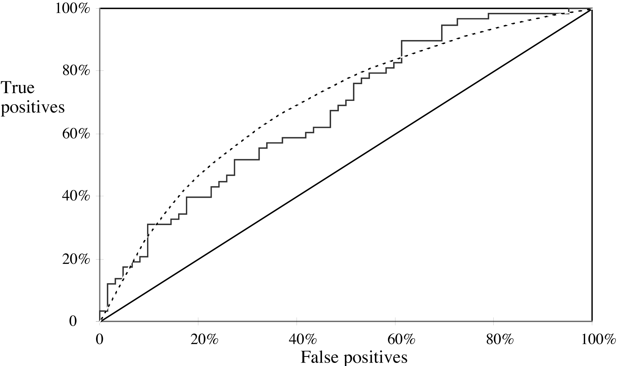
A sample ROC curve
Jagged curve—one set of test data
Smooth curve—use cross-validation

Slide 49
Cross-validation and ROC curves
Simple method of getting a ROC curve using cross-validation:
  Collect probabilities for instances in test folds
  Sort instances according to probabilities
This method is implemented in WEKA
However, this is just one possibility
  Another possibility is to generate an ROC curve for each fold and average them

Slide 50
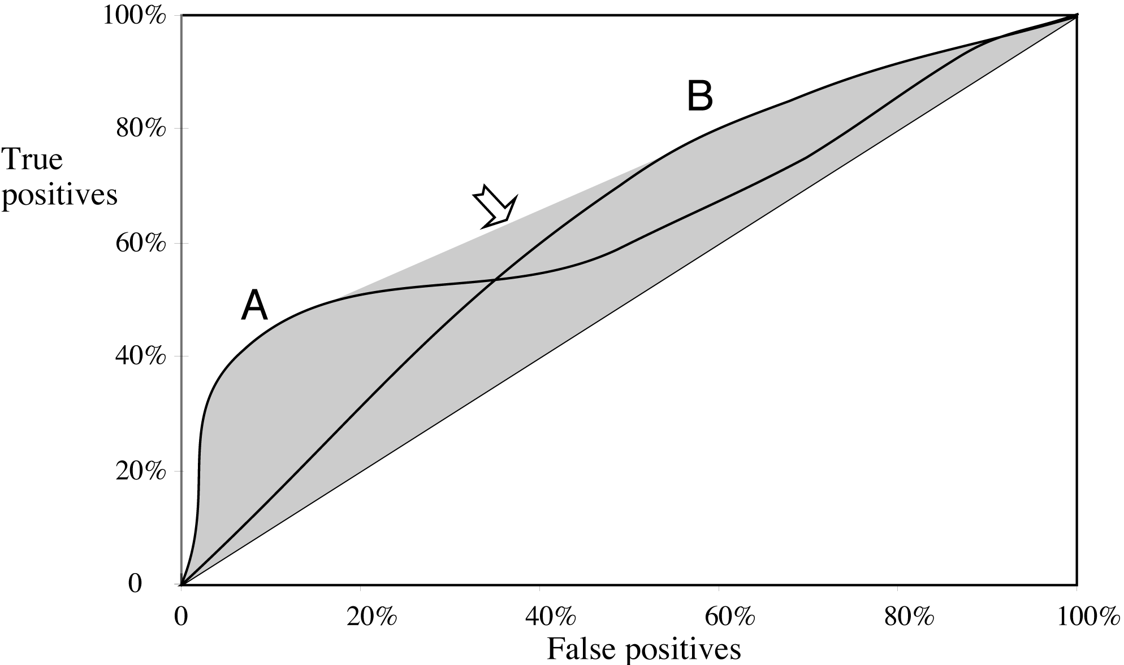
ROC curves for two schemes
For a small, focused sample, use method A
For a larger one, use method B
In between, choose between A and B with appropriate probabilities

Slide 51
The convex hull
Given two learning schemes we can achieve any point on the convex hull!
TP and FP rates for scheme 1: t₁ and f₁
TP and FP rates for scheme 2: t₂ and f₂
If scheme 1 is used to predict 100 × q % of the cases and scheme 2 for the rest, then
  TP rate for combined scheme:
  q × t₁ + (1-q) × t₂
  FP rate for combined scheme:
  q × f₁+(1-q) × f₂

Slide 52
More measures...
Percentage of retrieved documents that are relevant: precision=TP/(TP+FP)
Percentage of relevant documents that are returned:
recall =TP/(TP+FN)
Precision/recall curves have hyperbolic shape
Summary measures: average precision at 20%, 50% and 80% recall (three-point average recall)
F-measure=(2 × recall × precision)/(recall+precision)
sensitivity × specificity = (TP / (TP + FN)) × (TN / (FP + TN))
Area under the ROC curve (AUC):
probability that randomly chosen positive instance is ranked above randomly chosen negative one

Slide 53
Summary of some measures
Domain
Plot
Explanation
Lift chart
Marketing
TP
Subset size
TP
(TP+FP)/(TP+FP+TN+FN)
ROC curve
Communications
TP rate
FP rate
TP/(TP+FN)
FP/(FP+TN)
Recall-precision curve
Information retrieval
Recall
Precision
TP/(TP+FN)
TP/(TP+FP)

Slide 54
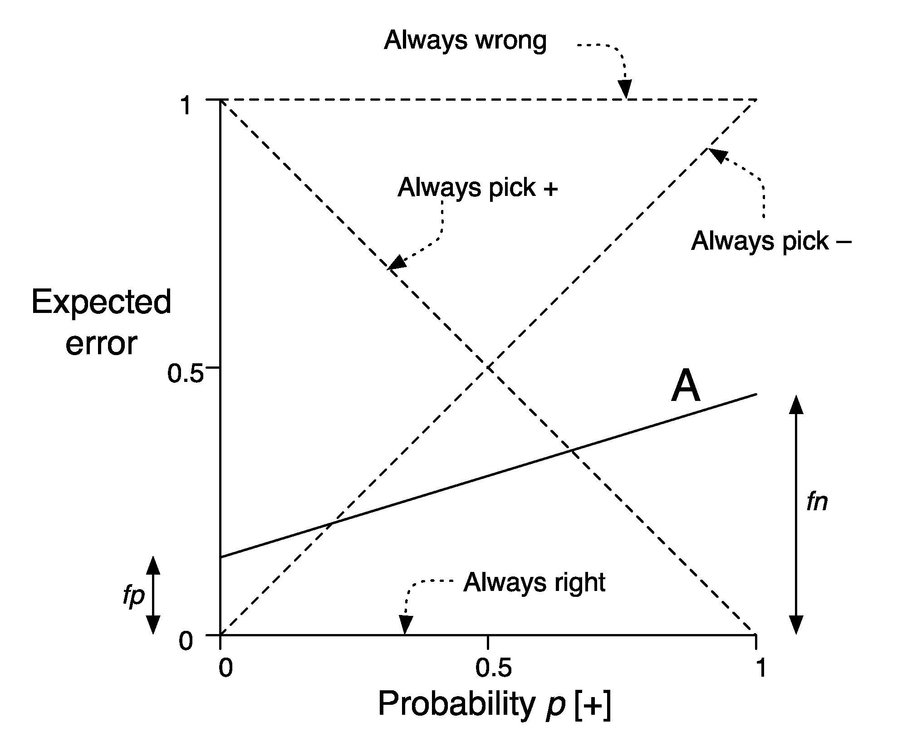
Cost curves
Cost curves plot expected costs directly
Example for case with uniform costs (i.e. error):

Slide 55
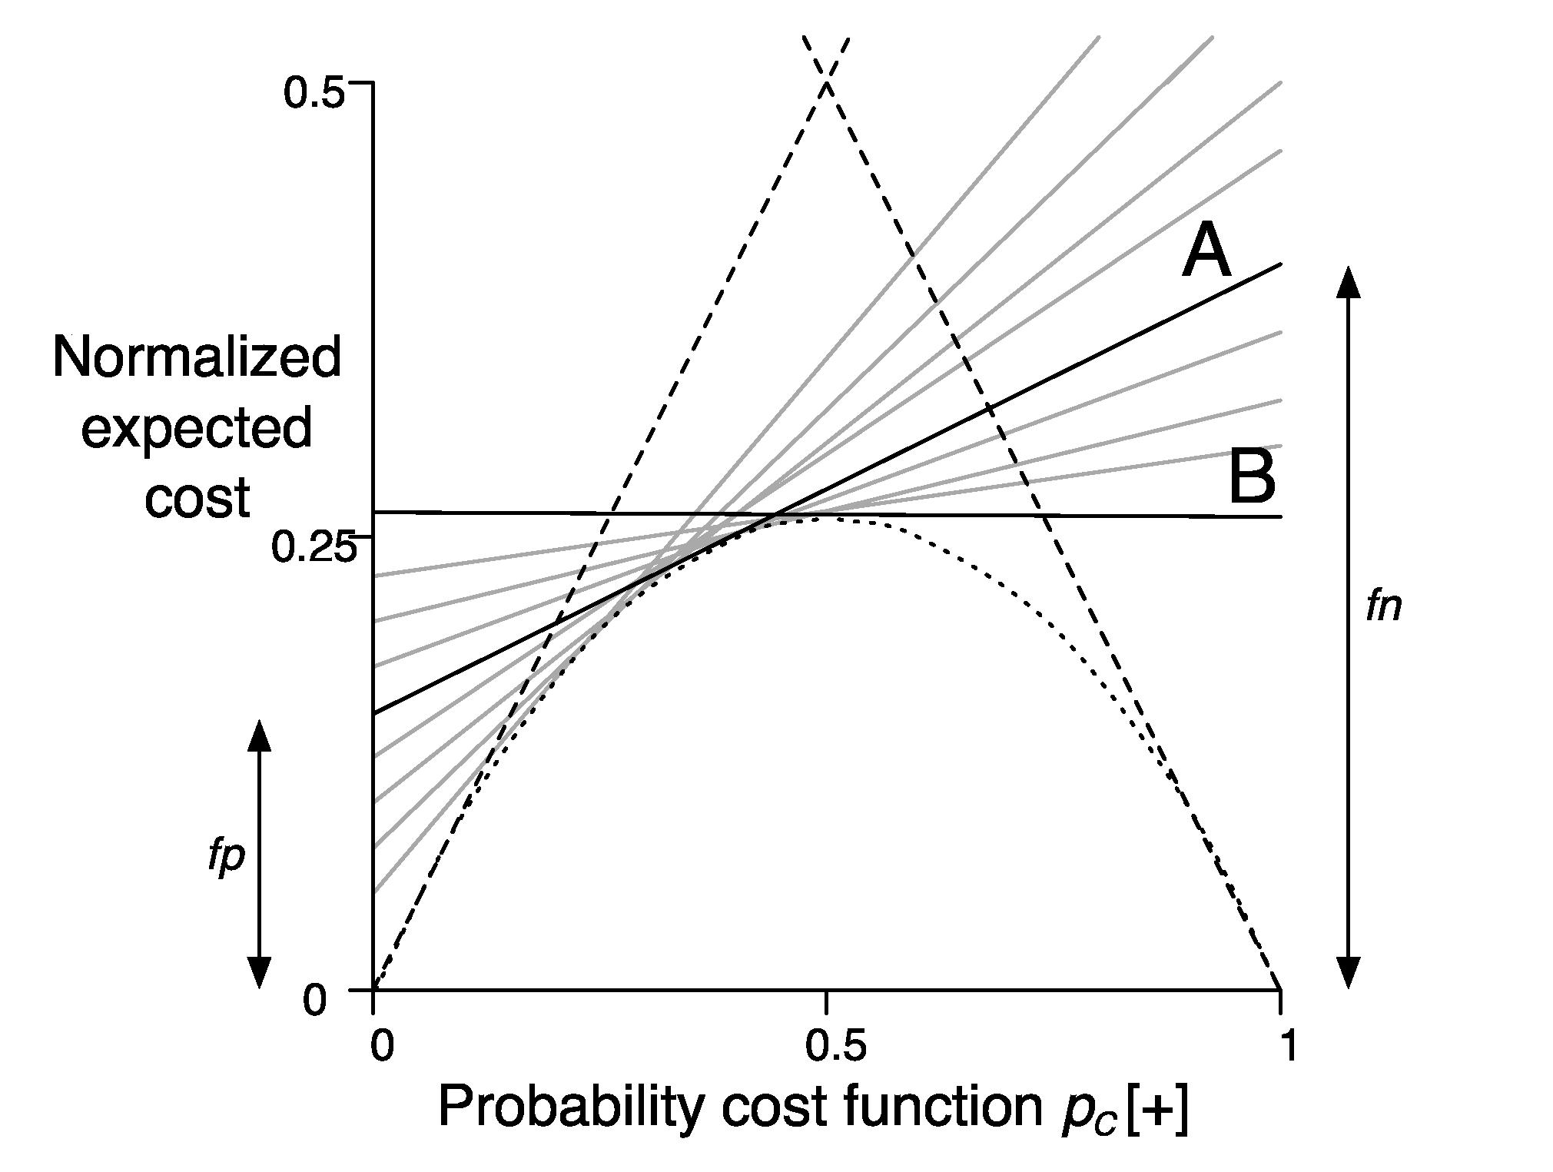
Cost curves: example with costs

Slide 56
Evaluating numeric prediction
Same strategies: independent test set, cross-validation, significance tests, etc.
Difference: error measures
Actual target values: a₁ a₂ …a_{n}
Predicted target values: p₁ p₂ … p_{n}
Most popular measure: mean-squared error
  Easy to manipulate mathematically

Slide 57
Other measures
The root mean-squared error :
The mean absolute error is less sensitive to outliers than the mean-squared error:
Sometimes relative error values are more appropriate (e.g. 10% for an error of 50 when predicting 500)

Slide 58
Improvement on the mean
How much does the scheme improve on simply predicting the average?
The relative squared error is:
The relative absolute error is:

Slide 59
Correlation coefficient
Measures the statistical correlation between the predicted values and the actual values
Scale independent, between –1 and +1
Good performance leads to large values!

Slide 60
Which measure?
Best to look at all of them
Often it doesn’t matter
Example:
A
B
C
D
Root mean-squared error
67.8
91.7
63.3
57.4
Mean absolute error
41.3
38.5
33.4
29.2
Root rel squared error
42.2%
57.2%
39.4%
35.8%
Relative absolute error
43.1%
40.1%
34.8%
30.4%
Correlation coefficient
0.88
0.88
0.89
0.91
D best
C second-best
A, B arguable

Slide 61
The MDL principle
MDL stands for minimum description length
The description length is defined as:
space required to describe a theory
+
space required to describe the theory’s mistakes
In our case the theory is the classifier and the mistakes are the errors on the training data
Aim: we seek a classifier with minimal DL
MDL principle is a model selection criterion

Slide 62
Model selection criteria
Model selection criteria attempt to find a good compromise between:
  The complexity of a model
  Its prediction accuracy on the training data
Reasoning: a good model is a simple model that achieves high accuracy on the given data
Also known as Occam’s Razor :
the best theory is the smallest one
that describes all the facts

Slide 63
Elegance vs. errors
Theory 1: very simple, elegant theory that explains the data almost perfectly
Theory 2: significantly more complex theory that reproduces the data without mistakes
Theory 1 is probably preferable
Classical example: Kepler’s three laws on planetary motion
  Less accurate than Copernicus’s latest refinement of the Ptolemaic theory of epicycles

Slide 64
MDL and compression
MDL principle relates to data compression:
  The best theory is the one that compresses the data the most
  I.e. to compress a dataset we generate a model and then store the model and its mistakes
We need to compute
(a) size of the model, and
(b) space needed to encode the errors
(b) easy: use the informational loss function
(a) need a method to encode the model

Slide 65
MDL and Bayes’s theorem
L[T]=“length” of the theory
L[E|T]=training set encoded wrt the theory
Description length= L[T] + L[E|T]
Bayes’s theorem gives a posteriori probability of a theory given the data:
Equivalent to:
constant

Slide 66
MDL and MAP
MAP stands for maximum a posteriori probability
Finding the MAP theory corresponds to finding the MDL theory
Difficult bit in applying the MAP principle: determining the prior probability Pr[T] of the theory
Corresponds to difficult part in applying the MDL principle: coding scheme for the theory
I.e. if we know a priori that a particular theory is more likely we need fewer bits to encode it

Slide 67
Discussion of MDL principle
Advantage: makes full use of the training data when selecting a model
Disadvantage 1: appropriate coding scheme/prior probabilities for theories are crucial
Disadvantage 2: no guarantee that the MDL theory is the one which minimizes the expected error
Note: Occam’s Razor is an axiom!
Epicurus’s principle of multiple explanations: keep all theories that are consistent with the data

Slide 68
MDL and clustering
Description length of theory:
bits needed to encode the clusters
  e.g. cluster centers
Description length of data given theory:
encode cluster membership and position relative to cluster
  e.g. distance to cluster center
Works if coding scheme uses less code space for small numbers than for large ones
With nominal attributes, must communicate probability distributions for each cluster

