Slide 1
Data Mining
Practical Machine Learning Tools and Techniques
Slides for Chapter 6 of Data Mining by I. H. Witten, E. Frank and
M. A. Hall
Part 2

Slide 2
Implementation:
Real machine learning schemes
6.8 Clustering: hierarchical, incremental, probabilistic
  Hierarchical, incremental, probabilistic, Bayesian
6.9 Semisupervised learning
  Clustering for classification, co-training

Slide 3
Clustering: how many clusters?
How to choose k in k-means? Possibilities:
  Choose k that minimizes cross-validated squared distance to cluster centers
  Use penalized squared distance on the training data (eg. using an MDL criterion)
  Apply k-means recursively with k = 2 and use stopping criterion (eg. based on MDL)
    Seeds for subclusters can be chosen by seeding along direction of greatest variance in cluster
    (one standard deviation away in each direction from cluster center of parent cluster)
    Implemented in algorithm called X-means (using Bayesian Information Criterion instead of MDL)

Slide 4
Hierarchical clustering
Recursively splitting clusters produces a hierarchy that can be represented as a dendogram
  Could also be represented as a Venn diagram of sets and subsets (without intersections)
  Height of each node in the dendogram can be made proportional to the dissimilarity between its children

Slide 5
Agglomerative clustering
Bottom-up approach
Simple algorithm
  Requires a distance/similarity measure
  Start by considering each instance to be a cluster
  Find the two closest clusters and merge them
  Continue merging until only one cluster is left
  The record of mergings forms a hierarchical clustering structure – a binary dendogram

Slide 6
Distance measures
Single-linkage
  Minimum distance between the two clusters
  Distance between the clusters closest two members
  Can be sensitive to outliers
Complete-linkage
  Maximum distance between the two clusters
  Two clusters are considered close only if all instances in their union are relatively similar
  Also sensitive to outliers
  Seeks compact clusters

Slide 7
Distance measures cont.
Compromise between the extremes of minimum and maximum distance
Represent clusters by their centroid, and use distance between centroids – centroid linkage
  Works well for instances in multidimensional Euclidean space
  Not so good if all we have is pairwise similarity between instances
Calculate average distance between each pair of members of the two clusters – average-linkage
Technical deficiency of both: results depend on the numerical scale on which distances are measured

Slide 8
More distance measures
Group-average clustering
  Uses the average distance between all members of the merged cluster
  Differs from average-linkage because it includes pairs from the same original cluster
Ward's clustering method
  Calculates the increase in the sum of squares of the distances of the instances from the centroid before and after fusing two clusters
  Minimize the increase in this squared distance at each clustering step
All measures will produce the same result if the clusters are compact and well separated

Slide 9
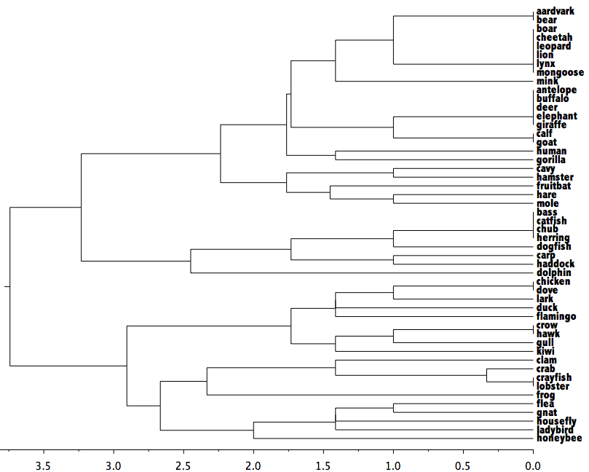
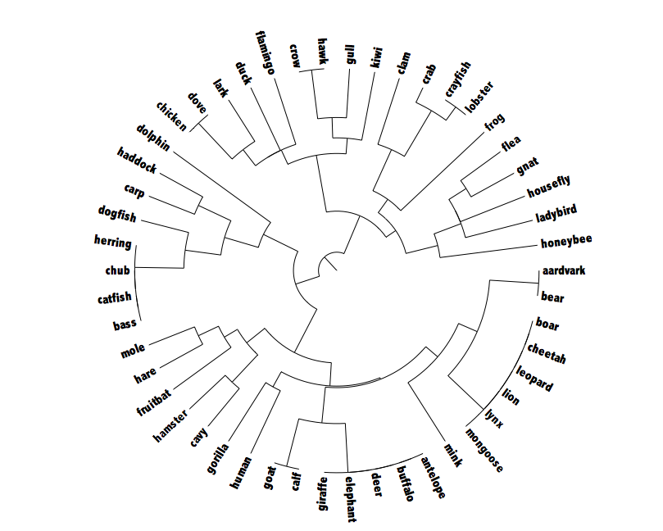
Example hierarchical clustering
50 examples of different creatures from the zoo data
Complete-linkage
Dendogram
Polar plot

Slide 10
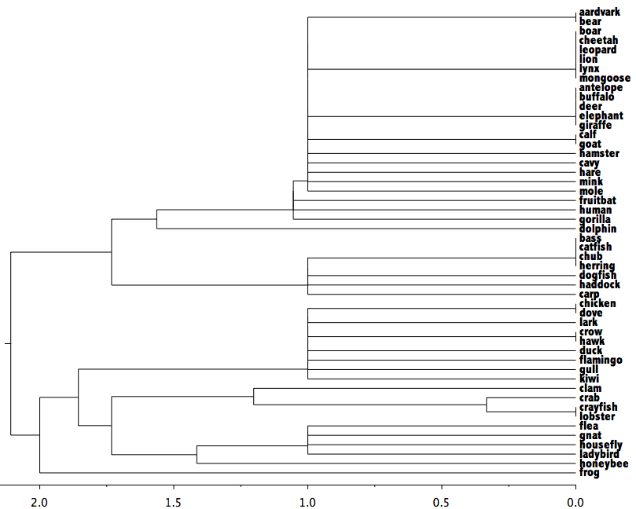
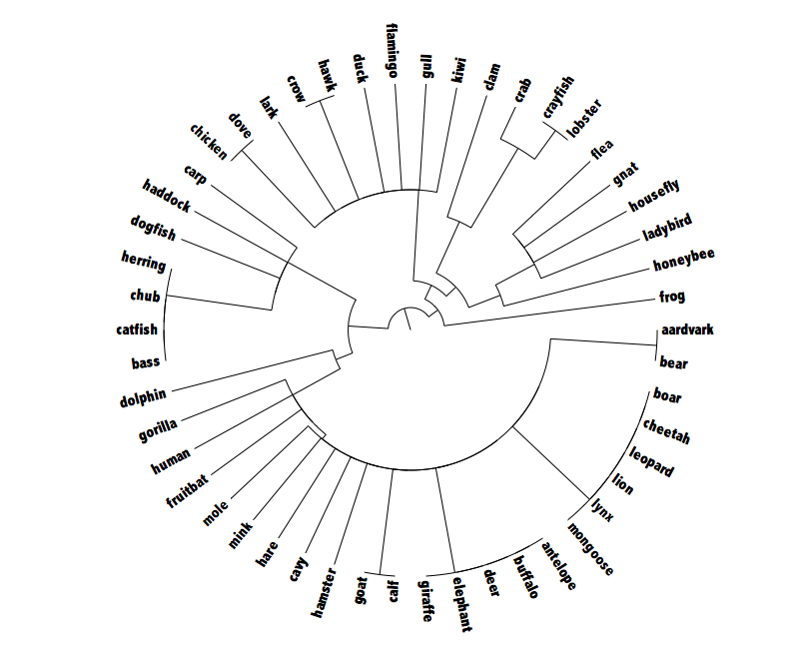
Example hierarchical clustering 2
Single-linkage

Slide 11
Incremental clustering
Heuristic approach (COBWEB/CLASSIT)
Form a hierarchy of clusters incrementally
Start:
  tree consists of empty root node
Then:
  add instances one by one
  update tree appropriately at each stage
  to update, find the right leaf for an instance
  May involve restructuring the tree
Base update decisions on category utility

Slide 12
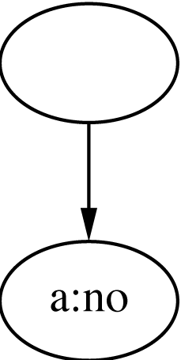
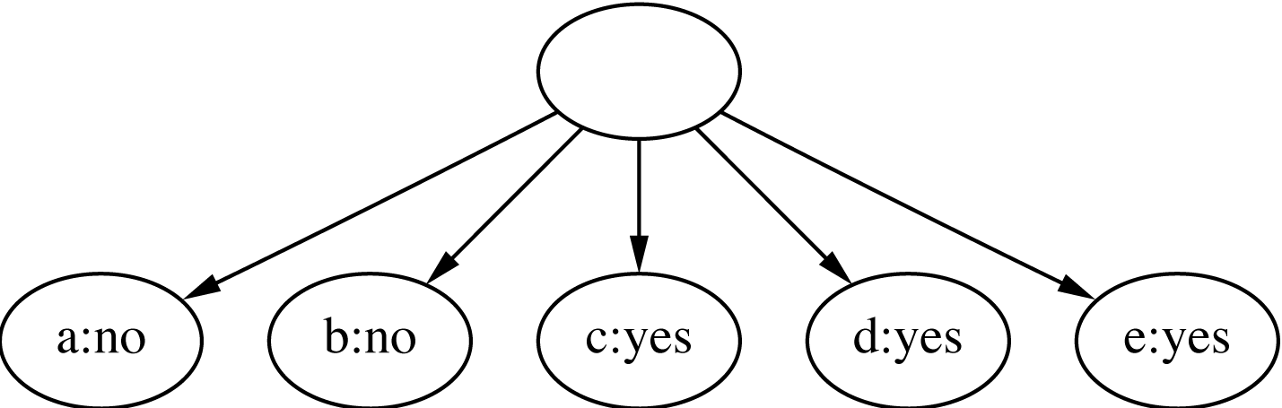
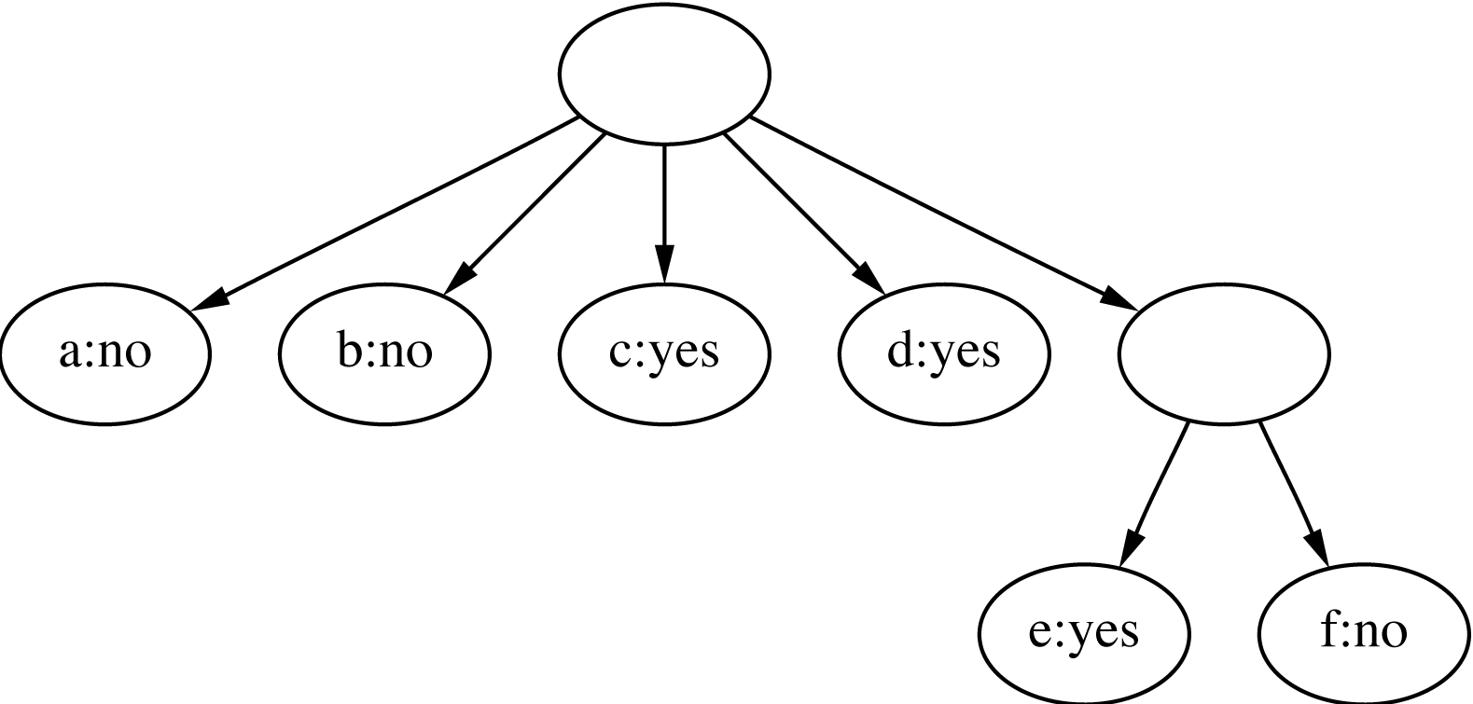
Clustering weather data
1
ID
Outlook
Temp.
Humidity
Windy
A
Sunny
Hot
High
False
B
Sunny
Hot
High
True
C
Overcast
Hot
High
False
D
Rainy
Mild
High
False
2
E
Rainy
Cool
Normal
False
F
Rainy
Cool
Normal
True
G
Overcast
Cool
Normal
True
H
Sunny
Mild
High
False
I
Sunny
Cool
Normal
False
J
Rainy
Mild
Normal
False
3
K
Sunny
Mild
Normal
True
L
Overcast
Mild
High
True
M
Overcast
Hot
Normal
False
N
Rainy
Mild
High
True

Slide 13
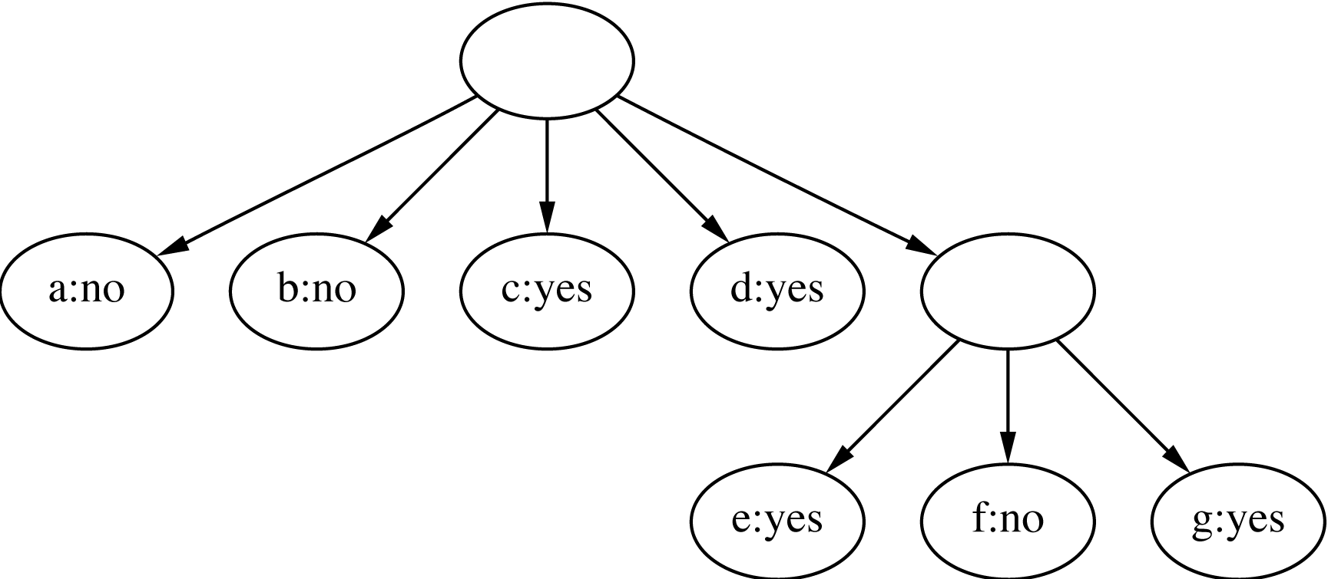
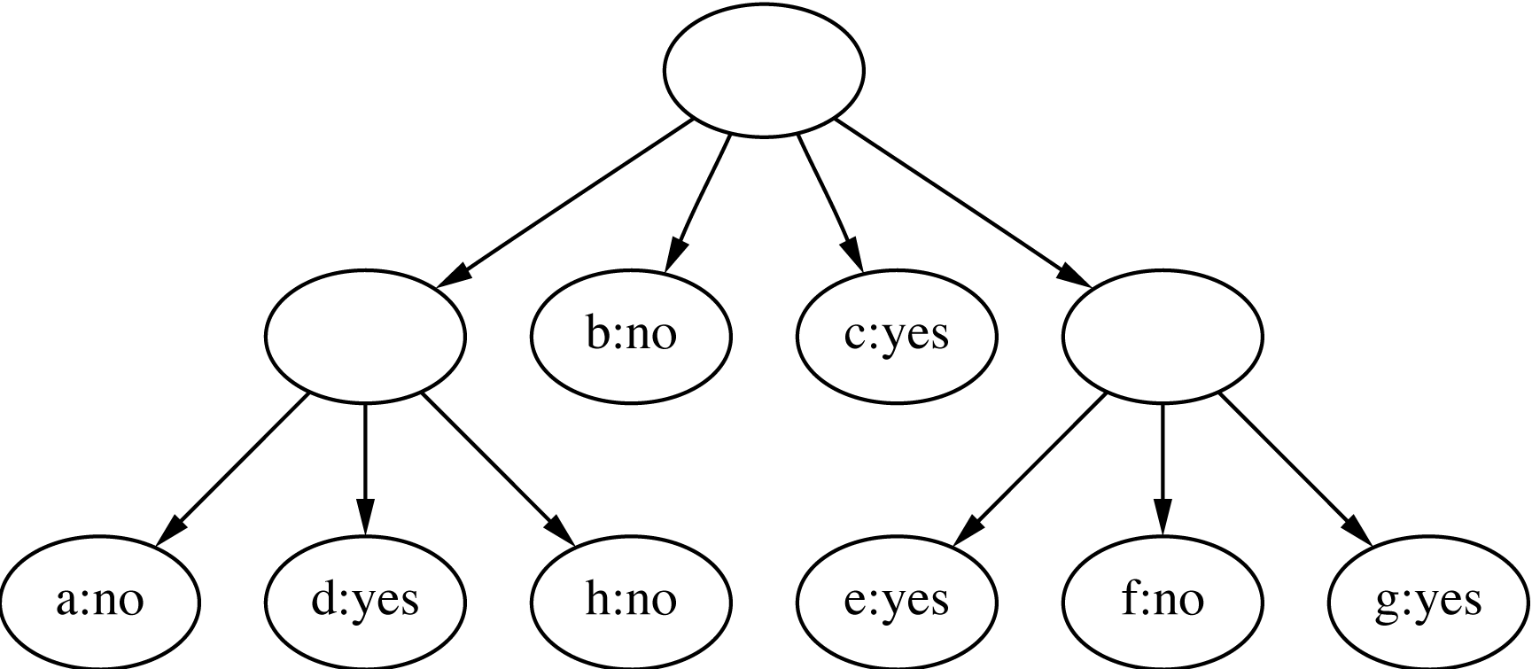
Clustering weather data
4
ID
Outlook
Temp.
Humidity
Windy
A
Sunny
Hot
High
False
B
Sunny
Hot
High
True
C
Overcast
Hot
High
False
D
Rainy
Mild
High
False
E
Rainy
Cool
Normal
False
5
F
Rainy
Cool
Normal
True
G
Overcast
Cool
Normal
True
Merge best host and runner-up
H
Sunny
Mild
High
False
I
Sunny
Cool
Normal
False
J
Rainy
Mild
Normal
False
3
K
Sunny
Mild
Normal
True
L
Overcast
Mild
High
True
M
Overcast
Hot
Normal
False
N
Rainy
Mild
High
True
Consider splitting the best host if merging doesn’t help

Slide 14
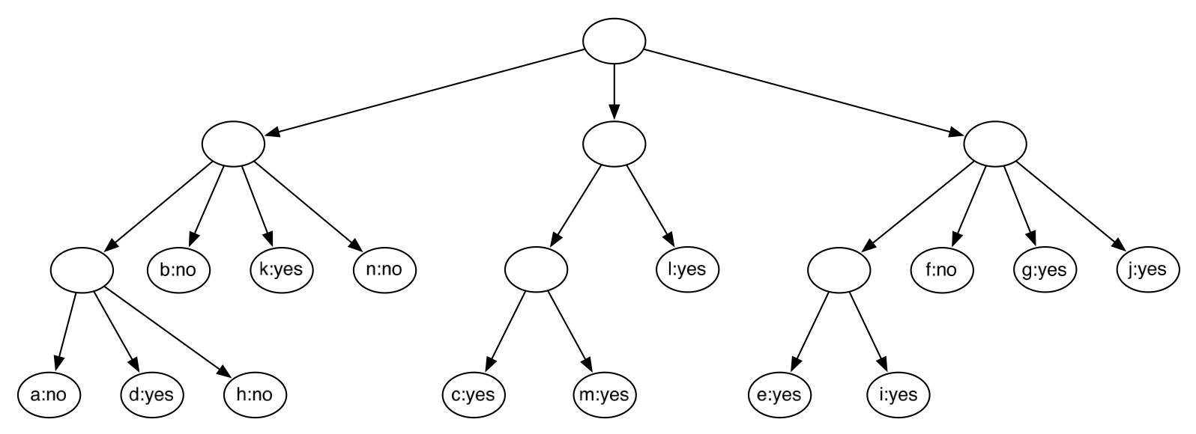
Final hierarchy

Slide 15
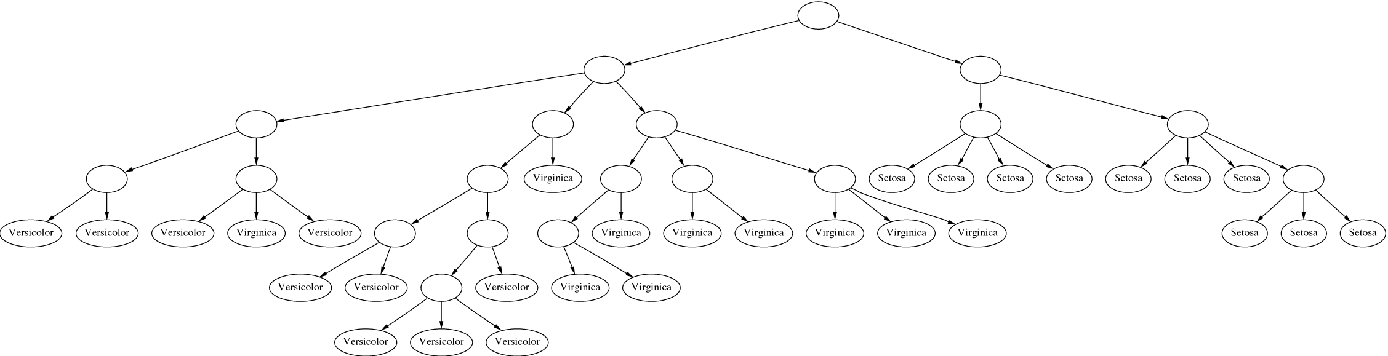
Example: the iris data (subset)

Slide 16
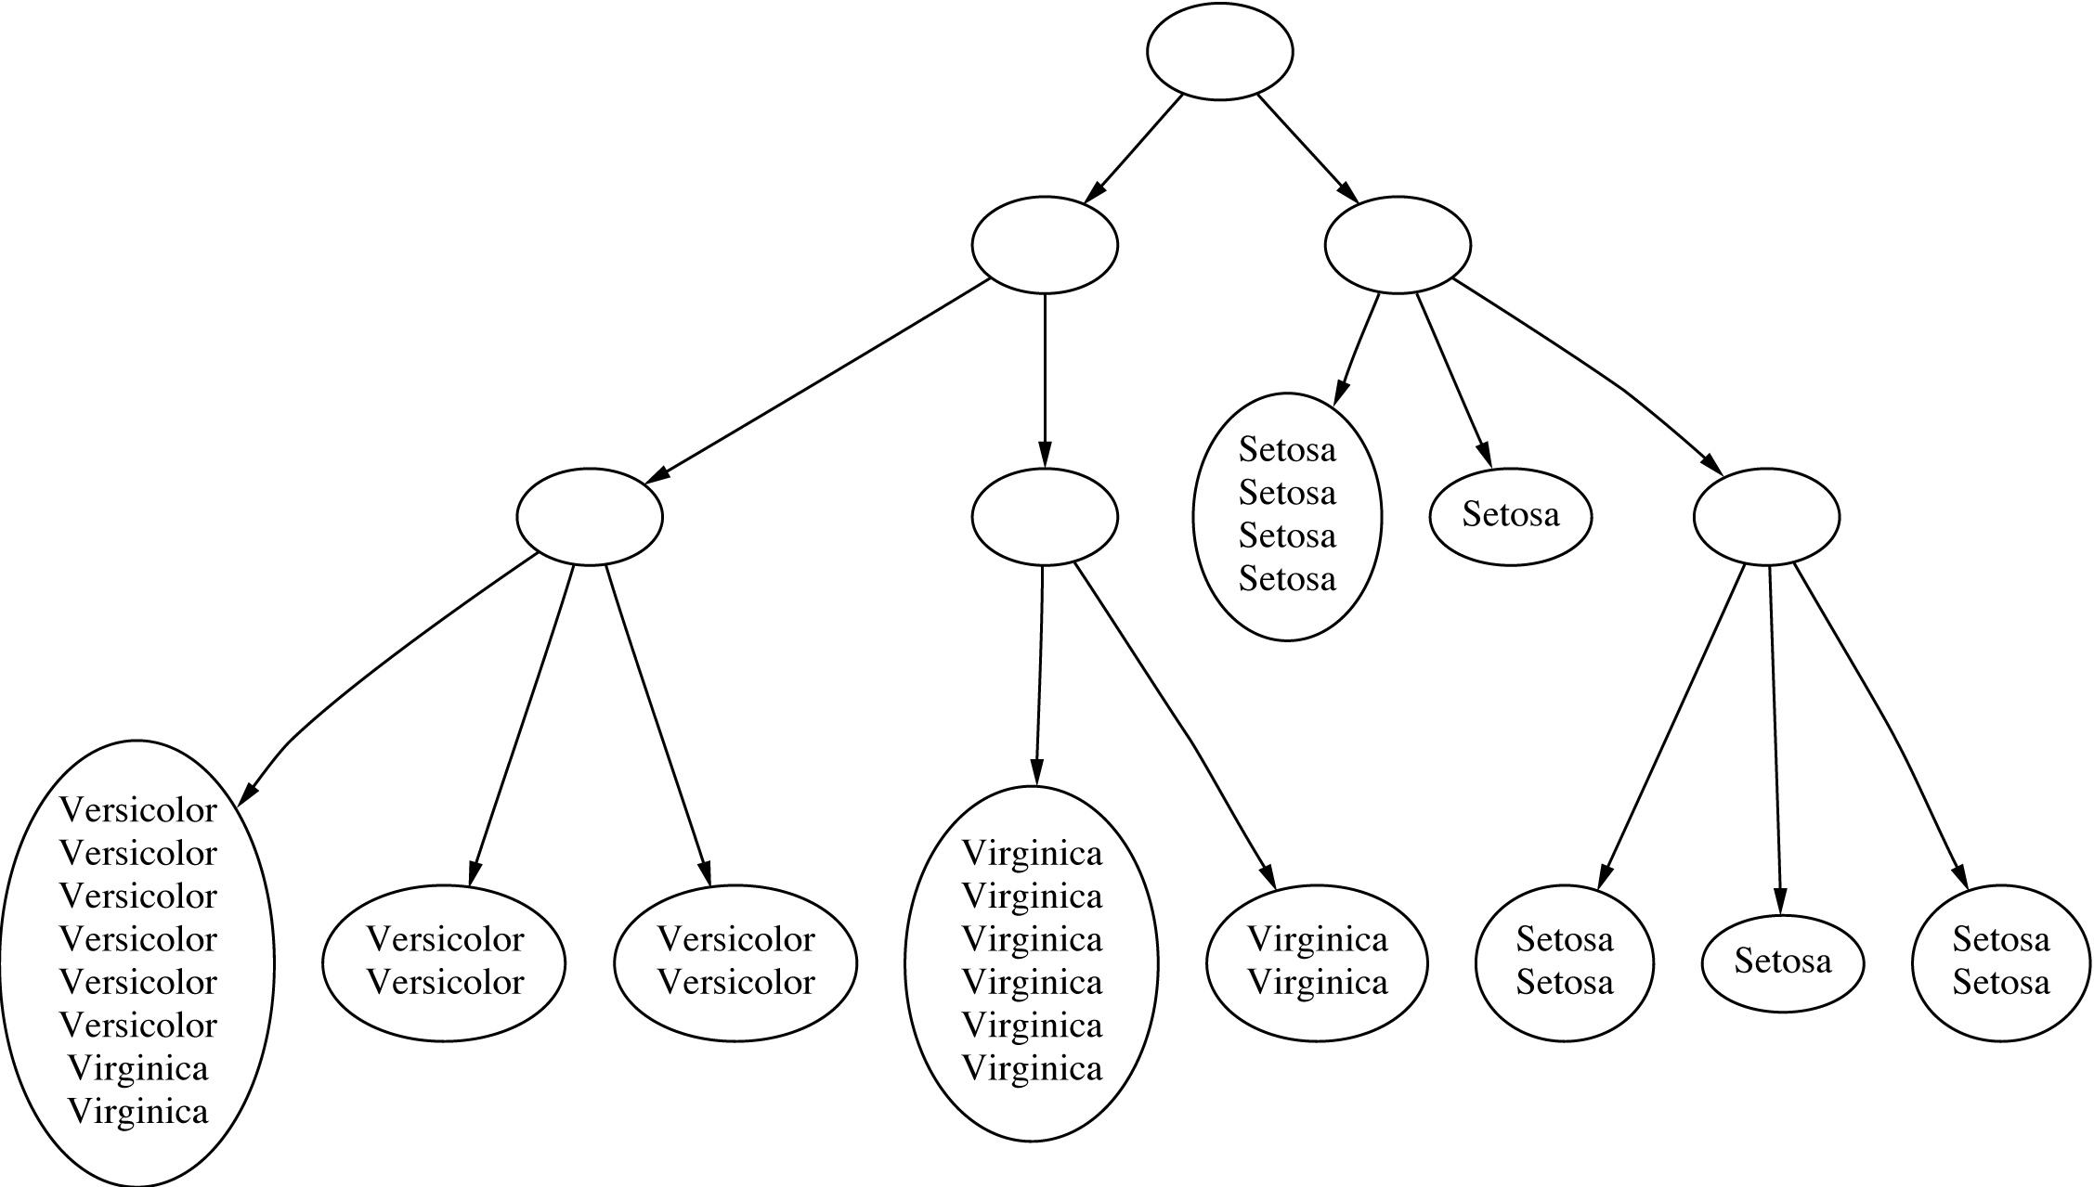
Clustering with cutoff

Slide 17
Category utility
Category utility: quadratic loss function
defined on conditional probabilities:
Every instance in different category ⇒
numerator becomes
maximum
number of attributes

Slide 18
Numeric attributes
Assume normal distribution:
Then:
Thus
becomes
Prespecified minimum variance
  acuity parameter

Slide 19
Probability-based clustering
Problems with heuristic approach:
  Division by k?
  Order of examples?
  Are restructuring operations sufficient?
  Is result at least local minimum of category utility?
Probabilistic perspective ⇒
seek the most likely clusters given the data
Also: instance belongs to a particular cluster with a certain probability

Slide 20
Finite mixtures
Model data using a mixture of distributions
One cluster, one distribution
  governs probabilities of attribute values in that cluster
Finite mixtures : finite number of clusters
Individual distributions are normal (usually)
Combine distributions using cluster weights

Slide 21
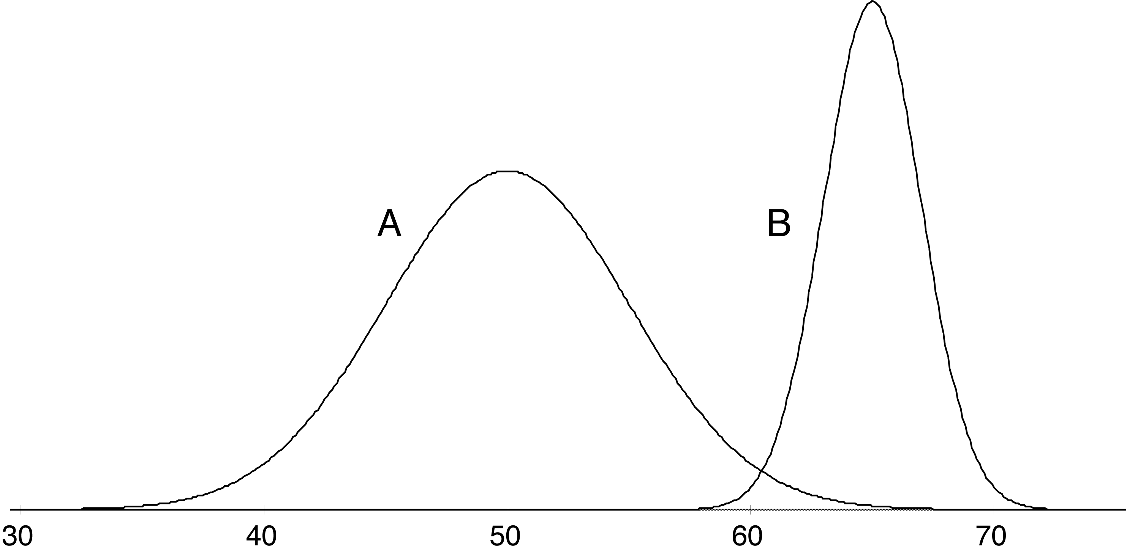
Two-class mixture model
A 51
A 43
B 62
B 64
A 45
A 42
A 46
A 45
A 45
B 62
A 47
A 52
B 64
A 51
B 65
A 48
A 49
A 46
B 64
A 51
A 52
B 62
A 49
A 48
B 62
A 43
A 40
A 48
B 64
A 51
B 63
A 43
B 65
B 66
B 65
A 46
A 39
B 62
B 64
A 52
B 63
B 64
A 48
B 64
A 48
A 51
A 48
B 64
A 42
A 48
A 41
data
model
μ_{A}=50, σ_{A} =5, p_{A}=0.6 μ_{B}=65, σ_{B} =2, p_{B}=0.4

Slide 22
Using the mixture model
Probability that instance x belongs to cluster A:
with
Probability of an instance given the clusters:

Slide 23
Learning the clusters
Assume:
  we know there are k clusters
Learn the clusters ⇒
  determine their parameters
  I.e. means and standard deviations
Performance criterion:
  probability of training data given the clusters
EM algorithm
  finds a local maximum of the likelihood

Slide 24
EM algorithm
EM = Expectation-Maximization
  Generalize k-means to probabilistic setting
Iterative procedure:
  E “expectation” step:
  Calculate cluster probability for each instance
  M “maximization” step:
  Estimate distribution parameters from cluster probabilities
Store cluster probabilities as instance weights
Stop when improvement is negligible

Slide 25
More on EM
Estimate parameters from weighted instances
Stop when log-likelihood saturates
Log-likelihood:

Slide 26
Extending the mixture model
More then two distributions: easy
Several attributes: easy—assuming independence!
Correlated attributes: difficult
  Joint model: bivariate normal distribution
  with a (symmetric) covariance matrix
  n attributes: need to estimate n + n (n+1)/2 parameters

Slide 27
More mixture model extensions
Nominal attributes: easy if independent
Correlated nominal attributes: difficult
  Two correlated attributes ⇒ v₁ v₂ parameters
Missing values: easy
Can use other distributions than normal:
  “log-normal” if predetermined minimum is given
  “log-odds” if bounded from above and below
  Poisson for attributes that are integer counts
Use cross-validation to estimate k !

Slide 28
Bayesian clustering
Problem: many parameters ⇒ EM overfits
Bayesian approach : give every parameter a prior probability distribution
  Incorporate prior into overall likelihood figure
  Penalizes introduction of parameters
Eg: Laplace estimator for nominal attributes
Can also have prior on number of clusters!
Implementation: NASA’s AUTOCLASS

Slide 29
Discussion
Can interpret clusters by using supervised learning
  post-processing step
Decrease dependence between attributes?
  pre-processing step
  E.g. use principal component analysis
Can be used to fill in missing values
Key advantage of probabilistic clustering:
  Can estimate likelihood of data
  Use it to compare different models objectively

Slide 30
Semisupervised learning
Semisupervised learning: attempts to use unlabeled data as well as labeled data
  The aim is to improve classification performance
Why try to do this? Unlabeled data is often plentiful and labeling data can be expensive
  Web mining: classifying web pages
  Text mining: identifying names in text
  Video mining: classifying people in the news
Leveraging the large pool of unlabeled examples would be very attractive

Slide 31
Clustering for classification
Idea: use naïve Bayes on labeled examples and then apply EM
  First, build naïve Bayes model on labeled data
  Second, label unlabeled data based on class probabilities (“expectation” step)
  Third, train new naïve Bayes model based on all the data (“maximization” step)
  Fourth, repeat 2nd and 3rd step until convergence
Essentially the same as EM for clustering with fixed cluster membership probabilities for labeled data and #clusters = #classes

Slide 32
Comments
Has been applied successfully to document classification
  Certain phrases are indicative of classes
  Some of these phrases occur only in the unlabeled data, some in both sets
  EM can generalize the model by taking advantage of co-occurrence of these phrases
Refinement 1: reduce weight of unlabeled data
Refinement 2: allow multiple clusters per class

Slide 33
Co-training
Method for learning from multiple views (multiple sets of attributes), eg:
  First set of attributes describes content of web page
  Second set of attributes describes links that link to the web page
Step 1: build model from each view
Step 2: use models to assign labels to unlabeled data
Step 3: select those unlabeled examples that were most confidently predicted (ideally, preserving ratio of classes)
Step 4: add those examples to the training set
Step 5: go to Step 1 until data exhausted
Assumption: views are independent

Slide 34
EM and co-training
Like EM for semisupervised learning, but view is switched in each iteration of EM
  Uses all the unlabeled data (probabilistically labeled) for training
Has also been used successfully with support vector machines
  Using logistic models fit to output of SVMs
Co-training also seems to work when views are chosen randomly!
  Why? Possibly because co-trained classifier is more robust

