Slide 1
Data Mining
Practical Machine Learning Tools and Techniques
Slides for Chapter 1, What’s it all about?
of Data Mining by I. H. Witten, E. Frank,
M. A. Hall, and C. J. Pal

Slide 2
Chapter 1: What’s it all about?
Data mining and machine learning
Simple examples: the weather problem and others
Fielded applications
The data mining process
Machine learning and statistics
Generalization as search
Data mining and ethics

Slide 3
Information is crucial
Example 1: in vitro fertilization
Given: embryos described by 60 features
Problem: selection of embryos that will survive
Data: historical records of embryos and outcome
Example 2: cow culling
Given: cows described by 700 features
Problem: selection of cows that should be culled
Data: historical records and farmers’ decisions

Slide 4
From data to information
Society produces huge amounts of data
Sources: business, science, medicine, economics, geography, environment, sports, …
This data is a potentially valuable resource
Raw data is useless: need techniques to automatically extract information from it
Data: recorded facts
Information: patterns underlying the data
We are concerned with machine learning techniques for automatically finding patterns in data
Patterns that are found may be represented as structural descriptions or as black-box models

Slide 5
Structural descriptions
Example: if-then rules
If tear production rate = reduced then recommendation = none
Otherwise, if age = young and astigmatic = no then recommendation = soft
Age
Spectacle prescription
Astigmatism
Tear production rate
Recommended lenses
Young
Myope
No
Reduced
None
Young
Hypermetrope
No
Normal
Soft
Pre-presbyopic
Hypermetrope
No
Reduced
None
Presbyopic
Myope
Yes
Normal
Hard
…
…
…
…
…

Slide 6
Machine learning
Definitions of “learning” from dictionary:
To get knowledge of by study, experience, or being taught
To become aware by information or from observation
To commit to memory
To be informed of, ascertain; to receive instruction
Difficult to measure
Trivial for computers
Operational definition:
Things learn when they change their behavior in a way that makes them perform better in the future.
Does a slipper learn?
Does learning imply intention?

Slide 7
Data mining
Finding patterns in data that provide insight or enable fast and accurate decision making
Strong, accurate patterns are needed to make decisions
Problem 1: most patterns are not interesting
Problem 2: patterns may be inexact (or spurious)
Problem 3: data may be garbled or missing
Machine learning techniques identify patterns in data and provide many tools for data mining
Of primary interest are machine learning techniques that provide structural descriptions

Slide 8
The weather problem
Conditions for playing a certain game
Outlook
Temperature
Humidity
Windy
Play
Sunny
Hot
High
False
No
Sunny
Hot
High
True
No
Overcast
Hot
High
False
Yes
Rainy
Mild
Normal
False
Yes
…
…
…
…
…
If outlook = sunny and humidity = high then play = no
If outlook = rainy and windy = true then play = no
If outlook = overcast then play = yes
If humidity = normal then play = yes
If none of the above then play = yes

Slide 9
Classification vs. association rules
Classification rule: predicts value of a given attribute (the classification of an example)
Association rule: predicts value of arbitrary attribute (or combination)
If outlook = sunny and humidity = high then play = no
If temperature = cool then humidity = normal
If humidity = normal and windy = false then play = yes
If outlook = sunny and play = no then humidity = high
If windy = false and play = no then outlook = sunny and humidity = high

Slide 10
Weather data with mixed attributes
Some attributes have numeric values
Outlook
Temperature
Humidity
Windy
Play
Sunny
85
85
False
No
Sunny
80
90
True
No
Overcast
83
86
False
Yes
Rainy
75
80
False
Yes
…
…
…
…
…
If outlook = sunny and humidity > 83 then play = no
If outlook = rainy and windy = true then play = no
If outlook = overcast then play = yes
If humidity < 85 then play = yes
If none of the above then play = yes

Slide 11
The contact lenses data
Age
Spectacle prescription
Astigmatism
Tear production rate
Recommended lenses
Young
Myope
No
Reduced
None
Young
Myope
No
Normal
Soft
Young
Myope
Yes
Reduced
None
Young
Myope
Yes
Normal
Hard
Young
Hypermetrope
No
Reduced
None
Young
Hypermetrope
No
Normal
Soft
Young
Hypermetrope
Yes
Reduced
None
Young
Hypermetrope
Yes
Normal
hard
Pre-presbyopic
Myope
No
Reduced
None
Pre-presbyopic
Myope
No
Normal
Soft
Pre-presbyopic
Myope
Yes
Reduced
None
Pre-presbyopic
Myope
Yes
Normal
Hard
Pre-presbyopic
Hypermetrope
No
Reduced
None
Pre-presbyopic
Hypermetrope
No
Normal
Soft
Pre-presbyopic
Hypermetrope
Yes
Reduced
None
Pre-presbyopic
Hypermetrope
Yes
Normal
None
Presbyopic
Myope
No
Reduced
None
Presbyopic
Myope
No
Normal
None
Presbyopic
Myope
Yes
Reduced
None
Presbyopic
Myope
Yes
Normal
Hard
Presbyopic
Hypermetrope
No
Reduced
None
Presbyopic
Hypermetrope
No
Normal
Soft
Presbyopic
Hypermetrope
Yes
Reduced
None
Presbyopic
Hypermetrope
Yes
Normal
None

Slide 12
A complete and correct rule set
If tear production rate = reduced then recommendation = none
If age = young and astigmatic = no and tear production rate = normal then recommendation = soft
If age = pre-presbyopic and astigmatic = no and tear production rate = normal then recommendation = soft
If age = presbyopic and spectacle prescription = myope and astigmatic = no then recommendation = none
If spectacle prescription = hypermetrope and astigmatic = no and tear production rate = normal then recommendation = soft
If spectacle prescription = myope and astigmatic = yes and tear production rate = normal then recommendation = hard
If age young and astigmatic = yes and tear production rate = normal then recommendation = hard
If age = pre-presbyopic and spectacle prescription = hypermetrope and astigmatic = yes then recommendation = none
If age = presbyopic and spectacle prescription = hypermetrope and astigmatic = yes then recommendation = none

Slide 13
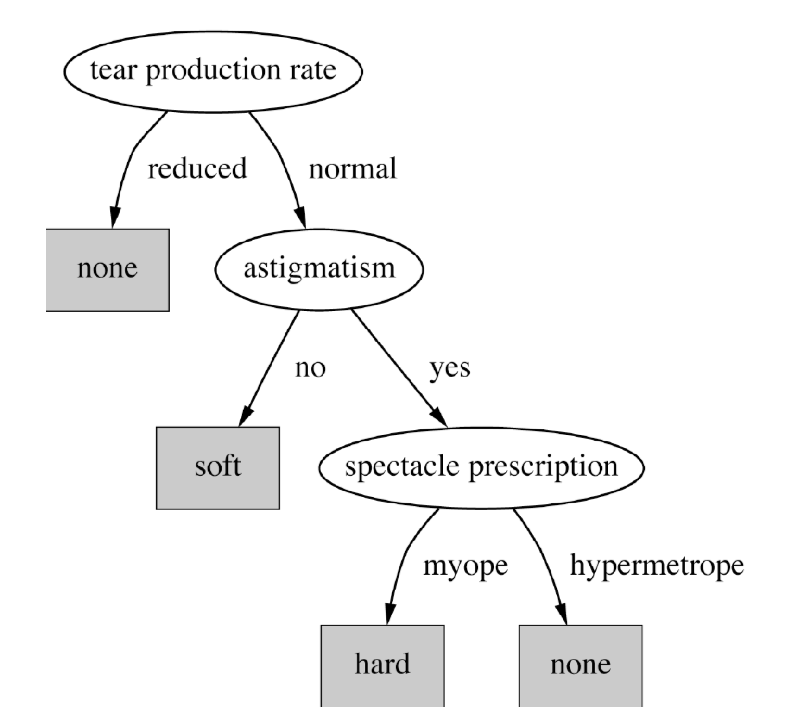
A decision tree for this problem

Slide 14
Classifying iris flowers
Sepal length
Sepal width
Petal length
Petal width
Type
1
5.1
3.5
1.4
0.2
Iris setosa
2
4.9
3.0
1.4
0.2
Iris setosa
…
51
7.0
3.2
4.7
1.4
Iris versicolor
52
6.4
3.2
4.5
1.5
Iris versicolor
…
101
6.3
3.3
6.0
2.5
Iris virginica
102
5.8
2.7
5.1
1.9
Iris virginica
…
If petal length < 2.45 then Iris setosa
If sepal width < 2.10 then Iris versicolor
...

Slide 15
Predicting CPU performance
Example: 209 different computer configurations
Linear regression function
Cycle time (ns)
Main memory (Kb)
Cache (Kb)
Channels
Performance
MYCT
MMIN
MMAX
CACH
CHMIN
CHMAX
PRP
1
125
256
6000
256
16
128
198
2
29
8000
32000
32
8
32
269
…
208
480
512
8000
32
0
0
67
209
480
1000
4000
0
0
0
45
PRP = -55.9 + 0.0489 MYCT + 0.0153 MMIN + 0.0056 MMAX + 0.6410 CACH - 0.2700 CHMIN + 1.480 CHMAX

Slide 16
Data from labor negotiations
Attribute
Type
1
2
3
…
40
Duration
(Number of years)
1
2
3
2
Wage increase first year
Percentage
2%
4%
4.3%
4.5
Wage increase second year
Percentage
?
5%
4.4%
4.0
Wage increase third year
Percentage
?
?
?
?
Cost of living adjustment
{none,tcf,tc}
none
tcf
?
none
Working hours per week
(Number of hours)
28
35
38
40
Pension
{none,ret-allw, empl-cntr}
none
?
?
?
Standby pay
Percentage
?
13%
?
?
Shift-work supplement
Percentage
?
5%
4%
4
Education allowance
{yes,no}
yes
?
?
?
Statutory holidays
(Number of days)
11
15
12
12
Vacation
{below-avg,avg,gen}
avg
gen
gen
avg
Long-term disability assistance
{yes,no}
no
?
?
yes
Dental plan contribution
{none,half,full}
none
?
full
full
Bereavement assistance
{yes,no}
no
?
?
yes
Health plan contribution
{none,half,full}
none
?
full
half
Acceptability of contract
{good,bad}
bad
good
good
good

Slide 17
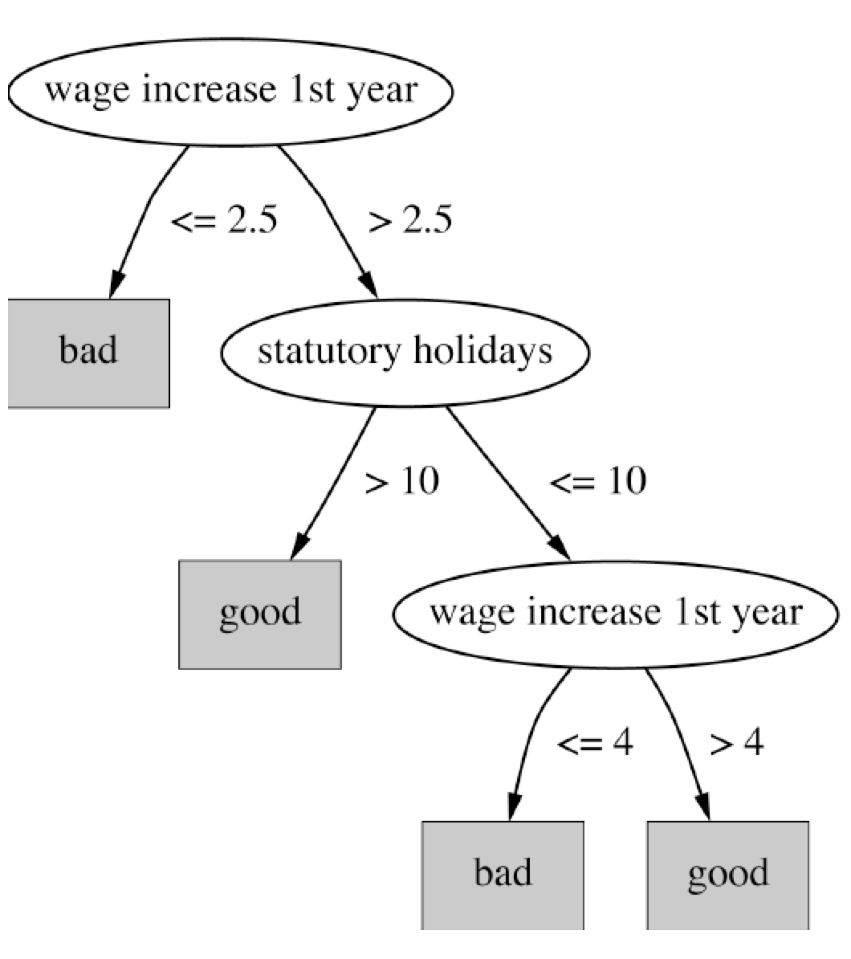
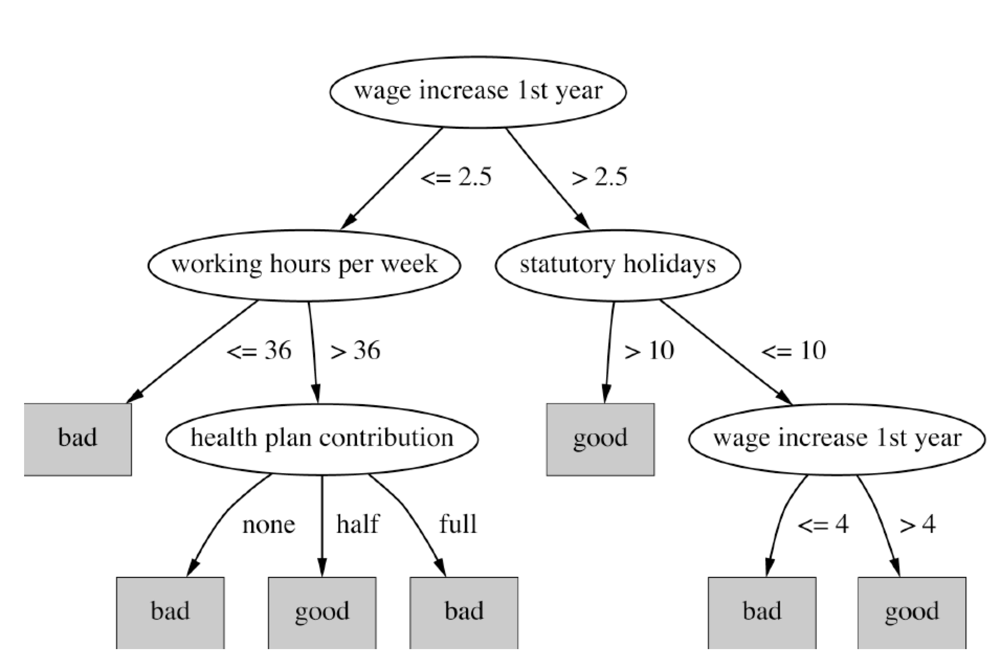
Decision trees for the labor data

Slide 18
Soybean classification
Attribute
Number of values
Sample value
Environment
Time of occurrence
7
July
Precipitation
3
Above normal
…
Seed
Condition
2
Normal
Mold growth
2
Absent
…
Fruit
Condition of fruit pods
4
Normal
Fruit spots
5
?
Leaf
Condition
2
Abnormal
Leaf spot size
3
?
…
Stem
Condition
2
Abnormal
Stem lodging
2
Yes
…
Root
Condition
3
Normal
Diagnosis
19
Diaporthe stem canker

Slide 19
The role of domain knowledge
If leaf condition is normal and stem condition is abnormal and stem cankers is below soil line and canker lesion color is brown
then diagnosis is rhizoctonia root rot
If leaf malformation is absent and stem condition is abnormal and stem cankers is below soil line and canker lesion color is brown
then diagnosis is rhizoctonia root rot
But in this domain, “leaf condition is normal” implies “leaf malformation is absent”!

Slide 20
Fielded applications
The result of learning—or the learning method itself—is deployed in practical applications
Processing loan applications
Screening images for oil slicks
Electricity supply forecasting
Diagnosis of machine faults
Marketing and sales
Separating crude oil and natural gas
Reducing banding in rotogravure printing
Finding appropriate technicians for telephone faults
Scientific applications: biology, astronomy, chemistry
Automatic selection of TV programs
Monitoring intensive care patients

Slide 21
Processing loan applications (American Express)
Given: questionnaire with financial and personal information
Question: should money be lent?
Simple statistical method covers 90% of cases
Borderline cases referred to loan officers
But: 50% of accepted borderline cases defaulted!
Solution: reject all borderline cases?
No! Borderline cases are most active customers

Slide 22
Enter machine learning
1000 training examples of borderline cases
20 attributes:
age
years with current employer
years at current address
years with the bank
other credit cards possessed,…
Learned rules: correct on 70% of cases
human experts only 50%
Rules could be used to explain decisions to customers

Slide 23
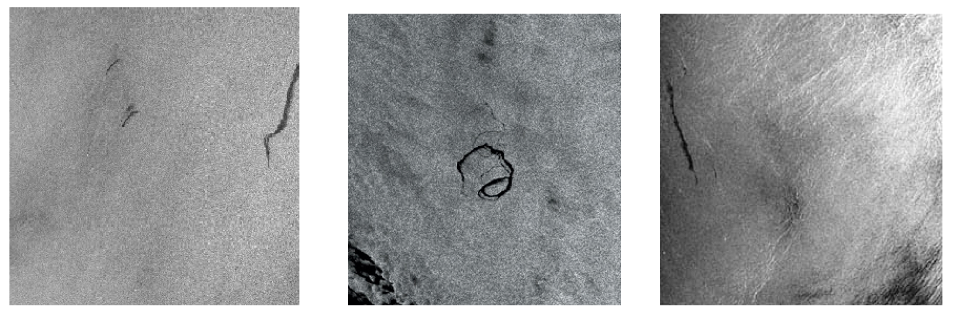
Screening images
Given: radar satellite images of coastal waters
Problem: detect oil slicks in those images
Oil slicks appear as dark regions with changing size and shape
Not easy: lookalike dark regions can be caused by weather conditions (e.g. high wind)
Expensive process requiring highly trained personnel

Slide 24
Enter machine learning
Extract dark regions from normalized image
Attributes:
size of region
shape, area
intensity
sharpness and jaggedness of boundaries
proximity of other regions
info about background
Constraints:
Few training examples—oil slicks are rare!
Unbalanced data: most dark regions aren’t slicks
Regions from same image form a batch
Requirement: adjustable false-alarm rate

Slide 25
Load forecasting
Electricity supply companies need forecast of future demand for power
Forecasts of min/max load for each hour => significant savings
Given: manually constructed load model that assumes “normal” climatic conditions
Problem: adjust for weather conditions
Static model consist of:
base load for the year
load periodicity over the year
effect of holidays

Slide 26
Enter machine learning
Prediction corrected using “most similar” days
Attributes:
temperature
humidity
wind speed
cloud cover readings
plus difference between actual load and predicted load
Average difference among three “most similar” days added to static model
Linear regression coefficients form attribute weights in similarity function

Slide 27
Diagnosis of machine faults
Diagnosis: classical domain of expert systems
Given: Fourier analysis of vibrations measured at various points of a device’s mounting
Question: which fault is present?
Preventative maintenance of electromechanical motors and generators
Information very noisy
So far: diagnosis by expert/hand-crafted rules
Notes:
27

Slide 28
Enter machine learning
Available: 600 faults with expert’s diagnosis
~300 unsatisfactory, rest used for training
Attributes augmented by intermediate concepts that embodied causal domain knowledge
Expert not satisfied with initial rules because they did not relate to his domain knowledge
Further background knowledge resulted in more complex rules that were satisfactory
Learned rules outperformed hand-crafted ones

Slide 29
Marketing and sales I
Companies precisely record massive amounts of marketing and sales data
Applications:
Customer loyalty: identifying customers that are likely to defect by detecting changes in their behavior (e.g. banks/phone companies)
Special offers: identifying profitable customers (e.g. reliable owners of credit cards that need extra money during the holiday season)

Slide 30
Marketing and sales II
Market basket analysis
Association techniques find groups of items that tend to occur together in a transaction (used to analyze checkout data)
Historical analysis of purchasing patterns
Identifying prospective customers
Focusing promotional mailouts (targeted campaigns are cheaper than mass-marketed ones)

Slide 31
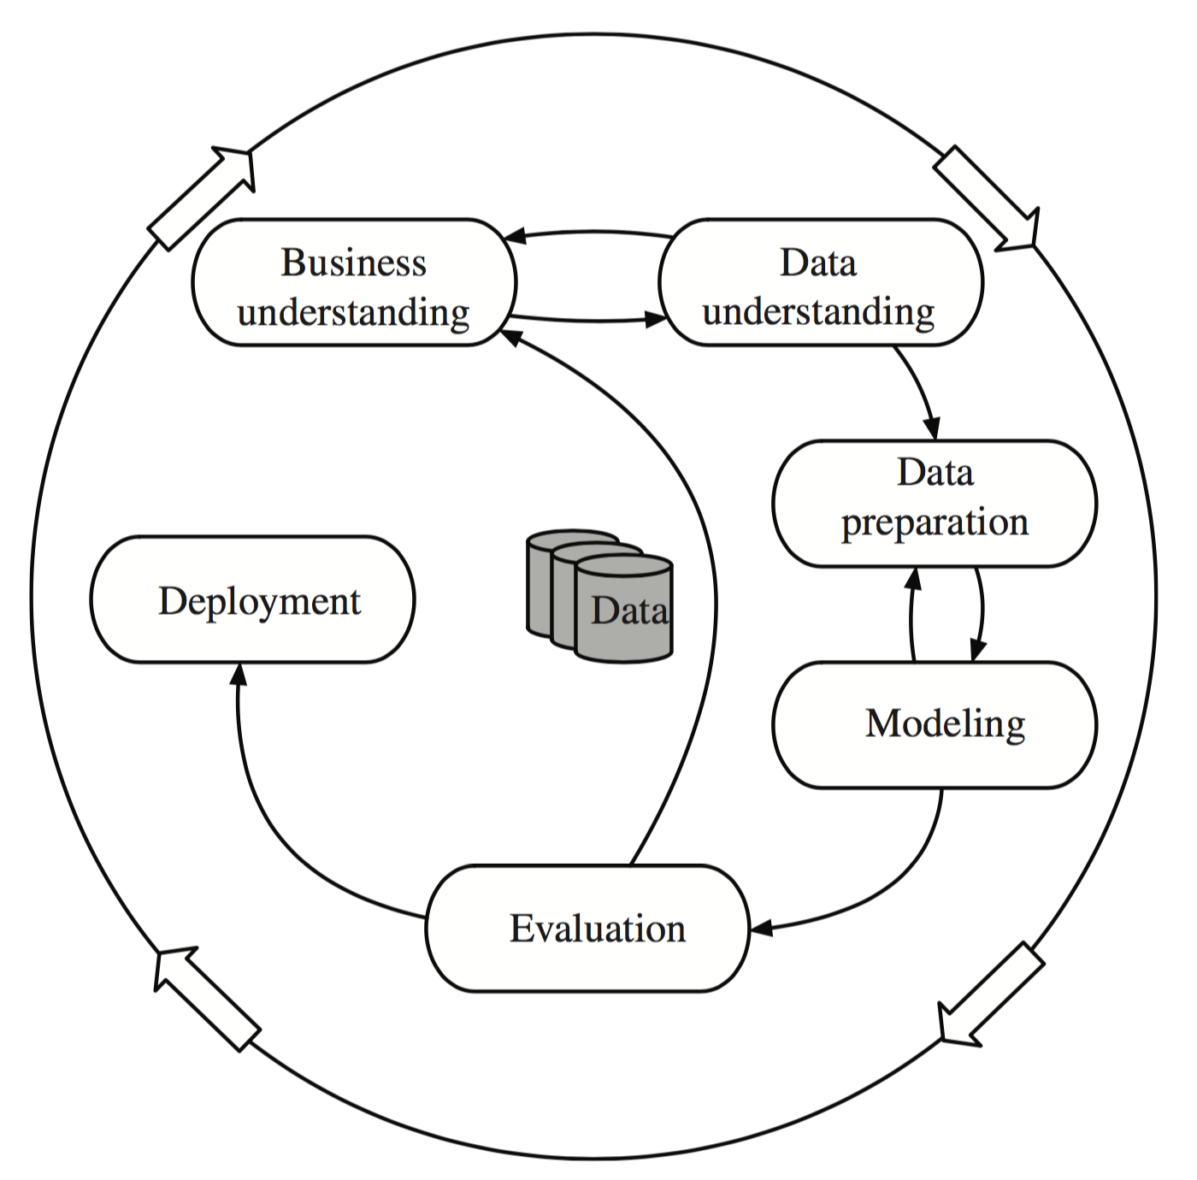
The data mining process

Slide 32
Machine learning and statistics
Historical difference (grossly oversimplified):
Statistics: testing hypotheses
Machine learning: finding the right hypothesis
But: huge overlap
Decision trees (C4.5 and CART)
Nearest-neighbor methods
Today: perspectives have converged
Most machine learning algorithms employ statistical techniques

Slide 33
Generalization as search
Inductive learning: find a concept description that fits the data
Example: rule sets as description language
Enormous, but finite, search space
Simple solution:
enumerate the concept space
eliminate descriptions that do not fit examples
surviving descriptions contain target concept

Slide 34
Enumerating the concept space
Search space for weather problem
4 x 4 x 3 x 3 x 2 = 288 possible combinations
With 14 rules => 2.7x10³⁴ possible rule sets
Other practical problems:
More than one description may survive
No description may survive
Language is unable to describe target concept
or data contains noise
Another view of generalization as search: hill-climbing in description space according to pre-specified matching criterion
Many practical algorithms use heuristic search that cannot guarantee to find the optimum solution

Slide 35
Bias
Important decisions in learning systems:
Concept description language
Order in which the space is searched
Way that overfitting to the particular training data is avoided
These form the “bias” of the search:
Language bias
Search bias
Overfitting-avoidance bias

Slide 36
Language bias
Important question:
is language universal or does it restrict what can be learned?
Universal language can express arbitrary subsets of examples
If language includes logical or (“disjunction”), it is universal
Example: rule sets
Domain knowledge can be used to exclude some concept descriptions a priori from the search

Slide 37
Search bias
Search heuristic
“Greedy” search: performing the best single step
“Beam search”: keeping several alternatives
…
Direction of search
General-to-specific
E.g. specializing a rule by adding conditions
Specific-to-general
E.g. generalizing an individual instance into a rule

Slide 38
Overfitting-avoidance bias
Can be seen as a form of search bias
Modified evaluation criterion
E.g., balancing simplicity and number of errors
Modified search strategy
E.g., pruning (simplifying a description)
Pre-pruning: stops at a simple description before search proceeds to an overly complex one
Post-pruning: generates a complex description first and simplifies it afterwards

Slide 39

Data mining and ethics I
Ethical issues arise in practical applications
Anonymizing data is difficult
85% of Americans can be identified from just zip code, birth date and sex
Data mining often used to discriminate
E.g., loan applications: using some information (e.g., sex, religion, race) is unethical
Ethical situation depends on application
E.g., same information ok in medical application
Attributes may contain problematic information
E.g., area code may correlate with race

Slide 40
Data mining and ethics II
Important questions:
Who is permitted access to the data?
For what purpose was the data collected?
What kind of conclusions can be legitimately drawn from it?
Caveats must be attached to results
Purely statistical arguments are never sufficient!
Are resources put to good use?

