Slide 1
Introduction
Chapter 1

Slide 2
Contents
The basic EC metaphor
Historical perspective
Biological inspiration:
  Darwinian evolution theory (simplified!)
  Genetics (simplified!)
Motivation for EC
What can EC do: examples of application areas

Slide 3
The Main Evolutionary Computing Metaphor
EVOLUTION
Environment
Individual
Fitness
PROBLEM SOLVING
Problem
Candidate Solution
Quality
Fitness → chances for survival and reproduction
Quality → chance for seeding new solutions

Slide 4
Brief History 1: the ancestors
1948, Turing:
  proposes “genetical or evolutionary search”
1962, Bremermann
  optimization through evolution and recombination
1964, Rechenberg
  introduces evolution strategies
1965, L. Fogel, Owens and Walsh
  introduce evolutionary programming
1975, Holland
  introduces genetic algorithms
1992, Koza
  introduces genetic programming

Slide 5
Brief History 2: The rise of EC
1985: first international conference (ICGA)
1990: first international conference in Europe (PPSN)
1993: first scientific EC journal (MIT Press)
1997: launch of European EC Research Network EvoNet

Slide 6
EC in the early 21st Century
3 major EC conferences, about 10 small related ones
3 scientific core EC journals
750-1000 papers published in 2003
numerous applications
numerous consultancy and R&D firms

Slide 7
Darwinian Evolution 1:
Survival of the fittest
All environments have finite resources
  (i.e., can only support a limited number of individuals)
Life forms have basic instinct/ lifecycles geared towards reproduction
Therefore some kind of selection is inevitable
Those individuals that compete for the resources most effectively have increased chance of reproduction
Note: fitness in natural evolution is a derived, secondary measure, i.e., we (humans) assign a high fitness to individuals with many offspring

Slide 8
Darwinian Evolution 2:
Diversity drives change
Phenotypic traits:
  Behavior / physical differences that affect response to environment
  Partly determined by inheritance, partly by factors during development
  Unique to each individual, partly as a result of random changes
If phenotypic traits:
  Lead to higher chances of reproduction
  Can be inherited
then they will tend to increase in subsequent generations,
leading to new combinations of traits …

Slide 9
Darwinian Evolution:Summary
Population consists of diverse set of individuals
Combinations of traits that are better adapted tend to increase representation in population
Individuals are “units of selection”
Variations occur through random changes yielding constant source of diversity, coupled with selection means that:
Population is the “unit of evolution”
Note the absence of “guiding force”

Slide 10
Adaptive landscape metaphor (Wright, 1932)
Can view a population with n traits as existing in a n+1-dimensional space (landscape) with height corresponding to fitness
Each different individual (phenotype) represents a single point on the landscape
Population is therefore a “cloud” of points, moving on the landscape over time as it evolves - adaptation

Slide 11
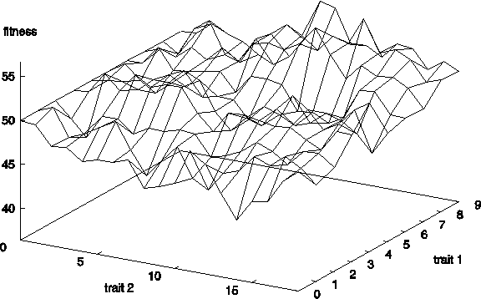
Example with two traits

Slide 12
Adaptive landscape metaphor (cont’d)
Selection “pushes” population up the landscape
Genetic drift:
  random variations in feature distribution
  (+ or -) arising from sampling error
  can cause the population “melt down” hills, thus crossing valleys and leaving local optima (or alternative global optima!)

Slide 13
Natural Genetics
The information required to build a living organism is coded in the DNA of that organism
Genotype (DNA inside) determines phenotype (outside)
[Genes → phenotypic traits] is a complex mapping
  One gene may affect many traits (pleiotropy)
  Many genes may affect one trait (polygeny)
Causality: Small changes in the genotype lead to small changes in the organism (e.g., height, hair color)
Epistases: The effect of one gene on phenotype depends on the values of other genes (opposite is orthogonality)

Slide 14
Genes and the Genome
Genes are encoded in strands of DNA called chromosomes
In most cells, there are two (homologous) copies of each chromosome (diploidy)
The complete genetic material in an individual’s genotype is called the Genome
Within a species, most of the genetic material is the same

Slide 15
Example: Homo Sapiens
Human DNA is organized into chromosomes
Most human body cells contain 23 pairs of chromosomes which together define the physical attributes of the individual:

Slide 16
Reproductive Cells
Gametes (sperm and egg cells) contain 23 individual chromosomes rather than 23 pairs
Cells with only one copy of each chromosome are called Haploid
Gametes are formed by a special form of cell splitting called meiosis
During meiosis the pairs of chromosomes undergo an operation called crossing-over

Slide 17
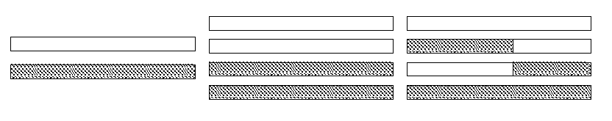
Crossing-over during meiosis
Chromosome pairs align and duplicate
Inner pairs link at a centromere and swap parts of themselves
Outcome is one copy of maternal/paternal chromosome plus two entirely new combinations
After crossing-over one of each pair goes into each gamete

Slide 18
Fertilization
Sperm cell from Father
Egg cell from Mother
New person cell (zygote)

Slide 19
After fertilization
New zygote rapidly divides creating many cells all with the same genetic contents
Although all cells contain the same genes, depending on, for example where they are in the organism, they will behave differently
This process of differential behavior during development is called ontogenesis
All of this uses, and is controlled by, the same mechanism for decoding the genes in DNA

Slide 20
Genetic code
All proteins in life on earth are composed of sequences built from 20 different amino acids
DNA is built from four nucleotides in a double helix spiral: purines A,G; pyrimidines T,C
Triplets of these form codons, each of which codes for a specific amino acid
Much redundancy:
  purines complement pyrimidines
  the DNA contains much rubbish
  4³=64 codons code for 20 amino acids
  genetic code = the mapping from codons to amino acids
For all natural life on earth, the genetic code is the same !

Slide 21
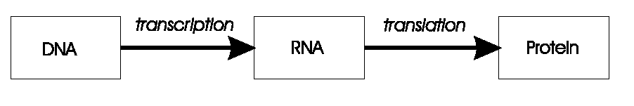
Transcription, translation
A central claim in molecular genetics: only one way flow
Genotype Phenotype
Genotype Phenotype
Lamarckism (saying that acquired features can be inherited) is thus wrong!

Slide 22
Mutation
Occasionally some of the genetic material changes very slightly during this process (replication error)
This means that the child might have genetic material information not inherited from either parent
This can be
  catastrophic: offspring in not viable (most likely)
  neutral: new feature does not influence fitness
  advantageous: strong new feature occurs
Redundancy in the genetic code forms a good way of error prevention

Slide 23
Motivations for EC: 1
Nature has always served as a source of inspiration for engineers and scientists
The best problem solver known in nature is:
  the (human) brain that created “the wheel, New York, wars and so on” (after Douglas Adams’ Hitch-Hikers Guide)
  the evolution mechanism that created the human brain (after Darwin’s Origin of Species)
Answer 1 → neurocomputing
Answer 2 → evolutionary computing

Slide 24
Motivations for EC: 2
Developing, analyzing, applying problem solving methods a.k.a. algorithms is a central theme in mathematics and computer science
Time for thorough problem analysis decreases
Complexity of problems to be solved increases
Consequence:
Robust problem solving technology needed

Slide 25
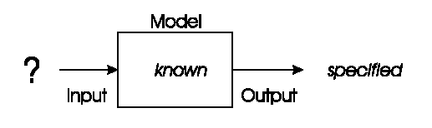
Problem type 1 : Optimization
We have a model of our system and seek inputs that give us a specified goal
e.g.
  time tables for university, or hospital
  design specifications, etc.

Slide 26
Optimization example 1: University timetabling
Enormously big search space
Timetables must be good
“Good” is defined by a number of competing criteria
Timetables must be feasible
Vast majority of search space is infeasible

Slide 27
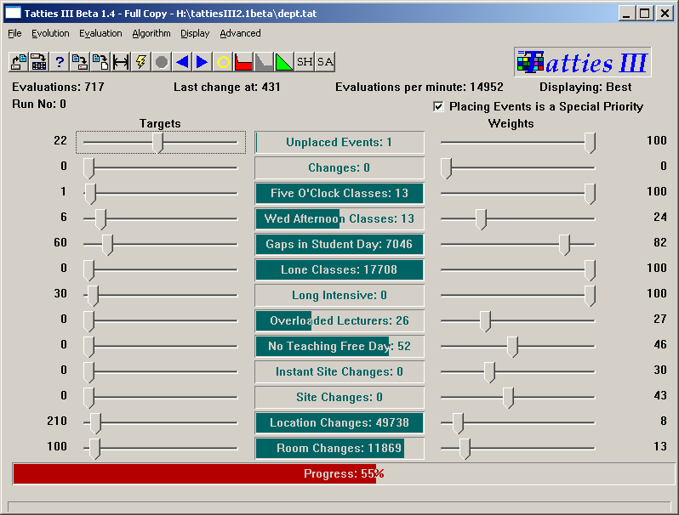

Slide 28

Optimization example 2: Satellite structure
Optimized satellite designs for NASA to maximize vibration isolation
Evolving: design structures
Fitness: vibration resistance
Evolutionary “creativity”

Slide 29
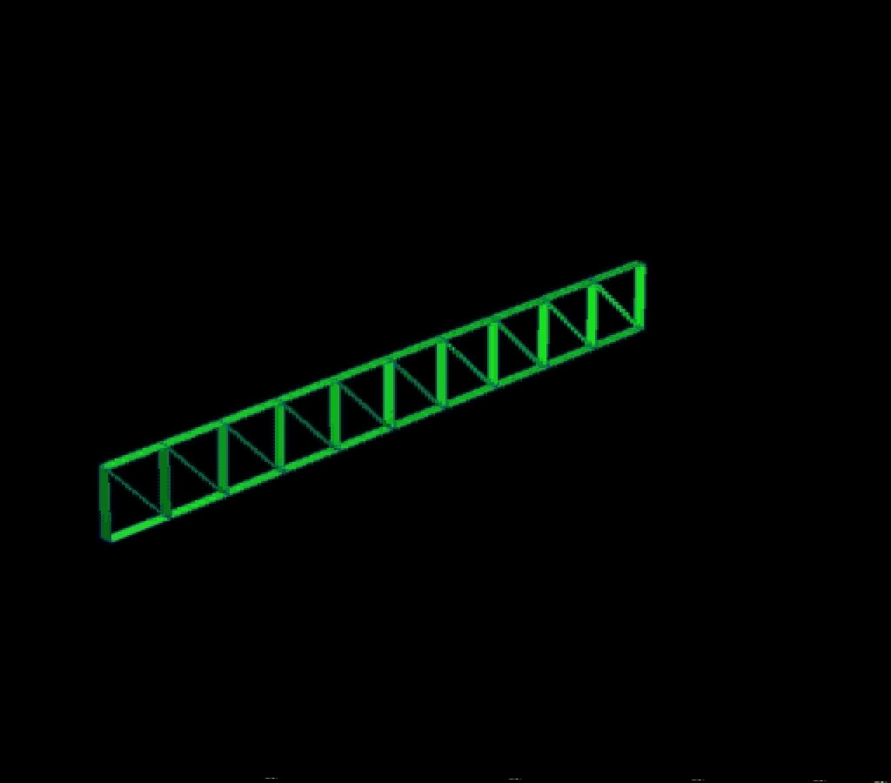

Slide 30
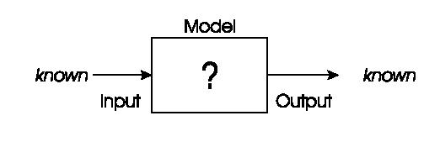
Problem types 2: Modeling
We have corresponding sets of inputs & outputs and seek a model that delivers the correct output for every known input
Evolutionary machine learning

Slide 31
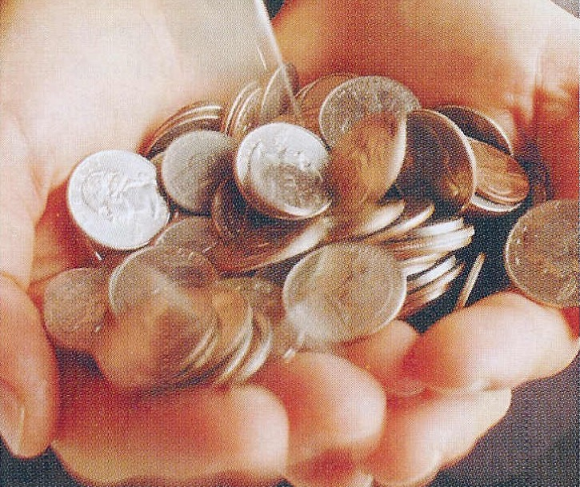
Modelling example: loan applicant creditibility
British bank evolved creditability model to predict loan paying behavior of new applicants
Evolving: prediction models
Fitness: model accuracy on
historical data

Slide 32
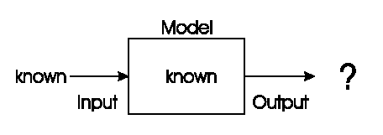
Problem type 3: Simulation
We have a given model and wish to know the outputs that arise under different input conditions
Often used to answer “what-if” questions in evolving dynamic environments
e.g. Evolutionary economics, Artificial Life

Slide 33
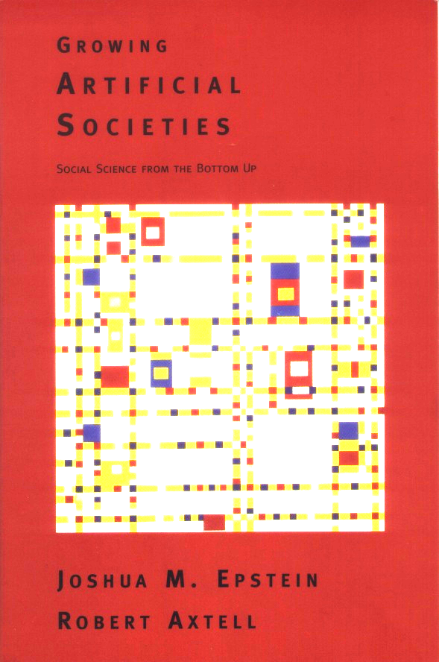
Simulation example: evolving artificial societies
Simulating trade, economic competition, etc. to calibrate models
Use models to optimize strategies and policies
Evolutionary economy
Survival of the fittest is universal (big/small fish)

Slide 34
Simulation example 2: biological interpretations
Incest prevention keeps evolution from rapid degeneration
(we knew this)
Multi-parent reproduction, makes evolution more efficient
(this does not exist on Earth in carbon!)

