Slide 1
Intro to WEKA GUI
Cesar Koirala

Slide 2
What is WEKA?
WEKA is a collection of machine learning algorithms in the form of JAVA Package.
You can download it from:
(www.cs.waikato.ac.nz/ml/weka)
OR
Just google ‘weka’ and it’s the first link you get.

Slide 3
What machine learning algorithms does the package have?
You name one and you will get it in the package. Some examples are Decision trees, Neural Networks, Bayesian networks etc.
It also allows you to implement ensemble learning algorithms like bagging, boosting and stacking.

Slide 4
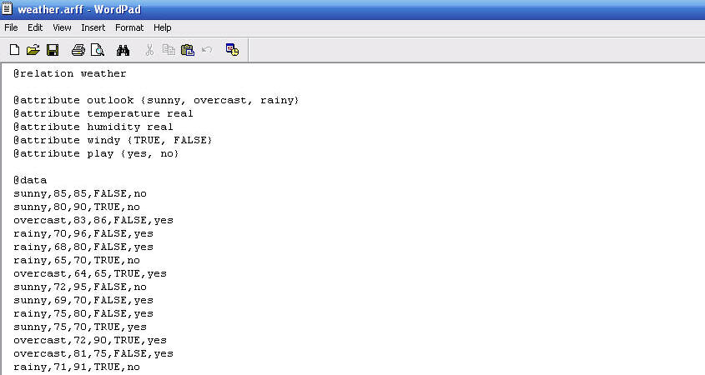
How to use GUI?
Step 1
Arrange the data in the following format and save as ARFF file.
//@relation is the data set’s name.
//@attribute defines names, types and values of each
attribute.
//@data lists all the data available. The data is comma
separated and the last attribute is the class of the
data.
//Comments can be included using % sign.

Slide 5
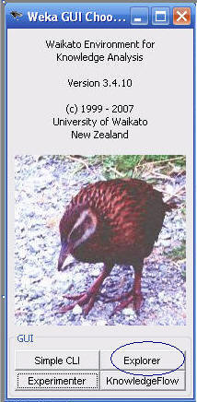
Step 2
Run the package and choose Explorer
You have choice between Simple CLI, Explorer, Experimenter and KnowledgeFlow. CLI is for running Weka using command line interface, Experimenter allows you to run more than one experiment at the time and KnowledgeFlow is an alternative interface with different features.

Slide 6
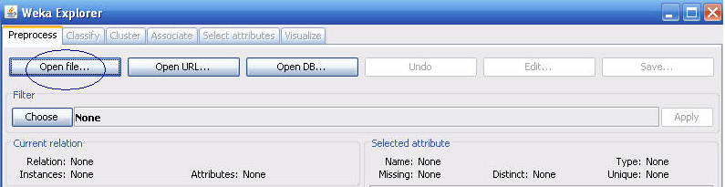
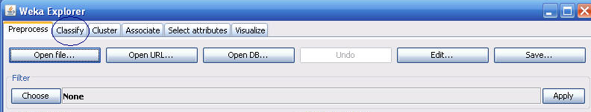
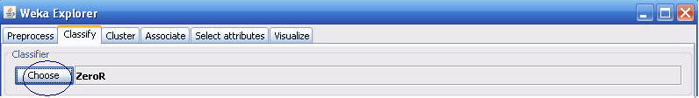
Step 3
Open the file that you created in step 1.
Select ‘classify’ tab
Choose a classifier

Slide 7
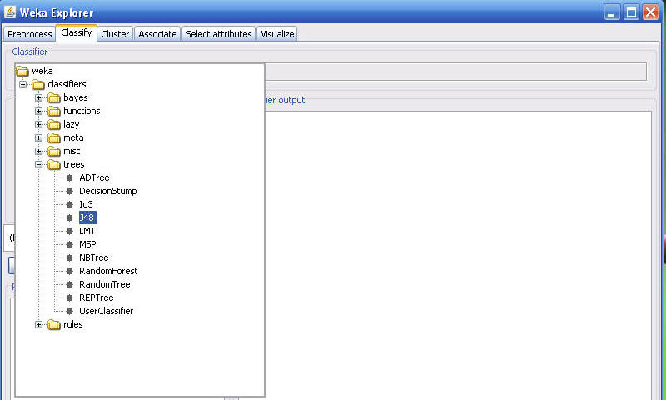
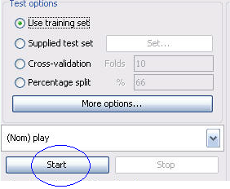
Step 3..Continued..
You will get a number of classifiers to choose from. For this demo I am selecting J4.8 algorithm which is WEKA’s implementation of C4.5 decision tree learner
Then select one of the four test options listed or go for more options.
Click ‘start’.

Slide 8
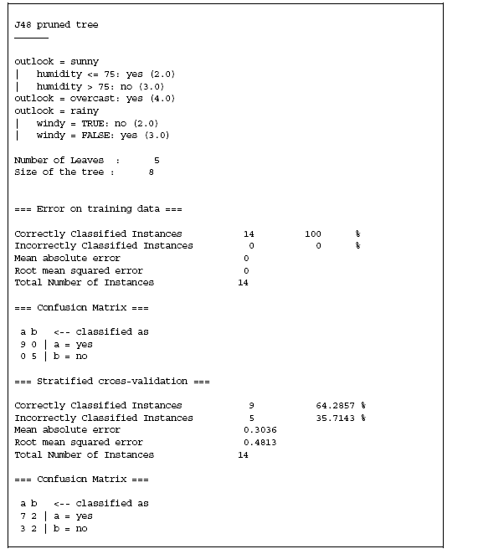
You’re done!!
You should be able to see the result as below:

Slide 9
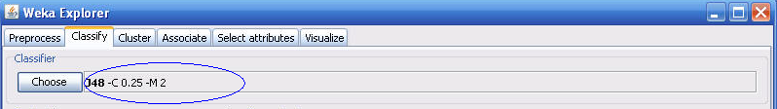
Interpretation of the result
The first part is the decision tree in the textual form.
The second part is the result, it produced, for the training data.
Note that it classified all the instances correctly. However,5
instances were misclassified on 10 fold cross validation.
Changing the settings of a classifier
You can change the parameters of any classifier according
to your needs.
All you need to do is click on the classifier’s name displayed
on the top of the Explorer.

Slide 10
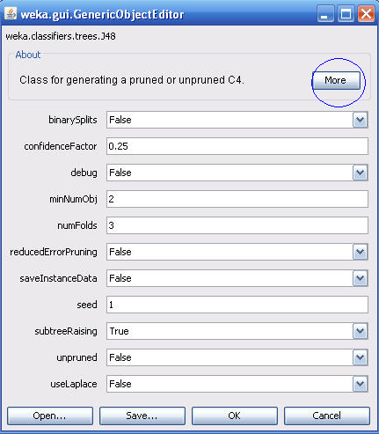
Changing the settings of a classifier..contd..
Clicking on that tab will display a window which will allow you to change the default values of the parameters.
You can select ‘more’ to get information about the parameters.

Slide 11
Conclusions
The GUI allows you to feed the data set to any classifier and analyze the results without having to write even a single line of a program code. However, for some projects it becomes necessary to call Weka from your Java program.
You can read about how to do it in the online documentation
This is a very brief introduction. Explore more about all the features and you will definitely admire it.
…Good Luck…

