Slide 1
Genetic Programming
Chapter 6

Slide 2
GP quick overview
Developed: USA in the 1990’s
Early names: J. Koza
Typically applied to:
  machine learning tasks (prediction, classification…)
Attributed features:
  competes with neural nets and alike
  needs huge populations (thousands)
  slow
Special:
  non-linear chromosomes: trees, graphs
  mutation possible but not necessary (disputed!)

Slide 3
GP technical summary tableau
Representation | Tree structures
Recombination | Exchange of subtrees
Mutation | Random change in trees
Parent selection | Fitness proportional
Survivor selection | Generational replacement

Slide 4
Introductory example: credit scoring
Bank wants to distinguish good from bad loan applicants
Model needed that matches historical data
ID | No of children | Salary | Marital status | OK?
ID-1 | 2 | 45000 | Married | 0
ID-2 | 0 | 30000 | Single | 1
ID-3 | 1 | 40000 | Divorced | 1
…

Slide 5
Introductory example: credit scoring
A possible model:
IF (NOC = 2) AND (S > 80000) THEN good ELSE bad
In general:
IF formula THEN good ELSE bad
Only unknown is the right formula, hence
Our search space (phenotypes) is the set of formulas
Natural fitness of a formula: percentage of well classified cases of the model it stands for
Natural representation of formulas (genotypes) is: parse trees

Slide 6
Introductory example: credit scoring
IF (NOC = 2) AND (S > 80000) THEN good ELSE bad
can be represented by the following tree
AND
=
>
NOC
2
S
80000

Slide 7
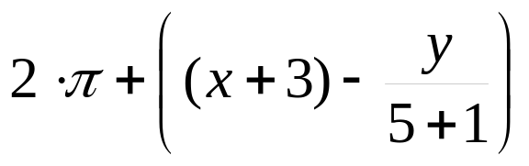
Tree based representation
Trees are a universal form, e.g. consider
Arithmetic formula
Logical formula
Program
(x ∧ true) → (( x ∨ y ) ∨ (z ↔ (x ∧ y)))
i =1;
while (i < 20)
{
i = i +1
}

Slide 8
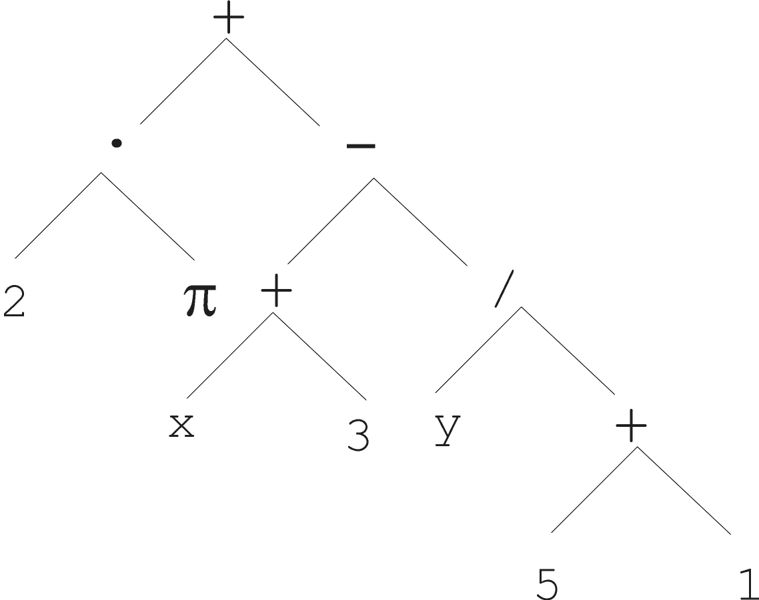
Tree based representation

Slide 9
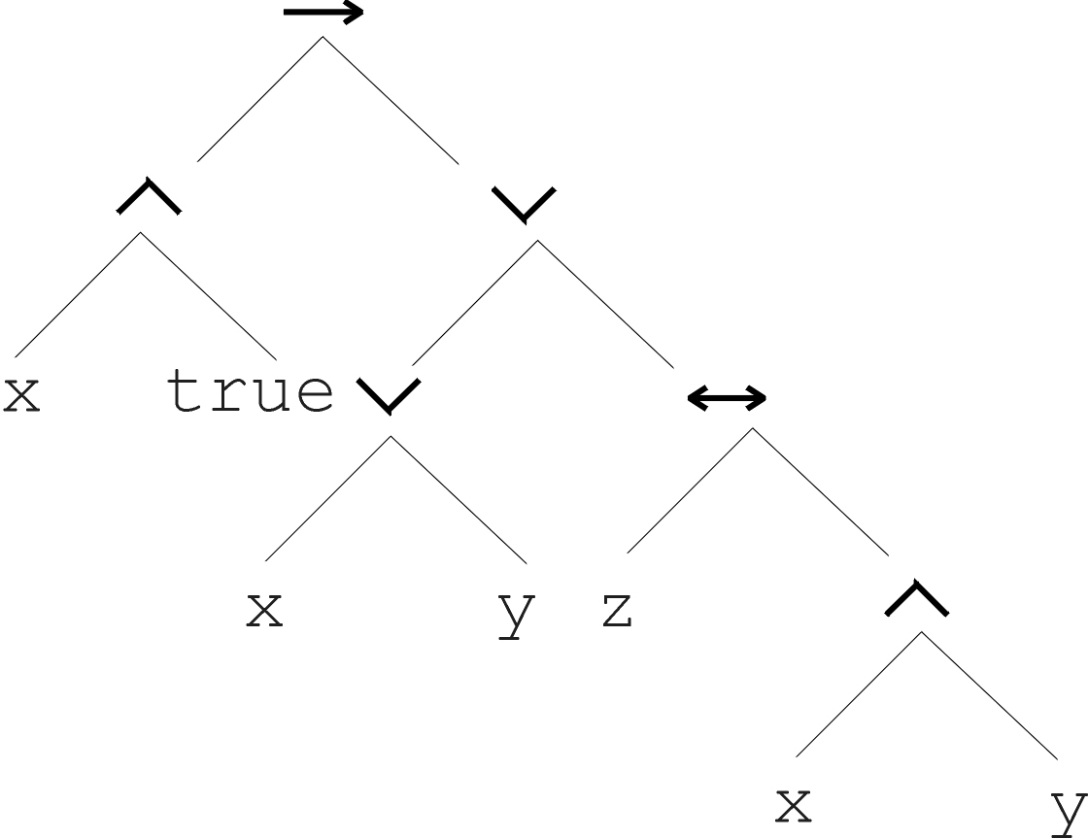
Tree based representation
(x ∧ true) → (( x ∨ y ) ∨ (z ↔ (x ∧ y)))

Slide 10
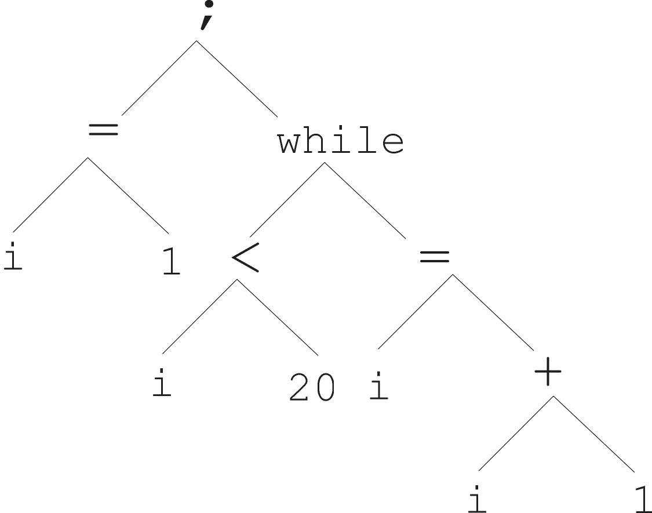
Tree based representation
i =1;
while (i < 20)
{
i = i +1
}

Slide 11
Tree based representation
In GA, ES, EP chromosomes are linear structures (bit strings, integer string, real-valued vectors, permutations)
Tree shaped chromosomes are non-linear structures
In GA, ES, EP the size of the chromosomes is fixed
Trees in GP may vary in depth and width

Slide 12
Tree based representation
Symbolic expressions can be defined by
  Terminal set T
  Function set F (with the arities of function symbols)
Adopting the following general recursive definition:
  Every t ∈ T is a correct expression
  f(e₁, …, e_{n}) is a correct expression if f ∈ F, arity(f)=n and e₁, …, e_{n} are correct expressions
  There are no other forms of correct expressions
In general, expressions in GP are not typed (closure property: any f ∈ F can take any g ∈ F as argument)

Slide 13
Offspring creation scheme
Compare
GA scheme using crossover AND mutation sequentially (be it probabilistically)
GP scheme using crossover OR mutation (chosen probabilistically)

Slide 14
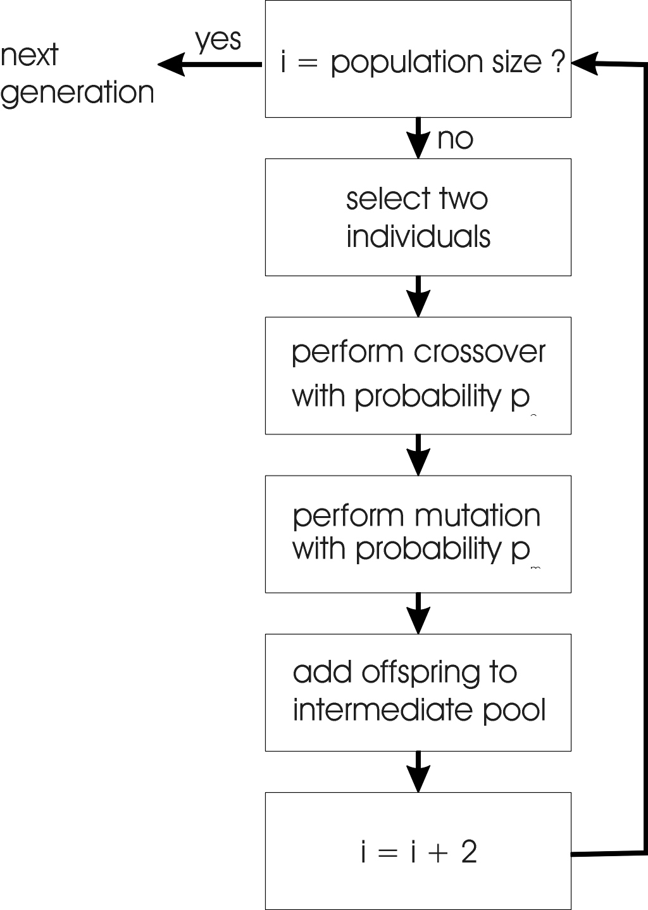
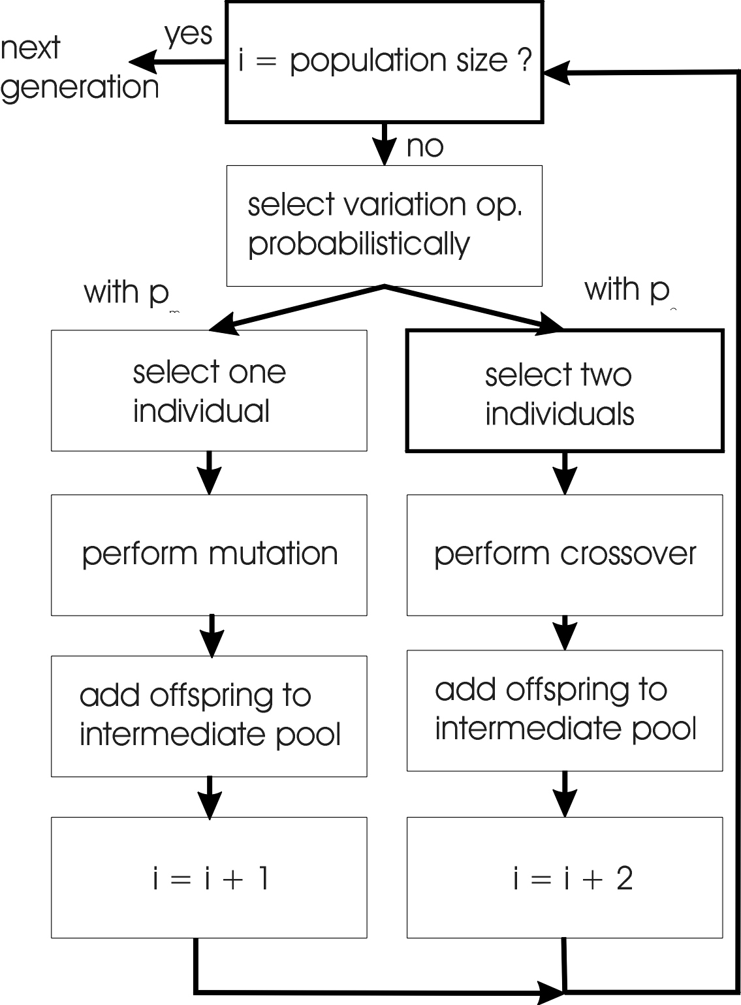
GA flowchart
GP flowchart

Slide 15
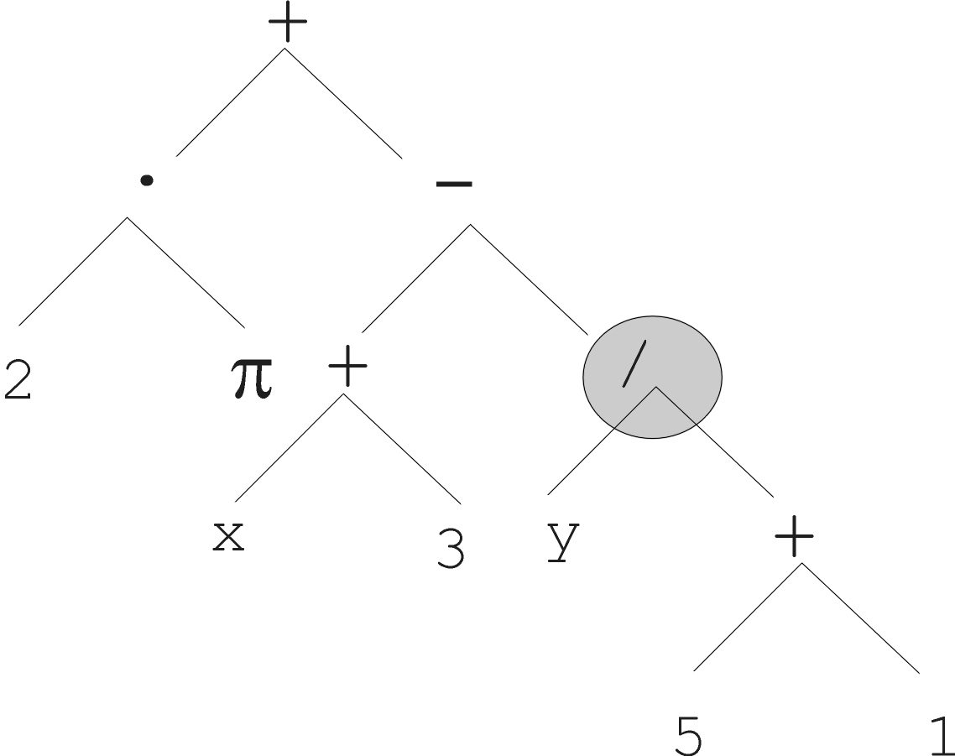
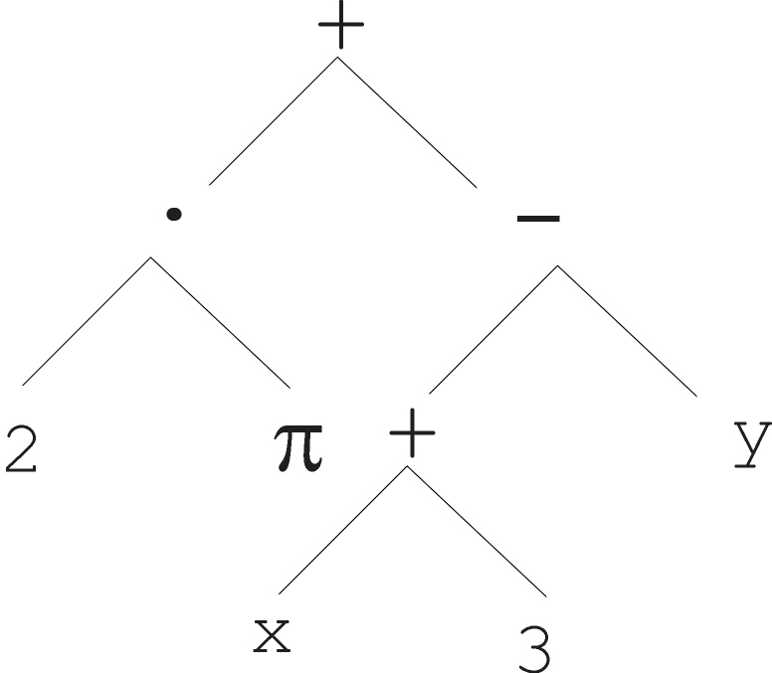
Mutation
Most common mutation: replace randomly chosen subtree by randomly generated tree

Slide 16
Mutation cont’d
Mutation has two parameters:
  Probability p_{m} to choose mutation vs. recombination
  Probability to choose an internal point as the root of the subtree to be replaced
Remarkably p_{m} is recommended to be 0 (Koza’92) or very small, like 0.05 (Banzhaf et al. ’98)
The size of the child can exceed the size of the parent

Slide 17
Recombination
Most common recombination: exchange two randomly chosen subtrees among the parents
Recombination has two parameters:
  Probability p_{c} to choose recombination vs. mutation
  Probability to chose an internal point within each parent as crossover point
The size of offspring can exceed that of the parents

Slide 18
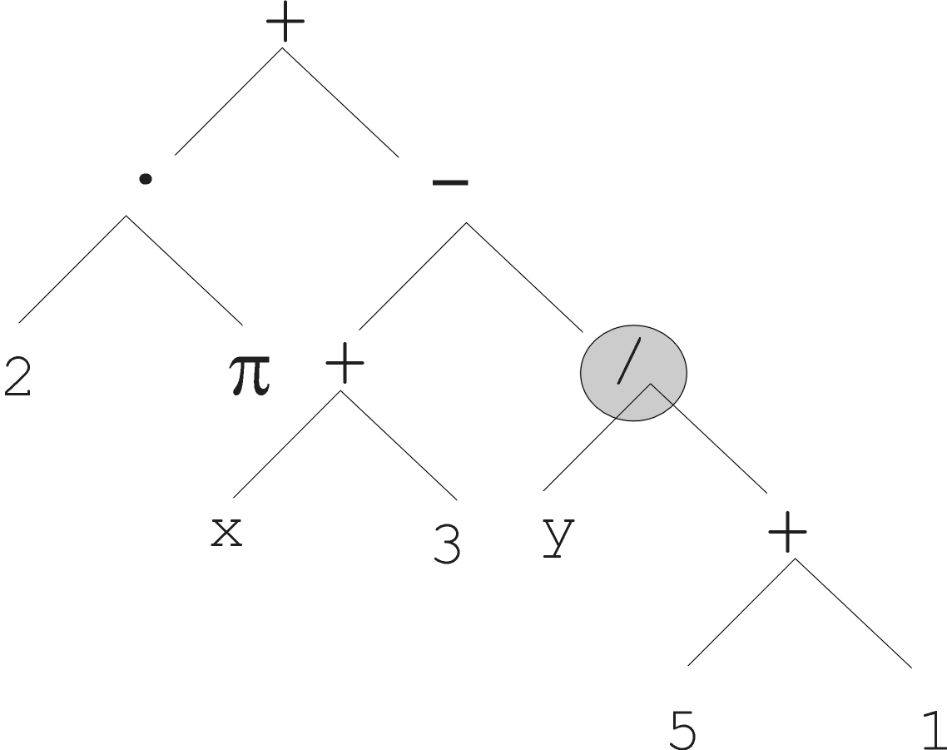
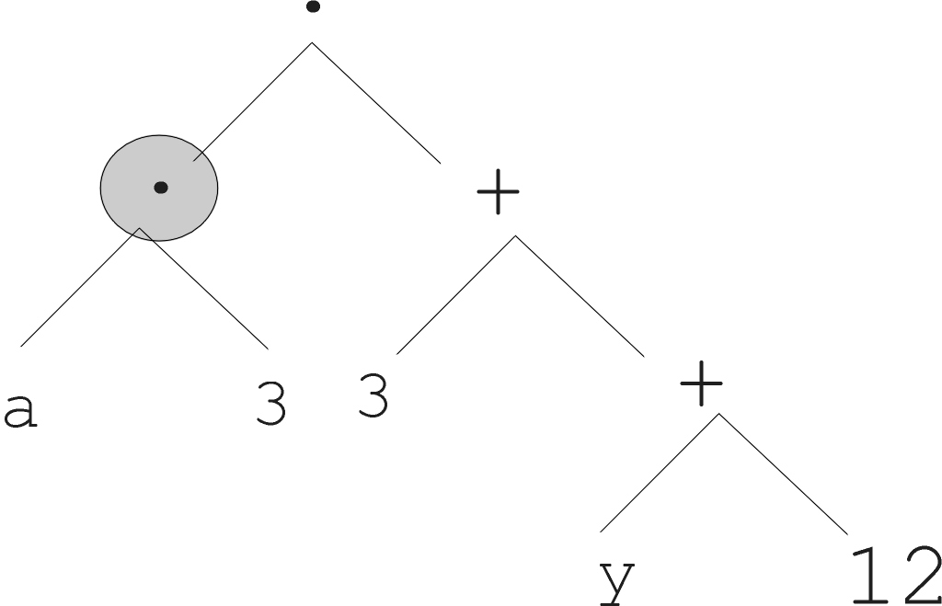
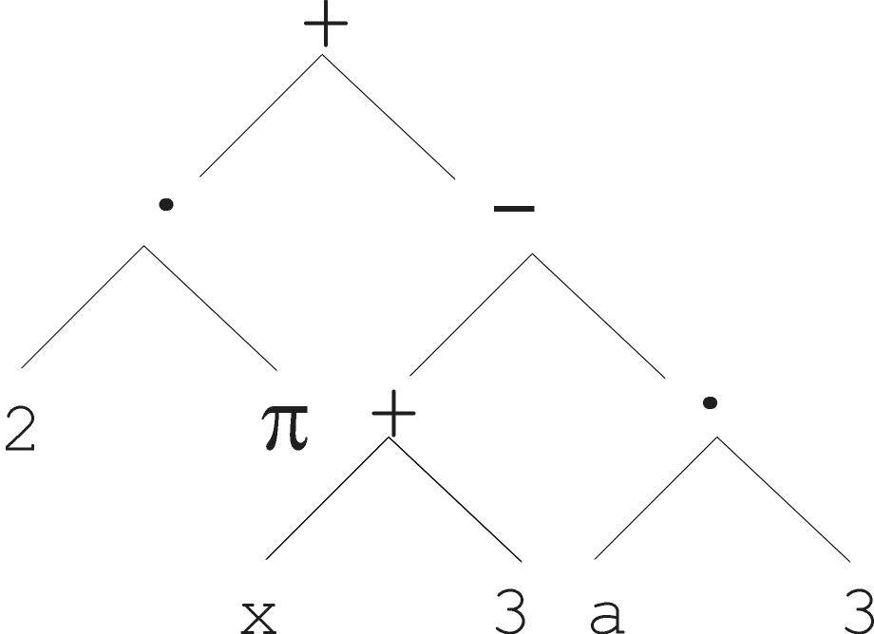
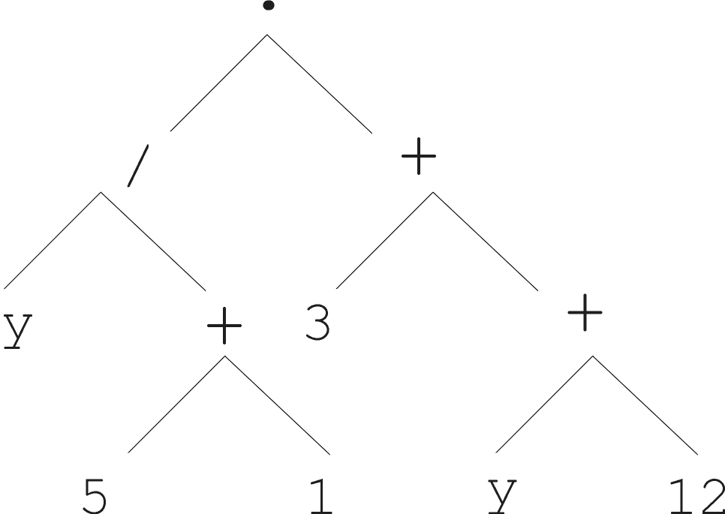
Parent 1
Parent 2
Child 1
Child 2

Slide 19
Selection
Parent selection is typically fitness proportionate
Over-selection in very large populations
  rank population by fitness and divide it into two groups:
  group 1: best x% of population, group 2 other (100-x)%
  80% of selection operations chooses from group 1, 20% from group 2
  for pop. size = 1000, 2000, 4000, 8000 x = 32%, 16%, 8%, 4%
  motivation: to increase efficiency, %’s come from rule of thumb
Survivor selection:
  Typical: generational scheme (thus none)
  Recently steady-state is becoming popular for its elitism

Slide 20
Initialization
Maximum initial depth of trees D_{max} is set
Full method (each branch has depth = D_{max}):
  nodes at depth d < D_{max} randomly chosen from function set F
  nodes at depth d = D_{max} randomly chosen from terminal set T
Grow method (each branch has depth ≤ D_{max}):
  nodes at depth d < D_{max} randomly chosen from F ∪ T
  nodes at depth d = D_{max} randomly chosen from T
Common GP initialization: ramped half-and-half, where grow & full method each deliver half of initial population

Slide 21
Bloat
Bloat = “survival of the fattest”, i.e., the tree sizes in the population are increasing over time
Ongoing research and debate about the reasons
Needs countermeasures, e.g.
  Prohibiting variation operators that would deliver “too big” children
  Parsimony pressure: penalty for being oversized

Slide 22
Problems involving “physical” environments
Trees for data fitting vs. trees (programs) that are “really” executable
Execution can change the environment → the calculation of fitness
Example: robot controller
Fitness calculations mostly by simulation, ranging from expensive to extremely expensive (in time)
But evolved controllers are often very good

Slide 23
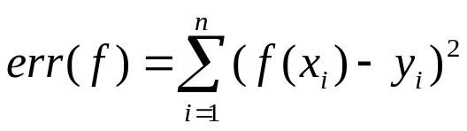
Example application: symbolic regression
Given some points in R², (x₁, y₁), … , (x_{n}, y_{n})
Find function f(x) s.t. ∀i = 1, …, n : f(x_{i}) = y_{i}
Possible GP solution:
  Representation by F = {+, -, /, sin, cos}, T = R ∪ {x}
  Fitness is the error
  All operators standard
  pop.size = 1000, ramped half-half initialization
  Termination: n “hits” or 50000 fitness evaluations reached (where “hit” is if | f(x_{i}) – y_{i} | < 0.0001)

