Slide 1
What is an Evolutionary Algorithm?
Chapter 2

Slide 2
Contents
Recap of the Evolutionary Metaphor
Basic scheme of an EA
Basic Components:
  Representation / Evaluation / Population / Parent Selection / Recombination / Mutation / Survivor Selection / Termination
Examples : eight queens / knapsack
Typical behaviours of EAs
EC in context of global optimization

Slide 3
Recap of EC metaphor
A population of individuals exists in an environment with limited resources
Competition for those resources causes selection of those fitter individuals that are better adapted to the environment
These individuals act as seeds for the generation of new individuals through recombination and mutation
The new individuals have their fitness evaluated and compete (possibly also with parents) for survival.
Over time Natural selection causes a rise in the fitness of the population

Slide 4
Recap 2:
EAs fall into the category of “generate and test” algorithms
They are stochastic, population-based algorithms
Variation operators (recombination and mutation) create the necessary diversity and thereby facilitate novelty
Selection reduces diversity and acts as a force pushing quality

Slide 5
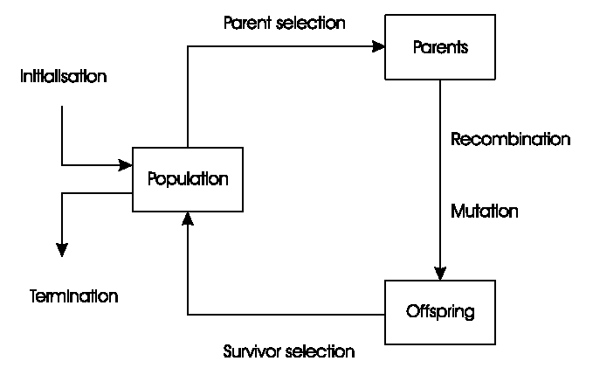
General Scheme of EAs

Slide 6
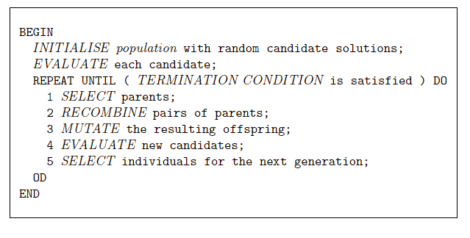
Pseudo-code for typical EA

Slide 7
What are the different types of EAs
Historically different flavours of EAs have been associated with different representations
  Binary strings : Genetic Algorithms
  Real-valued vectors : Evolution Strategies
  Finite state Machines: Evolutionary Programming
  LISP trees: Genetic Programming
These differences are largely irrelevant, best strategy
  choose representation to suit problem
  choose variation operators to suit representation
Selection operators only use fitness and so are independent of representation

Slide 8
Representations
Candidate solutions (individuals) exist in phenotype space
They are encoded in chromosomes, which exist in genotype space
  Encoding : phenotype=> genotype (not necessarily one to one)
  Decoding : genotype=> phenotype (must be one to one)
Chromosomes contain genes, which are in (usually fixed) positions called loci (sing. locus) and have a value (allele)
In order to find the global optimum, every feasible solution must be representable in genotype space

Slide 9
Evaluation (Fitness) Function
Represents the requirements that the population should adapt to
a.k.a. quality function or objective function
Assigns a single real-valued fitness to each phenotype which forms the basis for selection
  So the more discrimination (different values) the better
Typically we talk about fitness being maximized
  Some problems may be best posed as minimization problems, but conversion is trivial

Slide 10
Population
Holds (representations of) possible solutions
Usually has a fixed size and is a multi-set of genotypes
Some sophisticated EAs also assert a spatial structure on the population e.g., a grid.
Selection operators usually take whole population into account i.e., reproductive probabilities are relative to current generation
Diversity of a population refers to the number of different fitnesses / phenotypes / genotypes present (note not the same thing)

Slide 11
Parent Selection Mechanism
Assigns variable probabilities of individuals acting as parents depending on their fitnesses
Usually probabilistic
  high quality solutions more likely to become parents than low quality
  but not guaranteed
  even worst in current population usually has non-zero probability of becoming a parent
This stochastic nature can aid escape from local optima

Slide 12
Variation Operators
Role is to generate new candidate solutions
Usually divided into two types according to their arity (number of inputs):
  Arity 1 : mutation operators
  Arity >1 : Recombination operators
  Arity = 2 typically called crossover
There has been much debate about relative importance of recombination and mutation
  Nowadays most EAs use both
  Choice of particular variation operators is representation dependant

Slide 13
Mutation
Acts on one genotype and delivers another
Element of randomness is essential and differentiates it from other unary heuristic operators
Importance ascribed depends on representation and dialect:
  Binary GAs – background operator responsible for preserving and introducing diversity
  EP for FSM’s/ continuous variables – only search operator
  GP – hardly used
May guarantee connectedness of search space and hence convergence proofs

Slide 14
Recombination
Merges information from parents into offspring
Choice of what information to merge is stochastic
Most offspring may be worse, or the same as the parents
Hope is that some are better by combining elements of genotypes that lead to good traits
Principle has been used for millennia by breeders of plants and livestock

Slide 15
Survivor Selection
a.k.a. replacement
Most EAs use fixed population size so need a way of going from (parents + offspring) to next generation
Often deterministic
  Fitness based : e.g., rank parents+offspring and take best
  Age based: make as many offspring as parents and delete all parents
Sometimes do combination (elitism)

Slide 16
Initialization / Termination
Initialization usually done at random,
  Need to ensure even spread and mixture of possible allele values
  Can include existing solutions, or use problem-specific heuristics, to “seed” the population (care should be taken!)
Termination condition checked every generation
  Reaching some (known/hoped for) fitness
  Reaching some maximum allowed number of generations
  Reaching some minimum level of diversity
  Reaching some specified number of generations without fitness improvement

Slide 17
Example: the 8 queens problem
Place 8 queens on an 8x8 chessboard in
such a way that they cannot check each other

Slide 18
The 8 queens problem: representation
Phenotype:
a board configuration
Genotype:
a permutation of
the numbers 1 - 8
Obvious mapping
1
3
5
2
6
4
7
8

Slide 19
8 Queens Problem: Fitness evaluation
Penalty of one queen:
the number of queens she can check.
Penalty of a configuration:
the sum of the penalties of all queens.
Note: penalty is to be minimized
Fitness of a configuration:
inverse penalty to be maximized

Slide 20
The 8 queens problem: Mutation
Small variation in one permutation, e.g.:
swapping values of two randomly chosen positions,
1
3
5
2
6
4
7
8
1
3
7
2
6
4
5
8

Slide 21
The 8 queens problem: Recombination
Combining two permutations into two new permutations:
choose random crossover point
copy first parts into children
create second part by inserting values from other parent:
  in the order they appear there
  beginning after crossover point
  skipping values already in child
1
3
5
2
6
4
7
8
1
3
5
4
2
8
7
6
8
7
6
5
4
3
2
1
8
7
6
2
4
1
3
5

Slide 22
The 8 queens problem: Selection
Parent selection:
  Pick 5 parents and take best two to undergo crossover
Survivor selection (replacement)
  insert the two new children into the population
  sort the whole population by decreasing fitness
  delete the worst two

Slide 23
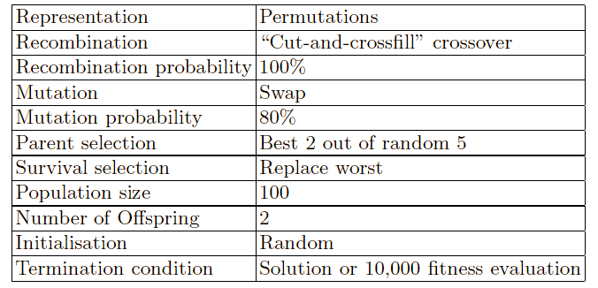
8 Queens Problem: summary
Note that this is only one possible
set of choices of operators and parameters

Slide 24
The Knapsack Problem
Given a set of n items, each of which has some value Vi and cost Ci. How do you select a subset of those items that maximizes the value while keeping the summed cost within some capacity Cmax ?
Genotype: Binary vector of length n
Phenotype (subset):
  Same as genotype (problem if subset > Cmax)
  Decoder: scan genotype and add items that correspond to 1s and do not push cost over Cmax

Slide 25
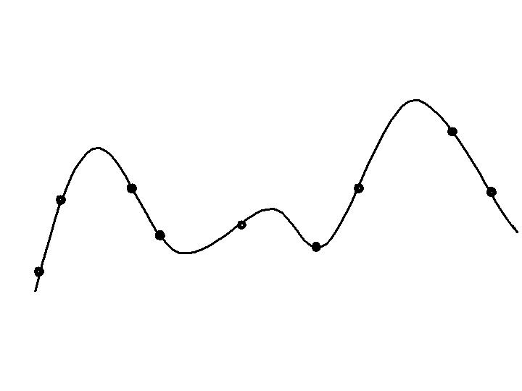
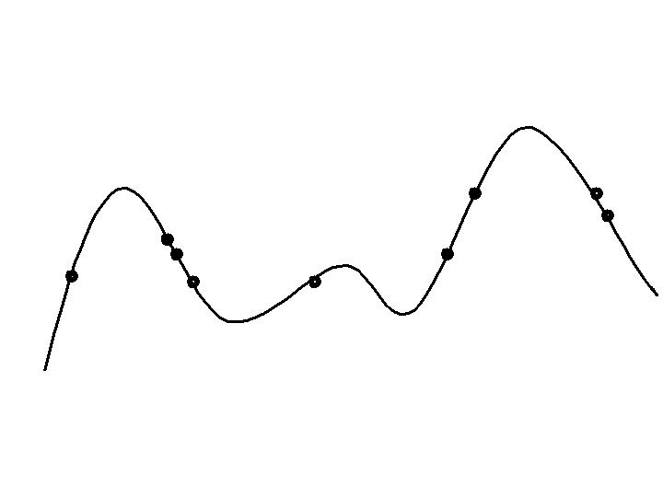
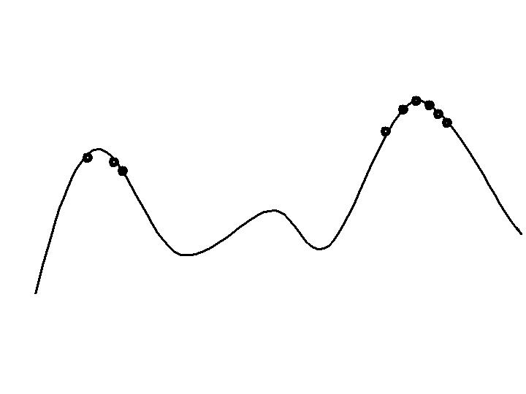
Typical behavior of an EA
Phases in optimizing on a 1-dimensional fitness landscape
Early phase:
quasi-random population distribution
Mid-phase:
population arranged around/on hills
Late phase:
population concentrated on high hills

Slide 26
Typical run: progression of fitness
Best fitness in population
Time (number of generations)
Typical run of an EA shows so-called “anytime behavior”

Slide 27
Are long runs beneficial?
Progress in 2nd half
Best fitness in population
Progress in 1st half
Time (number of generations)
Answer:
- it depends on how much you want the last bit of progress
- it may be better to do more shorter runs

Slide 28
Is it worth expending effort on smart initialization?
Best fitness in population
F
F: fitness after smart initialization
T: time needed to reach level F after random initialization
T
Time (number of generations)
Answer : it depends:
- possibly, if good solutions/methods exist.
- care is needed, see chapter on hybridization

Slide 29
Evolutionary Algorithms in Context
There are many views on the use of EAs as robust problem solving tools
For most problems a problem-specific tool may:
  perform better than a generic search algorithm on most instances,
  have limited utility,
  not do well on all instances
Goal is to provide robust tools that provide:
  evenly good performance
  over a range of problems and instances

Slide 30
EAs as problem solvers:
Goldberg’s 1989 view
Special, problem tailored method
Evolutionary algorithm
Performance of methods on problems
Random search
Scale of “all” problems

Slide 31
EAs and domain knowledge
Trend in the 90’s:
adding problem specific knowledge to EAs
(special variation operators, repair, etc)
Result: EA performance curve “deformation”:
  better on problems of the given type
  worse on problems different from given type
  amount of added knowledge is variable
Recent theory suggests the search for an “all-purpose” algorithm may be fruitless

Slide 32
EC and Global Optimization
Global Optimization: search for finding best solution x* out of some fixed set S
Deterministic approaches
  e.g. box decomposition (branch and bound etc)
  Guarantee to find x* , but may run in super-polynomial time
Heuristic Approaches (generate and test)
  rules for deciding which x ∈ S to generate next
  no guarantees that best solutions found are globally optimal

Slide 33
EC and Neighbourhood Search
Many heuristics impose a neighbourhood structure on S
Such heuristics may guarantee that best point found is locally optimal e.g. Hill-Climbers:
  But problems often exhibit many local optima
  Often very quick to identify good solutions
EAs are distinguished by:
  Use of population,
  Use of multiple, stochastic search operators
  Especially variation operators with arity >1
  Stochastic selection is common.

