Slide 1
Welcome To The Institute for Artificial Intelligence University of Georgia
Khaled Rasheed – Director
Fred Maier – Associate Director
Neal Outland – Graduate Coordinator
Sarah Wright – Undergraduate Coordinator
Kimberly Van Orman – AI Lecturer
Evette Dunbar – Office Manager

Slide 2
Evolutionary Computation
Khaled Rasheed
Computer Science Dept.
University of Georgia
http://www.cs.uga.edu/~khaled

Slide 3
Presentation outline
Genetic algorithms
Parallel genetic algorithms
Genetic programming
Evolution strategies
Classifier systems
Evolution programming
Related topics
Conclusion

Slide 4
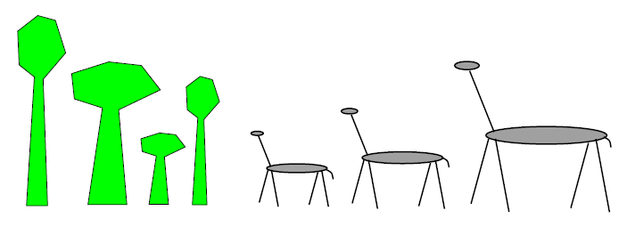
In the forest
Initially equal proportions of Giraffe and tree species

Slide 5
One million years later
Average Giraffe height will probably
Increase
same
Decrease

Slide 6
One million years later
Average tree height will probably
Increase
same
Decrease

Slide 7
One million years later
Maximum Giraffe height will probably
Increase
same
Decrease

Slide 8
One million years later
Maximum tree height will probably
Increase
same
Decrease

Slide 9
In the forest
Fitness = Height
Survival of the fittest

Slide 10
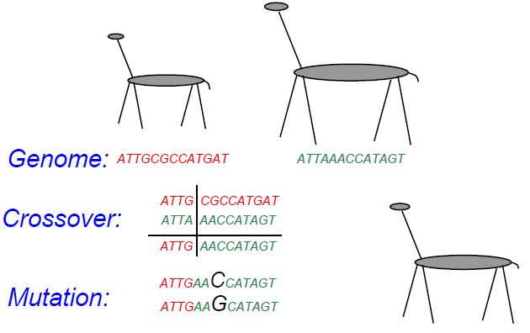
Reproduction

Slide 11
Genetic Algorithms
Maintain a population of potential solutions
New solutions are generated by selecting, combining and modifying existing solutions
Crossover
Mutation
Objective function = Fitness function
Better solutions favored for parenthood
Worse solutions favored for replacement

Slide 12
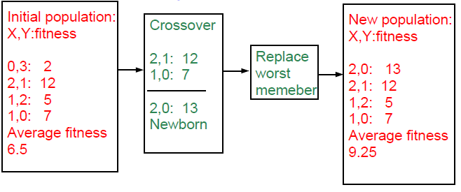
Example: numerical optimization
Maximize 2X^2-y+5 where X:[0,3],Y:[0,3]

Slide 13
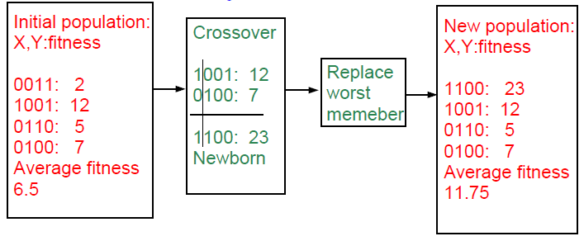
Example with binary representation
Maximize 2X^2-y+5 where X:[0,3],Y:[0,3]

Slide 14
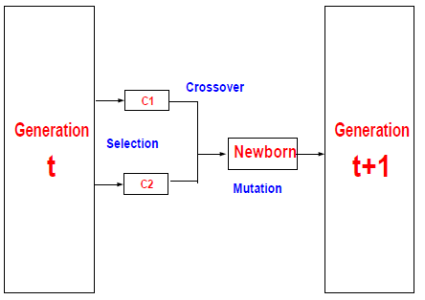
Elements of a generational genetic algorithm
Representation
Fitness function
Initialization strategy
Selection strategy
Crossover operators
Mutation operators

Slide 15
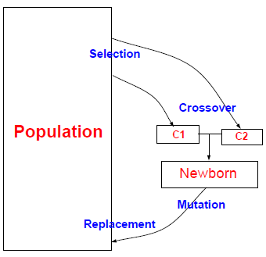
Elements of a steady state genetic algorithm
Representation
Fitness function
Initialization strategy
Selection strategy
Crossover operators
Mutation operators
Replacement strategy

Slide 16
Selection strategies
Proportional selection (roulette wheel)
Selection probability of individual = individual’s fitness/sum of fitness
Rank based selection
Example: decreasing arithmetic/geometric series
Better when fitness range is very large or small
Tournament selection
Virtual tournament between randomly selected individuals using fitness

Slide 17
Crossover Operators
Point crossover (classical)
Parent1=x1,x2,x3,x4,x5,x6
Parent2=y1,y2,y3,y4,y5,y6
Child =x1,x2,x3,x4,y5,y6
Uniform crossover
Parent1=x1,x2,x3,x4,x5,x6
Parent2=y1,y2,y3,y4,y5,y6
Child =x1,x2,y3,x4,y5,y6
Arithmetic crossover
Parent1=x1,x2,x3
Parent2=y1,y2,y3
Child =(x1+y1)/2,(x2+y2)/2,(x3+y3)/2

Slide 18
Mutation Operators
change one or more components
Let Child=x1,x2,P,x3,x4...
Gaussian mutation:
P ¬ P ± ∆p
∆ p: (small) random normal value
Uniform mutation:
P ¬ P new
p new : random uniform value
boundary mutation:
P ¬ Pmin OR Pmax
Binary mutation=bit flip

Slide 19
Advantages of Genetic-Algorithm based optimization
Finds global optima
Can handle discrete, continuous and mixed variable spaces
Easy to use (short programs)
Robust (less sensitive to noise, ill conditions)

Slide 20
Disadvantages of Genetic- Algorithm based optimization
Relatively slower than other methods (not suitable for easy problems)
Theory lags behind applications

Slide 21
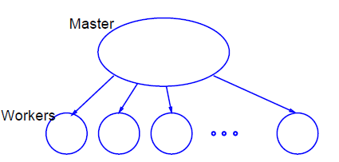
Global parallel GA

Slide 22
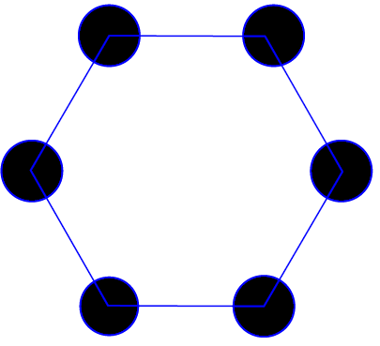
Coarse-grained parallel GA (Island model)

Slide 23
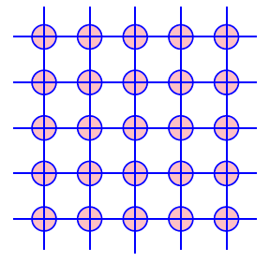
Fine-grained parallel GA

Slide 24
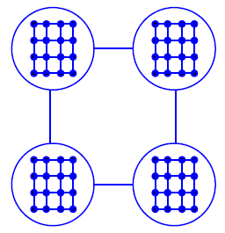
Hybrid parallel GA
Coarse-grained GA at high level
Fine-grained GA at low level

Slide 25
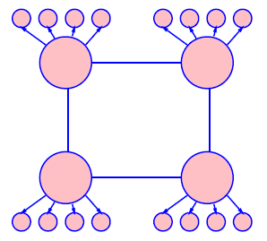
Hybrid parallel GA
Coarse-grained GA at high level
Global parallel GA at low level

Slide 26
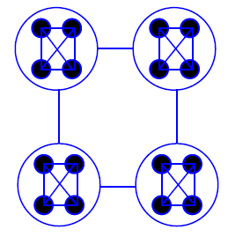
Hybrid parallel GA
Coarse-grained GA at high level
Coarse-grained GA at low level

Slide 27
Genetic Programming (GP)
Introduced (officially) by John Koza in his book (genetic programming, 1992)
Early attempts date back to the 50s (evolving populations of binary object codes)
Idea is to evolve computer programs
Declarative programming languages usually used (Lisp)
Programs are represented as trees

Slide 28
GP individuals
A population of trees representing programs
The programs are composed of elements from the FUNCTION SET and the TERMINAL SET
These sets are usually fixed sets of symbols
The function set forms "non-leaf" nodes. (e.g. +,-,*,sin,cos)
The terminal set forms leaf nodes. (e.g. x,3.7, random())

Slide 29
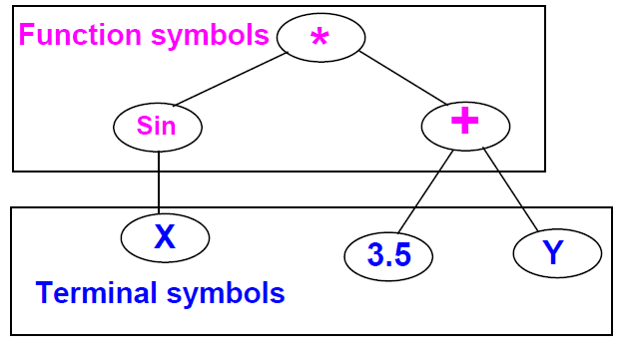
Example: GP individual

Slide 30
GP operation
Fitness is usually based on I/O traces
Crossover is implemented by randomly swapping subtrees between individuals
GP usually does not extensively rely on mutation (random nodes or subtrees)
GPs are usually generational (sometimes with a generation gap)
GP usually uses huge populations (1M individuals)

Slide 31
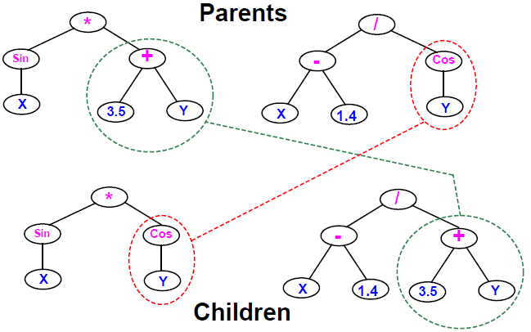
Example: GP crossover

Slide 32
Advantages of GP over GAs
More flexible representation
Greater application spectrum
If tractable, evolving a way to make “things” is more useful than evolving the “things”.
Example: evolving a learning rule for neural networks (Amr Radi, GP98) vs. evolving the weights of a particular NN.

Slide 33
Disadvantages of Genetic Programming
Extremely slow
Very poor handling of numbers
Very large populations needed

Slide 34
GP variants
Genetic programming with linear genomes (Wolfgang Banzaf)
Kind of going back to the evolution of binary program codes
Hybrids of GP and other methods that better handle numbers:
Least squares methods
Gradient based optimizers
Genetic algorithms, other evolutionary computation methods
Evolving things other than programs
Example: electric circuits represented as trees (Koza, AI in design 1996)

Slide 35
Evolution Strategies (ES)
Were invented to solve numerical optimization problems
Originated in Europe in the 1960s
Initially: two-member or (1+1) ES:
one PARENT generates one OFFSPRING per GENERATION
by applying normally distributed (Gaussian) mutations
until offspring is better and replaces parent
This simple structure allowed theoretical results to be obtained (speed of convergence, mutation size)
Later: enhanced to a (μ+1) strategy which incorporated crossover

Slide 36
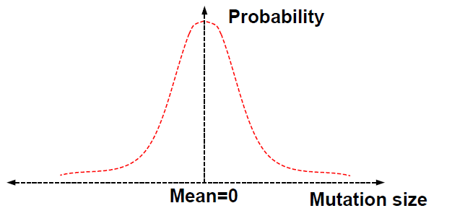
Normal (Gaussian) mutation

Slide 37
Modern evolution strategies
Schwefel introduced the multi-membered ESs now denoted by (μ +λ) and (μ, λ)
(μ, λ) ES: The parent generation is disjoint from the child generation
(μ + λ) ES: Some of the parents may be selected to "propagate" to the child generation

Slide 38
ES individuals
Real valued vectors consisting of two parts:
Object variable: just like real-valued GA individual
Strategy variable: a set of standard deviations for the Gaussian mutation
This structure allows for "Self-adaptation“ of the mutation size
Excellent feature for dynamically changing fitness landscape

Slide 39
Machine learning and evolutionary computation
In machine learning we seek a good hypothesis
The hypothesis may be a rule, a neural network, a program ... etc.
GAs and other EC methods can evolve rules, NNs, programs ...etc.
Classifier systems (CFS) are the most explicit GA based machine learning tool.

Slide 40
Elements of a classifier system
Rule and message system
if <condition> then <action>
Apportionment of credit system
Based on a set of training examples
Credit (fitness) given to rules that match the example
Example: Bucket brigade (auctions for examples, winner takes all, existence taxes)
Genetic algorithm
evolves a population of rules or a population of entire rule systems

Slide 41
The Michigan approach: population of rules
Evolves a population of rules, the final population is used as the rule and message system
Diversity maintenance among rules is hard
If done well converges faster
Need to specify how to use the rules to classify
what if multiple rules match example?
exact matching only or inexact matching allowed?

Slide 42
The Pittsburgh approach
Each individual is a complete set of rules or complete solution
Avoids the hard credit assignment problem
Slow because of complexity of space

Slide 43
Evolution programming (EP)
Classical EP evolves finite state machines (or similar structures)
Relies on mutation (no crossover)
Fitness based on training sequence(s)
Good for sequence problems (DNA) and prediction in time series

Slide 44
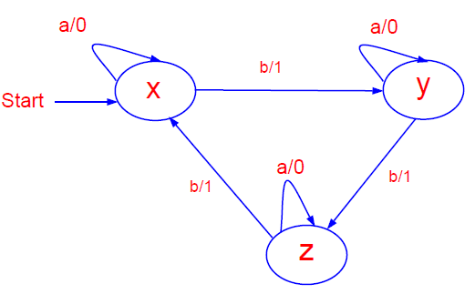
EP individual

Slide 45
EP mutation operators
Add a state (with random transitions)
Delete a state (reassign state transitions)
Change an output symbol
Change a state transition
Change the start state

Slide 46
Modern EP
No specific representation
Similar to Evolution Strategies
Most work in continuous optimization
Self adaptation common
No crossover ever used!

Slide 47
Other evolutionary computation "ways"
Representations based on description of transformations
instead of enumerating the parameters of the individual, describe how to change another (nominal) individual to be it.
Good for dimension reduction, at the expense of optimality
Surrogate assisted evolution methods
Good when objective function is very expensive
fit an approximation to the objective function and uses it to speed up the evolution
Differential Evolution

Slide 48
Related Topics
Artificial life
An individual’s fitness depends on genes + lifetime experience
An individual can pass the experience to offspring
Co-evolution
Several populations of different types of individuals co-evolve
Interaction between populations changes fitness measures

Slide 49
Other Nature Inspired Heuristics
Ant Colony Optimization
Inspired by the social behavior of ants
Useful in problems that need to find paths to goals
Particle Swarm optimization
Inspired by social behavior of bird flocking or fish schooling
The potential solutions, called particles, fly through the problem space by following the current optimum particles

Slide 50
The bigger picture
All evolutionary computation models are getting closer to each other
The choice of method is important for success
EC provides a very flexible architecture
easy to combine with other paradigms
easy to inject domain knowledge

Slide 51
EC journals
Evolutionary Computation
IEEE transactions on evolutionary computation
Genetic programming and evolvable machines
other: AIEDAM, AIENG ...

Slide 52
EC conferences
Genetic and evolutionary computation conference (GECCO)
Congress on evolutionary computation (CEC)
Parallel problem solving from nature (PPSN)
other: AI in design, IJCAI, AAAI ...

