Slide 1

An Evolutionary Approach forVLSI Standard Cell Design
Anil Bahuman
Khaled Rasheed
Benjamin Bishop
University of Georgia

Slide 2
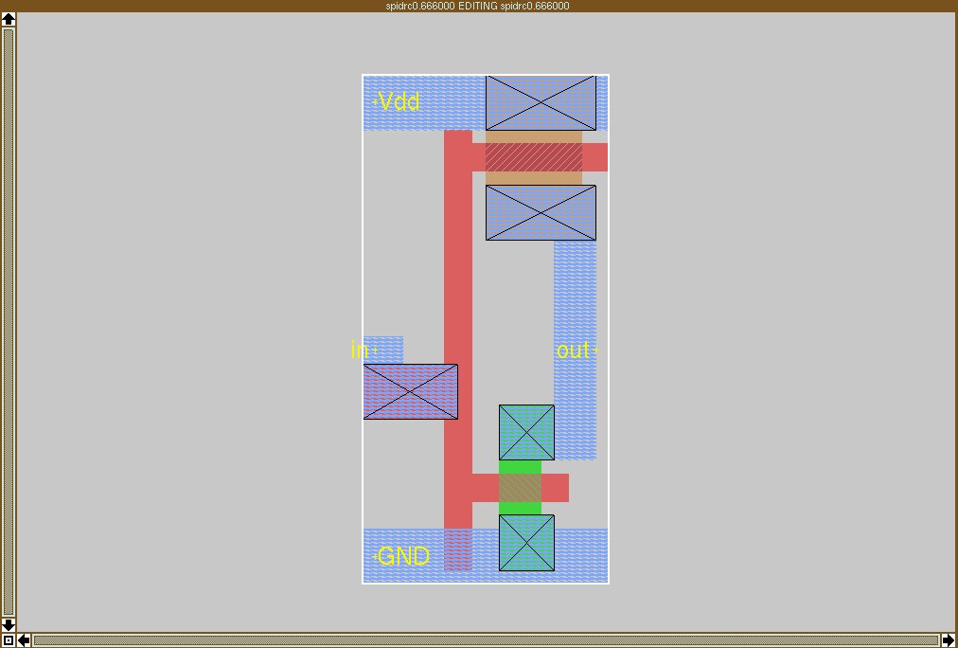
Research Goal – Inverter
Standard cells are building blocks of frequently used logics employed in VLSI Design. Examples include NAND, Full Adder, Latch and Inverter. These libraries are typically designed by hand in a very costly and time consuming process. One of the major challenges is the migration of standard cell layouts every time there is a change in the process. There is a strong need for automation alternatives.
“Schematic and layout are designed in parallel”
In | Out
0 | 1
1 | 0
0 | 1
Truth Table
Layout with “minimum” area

Slide 3
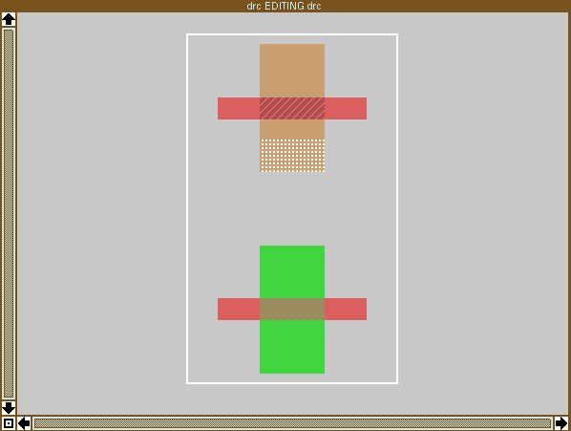
Magic – A Design Tool
White tiles indicate design rule check (DRC) Errors- constraints arising from the manufacturing process

Slide 4
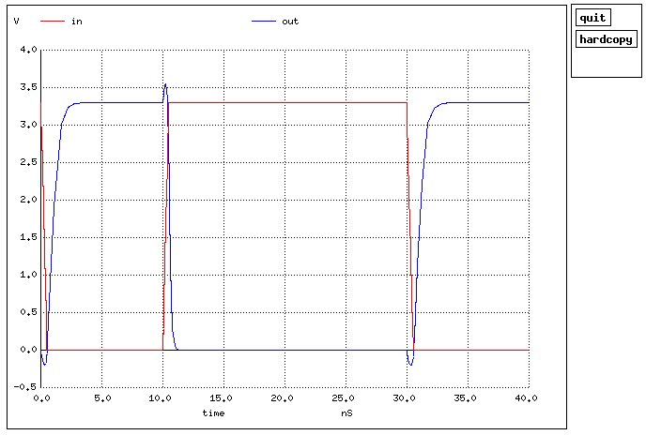
Spice Simulation of an Inverter
This is a plot of the input and output voltage waveforms with respect to time. Note that input is zero when output is one and vice versa.

Slide 5
Architecture
DESIGN ENGINE
EVALUATOR
Modified GADO
(CIRCUIT FILE)
Fitness module
(DRC ERRORS , AREA)
(CORRECTNESS)
MAGIC
SPICE
DESIGN RULE CHECKER
CIRCUIT SIMULATOR

Slide 6
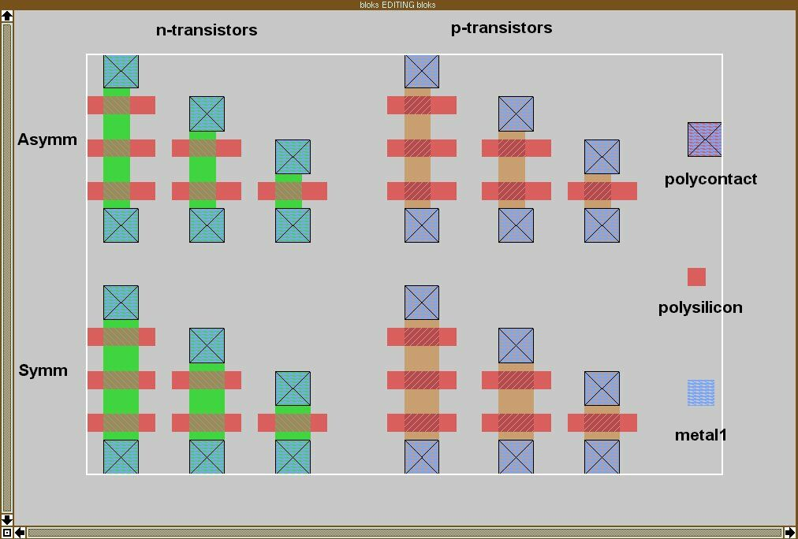
Building Blocks used by GA
11

Slide 7
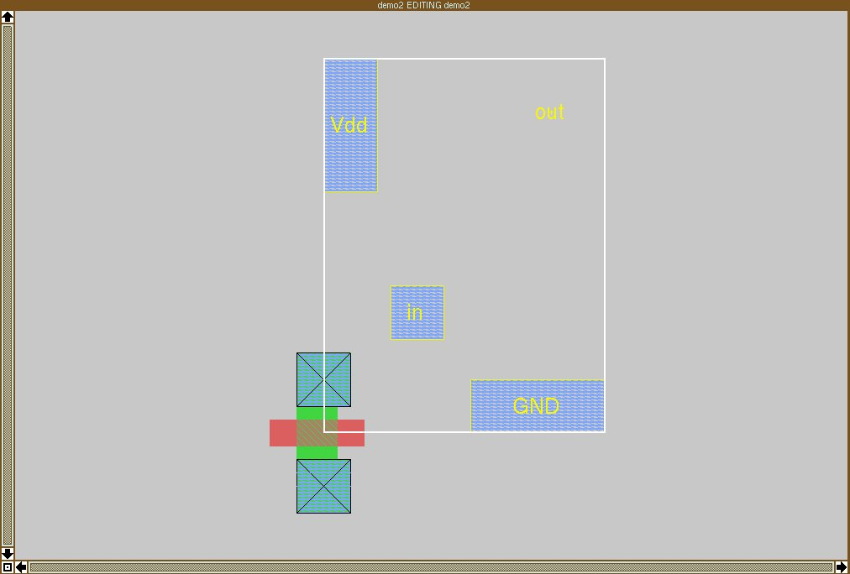
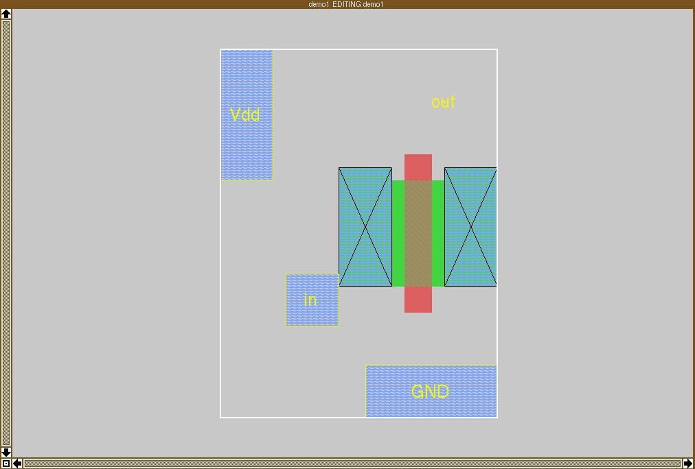
Encoding an Object
PARAMETER | VALUE | A | B
Object Type | 1-15 | 11 | 11
Orientation | 0-3 | 0 | 2
Stretch Factor | Cell limits | 0 | 5
X | Cell limits | 0 | 15
Y | Cell limits | 0 | 14
A
B

Slide 8
An Individual in the GA
Object Type | Orientation | Stretch Factor | X | Y
An integer representation was chosen. Note that by the nature of the chosen representation scheme it is possible to have ill-formed/incorrect circuits.

Slide 9
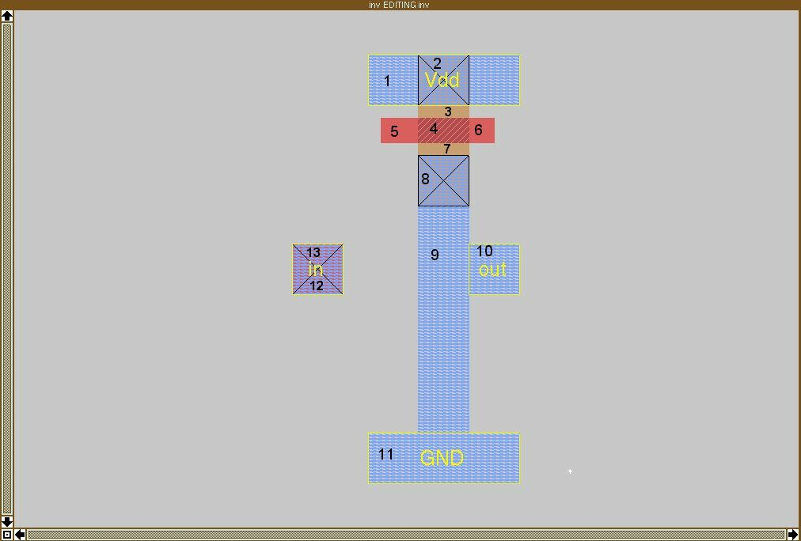
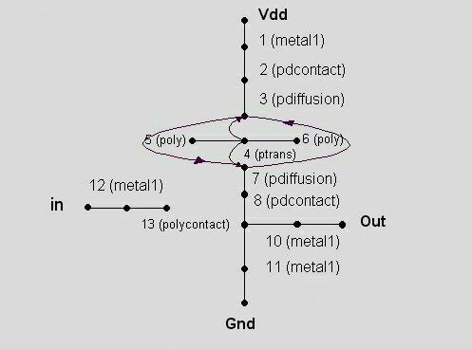
Sample Cell
Corresponding Graph

Slide 10
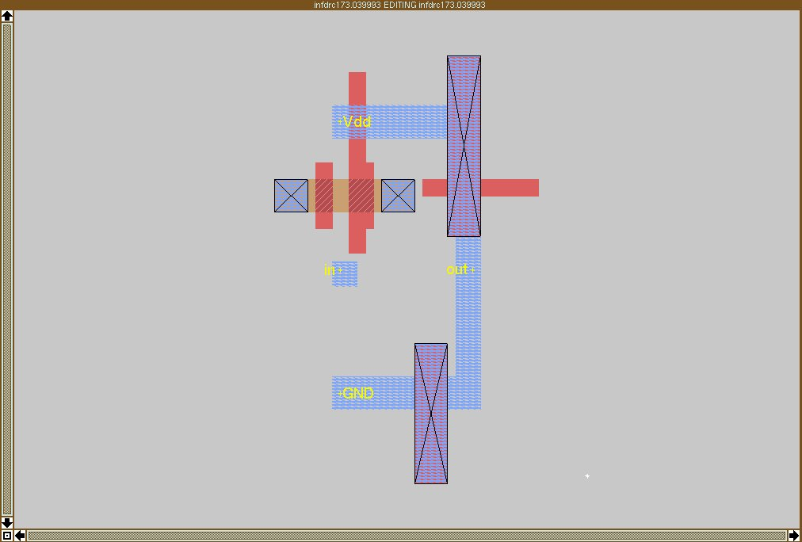
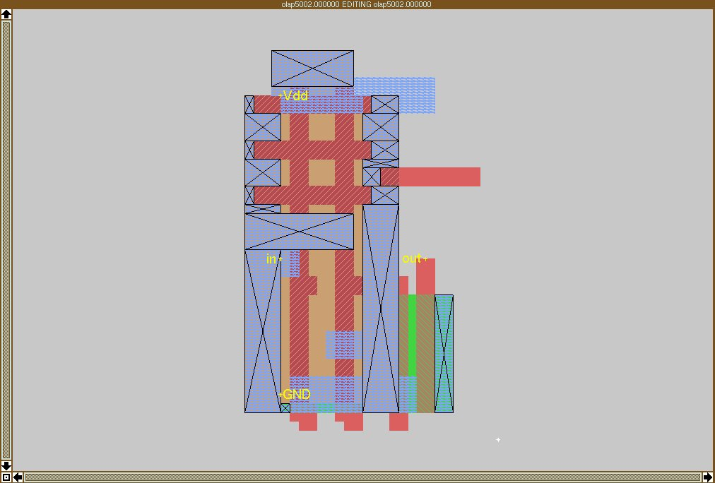
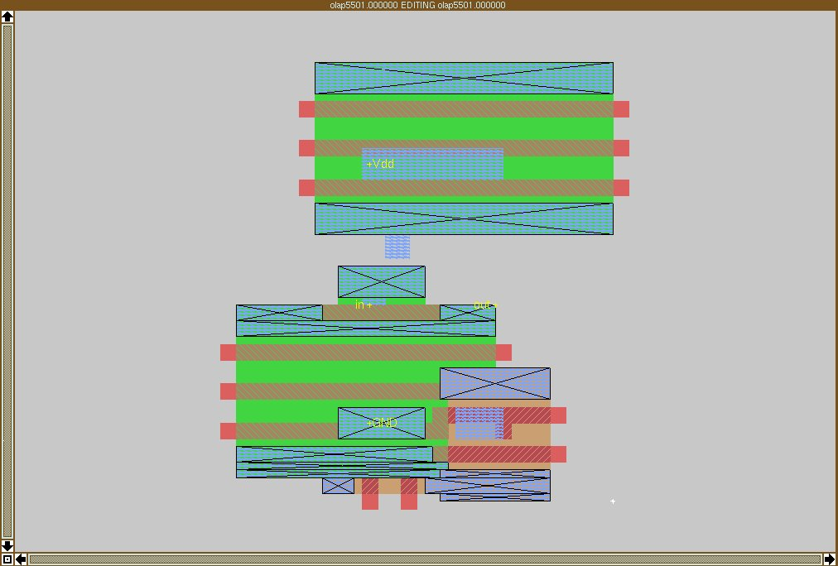
Evolving an Inverter 1-3
1
2
3

Slide 11
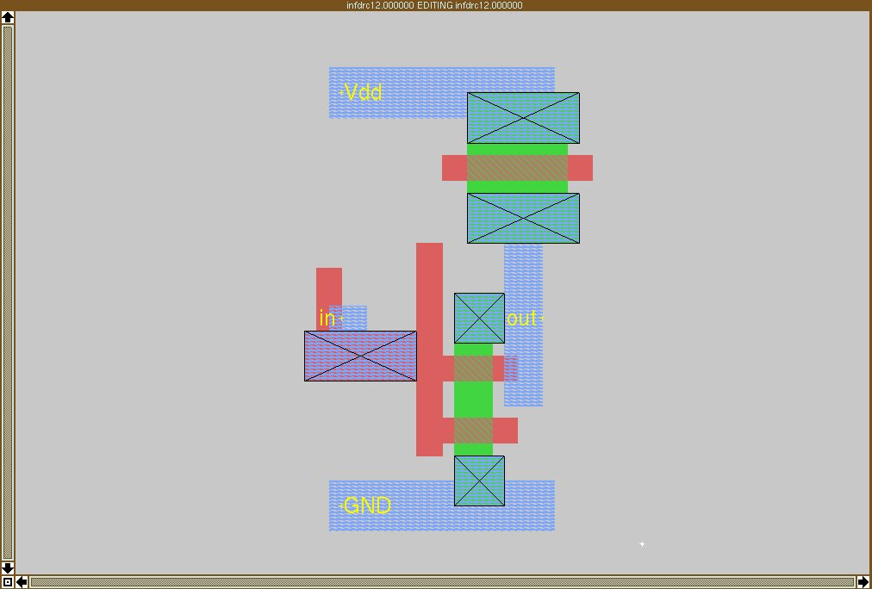
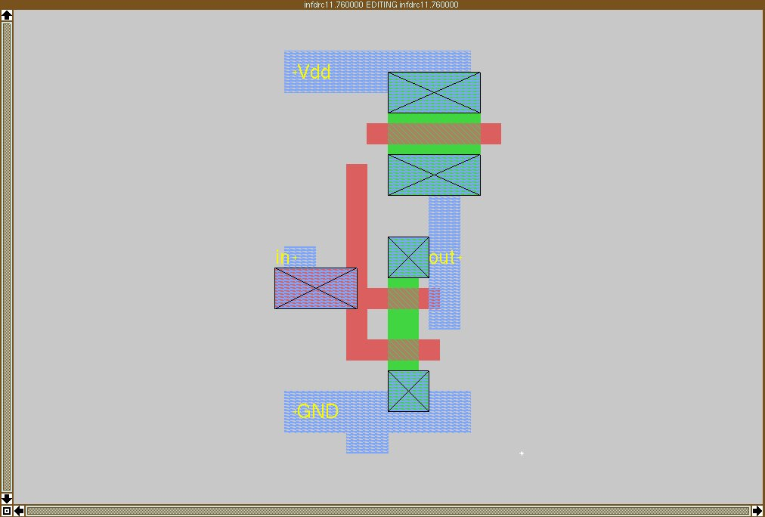
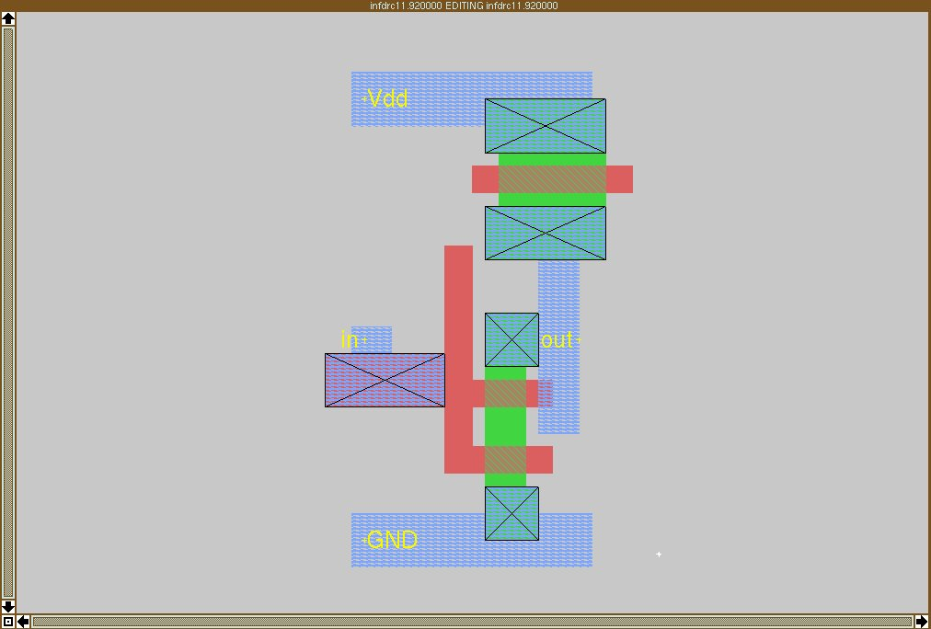
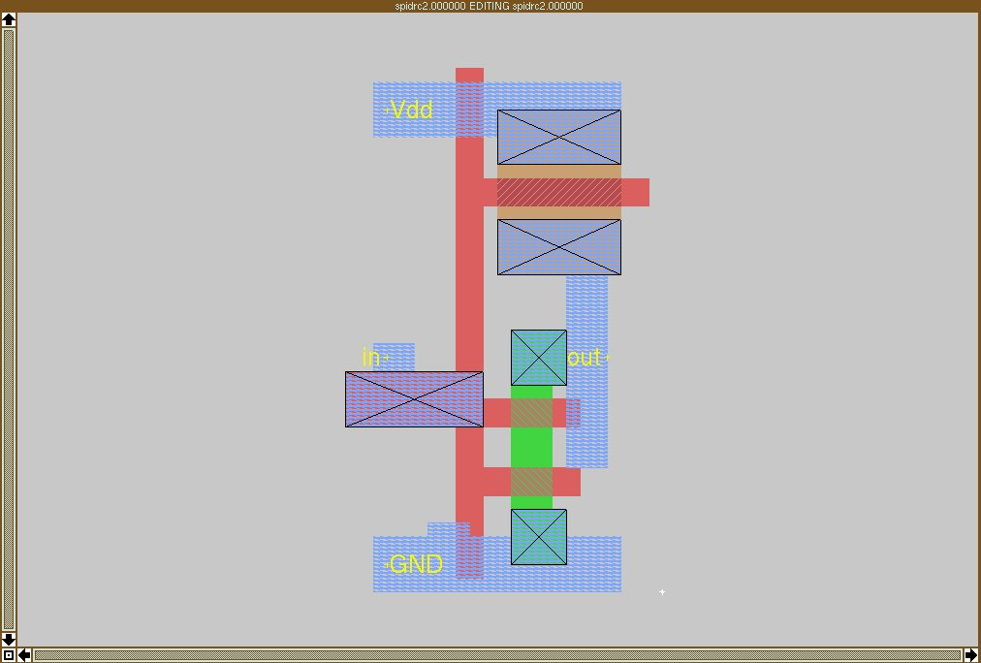
Evolving an Inverter 4-7
4
6
5
7

Slide 12
Success 1 (arbitrary label placement)

Slide 13
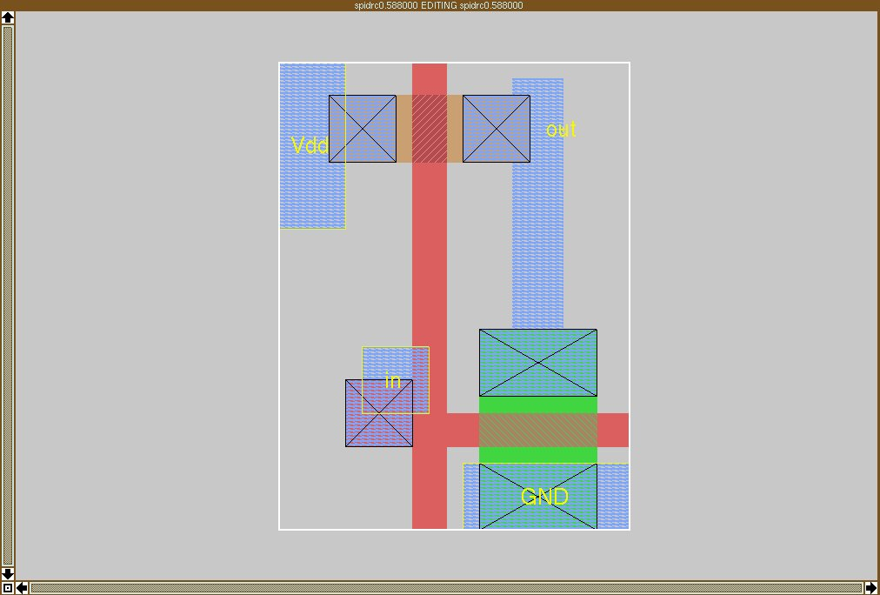
Success 2 (arbitrary label placement)

Slide 14
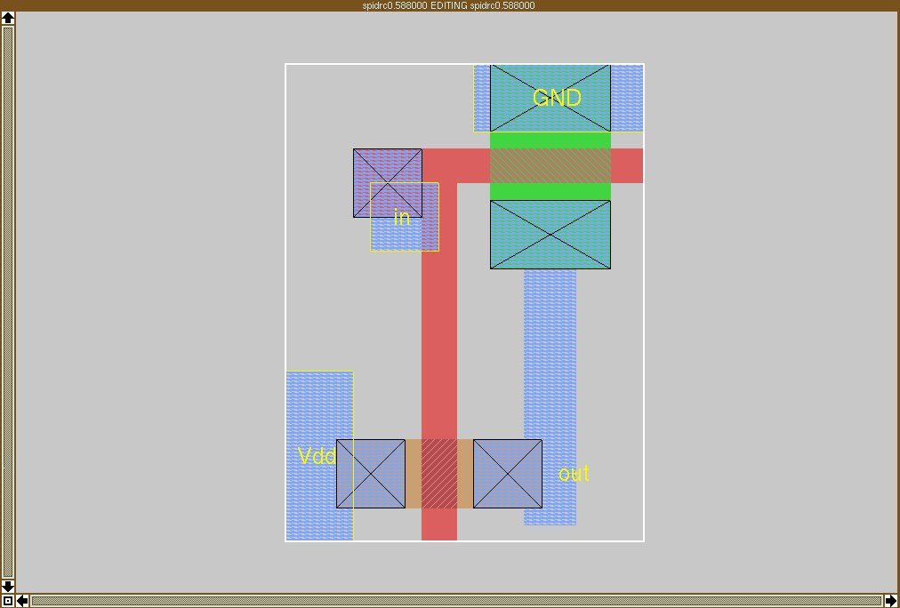
Success 3 (arbitrary label placement)

