Slide 1

Improving Learning Outcomes by Using Clustering Validity Analysis to Reduce Label Uncertainty Department of Computer Science July 11th, 2013
U, Man Chon (Kevin)
manchonu@uga.edu
www.cs.uga.edu/~manchonu

Slide 2
Committee Members
Khaled Rasheed, Ph.D. (Major Advisor)
Department: Computer Science
Email: khaled@cs.uga.edu
Natarajan Kannan, Ph.D.
Department: Biochemistry & Molecular Biology
Email: kannan@bmb.uga.edu
Roberto Perdisci, Ph.D.
Department: Computer Science
Email: perdisci@cs.uga.edu
Hamid R. Arabnia, Ph.D.
Department: Computer Science
Email: hra@cs.uga.edu

Slide 3
Outline
Motivation
Introduction
GOAL
ROMP (Rare Oncogenic Mutation Predictor)
VAMO (Validity Analysis of Malware-clustering Outputs)
Conclusions & Future Work

Slide 4
Motivation
We generate a huge amount of data in our daily lives
searching, online shopping, phone calls, accessing social media
Researchers have been trying various methods to extract useful information from different sources of data
Machine Learning has become one of the most active research areas
Clean and well structured data seldom exists
Missing label, no label, labeled with certain degrees of uncertainty
No best machine learning approach for all different domains
Combining multiple learning outcomes and/or multiple learning approaches
Introduce ROMP and VAMO
Combine multiple learning outcomes
Improve the learning outcomes by using clustering validity analysis to reduce label uncertainty

Slide 5
Introduction
Present ROMP and VAMO in two different domains
ROMP – Cancer Research
VAMO – Malware Clustering
Both domains containing some degrees of uncertainty
Confirmed cancer-causing mutations (correct labels) are limited, and mutations labeled as cancer-causing in some public databases (i.e. somatic mutations observed in clinical samples) are under certain assumptions
Labels of a same malware sample that generated by different anti-virus scanners are greatly different, and the mapping between these labels are usually unavailable
Can be apply to many other domains
Similar data structure, similar problem to solve

Slide 6
Goal
ROMP
To identify rare oncogenic mutations as well as mutations with suspicious labels
VAMO
To provide a fully automated quantitative analysis of the validity of malware clustering results

Slide 7
ROMP – Rare Oncogenic Mutation Predictor

Slide 8
Introduction
Given a labeled dataset
Supervised learning is always a good choose to analyze the data and to produce an inferred function for mapping new samples
Given a dataset labeled with certain degrees of uncertainty
Using only supervised learning schemes might not be sufficient
ROMP
Construct a high performance ensemble classifier using the labeled dataset
Use clustering algorithm and our self-invented cluster validity metrics to improve the learning outcomes

Slide 9
Possible Application
ROMP can be used in any problem domain with labeled dataset
It will be a great fit to domains that satisfy (or partially satisfy) the following criteria:
Labels in the dataset contain some degrees of uncertainty
Prefers to consider the outputs from multiple experts (learning algorithms)
Requires an probability score rather than just a class label as prediction

Slide 10
Our application
We use ROMP for identifying causative mutations in human protein kinases, a class of signaling proteins known to be frequently mutated in human cancers

Slide 11
Background
Cancer is a genetic disease which develops through a series of somatic mutations, a subset of which drive cancer progression
Not all mutations have equal influence on the disease state of a cell
“Driver” (Causative) and “Pessenger” (Non-Causative)
Mutated driver genes are worthwhile targets for drug discovery
Counteracting the mutation's effects can potentially slow or reverse cancer progression in individual patients
Machine Learning approaches have been used extensively to predict/prioritize causative mutations, but…
Used standard features of mutated residues, didn’t consider gene- or family-specific features
Used one or two popular machine learning algorithms, didn’t consider the bias
Provided binary classification results, seldom provide ranking of mutations
Unsupervised learning approaches have never been utilized to tackle this problem

Slide 12
Evaluation
To evaluate our framework, we conducted experiments on benchmark datasets from UCI Machine Learning Repository. We selected 3 datasets:
Tic-Tac-Toe Dataset
Wisconsin Breast Cancer (Original) Dataset
Wisconsin Breast Cancer (Diagnostic) Dataset

Slide 13
Performance of ROMP
Dataset | TP Rate | FP Rate | Accuracy (%) | F-Measure | S-P | S-N
Tic-Tac-Toe | 1 | 0 | 100 | 1 | 0 | 0
WBC-Original | 0.9959 | 0..0209 | 98.33 | 0.9677 | 2 | 19
WBC-Diagnostic | 0.9764 | 0.0112 | 98.42 | 0.9787 | 8 | 11

Slide 14
Tic-Tac-Toe Dataset
Reference | Method | Accuracy (%) | F-Measure
[82] | IB3-CI | 99.1 | n/a
[83] | CI3 | 98.4 | n/a
[84] | Cluster Based Classification | 99.2 | n/a
[85] | ROMP | 100 | 1

Slide 15
Wisconsin Breast Cancer (Original) Dataset
Reference | Method | Accuracy (%) | F-Measure
[86] | Fuzzy c-means clustering | 91.42 | 0.8893
[85] | ROMP | 98.33 | 0.9677

Slide 16
Wisconsin Breast Cancer (Diagnostic) Dataset
Reference | Method | Accuracy (%) | F-Measure
[87] | Fuzzy k-nearest neighbor | 97.17 | 0.9534
[88] | Random Forest with feature selection | 99.82 | 0.9952
[85] | ROMP | 98.42 | 0.9787

Slide 17
System Overview

Slide 18
Data Sources
Welcome Trust Sanger Institute's Cancer Genome Project (CGP) – version 50 and version 57
Catalogue of Somatic Mutations in Cancer (COSMIC)
Causative dataset
SNP@Domain
http://variome.kobic.re.kr/SnpNavigator/
Non-causative dataset (non-synonymous)
KinBase, EMBOSS, UniProtKB, and UniRef90
Extract Protein Features

Slide 19
Data Subset (Both v50 and v57)
COSMIC-ALL
The positive set consist of all gene mutations (Kinase domain) from the COSMIC dataset. The non-causative set is the non-synonymous mutations obtained from SNP@Domain
COSMIC-FG1 (Main Focus – Training)
The causative set of mutations in COSMIC that are observed in more than one distinct sample (Frequency Greater than 1). The non-causative set is the non-synonymous mutations obtained from SNP@Domain
COSMIC-FE1 (Main Focus – Prediction)
The “unconfirmed”set of mutations in COSMIC that are observed only once. (Frequency Equal to 1)

Slide 20
Features
Structural and Sequential features
New: Multiple levels of evolutionary conservation
Among all protein kinases (superfamily)
Within the 7 recognized major groups
Within each family and subfamily
29 Attributes in total (Before Feature Selection)
17 features (After Feature Selection)

Slide 21
Feature Selections
Selected Feature | Votes | Avg Rank
Protein Kinase Family Protein Kinase Group Amino Acid Type, WT BLOSUME 62 pairwise score Side-Chan polarity, Mutant Conservation of wild type in all kinases Conservation of consensus type in kinase group Conservation of consensus type in all kinases Conservation of consensus type in kinase family Kinase subdomain Average mass of amino acid, WT Is a binding site? Van der Waals volume, WT Site modification type (if any) Amino Acid Type, Mutant Side-Chain polarity, WT Is in protein kinase domain? | 5 5 5 5 5 5 5 5 4 4 4 4 4 4 4 4 3 | 1.40 1.80 8.00 8.20 11.00 11.60 11.60 13.00 5.75 6.00 7.50 8.25 8.75 9.25 10.75 11.50 11.67

Slide 22
Selected Features
5 feature selection methods
OneR Algorithm, with a minimum bucket size of 14.
Relief-based selection , with 10 nearest neighbors for attribute estimation.
Chi-Square selection with ranker search
Filter approach, utilizes Gain Ratio Attribute Evaluator and Spread Subsample approach.
Correlation-based selection , with Greedy (forward) searching algorithm
Use Majority Voting to select the features, then select the top 60% of features
Finally we have 17 features

Slide 23
Classifiers
We compare the performance of 11 established machine learning algorithms.
Covers the major categories of classifier algorithms: Trees, Rules, Instance-based, Functions, and Bayes.
J48 (Tree)
Random Forest
NB Tree
Functional Tree
Decision Table
DTNB
LWL (J48+KNN)
Bayes Net
Naïve Bayes
SVM
Neural Network

Slide 24

Combining Multiple Classifiers
Weighted Voting: ${U−Score}_{i}=\frac{\sum_{i}{({Pr}_{i}^{j,D}×{Accuracy}^{j})}}{\sum_{j}{{Accuracy}^{j}}}$
Stacking
Grading

Slide 25
Performance of Ensemble Classifier Trained with Selected Features on COSMIC-fg1 v50 Dataset
Algorithms | TP Rate | FP Rate | Precision | Recall | F-Measure
Weighted Voting | 1 | 0.009 | 0.957 | 1 | 0.978
Stacking | 0.925 | 0.115 | 0.62 | 0.925 | 0.743
Grading | 0.91 | 0.021 | 0.897 | 0.91 | 0.904
COSMIC-FG1 v50: 67 causative mutations, 331 non-causative mutations
Show the advantage of using the combined classifier by various measurement indexes
F-Measure with 50% threshold, the combined classifier performs:
~7.4% better (from 0.904 to 0.978) than the best single classifier (SVM) in COSMIC FG1 dataset

Slide 26
Application of Ensemble Classier to Predict Rare Variants in EGFR with COSMIC v50

Slide 27
Select Mutations for In-Vitro Experiments
Use the combined classifier to rank the EGFR mutations that appear only once in COSMIC v50
Mutation | Rank | U-Score | Experiment Result
L861R | 1 | 0.97699 | Activating
G724S | 2 | 0.97649 | --
T725M | 21 | 0.96238 | Activating
L858Q | 25 | 0.95649 | --
E746K | 161 | 0.61788 | Activating
Notes:
much of the focus thus far has been on a handful of frequently occurring mutations such as L858R and L861Q.

Slide 28
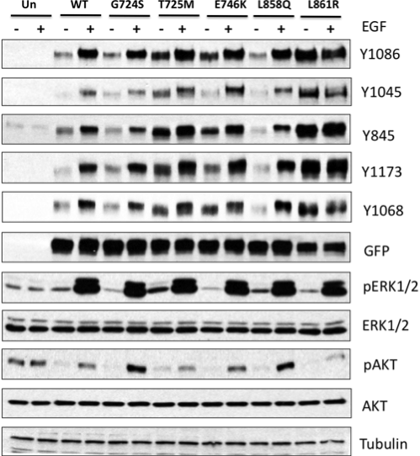
Auto-Phosphorylation of Wild-Type and Mutant Type EGFR

Slide 29
Comparison of COSMIC v50 and v57 : Justification of Using COSMIC-FG1 as Positive Set
COSMIC-FG1 v57: 226 causative mutations, 331 non-causative mutations
COSMIC-FG1 v50: 67 causative mutations, 331 non-causative mutations
177 single-observation EGFR mutations in v50
165 single-observation EGFR mutations in v57
106 single-observation EGFR mutations shared between v50 and v57
71 EGFR mutations observed once in v50 but more than once in v57
59 EGFR mutations in v57 are new (not in v50)
Question: How well can our previously trained model (with COSMIC v50 FG1 as positive set) predicted the 71 EGFR mutations that appear only once in COSMIC v50 but appear more than once in COSMIC v57

Slide 30
Application of Ensemble Classier to Predict Rare Variants in EGFR with COSMIC v50

Slide 31
Performance of Ensemble Classifier Trained with Selected Features on COSMIC-FG1 v57 Dataset
Algorithms | TP Rate | FP Rate | Precision | Recall | F-Measure
Weighted Voting | 0.987 | 0.009 | 0.987 | 0.987 | 0.987
Stacking | 0.96 | 0.024 | 0.964 | 0.96 | 0.962
Grading | 0.973 | 0.024 | 0.965 | 0.973 | 0.969
F-Measure with 50% threshold, the combined classifier performs:
~2% better (from 0.967 to 0.987) than the best single classifier (SVM) in COSMIC FG1 dataset.

Slide 32
Application of Ensemble Classier to Predict Rare Variants in EGFR with COSMIC v57

Slide 33
Unsupervised Learning Module
Expectation Maximization (EM) clustering algorithm
Finds clusters by determining a mixture of Gaussians that t a given dataset
Our self-invented cluster validity metrics

Slide 34
Methodology
Filter the labeled (COSMIC-FG1 v57) and unlabeled (COSMIC-FE1) dataset with the selected features
Randomize the labeled dataset, followed by randomly splitting the labeled dataset into 90% and 10%
Combine the 90% split labeled data with the unlabeled dataset, apply EM algorithm onto this combined dataset to perform clustering
Use the trained EM model to cluster the split 10% labeled data
Integrate the unlabeled dataset, and the labeled dataset (both the 90% and 10%) together for validity analysis
For each instance in this combined dataset, we first find the cluster it belongs to, then we compute the metrics
Repeats step 1 to 6 for 10 times, then we generated the averaged result for every single instance in both the labeled and unlabeled dataset, namely “U-Score”

Slide 35
Measurement Metrics
Class Ratio
Intra Distance
Raw Score
Weighted U-Score
Normalized U-Score

Slide 36
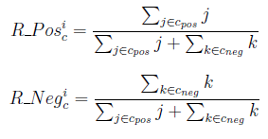
Measurement Metrics – Class Ratio
Calculates the ratio of the causative instances and the ratio of the non-causative instances in the same cluster

Slide 37
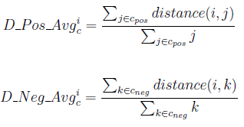
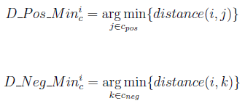
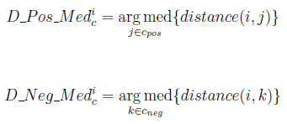
Measurement Metrics – Intra Distance
Calculates the Euclidean Distance of instances in a same cluster c. distance(i, j) is the distance between instance i and instance j in cluster c
Distances between an instance i to other instances of a class (i.e. Positive or Negative) is infinity if there is no instance in c belongs to that particular class

Slide 38


Measurement Metrics – Raw Score
Calculates the Purity Score of instance i in cluster c with the pre-computed distance parameters. Ф is an optional cost ratio that a user can set if the number of instances between different classes in the input dataset are highly imbalanced. ϵ is a very small value (10⁻³²) to avoid divided by zero error

Slide 39
Measurement Metrics – Weighted U-Score
Calculates the level of oncogenicity of a instance i in a specific cluster c, based on the average, median, and min pre-calculated Raw Scores. α=0.5, β=0.4, γ=0.1

Slide 40
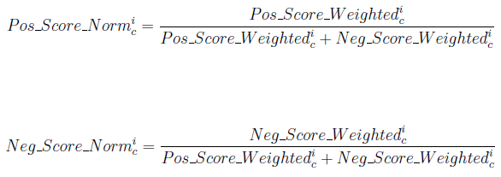
Measurement Metrics – Normalized U-Score
Calculates the level of oncogenicity of a instance i in a specific cluster c, with normalization

Slide 41
Evaluation of Module Using COSMIC-FG1 v57
COSMIC-FG1 v57: 226 Causative, 331 Non-Causative
TP | FN | TN | FP
222 | 4 | 255 | 76
TP Rate | FP Rate | Recall | Precision | F-Measure | Accuracy
0.98230 | 0.22961 | 0.98230 | 0.74497 | 0.84733 | 0.85637

Slide 42
Evaluation of Module Using COSMIC-FG1 v57

Slide 43
Application of Unsupervised Learning Module to Predict Rare Variants in EGFR with COSMIC v57

Slide 44
Combining Supervised and Unsupervised Learning Outputs to Predict Rare Variants in EGFR and to Identify Suspicious Mutations with COSMIC v57
 | 1S/9U | 2S/8U | 3S/7U | 4S/6U | 5S/5U | 6S/4U | 7S/3U | 8S/2U | 9S/1U
TP | 223 | 225 | 224 | 224 | 223 | 223 | 223 | 223 | 223
FN | 3 | 1 | 2 | 2 | 3 | 3 | 3 | 3 | 3
TN | 272 | 284 | 309 | 321 | 324 | 326 | 328 | 328 | 328
FP | 59 | 47 | 22 | 10 | 7 | 5 | 3 | 3 | 3
 | 1S/9U | 2S/8U | 3S/7U | 4S/6U | 5S/5U | 6S/4U | 7S/3U | 8S/2U | 9S/1U
TP Rate | 0.9867 | 0.9956 | 0.9912 | 0.9912 | 0.9867 | 0.9867 | 0.9867 | 0.9867 | 0.9867
FN Rate | 0.1782 | 0.142 | 0.0665 | 0.0302 | 0.0211 | 0.0151 | 0.0091 | 0.0091 | 0.0091
Recall | 0.9867 | 0.9956 | 0.9912 | 0.9912 | 0.9867 | 0.9867 | 0.9867 | 0.9867 | 0.9867
Precision | 0.7908 | 0.8272 | 0.9106 | 0.9573 | 0.9696 | 0.9781 | 0.9867 | 0.9867 | 0.9867
FMeasure | 0.878 | 0.9036 | 0.9492 | 0.9739 | 0.9781 | 0.9824 | 0.9867 | 0.9867 | 0.9867
TP Rates at least 98.67% and FP rates at most 17.82%
The “5S/5U” split reaches 98.67% TP rate and 2.11% FP rate

Slide 45
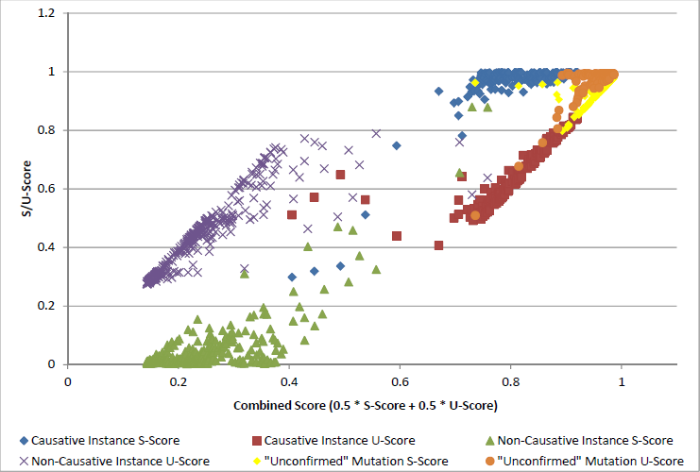
Visualization of the Combined Score of mutations in COSMIC-FG1 v57 and COSMIC-FE1 v57 dataset.

Slide 46
Application of ROMP to Identify Suspicious Mutations in COSMIC-FG1 v57
 | Causative Labeled Instances |  | Non-Causative Labeled Instances
 | U-Score > 0.5 | U-Score <= 0.5 | U-Score > 0.5 | U-Score <= 0.5
U-Score > 0.5 | E | S | S | S
U-Score <= 0.5 | S | S | S | E
E = Expected, S = Suspicious

Slide 47
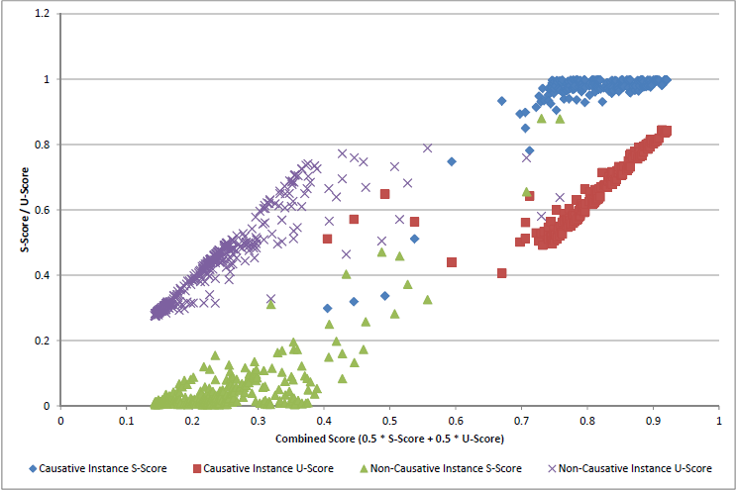
Application of ROMP to Identify Suspicious Mutations in COSMIC-FG1 v57
219 out of 226 instances (≈ 97%) that labeled as causative fall into the ``Expected'' category, and 255 out of 331 instances (≈ 77%) that labeled as non-causative fall into the ``Expected'' category

Slide 48
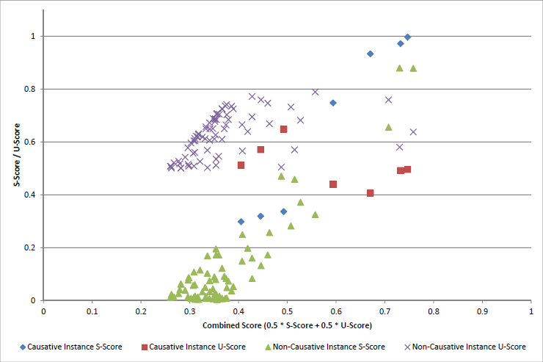
Details of the Suspicious Mutations in COSMIC-FG1 v57
7 with causative label and 76 with non-causative label. (List on page 101)

Slide 49
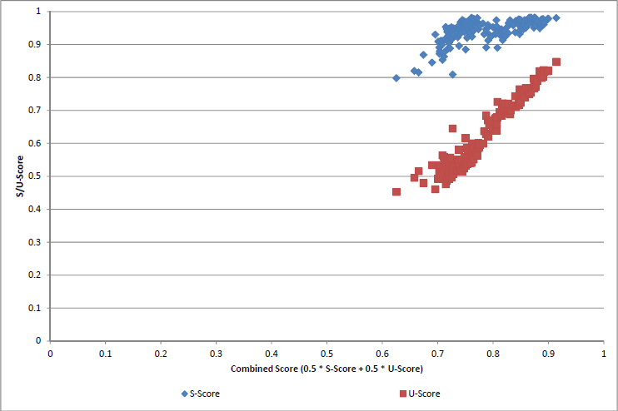
Application of ROMP to Predict Rare Variants in EGFR with COSMIC-FE1 v57
1 mutations ranked between 90% and 100%, 67 ranked 80% to 89.99%, 91 ranked 70% to 79.99%, 6 ranked 60% to 69.99%

Slide 50
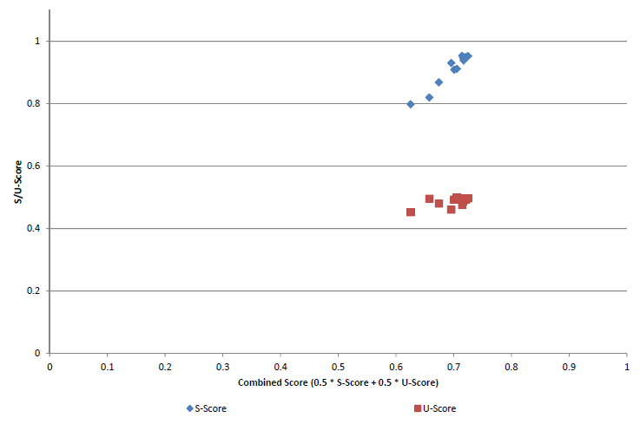
Application of ROMP to Identify Suspicious Rare Variantsin EGFR with COSMIC-FE1 v57
12 out of 165 ( 7.2%) suspicious instances

Slide 51
Contributions
We introduce new kinase-specific features, beyond those used in previous methods to improve prediction accuracy
We combine supervised and unsupervised learning to provide a reliable schema for the prioritization of a set of “unconfirmed” mutations
The supervised component combines multiple supervised learning algorithms (individual classifiers), overcomes the biases introduced by each method
The unsupervised component strengthens the confidence of our prioritization
We use our machine learning schema to produce a numerical ranking of causative mutations in EGFR and test the impact of predicted mutations on EGFR kinase activity using cell-based assays
Our studies identify T725M as a rare causative mutation inasmuch as the T725M mutation increases EGFR autophosphorylation and displays catalytic activity in the absence of the activating EGF ligand

Slide 52
Discussion
In ROMP
No missing labels in the COSMIC dataset
Amount of different labels in the dataset are easy to manage
causative and non-causative
Labels that generated by different experts (individual learning algorithms) are commonly understood by each other
Have good understanding of how each expert performs on the given dataset
10-fold cross-validation accuracy
However, in some situations…
Experts do not have enough knowledge to label all instances
Labels that generated by different experts are partially understood (or even can’t be understood) by each other
M=W32/Viut.gen
A=WORM/Korgo.U
T=PE_VIRUT.D-4
No prior information available about how accurate each expert performs
Notes:
Then the task of combing the outputs of multiple experts to generate robust outputs would become dicult. Even though such “robust” outputs can be generated, it might be under certain restrictions. For instance, by applying the majority voting approach, samples that cannot be reached the consensus by majority experts need to be removed.

Slide 53
VAMO – Validity Analysis of Malware-clustering Outputs
Generates reliable outputs by automatically reducing the label uncertainty
Can be used by other experts to assess the quality of their learning results

Slide 54
Introduction
Given a labeled or unlabeled dataset
Experts (automated algorithms, humans, etc.) analysis the data and generalize the dataset based on some rules
However…
Experts might not have enough knowledge to label all instances
Labels that generated by different experts are partially understood (or even can’t be understood) by each other
No prior information available about how accurate each expert performs

Slide 55
Introduction (Cont’d)
VAMO
Build the Label Graph
Automatically learn the mapping between different labels assigned by multiple experts to the same object, thus avoiding the need to manually build or adjust such mappings
Identify cases in which one (or more) expert(s) tend to inconsistently use several labels to label samples that belong to the same group according to other experts
Learn the level of similarity between labels assigned by different experts, by looking at the number of times that certain labels are jointly assigned to the same samples.
Apply Average-Linkage Hierarchical Clustering Algorithm
Generate a dendrogram that expresses the “relationship” between the samples according to their labels
Generate robust reference clustering

Slide 56
Possible Application
VAMO can be used in any problem domain with labeled or unlabeled dataset
Missing label is allowed
It will be a great fit to domains that satisfy (or partially satisfy) the following criteria:
Labels (outputs of an expert) in the dataset contain some degrees of uncertainty
Prefers to consider the outputs from multiple experts (i.e. AV Scanners)
Requires a fully automated quantitative analysis of the validity of clustering results

Slide 57
Our application
We use VAMO for clustering malware samples according to the labels that assigned to these samples by multiple anti-virus scanners.

Slide 58

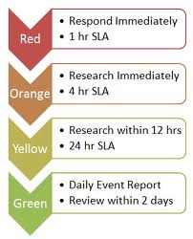



Malware Clustering
Clustering malware into families is useful
Use to generate better signatures
Malware Triage
New family

Slide 59
Malware Clustering Research
Bailey et al. Automated classification and analysis of internet malware (RAID'07)
Bayer et al. Scalable, behavior-based malware clustering (NDSS'09)
Hu et al. Large-scale malware indexing using function-call graphs (CCS'09)
Perdisci et al. Behavioral clustering of http-based malware and signature generation using malicious network traces (NSDI'10)
Jang et al. Bitshred: feature hashing malware for scalable triage and semantic analysis (CCS'11)

Slide 60

Validating Clustering Results
How do we know clustering output is good?
Need a reference clustering to compare
Challenge: unsupervised learning
Limited or no ground truth
Reference clustering (previous work)
Use multiple AV scanners
Extract family names from AV labels
Samples that are assigned the same label by majority of AVs are considered in same family

Slide 61
Drawbacks of Majority Voting
Different AV vendors use different notation
Different family names
One-to-many mapping
Missing and inconsistent labels
Difficult to find majority consensus
Samples with no consensus are excluded
3rd-party clustering results
Comparison
AV label-based reference clustering
using majority voting

Slide 62
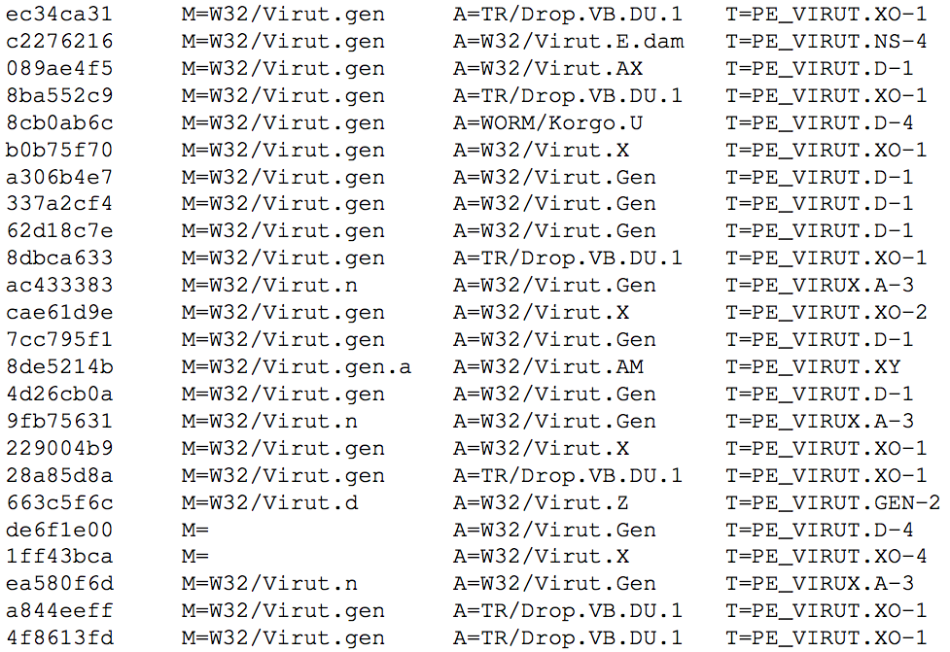
MD5
McAfee
Avira
TrendMicro
One-to-many mapping of family names
Missing Labels
Inconsistent Labels

Slide 63
Drawbacks of Majority Voting
Majority consensus found only for a fraction of dataset!
Bayer et al. (NDSS’09)
Our malware dataset
2,658
14,212
= 18.7 %
5.6% of 1.1M samples
Reference clustering built using majority voting not representative of dataset
Li et al. On challenges in evaluating malware clustering (RAID'10)
“existing approaches to obtaining ground-truth data for malware clustering evaluation biases results by isolating those instances that are simple to cluster”

Slide 64
VAMO – Validity Analysis of Malware-clustering Outputs
Research Goals
Consider entire malware dataset for validation
No manual mappings between AV labels
Deal with AV naming inconsistencies
Fully automated
3rd-party clustering results
Comparison
AV label-based reference clustering
using VAMO

Slide 65
Enables tuning clustering parameters
Allows comparison of different systems

Slide 66
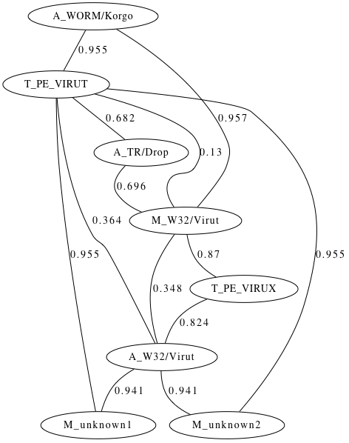
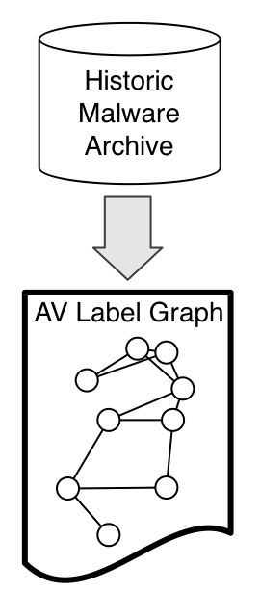
AV Label Graph
Learns mappings between AV labels
Labels that often appear “together” are considered similar
Node = <AV>_<Family>
Edge Weight = Label distance
0.13
McAfee Avira Trend
Sample X : W32/Virut TR/Drop PE_VIRUT

Slide 67
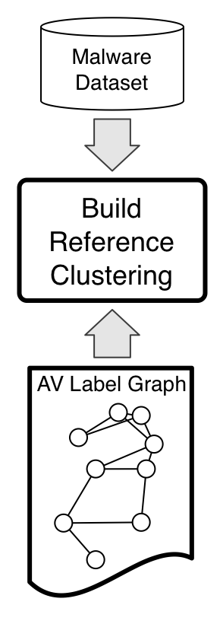
Building Reference Clustering
Measure distance between each pair of malware samples in dataset
Third-Party Malware Dataset
. . .
Sample X :
AV1_Lx
AV2_Lx
AVn_Lx
d = med(d1,d2,..,dn)
d1
d2
dn
. . .
Sample Y :
AV1_Ly
AV2_Ly
AVn_Ly

Slide 68
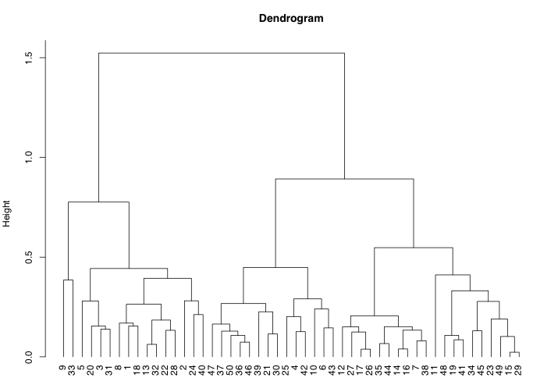
Building Reference Clustering
Apply average-linkage hierarchical clustering on distance matrix
Third-Party Malware Dataset

Slide 69
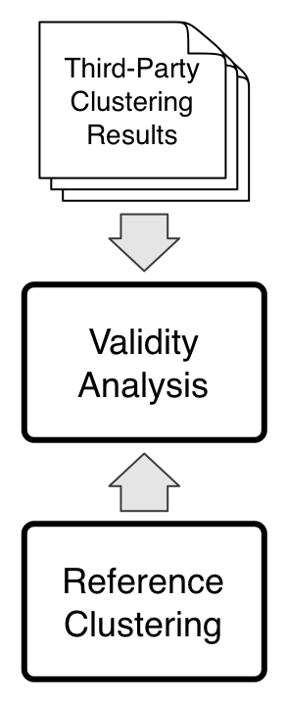
Computing Validity Indices
3rd-party
Clustering Results
AV label-based
Reference Clustering
External
Validity
Index
(e.g., Jaccard)
Quality Index = max(validity index)

Slide 70
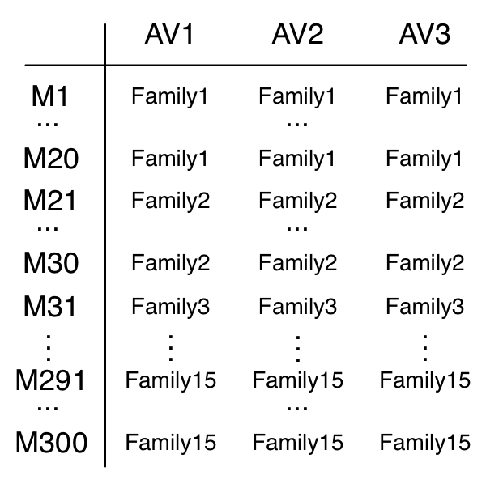
VAMO v.s. Majority Voting
Which one can better tolerate AV label inconsistencies?
Experimental Setup
Synthetic Dataset
complete ground truth
3k samples in historic archive
15 families, 200 samples each
3 AVs (assume identical notation)
300 samples in 3rd-party dataset
Simulating AV Label Inconsistencies
Missing Labels
Label “Flips”
Family5
Family11
Family1
Family8

Slide 71
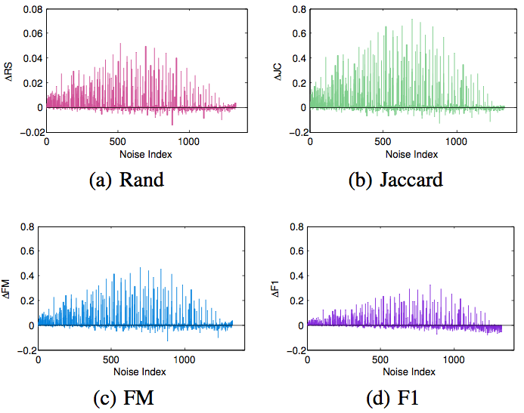
VAMO v.s. Majority Voting
VAMO’s reference clustering agrees more closely with ground truth
External validity indices
Rand Index
Jaccard Coefficient
Folkes-Mallows
F1 Index
Precision-Recall

Slide 72
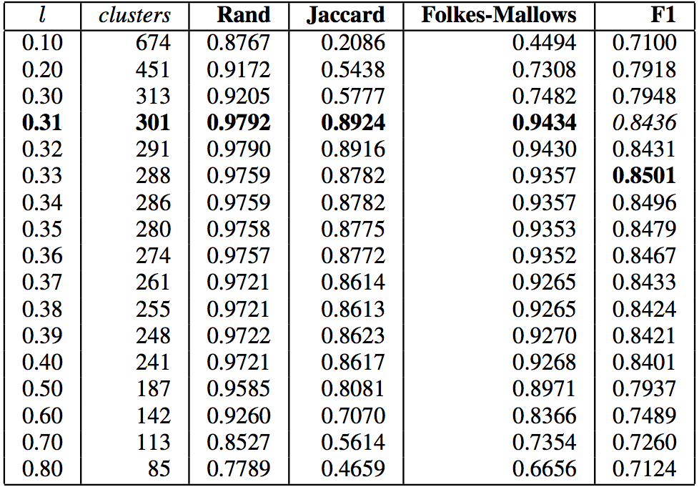
VAMO in Practice
Real-world malware dataset: 2,026 samples
3rd-party clustering algorithm: Bayer et al. (NDSS 2009)
Distance matrix based on system events
Hierarchical clustering
L = cut height
VAMO’s configuration
~1M samples AV labels
4 validity indices

Slide 73
Limitations
Beware of feature mismatch
AVs categorize malware based on reversing
Malware clustering systems use different features (e.g., behavioral)
AV labels “evolve” in time
Samples detected using heuristics labeled as generic
Later, AVs may re-assign samples to a more specific family
Heuristics-based detection more and more common
Will most samples be labeled as generic in the future?
Do AV customers care about reliable malware naming?

Slide 74
Contributions
We proposed a novel system – VAMO, that enables a fully automated malware clustering validity analysis
We performed an extensive evaluation of VAMO
How different types of AV label inconsistencies may negatively impact analysis performed via majority voting
The advantages that VAMO brings over previous work
Demonstrated a practical application of VAMO over a real-world malware dataset

Slide 75
Conclusions and Future Work
Present two effective machine learning frameworks to tackle challenging problems in the domain of Cancer Prediction and Malware Clustering
The frameworks successfully improve the learning outcomes by using cluster validity analysis to reduce the label uncertainty
ROMP – Ranked “unconfirmed” EGFR mutations, and identified mutations with suspicious labeled
VAMO – Provided a fully automated assessment of the quality of malware clustering results
Problem formulation is most important

Slide 76

Question?

