Slide 1
Discrete Mathematics
CSCI/MATH 2610
Counting

Slide 2
Outline
Product Rule
Sum Rule
Inclusion-Exclusion Principle
Tree Diagrams
Pigeonhole Principle
Permutations
Combinations

Slide 3
Combinatory
How many ways are there to match 10 lockers to 10 boys in a school?
How many ways are there to pick 5 basketball players out of a 15-player team?”
If a password is 6-8 letters and/or digits how many passwords can there be?

Slide 4
Product Rule
Problem:The UGA Cafeteria offers a combo menu for $4.00 The menu offers 4 sandwiches (ham & cheese, turkey, chicken and roast beef) and 3 beverages (water, soda and root beer).
How many different combos can a student select ?
t₁
t₂
water
ham
soda
RB
4x3=12
turkey
water
soda
selection
RB
chicken
water
soda
RB
water
roastbeef
soda
RB

Slide 5
Product Rule
Product Rule: Suppose that a procedure involves the completion of two tasks t₁ and t₂ such that
There are n₁ ways to do t₁ and n₂ ways to do t₂ after the first task has been done
The way each task is completed does not depend on the way the other task is completed.
Then there are n₁n₂ ways to do the procedure
In the previous problem:
    t₁:4 ways to pick a sandwich
    t₂:3 ways to pick a beverage

Slide 6
Product Rule
Generalized product rule
If we have a procedure consisting of tasks t₁, t₂, …, t_{m} that can be done in n₁, n₂, …, n_{m} ways, respectively, then there are n₁ ⋅ n₂ ⋅ … ⋅ n_{m} ways to carry out the procedure.
To complete the procedure the tasks t₁, t₂, …, t_{m} must be completed in that order.
Problem: In a survey, a person is asked to answer 5 multiple choice questions. The first two questions have 3 options and the last three questions have 4 options each.
How many different ways are there to answer the questionnaire?
t_{i}: answer question i
3.3.4.4.4=2304

Slide 7
Product Rule
Problem: How many strings of 3 decimal digits do not contain the same digit twice?
  We want to choose a digit, then another that is not the same as the previous, then another…
    First digit: 10 possibilities
    Second digit: 9 possibilities (all but first digit)
    Third digit: 8 possibilities
  Total = 10*9*8 = 720
Problem: How many strings of 3 decimal digits end with an even digit?
    First digit from left to right: 10 possibilities
    Second digit from left to right : 10 possibilities
    Third digit: 5 possibilities (even digits 0,2,4,6,8)
  Total = 10*10*5 = 500

Slide 8
Sum Rule
Problem: In a homework, a student must select a problem from two lists of problems provided by his/her professor. The two lists contain 6, 9 problems respectively.
How many possible homeworks are there to choose from?
Solution:
The student can pick exactly one problem either from the first list (6 possible ways) or (exclusively) from the second list (possible ways).
  The student can select one out of 15 possible options

Slide 9
Sum Rule
Sum Rule:
If a task t₁ can be done in n₁ ways and a second task t₂ in n₂ ways, and if these two tasks cannot be done at the same time (only one of the tasks can be done), then there are n₁ + n₂ ways to do either task.
In the previous problem:
The student must select one problem from either list, so (s)he has 15 problems to choose from
    6 problems from the first list
    9 problems from the second list

Slide 10
Generalized Sum Rule
If we have tasks t₁, t₂, …, t_{m} that can be done in n₁, n₂, …, n_{m} ways, respectively, and no two of these tasks can be done at the same time, then there are n₁ + n₂ + … + n_{m} ways to do one of these tasks.
Problem:
A CS major plans to take one course in the Spring.
(S)He can choose from among 2 Application design courses, 3 System courses, and 1 Compute Architecture courses.
How many options does (s)he have?
6

Slide 11
Sum and Product Rule
We can express the product and sum rules using set theory in the following way:
Assume that task t_{i} is associated with set A_{i}
Sum rule: If A₁, A₂, …, A_{m} are disjoint sets then the number of ways to choose an element from one of these sets is
|A₁ ∪ A₂ ∪ … ∪ A_{m} | =|A₁| + |A₂| + … + |A_{m}|.
Product rule: Let A₁, A₂, …, A_{m} be finite sets. Then the number of ways to choose an element in A₁, an element in A₂, …, an element in A_{m} is
|A₁ × A₂ × … × A_{m} | = |A₁| ⋅ |A₂| ⋅ … ⋅ |A_{m}|.

Slide 12
Combining the Product and Sum Rule
Problem: How many license plates can be made using two or three letters followed by 2 or three numbers?
Solution:
Let LP₂₂,LP₂₃,LP₃₂, LP₃₃ denote the possible license plates having i letters, 2≤i ≤ 3 , and j numbers 2≤ j ≤ 3.
By the sum rule: LP= LP₂₂+LP₂₃ + LP₃₂ + LP₃₃
To compute L_{ij}, let L_{i} denote the possible combination of i letters and D_{j} denote the possible combination of j digits. Using the product rule:
    L₂ (2 letters): 26x26=676
    L₃ (3 letters): 26x26x26=17,576
    D₂ (2 digits): 10x10=100
    D₃ (3 digits): 10x10x10=1000
Then L_{ij} can be calculated using the product rule as L_{i}xD_{j}:
L₂₂=67,600, L₂₃=676,000,L₃₂=1,757,600, L₃₃=17,576,000
Total=20,077,200
20077200

Slide 13
Inclusion-Exclusion principle
Problem: A student must take exactly one class next semester offered either by the Computer Science Dept. or the Math Dept .
How many choices does (s)he have ?
Some courses offered by the Math Department are also offered by CS (for example CSCI 2610)
If we simply added the number of CS courses and the number of Math course, we count these common courses twice.

Slide 14
Inclusion-Exclusion principle
Some courses offered by the Math Department are also offered by CS (for example CSCI 2610)
If we simply added the number of CS courses and the number of Math course, we count these common courses twice
twice
M: Courses offered by Math Dept.
C: Courses offered by CS
C
C∩M
M
Once
|C∪M | =|C| + |M| - |C ∩ M|

Slide 15
Inclusion-Exclusion principle
Suppose that a task t₁ can be done in n₁ ways and a second task t₂ in n₂ ways, and these two tasks cannot be done at the same time (only one of the tasks needs to be done) but
  there are k≤n₁ , k≤n₂ of the ways of doing t₁ that are also done by t₂
  The total number of ways as
  n₁ + n₂ - k

Slide 16
Inclusion-Exclusion principle
Principle of inclusion-exclusion: In set theory, let A₁ and A₂ be two sets not necessarily disjoint .Then we have:
|A₁ ∪ A₂| = |A₁| + |A₂| - |A₁ ∩ A₂|
Observe that
  the Sum Rule is a particular case of the principle of inclusion-exclusion.
    If A₁ ∩ A₂=∅, then |A₁ ∩ A₂|=0 ;

Slide 17
Tree Diagrams
We can use tree diagrams to enumerate all the possible ways in a problem
  Start at the root
  A branch represent an outcome
  A node represent a choice in the process of computing the outcome
t₁
t₂
water
ham
soda
RB
turkey
water
soda
selection
RB
chicken
water
soda
RB
water
roastbeef
soda
RB

Slide 18
Tree Diagrams
How many bit strings of length four do not have two consecutive 1s?
Task 1
(1st bit)
Task 2
(2nd bit)
Task 3
(3rd bit)
Task 4
(4th bit)
0
0
0
1
1
0
0
1
0
0
1
0
0
1
0
1
1
0
There are 8 strings.

Slide 19

PigeonHole Principle
Problem: If a flock of n+1 pigeons flies into a set of n pigeonholes,
Is there a pigeonhole with more than one pigeon?

Slide 20
Pigeonhole Principle
Example:
In a group of 3 people, there are at least two people of the same gender.
Applying the Pigeonhole Principle involves identifying
pigeons: each person
pigeonholes: genders

Slide 21
Pigeonhole Principle
Example:
In a group of 13 people, there are at least two people that were born in the same month.
Applying the Pigeonhole Principle involves identifying
pigeons:each person
pigeonholes: months of the year

Slide 22
Genralized Pigeonhole Principle
Example:
Let S = {1, 2, 3, 4, 5, 6}. How many numbers should be selected from S to guarantee that at least a pair add up to 7
pigeons: the 6 digits
pigeonholes: pairs that add up to 7:
{ (1,6), (2,5),(3,4) }
By pigeonhole principle, we should at least select 4

Slide 23
Pigeonhole Principle
Problem: In a party of 11 or more people, there are at least 2 people with the same number of friends in the party.
Applythe Pigeonhole Principle to prove the claim
pigeons: ??
pigeonholes: ??

Slide 24
Pigeonhole Principle
If A knows (is friendly with) B then B knows (is friendly with) A
pigeons:each person
pigeonholes: number of friends per person in the party:0,…,10.
How many pigeonholes are there?
  0 : people who know nobody
  1 : people who know only 1 person
  2: people who know 2 people
  …
  10: people who know 10 people
Is it possible to have someone who knows ten people at the same time as there is someone in the room that knows nobody?

Slide 25
Generalized Pigeonhole Principle
Theorem 4.2.2 :If N objects are placed into k boxes, then there is at least one box containing ⎡N/k⎤ objects
Example:
In a room of 200 hundred people , at least 17 people have their birthday in the same month
  pigeons: people
  pigeonholes : months
    ⎡200/12⎤ =17
How many students in a class must there be to ensure that at least 3 students get the same grade (one of A, B, C, D, or F)?
  pigeons: the students
  pigeonholes : the grades. Thus, k = 5
    ⎡N/5⎤ = 3
  Lowest possible value for N is 11

Slide 26
Generalized Pigeonhole Principle
Theorem 4.2.2 :If N objects are placed into k boxes, then there is at least one box containing ⎡N/k⎤ objects
Problem: In a class with 9 students there are at least five female or five males
Solution:
Applying the Generalized Pigeonhole principle there is a group that has at least ⎡9/2⎤ =5 students

Slide 27
Permutations vs. Combinations
Both are ways to count the possibilities
The difference between them is whether order matters or not
Consider a group of people:
  Mathew, Jack, John, Jean
Is that the same as:
  Jack, Jean, Mathew, John
Does the order in which the people are listed matter?
  If yes, then we are dealing with permutations
    Reach the end line in a marathon
  If no, then we are dealing with combinations
    People in a committee

Slide 28
Permutation
Def.:A permutation is an ordered arrangement of the elements of some set S in which each element of S appears exactly one time
  The order of the elements in the permutation matters
Example:
S={1,2,3,4}
  2,3,1,4 is a permutation
  4,1,2,3 is a different permutation
A deck of cards is a permutation

Slide 29
Permutation
Def.:An r-permutation is an ordered arrangement of r elements of some set S in which an element of S appears at most one time
Example:
S={1,2,3,4}
  2,4 is a 2-permutation
  1,3 is a different 2-permutation
  P(4,2)
A♦, 5♥, 7♣, 10♠, K♠ is a 5-permutation of the set of cards
  The poker hand is one of P(52,5) permutations

Slide 30
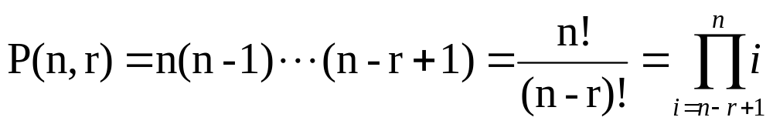
Permutation
How do we construct an r-permutation from a set on n different elements?
1st place
n
2nd place
n -1
3rd place
n -2
r^{th} place
n – r + 1
…
The number of r-permutations of a set S, |S|=n is

Slide 31
Permutation formula proof
There are n ways to choose the first element
  n-1 ways to choose the second
  n-2 ways to choose the third
  …
  n-r+1 ways to choose the r^{th} element
By the product rule, that gives us:
P(n,r) = n(n-1)(n-2)…(n-r+1)

Slide 32
Sample question
How many permutations of
{1, 2, 3, 4, 5, 6, 7, 8 ,9, 0} end with 2?
  Note that the set has 10 elements
The last digit must be 2
  The rest can be in any order
Thus, we want a 9-permutation on the set
  {1, 3, 4, 5, 6, 7, 8 ,9, 0}

Slide 33
Permutations
Problem: How many ways are there for 5 people in a class of 27 students to give presentations?
There are 27 students in a class
  P(27,5) = 27*26*25*24*23 = 9,687,600
  Note that the order they go in does matter in this example!

Slide 34
Permutations
How many ways can be the letters A,M,I,O,D,G rearranged in such a way that the word DOG does not appear?
Strategy:
  Compute the total number of permutations of 6 letters: 6!
  Subtract the number of arrangements in which the word DOG appears
    Consider a permutation of four objects
      Letter A
      Letter M
      Letter I
      word DOG
    4! Arrangements that include the word DOG
There are 6! – 4!=696 arrangements that do not contain the word DOG

Slide 35
Permutation
Def.:An r-permutation with repetition is an ordered arrangement of r elements of some set S in which an element of S may appear more than once
Example:
S={1,2,3,4}
  2,2,2 is an r-permutation with repetition
  2,3,2 is a different 3-permutation with repetition
The number of r-permutations of a set S, |S|=n, is n^{r}

Slide 36
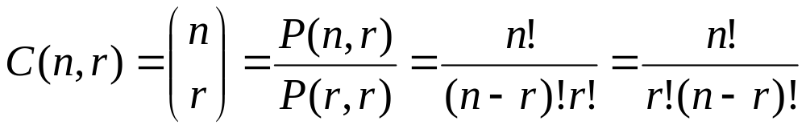
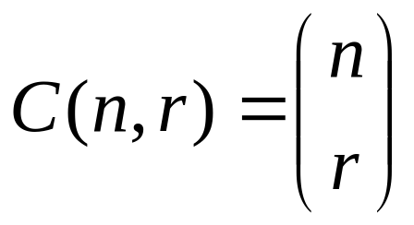
Combinations
Def.: An r-combination of elements of a set S is simply a subset S’⊆S with r members, |S’|=r.
  The order of the elements in an r-combination does not matter
Alternatively, C(n,r) is also denoted as

Slide 37
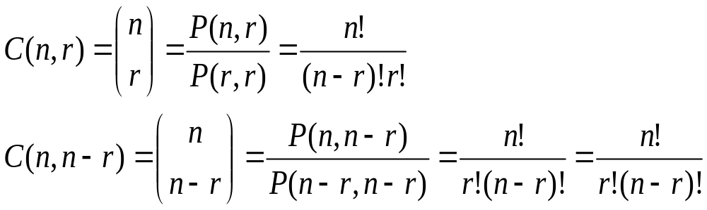
Combinations
Let n,r ∈ N, r ≤ n, observe that
Corollary: Let n and r be nonnegative integers with r ≤ n. Then
C(n, r) = C(n, n – r).

Slide 38
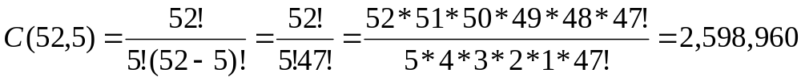
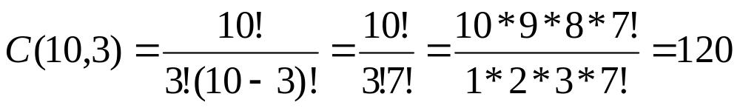
Combinations
Examples
How many different poker hands of 5 cards are there ?
How many groups of three people are there in a class of 10 students?

Slide 39
Combinations
Problem: : In poker, a flush is a hand with five cards of the same suit.
How many different flushes are there ?
Two tasks:
t₁: choose the suit
C(4,1)
t₂: choose the rank
C(13,5)
Applying the product rule:
C(4,1)*C (13,5)· = 1287

Slide 40
Combinations
A committee of three has to be chosen from four math majors and three physics majors, must include at least one math major.
  C(7,3) – C(3,3) = 34
    All the committees of three people minus the committees with no math majors
  C(4,1)*C(3,2) + C(4,2)*C(3,1) + C(4,3) = 34
    Committees with
      1 Math major
      2 Math majors
      3 Math majors

Slide 41
Reading Assignment
Discrete Mathematics and its Applications ,
by Kenneth H. Rosen.
  Chapter 5, Sections 5.1 – 5.3

