Slide 1
Discrete Mathematics
CSCI/MATH 2610
Discrete Probability

Slide 2
Outline
Definition of Probability
  Laplacian
  Frequentist
  Axiomatic
Probability Laws
Conditional Probability
Independence
Bernoulli Trials

Slide 3
Probability
One of the most interesting and (for some) counterintuitive applications of discrete probability is the Monty Hall problem.
There are 3 doors, only one of which has a prize behind it.
After selecting a door, the contestant is shown one of the doors not picked that doesn’t contain a prize.
The contestant can then keep their door, or switch to the other unopened door.
What should the contestant choose?

Slide 4
Probability Theory
Some applications
  Gambling
  Simulation
  Average case complexity analysis
  Decision Analysis
  Risk Assessment

Slide 5
Discrete Probability
Def.: A random experiment is a repeatable procedure that can produce several (more than one) outcomes
Examples:
  Rolling a dice
  Tossing a coin

Slide 6
Discrete Probability
Def.: The sample space S of a random experiment is the set of its possible outcomes.
A sample space S is discrete whenever S is finite or countable infinite
Example:
  Rolling a die
    S={1,2,3,4,5,6}, S is discrete
  Tossing a coin
    S={H,T}, S is discrete
  Rolling two dice
    S={(1,1),(1,2),(1,3),…..,(6,1),(6,2),(6,3),(6,4),(6,5),(6,6)}

Slide 7
Discrete Probability
Def.: An event is a subset of the sample space.
Each of the elements of the sample space S defines an event called a simple event.
Example:
  Rolling a dice
    S={1,2,3,4,5,6}, S is discrete
    {3} is a simple event, {1,2,5} is another event
    Both are mutually excusive
    E₁={odd outcomes}, E₂={even outcomes},
    E₃={multiples of 3 outcomes},
  Tossing a coin
    S={H,T}, S is discrete
    {H} is a simple event, {T} is another simple event

Slide 8
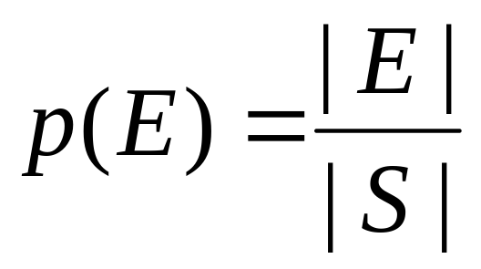
Probability: Laplacian definition
Def.: The probability of an event E of a finite sample space S of equally likely outcomes is
Note:
  0 ≤ |E| ≤ |S|
    0 ≤ p(E) ≤ 1
    An event that will never happen has probability 0
    An event that will always happen has probability 1
    The probability of ∅ is 0.
    p(S) = 1
    If somebody says it has a “100% probability”, this means it has a probability of 1

Slide 9
Probability: Laplacian Definition
Examples
Tossing a die
  E = {3}: P(E) = 1/6
  Let E= {1,3,5}: P(E)=1/2
Tossing two dice
  S={(1,1),(1,2),(1,3),…..,(6,1),(6,2),(6,3),(6,4),(6,5),(6,6)},|S|=36
  Let E={(a,b)∈S| a+b=6}
  = {(1,5),(2,4),(3,3),(4,2),(5,1)}
P(E)=5/36≈0.138888889
What is the probability of getting “snake-eyes” (two 1’s) on two six-sided dice?
  1/6* 1/6 = 1/36

Slide 10
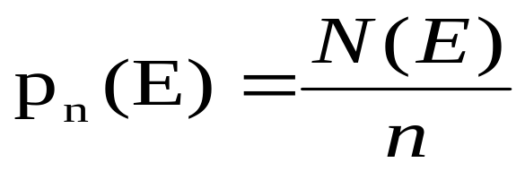
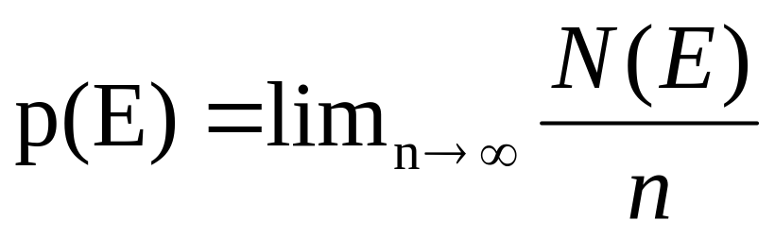
Probability:Frequentist Definition
Def.: Given a sequence of n independent trials of a random experiment. Let N(E) be the number of trials that result in the event E.
pn(E) is an approximation of the true probability p(E)
  empirical probability of E.
p(E) : probability of E is
This is called the frequency definition of probability

Slide 11
Probability: Axiomatic definition
Def.: Let S be a discrete sample space and let p:S→[0,1] be a function such that
∑_{s∈S} p(s) = 1
p is called a probability distribution.
The outcomes of the experiment do not need to be equally likely.
Example:
  Tossing a biased coin:
    p(H)=1/4, p(T)=3/4

Slide 12
Probability: Axiomatic definition
Def.: Let p be a probability distribution on a discrete sample space S. Let E be an event, (E ⊆ S)
p(E) = ∑_{s∈E} p(s)
Example:
  Tossing a biased coin twice:
    S= { (H,H), (H,T), (T,H),(T,T) }
    Let E={ (H,H), (T,T)}
      p(E) = 1/16+9/16=5/8

Slide 13
Uniform Distribution
Def.: Let S be a discrete sample space consisting of n possible outcomes.
The uniform distribution assigns the probability 1/n to each outcome
Corresponds to the Laplacian definition of probability
All the outcomes are equally likely, i.e, have the same probability.

Slide 14
Probability
If we are interested in events that happen in E₁ and E₂ then the event will be E₁ ∩ E₂
p(E1 ∩ E2)
E1
E2

Slide 15
Probability
If we are interested in events that happen in E₁ and E₂ then the event will be E₁ ∩ E₂
Two events E₁ and E₂ are mutually exclusive iff
E₁ ∩E₂ = ∅
p(E1 ∩ E2) = 0
E2
E1

Slide 16
Probability
If you choose a number between 1 and 100, what is the probability that it is divisible by 2 and 5?
  m|n : m divides n
Let n be the number chosen
  p(2|n) and p(5|n) = p(10|n) = 10/100

Slide 17
Probability
Theorem : Let E₁ and E₂ be events in the sample space S. Then
p(E1 ∪ E2)
E1
E2

Slide 18
Probability
If you choose a number between 1 and 100, what is the probability that it is divisible by 2 or 5 or both?
Let n be the number chosen
  p(2|n) = 50/100 (all the even numbers)
  p(5|n) = 20/100
  p(2|n) and p(5|n) = p(10|n) = 10/100
  p(2|n) or p(5|n) = p(2|n) + p(5|n) - p(10|n)
  = 50/100 + 20/100 – 10/100
  = 3/5

Slide 19
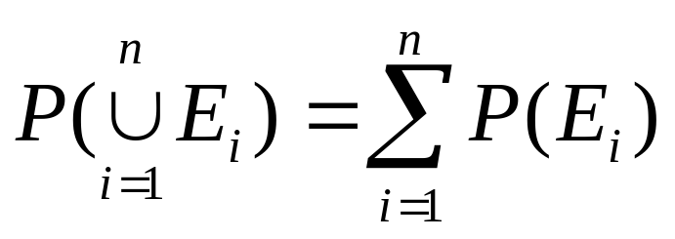
Probability
Theorem : Let E1,…,En be a sequence of pairwise disjoint sets:

Slide 20
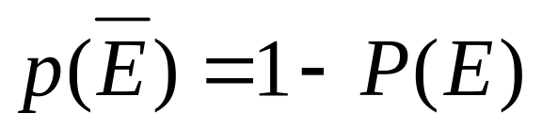
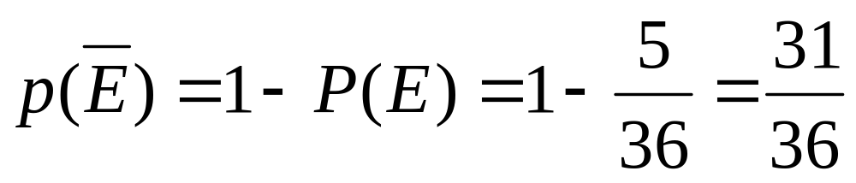
Probability
Theorem : Let E be an event in a sample space S. The probability that the event E does not occur is given by
Example: What is the probability that the sum of two dices is not 6.
E={(a,b)∈S| a+b=6}

Slide 21
Probability
The probability of getting a royal flush is 0.0000015
  The probability of not getting a royal flush is
  1-0.0000015 or 0.9999985
The probability of getting a four of a suit is 0.00024
  The probability of not getting a four of a suit is
  1-0.00024 or 0.99976

Slide 22
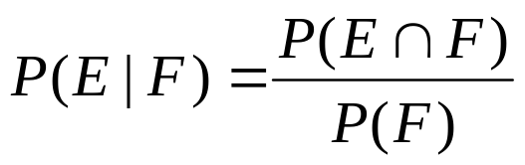
Conditional Probability
Def.: The conditional probability
The P(E|F) is the probability that E occurs when we know that F has occurred
P(F) > 0
E
F

Slide 23
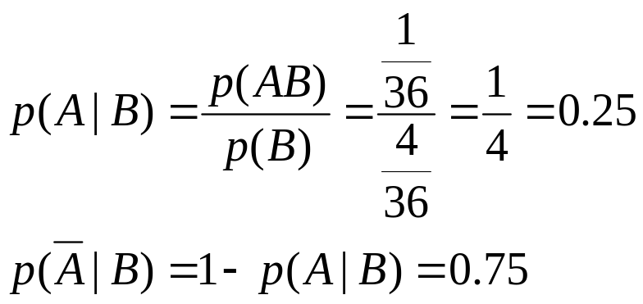
Conditional Probability
Example:
  In an experiment involving two successive rolls of a die, you are told that the sum is 9
  What is the probability that the first is six ?
  What is the probability that the first is not a six?
Solution:
S={(a,b) | 1≤a,b ≤6}
B={ (a,b) ∈ S | a +b =9} = { (4,5),(5,4),(6,3),(3,6) }
A={ (a,b) ∈ S | a = 6 }

Slide 24
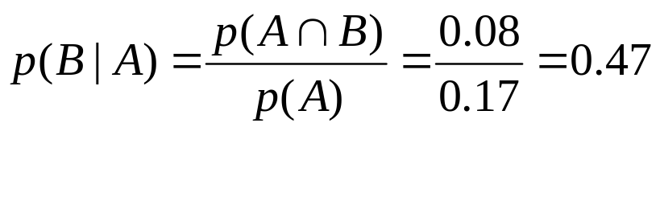
Conditional Probability
Example:
  In a drug trial, 17% of the patients responded positively to treatment A, 34 % responded positively to treatment B and 8% responded positively to both treatments
  What is the probability that a patient responds positively to treatment B if (s)he responds positively to treatment A ?
Solution:
p(A) = 0.17
p(B) = 0.34
p(A∩B)=0.08

Slide 25
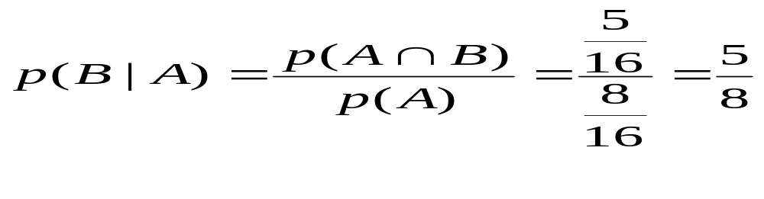
Conditional Probability
Example:
  Consider bit Strings of length 4
  What is the probability that a 4-bit string has 2 consecutive 0’ s given that it starts with 0.
A: Starts with 0
B: The bit string has at least 2 consecutive 0s
A∩B: {0100, 0000, 0010, 0001, 0011}
p(A)= 2³/16 = 8/16
p(A∩B)=5/16

Slide 26
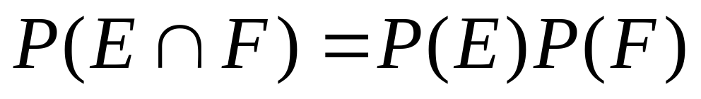
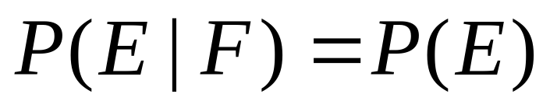
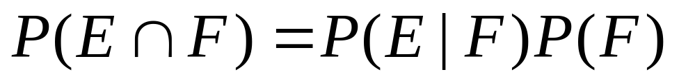
Independence
Def.: Two events E and F are independent iff
This means that the fact that F has occurred does not give us information about the occurrence of E:
If the events E and F are not independent

Slide 27
Independence
Example: Consider an experiment involving two successive rolls of a fair die in which all the 36 combinations are equally likely.
Are the following events independent ?
A₁={1st roll is a 1}, B₃={2nd roll is a 3}
P(A₁)=6/36=1/6 P(B₃)=6/36=1/6
P(A₁∩ B₃)=1/36=1/6*1/6=P(A₁)P(B₃)

Slide 28
Independence
Suppose that we have a box with 4 red balls and 5 blue balls
  We draw two balls:
    What is the probability that the first one is red and the second one is blue?
    Sampling with Replacement: After we draw a ball , we record its color and return the ball to the box
      P(first Red and Second Blue) = 4/9*5/9= 20/81

Slide 29
Bernoulli Trials
A trial with two possible outcomes
  Success
  Failure
The probability of success is p, and the probability of failure is 1 – p
n = the number of trials conducted
The trials are independent; that is, the outcome of one trial does not affect the outcome of other trials.
The probability of exactly k successes in n independent trials is
C(n,k) p^{k} q^{n-k}
This is called the binomial distribution.

Slide 30
Bernoulli Trials
Examples of Bernoulli Trials:
  Number of insurance holders who will claim in a given period.
  Number of loan holders who will default in a certain period.
  Number of faulty items in n items from a production line.

Slide 31
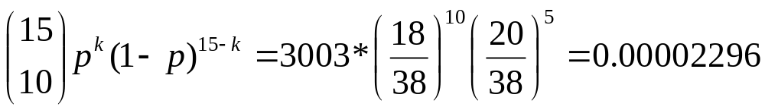
Bernoulli Trials
An American roulette wheel has 38 slots; 18 are red, 18 are black, and 2 are green.
A gambler plays roulette 15 times, betting on red each time.
  Probability of winning on each bet
    p: 18/38
  What is probability of winning exactly 10 times?
.

Slide 32
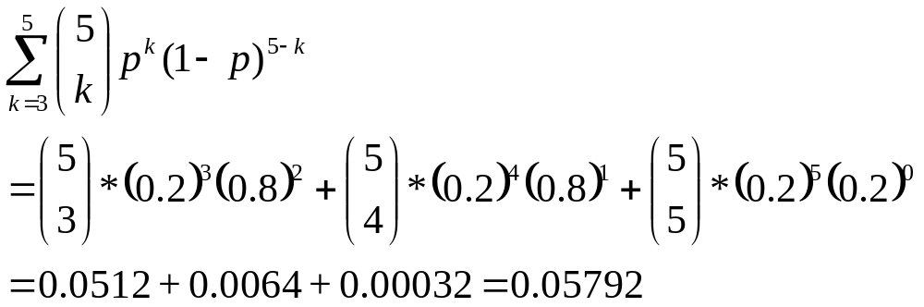
Bernoulli Trials
The probability that a student is accepted to a prestigious university is 0.2. If 5 unrelated students apply, what is the probability that 3 or more are accepted?
  Bernoulli Trials:
    p_{sucess}:0.2, p_{failure}:0.8
  E1: 3 students are accepted
  E2: 4 student are accepted
  E3: 5 students are accepted

Slide 33
Reading Assignment
Discrete Mathematics and its Applications ,
by Kenneth H. Rosen.
  Chapter 6, Section 6.1, 6.2

