Slide 1
Discrete Mathematics
CSCI/MATH 2610
Recursive Definitions and Structural Induction

Slide 2
Outline
Recursion
  Sequences
    Fibonacci Lowest bound
  Functions
  Sets
Structural Induction
Generalized Induction

Slide 3
Recursion
Recursion means defining an object in terms of
  itself
  part of itself
  versions of itself
An object can be
  Sequence
  Function
  Set
  Algorithm
  Fractal
  …

Slide 4


A Game- Von Koch’s Snowflake
Von Koch’s Snowflake
Trisect the sides of an equilateral triangle
Rule: replace the second segment of each straight
line by a clockwise , where the two new segments and the old segment form an equilateral triangle to obtain:
Repeat step 2 as many times as you wish
What will you get ?

Slide 5
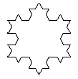
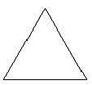

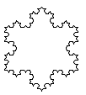
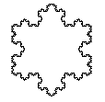
A Game- Von Koch’s Snowflake

Slide 6
Recursion
Recursion means defining an object in terms of
  itself
  part of itself
  versions of itself
An object can be
  Sequence
  Function
  Set
  Algorithm

Slide 7
Recursively Defined Sequence
Def.: A sequence is defined recursively whenever some initial terms are specified and later terms are defined in terms of earlier terms.
  AKA recurrence relation
Examples
Arithmetic Progression
a₀=1, r=3
a_{n}=a_{n-1}+r, n>0
Geometric Progression
a₀=3, r=2
a_{n}=a_{n-1}r, n>0

Slide 8
Recursively Defined Sequence
In a recursively defined sequence:
Basis step or Initial Conditions
  The first defined terms of the sequence
Recursion or Recursive Step
  The n^{th} term is defined in term of previous terms
The formula that express the n^{th} term is called a recurrence formula
Arithmetic Progression:
  Basis: a₀=1, r=3
  Recursion: a_{n}=a_{n-1}+r, n> 0
Geometric Progression:
Basis: a₀=3, r=2
Recursion: a_{n}=a_{n-1}r, n>0
Recurrence Formula

Slide 9
Recursively Defined Sequence
Be sure that the recursive definition of the sequence produces a well-defined sequence, in which all the terms 0,1,2… are properly covered by the definition
Example:
Basis: a₀=1
Recursion: a_{n}=3a_{n-2} - a_{n-1}
What is a₁?

Slide 10
Fibonacci Sequence
Fibonnaci Sequence
Recursive Definition:
Base Cases: f₀=0, f₁=1
Recurrence: fn=f_{n-1}+f_{n-2} n>1
The Fibonacci series is
0,1,1,2,3,5,8,13,21,…

Slide 11
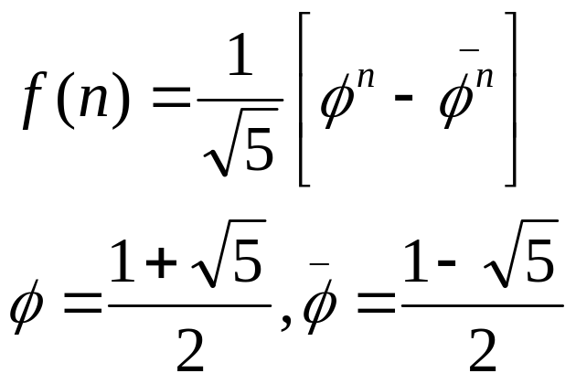
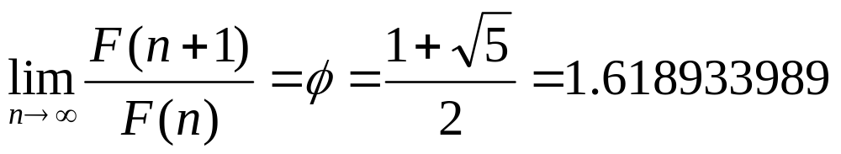
Fibonacci Sequence
Fibonnaci Sequence
Non-recursive Definition
In the limit n→∝, the ratio between successive terms of the Fibonacci sequence approaches Φ (Golden Ratio)

Slide 12
Fibonacci Sequence
Theorem: ∀n≥0 ,f_{n} < 2^{n}
Proof: (By strong induction.)
Base cases:
f₀ = 0 < 2⁰ = 1
f₁ = 1 < 2¹ = 2
Inductive Hypothesis:
Assume ∀ 0 ≤ j ≤k, f_{j} < 2^{j}. where k ≥ 1
Inductive step Proof

Slide 13
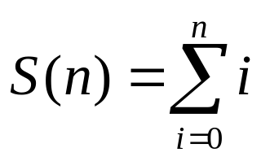
Summations
We can use recursion to express summations
Example:
Expressed Recursively:
Base Case: S(0) = 0
Recursive Rule: S(n) = S(n-1) + n, n > 0

Slide 14
Recursively Defined Functions
A function f(n) with domain N or a subset of N is defined recursively when f(n) is defined in terms of function values f(m) where m<n
Basis: f(0)=1
Recursion:
Define f(n) from f defined at smaller integers
Example
Let f : N -> N defined recursively as
Basis: f(0) = 1
Recursion: f(n) = n*f(n-1).
What are the values of the following?
  f(1)= f(2)= f(3)= f(4)=
What does this function compute?

Slide 15
Recursively Defined Function
Be sure that the recursive definition produced a well-defined function, i.e., every element in the domain has exactly one image under f
Example:
Base: f(1)=1
Recursion: f(n)= 1 + f(⎣n/2⎦ ), n ≥ 1
Is this function correctly defined ?

Slide 16
Recursively Defined Sets
An infinite set S may be defined recursively by giving:
  Basis Step: A finite set of base elements
  Recursive Step: rule for forming new elements in the set from those already in the set
  Exclusion Rule: specifies that the set only contains those elements in the basis or those formed by the recursive Step
Example:
Let S be defined as follows
Basis Step: 1 ∈ S
Recursive Step: if n ∈ S then 2n ∈ S
S={2^{k} | k ∈ N }

Slide 17
Recursively Defined Sets
Example:
Basis Step: 0 ∈ S
Recursive Step:
if n ∈ S then n+3 ∈ S
if n ∈ S then -n ∈ S
Exclusion Rule: No other numbers are in S.
What is S?
Example:
Basis Step: 1 ∈ S
Recursive Step: if n is in S then -n ∈ S
Exclusion Rule: No other numbers are in S
What is S?

Slide 18
Set of Strings
Def.:An alphabet Σ is a non empty set of symbols
Def.: A String over an alphabet Σ is a finite sequence of zero or more symbols from Σ
The set Σ* of strings over Σ can be defined as:
Basis Step: λ ∈ Σ* where λ is the empty string containing no symbols
Recursive Step: if w ∈ Σ* and x ∈ Σ then wx ∈ Σ*

Slide 19
Set of Strings
Let Σ = {0,1}
A string in Σ* is defined as
Basis Step: λ ∈ Σ*
Recursive Step: if w ∈ Σ* and x ∈ Σ then wx ∈ Σ*

Slide 20
Recursive Definitions on Strings
Concatenation
Basis Step: if w ∈ Σ* then w. λ = w, where λ is the empty string containing no symbols.
Recursive Step: if w₁ ∈ Σ*, w₂ ∈ Σ* and x ∈ Σ then
w₁ .(w₂x) = (w₁.w₂)x ∈ Σ*
Note: The parenthesis are used for grouping , they are not symbols of Σ.
The definition shows that concatenation is associative!

Slide 21
Recursive Definitions on Strings
Length
Basis Step: l(λ )=0
Recursive Step: if w ∈ Σ* and x ∈ Σ then l(wx)=l(w) +1
Example:
Σ={a,b}
l(aba)=l((ab)a)=l(ab) + 1 = 2 + 1 = 3
l(ab)=l((a)b)=l(a) + 1 = 1 + 1 =2
l(a)=l((λ)a)=l(λ) + 1 = 0 + 1 = 1
l(λ)=0

Slide 22
Recursive Definitions on Strings
A palindrome is a string that is the same forward and backward
Example
hanah
racecar
Let Σ be an alphabet, i.e., a non empty set of symbols
Give a recursive definition of a palindrome

Slide 23
Recursive Definitions on Strings
Give a recursive definition of a bit string
Base Step:
λ is a bit string
Recursive Step:
if b is a bit string b0 is a bit string
if b is a bit string b1 is a bit string

Slide 24
Why Define Recursively?
Why bother to define sets, functions, or structures recursively, when there are many other ways to define them?
Recursive definitions can greatly simplify the inductive proof process.

Slide 25
Structural Induction
Structural Induction is useful to prove properties about recursively defined objects
Method
1) Basis Step: Show that the property is true for all the basis cases of the recursive definition
2) Inductive Step:
Inductive Hypothesis: Assume that the property is true for the elements used in the recursive rule(s) to construct new elements.
Prove that the property is true for the new elements constructed using the recursive rule

Slide 26
Structural Induction
Let S be defined as follows:
Basis Step: 1 ∈ S
Recursive Step: if n ∈ S then 2n ∈ S
Problem:Show that S is the set of all positive powers of 2
Let A={2^{k} | k ∈ N } , we need to prove A⊆S and S⊆A
Part 1. A⊆S: let n=2^{k}, k ≥0 such that n ∈ A , show that n ∈S
Inductive proof.
Let P(k) : 2^{k}∈S, k ≥0
Base case: k=0, 2⁰=1 ∈S by definition of S.
Inductive step:
Inductive Hypothesis: Assume P(k), i.e. 2^{k}∈S where k ≥0
Consider 2^{k+1} ∈ A, 2^{k+1} =2.2^{k}
By inductive hypothesis, 2^{k} ∈S .
Applying the recursive def. of S, 2.2^{k} ∈S, so 2^{k+1} ∈S,
∴ P(k+1) is true

Slide 27
Structural Induction
Part 2. S⊆A: let n ∈S, show n ∈A.
Structural inductive proof.
Let P(n): n is an element in S implies that n∈A.
Base Case: n=1 (base case)
For n=1 , n=2⁰ therefore n ∈A.
Inductive Step:
Let’s take some n ∈A such n is constructed through the
recursive rule .
i.e., ∃m ∈S such that n=2m
Struct. Inductive Hypothesis: P(m): m is an element in S implies that m∈A.
Recursive rule: if m ∈S then 2m ∈S.
Proof:

Slide 28
Structural Induction
Problem: Let w^{i} represent the concatenation of i copies of w.
Give a recursive definition of w^{i}
Recursive Definition:
Basis Step: if w ∈ Σ* then w⁰=λ
Recursive Step: w^{k+1}=w w^{k}
Problem: prove that l(w^{n})=n.l(w)

Slide 29
Structural Induction
Problem: prove that l(w^{n})=n.l(w)
Proof: (By Structural Induction)
P(i): l(w^{i}) is i*l(w)
1)Basis Step:
l(w⁰) =l(λ)=0=0.l(w)∴ P(0): is true
2)Inductive Step:
Inductive Hypothesis: l(w^{k})=k.l(w)

Slide 30
Totally Ordered Set
Let S be a set of structures . The set S is totally ordered if there is a relation ≤ defined over S such that:
1. a ≤ a ∀a∈S (reflexivity)
2. if a ≤ b and b ≤ a then a = b (antisymmetry)
3. if a ≤ b and b ≤ c then a ≤ c (transitivity)
4. ∀a,b∈S, either a ≤ b or b ≤ a (totalness)

Slide 31
Totally Ordered Set
Example: S = N x N is totally ordered with respect to ≤ defined as follows:
For each pair of tuples in S: (x1,y1), (x2,y2)
  (x1,y1) ≤ (x2,y2) iff either x1< x2 or x1=x2 and y1≤y2.
    (0,0) ≤ (0,1) ≤ (1,0) ≤ (1,1) ≤(1,2) ≤(3.1)
Observe that
  if (x1,y1) ≤ (x2,y2) and (x2,y2) ≤ (x1,y1) then
    x1=x2 and y1=y2.
  if (x1,y1) < (x2,y2) if either x1 < x2 or x1=x2 and y1 < y2
    (1,1) < (1,2), < (1,3)
This order is called the lexicographic order

Slide 32
Well-Ordering Principle
Let S be a set of structures . The set S is totally ordered if there is a relation ≤ defined over S such that:
1. a ≤ a ∀a∈S (reflexivity)
2. if a ≤ b and b ≤ a then a = b (antisymmetry)
3. if a ≤ b and b ≤ c then a ≤ c (transitivity)
4. ∀a,b∈S, either a ≤ b or b ≤ a (totalness)
Well-Ordering Principle:
A totally ordered set S is said to be well ordered iff every nonempty subset has a least element

Slide 33
Generalized Induction
Induction can be generalized for well-ordered sets:
Let S be a well-ordered set.
Let P(x) be a property that we want to prove for every object x in S.
[Base Case] P (x) is true for all the basis cases.
[Inductive Step]
Inductive Hypothesis: Assume P(x) holds ∀ x < y (x ≤ y,x≠y) x,y∈S
Prove that for all y ∈S
∀x < y ( P(x)→P(y) ) is true
Then:
∀x ∈S P(x) is true

Slide 34
Generalized Induction
Example:
  a_{0,0}=0
  a_{0,1}= a_{0,0}+ 1 = 1
  a_{0,2}= a_{0,1}+ 1 = 2
  a_{1,0}= a_{0,0} + 1 = 1
  a_{2,0}= a_{1,0} + 1 = 2
  a_{1,1} = a_{1,0} +1 = 2
  a_{2,1} = a_{1,1} +1 = 3
Problem: Prove that a_{m,n}=m+n where the sequence a_{m,n} is defined as
a_{0,0}=0 and
a_{m-1,n} + 1 if n=0, m>0
a_{m,n}
a_{m,n-1} + 1 if n> 0

Slide 35
Generalized Induction
Proof:
Basis Step: a_{0,0}=0+0=0
Inductive Step:
Inductive Hypothesis: Assume a_{m’,n’}=m’+n’ for (0,0)≤ (m’,n’)<(m,n)
Consider a_{m,n}
Case I: n=0
Case II: n > 0
Problem: Prove that a_{m,n}=m+n where the sequence a_{m,n} is defined as
a_{0,0}=0 and
a_{m-1,n} + 1 if n=0, m>0
a_{m,n}
a_{m,n-1} + 1 if n> 0

Slide 36
Reading Assignment
Discrete Mathematics and its Applications ,
by Kenneth H. Rosen.
  Chapter 4, Sections 4.3

