Slide 1
Discrete Mathematics
CSCI/MATH 2610
Relations

Slide 2

Outline
Definition of Relation
Properties of relations
Equivalence Relations
Relation Composition

Slide 3
Relations
Relationships exist
  the set of activities and the resources to do them
  students and subjects
  the set of pairs of compatible values
  people that we know
  siblinghood
  Less than or equal to

Slide 4



Relations
Def.: Let A and B be sets. A binary relation R is a subset of A × B
Notation: R:A×B, R:A,B
“a is related to b by R” where R is a relation
“a is not related to b by R” where R is a relation

Slide 5
Relations
Example:
  Let A be the cities in the US
  Let B be the states in the US
  a R b : a is a city in state b
    R= {(Athens, GA), (Seattle,WA), (Sacramento,CA),(Philadelphia, PA)
    (Portland, MA), (Portland, OR)
    … }

Slide 6
Relations
A binary relation can be defined between elements in the same set
  Example:
    Let P be people
    a R b : a is the father of b, a and b belong to P
  Example:
    < : the relation defined on the natural numbers as follows:
      R = {(n,m) | n < m}

Slide 7
Relations
Example:
Courses = { CSCI1301, CSCI1302, CSCI2610, CSCI1730}
Students = { Nick, Mary, John, Alice, Ed,Tom}
The relation R : Students × Courses as the set that lists all students s ∈ Students enrolled in class c ∈ Courses
  R = {(Mary, CSCI2610),(Nick, CSCI1301),
  (Mary, CSCI1730),(Tom,CSCI1302),
  (Nick, CSCI2610), (Alice, CSCI1302),
  (Tom,CSCI2610},(Tom,CSCI1730) }
The order in which the pairs appear in R is not significant

Slide 8
Relations
R : Students × Courses
  R = {(Mary, CSCI2610),(Nick, CSCI1301),
  (Mary, CSCI1730),(Tom,CSCI1302),
  (Nick, CSCI2610), (Alice, CSCI1302),
  (Tom,CSCI2610},(Tom,CSCI1730) }
 | CSCI1301 | CSCI1302 | CSCI2610 | CS1730
Nick | X |  | X
Mary |  |  | X | X
John
Alice |  | X
Tom |  | X | X | X

Slide 9
Relations
Nick
CSCI 1301
Mary
CSCI 1302
John
CSCI 2610
Alice
CSCI 1730
Tom

Slide 10
Functions
Def.: A function f:A→B can be represented as a set of ordered pairs
{(a, f(a)) | a ∈A ∧ f(a) ∈B } ⊆ A x B
For every a ∈A, there is only one pair (a,f(a)).
a
b
c
d
1
2
3
4
Not every Relation is a function!
But all functions are relations!!

Slide 11
Complementary Relations
Let R:A,B be any binary relation.
Then, R:A×B, the complement of R, is the binary relation defined by
R = {(a,b) | (a,b)∉R} = (A×B) − R
Example:
< : defined on the natural number as follows:
      < = {(n,m) | n < m }
Then
< = {(a,b) | (a,b)∉<} = {(a,b) | ¬(a < b) } = ≥

Slide 12
Inverse Relations
Any binary relation R:A×B has an inverse relation R⁻¹:B×A, defined by
R⁻¹ = {(b,a) | (a,b)∈R}
Examples
R: Cities → States defined by
c R s ⇔ c is a city in state b, then:
s R⁻¹ c ⇔ b is the state where city c is located
Let < :≡ {(n,m) | n < m, n ∈N ∧ m ∈N}
  <⁻¹ = {(m,n) | n < m} = {(m,n) | m > n} = >.

Slide 13
Relations on a set
Def.: A relation on the set A is a relation from A to A
Example:
A = { 1, 2, 3, 4 }
R = { (a,b) | a divides b } =
{ (1,1), (1,2), (1,3), (1,4), (2,2), (2,4), (3,3), (4,4) }
1
R | 1 | 2 | 3 | 4
1 | X | X | X | X
2 |  | X |  | X
3 |  |  | X
4 |  |  |  | X
2
3
4

Slide 14
Relations on a set
Consider some relations on the set Z
For each pair, identify the relation(s) that it belongs to
(1,1) (1,2) (2,1) (1,-1) (2,2)
R₁ = { (a,b) | a ≤b }
R₂ = { (a,b) | a >b }
R₃ = { (a,b) | a |b }
R₄ = { (a,b) | a =b }
R₅ = { (a,b) | a =b+1 }
R₆ = { (a,b) | a +b ≤ 3 }
R1
X
X
X
R2
X
X
R3
X
X
X
X
R4
X
X
R5
X
R6
X
X
X
X

Slide 15
Relations on a set
How many relations are there on a set of n elements?
A relation R on a set A is a subset of the Cartesian product of A and A
    A x A = {(a,b)| a ∈A ∧ b ∈ A}
The cardinality of A x A is |A x A| = n²
There are 2 ^{n2} possible subsets of the Cartesian product
∴ 2^{n2} possible relations

Slide 16
Relations on a Set: Properties
  Reflexive
  Irreflexive
  Symmetric
  Antisymmetric
  Transitive
  Antitransitive

Slide 17
Reflexivity
A binary relation R on a set A is reflexive iff
  ∀a∈A, aRa.
Examples
  = :≡ {(a,b) | a =b}
  ≤ :≡ {(a,b) | a ≤ b}
  ≥ :≡ {(a,b) | a ≥ b}

Slide 18
Irreflexivity
A binary relation R on a set A is irreflexive iff no element is related to itself
  A relation is irreflexive if its complementary relation R is reflexive.
Examples:
  < :≡ {(a,b) | a <b}
    < is irreflexive, because ≥ is reflexive
  > :≡ {(a,b) | a >b}
    > is irreflexive, because ≤ is reflexive
“irreflexive” does NOT mean “not reflexive”!
  The negation of reflexive would be
    ∃ a aRa

Slide 19
Reflexivity versus irreflexivity
Neither reflexive nor irreflexive: some elements are related to themselves but some aren’t.
Example:
R: {(a,b) | a + b = 0, a∈Z, b∈Z}
Are there elements related to themselves?
Are there elements not related to themselves?

Slide 20
Symmetry
A binary relation R on a set A is symmetric if for all a, b ∈ A whenever (a,b)∈R, this implies (b,a)∈R as well.
  ∀a ∀b (a R b → b R a)
Examples:
  = :≡ {(a,b) | a = b}
  “is married to”
    M :≡ {(a,b) | a, b are people, a is married to b }
  Sibling
    S :≡ {(a,b) | a, b are people, a is sibling of b }
  Sister
    S :≡ {(a,b) | a, b are women, a is sister of b }
    What about:
      S :≡ {(a,b) | a, b are people, a is sister of b } ?
Note: if R is symmetric then R = R⁻¹,
(a,b)∈R ↔ (b,a)∈R.

Slide 21
Asymmetry
A binary relation R on a set A is asymmetric iff
  ∀a≠b, (a,b)∈R → (b,a)∉R
Examples
< :≡ {(a,b) | a < b}
  > :≡ {(a,b) | a > b}
  isFatherOf
“asymmetric” does NOT mean “not symmetric”!

Slide 22
Symmetry versus asymmetry
Neither symmetric nor asymmetric
Example:
  P: people
likes :≡ {(a,b) | a likes b }
    a may like b, b may or may not like a

Slide 23
AntiSymmetry
A binary relation R on A is antisymmetric if for every a,b ∈ A, if (a,b)∈R and (b,a) ∈R then a = b
∀a ∀b (a R b ∧ b R a → a = b)
Examples:
  ≥ :≡ {(a,b) | a ≥ b}
  = :≡ {(a,b) | a = b}

Slide 24
Symmetry versus antisymmetry
Neither symmetric nor antisymmetric
Example:
  | :≡ {(a,b) ∈ ZxZ |a divides b}
  3 divides 6 but 6 does not divide 3 (not symmetric)
  3 divides -3 and -3 divides 3 but 3 ≠ -3
Both symmetric and antisymmetric
  = :≡ {(a,b) | a = b}

Slide 25
Transitivity
A binary relation R on a set A is transitive iff for all a, b, c
(a,b)∈R ∧ (b,c)∈R → (a,c)∈R
Examples
  = :≡ {(a,b) | a = b}
  ≤ :≡ {(a,b) | a ≤b}
  < :≡ {(a,b) | a <b}
  > :≡ {(a,b) | a >b}
  ≥ :≡ {(a,b) | a ≥b}
  isAncestorOf

Slide 26
Transitivity
A binary relation R on a set A is intransitive iff it is not transitive.
  There exist a, b, c ∈ A( aRb ∧ bRc a ∧ aRc)
Examples
  isfatherOf between people
  “is located within 1 mile of” between places

Slide 27
Equivalence Relation
Def.: A relation R on a set A is called an equivalence relation if it is reflexive, symmetric, and transitive.

Slide 28
Equivalence Relation
Show that the relation R on N defined as follows is an equivalence relation
    R :≡ {(a,b) | a + b is even}
Reflexive
Proof:
Symmetric
Proof
Transitive
Proof

Slide 29
Combining relations
Let R₁ and R₂ be two binary relations
We can combine R₁ and R₂ in multiple ways:
  If R₁ and R₂ are binary relations on the same set(s), we can combine R₁ and R₂ using:
    Set operators ∩ ∪ ⊕ ⎯
    Relation “composition”

Slide 30
Combining relations via Set Operators
Consider two relations R₁ and R₂ on the set A={1,2,3,4}
R₁={(1,1),(1,2),(2,2)(2,3),(3,3),(3,4),(4,4)}
R₂={(1,1),(1,3),(2,2),(2,4),(3,3)}
We can combine them as follows:
  R₁ U R₂ = {(1,1),(1,2),(1,3),(2,2),(2,3),(2,4),(3,3) (3,4),(4,4)}
  R₁ ∩ R₂ = {(1,1),(2,2),(3,3),}
  R₁ - R₂ = {(1,2),(2,3),(3,4)}
  R₂ - R₁ = {(1,3),(2,4)}
  R₁ ⊕ R₂ = {(1,2), (1,3), (2,3),(2,4),(3,4), (4,4)}
The result might be the empty set

Slide 31
Combining relations via Set Operators
Consider two relations R₁ and R₂ on the sets A={1,2,3,4} and B={a,b,c}
R₁={(2,a),(3,b),(1,a)(2,b)}
R₂={(1,a),(2,c),(4,a),(3,c)}
We can combine them as follows:
  R₁ U R₂ = {(1,a),(2,a),(2,b),(2,c),(3,b) (3,c),(4,a)}
  R₁ ∩ R₂ = {(1,a)}
  R₁ - R₂ = { (2,a),(3,b),(2,b)}}
  R₂ - R₁ = { (2,c),(4,a),(3,c)}

Slide 32
Combining relations via relational composition
Let R be a relation from A to B, and S be a relation from B to C
  Let a ∈ A, b ∈ B, and c ∈ C
  Let (a,b) ∈ R, and (b,c) ∈ S
  Then the composite of R and S consists of the ordered pairs (a,c)
The composite of R and S is denoted as RoS

Slide 33
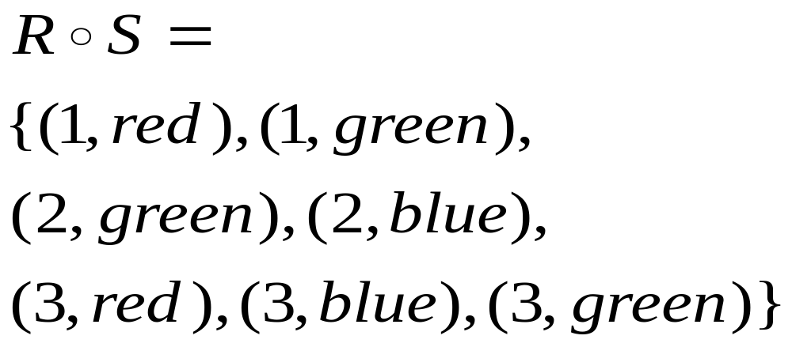
Combining relations via relational composition

Slide 34
Relation Composition
Let M be the relation “is mother of”
Let F be the relation “is father of”
  If (a,b) ∈ F, then a is the father of b
  If (a,b) ∈ M, then a is the mother of b
  Neither M nor F is transitive
What is M ◦ F ?
  M ◦ F denotes the relation “paternal grandmother”
What is F ◦ M ?
  F ◦ M denotes the relation “maternal grandfather”
What is M ◦ M?
  M ◦ M denotes the relation “maternal grandmother” e relation “maternal grandmother”

Slide 35
Reading Assignment
Discrete Mathematics and its Applications ,
by Kenneth H. Rosen.
  Chapter 8, Section 8.1 and 8.5 (Equivalence Relations Introduction)

