Slide 1
Discrete Mathematics
CSCI/MATH 2610
Sequences and Summations

Slide 2
Reading Assignment
Discrete Mathematics and its Applications ,
by Kenneth H. Rosen.
  Chapter 2, Section 2.4

Slide 3
Outline
Sequences
Summations
Countable and Uncountable Sets

Slide 4
Sequences
Def. :A sequence is a function from a subset of integers I to a set S, (I ⊆ Z)
f:I→S
Usually, the domain I is either a set of positive or non-negative consecutive integers.
I= {i ∈ Z | i > 0}
Notation:
Let i ∈I, the image f(i) is denoted as a_{i}, where a_{i} ∈ S
a_{i} is called a term of the sequence
{a_{i}} represents the entire sequence
Note:
If the domain I is finite the sequence is finite, otherwise the sequence is infinite.

Slide 5
Sequences
Examples:
Let the sequence {a_{i}} be defined as:
a_{i}= i + 3:
Terms: a₁, a₂, a₃, …
Sequence {a_{i}}: { 4,5,6,7,8….}
a_{i}=i²:
Terms: a₁, a₂, a₃, …
Sequence {a_{i}}: { 1,4,9,16,25….}
a_{i}=1/i:
Terms: a₁, a₂, a₃, …
Sequence {a_{i}}: { 1,1/2,1/3,1/4,1/5….}

Slide 6
Sequence
Example: Compound Interest
Suppose that we deposit $1000 in the bank, earning 8% a year.
Let’s call the original deposit b₀
At the end of the first year we will earn $80 that are deposited in our account and the balance at the end of the 1st year, b₁ will be $1080
At the end of the second year we will earn $86.40 (0.08*1080) and the balance b₂ will be $1166.40
At the end of the third year, we will earn $93.31 (0.08*1166.40). and the balance b₂ will be $1259.71
….
Observe that at the end of each year i+1, the balance is b_{i}*(1+0.08)
b₀=1000 (represents the initial amount)
r=1.08 (represents the yearly rate)
{b_{i}}={1000,1080,1166.4,1259.71,1360.49,…}

Slide 7
Sequence
Def.:An arithmetic progression is a sequence of the form
a, a + d, a + 2d, a + 3d,…
where a ∈ R is the initial term, and d ∈ R is the common difference,
Observe that if I={i |i ≥ 0 },
  a_{i} ⁼ a + i*d, a₀=a
  a_{i+1} = a_{i} + d
Example:
Let d=3, {a_{n}} such that a=2, d=3
{a_{n}}={2,5,8,11,14,…}

Slide 8
Sequence
Def.: A geometric progression is a sequence of the form
a, ar, ar², ar³,…
where a ∈ R is the initial term, and r ∈ R is the common ratio.
Observe that if I={i |i ≥ 0 },
  The first term a₀=a
  a_{i} ⁼ ar^{i}
  a_{i+1} = a_{i}r
  It grows by a constant factor (exponentially)
Example:
a_{i}=r^{i}, r=3, a=1:
Terms: a₁, a₂, a₃, …
Sequence {a_{i}}: { 1,3,9,27,81….}

Slide 9
Sequences
Examples:
a_{i}=i +3, a=0:
Terms: a₁, a₂, a₃, …
Sequence {a_{i}}: { 3,4,5,6,7,8….}
Grows linearly
a_{i}=r^{i}, r=3, a=1:
Terms: a₁, a₂, a₃, …
Sequence {a_{i}}: { 1,3,9,27,81….}
Grows exponentially

Slide 10
Sequences
Sequences can be neither geometric nor arithmetic
Examples:
  Fibonacci sequence
    F_{i} = F_{i-1} + F_{i-2}, n>2
    where the F₁=1 and F₂=1
    Each term is the sum of the two previous terms
    {F_{i}} : { 1, 1, 2, 3, 5, 8, 13, 21, 34, 55, … }
  a_{i}= i^{n}, n is a positive integer constant
  a_{i}=i!, i ∈ Z⁺

Slide 11
Some Useful Sequences
n² = 1, 4, 9, 16, 25, 36, …
n³ = 1, 8, 27, 64, 125, 216, …
n⁴ = 1, 16, 81, 256, 625, 1296, …
2^{n} = 2, 4, 8, 16, 32, 64, …
3^{n} = 3, 9, 27, 81, 243, 729, …
n! = 1, 2, 6, 24, 120, 720, …

Slide 12
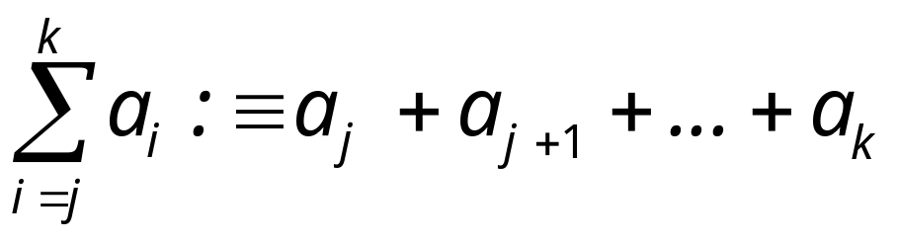
Summations
Let {a_{i}} be a sequence,
Summation
i is called the index of summation
j∈ Z⁺ is the lower bound (or limit)
k ∈ Z⁺, k≥j is the upper bound

Slide 13
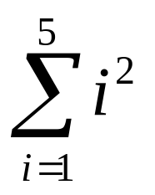
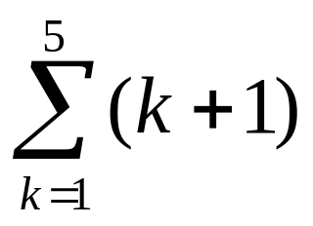
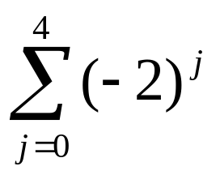
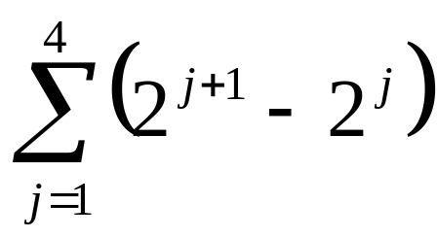
Summations
Example
=1 + 4 + 9 + 16 + 25 =55
=2 + 3 + 4 + 5 + 6 =20
=1 + -2 + 4 + -8 + 16 = 11
=(2² – 2) + (2³ – 2²)+ (2⁴ – 2³)+ (2⁵ – 2⁴)=30

Slide 14
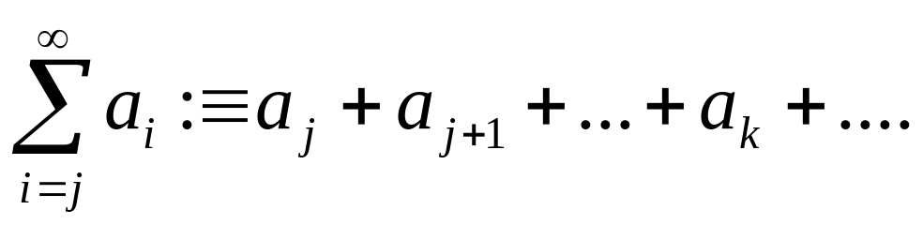
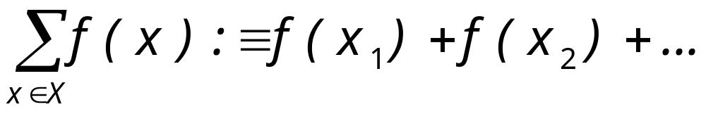
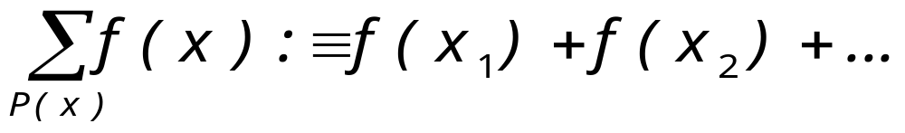
Summations
Let {a_{i}} be an infinite sequence,
Let X={x₁, x₂, …} and f(x) be a function on X
if X={x|P(x)},

Slide 15
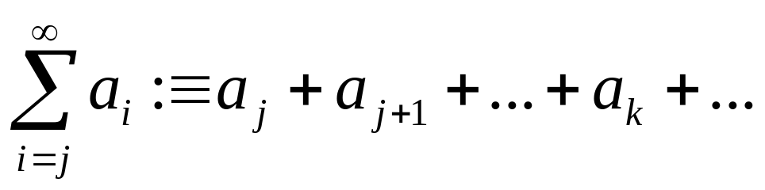
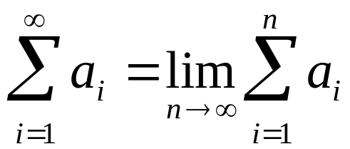
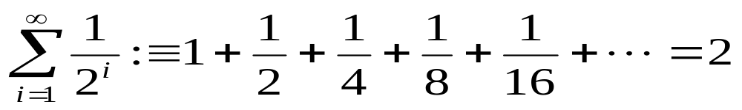
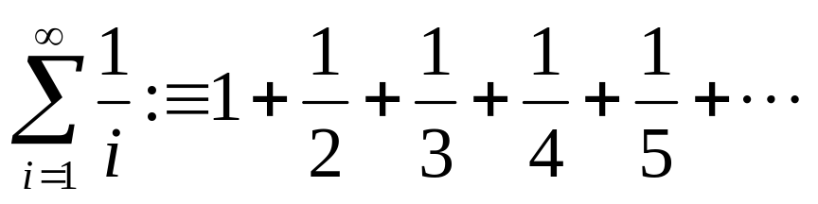
Summations
Let {a_{i}} be an infinite sequence,
The limit is defined as
The limit may or may not converge to a value
Example:
does not converge

Slide 16
Summations
Let X={x₁, x₂, …} and f(x) be a function on X
if X={x|P(x)},

Slide 17
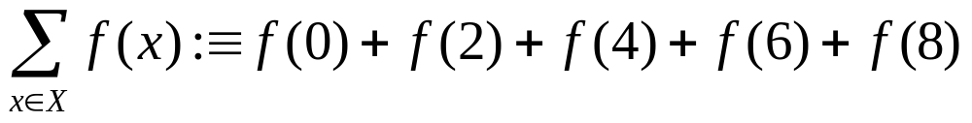
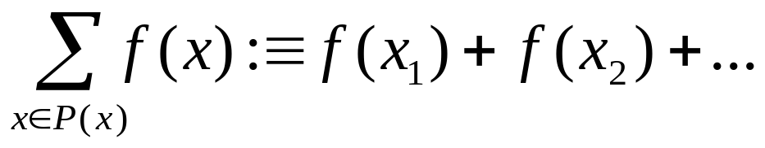
Summations
Examples
X={0,2,4,6,8},
X={x∈Z⁺| X is divisible by 11 and 3}
P(x): x is divisible by 3 and 11

Slide 18
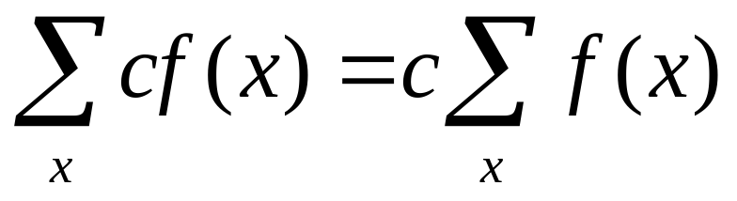
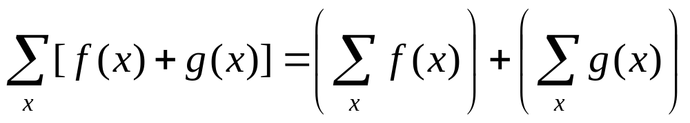
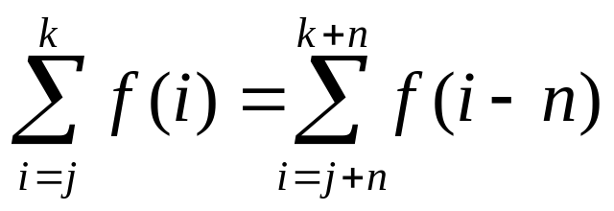
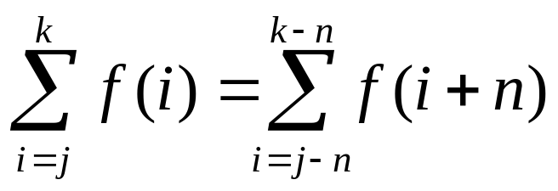
Summations- Properties
Index Shifting

Slide 19
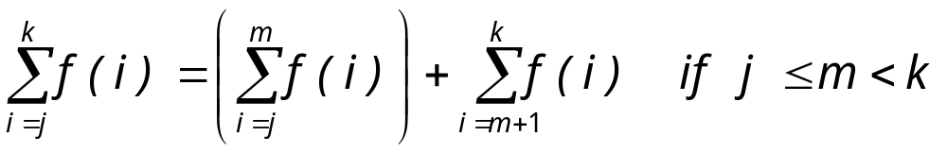
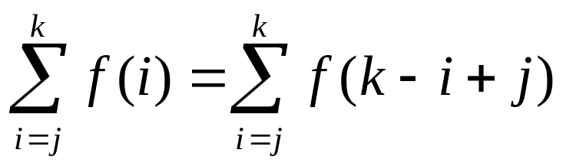
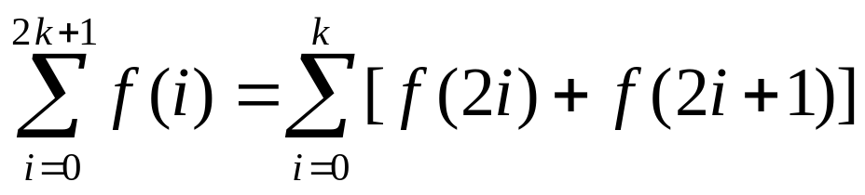
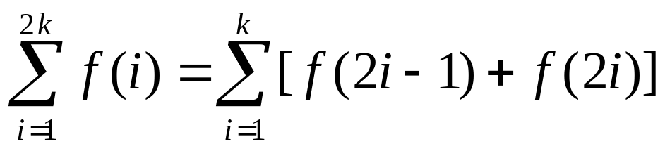
Summations- Properties
Series Splitting
Order Reversal
Grouping

Slide 20
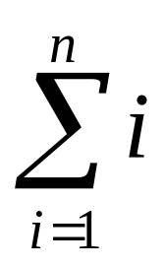
Summations
Theorem:
is
n(n+1)
2
Let’s see why:
S | = | 1 | + | 2 | + | … | + | n
S | = | n | + | n-1 | + | … | + | 1
2S | = | n+1 | + | n+1 | + | … | + | n+1
=n(n+1)
S= n(n+1)
2

Slide 21
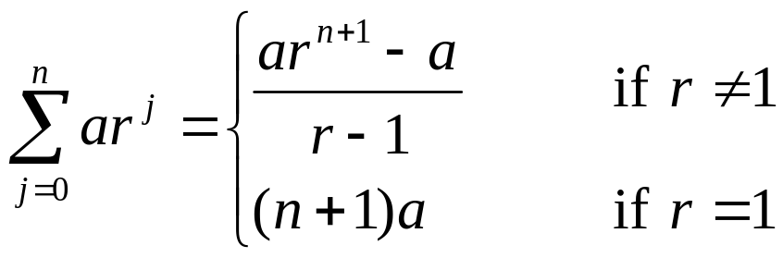
Summations
Theorem: If a and r are real numbers, r≠0, then
Proof:
Case I : r=1
The sum equals (n+1)a (there n+1 terms from 0-n)
Case II : r ≠ 1

Slide 22
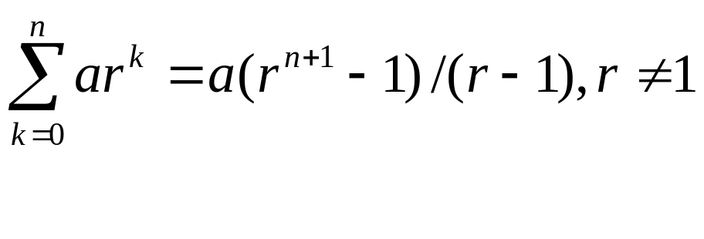
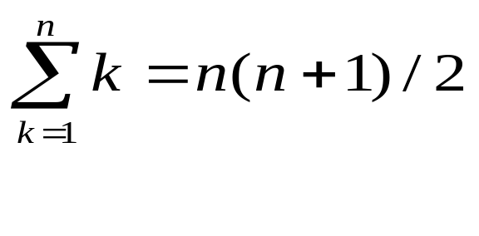
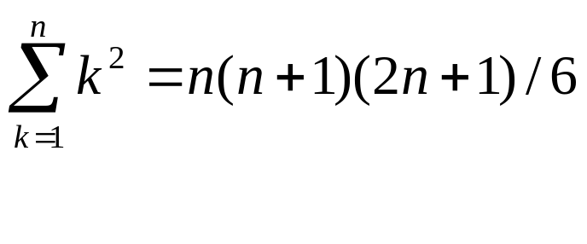
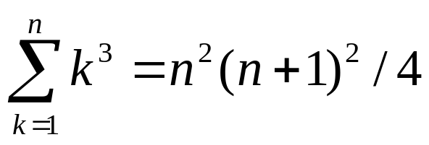
Some Useful Summation Formulae
Geometric series.
Arithmetic series.
Quadratic series.
Cubic series.

Slide 23
Cardinality
Def.: The cardinality of a set is the number of distinct elements in the set. |S | denotes the cardinality of S.
A set S is said to be finite if its cardinality is a nonnegative integer. Otherwise, S is said to be infinite.
Def.:Let A and B be two sets.
A and B have the same cardinality iff there is a one-to-one correspondence (bijection) between A and B

Slide 24
Cardinality
Example
On finite sets
  Let A = { 6, 3, 5, 4, 1 }
  Let B = { a, b, c, d, e }
  There is at least a one-to-one correspondence between the sets
    Observe both sets have the same cardinality.
    We can define a one-to-one and onto function f:A→B, for example:
    f(6)=a, f(3)=b, f(5)=c, f(4)=d, f(1)=e

Slide 25
Cardinality
On Infinite sets
  Z⁺ and E= {x∈Z⁺ | Even(x)} have the same cardinality
  There is a bijection f between the two sets
  f: Z⁺ → E
  f(x) = 2x
  1 ↔ 2 2 ↔ 4 3 ↔ 6 4 ↔ 8
  5 ↔ 10 6 ↔ 12 7 ↔ 14 8 ↔ 16
  f is one-to-one, for all x,y in Z⁺, if x > y then 2x > 2y
  f is onto: let y ∈ E,
    There exists k ∈ Z⁺ , y=2k, f⁻¹(y)=k

Slide 26
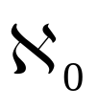
Countable Sets and Uncountable Sets
Def.:A set that is either finite or has the same cardinality as the set of positive integers (or any subset of natural numbers) is called countable; otherwise it is called uncountable.
denotes the cardinality of infinite countable sets
Examples:
Infinite Countable Sets: N, Z⁺, Z⁻,Z
Infinite Uncountable Sets: R, R⁺, R⁻

Slide 27
Countable Sets and Uncountable Sets
How do you demonstrate that an infinite set is countable ?
Theorem:
A infinite set is countable if and only if there is a bijective function f : A → N
An infinite set that is countable is called countably infinite
Corollary: A set is called countable if and only if there exists a list of the elements of the set in which each element appears exactly once

Slide 28
Countable Sets and Uncountable Sets
Theorem:
The set Z is countable.
Proof:
  Consider f : Z→N
2i for i ≥ 0
f( i ) =
-2i - 1 for i < 0
... -4 -3 -2 -1 0 1 2 3 4 …
... 7 5 3 1 0 2 4 6 8 …

Slide 29
Countable Sets and Uncountable Sets
Theorem:
The set Z is countable.
Proof:
  List the integers in increasing order of their absolute value then list the negative value before its corresponding positive value
  0, -1, 1, -2, 2, -3,3,-4, 4,….

Slide 30
Countability
Theorem: The set of all ordered pairs of positive integers (n,m) is countable.
Proof:
  List the pairs in increasing order according to their sum n+m and then by n in increasing order.
  Each pair will appear only once in the sequence
  (1,1) (1,2) (2,1) (2,2) (3,1), (3,2),(3,3)…
Corollary: The set of positive rational numbers is countable.

Slide 31
Countability
1
3
4
10
11
(1,1) | (2,1) | (3,1) | (4,1) | (5,1) | …
(1,2) | (2,2) | (3,2) | (4,2) | (5,2) | …
(1,3) | (2,3) | (3,3) | (4,3) | (5,3) | …
(1,4) | (2,4) | (3,4) | (4,4) | (5,4) | …
(1,5) | (2,5) | (3,5) | (4,5) | (5,5) | …
… | … | … | … | … | …
2
5
9
12
6
8
13
7
14
15

Slide 32
Uncountable sets: R
Theorem: The set of real numbers is uncountable.
We will use the following theorem:
If a subset of a set is not countable, then the set is not countable.
It is enough to prove that there is a subset of R that is not countable
Theorem: The open interval of real numbers
[0,1) :≡ {r∈R| 0 ≤ r < 1} is uncountable.
Proof by diagonalization: (Cantor, 1891)

Slide 33
Reading Assignment
Discrete Mathematics and its Applications ,
by Kenneth H. Rosen.
  Chapter 2, Section 2.4

