Slide 1

Chip-8 Tutorial
Chip-8
Khaled Mustafa

Slide 2
What is a Chip-8?
Before answering that we need to know first, what is an Emulator?

Slide 3
What is an Emulator?
An emulator could be hardware or software (in our case it is software) that mimics or imitates a computer system (called the Host) to be run on a computer (called the Guest) with a completely different architecture
We could say that it is a bridge between two different systems.

Slide 4
Why do we need an emulator?
We can not run programs that was written in Assembly Language for one system on an another system of different architecture.
It enables the Host computer to run programs that was written for the Guest computer.

Slide 5
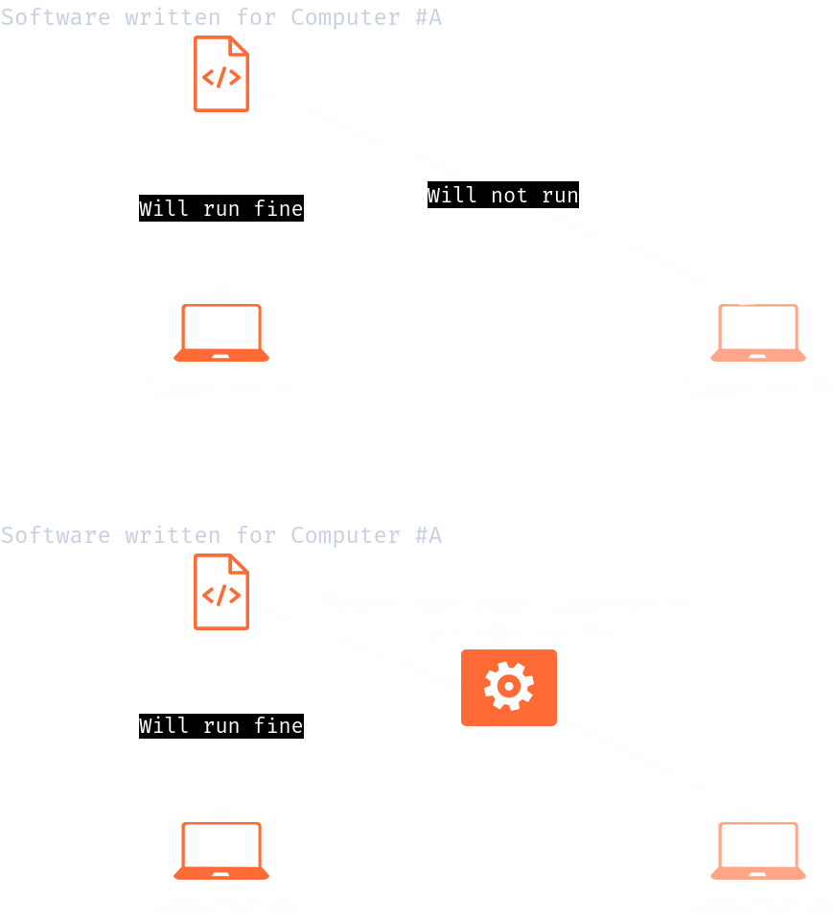
Illustration of an Emulator

Slide 6
Game Console History
Every game console has its own proprietary system architecture.
Games where written for those specific architectures
Developers wanted their games to run on different platforms.
To solve this every console implemented its own “translation layer”.

Slide 7
To sum it up
Chip-8 interpreter would read the instructions line-by-line.
And, for every Chip-8 opcode it would perform the corresponding operation on the Host machine.

Slide 8
Chip-8 specs.
Memory
It had a 4kB (4096B) of memory.
Registers
  It had 15 8-bits general purpose registers + 1 special function register (Carry flag reg.)
  Index register (I need to understand more about this reg.)
  Program Counter reg. (PC) used to point to the next instruction to be executed.

Slide 9
Chip-8 specs. (cont.)
The Stack
  Used to store the return addresses when there is a function call.
  Since, the memory is 4kB, the stack memory width needs to be 16-bits to address all the memory address range.
  When there is a stack, there is a stack pointer (SP)
  The stack is 16 levels.
Notes:
Would it make a difference if we increased the 16 levels stack?
The answer is no, but that would lose the spirit of the Chip-8.

Slide 10
Chip-8 specs. (cont.)
The Stack
  Used to store the return addresses when there is a function call.
  Since, the memory is 4kB, the stack memory width needs to be 16-bits to address all the memory address range.
  When there is a stack, there is a stack pointer (SP)
  The stack is 16 levels.

Slide 11
وَقُلْ رَبِّ زِدْنِي عِلْمًا

