Slide 1
Khaled Rashed
HR Attrition: Insights & Recommendations ·
BI Developer | Data Analytics & Power BI

Slide 2
HR Attrition: Insights & Recommendations
Why 1 in 6 employees leave, and what to do about it
1,470
35
237
1,233
Employees
Columns
Leavers
Active
One row per employee
In the raw HR file
Attrition = Yes (16.12%)
Attrition = No

Slide 3
Objective
Section 1
Section 2
What I built and how
Dashboard and business questions
Excel converted to CSV
Logical schema, then the SQL warehouse
ELT pipeline: raw and DWH schemas
Power BI on DirectQuery, with DAX measures
Page 1: Workforce & Attrition Overview
Page 2: Employee Retention & Attrition Drivers
Four business questions, each answered by its chart
HR Attrition Dashboard · Objective

Slide 4
What I built and how
Section 1
From Excel and CSV to SQL Server ELT, the star schema and Power BI

Slide 5
Step 1: Excel converted to CSV
Source file: DATA_OF_HR_Attrition.xlsx, saved as DATA_OF_HR_Attrition_csv.csv
1,470 rows and 35 columns, ready for a SQL Server bulk insert
First rows of the CSV file:
EmployeeNumber | Age | Attrition | Department | JobRole | MonthlyIncome
1 | 41 | Yes | Sales | Sales Executive | 5993
2 | 49 | No | Research & Development | Research Scientist | 5130
4 | 37 | Yes | Research & Development | Laboratory Technician | 2090
5 | 33 | No | Research & Development | Research Scientist | 2909
Section 1 · What I built and how

Slide 6
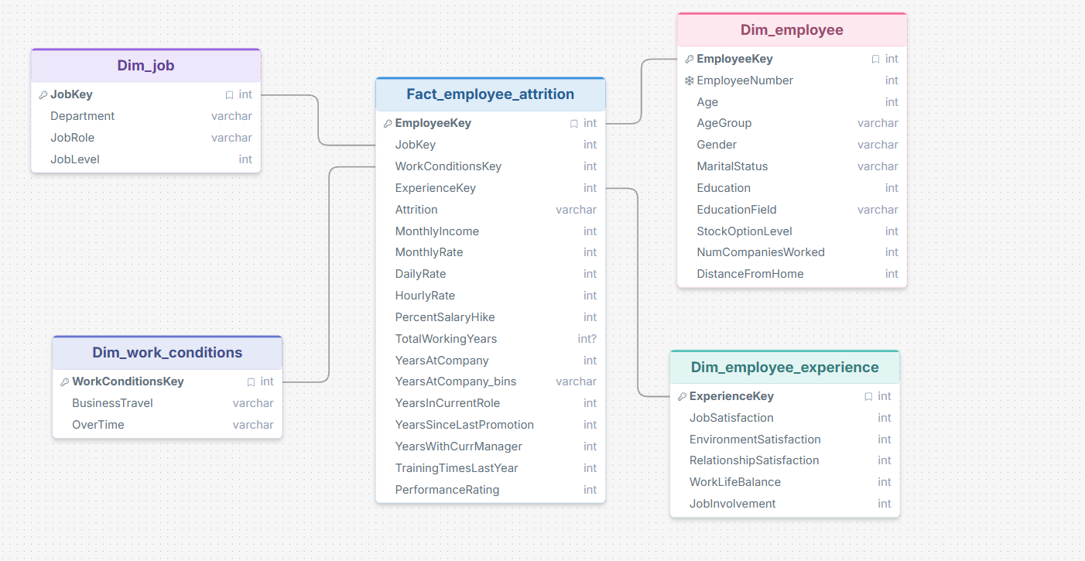
Step 2: Logical schema
One fact table and four dimensions
Grain: one row per employee
Surrogate key on every dimension
Designed in DrawSQL before any SQL was written
Section 1 · What I built and how · drawsql.app/teams/khaled-rashed/diagrams/attrition

Slide 7
Step 3: Raw layer in SQL Server
Database, two schemas and the raw table
Bulk insert from the CSV file
create database HR_Attrition;
use HR_Attrition;
create schema Attrition_Raw;
create schema Attrition_DWH;
create table Attrition_Raw.EmployeeAttritionRaw
( Age int,
Attrition varchar(50),
BusinessTravel varchar(50),
Department varchar(50),
JobRole varchar(50),
MonthlyIncome int,
OverTime varchar(20),
... -- 35 columns in total
);
bulk insert Attrition_Raw.EmployeeAttritionRaw
from '...\DATA_OF_HR_Attrition_csv.csv'
with (
format = 'CSV',
firstrow = 2,
codepage = '65001',
rowterminator = '0x0a'
);
-- make sure the whole data was added
select * from
Attrition_Raw.EmployeeAttritionRaw;
Section 1 · What I built and how

Slide 8
Step 4: ELT pipeline entirely in SQL
CSV file
→
Attrition_Raw
→
Attrition_DWH
→
Power BI
Converted from Excel
Bulk insert, raw copy
Dimensions, fact, cleaning, bins
DirectQuery and DAX
Why ELT
Why no staging layer
Data is loaded first, then every transformation runs inside SQL Server.
The grain is already one row per employee, so the raw table feeds the warehouse directly.
Section 1 · What I built and how

Slide 9
Step 5: Validation checks on the raw data
Nulls in key columns
Invalid values and duplicate employees
select
sum(case when EmployeeNumber is null
then 1 else 0 end) as NullEmpNo,
sum(case when Age is null
then 1 else 0 end) as NullAge,
sum(case when Attrition is null
then 1 else 0 end) as NullAttr,
sum(case when Department is null
then 1 else 0 end) as NullDept
from Attrition_Raw.EmployeeAttritionRaw;
select * from
Attrition_Raw.EmployeeAttritionRaw
where Age <= 0 or MonthlyIncome < 0
or YearsAtCompany < 0
or Attrition not in ('Yes', 'No');
select EmployeeNumber, count(*)
from Attrition_Raw.EmployeeAttritionRaw
group by EmployeeNumber
having count(*) > 1;
Section 1 · What I built and how

Slide 10
Step 6: Warehouse DDL, the physical star schema
Dimension example: Dim_job
Fact table with keys and constraints
create table Attrition_DWH.Dim_job
(
JobKey int identity(1,1) primary key,
Department varchar(50) not null,
JobRole varchar(50) not null,
JobLevel int not null,
constraint CO_DimJob unique
(Department, JobRole, JobLevel)
);
-- same pattern for Dim_employee,
-- Dim_work_conditions and
-- Dim_employee_experience
create table Attrition_DWH.Fact_employee_attrition
(
EmployeeKey int not null primary key,
JobKey int not null,
WorkConditionsKey int not null,
ExperienceKey int not null,
Attrition varchar(10),
MonthlyIncome int,
YearsAtCompany_Bins varchar(20),
... -- other measures
constraint FK_Fact_Job foreign key (JobKey)
references Attrition_DWH.Dim_job(JobKey),
... -- 3 more foreign keys
constraint CK_Fact_Attrition check
(Attrition in ('Yes', 'No'))
);
Section 1 · What I built and how

Slide 11
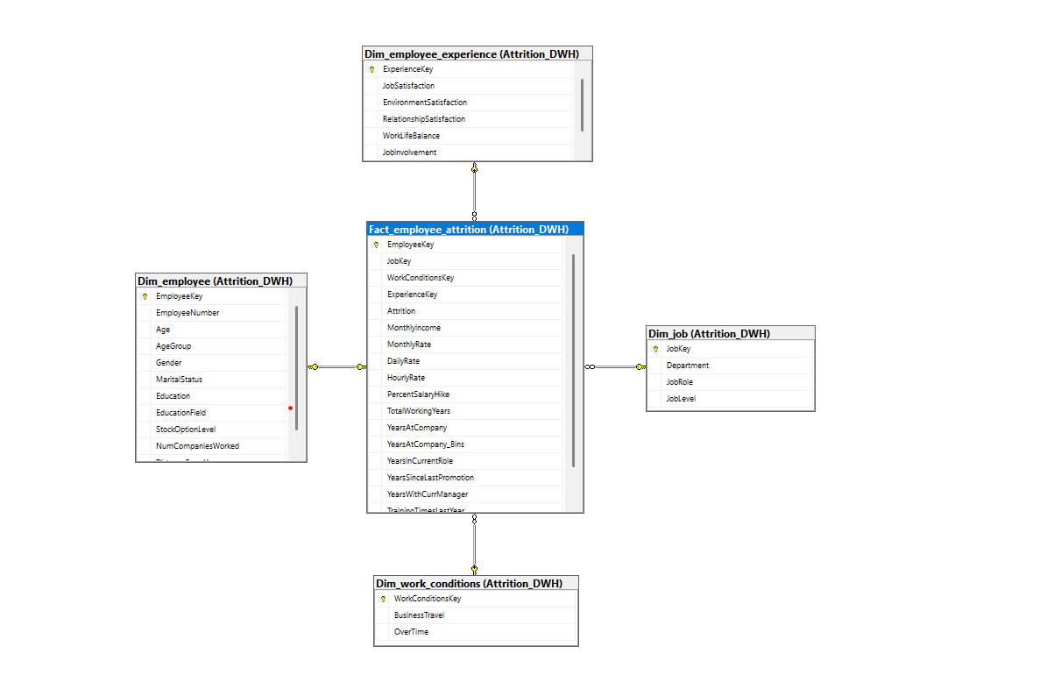
Step 7: Physical schema in SQL Server
Database diagram of Attrition_DWH
Fact_employee_attrition joined to four dimensions
Foreign keys enforce the one-to-many links
Section 1 · What I built and how

Slide 12
Step 8: ETL load from raw to warehouse
Dim_employee with derived AgeGroup
Fact table with key lookups and bins
insert into Attrition_DWH.Dim_employee (...)
select r.EmployeeNumber, r.Age,
case when r.Age < 25 then '<25'
when r.Age between 25 and 34
then '25-34'
...
else 'Unknown' end as AgeGroup,
r.Gender, r.MaritalStatus, ...
from Attrition_Raw.EmployeeAttritionRaw r
where not exists (select 1
from Attrition_DWH.Dim_employee e
where e.EmployeeNumber = r.EmployeeNumber);
insert into Attrition_DWH.Fact_employee_attrition
select e.EmployeeKey, j.JobKey,
w.WorkConditionsKey, x.ExperienceKey,
r.Attrition, r.MonthlyIncome, ...
case when r.YearsAtCompany between 0 and 4
then '0-4'
when r.YearsAtCompany between 5 and 9
then '5-9'
... end as YearsAtCompany_Bins
from Attrition_Raw.EmployeeAttritionRaw r
join Attrition_DWH.Dim_employee e
on r.EmployeeNumber = e.EmployeeNumber
join Attrition_DWH.Dim_job j
on r.Department = j.Department ...
where not exists (...);
Section 1 · What I built and how

Slide 13
Step 9: Reconciliation and the incremental load procedure
Raw vs warehouse reconciliation
Stored procedure for new data
select
(select count(*) from
Attrition_Raw.EmployeeAttritionRaw) as RawRows,
(select count(*) from
Attrition_DWH.Dim_employee) as DimEmployees,
(select count(*) from
Attrition_DWH.Fact_employee_attrition)
as FactRows;
select 'Raw' as DataSource, Attrition,
count(*) as EmployeeCount
from Attrition_Raw.EmployeeAttritionRaw
group by Attrition
union all
select 'DWH', Attrition, count(*) ...
create procedure
Attrition_DWH.sp_Incremental_Load
as
begin
set nocount on;
begin try
begin transaction;
-- load Dim_employee
-- load Dim_job
-- load Dim_work_conditions
-- load Dim_employee_experience
-- load Fact_employee_attrition
-- each insert uses "not exists",
-- so only new rows are added
...
Section 1 · What I built and how

Slide 14
Step 10: SQL case-study question
Department | Attrition_Count
Research & Development | 133
Sales | 92
Human Resources | 12
Attrition count by department, highest first
select
Department,
count(*) as Attrition_Count
from HR_Attrition.Attrition_Raw.EmployeeAttritionRaw
where Attrition = 'Yes'
group by Department
order by Attrition_Count desc;
These are departure counts, not attrition rates.
Section 1 · What I built and how

Slide 15
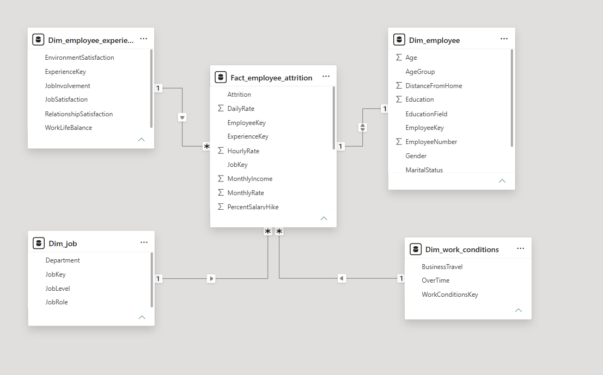
Step 11: Power BI connected with DirectQuery
DirectQuery mode, not Import
Queries run live on the SQL Server warehouse
One-to-many relationships from each dimension to the fact
Section 1 · What I built and how

Slide 16
Step 12: DAX measures
Core measures
Gap vs company (percentage points)
Total Employees =
COUNTROWS(Fact_employee_attrition)
Attrition Number =
CALCULATE([Total Employees],
Fact_employee_attrition[Attrition] = "Yes")
Active Employees =
CALCULATE([Total Employees],
Fact_employee_attrition[Attrition] = "No")
Attrition Rate =
DIVIDE([Attrition Number], [Total Employees], 0)
Average Monthly Income =
AVERAGE(Fact_employee_attrition[MonthlyIncome])
Attrition Rate Department VS Company =
VAR CompanyRate =
CALCULATE([Attrition Rate],
REMOVEFILTERS(Dim_job))
RETURN
[Attrition Rate] - CompanyRate
Section 1 · What I built and how

Slide 17
Dashboard and business questions
Section 2
The two report pages, and each question answered by its chart

Slide 18
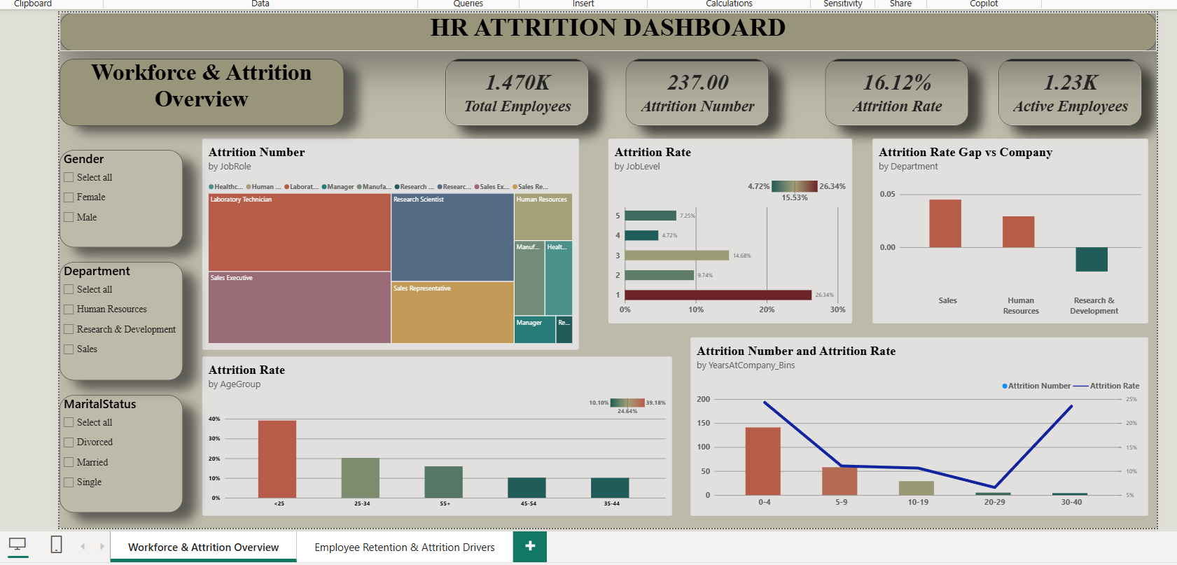
Dashboard page 1: Workforce & Attrition Overview
Section 2 · Dashboard and business questions

Slide 19
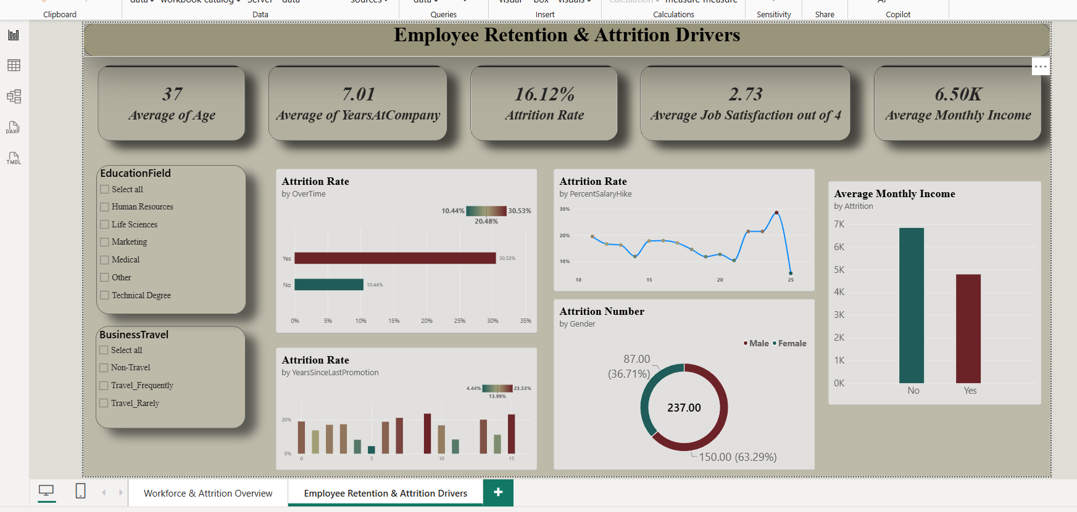
Dashboard page 2: Employee Retention & Attrition Drivers
Section 2 · Dashboard and business questions

Slide 20
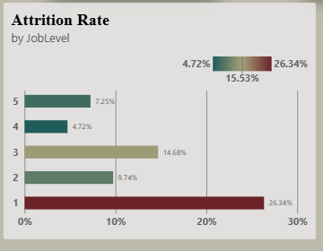
Question 1: Job level
Business question
Which job level has the highest attrition rate?
Answer
Job Level 1: 26.34% against the 16.12% company rate, 10.22 pp above. Level 4 is lowest at 4.72%.
Recommended action
Review entry-level onboarding, manager support and progression.
Section 2 · Dashboard and business questions

Slide 21
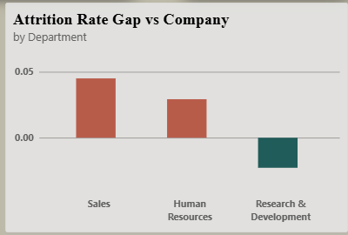
Question 2: Department
Business question
Which department has the highest relative attrition?
Answer
Sales: 20.63%. R&D has more departures (133) but a lower rate; HR is also above the company rate.
Recommended action
Compare rates and headcounts together before prioritizing.
Section 2 · Dashboard and business questions

Slide 22
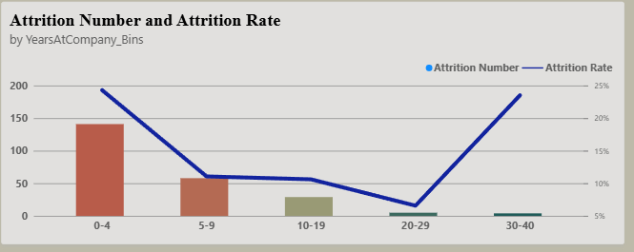
Question 3: Tenure
Business question
When do most employees leave?
Answer
0-4 years: 141 departures from 580 employees (24.31%), 59.5% of all leavers. The 30-40 band has only 17 people, so ignore its high rate.
Recommended action
Focus on the early-tenure employee experience.
Section 2 · Dashboard and business questions

Slide 23
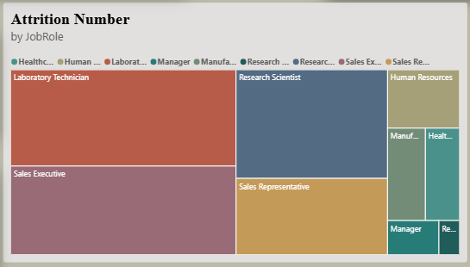
Question 4: Job role
Business question
Which job roles contribute most to departures?
Answer
Laboratory Technician and Sales Executive have the highest departure volumes. Volume also reflects how large each role is.
Recommended action
Review large-volume roles alongside their attrition rates.
Section 2 · Dashboard and business questions

Slide 24
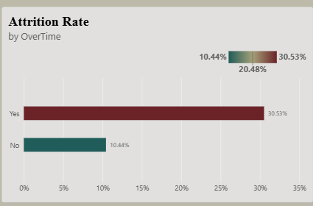
Question 5: Overtime
Business question
How is overtime associated with attrition?
Answer
Overtime Yes: 30.53% against No: 10.44%, a gap of 20.09 pp. This is an association, not proof of cause.
Recommended action
Investigate workload and scheduling within comparable roles.
Section 2 · Dashboard and business questions

Slide 25
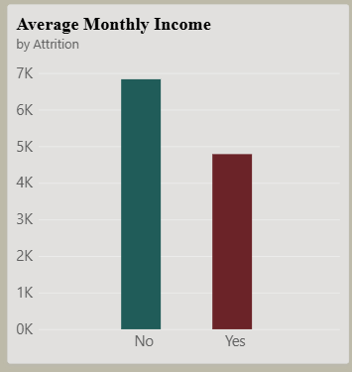
Question 6: Income
Business question
Do leavers earn the same as active employees?
Answer
No. In the dashboard, leavers average about 4.8K a month against about 6.8K for active employees.
Recommended action
Assess pay within job levels; do not infer causation.
Section 2 · Dashboard and business questions

Slide 26
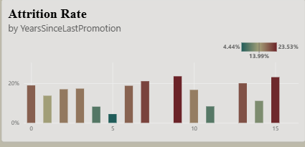
Question 7: Promotion
Business question
Does time since promotion relate to attrition?
Answer
Rates range from 4.44% to 23.53% by years since last promotion, and the pattern is not steady. Small groups can swing.
Recommended action
Review progression paths and group sizes.
Section 2 · Dashboard and business questions

Slide 27
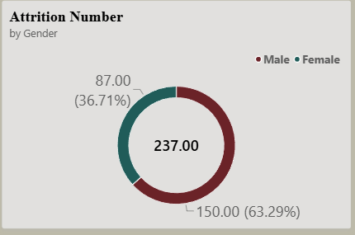
Question 8: Gender
Business question
What is the gender composition of leavers?
Answer
150 male (63.29%) and 87 female (36.71%) of the 237 leavers.
Recommended action
This is composition, not gender-specific risk; compare rates before concluding.
Section 2 · Dashboard and business questions

Slide 28
Outliers: two high-risk segments
Overtime: 30.53% against 10.44%
Job Level 1: 26.34% against 16.12% overall
These are unusually high observed rates, not formally tested statistical outliers or proof of cause. Next: investigate workload and entry-level retention.
HR Attrition Dashboard · Outliers

Slide 29
Four recommendations
Action | Target group | Evidence
Cap and rebalance overtime; add hiring or shift cover | Overtime workers | 30.53% vs 10.44% attrition
Onboarding, mentoring and a first-year career path | Under 25, Level 1, first 4 years | 39.18% and 26.34% attrition
Review pay bands and promotion cycles | Low earners, long gaps since promotion | Leavers earn well below stayers
Retention plans with department owners | Sales and HR | Above company rate
HR Attrition Dashboard · Recommendations

Slide 30
Next steps
First 30 days: confirm overtime and pay findings with HR and managers
60 days: pilot overtime limits and onboarding in Sales
90 days: review the dashboard against the 16.12% baseline and set a target of [__%]
Thank you · Questions

