Slide 1


PortOps Data Mart
and Power BI Analytics
Assessment walkthrough: SQL Server dimensional model, SSIS ETL, and DP World dashboard
Generated from repository contents

Slide 2
Executive Summary
What was built
Data Pipeline
Warehouse Model
- Excel source workbook ingested through SSIS
- Bronze -> Silver -> Gold medallion flow
- SQL Server star schema for analytics
- 5 dimensions and 3 fact tables
History Handling
BI Outcome
- Manual customer SCD Type 2
- Type 1 dimensions for terminal, equipment, shift
- Power BI model connected to Gold layer
- Operations, gate, customer, and vessel pages
The solution emphasizes traceability, surrogate-keyed facts, retained invalid records, and report-ready measures.

Slide 3
Repository Scope
What is included
The project is split into a data-mart implementation and a Power BI report package.
Part 1 - Data Mart
Part 2 - Power BI
- SQL DDL for bronze, silver, gold, audit, and dq schemas
- Silver delta stored procedures with validation and row_hash change detection
- SSIS solution with master, ingestion, silver, dimensions, SCD2, and fact packages
- Screenshots documenting package workflows
- DPWorld.pbix report file
- Branded assets and dashboard backgrounds
- Screenshots for home, operations, gate performance, customer/vessel performance, and data model
- Measures for moves, crane cycle, berth delay, truck turnaround, and rolling averages

Slide 4
End-to-End Architecture
Excel to dashboard
Excel Source
Bronze
Silver
Gold
Power BI
Full workbook extract from operational sheets
->
Raw landing tables with ingest metadata
->
Typed, cleaned, validated tables loaded in delta mode
->
Surrogate-keyed dimensional star schema
->
Report connects to Gold layer only
Design reason: each layer has a narrow responsibility, which makes reruns, debugging, audit review, and BI modeling easier.

Slide 5
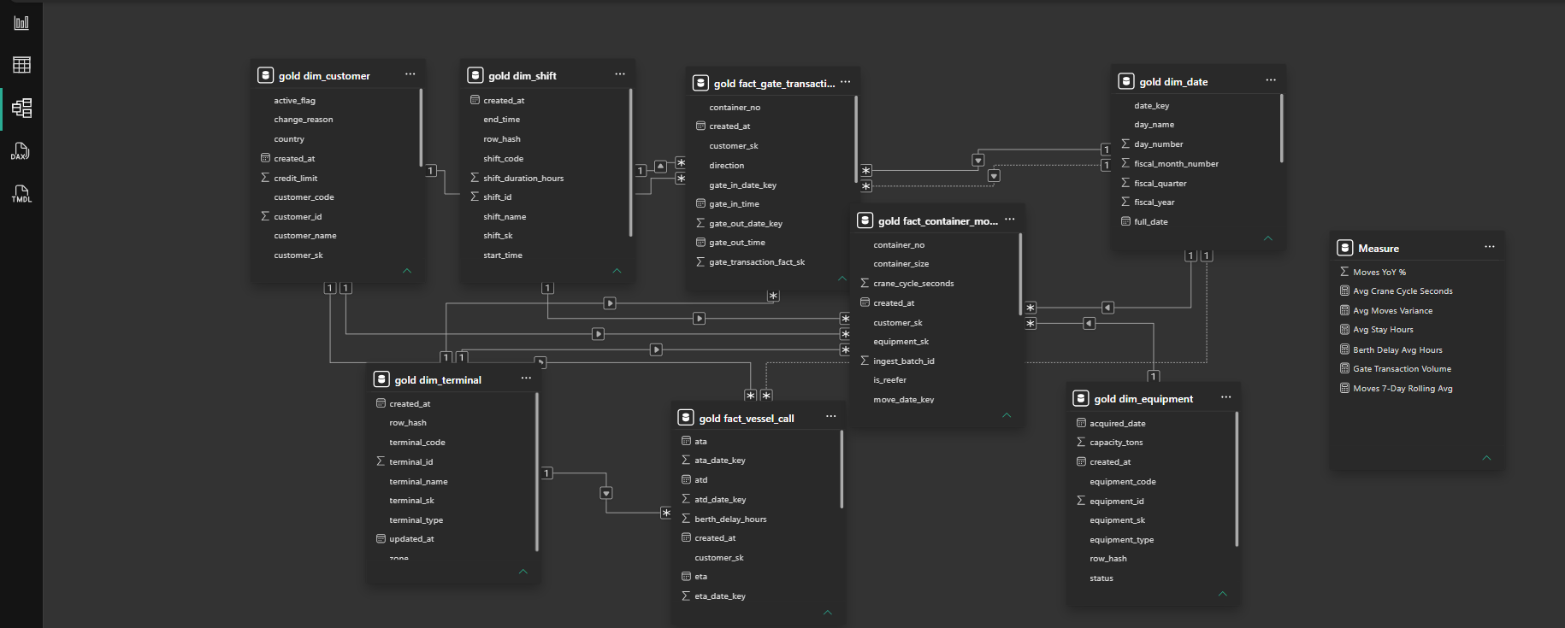
Gold Star Schema
Business-facing model
Dimensions
- gold.dim_date
- gold.dim_customer
- gold.dim_terminal
- gold.dim_equipment
- gold.dim_shift
Facts
- gold.fact_vessel_call
- gold.fact_container_movement
- gold.fact_gate_transaction
All facts resolve dimensions through surrogate keys.

Slide 6
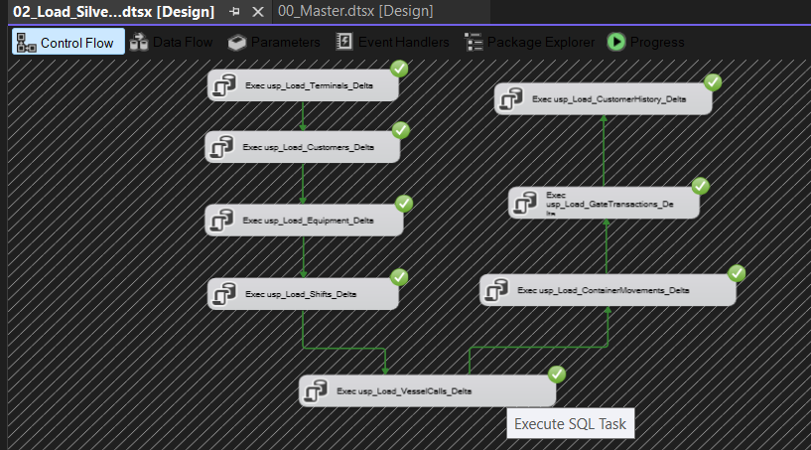
Silver Delta and Validation
Set-based cleaning
Stored procedure pattern
- Read only the current ingest_batch_id from Bronze
- TRIM, TRY_CAST, derive metrics, and validate rules
- Calculate SHA2_256 row_hash for change detection
- MERGE into Silver: insert new, update changed, ignore unchanged
- Retain invalid rows with is_valid = 0 and validation_message
Validation examples: missing business keys, invalid dates, negative weights, end time before start, invalid gate direction.

Slide 7
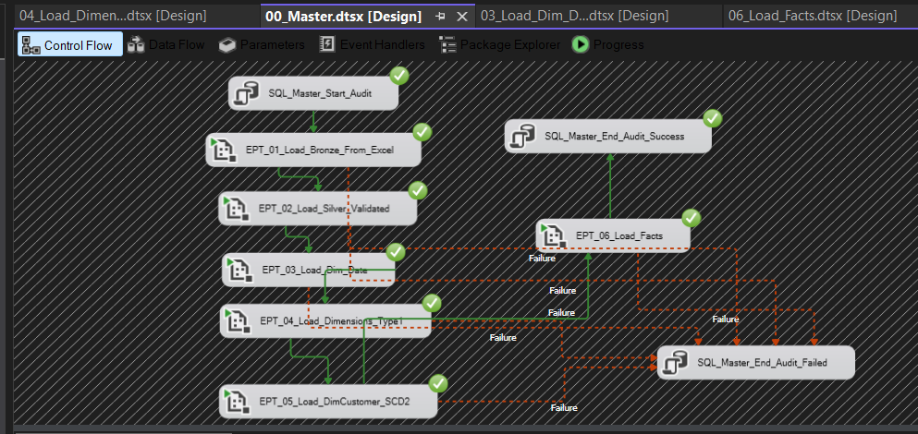
SSIS Orchestration
Package flow
Documented execution order
1. 01_Load_Bronze_From_Excel.dtsx
2. 02_Load_Silver_Validated.dtsx
3. 03_Load_Dim_Date.dtsx
4. 04_Load_Dimensions_Type1.dtsx
5. 05_Load_DimCustomer_SCD2.dtsx
6. 06_Load_Facts.dtsx
The master workflow includes start/end audit tasks and failure paths into failed audit handling.

Slide 8
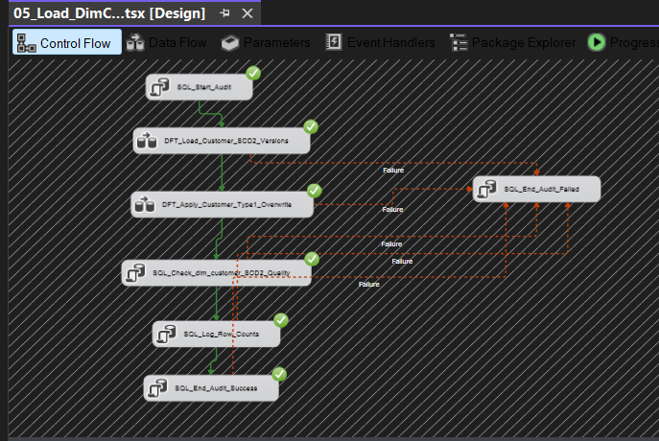
Dimension Strategy
Type 1 and customer SCD2
Type 1 dimensions
Terminal, equipment, and shift overwrite changed descriptive attributes using row_hash comparison.
Customer SCD Type 2
customer_tier and credit_limit create historical versions; current customer attributes are Type 1 overwritten across versions.
Unknown rows use surrogate key -1 to keep facts loadable when a referenced dimension is missing or late-arriving.

Slide 9
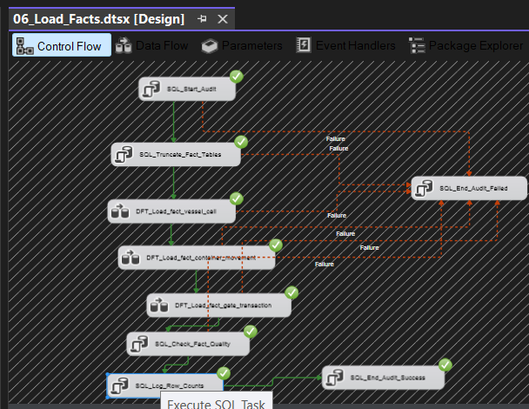
Fact Loading and Metrics
Grain and measures
Vessel Call
- Grain: one row per vessel call
- Measures: berth delay, stay hours, moves variance
- Customer SCD date: ATA, fallback ETA
Container Movement
- Grain: one row per move
- Measures: crane cycle seconds, weight tons
- Customer SCD date: move_start_time
Gate Transaction
- Grain: one row per truck gate transaction
- Measures: truck turnaround minutes
- Date keys: gate in active, gate out inactive
Facts use a controlled full refresh, suitable for the assessment workbook extract. Incremental loading is the production extension.

Slide 10
Audit and Data Quality
Traceability
Audit tables
Data quality handling
- audit.ingest_batch
- audit.package_execution_log
- audit.dimension_load_count_log
- audit.customer_scd2_load_count_log
- audit.fact_load_count_log
- Silver records keep is_valid and validation_message
- dq.dimension_type1_errors captures dimension load errors
- dq.fact_load_errors captures fact-level rejects
- Unknown members prevent null fact foreign keys
- Central reconciliation package is documented as planned, not implemented

Slide 11
Power BI Model and Measures
Gold layer reporting
Reported measures
- Total Container Moves
- Moves 7-Day Rolling Avg
- Moves YoY %
- Avg Crane Cycle Seconds
- Avg Moves Variance
- Avg Stay Hours
- Berth Delay Avg Hours
- Gate Transaction Volume
The model uses one-to-many relationships from Gold dimensions to facts.

Slide 12
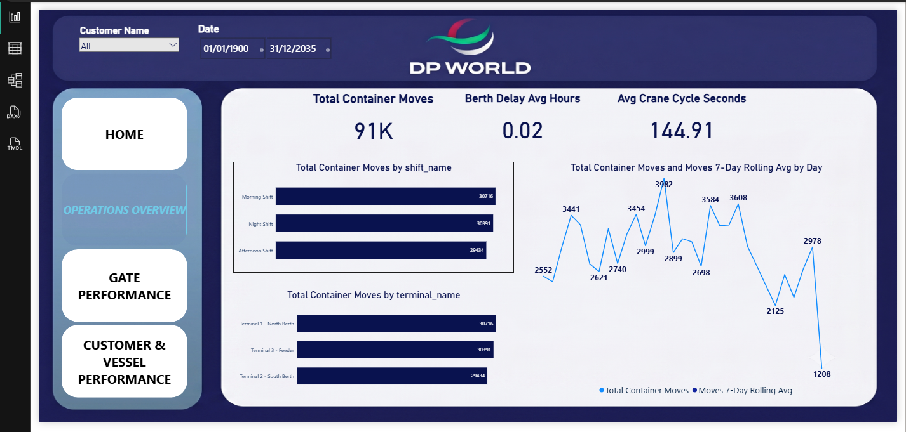
Dashboard Walkthrough
Home and operations
Home page routes users to Operations, Gate Performance, and Customer & Vessel Performance.
Operations page highlights 91K container moves, 0.02 average berth delay hours, and 144.91 average crane cycle seconds.
Navigation, customer slicer, and date slicer are consistent across dashboard pages.

Slide 13
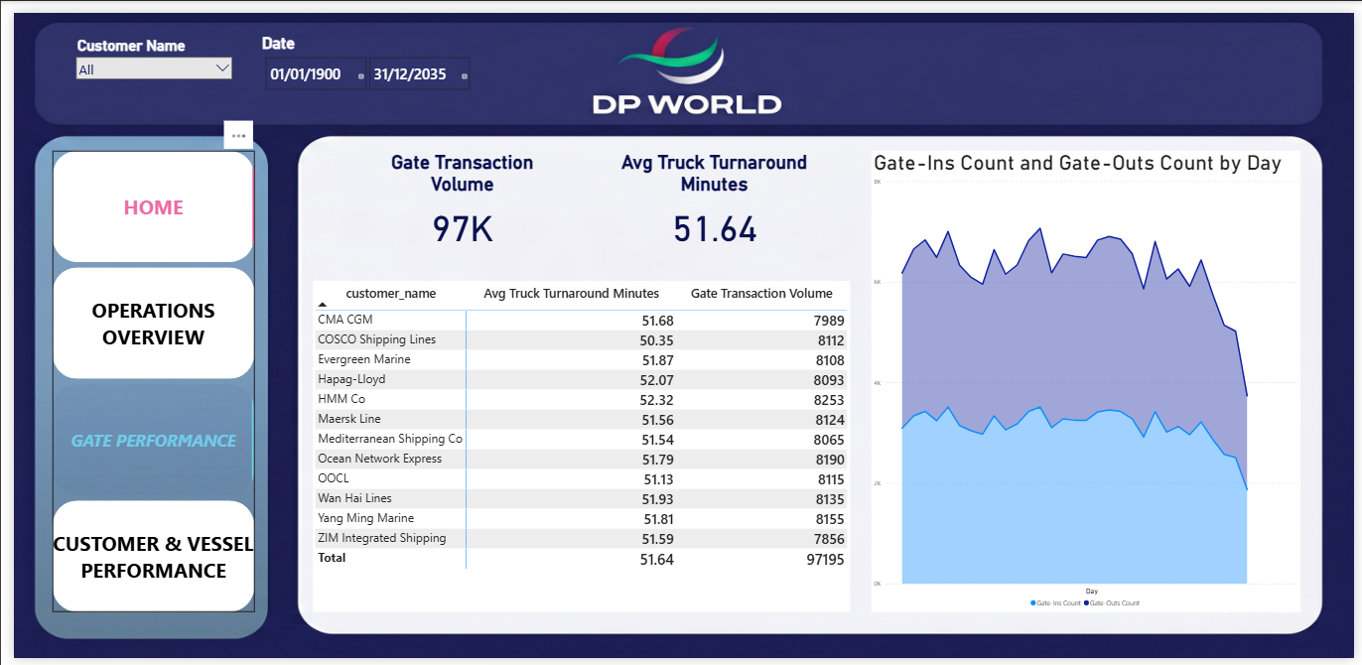
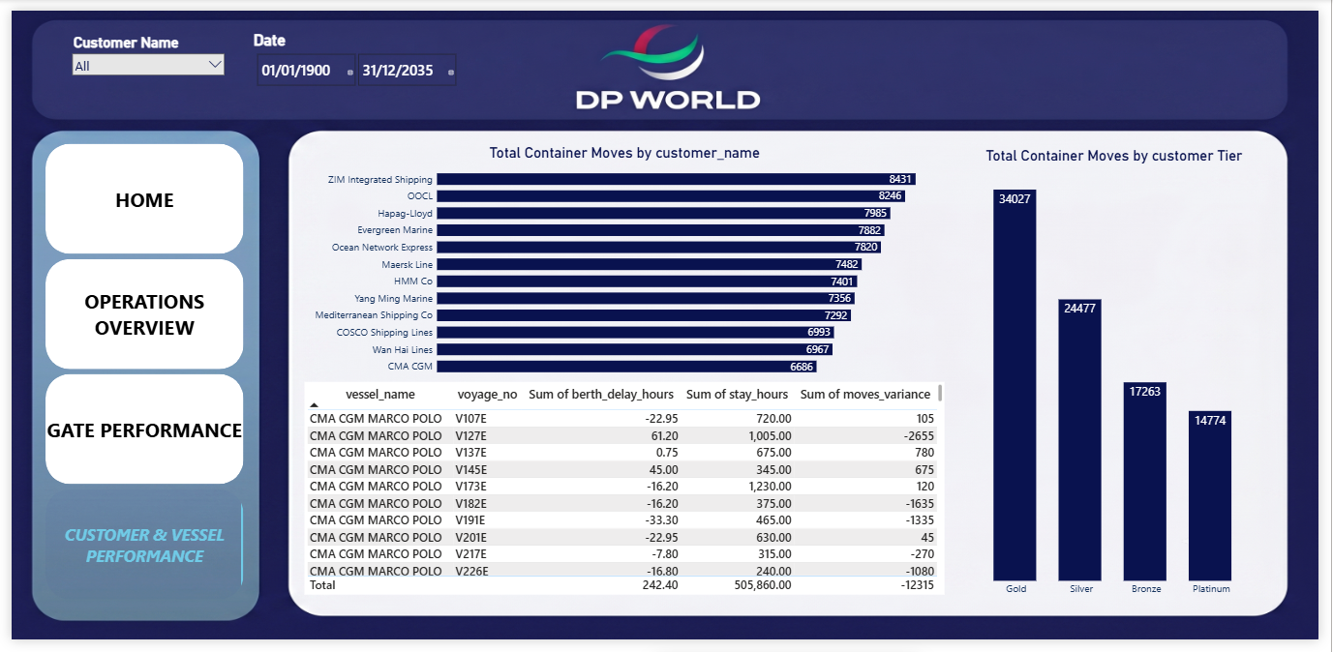
Gate, Customer, and Vessel Views
Operational analysis pages
Gate page reports 97K transactions and 51.64 average truck turnaround minutes by customer and day.
Customer & Vessel page compares moves by customer, customer tier, berth delay, stay hours, and moves variance.
These pages are the business-facing proof that the Gold model supports both throughput and service-performance questions.

Slide 14
Strengths, Limitations, and Next Steps
Handoff notes
Strengths
Limitations
Next steps
- Clear medallion separation
- Set-based Silver procedures
- Customer history modeled with SCD2
- Surrogate-keyed fact tables
- Audit tables and row-count logs
- BI model isolated to Gold layer
- Planned 07_Reconciliation_And_Audit package is not implemented
- Facts use full refresh rather than incremental loading
- Some SSIS updates use OLE DB Command, which does not scale well
- Master XML should be verified: EPT_01 label points to 06_Load_Facts.dtsx
- Add centralized reconciliation package
- Move large updates to set-based staging SQL
- Add incremental fact watermarks
- Add automated deployment and smoke tests
- Add model documentation for DAX measures

