Slide 1
Tic-Tac-Toe AI player
Prepared by Khaled Walid and Ahmed Waleed and Ahmed hesham
id: Khaled 222109
Ahmed 222147
ahmed227846

Slide 2
Introduction “What a Tic-Tac-Toe game ?”
Tic-Tac-Toe is a game in which two players seek alternate turns to complete a row, a column, or a diagonal with either three O’s or three X’s drawn in the spaces of a grid of nine squares.

Slide 3
Question: “What does the AI player intend to do?”
Our game is focused on creating an AI Tic-Tac-Toe player using the Pygame library to make the AI player play and win against a human being player.

Slide 4
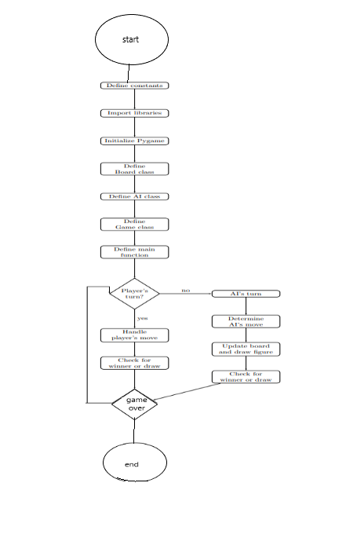
Explaining a Flow chart for the code
Initialization: The game starts by loading assets, importing libraries, initializing the system, and defining scores and turns.
Player’s Turn: If it’s the player’s turn, they make a move, the board is updated, and the game checks for a winner or draw.
AI’s Turn: If it’s the AI’s turn, it goes through a decision-making process, updates the board and scores, and checks for a winner or draw.
End Condition: The game ends when there is a winner or a draw.
This sequence continues until the game reaches the “game over” condition. Each turn’s actions and outcomes are clearly defined, ensuring the game progresses logically

Slide 5
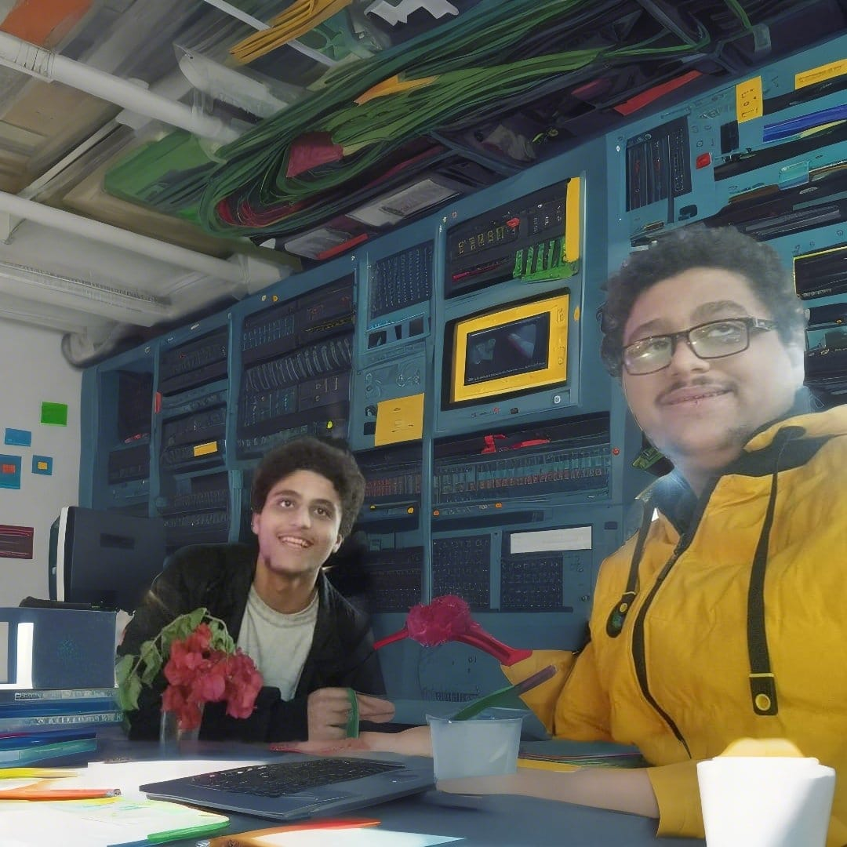

Now let us explain the code

Slide 6




This line imports some variables and methods by the Python interpreter itself
We are using a library in Python called py game that we need to install on our system to use that are used in common video games like tic-tac-toe game
This line is used to allow matrix and vector for two-dimensional array purposes

Slide 7




Width and height are variables defined to set the width and height of the screen to draw square dimensions 600 pixels by 600 pixels
SQSIZE: This variable determines the size of each square in the Tic Tac Toe grid. Since the grid has 3 rows and 3 columns, the window is divided into a 3x3 grid. Therefore, SQSIZE is calculated as the integer division of the WIDTH by 3, ensuring that each square is of equal size.
LINE_WIDTH: This variable specifies the width of the lines that draw the grid on the game window. It determines how thick the lines separating the Tic Tac Toe squares will be.

Slide 8
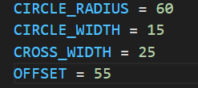



CIRCLE_RADIUS: This variable sets the radius of the circle to be drawn when a player marks a square with a circle symbol.
CIRCLE_WIDTH: It determines the width of the line used to draw the circle. This variable controls how thick the lines outlining the circle will be.
CROSS_WIDTH: Similarly, this variable specifies the width of the lines used to draw the "X" symbol when a player marks a square with a cross.
OFFSET: This variable sets the offset from the edges of the square to the symbols (circle or cross) drawn inside it. It ensures that the symbols are drawn within the square and are not too close to its edges, making the game visually appealing and easier to understand for the player.

Slide 9
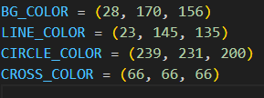
BG_COLOR: This variable represents the background color of the game window. It is typically the color behind all other elements of the game. In this case, the background color is a shade of turquoise.
LINE_COLOR: This variable represents the color of the lines that form the grid on the game board. It determines the color of the lines separating the Tic Tac Toe squares. In this case, the line color is a darker shade of turquoise.
CIRCLE_COLOR: This variable represents the color of the circle symbol used when a player marks a square with a circle. It determines the color of the circle outline. In this case, the circle color is a light cream color.
CROSS_COLOR: This variable represents the color of the cross symbol used when a player marks a square with a cross. It determines the color of the cross lines. In this case, the cross color is a dark gray color.

Slide 10

No of Rows for the three rows
And no of columns for three columns

Slide 11

We initialize py game constructor

Slide 12

screen = pygame.display.set_mode((WIDTH, HEIGHT)): This line creates a Pygame display surface with the specified width and height. The WIDTH and HEIGHT constants define the dimensions of the game window. This surface will be used to draw all the game graphics.
pygame.display.set_caption('Tic Tac Toe AI'): This line sets the title or caption of the game window. In this case, it sets the caption to 'Tic Tac Toe AI', which will be displayed in the title bar of the game window.
screen.fill(BG_COLOR): This line fills the entire game window with the background color defined by the BG_COLOR constant. It effectively sets the background color of the game window to the specified color.

Slide 13
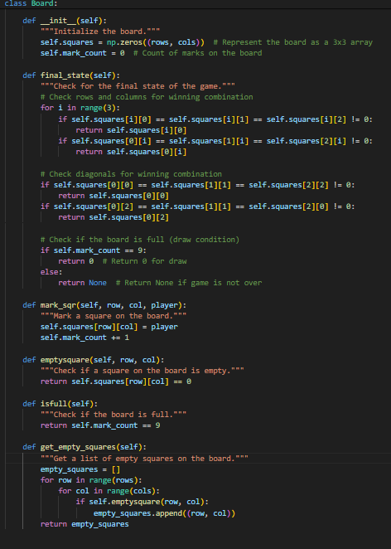
Checking Rows and Columns: It iterates over each row and column to check for winning combinations. If there is a row or column where all three squares have the same non-zero value (indicating that they are marked by the same player), it returns that player's mark as the winner.
Checking Diagonals: It checks both diagonal lines for winning combinations. If either diagonal has all three squares marked by the same player, it returns that player's mark as the winner.
Checking for a Draw: If none of the above conditions are met and the mark count is equal to 9 (indicating that all squares on the board are filled), it returns 0 to indicate a draw.
Returning None: If the game is not over yet (i.e., none of the above conditions are met), it returns None

Slide 14
This method marks a square on the board with the specified player's mark.
It takes three arguments: row (the row index of the square), col (the column index of the square), and player (the player's mark).
It updates the corresponding element in the self.squares array to the player's mark.
It increments self.mark_count to keep track of the total number of marks made on the board.
This method checks if a specific square on the board is empty (i.e., not marked by any player).
It takes row and col as arguments, representing the coordinates of the square to check.
It returns True if the square is empty, and False otherwise.

Slide 15
This method returns a list of coordinates for all the empty squares on the board.
It iterates over each square on the board and checks if it's empty using the emptysquare method.
If a square is empty, its coordinates (row, col) are added to the empty_squares list.
Finally, it returns the list of empty square coordinates.

Slide 16
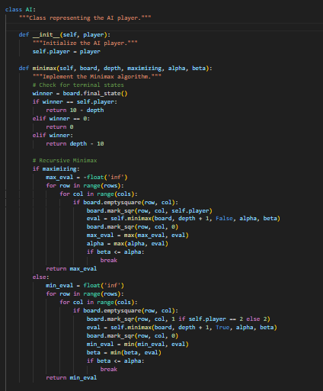
__init__(self, player):
Purpose: Initializes an instance of the AI class with the specified player number.
Parameters:
player: An integer representing the player number (1 or 2).
Description: This method sets the player attribute of the AI instance to the specified player number.
minimax(self, board, depth, maximizing, alpha, beta):
Purpose: Implements the Minimax algorithm to determine the optimal move for the AI player.
Parameters:
board: An instance of the Board class representing the current game state.
depth: An integer representing the depth of recursion in the Minimax algorithm.
maximizing: A boolean indicating whether the AI player is maximizing or minimizing.
alpha and beta: Parameters for alpha-beta pruning, used to optimize the search process.
Description: This method recursively evaluates all possible moves on the board and assigns a score to each move. It uses alpha-beta pruning to optimize the search process by eliminating unnecessary branches of the game tree. It returns the best score for the AI player.

Slide 17
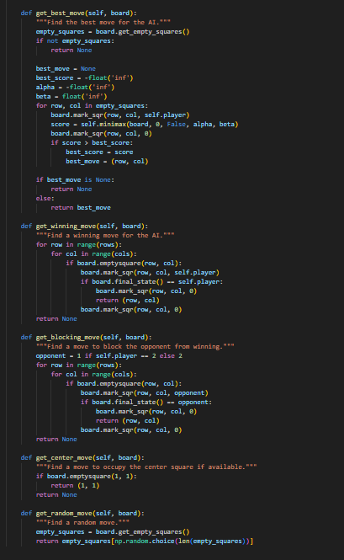
get_best_move(self, board):
Purpose: Finds the best move for the AI player using the Minimax algorithm.
Parameters:
board: An instance of the Board class representing the current game state.
Description: This method evaluates all possible moves on the board using the minimax method and selects the move with the highest score for the AI player. It returns the coordinates of the best move.

Slide 18
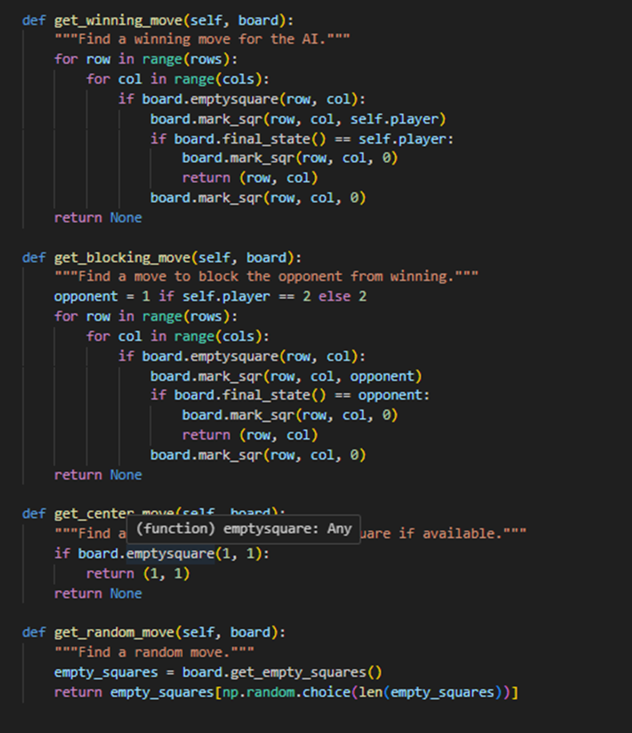
get_winning_move(self, board):
Purpose: Finds a winning move for the AI player if such a move exists.
Parameters:
board: An instance of the Board class representing the current game state.
Description: This method iterates through all empty squares on the board and simulates marking each square to see if it results in a win for the AI player. If a winning move is found, it returns the coordinates of that move; otherwise, it returns None.
get_blocking_move(self, board):
Purpose: Finds a move to block the opponent from winning.
Parameters:
board: An instance of the Board class representing the current game state.
Description: This method iterates through all empty squares on the board and simulates marking each square to see if it prevents the opponent from winning. If a blocking move is found, it returns the coordinates of that move; otherwise, it returns None.

Slide 19
get_center_move(self, board):
Purpose: Finds a move to occupy the center square if available.
Parameters:
board: An instance of the Board class representing the current game state.
Description: This method checks if the center square of the board is empty. If it is, it returns the coordinates (1, 1); otherwise, it returns None.
get_random_move(self, board):
Purpose: Finds a random move for the AI player.
Parameters:
board: An instance of the Board class representing the current game state.
Description: This method selects a random empty square on the board and returns its coordinates. It is used as a fallback strategy when other, more strategic moves are not available.

Slide 20
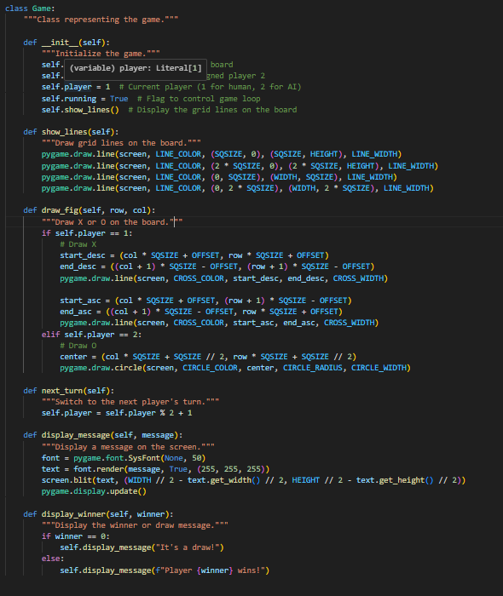
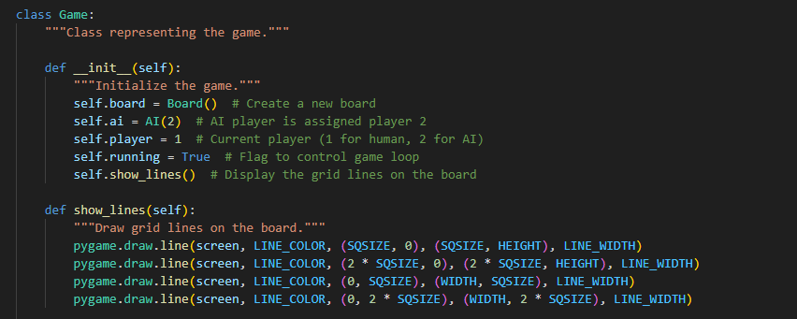
Here's an explanation of each method in the `Game` class:
1. **`__init__(self)`**:
- **Purpose**: Initializes a new instance of the `Game` class.
- **Description**: Creates a new `Board` object to represent the game board, initializes an AI player with player number 2, sets the current player to 1 (human player), sets the `running` flag to `True` to control the game loop, and calls the `show_lines()` method to display grid lines on the game board.
2. **`show_lines(self)`**:
- **Purpose**: Draws grid lines on the game board.
- **Description**: Uses Pygame's `draw.line()` method to draw horizontal and vertical lines to divide the game board into a 3x3 grid.

Slide 21

. **`draw_fig(self, row, col)`**:
- **Purpose**: Draws an X or O on the game board at the specified row and column.
- **Parameters**:
- `row`: The row index of the square where the X or O should be drawn.
- `col`: The column index of the square where the X or O should be drawn.
- **Description**: Depending on the current player (`1` for human, `2` for AI), this method draws either an X or O at the specified position on the game board using Pygame's drawing functions (`pygame.draw.line()` for X and `pygame.draw.circle()` for O).
4. **`next_turn(self)`**:
- **Purpose**: Switches to the next player's turn.
- **Description**: Changes the value of the `player` attribute to the next player's number (`1` if it's currently `2`, and vice versa).

Slide 22

5. **`display_message(self, message)`**:
- **Purpose**: Displays a message on the screen.
- **Parameters**:
- `message`: The text message to be displayed.
- **Description**: Renders the specified message using Pygame's font rendering functionality and displays it on the screen at the center. This method is used to show messages like "Player X wins!" or "It's a draw!".
6. **`display_winner(self, winner)`**:
- **Purpose**: Displays the winner or a draw message.
- **Parameters**:
- `winner`: The player number of the winner (or `0` for a draw).
- **Description**: Calls the `display_message()` method to display either "It's a draw!" or "Player X wins!" (where `X` is the player number) based on the value of the `winner` parameter. If `winner` is `0`, it displays "It's a draw!"; otherwise, it displays "Player X wins!".

Slide 23
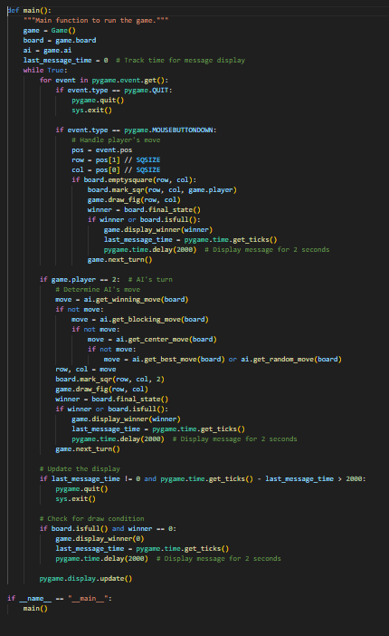
Now let’s explain the main method
1. **Initializing the game**:
- Creates a new instance of the `Game` class.
- Initializes variables to track the last time a message was displayed.
2. **Game Loop**:
- Enters a loop that continues indefinitely until the game is exited.
- Iterates over all events in the Pygame event queue.
- If the event type is `pygame.QUIT`, indicating the user closed the game window, it quits Pygame and exits the system.
- If the event type is `pygame.MOUSEBUTTONDOWN`, indicating a mouse click, it handles the player's move:
- Retrieves the position of the mouse click (`event.pos`) and calculates the corresponding row and column on the game board.
The `main()` function serves as the entry point for running the Tic Tac Toe game. Here's an explanation of each part of the function:

Slide 24
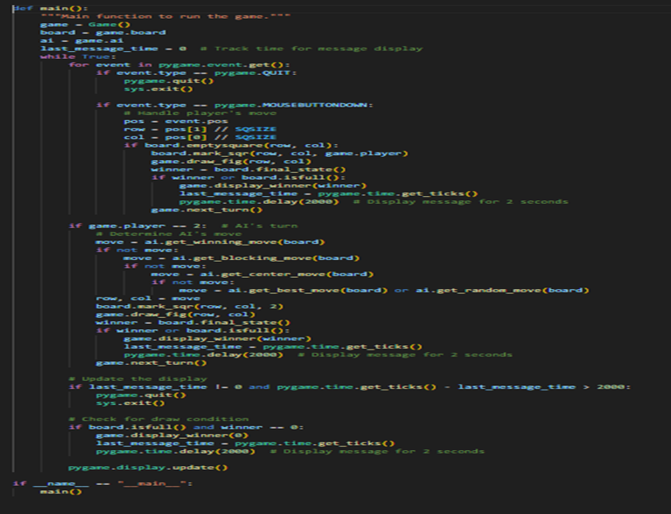
- Checks if the clicked square is empty and marks it with the current player's mark.
- Draws the player's mark on the board.
- Checks for a winner or a draw condition.
- Switches to the next player's turn.
- If it's the AI's turn (`game.player == 2`), it determines the AI's move:
- Attempts to find a winning move using `ai.get_winning_move()`.
- If no winning move is found, attempts to find a move to block the opponent from winning using `ai.get_blocking_move()`.

Slide 25

- If no blocking move is found, attempts to occupy the center square using `ai.get_center_move()`.
- If the center square is not available, chooses the best move using `ai.get_best_move()` or selects a random move using `ai.get_random_move()`.
- Marks the selected square on the board with the AI's mark.
- Draws the AI's mark on the board.
- Checks for a winner or a draw condition.
- Switches to the next player's turn.
3. **Updating the Display**:
- Checks if a message has been displayed (`last_message_time != 0`) and if the time since the last message exceeds 2 seconds, it quits Pygame and exits the system.
- Checks for a draw condition and displays the corresponding message if the board is full and there is no winner.
- Updates the Pygame display.
4. **Running the Main Function**:
- Checks if the script is being run as the main program (`__name__ == "__main__"`).
- If so, calls the `main()` function to start the game.

Slide 26
Thanks any questions

