Slide 1
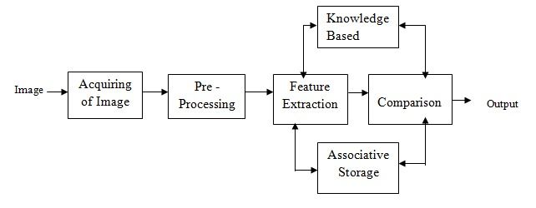
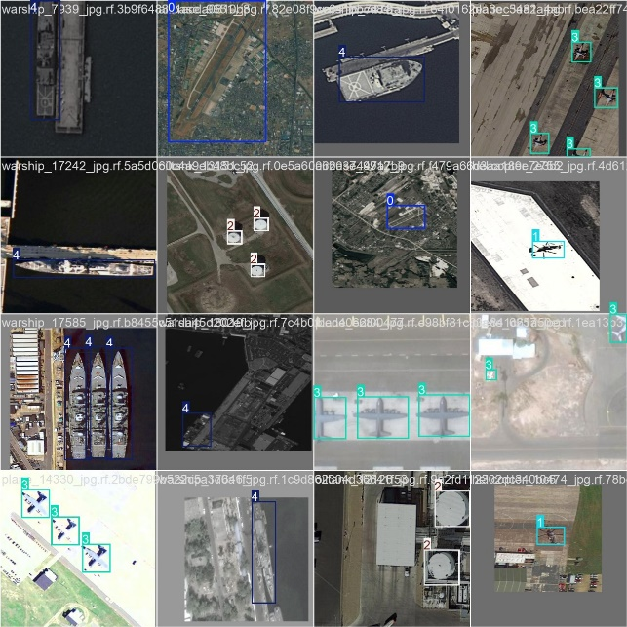
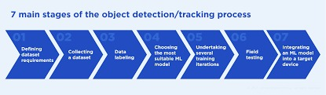
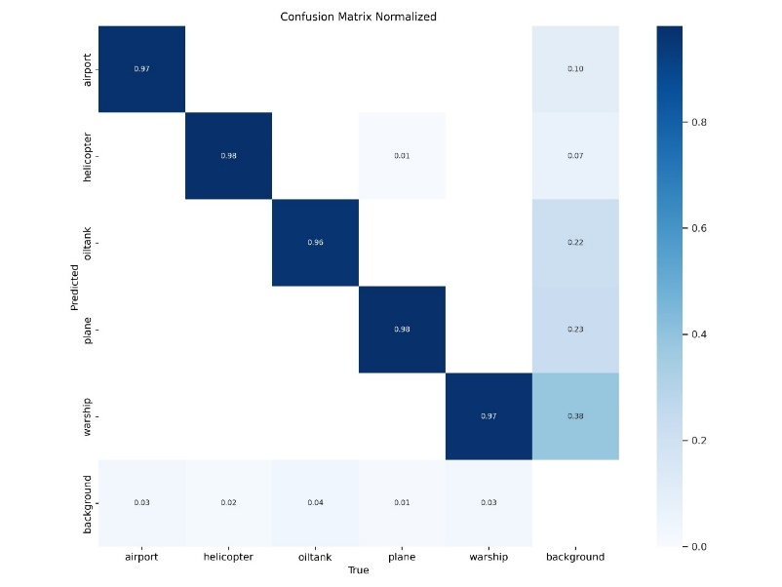
Military multi object detection
based on
COMPUTER VISION AND DEEP LEARNING
MOTIVATION
MATERIALS AND METHODOLOGY
Improving national security and defense capabilities .
Reducing Human Error specially in high-stress situations.
Reduced risk to human Because of this dependence on autonomous systems, militaries reduce the risks that come with putting human lives in harm's way during dangerous missions...
It may detect threats that may be potentially damaging well before the threat becomes a menace.
Stronger capability for protection against threats and ensuring national defense.
Military multi-object detection is a deep learning-based project. Collect datasets that are diverse, including annotated images and videos of military environments. Examples can include but are not limited to different objects, such as vehicles, personnel, equipment, and obstacles in diverse conditions.
Key Technologies:
Deep learning{Convolutional Neural Networks
CNNs, You Only Look Once (YOLO)}
Computer Vision{Feature Extraction, Object
Localization, Object Tracking
Data Augmentation and Preprocessing Image Normalization(Adjusting image pixel values to a standard range)
IMPLEMENTATION
RESULTS AND ANALYSIS.
Accuracy: Since the project is multi object , so the accuracy of each object is:
the airport accuracy is 97%
helicopter accuracy is 98%
oiltank accuracy is 96%
Plane accuracy is 98%
Warship accuracy is 97%
The importance of these features lies in their ability to provide distinctive characteristics that differentiate objects from their surroundings. Geometric features :size Motion-based features: Velocity
OBJECTIVE
.
Develop an Accurate Detection System
Ensure Real-Time Performance
Improve Situational Awareness
Adapt to Diverse Environmental Conditions
Develop a User-Friendly Interface
Advance Technological Capabilities
FUTURE WORK
.
We will add the project system to hardware components that will simulate the idea
Improve data and add more various object
And we plan to make a system to shoot their location
CONCLUSION
.
Advanced object detection systems around military deployment have greatly improved in terms of both accuracy and reliability, especially those which tend to exploit deep learning with AI. Most of the modern algorithms are now able to detect and identify with great precision various military objects such as vehicles, weapons
SUPERVISED BY:
Khaled Zakaria 4231810

