Slide 1
procedures
Lecture5

Slide 2
Why Write Procedures?
There is some sequence of instructions that performs some useful job, and you’ll need to use them over and over again.
A procedure is a construct to reduce the number of times you must repeat these same instructions in your code.
Using procedures makes your code legible
You can even make libraries of procedures so you can reuse them in different programs.

Slide 3
The main features of procedures
The main features of procedures are:
arguments,
return values,
local data,
body
being
.

Slide 4
The main features of procedures
The arguments are values passed into a procedure when it is called by some piece of code, which may or may not be another procedure .
The return values are values returned from the callee procedure to the caller in response to being called with particular arguments.

Slide 5
The main features of procedures
Local data is data used with the procedure that exists for only as long as a particular instance of a procedure call is still being
evaluated.
The being of a procedure is the fact that it must exist somewhere in memory, so it takes up space and has a position.

Slide 6
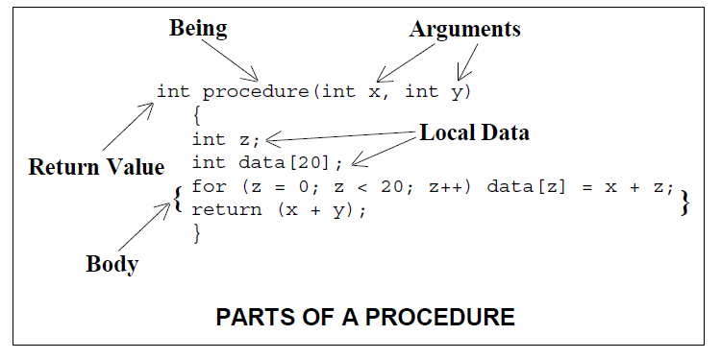

Slide 7
Steps to perform in the execution of a procedure (callee)
Place parameters in a place where procedure can access them
Transfer control to the procedure
Acquire storage resources needed for the procedure
Perform the desired task
Place the result value in a place where the calling program (caller) can access them
Return control to the point of origin, since a procedure can be called from several points in a program

Slide 8
Registers for procedure calling
Registers provide fast way of access
$a0-$a3: four argument registers to place parameters in (if we need more in the procedure, use stack)
$v0-$v1: two value registers for return values

Slide 9
Registers for procedure calling
$ra: one return address register to return to the point of origin. Address of next instruction after function call.
Return address (ra) is register number 31

Slide 10
Instruction Support for Procedures
MIPS supports an instruction just for functions jal
Syntax for jal (jump and link) is
jal label
Steps that jal does:
Step 1 (link): Save address of next instruction into $ra
Step 2 (jump): Jump to the given label

Slide 11
Instruction Support for Procedures
Syntax for jr (jump register):
jr register
Instead of providing a label to jump to, the jr instruction provides a register which contains an address to jump to.

Slide 12
Very useful for function calls:
jal stores return address in register ($ra)
jr $ra jumps back to that address

Slide 13
Procedure main steps
The caller put the parameter value in $a0-$a3
Use jal to save address in $ra and to jump to the procedure address (callee)
Callee executed and save result in $v0-$v1
Return control to caller by: jr ra

Slide 14
Register Spilling
Any registers used by the caller must keep their original value after calling the procedure.
Use register spilling to save the original register value before calling the procedure, then restore it back after procedure calling.

Slide 15
Register Spilling and Data Allocation
1) The static registers, $s0-$s7, must have the same value leaving a procedure as coming into a procedure.
2) The address in $ra register must be available at the end of the procedure to continue proper evaluation after the procedure has ended.
3) The registers, $t0-$t9, $a0-$a3, and $v0-v1 may be changed without restoring their previous values at the end.

Slide 16
Register Spilling and Data Allocation
The ideal data structure for register spilling is stack
MIPS reserves the stack pointer in register 29 $sp

Slide 17
Allocating space for new data in procedures
The stack is also used to store variables that are local to the function and can’t fit in the registers. Like arrays declared in functions.
The segment of the stack containing procedure’s saved registers and local variables is called a procedure frame

Slide 18
Allocating space for new data on heap
We need space in memory for static variables and for dynamic data structures.
The stack start in the high end of memory and grows down

Slide 19
Allocating space for new data on heap
The first part is reserved
Home of MIPS machine code
Static data segment: place for constants and other static variables
4. Arrays and linked lists grows and shrink; heap
5. Stack and heap grows towards each other.

Slide 20
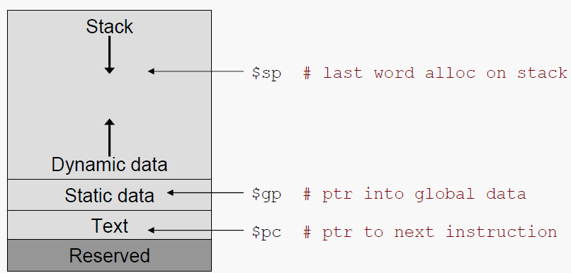
MIPS Memory Organization
Dynamic data is accessed via pointers held by the program being executed, with addresses returned by the memory allocator in the underlying operating system.

Slide 21
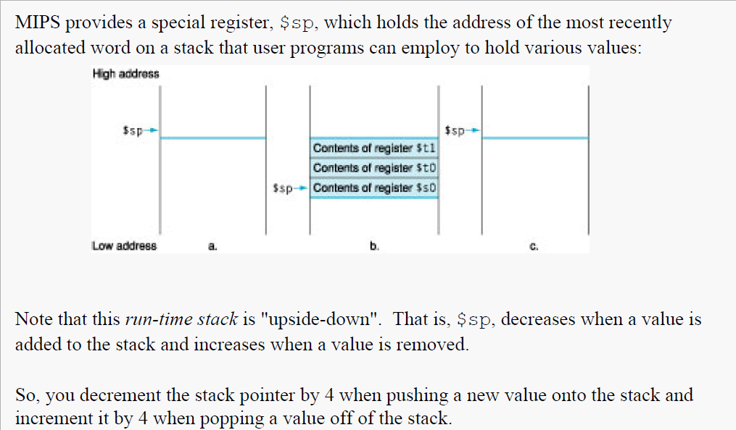
The System Stack

Slide 22
Allocating space for new data in procedures
$fp (frame pointer) pointer to the first word of the frame of a procedure.
fp is a good reference for local function variables
The addresses in $sp and $fp (frame pointer) should be the same leaving as entering.

Slide 23
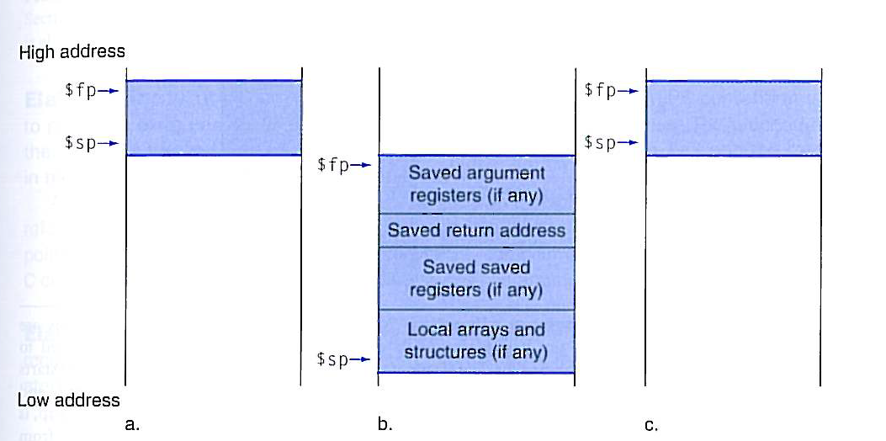
Stack allocation before and after function call

Slide 24
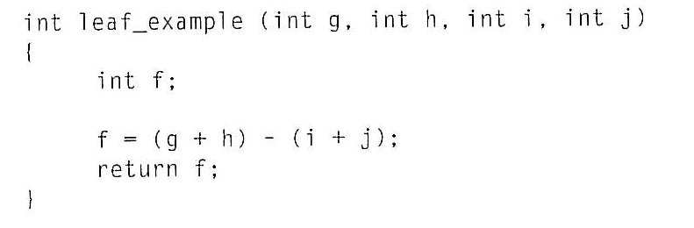
Register spilling-Example
g,h,i,j,f will be saved in $a0, $a1, $a2, $a3, $v0

Slide 25
Register spilling-Example
We need three registers $S0, $t0 and $t1.

Slide 26
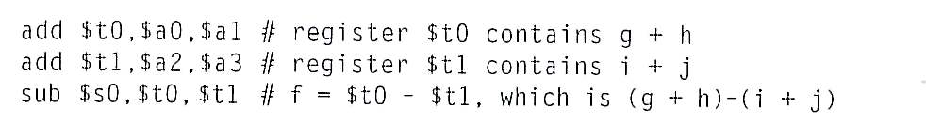
Function execution
leaf_example:
Body
Return
restore

Slide 27
Leaf procedures
Leaf procedures do not call other procedures.
We needn’t spill temp registers in Leaf procedures .
A non-leaf procedure is one that does call another procedure.

Slide 28
Non-leaf procedures
Non-leaf procedures make procedure calls
by executing a jump-and-link instruction:
jal procedure_0 # puts PC+4 into $ra for return
But, if procedure_0 also makes a call, say
jal procedure_1 # puts PC+4 into $ra for return
then the original return address just got overwritten…

Slide 29
Preserving the Return Address
Non-leaf procedures must back up the value of their return address before making a call to another procedure:
addi $sp, $sp, -4 # make room on stack
sw $ra, 0($sp) # save return address
And they must restore the return address before they attempt to return:
lw $ra, 0($sp) # retrieve return address
addi $sp, $sp, 4 # pop it off the stack

Slide 30
Failure to do this will almost certainly lead to a catastrophic runtime failure.
The safest way to do this is to back up the address immediately when the procedure is entered, and to restore it immediately before the return is executed. Of course, you must keep careful track of the stack pointer during all of this…

Slide 31
Nested (nonleaf )procedures
What will happen when a function calls another function?
In the nonleaf procedures save all arguments $a0-$a3 and $ra and temp registers $t0-$t9.

Slide 32
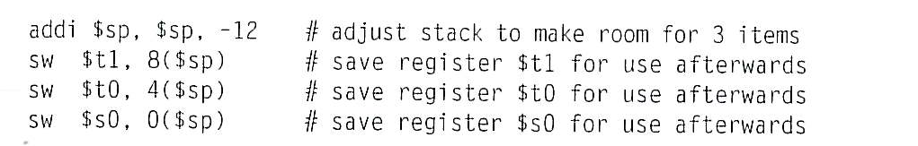
Register spilling-Example
We need to save three registers $S0, $t0 and $t1. We push the old values onto the stack by creating space for three words (12 bytes) on the stack.

Slide 33
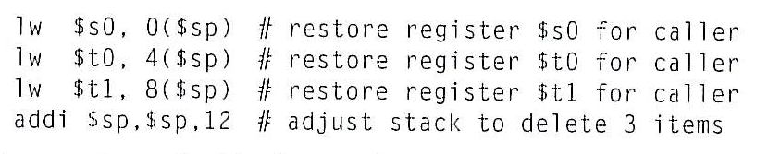
Function execution
leaf_example:
Body
Return
restore
restore

Slide 34
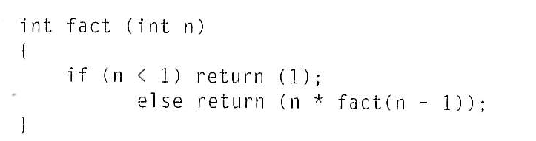
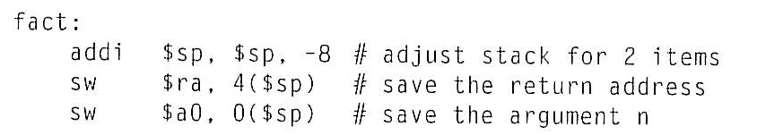
Recursive function-example
Push 2 items in the stack

Slide 35

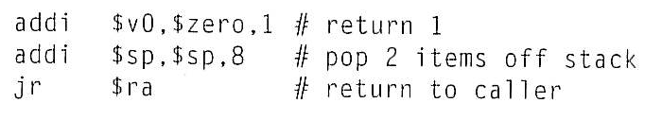
Recursive function-example- cont.
Test for n
Put 1 into a value register

Slide 36
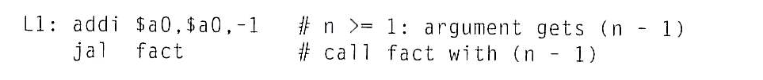
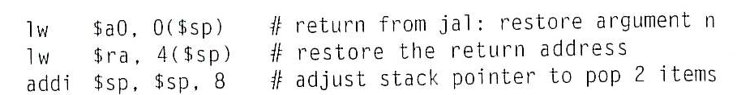
Recursive function-example- cont.
If n is not less than 1 the argument n is decremented and fact is called again.
The old return address and argument are restored

Slide 37
The value register $v0 gets the product of old argument $a0 and the current value of $v0 .
Fact jumps again to the return address.

Slide 38
Example Finding the Median Value 4
Consider implementing a MIPS procedure to find the median value in an array of integers.
The only efficient way to do this is to partially sort the array elements until the median value is revealed.
For example, given the list of eleven values below below
17 43 21 19 6 34 32 25 45 29 13
we could sort it into the following form
6 13 17 19 21 25 . . .
and then see that the median is clearly 25.

Slide 39
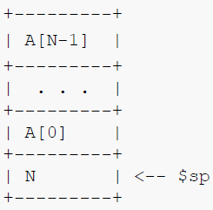
Stack Layout 5
What we do not want to do is destroy the original list while finding the median.
So, we need to give our MIPS procedure a copy of the list, and the place to do that is the runtime stack.
Before calling the procedure, we will organize the stack like this:
The procedure can then manipulate
the list elements directly on the stack,
and use an appropriate register to return the median value.

