Slide 1

PYTHON PROGRAMMING FOR QR CODE GENERATOR USING GUI
Team members
192210363-P.Khaleel Ahamed
192110114-T.Vithesh
192210137-N.Sai Chandu
GUIDED BY-
Raveena Selvanarayanan

Slide 2

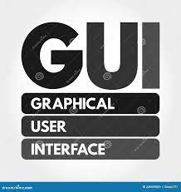
INTRODUCTION
A QR code generator with a graphical user interface (GUI) is a software tool designed to simplify the process of creating QR (Quick Response) codes for users of all technical backgrounds.
Unlike command-line interfaces, GUI-based generators offer a visually intuitive environment where users can interact with buttons, input fields, and dropdown menus to customize their QR codes.
One of the primary benefits of using such a tool is its ease of use, as it eliminates the need for users to have in-depth technical knowledge.

Slide 3
ABSTRACT
Additionally, GUI-based generators provide immediate visual feedback, allowing users to see real-time changes to their QR codes as they make adjustments
Some generators even allow users to add logos, images, or branding elements to their QR codes.
Furthermore, GUI-based QR code generators are often compatible with multiple operating systems, ensuring accessibility for users regardless of their preferred platform.
Overall, a GUI-based QR code generator offers a user-friendly, customizable solution for a variety of applications, including marketing, advertising, inventory management, and more.

Slide 4
LITERATURE
AUTHOR NAME | CONCEPT | ADVANTAGES | FUTURE SCOPE | ALGORITHM USED
Nielsen, J. (1993) | Usability and User Experience | Firstly, GUI-based applications are inherently more user-friendly, | Implementation of inclusive designs | Block chain algorithm
Lazar, J.Goldstein. | Ensuring Digital Accessibility Through Process and Policy. | This ease of use extends to individuals with varying levels of technical expertise, | Create more intuitive and immersive user interfaces | Augumented reality and virtual reality algorithms
Oinas-Kukkonen | Key Issues, Process Model, and System Features. | making the QR code generator accessible to a broader audience. | Integration of big data analytics | (mvc)model-view-controller algorithm

Slide 5
AUTHOR NAME | CONCEPT | ADVANTAGES | FUTURE SCOPE | ALGORITHM USED
Fogg, B. J. | Using Computers to Change What We Think and Do. | This visual confirmation enhances user confidence and ensures that the desired QR code has been created accurately | Improve user privacy and control over personal data | (mvvm)model view-view model algorithm
Cavoukian, A. | Privacy by Design in the Age of Big Data. | The cross-platform compatibility of GUI frameworks like Tkinter | Solutions for secure and verifiable QR code transactions | Model view-present(mvp) algorithm
Schneier, B | Enabling the Trust that Society Needs to Thrive. | creating a QR code generator with a GUI provides a user-friendly | Enable real-time updates and customization | Recommedation algorithms

Slide 6
CODE/PROGRAM
# pip install qrcode pillow
import qrcode, PIL
from PIL import ImageTk
import tkinter as tk
from tkinter import ttk,messagebox,filedialog
from PIL import ImageTk
def createQR(*args):
data = text_entry.get()
if data:
img = qrcode.make(data) #generate QRcode
res_img = img.resize((280,250)) # reszie QR Code Size
#Convert To photoimage
tkimage= ImageTk.PhotoImage(res_img)
qr_canvas.delete('all')
qr_canvas.create_image(0,0,anchor=tk.NW, image=tkimage)
qr_canvas.image = tkimage

Slide 7
else:
messagebox.showwarning("Warning",'Enter Data in Entry First')
def saveQR(*args):
ata = text_entry.get()
if data:
img = qrcode.make(data) #generate QRcode
res_img = img.resize((280,250)) # reszie QR Code Size
path = filedialog.asksaveasfilename(defaultextension=".png",)
if path:
res_img.save(path)
messagebox.showinfo("Sucess","QR Code is Saved ")
else:
messagebox.showwarning("Warning",'Enter Data in Entry First')
root = tk.Tk()
root.title("QR Code Generator")
root.geometry("300x380")
root.config(bg='white')
root.resizable(0,0)

Slide 8
frame1 = tk.Frame(root,bd=2,relief=tk.RAISED)
frame1.place(x=10,y=5,width=280,height=250)
frame2 = tk.Frame(root,bd=2,relief=tk.SUNKEN)
frame2.place(x=10,y=260,width=280,height=100)
coverImg = tk.PhotoImage(file="qrCodeCover.png")
qr_canvas = tk.Canvas(frame1)
qr_canvas.bind("<Double-1>",saveQR)
qr_canvas.create_image(0,0,anchor=tk.NW, image=coverImg)
qr_canvas.image = coverImg
qr_canvas.pack(fill=tk.BOTH)
text_entry = ttk.Entry(frame2,width=26,font=("Sitka Small",11),justify=tk.CENTER)
text_entry.place(x=5,y=5)
btn_1 = ttk.Button(frame2,text="Create",width=10,command=createQR)
btn_1.place(x=25,y=50)
btn_2 = ttk.Button(frame2,text="Save",width=10,command=saveQR)
btn_2.place(x=100,y=50)
btn_3 = ttk.Button(frame2,text="Exit",width=10,command=root.quit)
btn_3.place(x=175,y=50)
root.mainloop()

Slide 9
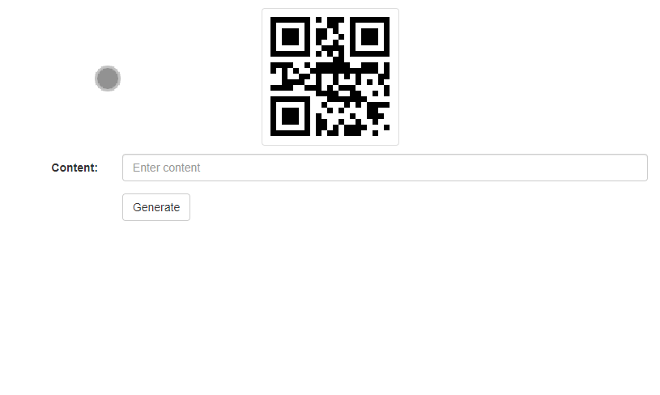

Slide 10
EXISTING WORK
* The process typically involves capturing user input, encoding it into a QR code using the qrcode library, and displaying the generated QR code image within the GUI interface.
* The example provided demonstrates a basic implementation where users can input text or links, click a button to generate the corresponding QR code, and view the generated QR code within the application window.

Slide 11


HARDWARE/SOFTWARE USED:
Software used for the research of QR(QUICK RESPONSE) code generator using GUI (GRAPHICAL USER INTERFACE) is VIRTUAL STUDIO CODE or else we may use the GOOGLE COLAB software.
GOOGLE COLAB --- One of its most notable features is its accessibility, as it requires no installation or configuration, leveraging Google's infrastructure for computation.
Visual Studio Code (VS Code) is a lightweight yet powerful source code editor d. It provides support like syntax highlighting, intelligent code completion, debugging capabilities, and version control integration.

Slide 12
PROPOSED MODEL
It involves several key elements includes:
Literature Review
Problem Definition
Methodology
Design and Development
Testing and Evaluation

Slide 13
RESEARCH GAP
In the context of developing a QR code generator with a graphical user interface (GUI), several potential research gaps may exist
Security and Privacy: Limited research may exist on the security and privacy implications associated with GUI-based QR code generators.
Investigating potential vulnerabilities, privacy risks, and security best practices for handling sensitive information within QR codes could contribute to the development of more secure and privacy-aware applications.

Slide 14
CONCLUSION
The development of a QR code generator with a graphical user interface (GUI) has been successfully achieved. This project aimed to provide users with a simple yet powerful tool to create QR codes efficiently. Throughout the development process, several key components were implemented, including a user-friendly interface, QR code generation functionality, and the ability to customize QR code content and design.

Slide 15
REFFRENCE
Arase K. (2020) QR Code Generator for JavaScript. http://d-project.googlecode.com/svn/trunk/misc/qrcode/js/qrcode.js [accessed 9 July 2019]
Denso Wave Incorporated. (2018) About QR code. http://www.qrcode.com/en/aboutqr.html [accessed 9 July 2019]
Denso Wave Inc. (n.d.c). QR code standardization. Retrieved Nov. 14, 2021, from http://www.denso-wave.com/qrcode/qrstandard-e.htm#notes01
Hadro, J. (2019, Aug. 19). Can mobile tech, collaboration, and a focus on user experience rejuvenate reference services? Library Journal. Retrievec Nov. 14, 2018 fromhttp://www.libraryjoumal.com/lj/community/academiclibraries/886418-

Slide 16


