Slide 1
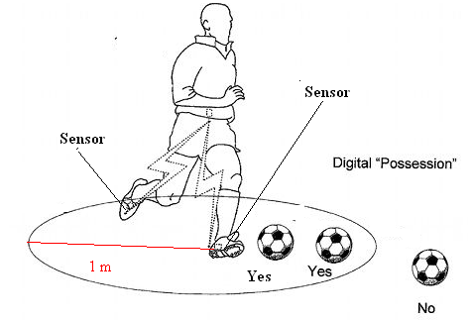
GC Implementation by Frequently Emitting
Parallel Windows and User-Defined Aggregate Functions
Sobhan Badiozamany
Lars Melander
Thanh Truong
Cheng Xu
Tore Risch
Uppsala University Sweden

Slide 2

Outline
EPIC System
The EPIC approach to GC Solution
  Overview
  Data Stream Flow
Evaluation
Conclusion

Slide 3
EPIC System
An Extensible, Parallel, Incremental, and Continuous System
Programming
languages:
Java
Python
C
LabView
Matlab
Query languages:
SPARQL
SQL
AmosQL
_{(Continuous) Query API}
Local
Semantic
DB
_{EPIC kernel}
_{Plug-in manager}
_{Wrapper manager}
_{Stream wrappers}
_{Data wrappers}
Data sources:
JSON feed
CSV
EPIC
JDBC

Slide 4
EPIC System
Extensibility by plug-ins in external programming languages
  Add stream wrappers to pull and pre-process data from different sources
  Add plug-in functionality on the fly
    for data mining (e.g. pattern matching)
    to tweak performance (e.g. indexing / optimization)
    to add third-party toolkits (e.g. visualization / hardware interface)
Parallelism
  Distributed as a network of EPIC nodes
  High throughput and low latency
  Reduced volume of data stream through the network

Slide 5
EPIC System
User defined incremental aggregate function over windows
  init() creates a new aggregation object o, which is used for accumulating changes in a window
  add(Object o, Object e) updates the aggregation object with the current stream element e
  remove(Object o, Object e_exp) removes the contribution of the expired stream element e_exp from the aggregation object o

Slide 6
EPIC System
Frequently Emit results over Windows to meet real-time demand
More stuff from the paper ????

Slide 7
The EPIC approach to GC
GC queries can be viewed as a Data Stream Flow with processing nodes – Parallel
Nodes are connected through TCP/IP – Parallel
Binary format: As parsing time is crucial, nodes communicate through binary format.
A DEBS wrapper (in C) to convert data stream elements into binary format and ??? – Extensible

Slide 8
The EPIC approach to GC
Routing/distribution of streams is specified by users queries – Parallel
Shared common (heavy) computation; i.e. ball hitters in Q2, Q4, heat-map 1 second in Q3
Computation is done incrementally in one pass – Incremental

Slide 9
DATA stream FLOW

Slide 10
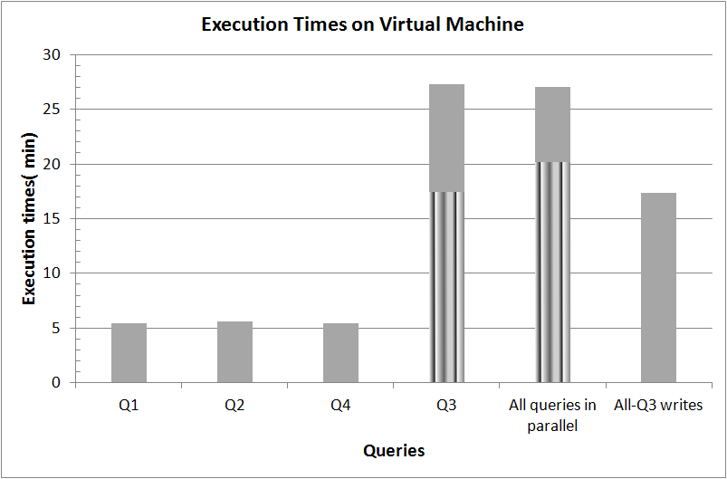
Overall process times
Queries Q1, Q2, and Q4 have fastest processing times
Query Q3 involves intensive report computations, therefore, it dominates the performance:
  Striped bars show that Q3 without writing to CSV files are 30-35% faster
Q2 and Q4 report current ball events which require fast processing times
By contrast, Q1 and Q3 accumulate player statistics and are less time critical

Slide 11
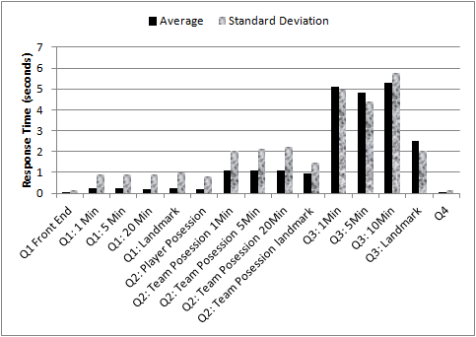
Delays
Delays Mean/Stdev
Fast process time usually means low delay except for Q2 team possession.
Q2 player possession has low delays compared to Q2team possession
  Q2 team possession has extra layer of processing node
Q3 has high delays because of intensive report computations

Slide 12
Conclusion
We expressed the GC by continuous queries over windows
Throughput and low latency were achieved by
  Extensibility, to speed up time critical code
  Parallelization, to process expensive computations with low delays
  Incremental evaluation of aggregate functions
  Continuously emitting windows for early reporting of partial aggregations

