Slide 1
Adv. Numerical Analysis Lecture 1: Matrix-Vector Multiplication; Orthogonal Vectors and Matrices
Panruo Wu
To accompany the Numerical Linear Algebra book, Lectures 1 and 2.

Slide 2
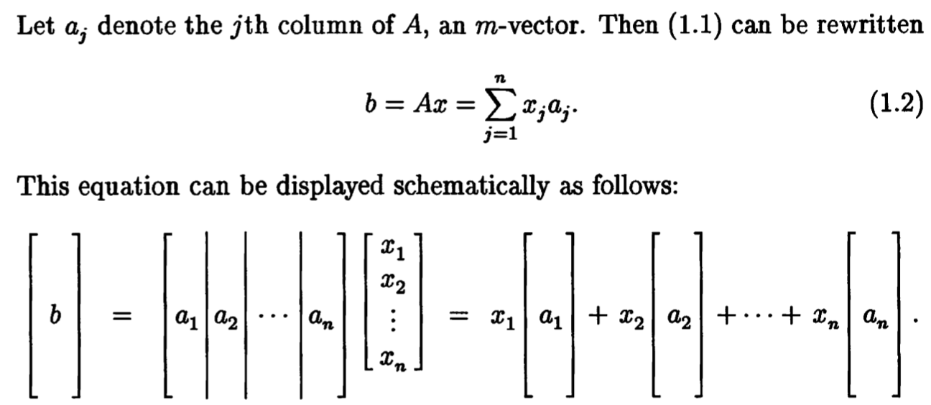
Matrix-vector Multiplication (1)
New interpretation that is essential for numerical linear algebra: if b=Ax, then b is the linear combination of the columns of A.

Slide 3
Matrix-vector Multiplication (2)
Mathematician: Ax=b means matrix A (representing linear transformation) acts on vector x to produce b.
Numerical analyst: Ax=b means vector x acts on A to produce b (as linear combination of columns of A).
Function can be seen as infinite dimensional vector Matrix A’s column can be function

Slide 4
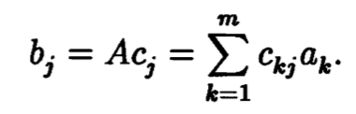
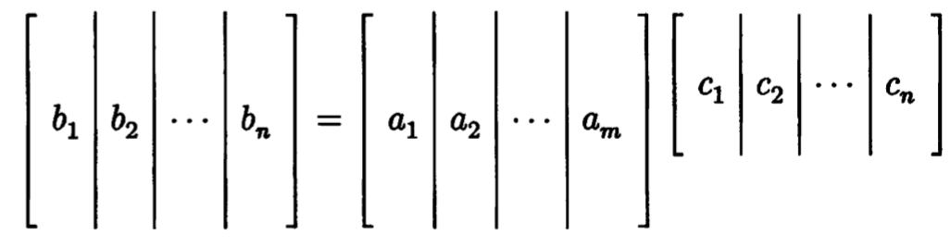
Matrix Times a Matrix
Matrix product B=A*C, each column of B is a linear combination of the columns of A.

Slide 5
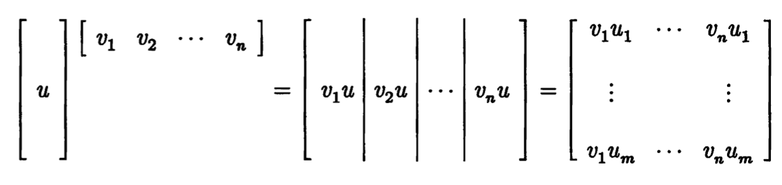
Example 1: Outer Product

Slide 6
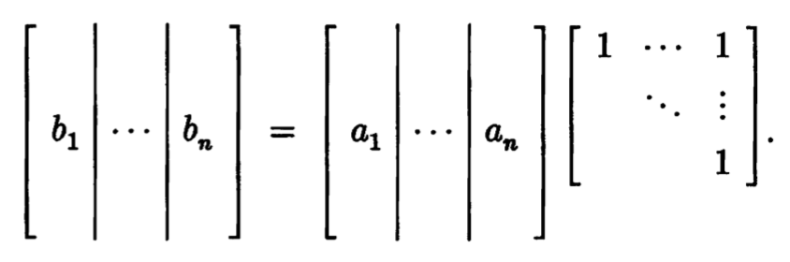
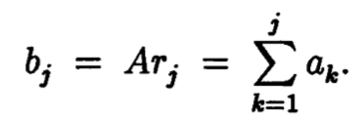
Example 2: Matrix Times Triangular Matrix
B = A*R
The j-th column of B is the sum of the first j columns of A.

Slide 7
Range
Range of matrix A (size m by n), denoted by range(A) or sometimes ran(A), means the set of vectors that can be expressed as Ax for some x. Namely
Ran(A) = {Ax : any x}
Theorem 1.1 Ran(A) is the space spanned by the columns of A. Why?
Ax = a1*x1 + a2*x2 + … + an*xn
Because of the new interpretation that Ax is a linear combination of columns of A!
Thus ran(A) is also sometimes called the column space of A

Slide 8
Nullspace
The nullspace of matrix A, written as null(A), is the set of vectors x that satisfy Ax=0. i.e. null(A) = {x : Ax=0}

Slide 9
Rank
Column rank is the dimension of the column space.
Row rank is the dimension of the row space.
Row rank = column rank (?!! Why?) So we are going to simply say rank(A) to refer to either column rank or row rank.
For a matrix A of size m by n (m>=n), we say A is of full rank if A has the maximal rank (which is n). i.e. A has independent columns.
Theorem1.2 A matrix A with size m>=n has full rank if and only if it maps no two distinct vectors to the same vector.

Slide 10
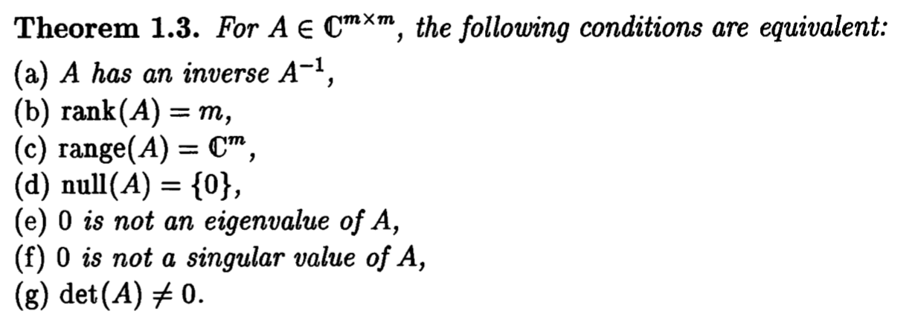

Inverse
A full-rank square matrix is called non-singular. If not full rank the it’s called singular.
A non-singular matrix is invertible, and its inverse is denoted by $A^{−1}$, which satisfies $A×A^{−1}=A^{−1}×A=I$

Slide 11
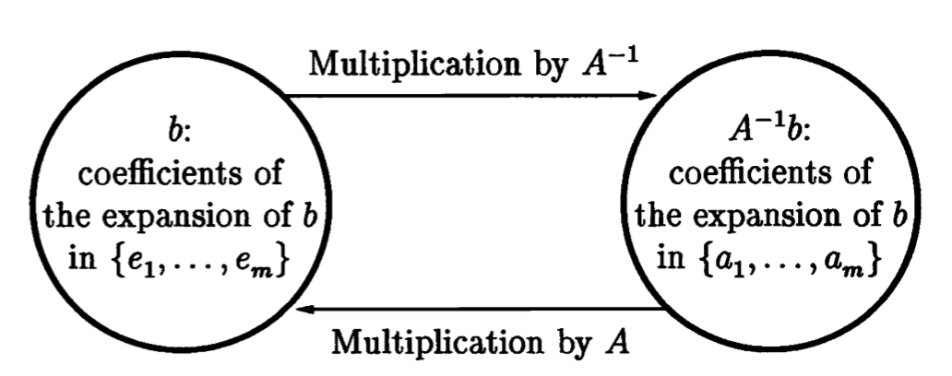
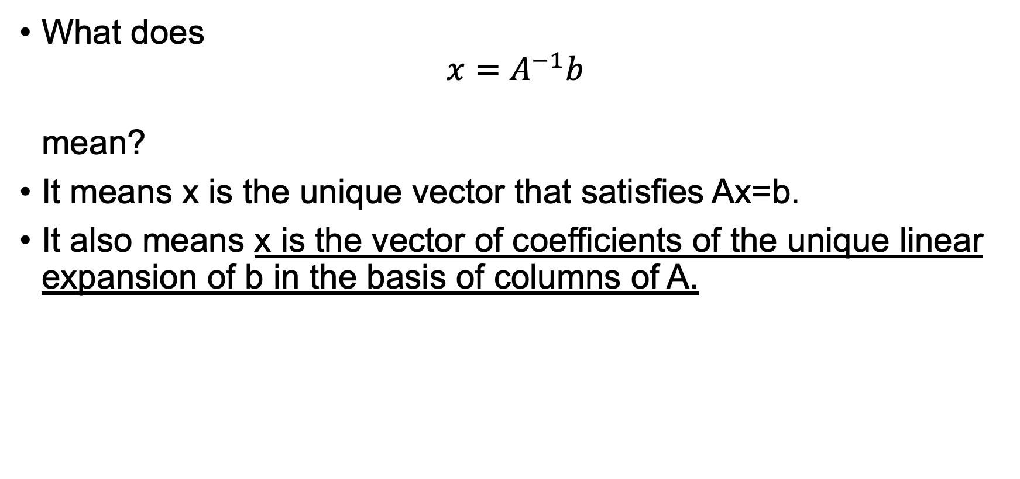
A Matrix Inverse Times a Vector
What does ${x=A}^{−1}b$ mean?
It means x is the unique vector that satisfies Ax=b.
It also means x is the vector of coefficients of the unique linear expansion of b in the basis of columns of A.

Slide 12
Orthogonal Vectors and Matrices
Orthogonality is the base for many of the best algorithms of numerical linear algebra.
Two ingredients: orthogonal vectors and orthogonal (unitary) matrices.

Slide 13

Symmetric matrix
We are going to focus on real matrix.
A is symmetric iff $A=A^{T}$
Symmetric matrices are a class of very nice and important matrices; And very useful in practice because a lot of applications will generate symmetric matrices!

Slide 14
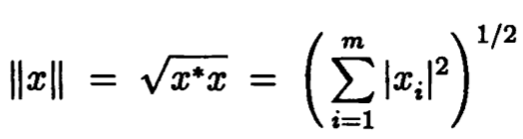
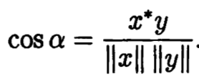
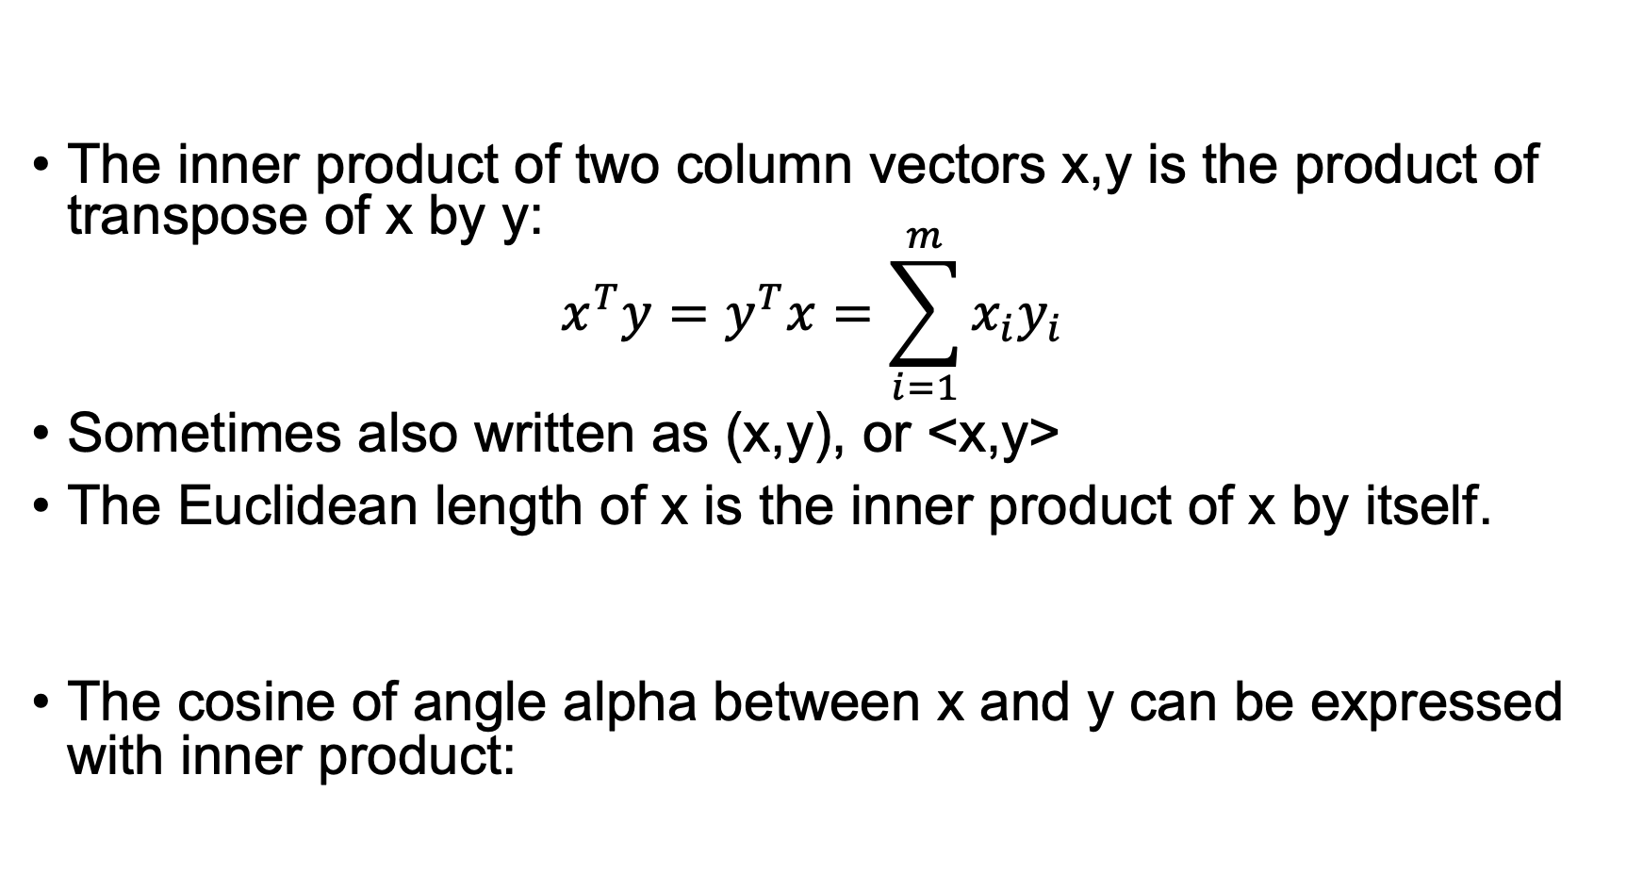
Inner Product (1)
The inner product of two column vectors x,y is the product of transpose of x by y: $x^{T}y=y^{T}x=\sum_{i=1}^{m}{x_{i}y_{i}}$
Sometimes also written as (x,y), or <x,y>
The Euclidean length of x is the inner product of x by itself.
The cosine of angle alpha between x and y can be expressed with inner product:

Slide 15
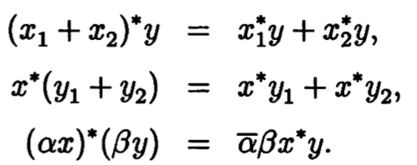


Inner Product (2)
Inner product is bilinear:
Some formulas for matrix products:

Slide 16
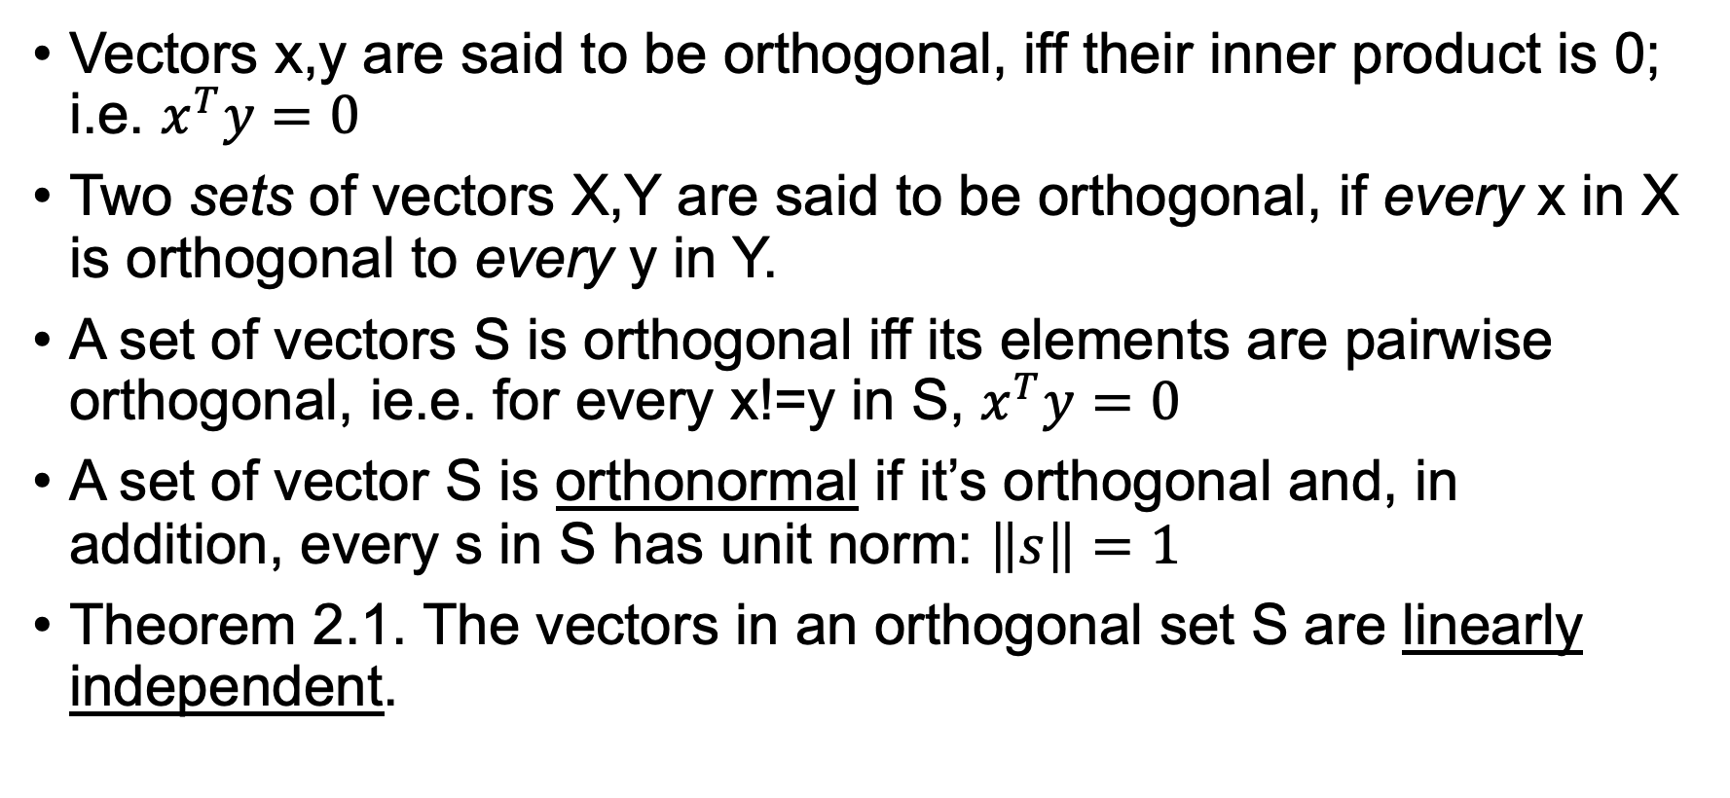
Orthogonal Vectors
Vectors x,y are said to be orthogonal, iff their inner product is 0; i.e. $x^{T}y=0$
Two sets of vectors X,Y are said to be orthogonal, if every x in X is orthogonal to every y in Y.
A set of vectors S is orthogonal iff its elements are pairwise orthogonal, ie.e. for every x!=y in S, $x^{T}y=0$
A set of vector S is orthonormal if it’s orthogonal and, in addition, every s in S has unit norm: $\left\|s\right\|=1$
Theorem 2.1. The vectors in an orthogonal set S are linearly independent.

Slide 17

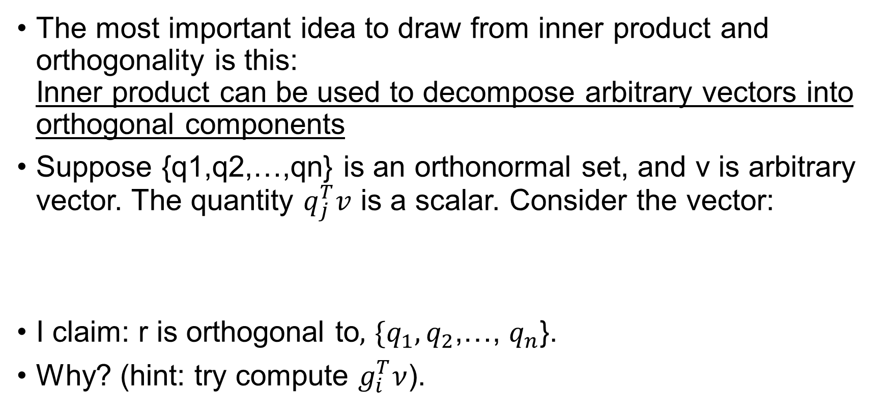
Components of a Vector (1)
The most important idea to draw from inner product and orthogonality is this: Inner product can be used to decompose arbitrary vectors into orthogonal components
Suppose {q1,q2,…,qn} is an orthonormal set, and v is arbitrary vector. The quantity $q_{j}^{T}v$ is a scalar. Consider the vector:
I claim: r is orthogonal to$,$ ${\{q}_{1},q_{2}$,…, $q_{n}$}.
Why? (hint: try compute $g_{i}^{T}ν$).

Slide 18

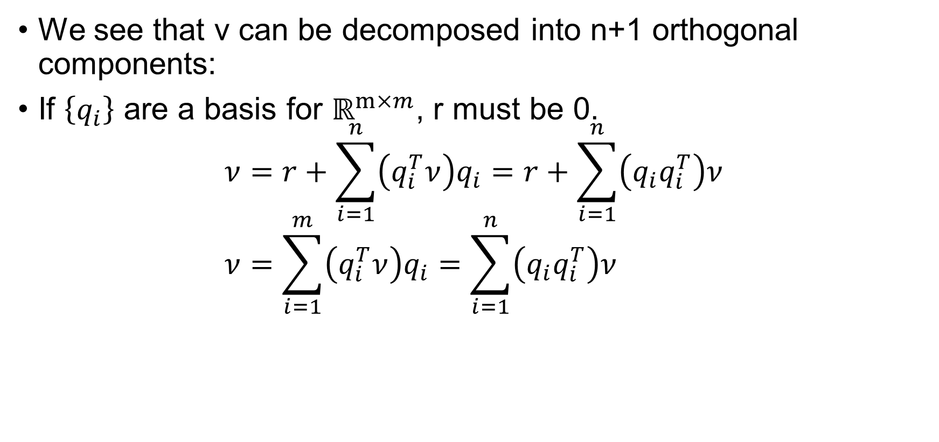





Components of a Vector (2)
We see that v can be decomposed into n+1 orthogonal components:
If $\left\{q_{i}\right\}$ are a basis for $ℝ^{m×m}$, r must be 0. $ν=r+\sum_{i=1}^{n}{\left(q_{i}^{T}ν\right)q_{i}}=r+\sum_{i=1}^{n}{\left(q_{i}q_{i}^{T}\right)ν}$ $ν=\sum_{i=1}^{m}{\left(q_{i}^{T}ν\right)q_{i}}=\sum_{i=1}^{n}{\left(q_{i}q_{i}^{T}\right)ν}$

Slide 19
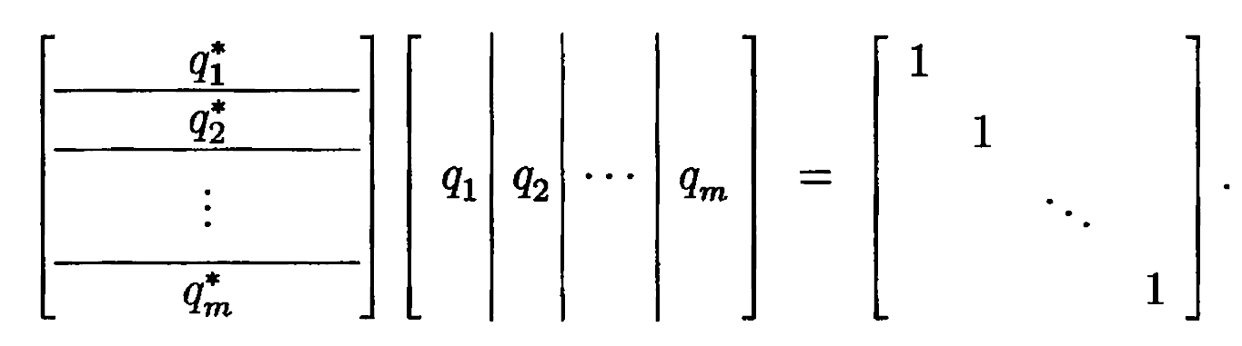

Orthogonal(Unitary) Matrices
A square matrix $Q∈ℂ^{m×m}$ is unitary (in the real case, we say orthogonal) iff $Q^{∗}=Q^{−1}$, i.e. $Q^{∗}Q=I$

Slide 20
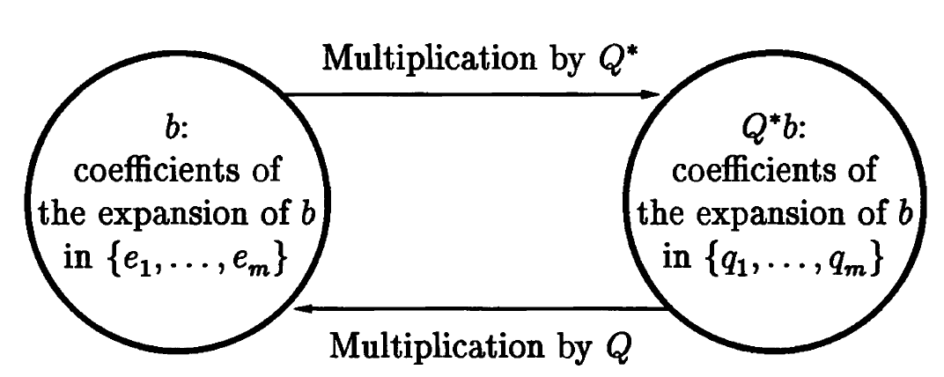

Multiplication by a Unitary Matrix (1)
Last time, we discussed the interpretation of matrix-vector products $Ax$ and $A^{−1}b$. If $A$ is a unitary matrix $Q$ these products become $Qx$ and $Q^{∗}b$, and the same interpretation is still valid.

Slide 21
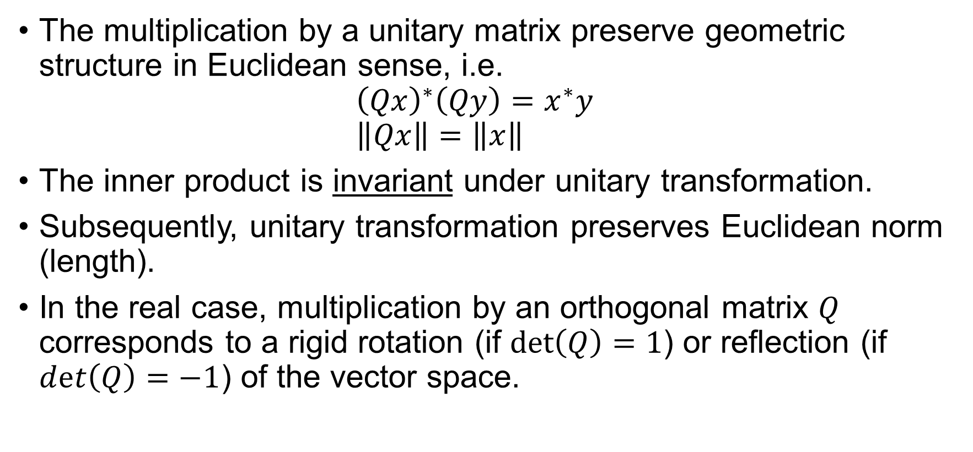
Multiplication by a Unitary Matrix (2)
The multiplication by a unitary matrix preserve geometric structure in Euclidean sense, i.e. ${\left(Qx\right)}^{∗}\left(Qy\right)=x^{∗}y$ $\left\|Qx\right\|=\left\|x\right\|$
The inner product is invariant under unitary transformation.
Subsequently, unitary transformation preserves Euclidean norm (length).
In the real case, multiplication by an orthogonal matrix $Q$ corresponds to a rigid rotation (if $\det\left(Q\right)=1$) or reflection (if $dⅇt\left(Q\right)=−1$) of the vector space.

Slide 22
Norms
Corresponds to Lecture 3 in NLA book.

Slide 23
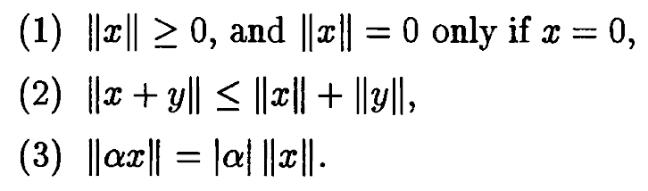
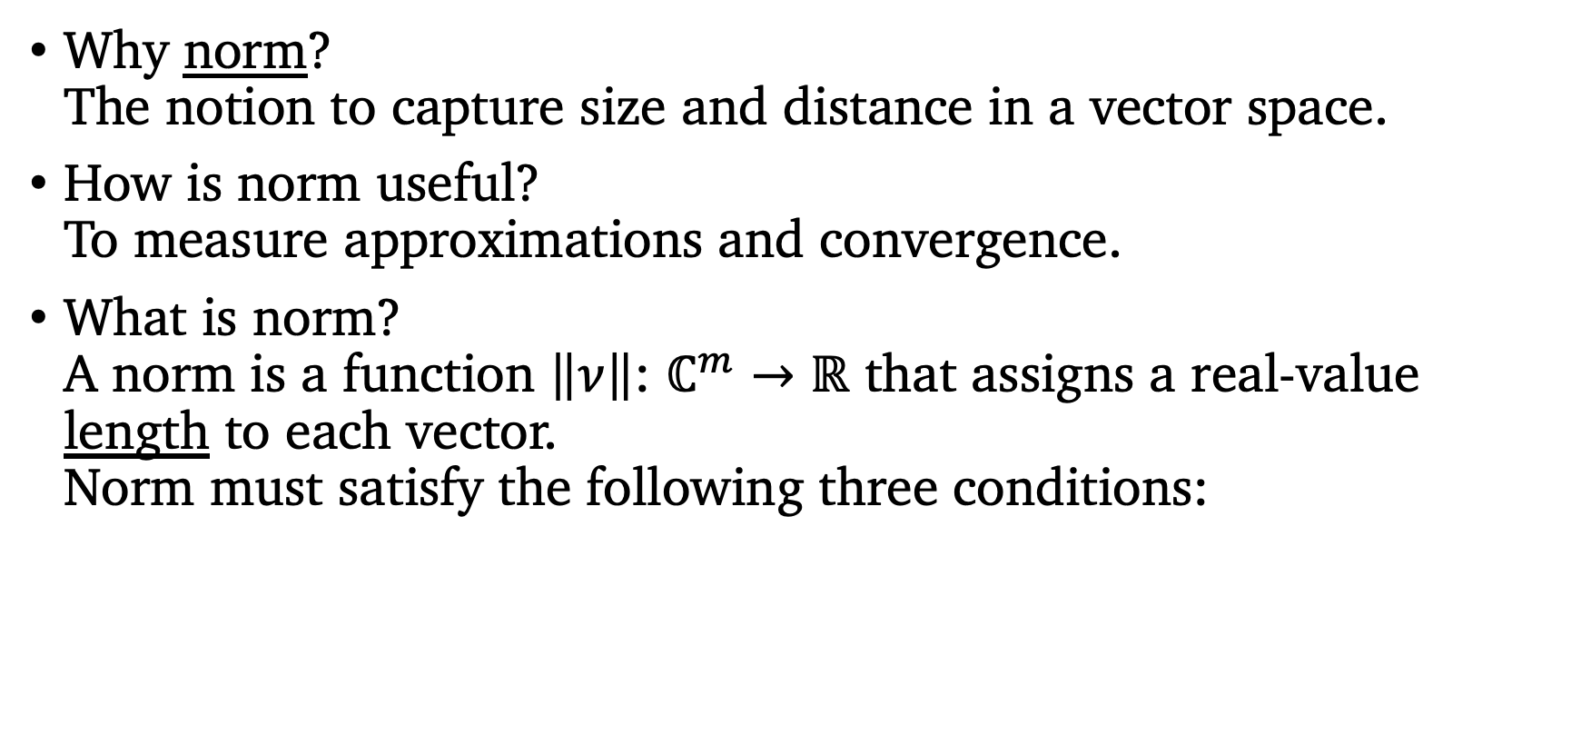
Vector Norm
Why norm? The notion to capture size and distance in a vector space.
How is norm useful? To measure approximations and convergence.
What is norm? A norm is a function $\left\|ν\right\|$: $ℂ^{m}→ℝ$ that assigns a real-value length to each vector. Norm must satisfy the following three conditions:

Slide 24
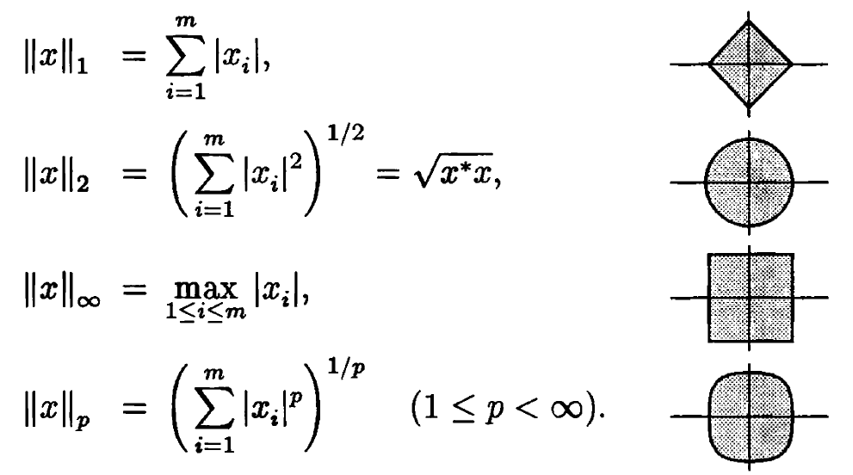

The p-norm of Vectors
The most important class of vector norms, the p-norm and their closed unit ball $\left\{x∈ℂ^{m}:\left\|x\right\|≤1\right\}$ for m=2:

Slide 25

Matrix Norms Induced by Vector Norms
We know the norm of vectors, how about norms of matrices?
Induced matrix norm:$A∈ℂ^{m×n}$, ${\left\|A\right\|}_{\left(m,n\right)}=\max{\frac{{\left\|Ax\right\|}_{\left(m\right)}}{{\left\|x\right\|}_{\left(n\right)}}}$ The maximum factor by which A can stretch a vector x.

Slide 26
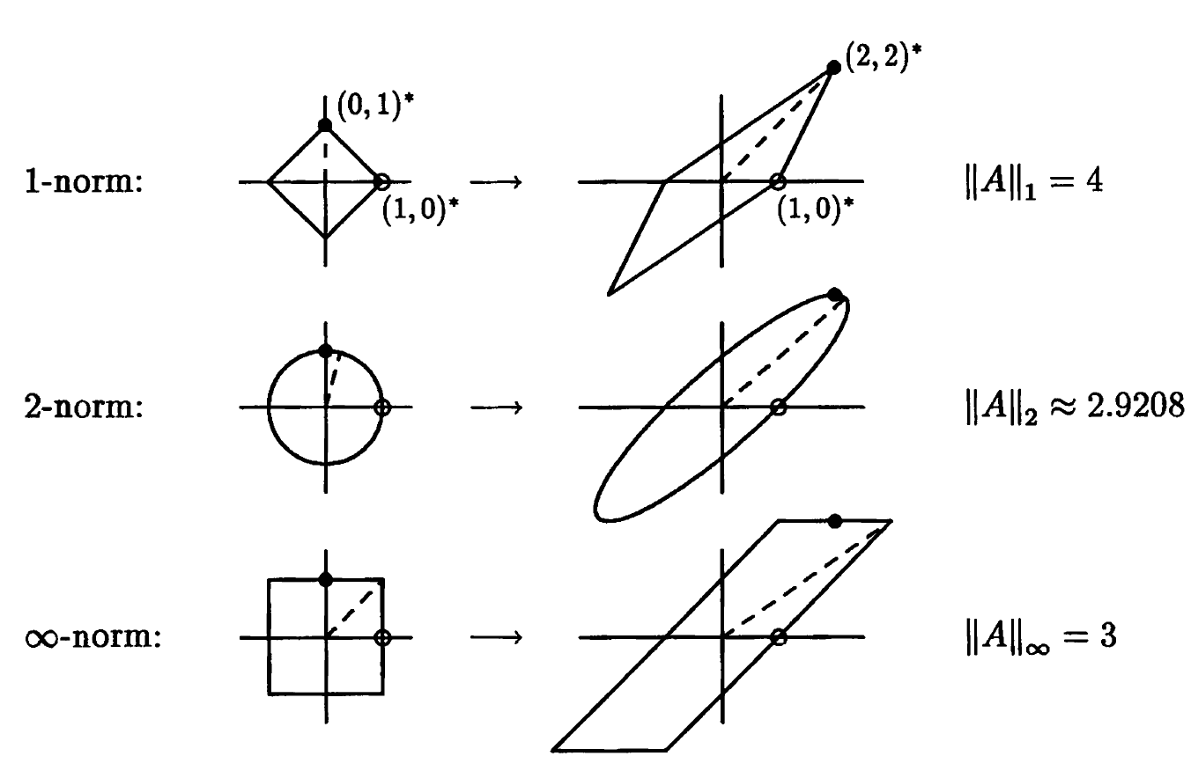
Example
The matrix $A=\left[\begin{matrix}1 & 2 \\ 0 & 2\end{matrix}\right]$ maps $ℝ^{2}$ to $ℝ^{2}$; the following figure depicts its action on the unit ball defined by 1-, 2-, $∝$-norms.

Slide 27
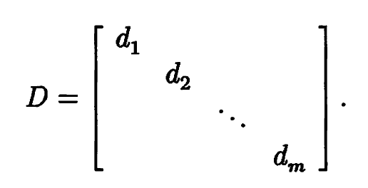
Example
The p-norm of a Diagonal Matrix. Let
In 2-norm, how does D map a unit ball? An ellipse whose semiaxis lengths are given by $\left|ⅆ_{i}\right|$. The most amplified factor thus is ${\left\|D\right\|}_{2}=\max_{1≤ⅈ≤m}\left\{\left|ⅆ_{i}\right|\right\}$
In fact, this generates to arbitrary p-norm (only for diagonal matrix!!!): ${\left\|D\right\|}_{p}=\max_{1≤ⅈ≤m}\left\{\left|ⅆ_{i}\right|\right\}$

Slide 28
$∞$-norm and 1-norm of Matrix
The 1-norm of a matrix A is the maximum column sum of A. Why? Hint: write $A=\left[a_{1}\left|a_{2}\right|\left.…\right|a_{n}\right]$
The $∞$-norm of a matrix A is the maximum row sum of A. Why?

Slide 29
The 2-norm of an Outer-Product
The rank 1 matrix of outer product of column vectors u and v: ${\left\|uν^{∗}\right\|}_{2}={\left\|u\right\|}_{2}{\left\|ν\right\|}_{2}$ why? Hint: try the definition. And Cauchy-Schwarz inequality $\left|x^{∗}y\right|≤{\left\|x\right\|}_{2}{\left\|y\right\|}_{2}$

Slide 30
Bounding $\left\|AB\right\|$ in an Induced Matrix Norm
The induced norm of matrix product can be bounded: $A∈ℝ^{l×m},B∈ℝ^{m×n}$ ${\left\|AB\right\|}_{\left(l,n\right)}≤{\left\|A\right\|}_{\left(l,m\right)}×{\left\|B\right\|}_{\left(m,n\right)}$

Slide 31
Frobenius Norm
The most important matrix norm that is not induced by a vector norm is the Frobenius norm (F-norm) ${\left\|A\right\|}_{F}=(\sum_{i=1}^{m}{{\sum_{j=1}^{n}{{\left|a_{ij}\right|}^{2})}}^{1/2}}$
${\left\|A\right\|}_{F}=\sqrt{\operatorname{tr}\left(A^{∗}A\right)}=\sqrt{\operatorname{tr}\left(AA^{∗}\right)}$, where tr(B) denotes the trace of B, the sum of diagonal entries.
Like induced matrix norm, the F-norm can be used to bound products of matrices. ${\left\|AB\right\|}_{F}^{2}≤{\left\|A\right\|}_{F}{\left\|B\right\|}_{F}$

Slide 32
Invariance under Unitary Multiplication
Theorem 3.1 For any $A∈ℂ^{m×n}$ and unitary $Q∈ℂ^{m×m}$ we have ${\left\|QA\right\|}_{2}={\left\|A\right\|}_{2}$ ${\left\|QA\right\|}_{F}={\left\|A\right\|}_{F}$ why? For 2-norm, think the definition of 2-norm. For F-norm, use the trace equality ${\left\|A\right\|}_{F}=\sqrt{\operatorname{tr}\left(AA^{∗}\right)}$
The theorem remains valid if $Q$ is a rectangular matrix with orthonormal columns, that is, $Q∈ℂ^{p×m}$ with p>m.
Analogous results hold for multiplication by unitary matrices on the right. The matrix can be generalized to rectangular matrix with orthonormal rows.

