Slide 1
COSC6464 Lecture 4 Projection
NLA Chapter 6

Slide 2
Orthogonality
In this lecture and the next few, we are going to study the QR factorization and related orthogonal transformation and its use in least square problem.
This is kind of unusual approach (usually LU factorization comes first) but I’m convinced that QR factorization (and orthogonality) is the more important and should be taught first.
In this lecture we are focusing on a specific class of linear transformations (represented by a matrix) called projectors
Projector can be either orthogonal or oblique (non-orthogonal); for now orthogonal projection is more important.

Slide 3
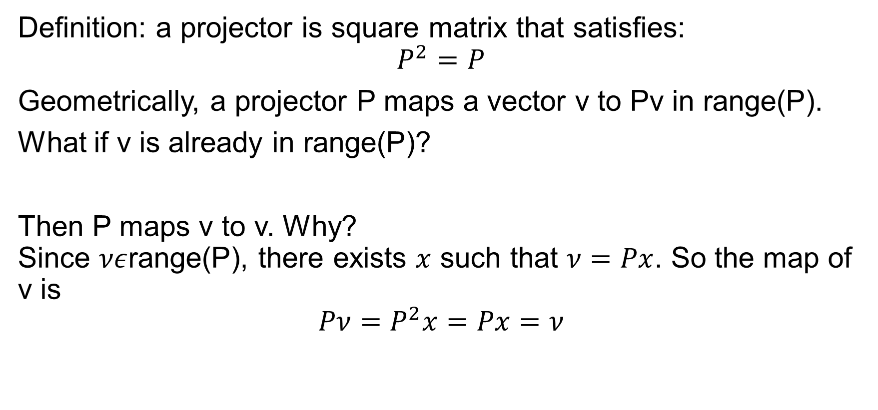
Projector (projection matrix)
Definition: a projector is square matrix that satisfies: $$P^{2}=P$$
Geometrically, a projector P maps a vector v to Pv in range(P).
What if v is already in range(P)?
Then P maps v to v. Why? Since $νε$range(P), there exists $x$ such that $ν=Px$. So the map of v is
$$Pν=P^{2}x=Px=ν$$

Slide 4
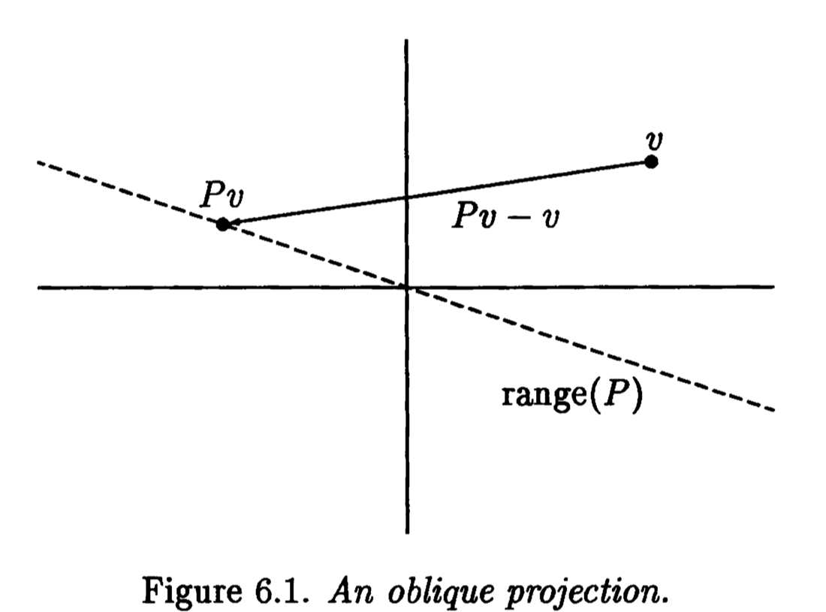
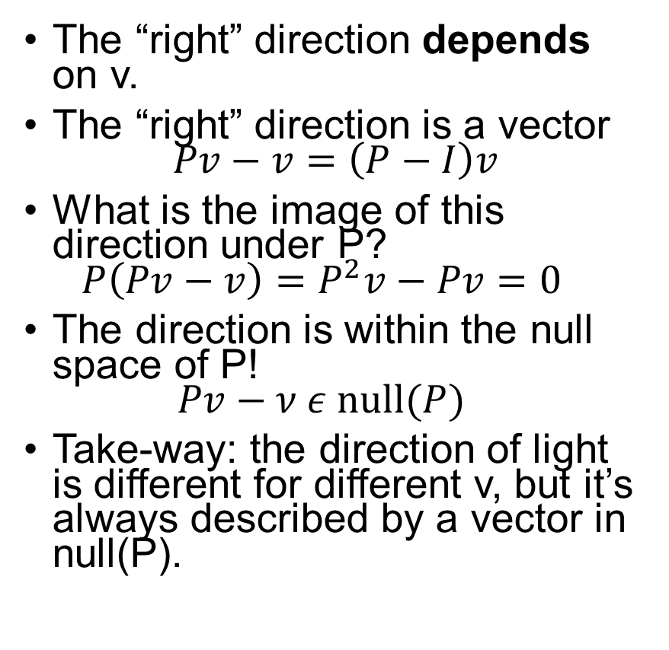
Projector Geometry
If you were to shine a light at the “right” direction (which is Pv-v) then Pv is the shadow of v.
The “right” direction depends on v.
The “right” direction is a vector $Pv−v=\left(P−I\right)v$
What is the image of this direction under P? $P\left(Pv−v\right)=P^{2}v−Pv=0$
The direction is within the null space of P! $Pv−ν ε null(P)$
Take-way: the direction of light is different for different v, but it’s always described by a vector in null(P).

Slide 5
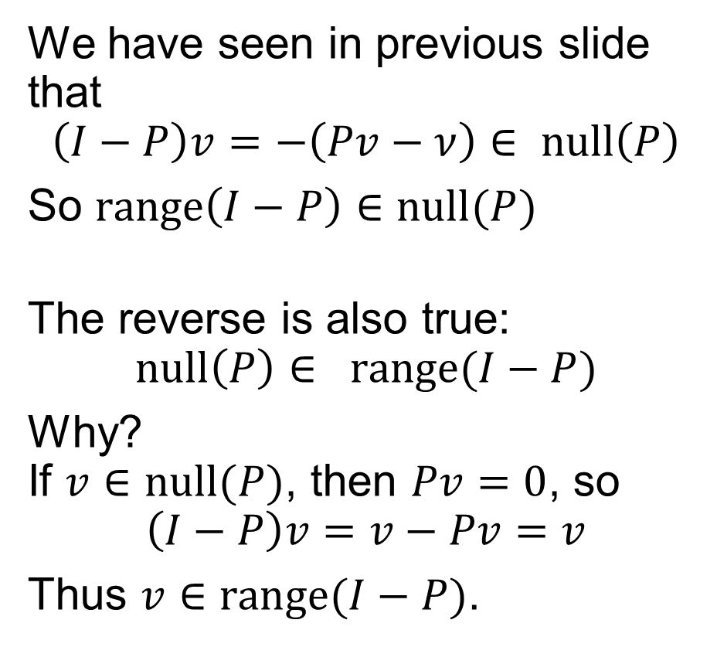
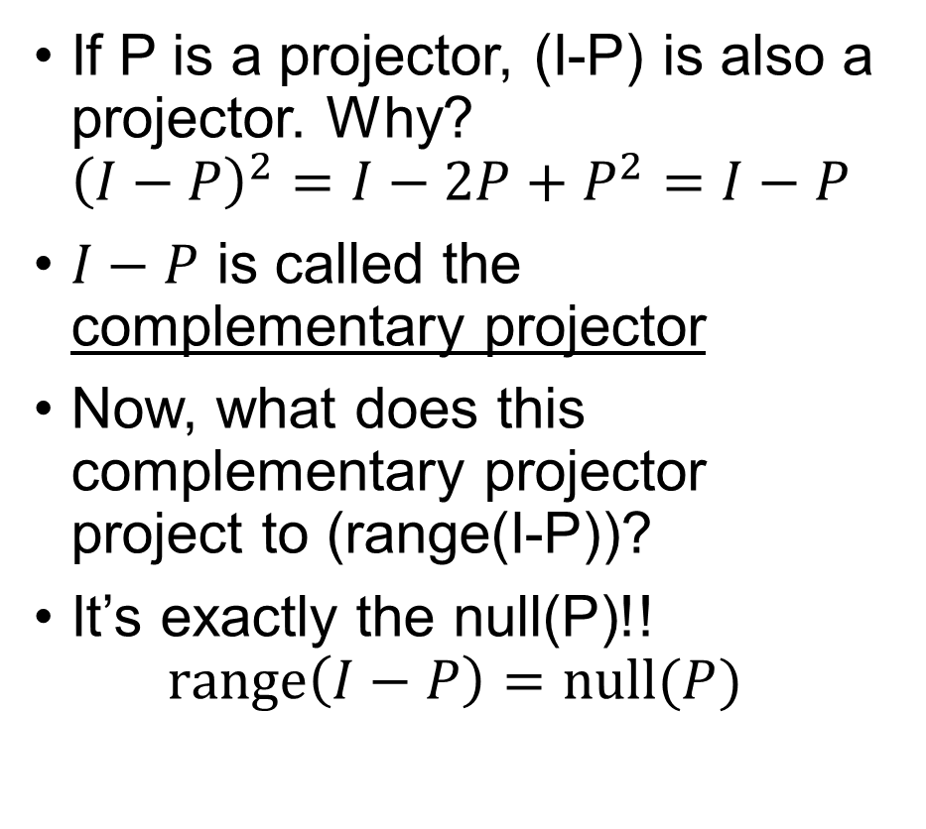
Complementary Projector
If P is a projector, (I-P) is also a projector. Why? ${\left(I−P\right)}^{2}=I−2P+P^{2}=I−P$
$I−P$ is called the complementary projector
Now, what does this complementary projector project to (range(I-P))?
It’s exactly the null(P)!! $range\left(I−P\right)=null(P)$
We have seen in previous slide that $$\left(I−P\right)v=−\left(Pv−ν\right)∈ null\left(P\right)$$
So $range\left(I−P\right)∈null(P)$
The reverse is also true: $$null\left(P\right)∈ range(I−P)$$
Why? If $v∈null(P)$, then $Pv=0$, so $$\left(I−P\right)v=v−Pv=v$$
Thus $v∈range(I−P)$.

Slide 6

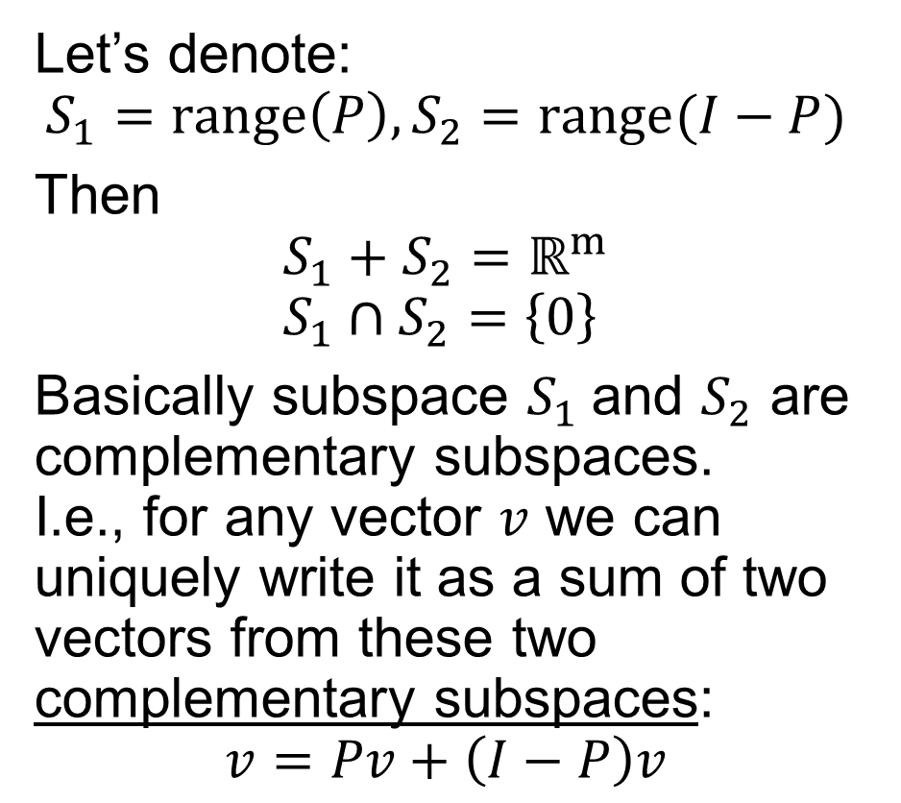

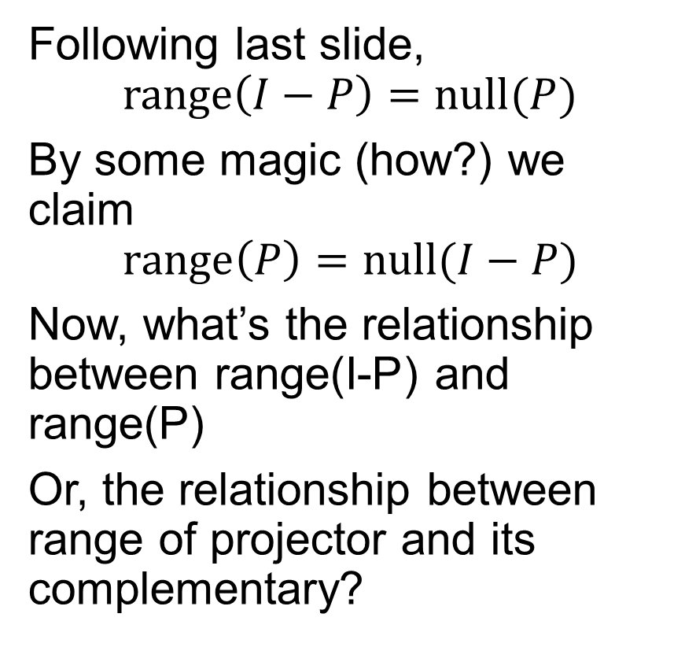


Complementary Projector (cont’d)
Following last slide, $$range\left(I−P\right)=null(P)$$
By some magic (how?) we claim $$range\left(P\right)=null(I−P)$$
Now, what’s the relationship between range(I-P) and range(P)
Or, the relationship between range of projector and its complementary?
Let’s denote: $$S_{1}=range\left(P\right), S_{2}=range(I−P)$$
Then $$S_{1}+S_{2}=ℝ^{m} \\ S_{1}∩S_{2}=\left\{0\right\}$$
Basically subspace $S_{1}$and $S_{2}$ are complementary subspaces. I.e., for any vector $v$ we can uniquely write it as a sum of two vectors from these two complementary subspaces: $$v=Pv+\left(I−P\right)v$$

Slide 7
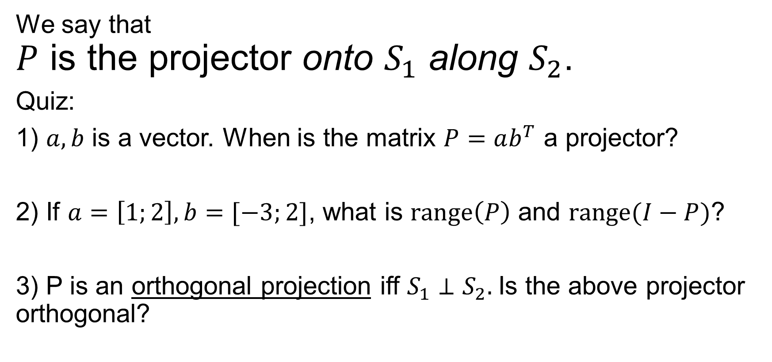
Complementary Projector (cont’d)
We say that $P$ is the projector onto $S_{1}$ along $S_{2}$.
Quiz:
1) $a,b$ is a vector. When is the matrix $P=ab^{T}$ a projector?
2) If $a=\left[1;2\right], b=[−3;2]$, what is $range\left(P\right)$ and $range(I−P)$?
3) P is an orthogonal projection iff $S_{1}⊥S_{2}.$Is the above projector orthogonal?

Slide 8
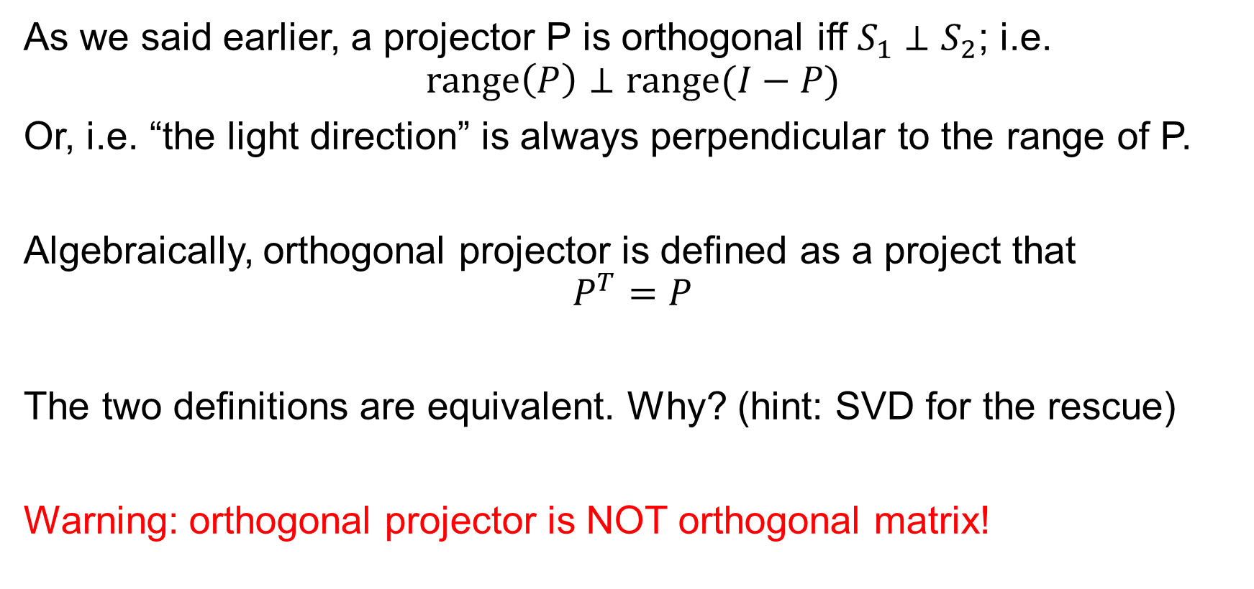
Orthogonal projector
As we said earlier, a projector P is orthogonal iff $S_{1}⊥S_{2}$; i.e. $$range\left(P\right)⊥range(I−P)$$
Or, i.e. “the light direction” is always perpendicular to the range of P.
Algebraically, orthogonal projector is defined as a project that $$P^{T}=P$$
The two definitions are equivalent. Why? (hint: SVD for the rescue)
Warning: orthogonal projector is NOT orthogonal matrix!

Slide 9
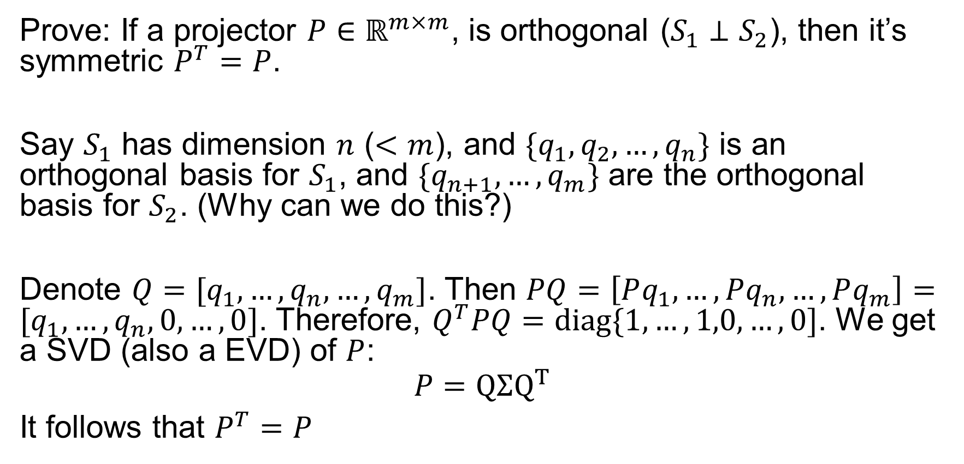

Orthogonal Projector, $P^{T}=P$
Prove: If a projector $P∈ℝ^{m×m}$, is orthogonal ($S_{1}⊥S_{2}$), then it’s symmetric $P^{T}=P$.
Say $S_{1}$ has dimension $n$ ($<m$), and ${\{q}_{1},q_{2},…,q_{n}\}$ is an orthogonal basis for $S_{1}$, and $\{q_{n+1},…,q_{m}\}$ are the orthogonal basis for $S_{2}$. (Why can we do this?)
Denote $Q=[q_{1},…,q_{n},…,q_{m}]$. Then $PQ=\left[Pq_{1},…,Pq_{n},…,Pq_{m}\right]=[q_{1},…,q_{n},0,…,0]$. Therefore, $Q^{T}PQ=diag\{1,…,1,0,…,0]$. We get a SVD (also a EVD) of $P$:
$$P=QΣQ^{T}$$
It follows that $P^{T}=P$

Slide 10
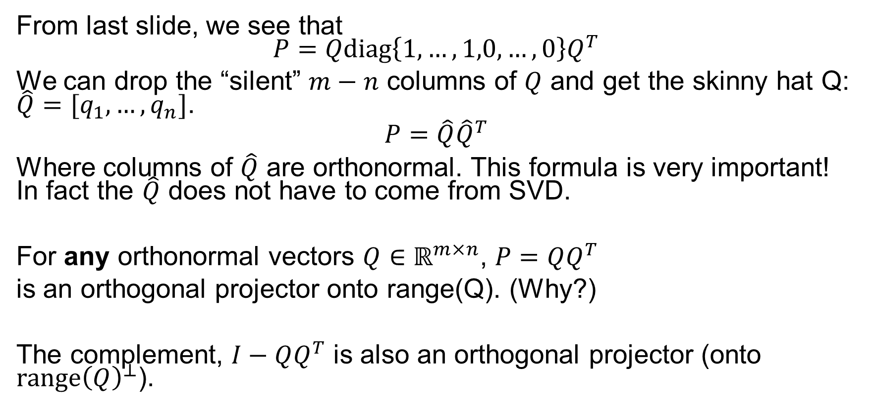
Projection with Orthogonal Basis
From last slide, we see that $$P=Qdiag\left\{1,…,1,0,…,0\right\}Q^{T}$$
We can drop the “silent” $m−n$ columns of $Q$ and get the skinny hat Q: $\hat{Q}=[q_{1},…,q_{n}]$.
$$P=\hat{Q}{\hat{Q}}^{T}$$
Where columns of $\hat{Q}$ are orthonormal. This formula is very important! In fact the $\hat{Q}$ does not have to come from SVD.
For any orthonormal vectors $Q∈ℝ^{m×n}$, $P=QQ^{T}$
is an orthogonal projector onto range(Q). (Why?)
The complement, $I−QQ^{T}$ is also an orthogonal projector (onto $range{\left(Q\right)}^{⊥}$).

Slide 11
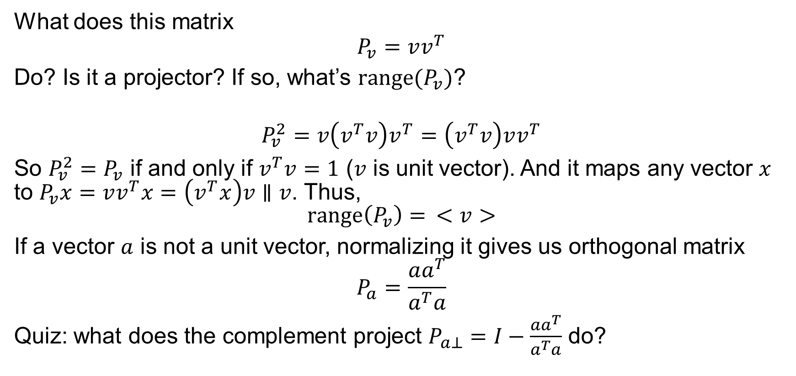
Example: rank-1 orthogonal projector
What does this matrix
$$P_{v}=vv^{T}$$
Do? Is it a projector? If so, what’s $range(P_{v})$?
$$P_{v}^{2}=v\left(v^{T}v\right)v^{T}=\left(v^{T}v\right)vv^{T}$$
So $P_{v}^{2}=P_{v}$ if and only if $v^{T}v=1$ ($v$ is unit vector). And it maps any vector $x$ to $P_{v}x=vv^{T}x=\left(v^{T}x\right)v∥v$. Thus, $$range\left(P_{v}\right)= <v>$$
If a vector $a$ is not a unit vector, normalizing it gives us orthogonal matrix
$$P_{a}=\frac{aa^{T}}{a^{T}a}$$
Quiz: what does the complement project $P_{a⊥}=I−\frac{aa^{T}}{a^{T}a}$ do?

Slide 12
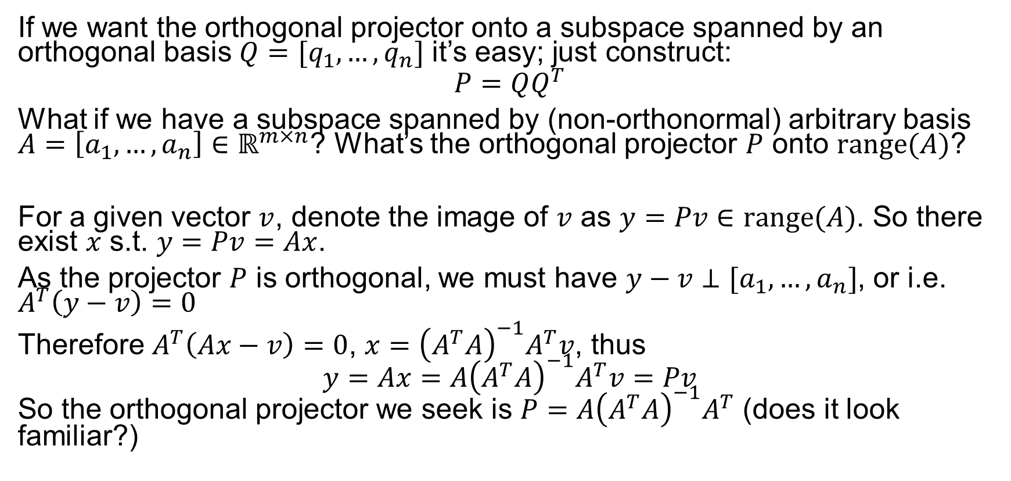
Orthogonal Projection From Arbitrary Basis
If we want the orthogonal projector onto a subspace spanned by an orthogonal basis $Q=[q_{1},…, q_{n}]$ it’s easy; just construct:
$$P=QQ^{T}$$
What if we have a subspace spanned by (non-orthonormal) arbitrary basis $A=\left[a_{1},…,a_{n}\right]∈ℝ^{m×n}$? What’s the orthogonal projector $P$ onto $range(A)$?
For a given vector $v$, denote the image of $v$ as $y=Pv∈range(A)$. So there exist $x$ s.t. $y=Pv=Ax$.
As the projector $P$ is orthogonal, we must have $y−v⊥[a_{1},…,a_{n}]$, or i.e. $A^{T}\left(y−v\right)=0$
Therefore $A^{T}\left(Ax−v\right)=0$, $x={\left(A^{T}A\right)}^{−1}A^{T}v$, thus $$y=Ax=A{\left(A^{T}A\right)}^{−1}A^{T}v=Pv$$ So the orthogonal projector we seek is $P=$ $A{\left(A^{T}A\right)}^{−1}A^{T}$ (does it look familiar?)

Slide 13
Questions
In 2d space, can we have an example of oblique (non-orthogonal projector)?
An example of orthogonal projector?
What are the eigenvalues/eigenvectors of a projector?
How about singular values/vectors of a projector?

