Slide 1
COSC6364 Lecture 5: QR factorization
NLA Chapter 7, 8, 10

Slide 2
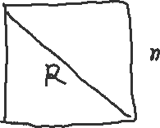

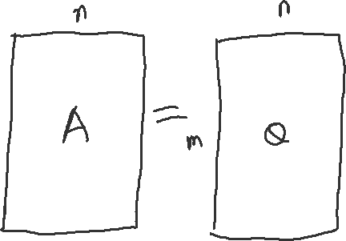
Probably the most important matrix factorization in NLA
QR factorization: (the reduce QR form)
$$A=\hat{Q}\hat{R}$$
Where $\hat{Q}$ columns are orthonormal and $\hat{R}$is upper triangular

Slide 3
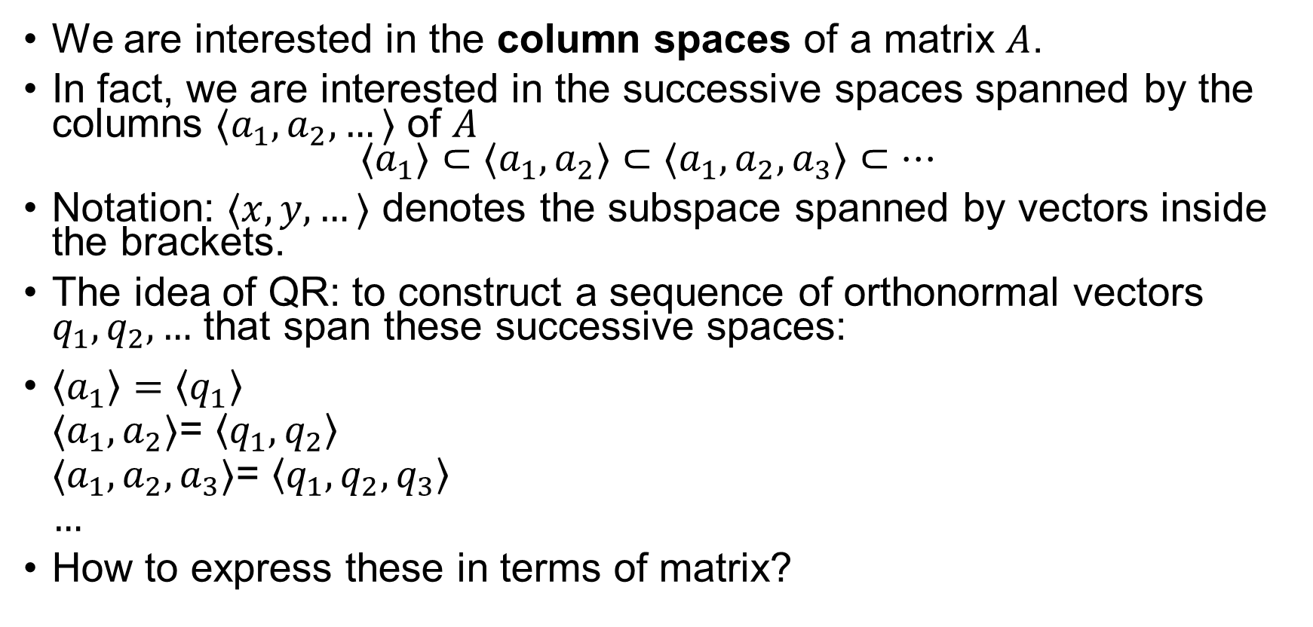
Reduced QR Factorization
We are interested in the column spaces of a matrix $A$.
In fact, we are interested in the successive spaces spanned by the columns $⟨a_{1},a_{2},…⟩$ of $A$ $⟨a_{1}⟩⊂⟨a_{1},a_{2}⟩⊂⟨a_{1},a_{2},a_{3}⟩⊂…$
Notation: $⟨x,y,…⟩$ denotes the subspace spanned by vectors inside the brackets.
The idea of QR: to construct a sequence of orthonormal vectors $q_{1},q_{2},…$ that span these successive spaces:
$\left\langle a_{1}\right\rangle =\left\langle q_{1}\right\rangle$ $⟨a_{1},a_{2}⟩$= $\left\langle q_{1},q_{2}\right\rangle$ $⟨a_{1},a_{2},a_{3}⟩$= $\left\langle q_{1},q_{2},q_{3}\right\rangle$ $…$
How to express these in terms of matrix?

Slide 4
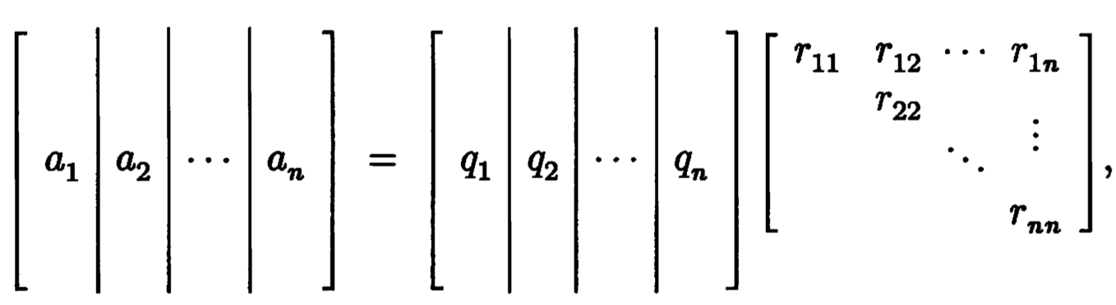

Reduced QR Factorization cont’d
To be precise, assume $A∈ℝ^{m×n} (m≥n)$ has full rank $n$. We want the sequence $q_{1},q_{2},…, q_{n}$ to have the property: $\left\langle q_{1},q_{2},…,q_{j}\right\rangle =$ $\left\langle a_{1},a_{2},…,a_{j}\right\rangle , j=1,…,n$
This amounts to
Or, $A=\hat{Q}\hat{R}$, where $\hat{Q}$ is a $m×n$ orthonormal columns, and $\hat{R}$ is $n×n$ upper triangular matrix. This is the reduced QR factorization.

Slide 5
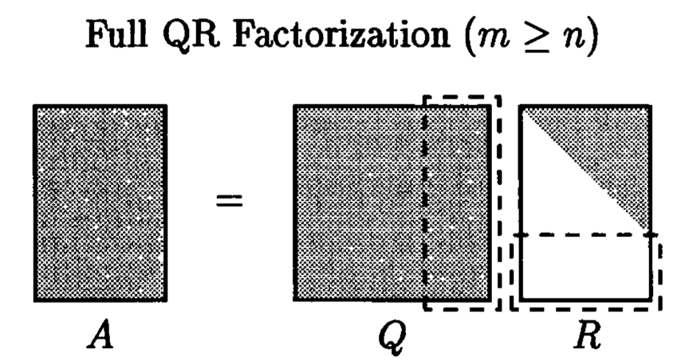

Full QR factorization
The full QR factorization extends $m−n$ columns to $\hat{Q}$ to make it square $m×m$. (Analogous to Full SVD vs. Reduced SVD)
The silent columns of $Q$ forms $range{\left(A\right)}^{⊥}$

Slide 6
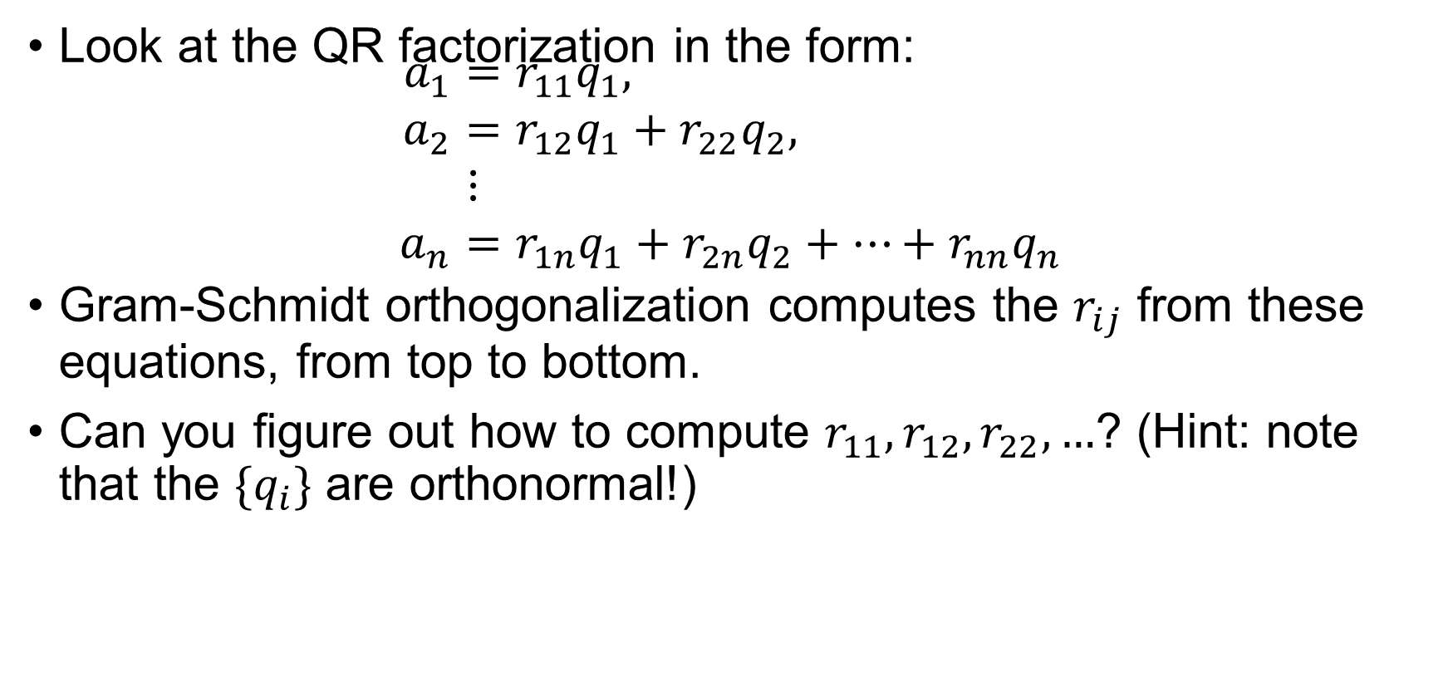
Gram-Schmidt Orthogonalization
Look at the QR factorization in the form: $\begin{aligned}a_{1}&=r_{11}q_{1}, \\ a_{2}&=r_{12}q_{1}+r_{22}q_{2}, \\ &⋮ \\ a_{n}&=r_{1n}q_{1}+r_{2n}q_{2}+…+r_{nn}q_{n}\end{aligned}$
Gram-Schmidt orthogonalization computes the $r_{ij}$ from these equations, from top to bottom.
Can you figure out how to compute $r_{11},r_{12},r_{22},…$? (Hint: note that the ${\{q}_{i}\}$ are orthonormal!)

Slide 7

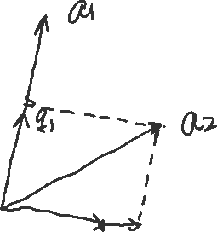
























GS-Ortho

Slide 8
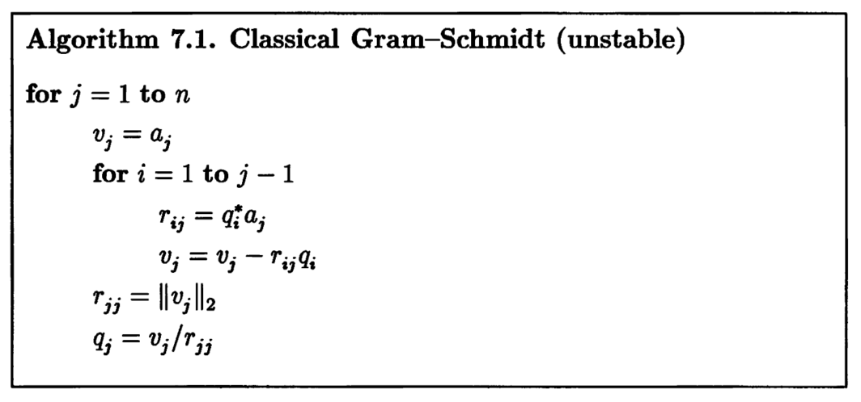
Classical Gram-Schmidt (CGS): Careful, may not be stable!
Conceptually simple to understand but numerical unstable
QR factorization by CGS:

Slide 9
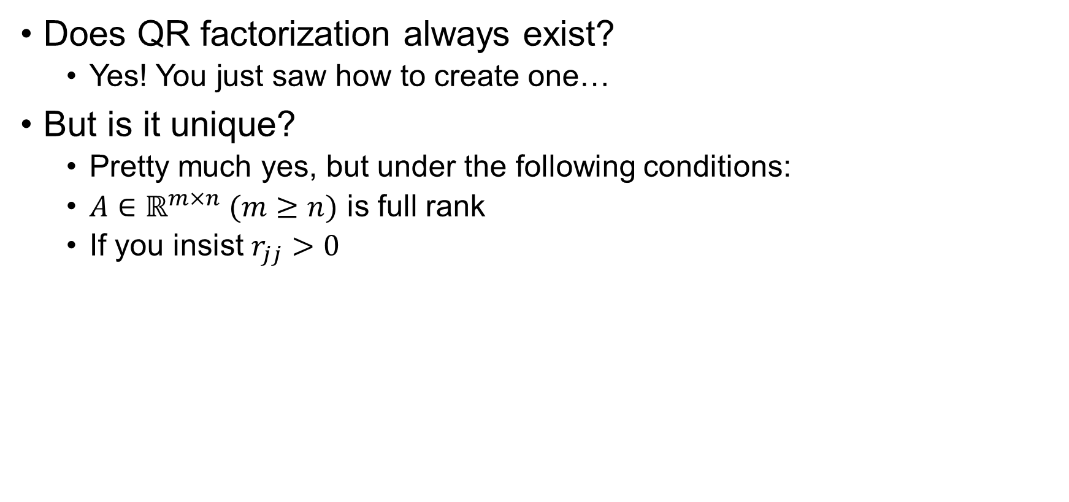
Existence and Uniqueness of (reduced) QR
Does QR factorization always exist?
Yes! You just saw how to create one…
But is it unique?
Pretty much yes, but under the following conditions:
$A∈ℝ^{m×n} (m≥n)$ is full rank
If you insist $r_{jj}>0$

Slide 10
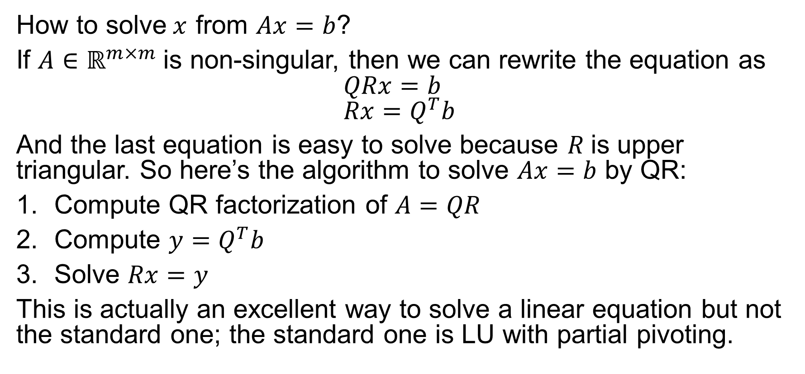

Solution of $Ax=b$ by QR Factorization
How to solve$x$ from $Ax=b$?
If $A∈ℝ^{m×m}$is non-singular, then we can rewrite the equation as $$QRx=b \\ Rx=Q^{T}b$$
And the last equation is easy to solve because $R$is upper triangular. So here’s the algorithm to solve $Ax=b$ by QR:
Compute QR factorization of $A=QR$
Compute $y=Q^{T}b$
Solve $Rx=y$
This is actually an excellent way to solve a linear equation but not the standard one; the standard one is LU with partial pivoting.

Slide 11
Gram-Schmidt Orthogonalization
GS is a “triangular orthogonalization”, which makes the columns of a matrix orthonormal via a sequence of right triangular matrix multiplications.
Soon we’ll learn another approach of doing QR factorization called “orthogonal triangularization” (Householder QR).

Slide 12
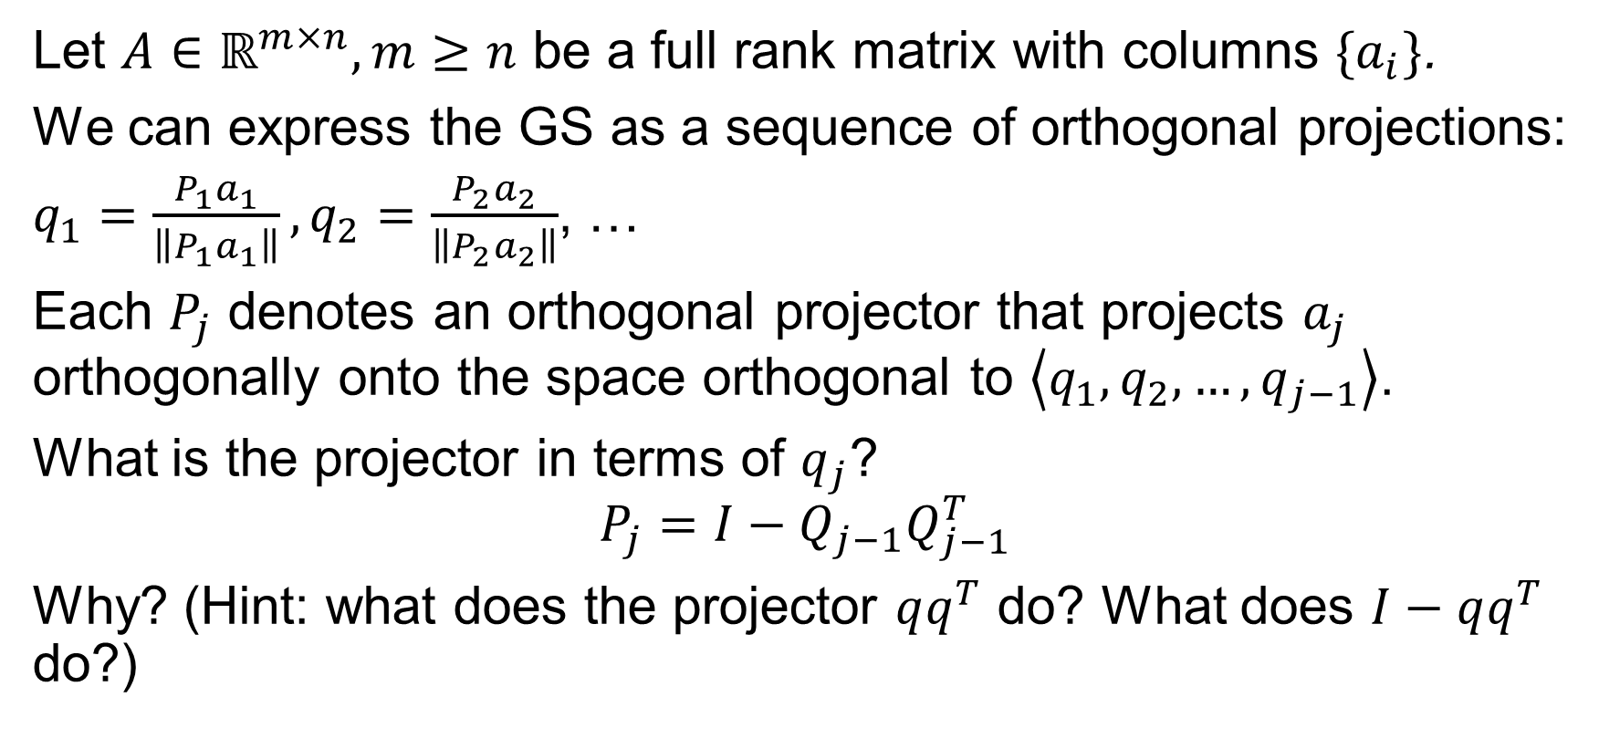
GS as a sequence of orthogonal projections
Let $A∈ℝ^{m×n}, m≥n$ be a full rank matrix with columns $\{a_{i}\}$.
We can express the GS as a sequence of orthogonal projections:
$q_{1}=\frac{P_{1}a_{1}}{\left\|P_{1}a_{1}\right\|}, q_{2}=\frac{P_{2}a_{2}}{\left\|P_{2}a_{2}\right\|}$, …
Each $P_{j}$ denotes an orthogonal projector that projects $a_{j}$ orthogonally onto the space orthogonal to $\left\langle q_{1},q_{2},…,q_{j−1}\right\rangle$.
What is the projector in terms of $q_{j}$?
$$P_{j}=I−Q_{j−1}Q_{j−1}^{T}$$
Why? (Hint: what does the projector $qq^{T}$ do? What does $I−qq^{T}$ do?)

Slide 13
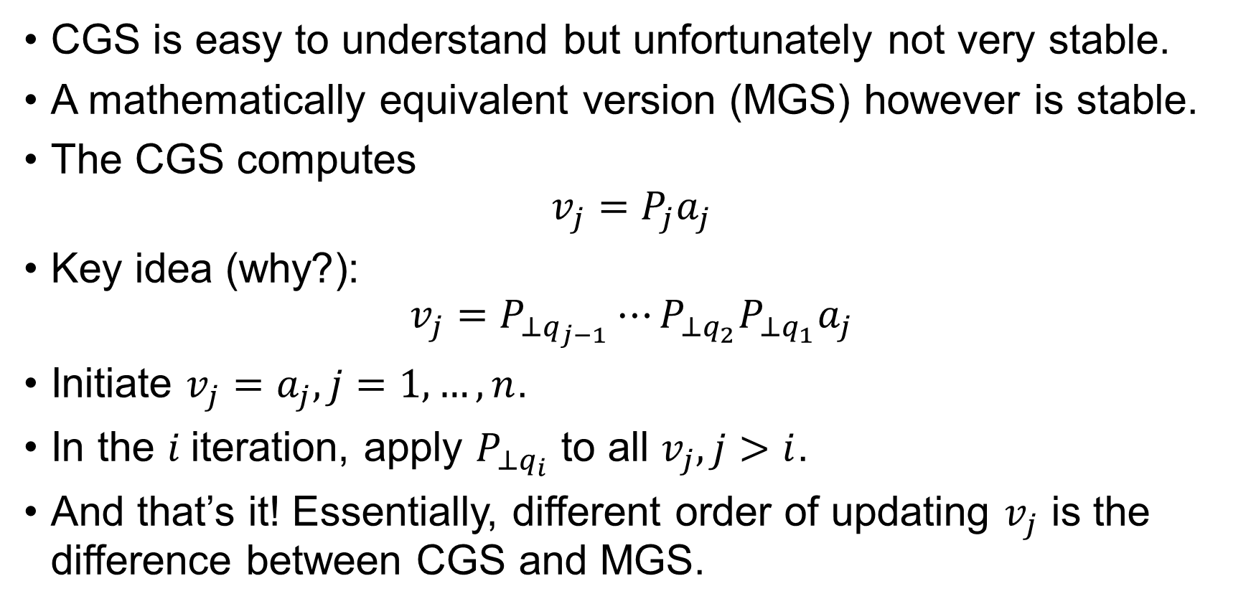
Modified Gram-Schmidt (MGS)
CGS is easy to understand but unfortunately not very stable.
A mathematically equivalent version (MGS) however is stable.
The CGS computes $v_{j}=P_{j}a_{j}$
Key idea (why?): $v_{j}=P_{⊥q_{j−1}}⋯P_{⊥q_{2}}P_{⊥q_{1}}a_{j}$
Initiate $v_{j}=a_{j},j=1,…,n$.
In the $i$iteration, apply $P_{⊥q_{i}}$ to all $v_{j}, j>i$.
And that’s it! Essentially, different order of updating $v_{j}$ is the difference between CGS and MGS.

Slide 14
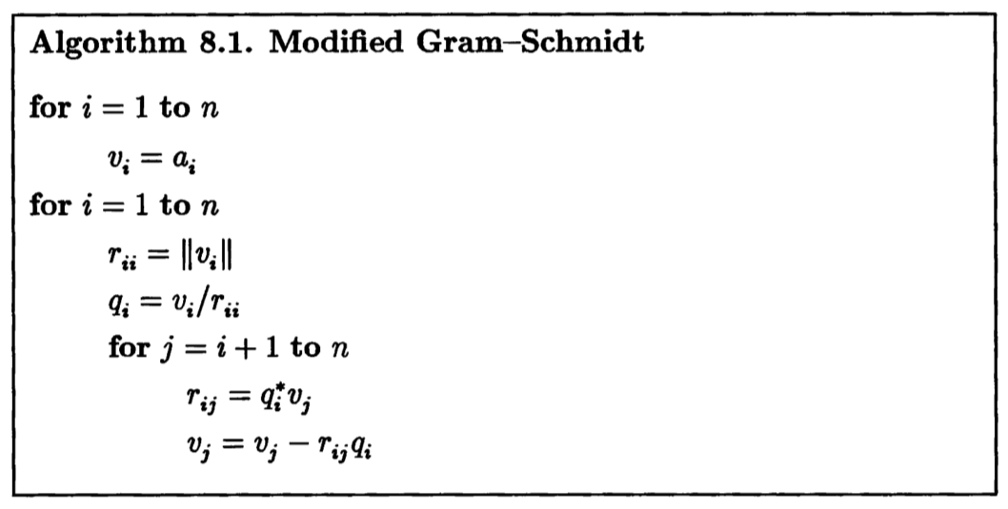
MGS:
Mathematically equivalent to CGS but numerically superior

Slide 15
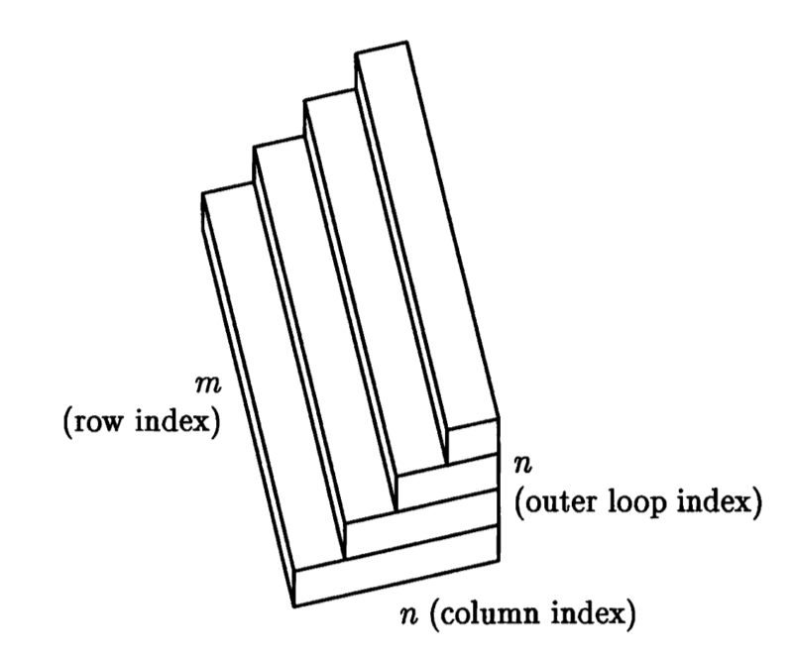

How much does Gram-Schmidt orthogonalization cost?
Unit of cost: floating point operations (FLOP)
Both CGS and MGS cost about the same: $2mn^{2}$ FLOPs.

Slide 16
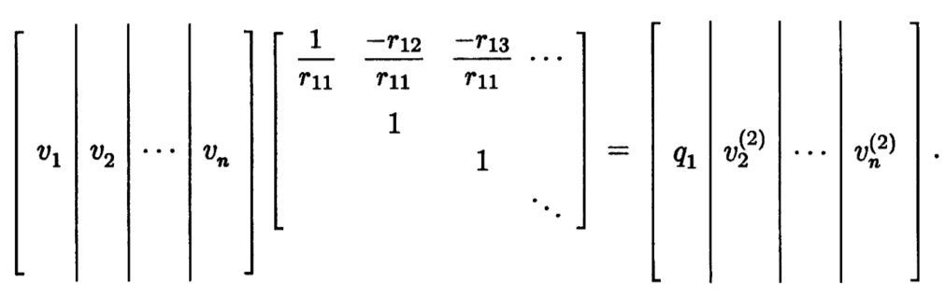
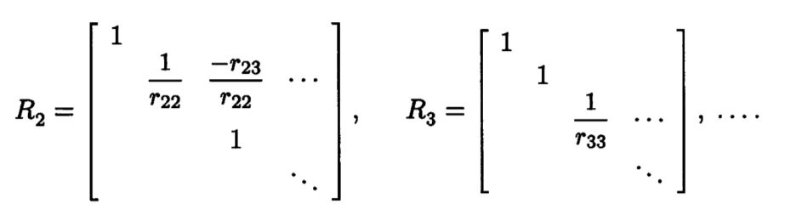

Gram-Schmidt as Triangular Orthogonalization
The way to look at MGS in matrix form:
The first outer iteration:
In general, each iteration is a right upper triangular matrix multiplication: $AR_{1}R_{2}⋯R_{n}=\hat{Q}$.

Slide 17
Householder Triangularization
Householder triangularization (HT) is another method to compute QR factorization. Compared to GS orthogonalization,
HT is more numerically stable.
Loss of ability as basis for iterative methods
HT is cheaper than GS (less FLOPs)
It’s orthogonal triangularization, rather than triangular orthogonalization:

Slide 18
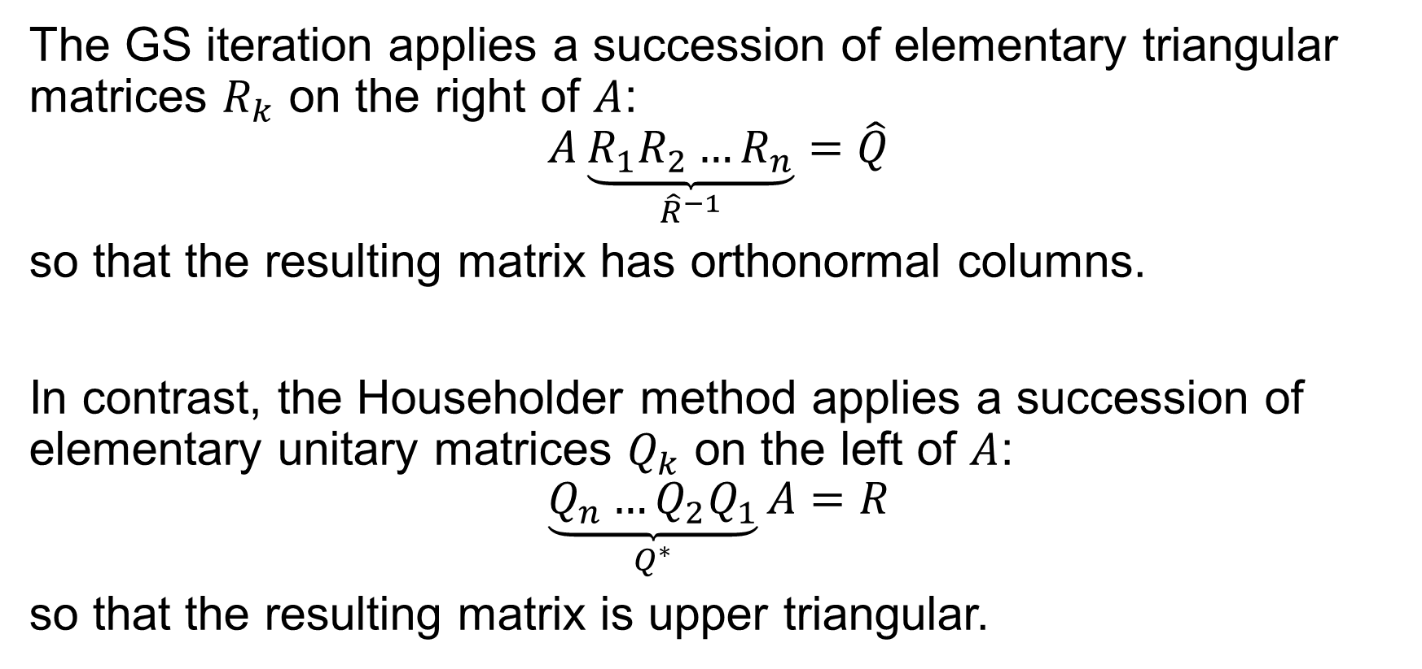
Householder vs. Gram-Schmidt
The GS iteration applies a succession of elementary triangular matrices $R_{k}$ on the right of $A$:
$$A\underset{{\hat{R}}^{−1}}{\underbrace{R_{1}R_{2}…R_{n}}}=\hat{Q}$$
so that the resulting matrix has orthonormal columns.
In contrast, the Householder method applies a succession of elementary unitary matrices $Q_{k}$ on the left of $A$:
$$\underset{Q^{∗}}{\underbrace{Q_{n}…Q_{2}Q_{1}}}A=R$$
so that the resulting matrix is upper triangular.

Slide 19
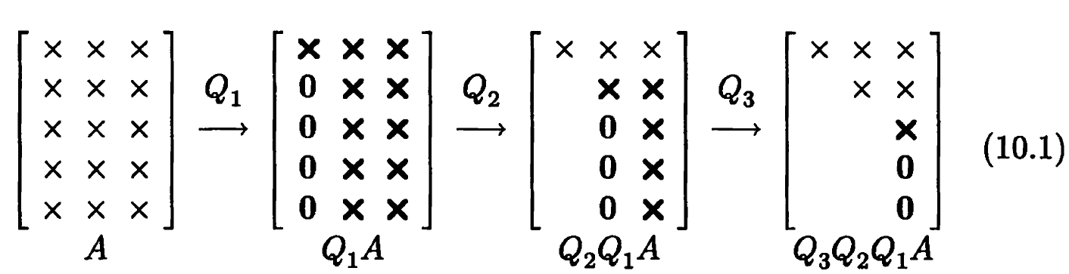

Triangularization by Introducing Zeros
At the heart of Householder Triangularization is the Householder reflector (orthogonal matrices) that introduces zeros below the diagonal in the $k$th column while preserving all the zeros previously introduced.

Slide 20
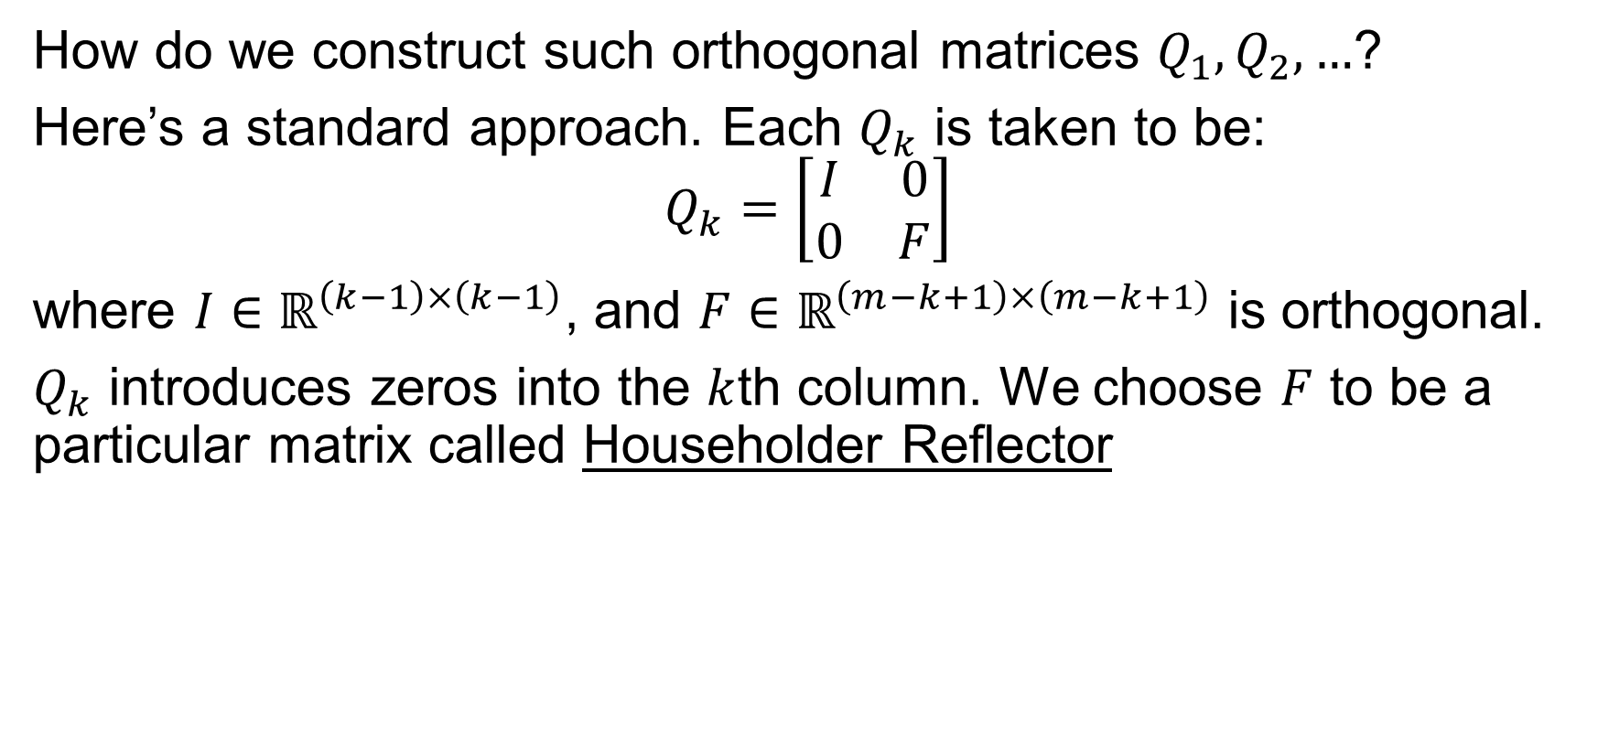
Householder Reflector (1/3)
How do we construct such orthogonal matrices $Q_{1}, Q_{2},…$?
Here’s a standard approach. Each $Q_{k}$ is taken to be:
$$Q_{k}=\left[\begin{matrix}I & 0 \\ 0 & F\end{matrix}\right]$$
where $I∈ℝ^{\left(k−1\right)×\left(k−1\right)}$, and $F∈ℝ^{\left(m−k+1\right)×\left(m−k+1\right)}$ is orthogonal.
$Q_{k}$ introduces zeros into the $k$th column. We choose $F$ to be a particular matrix called Householder Reflector

Slide 21
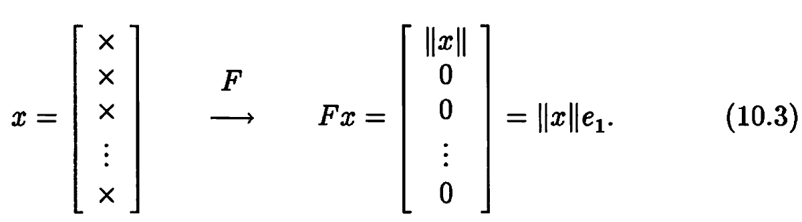

Householder Reflector (2/3)
Suppose, at the beginning of step $k$, the entries $k,k+1,…,m$ of the $k$th column are given by vector $x∈ℝ^{m−k+1}$. The Householder reflector $F$ should effect the following map:
(Why should the first component of $Fx$be $‖x‖$?)

Slide 22
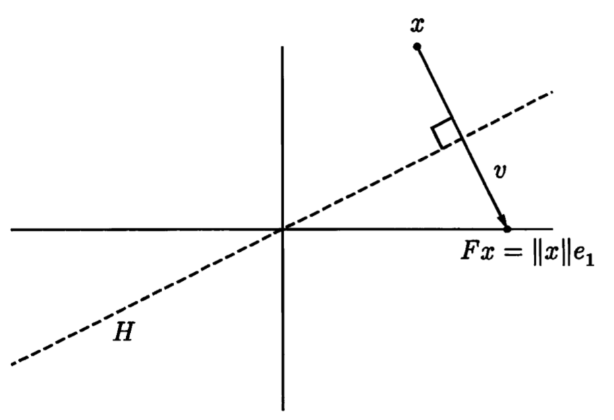
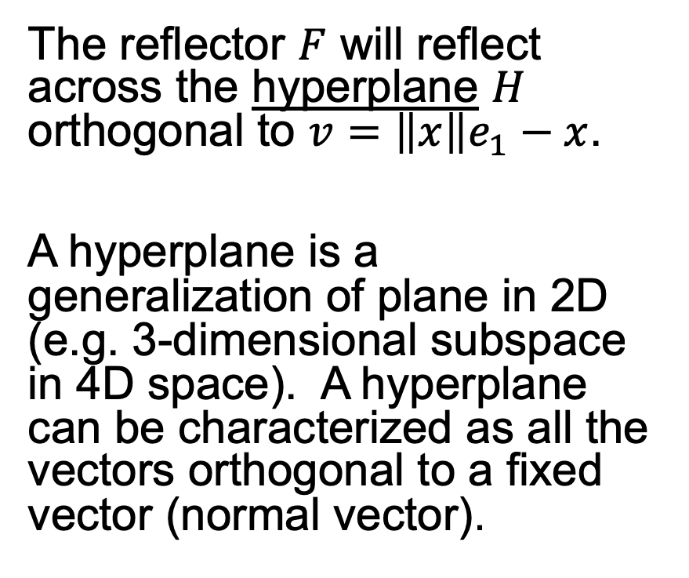
Householder Reflector (3/3)
The reflector $F$ will reflect across the hyperplane $H$ orthogonal to $v=\left\|x\right\|e_{1}−x$.
A hyperplane is a generalization of plane in 2D (e.g. 3-dimensional subspace in 4D space). A hyperplane can be characterized as all the vectors orthogonal to a fixed vector (normal vector).

Slide 23
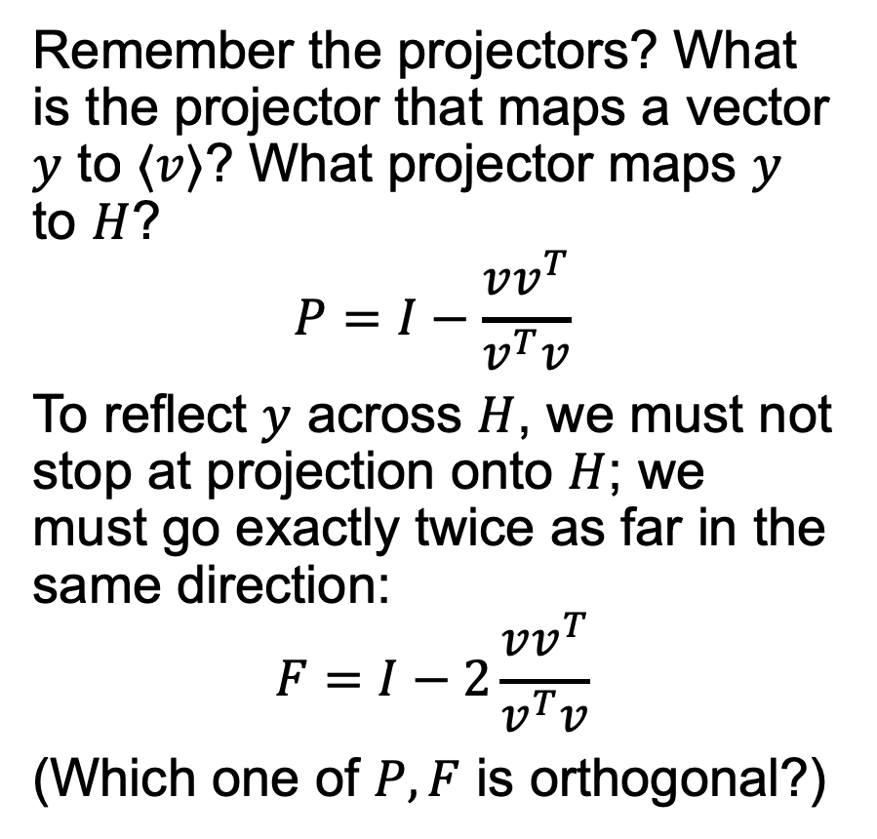
Projector and Reflector
Remember the projectors? What is the projector that maps a vector $y$ to $⟨v⟩$? What projector maps $y$ to $H$?
$$P=I−\frac{vv^{T}}{v^{T}v}$$
To reflect $y$ across $H$, we must not stop at projection onto $H$; we must go exactly twice as far in the same direction:
$$F=I−2\frac{vv^{T}}{v^{T}v}$$
(Which one of $P,F$ is orthogonal?)

Slide 24
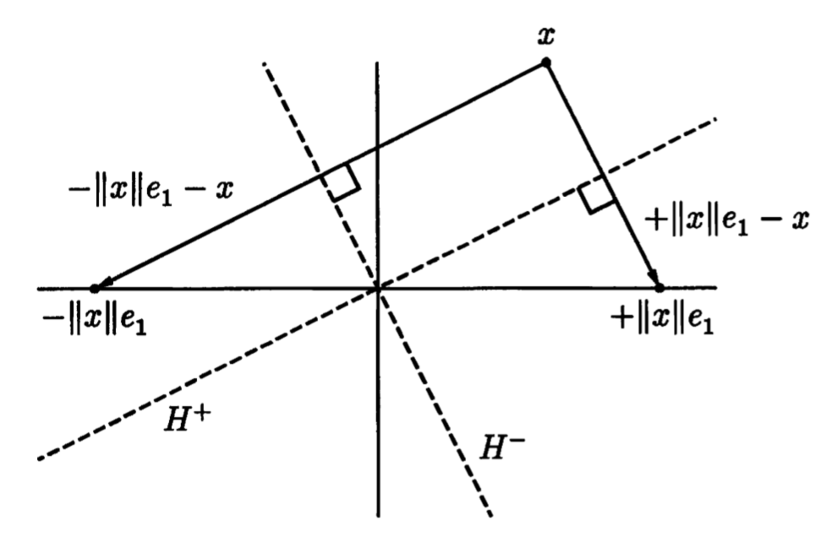
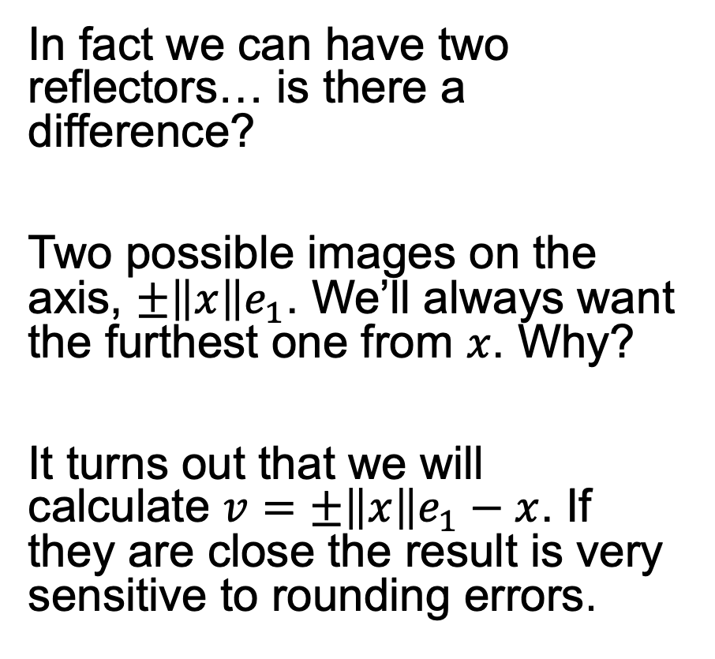
The Better of Two Reflectors
In fact we can have two reflectors… is there a difference?
Two possible images on the axis, $±\left\|x\right\|e_{1}$. We’ll always want the furthest one from $x$. Why?
It turns out that we will calculate $v=$ $±\left\|x\right\|e_{1}−x$. If they are close the result is very sensitive to rounding errors.

Slide 25
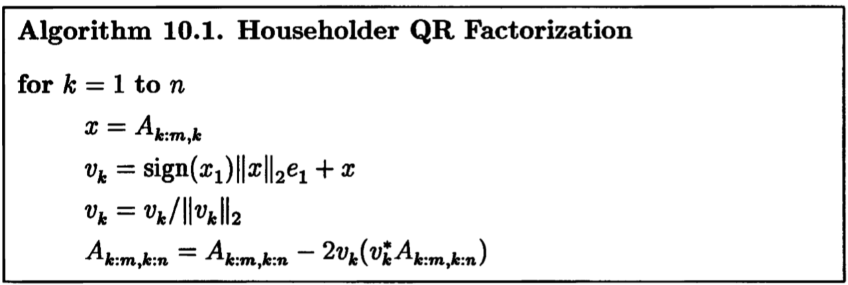
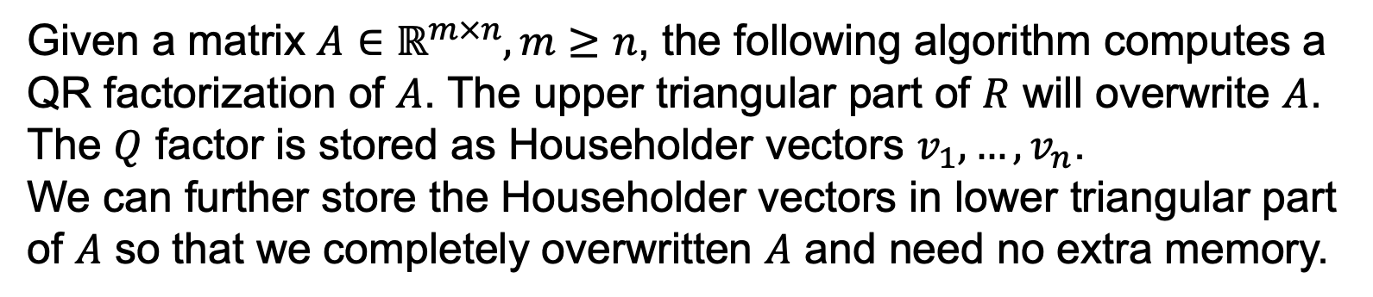
Householder QR
Given a matrix $A∈ℝ^{m×n},m≥n$, the following algorithm computes a QR factorization of $A$. The upper triangular part of $R$ will overwrite $A$. The $Q$ factor is stored as Householder vectors $v_{1},…,v_{n}$.
We can further store the Householder vectors in lower triangular part of $A$ so that we completely overwritten $A$ and need no extra memory.

Slide 26
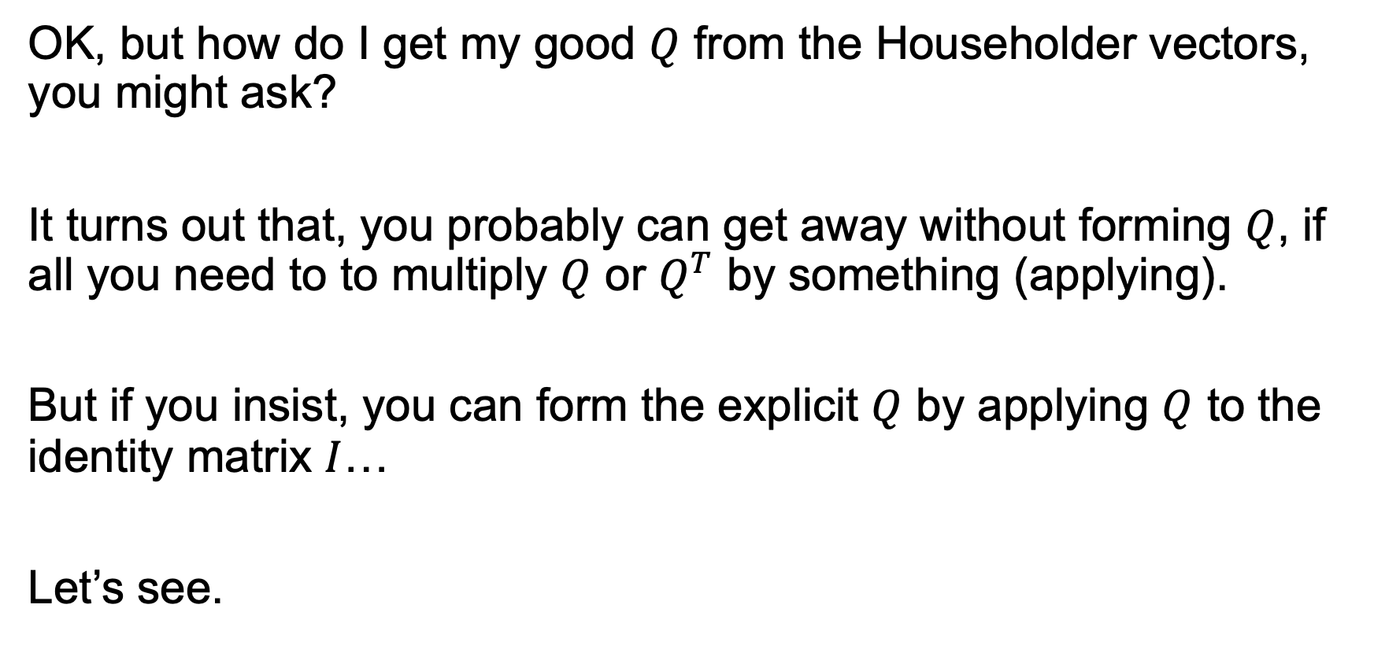

Applying or Forming $Q$
OK, but how do I get my good $Q$ from the Householder vectors, you might ask?
It turns out that, you probably can get away without forming $Q$, if all you need to to multiply $Q$ or $Q^{T}$ by something (applying).
But if you insist, you can form the explicit $Q$ by applying $Q$ to the identity matrix $I$…
Let’s see.

Slide 27
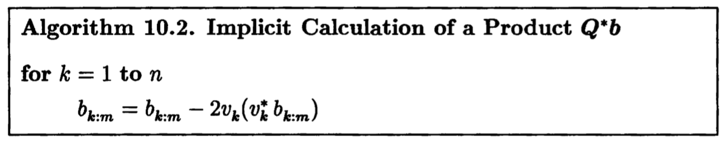
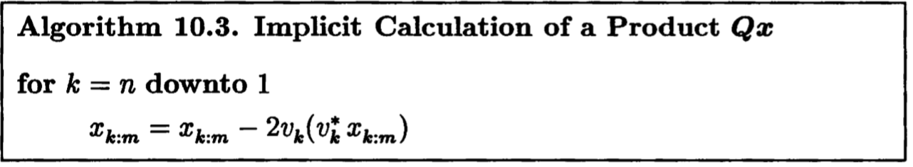


Applying $Q$ and $Q^{T}$
We know that:
$$Q^{T}=Q_{n}⋯Q_{2}Q_{1}$$
and its conjugate:
$$Q=Q_{1}Q_{2}⋯Q_{n}$$
(why there’s no transpose?)

Slide 28


Forming $Q$
A bunch of ways:
$QI$
$Q^{T}I$ then transpose
$IQ$
The first method is the best. Why?

Slide 29
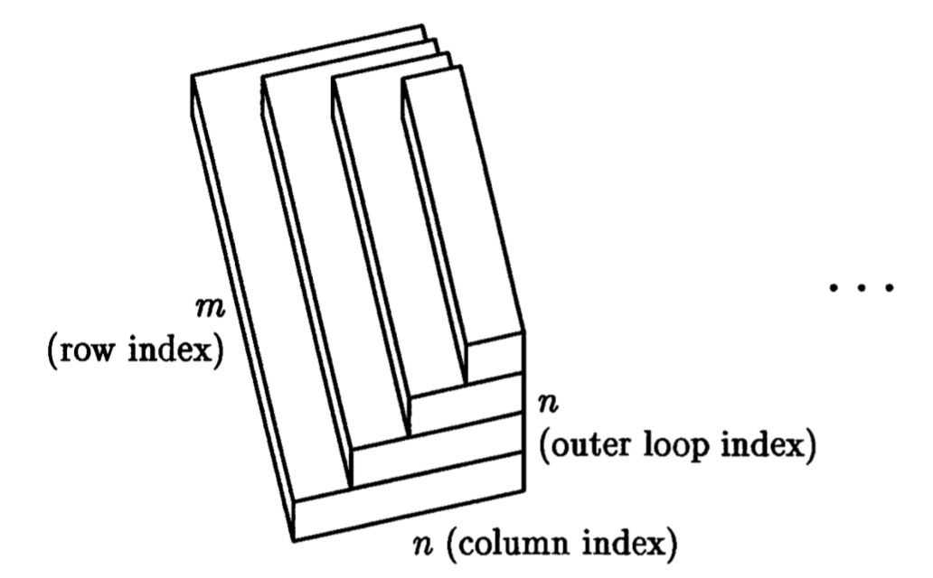

Operation Count
Householder QR:
$$\sim 2mn^{2}−\frac{2}{3}n^{3} flops$$

Slide 30
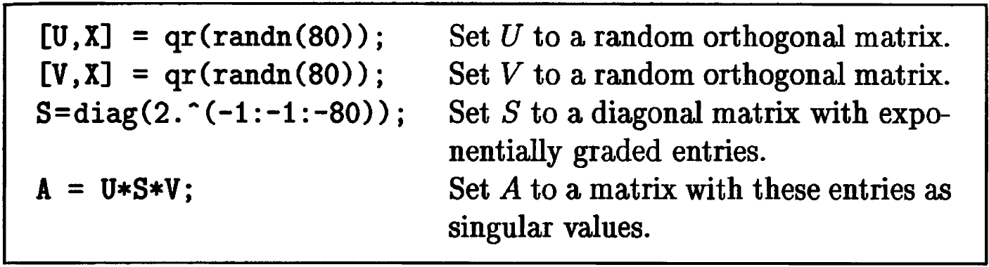

Classical vs. Modified Gram-Schmidt
Numerical stability between CGS and MGS.
First we create a matrix with a widely varying singular values spaced by factor of 2 between $2^{−1}$ and $2^{−80}$ using Matlab:

Slide 31

CGS and MGS to do QR
We plot the diagonal elements $r_{ii}$. Since $r_{ii}=\left\|P_{i}a_{i}\right\|$, we would estimate that $r_{ii}$ closes matches the $i$-th singular value $σ_{i}=2^{−i}$ within a constant factor.
Here’s the result of the $r_{ii}$ produced by CGS and MGS QR:

Slide 32
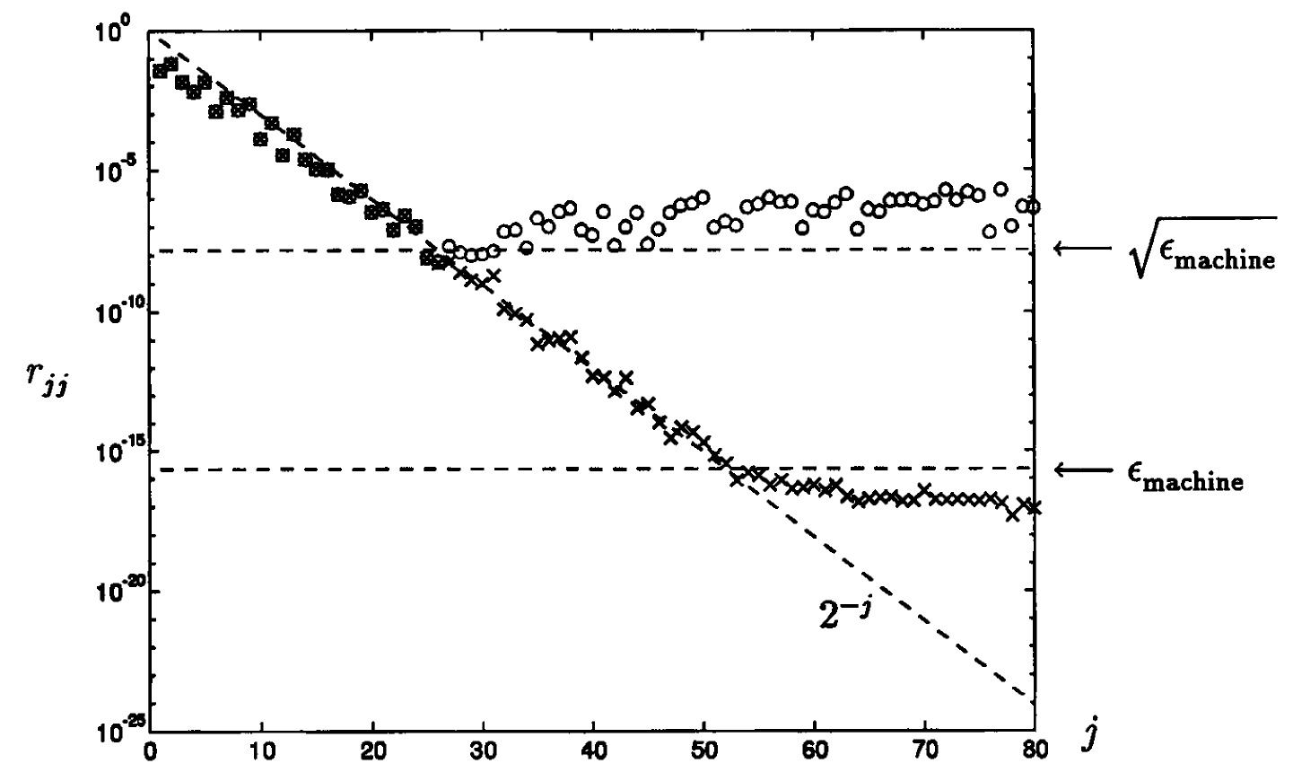
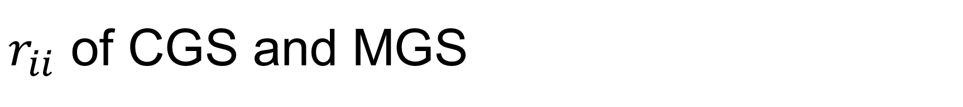
$r_{ii}$ of CGS and MGS

