Slide 1
Lecture 5: Linear Least Square Problem
NLA Chapter 11

Slide 2
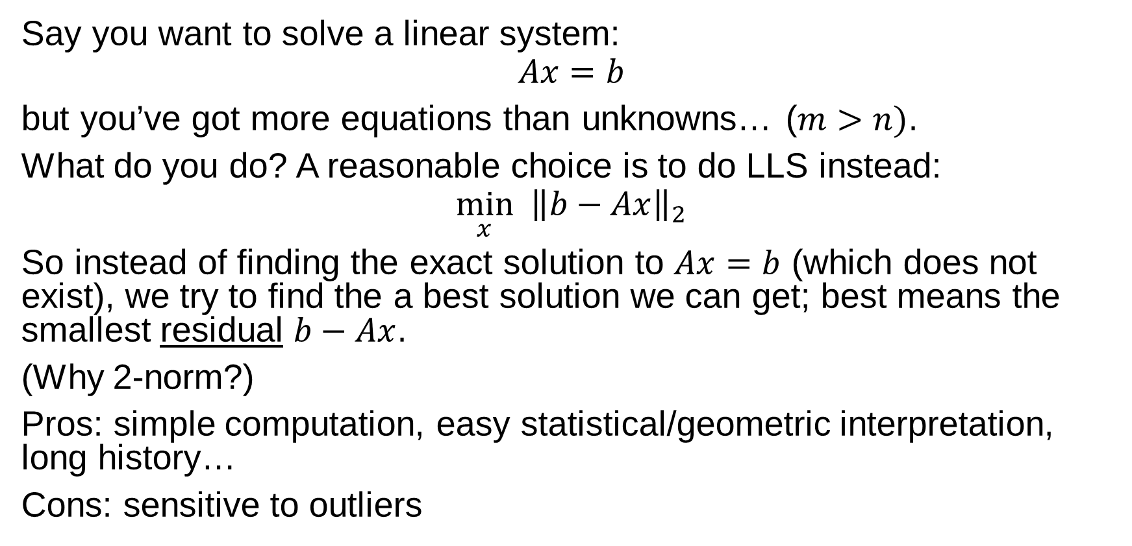
Linear Least Square (LLS) Problem
Say you want to solve a linear system:
$$Ax=b$$
but you’ve got more equations than unknowns… ($m>n)$.
What do you do? A reasonable choice is to do LLS instead:
$$\min_{x} {\left\|b−Ax\right\|}_{2}$$
So instead of finding the exact solution to $Ax=b$ (which does not exist), we try to find the a best solution we can get; best means the smallest residual $b−Ax$.
(Why 2-norm?)
Pros: simple computation, easy statistical/geometric interpretation, long history…
Cons: sensitive to outliers

Slide 3
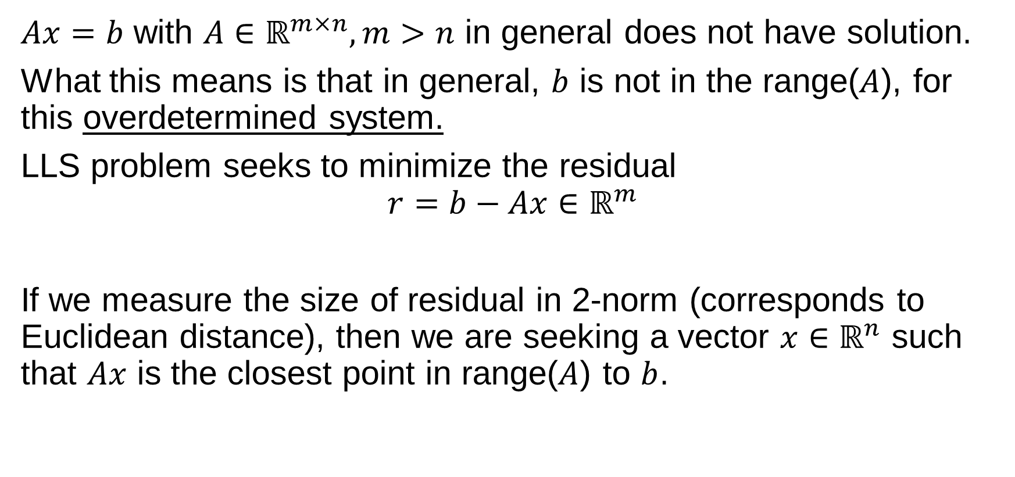
LLS in the language of linear algebra
$Ax=b$ with $A∈ℝ^{m×n}, m>n$ in general does not have solution.
What this means is that in general, $b$ is not in the range($A$), for this overdetermined system.
LLS problem seeks to minimize the residual
$$r=b−Ax∈ℝ^{m}$$
If we measure the size of residual in 2-norm (corresponds to Euclidean distance), then we are seeking a vector $x∈ℝ^{n}$ such that $Ax$ is the closest point in range($A$) to $b$.

Slide 4
Example: Polynomial Data-Fitting
Polynomial interpolation: square system; linear solve;
Polynomial data-fitting (low degree): rectangular system: LLS.

Slide 5
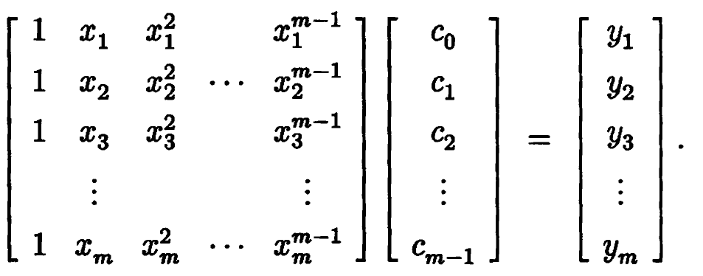
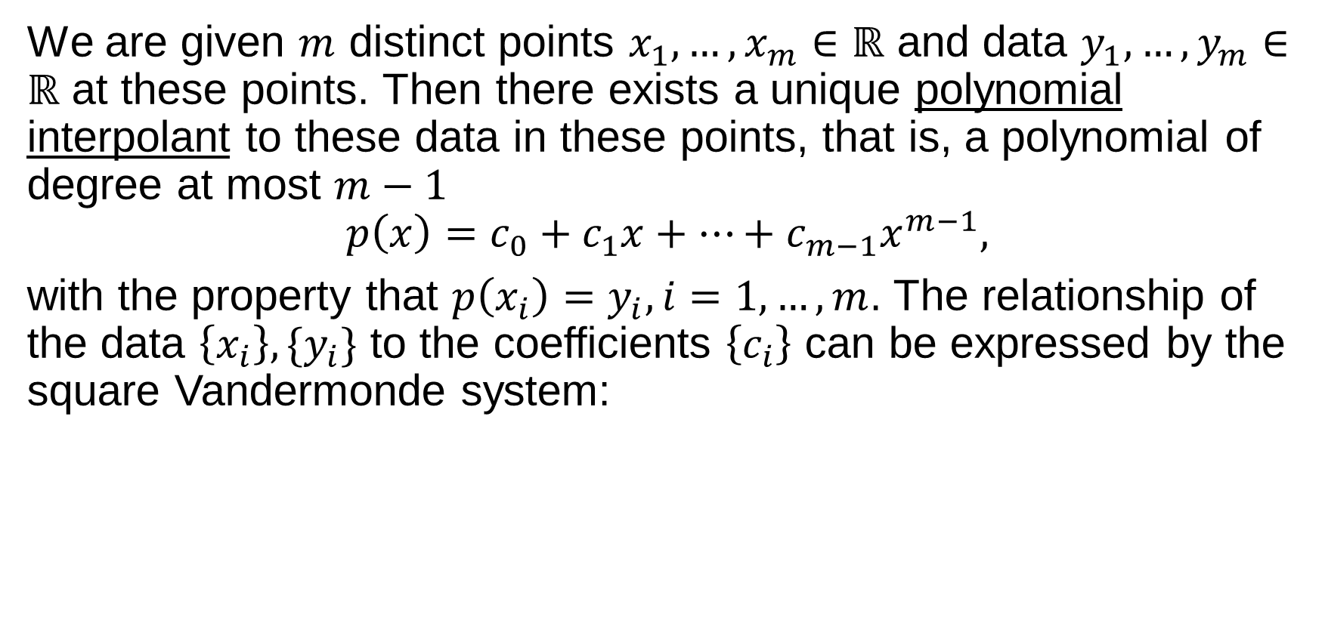
Polynomial Interpolation
We are given $m$ distinct points $x_{1},…,x_{m}∈ℝ$ and data $y_{1},…,y_{m}∈ℝ$ at these points. Then there exists a unique polynomial interpolant to these data in these points, that is, a polynomial of degree at most $m−1$
$$p\left(x\right)=c_{0}+c_{1}x+⋯+c_{m−1}x^{m−1},$$
with the property that $p\left(x_{i}\right)=y_{i}, i=1,…,m$. The relationship of the data $\left\{x_{i}\right\},\{y_{i}\}$ to the coefficients $\left\{c_{i}\right\}$ can be expressed by the square Vandermonde system:

Slide 6
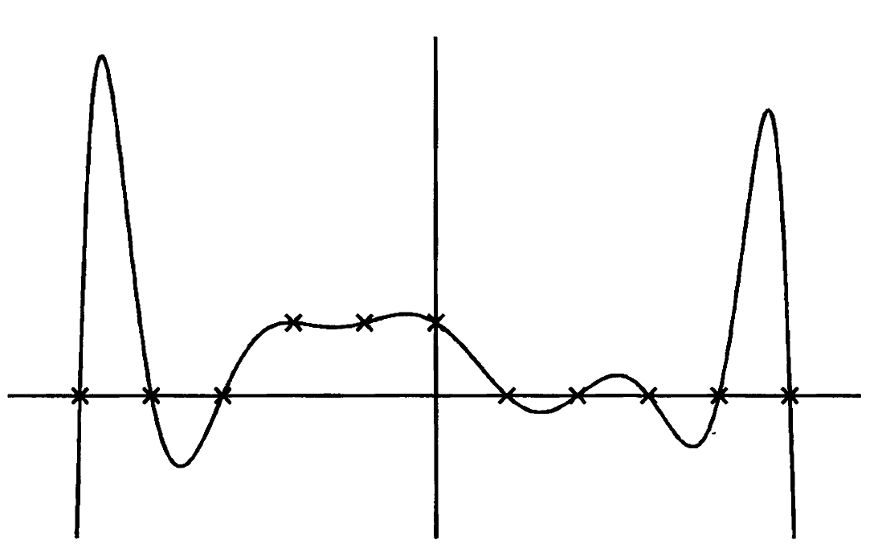

The square Vandermonde system can be solved as long as the ${\{x}_{i}\}$ are distinct.
In the figure we have 11 discrete data points (supposedly coming from square wave) and its degree 10 polynomial interpolant.
Is this a reasonable reflection of the data?

Slide 7
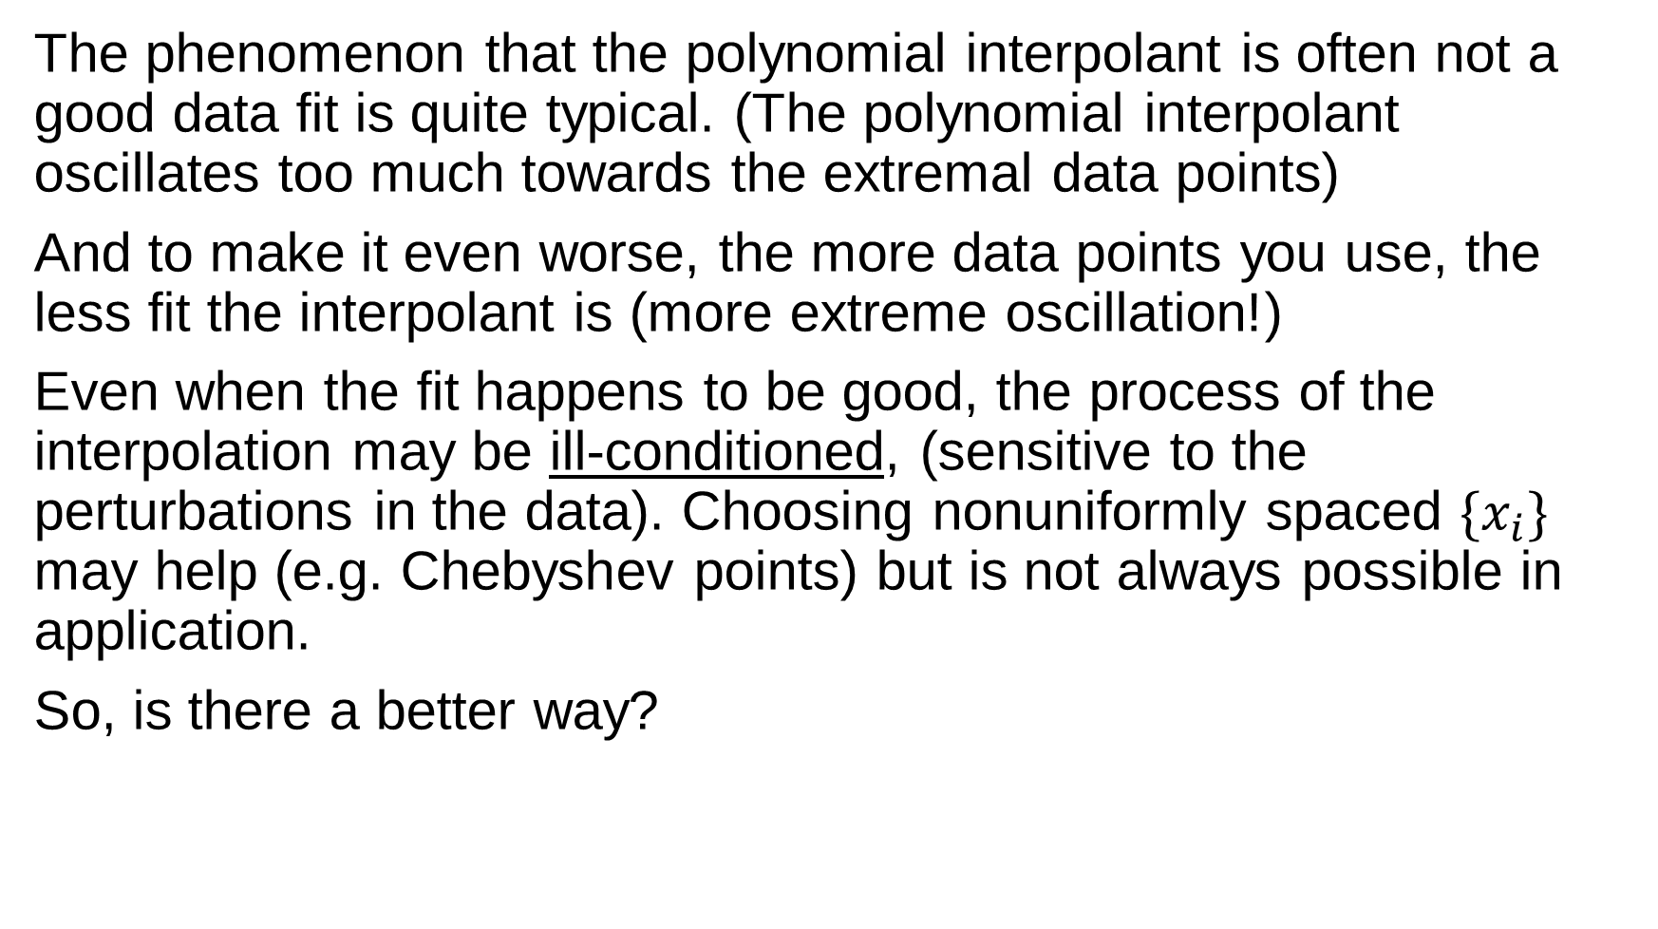
The phenomenon that the polynomial interpolant is often not a good data fit is quite typical. (The polynomial interpolant oscillates too much towards the extremal data points)
And to make it even worse, the more data points you use, the less fit the interpolant is (more extreme oscillation!)
Even when the fit happens to be good, the process of the interpolation may be ill-conditioned, (sensitive to the perturbations in the data). Choosing nonuniformly spaced $\{x_{i}\}$ may help (e.g. Chebyshev points) but is not always possible in application.
So, is there a better way?

Slide 8
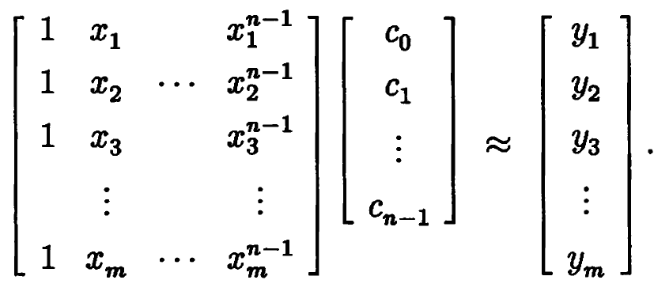
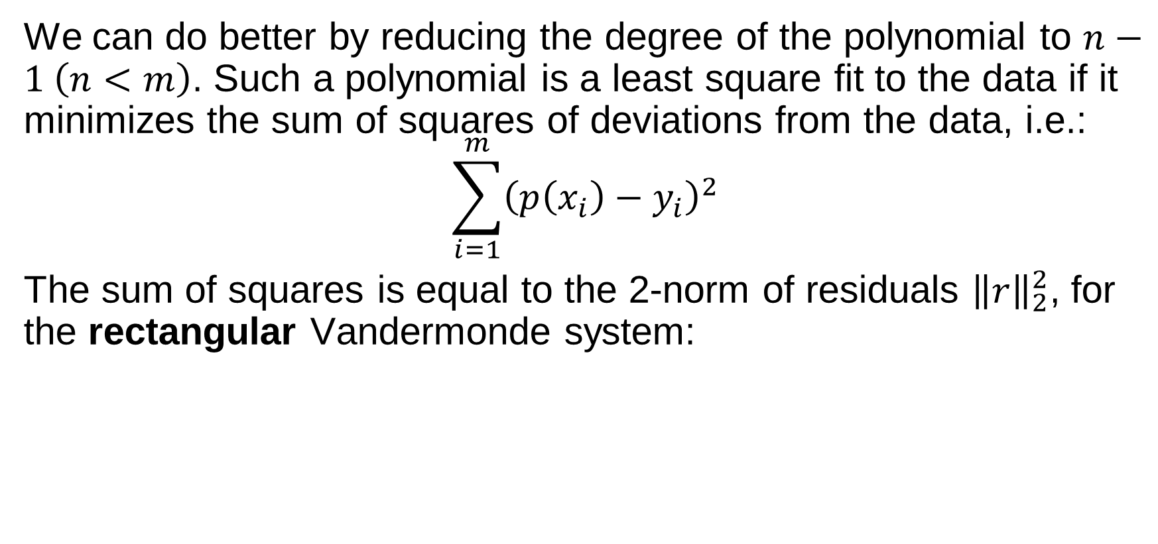
Polynomial Least Square Fitting
We can do better by reducing the degree of the polynomial to $n−1 \left(n<m\right)$. Such a polynomial is a least square fit to the data if it minimizes the sum of squares of deviations from the data, i.e.:
$$\sum_{i=1}^{m}{{\left(p\left(x_{i}\right)−y_{i}\right)}^{2}}$$
The sum of squares is equal to the 2-norm of residuals ${\left\|r\right\|}_{2}^{2}$, for the rectangular Vandermonde system:

Slide 9
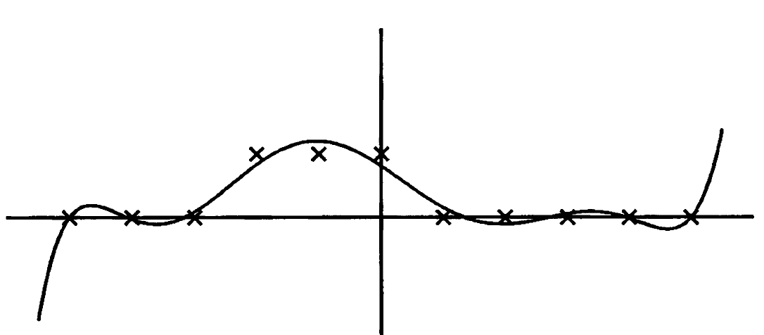
If we fit the same 11 data points with a degree 7 polynomial:
The polynomial no longer interpolates all the points, but the fit seems more reasonable. Plus, it’s less sensitive to the perturbations in the data.
How to compute this polynomial data-fit?

Slide 10
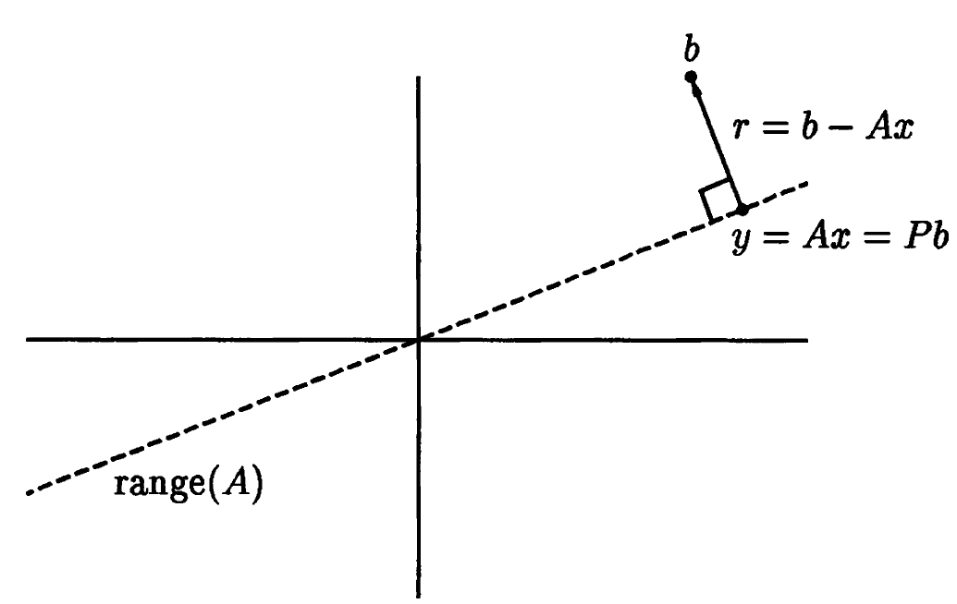
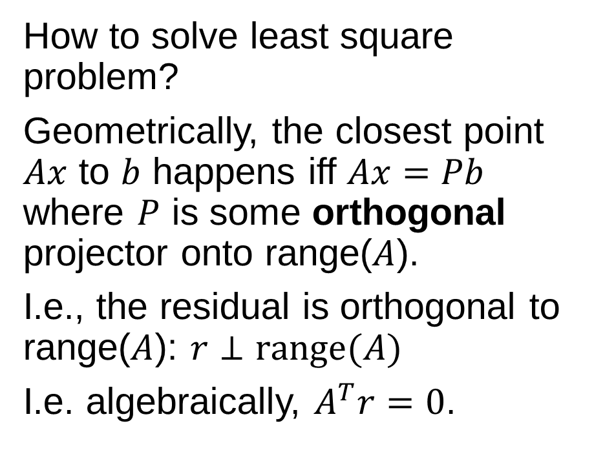
Orthogonal Projection
How to solve least square problem?
Geometrically, the closest point $Ax$ to $b$ happens iff $Ax=Pb$ where $P$ is some orthogonal projector onto range($A$).
I.e., the residual is orthogonal to range($A$): $r⊥range(A)$
I.e. algebraically, $A^{T}r=0$.

Slide 11
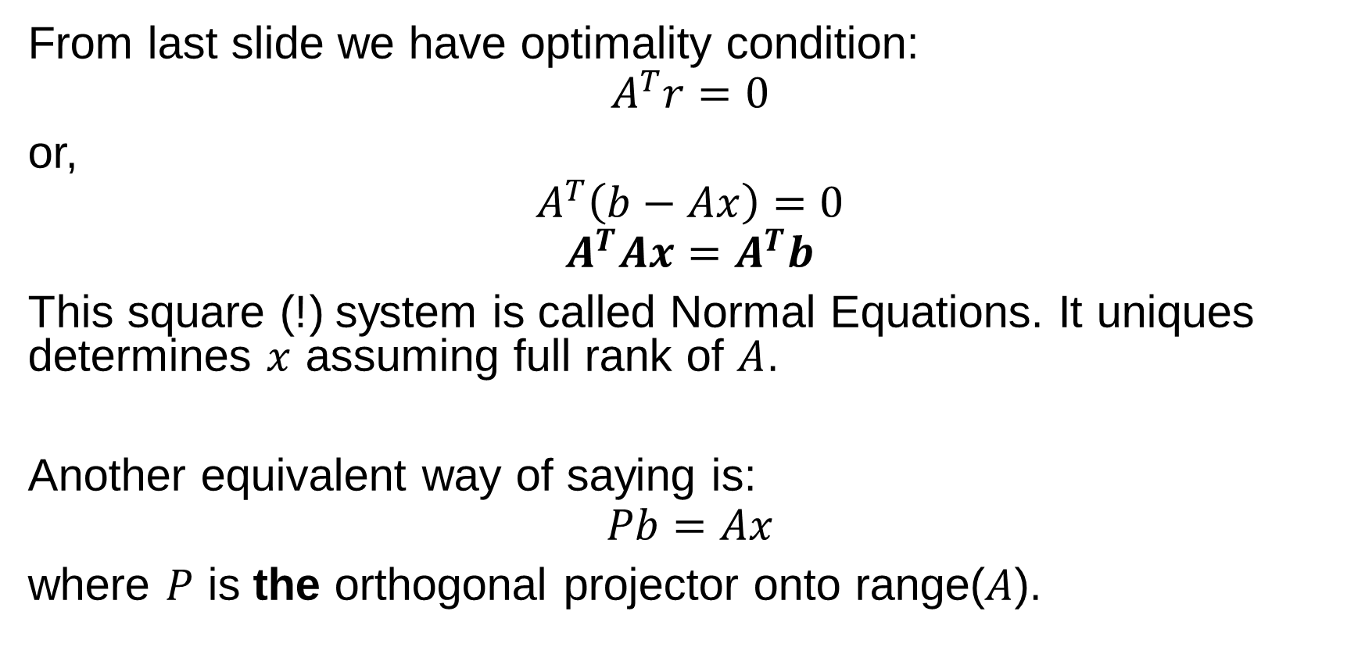
Normal Equations
From last slide we have optimality condition:
$$A^{T}r=0$$
or,
$$A^{T}\left(b−Ax\right)=0$$
$$A^{T}Ax=A^{T}b$$
This square (!) system is called Normal Equations. It uniques determines $x$ assuming full rank of $A$.
Another equivalent way of saying is:
$$Pb=Ax$$
where $P$ is the orthogonal projector onto range($A$).

Slide 12
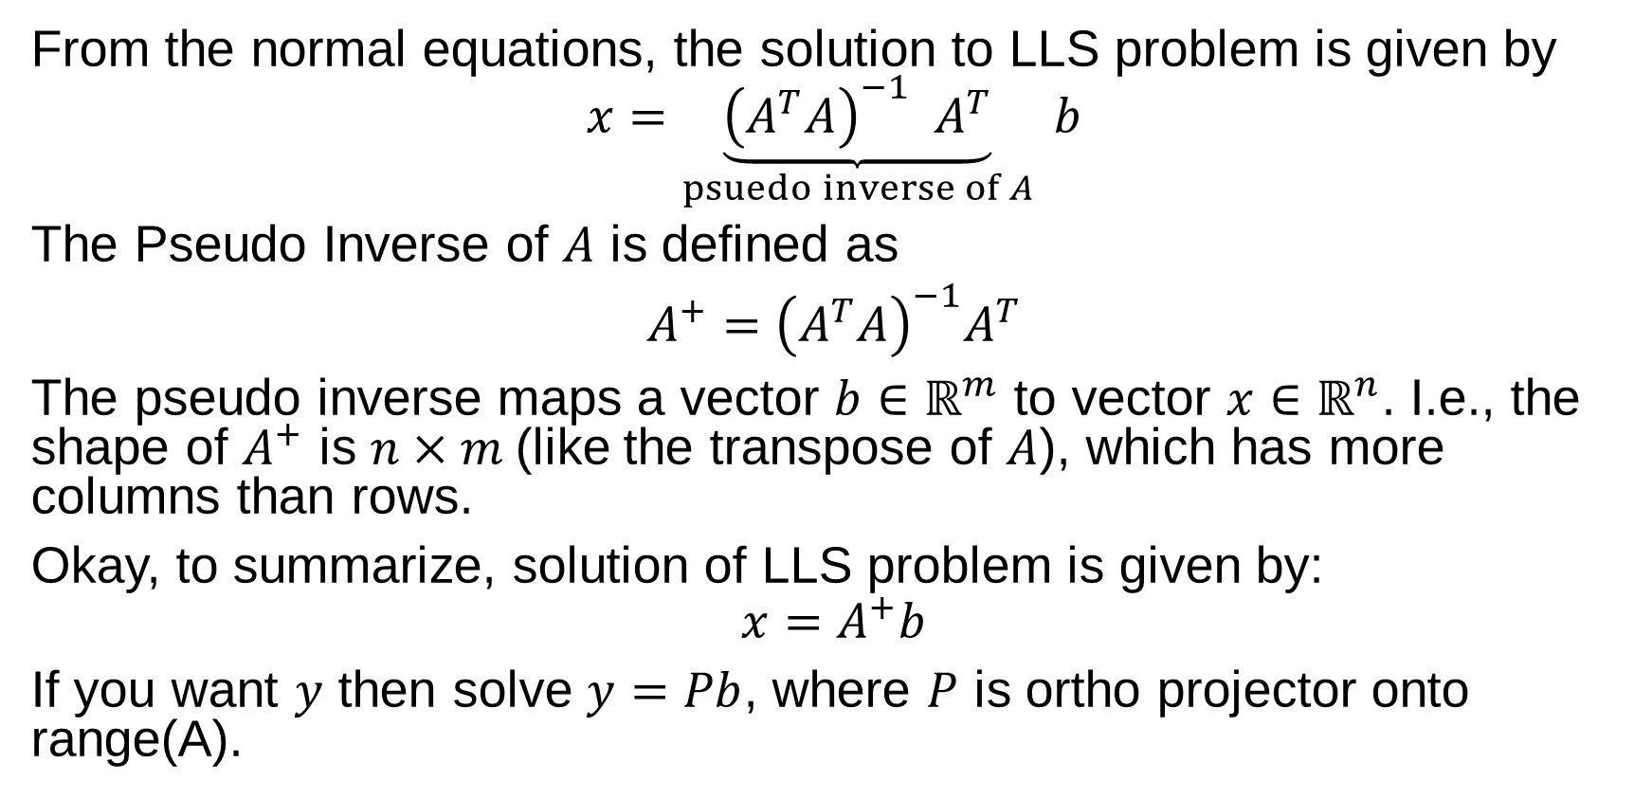
Pseudo Inverse
From the normal equations, the solution to LLS problem is given by
$$x=\underset{psuedo inverse of A}{\underbrace{{\left(A^{T}A\right)}^{−1} A^{T}}} b$$
The Pseudo Inverse of $A$ is defined as
$A^{+}=$ ${\left(A^{T}A\right)}^{−1}A^{T}$
The pseudo inverse maps a vector $b∈ℝ^{m}$ to vector $x∈ℝ^{n}$. I.e., the shape of $A^{+}$ is $n×m$(like the transpose of $A$), which has more columns than rows.
Okay, to summarize, solution of LLS problem is given by:
$$x=A^{+}b$$
If you want $y$ then solve $y=Pb$, where $P$ is ortho projector onto range(A).

Slide 13
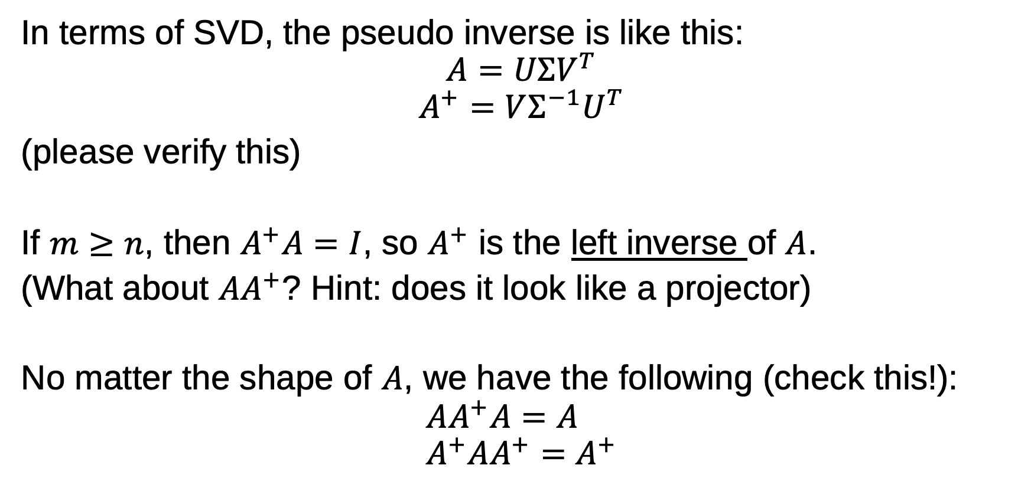
Pseudo Inverse
In terms of SVD, the pseudo inverse is like this:
$$A=UΣV^{T}$$
$$A^{+}=VΣ^{−1}U^{T}$$
(please verify this)
If $m≥n$, then $A^{+}A=I$, so $A^{+}$ is the left inverse of $A$.
(What about $AA^{+}$? Hint: does it look like a projector)
No matter the shape of $A$, we have the following (check this!):
$$AA^{+}A=A \\ A^{+}AA^{+}=A^{+}$$

Slide 14
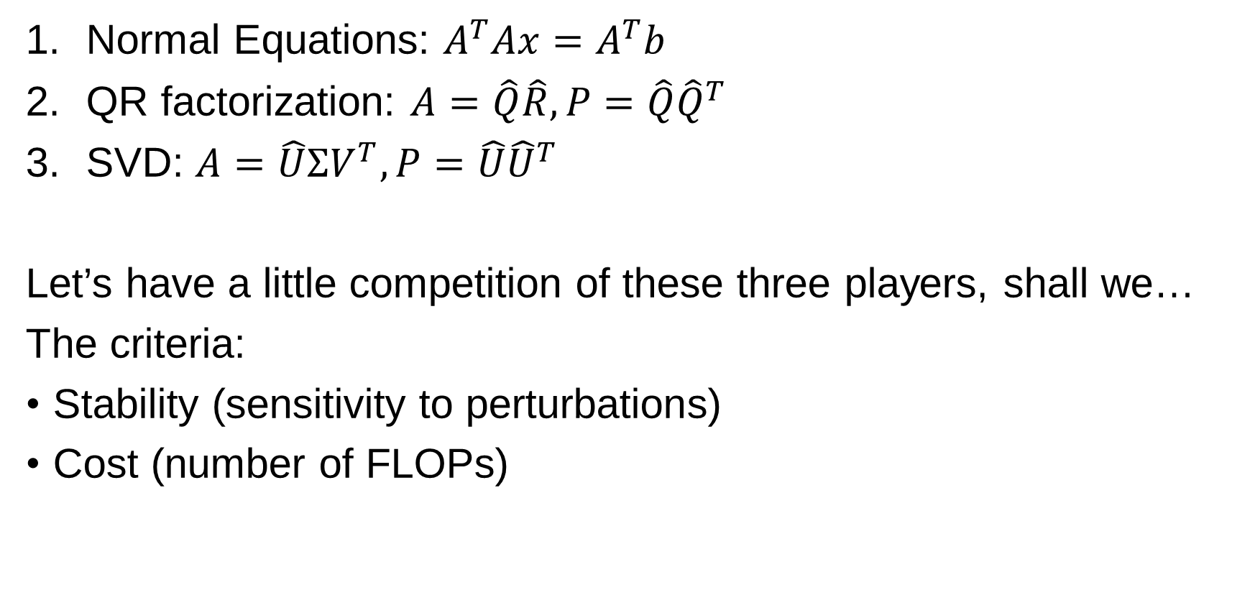
Three Algorithms to Solve LLS
Normal Equations: $A^{T}Ax=A^{T}b$
QR factorization: $A=\hat{Q}\hat{R}, P=\hat{Q}{\hat{Q}}^{T}$
SVD: $A=\hat{U}ΣV^{T}, P=\hat{U}{\hat{U}}^{T}$
Let’s have a little competition of these three players, shall we…
The criteria:
Stability (sensitivity to perturbations)
Cost (number of FLOPs)

Slide 15
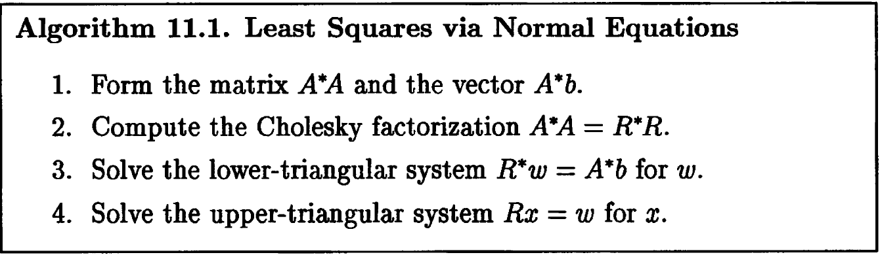







Normal Equations
The classical way (or the obvious one?) to solve LLS problem is through normal equations.
If $A$ has full rank, $A^{T}A$ is non-singular square matrix, and additionally it’s positive definite. The standard method of solving symmetric positive definite (SPD) system is by Cholesky factorization: $A^{T}A=R^{T}R$.

Slide 16
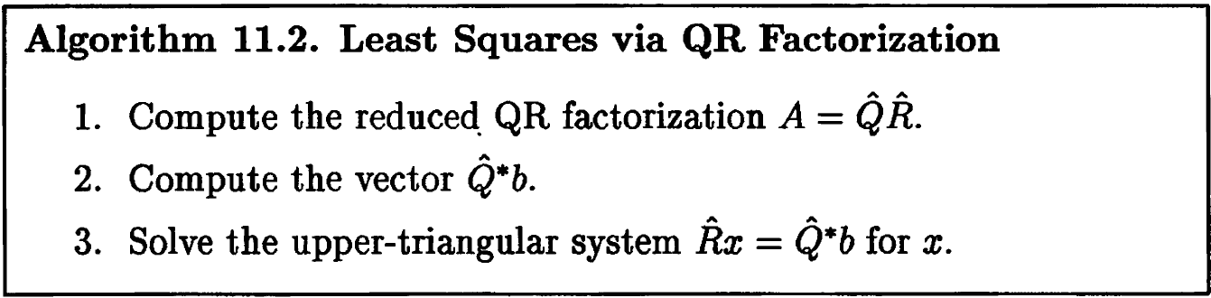

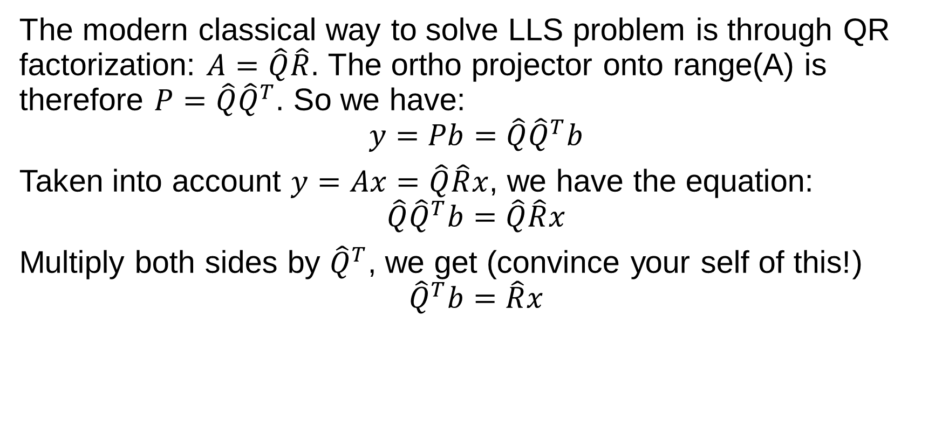
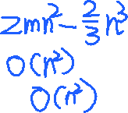


QR Factorization
The modern classical way to solve LLS problem is through QR factorization: $A=\hat{Q}\hat{R}$. The ortho projector onto range(A) is therefore $P=\hat{Q}{\hat{Q}}^{T}$. So we have:
$$y=Pb=\hat{Q}{\hat{Q}}^{T}b$$
Taken into account $y=Ax=\hat{Q}\hat{R}x$, we have the equation:
$$\hat{Q}{\hat{Q}}^{T}b=\hat{Q}\hat{R}x$$
Multiply both sides by ${\hat{Q}}^{T}$, we get (convince your self of this!)
$${\hat{Q}}^{T}b=\hat{R}x$$

Slide 17
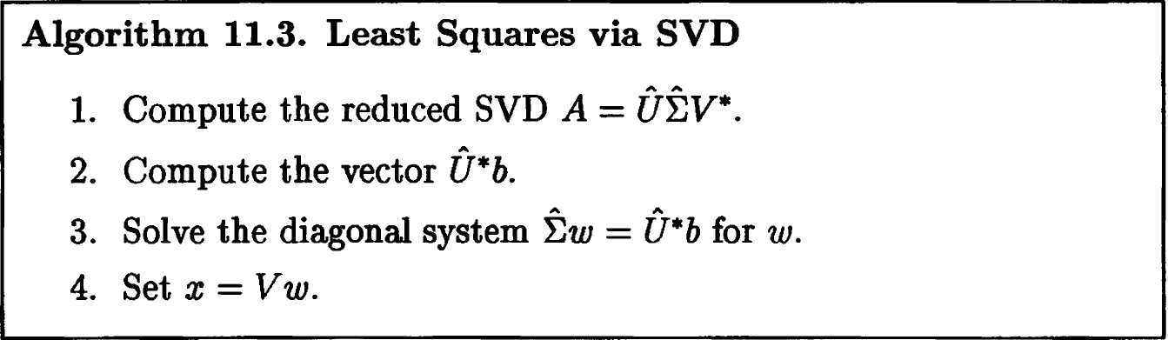






SVD
If we have SVD $A=\hat{U}ΣV^{T}$, just like in QR we have $P=\hat{U}{\hat{U}}^{T}$. From $y=Ax$ we have:
$$\hat{U}ΣV^{T}x=\hat{U}{\hat{U}}^{T}b$$
Multiply both sides by ${\hat{U}}^{T}$:
$$ΣV^{T}x={\hat{U}}^{T}b$$

Slide 18

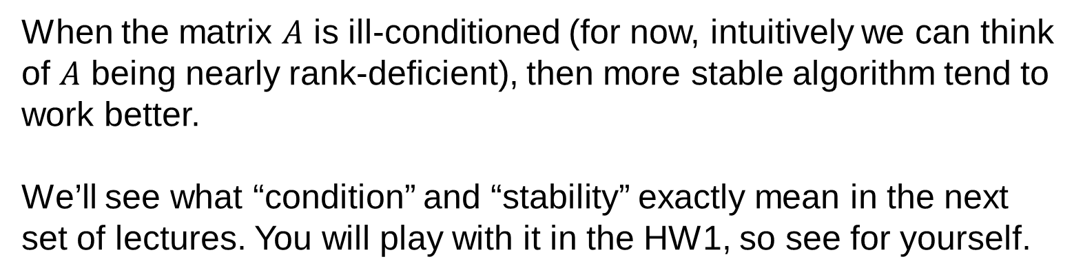


Comparison
When the matrix $A$ is ill-conditioned (for now, intuitively we can think of $A$ being nearly rank-deficient), then more stable algorithm tend to work better.
We’ll see what “condition” and “stability” exactly mean in the next set of lectures. You will play with it in the HW1, so see for yourself.

Slide 19
References
Numerical Linear Algebra, Trefethen & Bau, Chapter 11
Gallier, J., & Quaintance, J. (2017). Fundamentals of Linear Algebra and Optimization. https://doi.org/10.1007/978-1-4419-9887-3

