Slide 1
REFRESHER MODULE ON SPICE

Slide 2
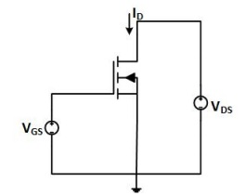
Write a SPICE code to implement the circuit
Vary the input voltage VGS from 2V to 10V in steps of 2V . For each value of VGS, vary output voltage VDS from 0V to 15V and plot output characteristics ID vs VDS.

