Slide 1
PROJECT
WEB TECHNOLOGY
Mohd khalid ansari
1713101836

Slide 2
ESTIMATION OF HOME PRICES
This WEB TECHNOLOGY project of a real estate price prediction website. We will first build a model using sklearn and linear regression using banglore home prices dataset from kaggle.com.
Second step would be to write a python flask server that uses the saved model to serve http requests. Third component is the website built in html, css and javascript that allows user to enter home square ft area, bedrooms etc and it will call python flask server to retrieve the predicted price.
During model building we will cover almost all data science concepts such as data load and cleaning, outlier detection and removal, feature engineering, dimensionality reduction, gridsearchcv for hyperparameter tunning, k fold cross validation etc.

Slide 3
Technology and tools used in this project covers
Sklearn for model building
Jupyter notebook, visual studio code and pycharm as IDE
Python flask for http server
HTML/CSS/Javascript for UI

Slide 4
Sklearn for model building
sklearn is a Python module integrating classical machine learning algorithms in the tightly-knit world of scientific Python packages (numpy, scipy, matplotlib).
It aims to provide simple and efficient solutions to learning problems that are accessible to everybody and reusable in various contexts: machine-learning as a versatile tool for science and engineering

Slide 5
Python flask
Flask is a lightweight WSGI web application framework. It is designed to make getting started quick and easy, with the ability to scale up to complex applications. It began as a simple wrapper around Werkzeug and Jinja and has become one of the most popular Python web application frameworks

Slide 6
HTML/CSS/Javascript
Hypertext Markup Language is the standard markup language for documents designed to be displayed in a web browser
JavaScript, often abbreviated as JS, is a programming language that conforms to the ECMAScript specification. JavaScript is high-level, often just-in-time compiled, and multi-paradigm
Cascading Style Sheets is a style sheet language used for describing the presentation of a document written in a markup language like HTML

Slide 7
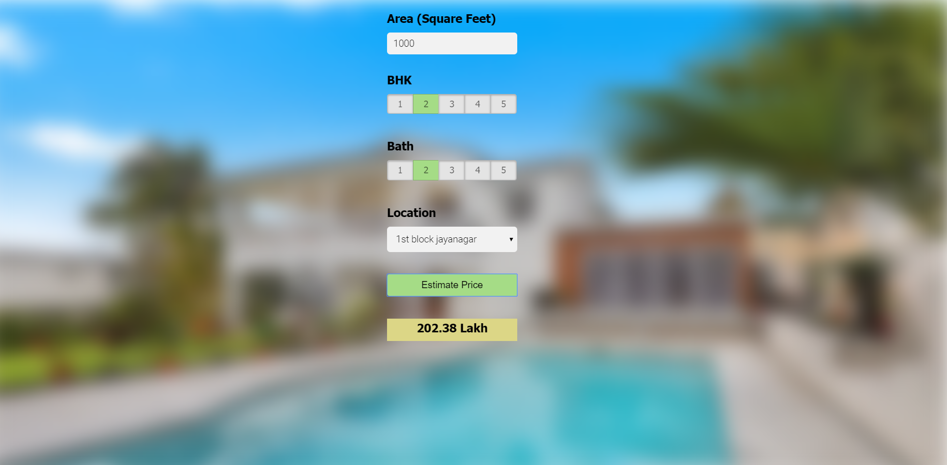
Snapeshot

