Slide 1
Introduction to GraphQL

Slide 2
What is GraphQL?
A query language for APIs (alternative to rest, soap).
Language-agnostic on backend and frontend.
Query exactly the data you need.
Strongly typed schema.

Slide 3
Benefits of GraphQL
1. “ Query exactly the data you need” (in a single request)
2. Declarative & strongly typed schema
3. Rich ecosystem & very active community

Slide 4
3 parts of a GraphQL server
Structure : The GraphQL schema
Behavior : Resolver functions
Network Layer: Network, Middleware

Slide 5
The GraphQL Schema
Special root types: Query , Mutation, Subscription

Slide 6
Query: A GraphQL query is used to read or fetch values while a mutation is used to write or post values.
Mutation : Mutation queries modify data in the data store and returns a value. It can be used to insert, update, or delete data. Mutations are defined as a part of the schema.
Subscription:
Subscriptions are a GraphQL feature that allows a server to send data to its clients when a specific event happens. Subscriptions are usually implemented with WebSocket .

Slide 7
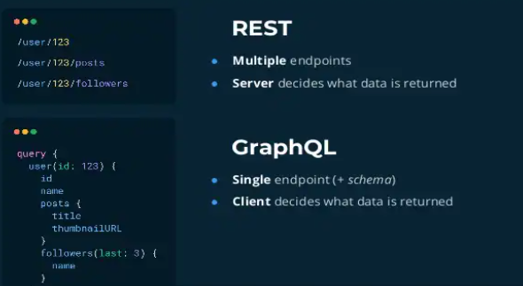
Rest vs GraphQL

Slide 8
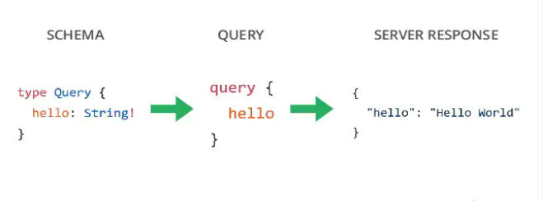
Example : Hello world

