Slide 1
Buffer and Stream

Slide 2
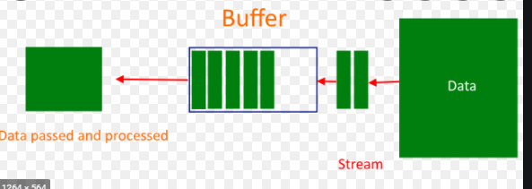
Buffer work flow:

Slide 3
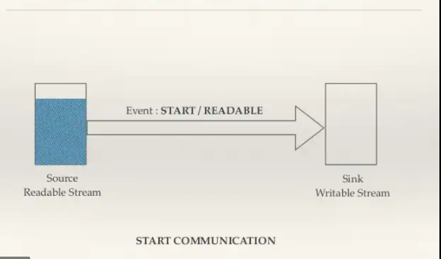
Stream work flow:

Slide 4
Read stream
Read data bit by bit which is binary data.
Read Stream have two mode:
1.Binary mode.
2. Object Mode.

Slide 5
Binary Mode -> If mode is binary we could read data binary or string to type of mode . In order to read binary data as string we have to use ‘UTF-8’;
Object Mode -> Stream instances are switched into object mode using the Object Mode option when the stream is created. Attempting to switch an existing stream into object mode is not safe.

Slide 6
Writeable Stream:
Writable streams are an abstraction for a destination to which data is written.
Drain :
Drain is an event will be emitted when it is appropriate to resume writing data to the stream.

Slide 7
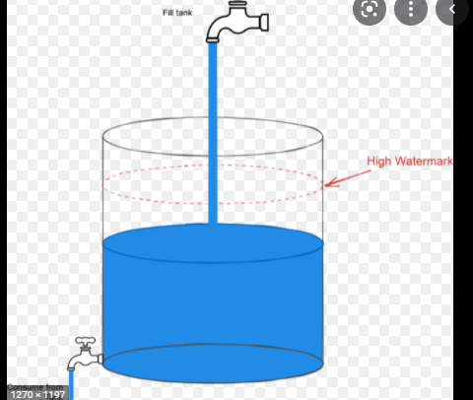
Back Pressure:

Slide 8
Pipe:
Pipe method is called on a readable stream, adding this writable to its set of destinations. Write data automatically handled back pressure

Slide 9
Duplex:
Both read and Write data.

Slide 10
Pass Through
Pass through -> Pass through lass is a trivial implementation of a transform stream that simply passes the input bytes across to the output. Delay the passing data
Throttle -> using custom class throttle we can delay time

Slide 11
Transform:
Transform stream change the data it is also a special type of duplex stream

Slide 12
