Slide 1
Mocha

Slide 2
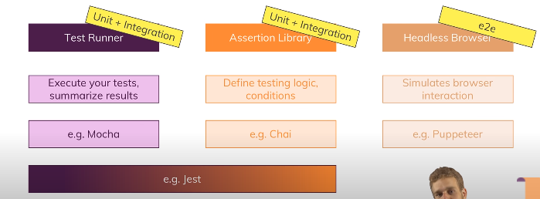

Slide 3
What is mocha?
Mocha is a testing framework. Which is basically use for unit testing.
Mocha runs for node js. But we can run it on browser.

Slide 4
Assertion in Mocha :-
It is a comparison . An assertion is a comparison which throws an exception upon failure.
In, mocha do not have any assert. Mocha use either node js default assert or chai assert.

Slide 5
UNIT Test:
A unit test asserts a unit behaves as intended. A ‘unit’ is typically a single function.

Slide 6
Integration test :-
An integration test assert an aggregate of units or modules behave as intended.

Slide 7
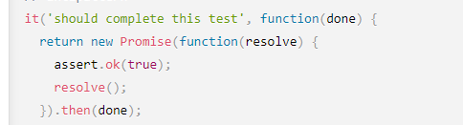
Create test:-
Mocha create test with It. Example:

Slide 8
Create a suite
It is a way to organize your test. Example:
Describe(title, callback) create a suite. (here, call is a body of function)

