Slide 1
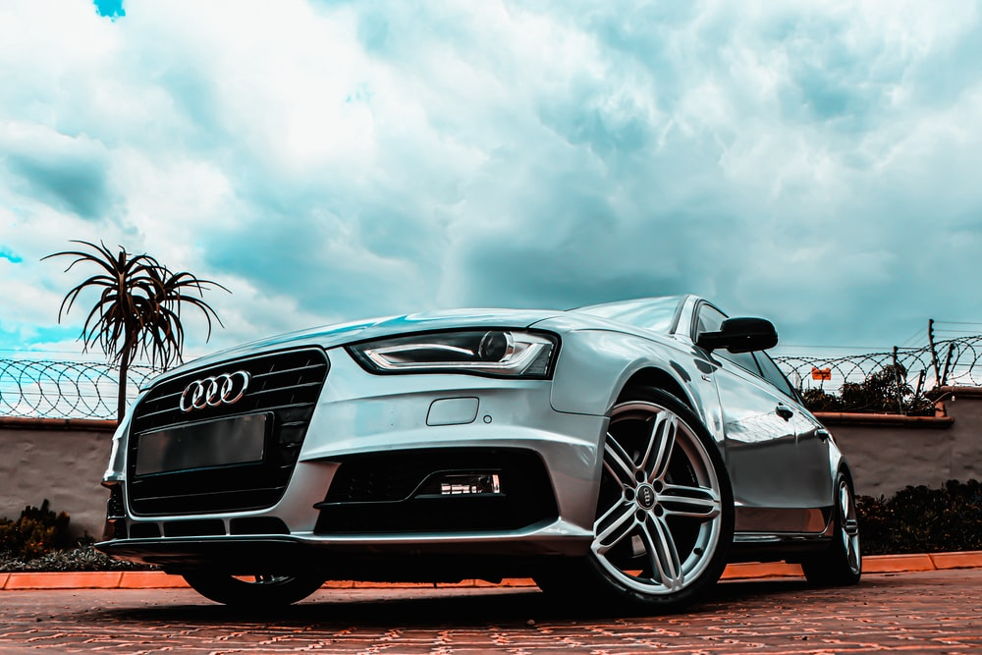
Saudi Used Car Sale Dataset Analysis
Presented by Khalid Alqahtani

Slide 2
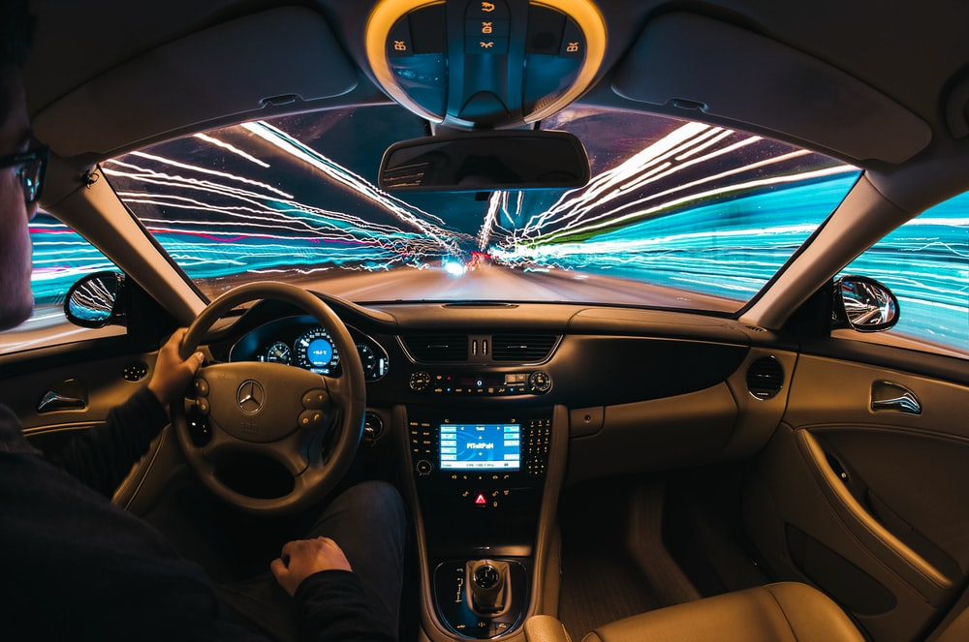
Outlines
Kaggle Dataset
EDA Insights
Missing Data Imputation
Future Work

Slide 3

Why used car?
Saving money
Lower insurance rates
Today’s cars and trucks remain reliable longer
Many people do not have enough money to buy new cars

Slide 4
Kaggle Dataset
8035 Rows - 13 Columns
Make | Type | Year | Origin | Color | Options | Engine_Size | Fuel_Type | Gear_Type | Mileage | Region | Price | Negotiable
Chrysler | C300 | 2018 | Saudi | Black | Full | 5.7 | Gas | Automatic | 103000 | Riyadh | 114000 | FALSE
Nissan | Patrol | 2016 | Saudi | White | Full | 4.8 | Gas | Automatic | 5448 | Riyadh | 0 | TRUE
Nissan | Sunny | 2019 | Saudi | Silver | Standard | 1.5 | Gas | Automatic | 72418 | Riyadh | 27500 | FALSE
Hyundai | Elantra | 2019 | Saudi | Grey | Standard | 1.6 | Gas | Automatic | 114154 | Riyadh | 43000 | FALSE
Hyundai | Elantra | 2019 | Saudi | Silver | Semi Full | 2 | Gas | Automatic | 41912 | Riyadh | 59500 | FALSE
Honda | Accord | 2018 | Saudi | Navy | Full | 1.5 | Gas | Automatic | 39000 | Riyadh | 72000 | FALSE
Toyota | Land Cruiser | 2011 | Saudi | White | Semi Full | 4.5 | Gas | Automatic | 183000 | Riyadh | 92000 | FALSE
GMC | Yukon | 2009 | Saudi | Bronze | Full | 5.7 | Gas | Automatic | 323000 | Riyadh | 0 | TRUE
Chevrolet | Impala | 2019 | Saudi | Black | Standard | 3.6 | Gas | Automatic | 70000 | Riyadh | 80000 | FALSE
Toyota | Yaris | 2018 | Saudi | White | Standard | 1.5 | Gas | Automatic | 131000 | Jeddah | 32000 | FALSE
Toyota | Camry | 2017 | Gulf Arabic | White | Standard | 2.5 | Gas | Automatic | 107000 | Dammam | 50000 | FALSE
Nissan | Patrol | 2014 | Saudi | White | Full | 5.6 | Gas | Automatic | 106000 | Dammam | 135000 | FALSE

Slide 5

Exploration Data Analysis

Slide 6
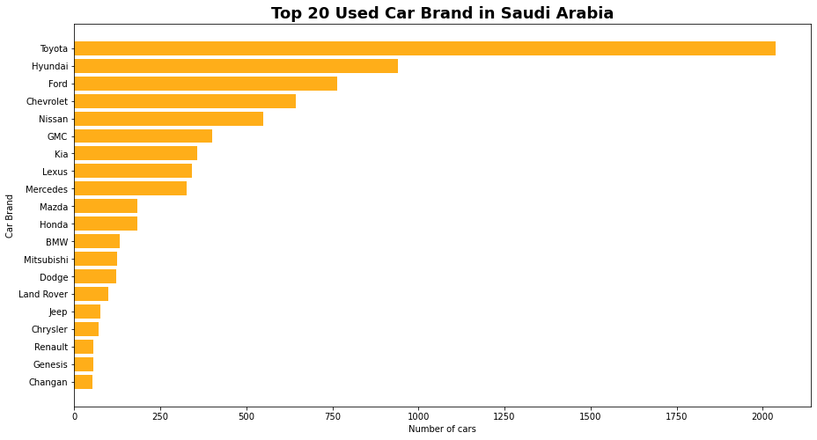


Insights
Japanese and American Cars are the top
6
6

Slide 7
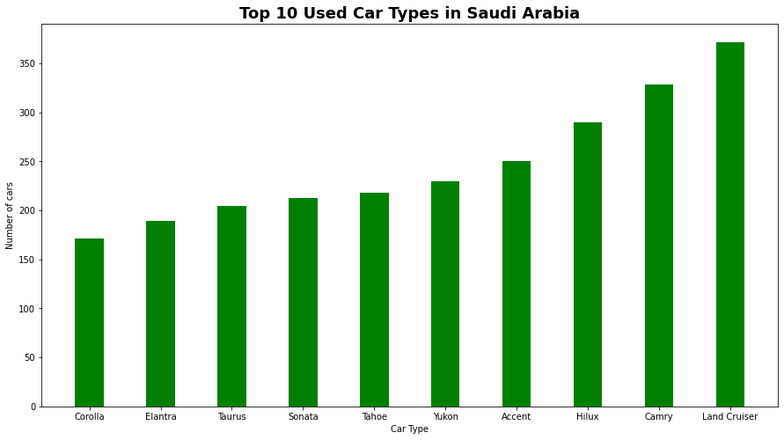


Insights
4
3

Slide 8
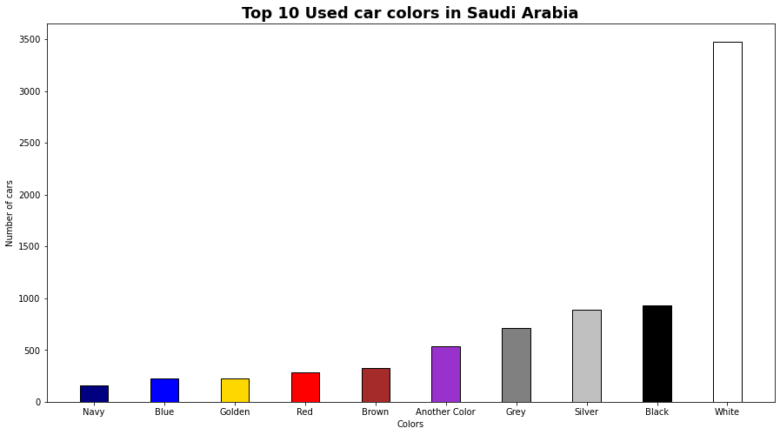
Insights
According to Forbes
White
Black
Silver
Grey
Red
Blue
Brown
Yellow
Green
Any color

Slide 9

Missing Data Imputation

Slide 10
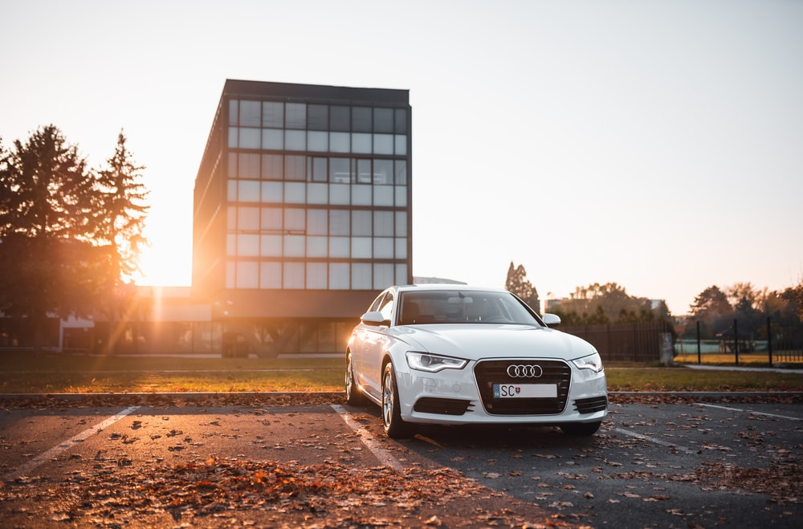
Missing Data Imputation Techniques
Median
Mean
Techniques
Most Frequent
KNN

Slide 11

Missing Data Imputation Process
Steps
Removing all rows in the column price which equal zeros.
Choosing a car type with highest number of rows that are not zeros.
Making about 25% of the price column as zero value.
Imputing these missing data with the four techniques.
Evaluating the four techniques.

Slide 12


Step 1: Remove all rows in the column price which equal zeros
Price
114000
0
27500
43000
59500
72000
92000
0
80000
Price
114000
0
27500
43000
59500
72000
92000
0
80000
Price
114000
27500
43000
59500
72000
92000
80000

Slide 13
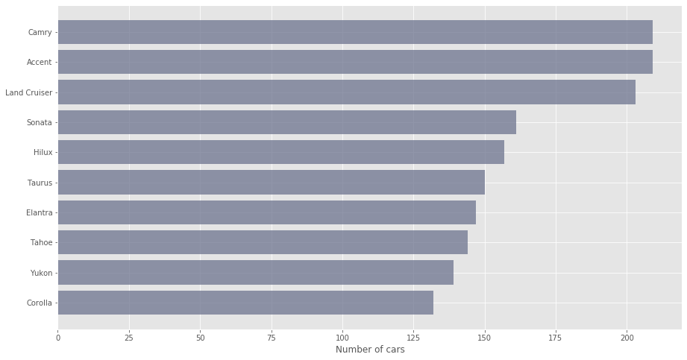
Step 2: Choose a car type with highest number of rows which do not have any zeros
I picked this column

Slide 14
Step 3: Make about 25% of the price column as zero value
Price
114000
27500
43000
59500
72000
92000
80000
32000
50000
135000
153000
235000
Price
114000
27500
0
59500
72000
0
80000
32000
50000
0
153000
235000
Picking 25% of the column

Slide 15
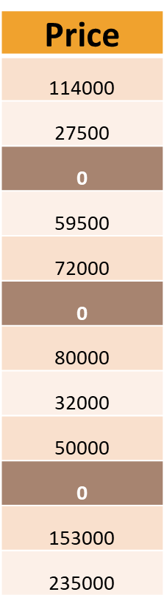
Step 4: Impute these missing data with the four techniques
Price
114000
27500
43000
59500
72000
92000
80000
32000
50000
135000
153000
235000
Input
Output
Imputer

Slide 16
The Results
Evaluation Method | Mean | Median | Most Frequent | KNN
Max Error | 71722.3 | 71000.0 | 71000.0 | 71722.36
Mean Squared Error | 476,574,400 | 469,942,909.1 | 469942909.1 | 476574400
Root Mean Square Error | 21830.6 | 21678.2 | 21678.2 | 21830.6
Mean Absolute Error | 10068 | 9989.1 | 9989.1 | 10067.9
R2_score | 0.58 | 0.59 | 0.59 | 0.58

Slide 17
Future Work
Create an application that can predict a used car price based on the user’s input
Try to examine other imputation algorithms
Automate the whole process

Slide 18
Thank You For Your attention

