Slide 1
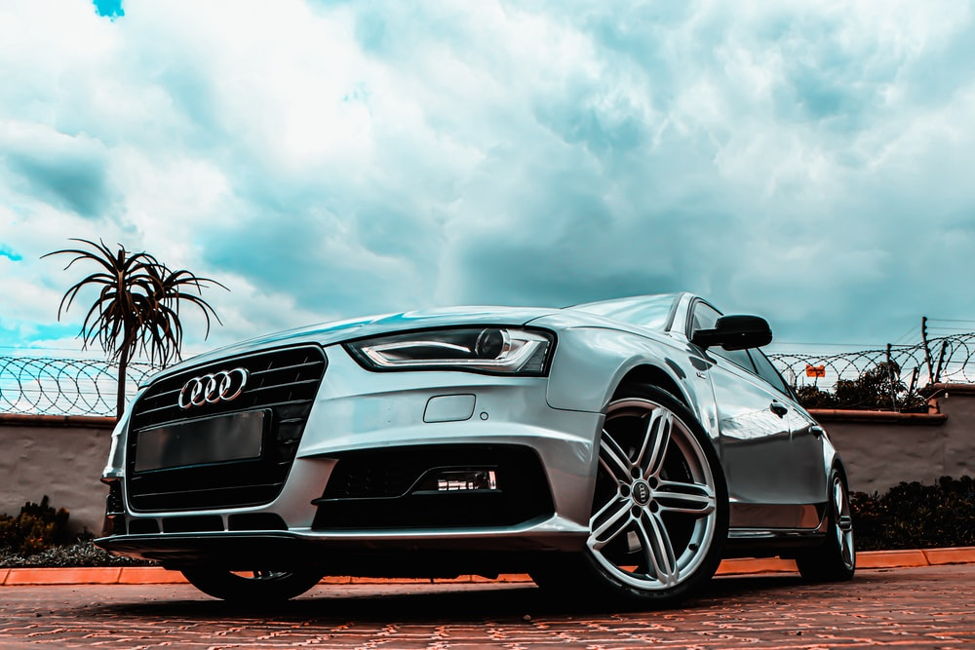
Saudi Used Car Sale Dataset Analysis
Presented by Khalid Alqahtani

Slide 2
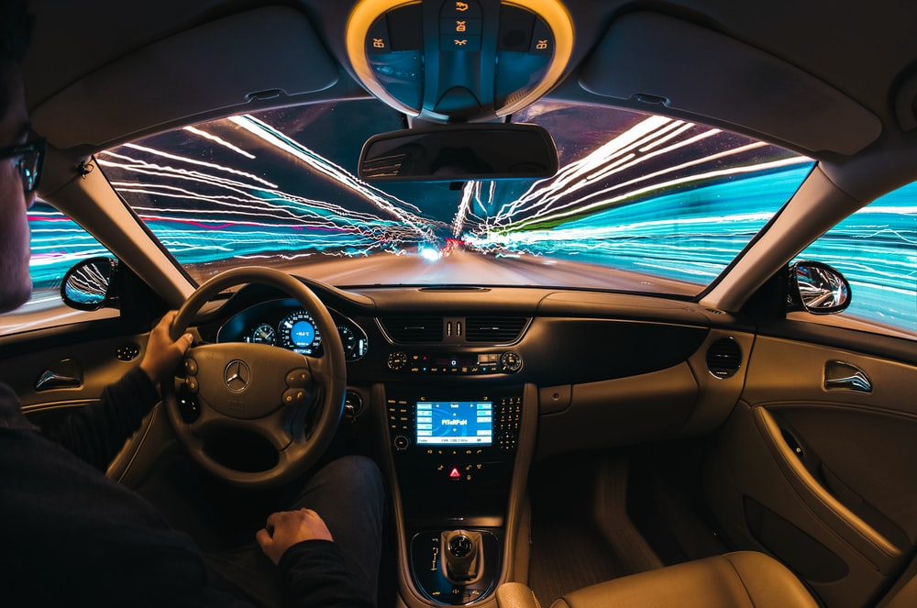
Outlines
Kaggle Dataset
EDA Insights
Missing Data Imputation
Future Work

Slide 3

Why used car?
Saving money
Lower insurance rates
Today’s cars and trucks remain reliable longer
Many people do not have enough money to buy new cars

Slide 4
Kaggle Dataset
8035 Rows - 13 Columns
Make | Type | Year | Origin | Color | Options | Engine_Size | Fuel_Type | Gear_Type | Mileage | Region | Price | Negotiable
Chrysler | C300 | 2018 | Saudi | Black | Full | 5.7 | Gas | Automatic | 103000 | Riyadh | 114000 | FALSE
Nissan | Patrol | 2016 | Saudi | White | Full | 4.8 | Gas | Automatic | 5448 | Riyadh | 0 | TRUE
Nissan | Sunny | 2019 | Saudi | Silver | Standard | 1.5 | Gas | Automatic | 72418 | Riyadh | 27500 | FALSE
Hyundai | Elantra | 2019 | Saudi | Grey | Standard | 1.6 | Gas | Automatic | 114154 | Riyadh | 43000 | FALSE
Hyundai | Elantra | 2019 | Saudi | Silver | Semi Full | 2 | Gas | Automatic | 41912 | Riyadh | 59500 | FALSE
Honda | Accord | 2018 | Saudi | Navy | Full | 1.5 | Gas | Automatic | 39000 | Riyadh | 72000 | FALSE
Toyota | Land Cruiser | 2011 | Saudi | White | Semi Full | 4.5 | Gas | Automatic | 183000 | Riyadh | 92000 | FALSE
GMC | Yukon | 2009 | Saudi | Bronze | Full | 5.7 | Gas | Automatic | 323000 | Riyadh | 0 | TRUE
Chevrolet | Impala | 2019 | Saudi | Black | Standard | 3.6 | Gas | Automatic | 70000 | Riyadh | 80000 | FALSE
Toyota | Yaris | 2018 | Saudi | White | Standard | 1.5 | Gas | Automatic | 131000 | Jeddah | 32000 | FALSE
Toyota | Camry | 2017 | Gulf Arabic | White | Standard | 2.5 | Gas | Automatic | 107000 | Dammam | 50000 | FALSE
Nissan | Patrol | 2014 | Saudi | White | Full | 5.6 | Gas | Automatic | 106000 | Dammam | 135000 | FALSE

Slide 5

Exploration Data Analysis

Slide 6
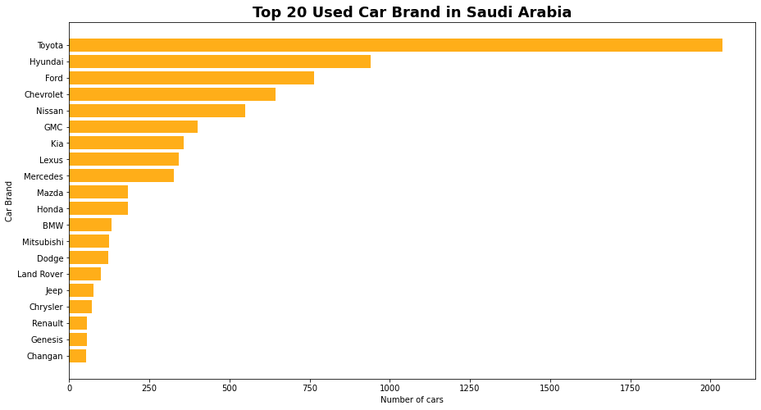


Insights
Japanese and American Cars are the top
6
6

Slide 7
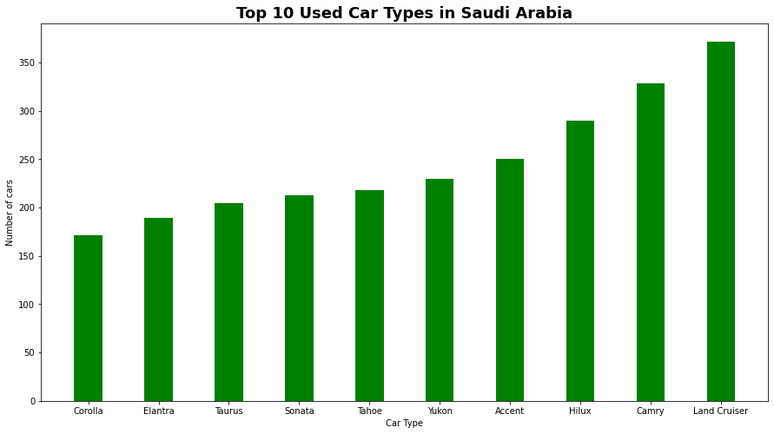


Insights
4
3

Slide 8
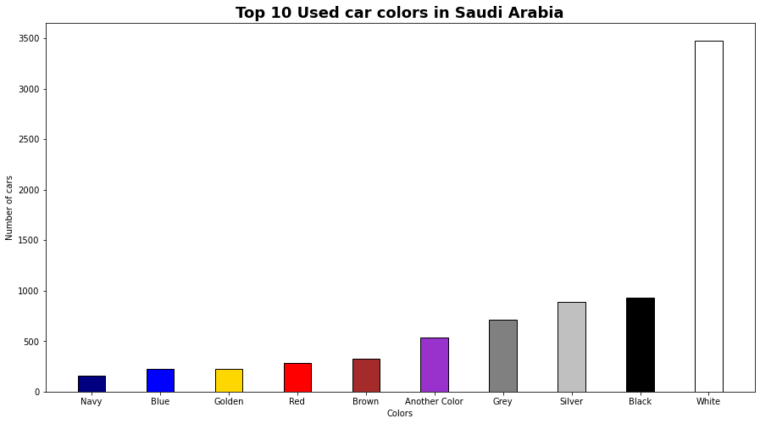
Insights
According to Forbes
White
Black
Silver
Grey
Red
Blue
Brown
Yellow
Green
Any color

Slide 9

Missing Data Imputation

Slide 10
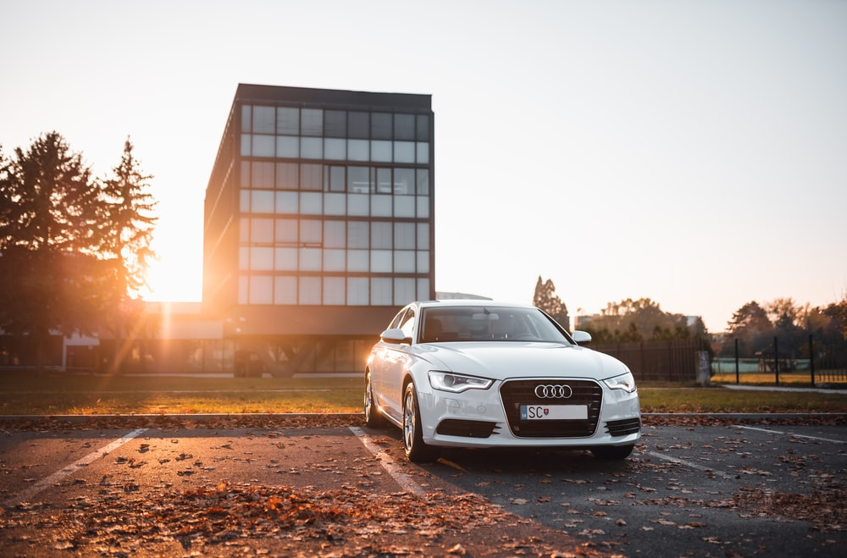
Missing Data Imputation Techniques
Median
Mean
Techniques
Most Frequent
KNN

Slide 11

Missing Data Imputation Process
Steps
Choosing a car type with highest number of rows that are not zeros.
Making about 25% of the price column as zero value.
Imputing these missing data with the four techniques.
Evaluating the four techniques.

Slide 12

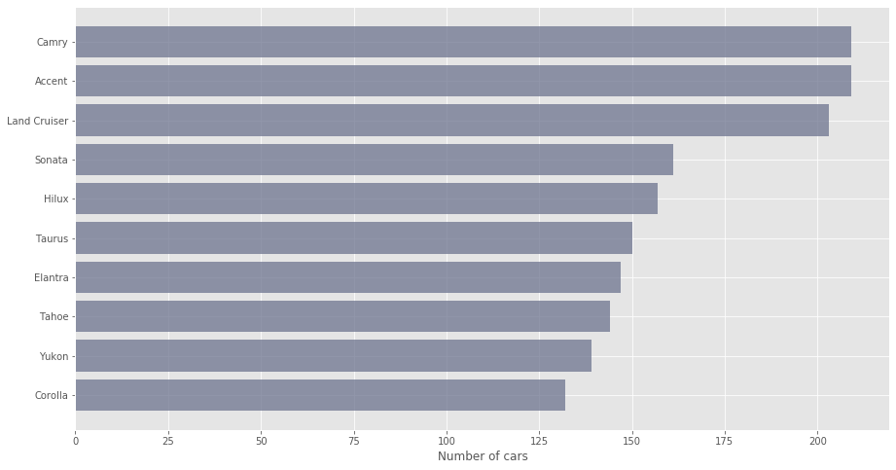
Step 2: Choose a car type with highest number of rows which do not have any zeros
I picked this column

Slide 13
Step 3: Make about 25% of the price column as zero value
Price
114000
27500
43000
59500
72000
92000
80000
32000
50000
135000
153000
235000
Price
114000
27500
0
59500
72000
0
80000
32000
50000
0
153000
235000
Picking 25% of the column

Slide 14
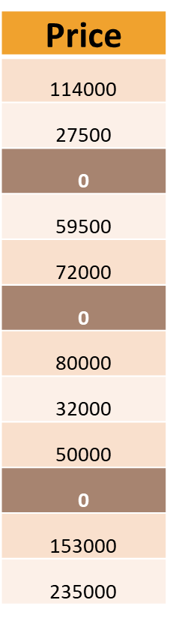
Step 4: Impute these missing data with the four techniques
Price
114000
27500
43000
59500
72000
92000
80000
32000
50000
135000
153000
235000
Input
Output
Imputer

Slide 15
The Results
Evaluation Method | Mean | Median | Most Frequent | KNN
Max Error | 71722.3 | 71000.0 | 71000.0 | 71722.36
Mean Squared Error | 476,574,400 | 469,942,909.1 | 469942909.1 | 476574400
Root Mean Square Error | 21830.6 | 21678.2 | 21678.2 | 21830.6
Mean Absolute Error | 10068 | 9989.1 | 9989.1 | 10067.9
R2_score | 0.58 | 0.59 | 0.59 | 0.58

Slide 16
Future Work
Create an application that can predict a used car price based on the user’s input
Try to examine other imputation algorithms
Automate the whole process

Slide 17
Thank You For Your attention

