Slide 1
Bro + ELK
BroCon 2015
Michael Pananen
Vigilant Technology Solutions
www.vigilantnow.com
mpananen@vigilantnow.com
Twitter: @panaman13
https://github.com/panaman/brocon2015

Slide 2

ELK
Elasticsearch
Logstash
Kibana

Slide 3

Elasticsearch
Recommended Hardware
Medium size machines
Dual 8 core CPU’s
64G Memory
Fastest hard drive on the planet

Slide 4
ELK Server Packages – CentOS 7
https://www.elastic.co/downloads
elasticsearch
logstash
java-1.8.0-openjdk – needed by elasticsearch
httpd – needed by Kibana
mod_ssl – needed by Kibana
GeoIP – needed by Logstash

Slide 5
Simple Install
1. Install Java
sudo yum install java-1.8.0-openjdk
2. Download and install Elasticsearch
curl -O https://download.elastic.co/elasticsearch/elasticsearch/elasticsearch-1.7.1.noarch.rpm
sudo yum install elasticsearch-1.7.1.noarch.rpm
3. Download and install Logstash
curl -O https://download.elastic.co/logstash/logstash/packages/centos/logstash-1.5.2-1.noarch.rpm
sudo yum install logstash-1.5.2-1.noarch.rpm
4. Install GeoIP and update it
sudo yum install GeoIP
sudo geoipupdate
5. Install Apache and mod_ssl
sudo yum install httpd
sudo yum install mod_ssl

Slide 6
Elasticsearch Config
/etc/elasticsearch/elasticsearch.yaml
cluster.name: panapad
node.name: deathstar
node.master: true
node.data: true
# This shard count is not recommended for production
index.number_of_shards: 1
index.number_of_replicas: 0
node.data.
path.data: /data/esdata
path.logs: /data/eslogs

Slide 7

Memory
In production environments it is recommended to disable swap
# /dev/mapper/centos-swap swap swap defaults 0 0
/etc/sysconfig/elasticsearch
# Set ES_HEAP_SIZE to 50% of available RAM, but no more than 31g
ES_HEAP_SIZE=31g

Slide 8
Shards & Indices
Shard = a single Lucene instance
Index = logstash-2015.08.05 = primary and replica shards if applicable
Multiple data nodes
Multiple primary shards spread across multiple machines to scale the load
Replica shards for redundancy and search speed

Slide 9
Elasticsearch - Four Data Node Cluster
Two Primary Shards and 1 replica
ESDATANODE1
Primary Shard
ESDATANODE2
Replica Shard
ESDATANODE3
Primary Shard
ESDATADATA4
Replica Shard

Slide 10
Elasticsearch - Four Data Node Cluster
Two Primary Shards and 1 replica
ESDATANODE1
Primary1 - Logstash-2015.08.05
Replica2 – Logstash-2015.08.04
ESDATANODE2
Replica1 - Logstash-2015.08.05
Primary2 – Logstash-2015.08.04
ESDATANODE3
Primary2 - Logstash-2015-08.05
Replica1 – Logstash-2015.08.04
ESDATADATA4
Replica2 - Logstash-2015.08.05
Primary1 – Logstash-2015.08.04

Slide 11
Reboot?
DISABLE
curl -XPUT http://localhost:9200/_cluster/settings -d '{ "transient" : { "cluster.routing.allocation.enable" : "none" }}’
ENABLE
curl -XPUT http://localhost:9200/_cluster/settings -d '{ "transient" : { "cluster.routing.allocation.enable" : "all" }}'

Slide 12

Logstash
/etc/logstash/conf.d/logstash.conf
input
filter
output

Slide 13
Logstash Input
input {
lumberjack {
port => 5555
ssl_certificate => "/etc/ssl/logstash.crt”
ssl_key => "/etc/ssl/logstash.key”
}
}

Slide 14
Logstash Filter
if [type] =~ /^bro_/ {
json {
source => "message »
}
date {
match => [ "ts", "UNIX" ]
}
if [type] == "bro_http" {
mutate {
rename => [ "host", "http_host" ]
}
}

Slide 15
Logstash Output
output {
elasticsearch {
cluster => "panapad"
host => localhost
protocol => transport
index => "logstash-%{+YYYY.MM.dd}"
}
}

Slide 16
Index Template
http://elasticsearch:9200/_template?pretty
Change field types
String
Integer
Float
boolean
index: analyzed
index: not_analyzed

Slide 17
Logstash Output – New template
output {
elasticsearch {
cluster => "panapad"
host => localhost
protocol => transport
index => "logstash-%{+YYYY.MM.dd}"
template => "/etc/logstash/bro_template.json"
template_name => "logstash"
template_overwrite => true
}
}

Slide 18
Logstash Cert
openssl req -subj '/CN=logstash.panapad.lan/' -x509 -batch -nodes -sha256 -newkey rsa:2048 -keyout logstash.key -out logstash.crt -days 365
Both the logstash server and the logstash-forwarder need the same certs
Common name must resolve

Slide 19

Turn Bro logs into json format
local.bro
@load policy/tuning/json-logs.bro

Slide 20

logstash-forwarder
AKA: Lumberjack
Light weight log forwarder designed
to ship logs to a Logstash Server.
Download
curl –O https://download.elastic.co/logstash-forwarder/binaries/logstash-forwarder-0.4.0-1.x86_64.rpm
Install
sudo yum install logstash-forwarder

Slide 21
Bro – Logstash Forwarder Config
/etc/logstash-forwarder.conf
{
"network": {
"servers": [ "logstash.panapad.lan:5555" ],
"ssl certificate": "/etc/ssl/logstash.crt",
"ssl key": "/etc/ssl/logstash.key",
"ssl ca": "/etc/ssl/logstash.crt"
},
"files": [
{
"paths": [ "/opt/bro/logs/current/conn.log" ],
"codec" : "json",
"fields": { "type": "bro_conn", "sensor": "dagobah" }
},
{
"paths": [ "/opt/bro/logs/current/dns.log" ],
"codec" : "json“,
"fields": { "type": "bro_dns", "sensor": "dagobah" }
},

Slide 22
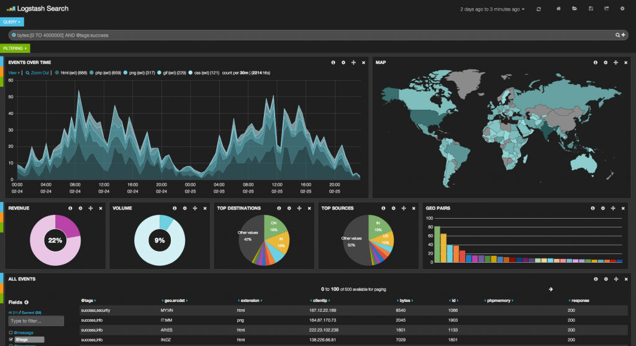
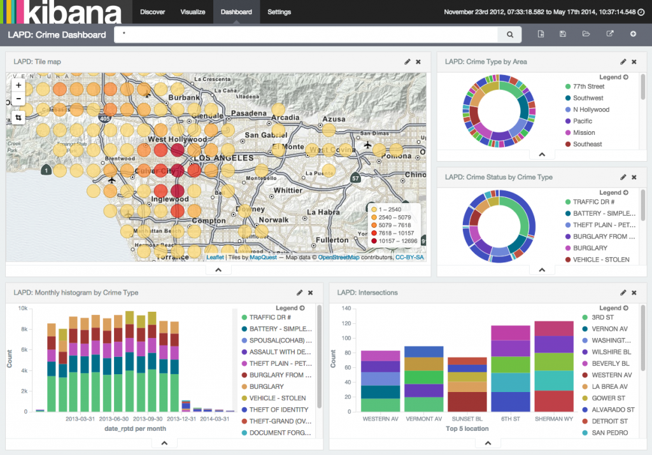
Kibana
Open source browser based analytics and search dashboard for Elasticsearch
Kibana 3 Kibana 4

Slide 23
Kibana 3 Config
config.js
elasticsearch: "http://deathstar.panapad.lan:9200",

Slide 24
Kibana 3 Apache Config
<VirtualHost *:443>
ServerName kibana3.panapad.lan
## Vhost docroot
DocumentRoot "/var/www/kibana3"
<Directory "/var/www/kibana3.panapad.lan">
Options Indexes FollowSymLinks MultiViews
AllowOverride None
Require all granted
</Directory>
## Logging
ErrorLog "/var/log/httpd/kibana3.error_ssl.log"
ServerSignature Off
CustomLog "/var/log/httpd/kibana3.access_ssl.log" combined
## SSL directives
SSLEngine on
SSLCertificateFile "/etc/ssl/kibana3..crt"
SSLCertificateKeyFile "/etc/ssl/kibana3.key”
SSLCACertificatePath "/etc/pki/tls/certs"
SSLProtocol all -SSLv2 -SSLv3 -TLSv1 -TLSv1.1
</VirtualHost>

Slide 25
Kibana 4 Config
kibana.yml
elasticsearch_url: "http://localhost:9200"

Slide 26
Kibana 4 Systemd Service
/etc/systemd/system/kibana.service
[Unit]
Description=Kibana Service
After=network.target
[Service]
Type=simple
User=kibana
ExecStart=/var/www/kibana4/bin/kibana
Restart=on-abort
[Install]
WantedBy=multi-user.target
# systemctl start kibana

Slide 27
Demo

Slide 28
Questions?
https://github.com/panaman/brocon2015

