Slide 1
Automated Waste Sorting Conveyor System
Khalid Kaddoura
Rayan Abou Matar

Slide 2
Table of contents
01
02
03
04
05
06
Introduction
Hopper
Image Processing
Calculations
Pusher Mechanism
Cost

Slide 3
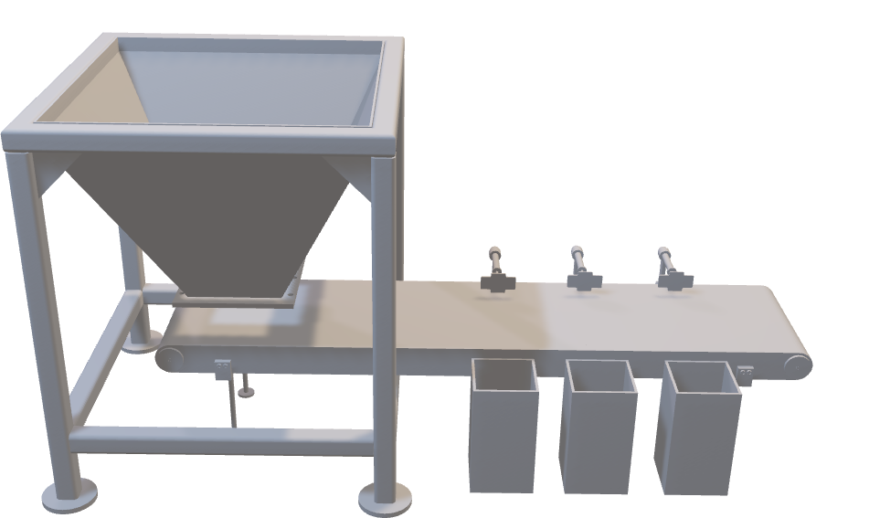
Introduction

Slide 4
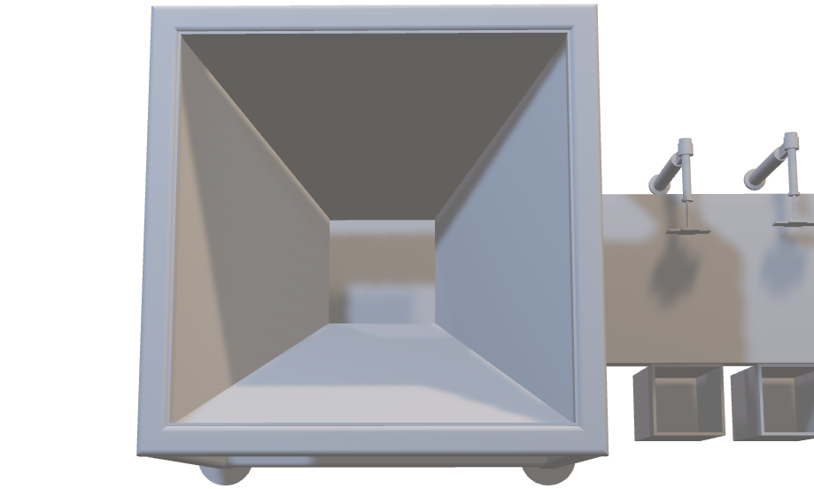
Hopper
Purpose:
Stores mixed municipal solid waste
Provides continuous and controlled feeding.
Prevents clogging due to sloped walls.
Ensures consistent material flow onto the conveyor.
Key Numbers:
Volume: 0.25 m³
Connected to the frame with M4 bolts
Distributes the waste evenly so items arrive one by one at the detection area
The hopper ensures the system never overfeeds or starves the conveyor.

Slide 5
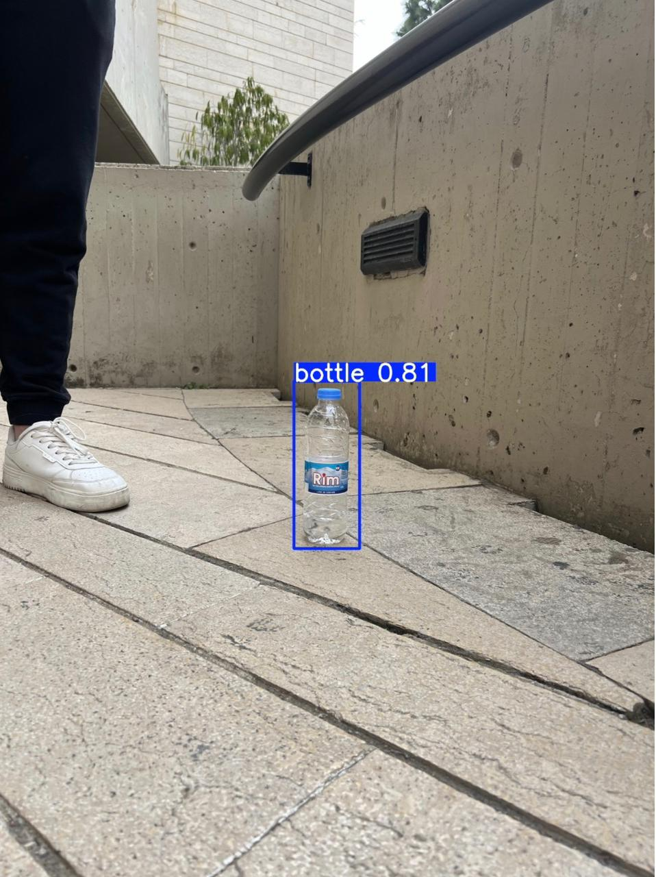
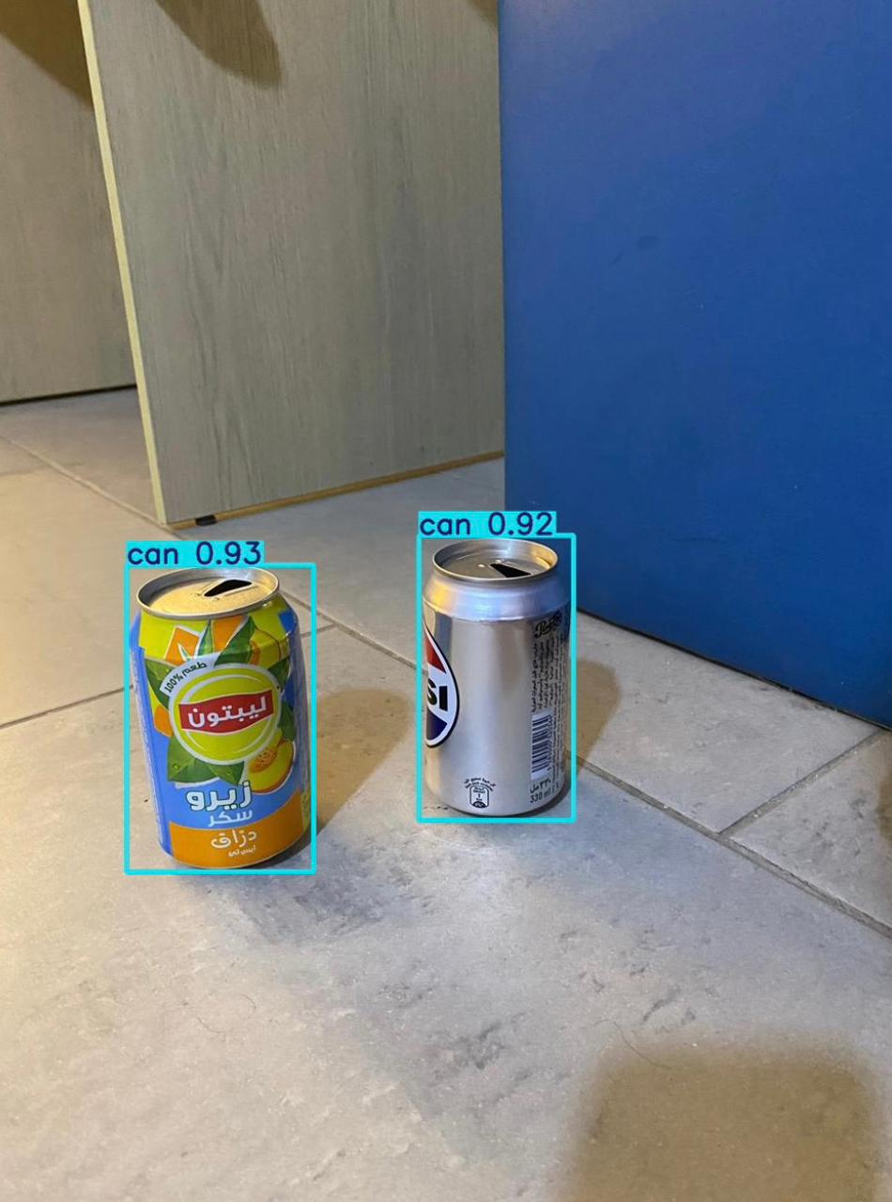
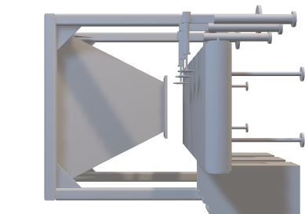
Image Processing
Function:
Captures a real-time image of each object
Classifies it into three categories:
Ferrous metal
Non-ferrous metal
Plastic
Sends a digital signal to trigger the correct pusher

Slide 6
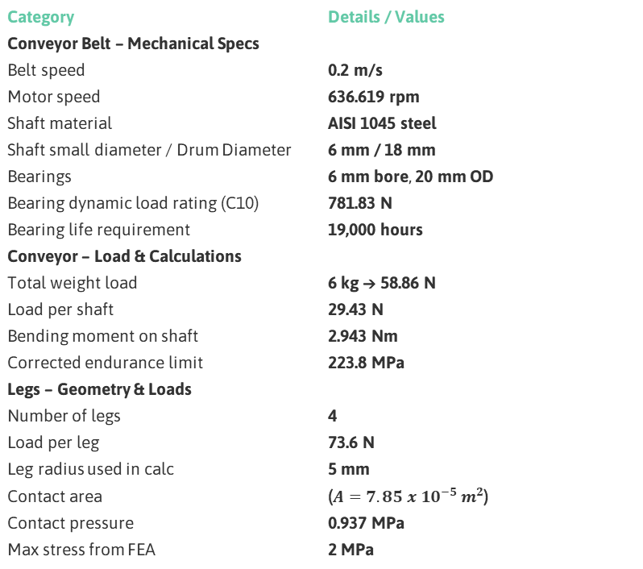
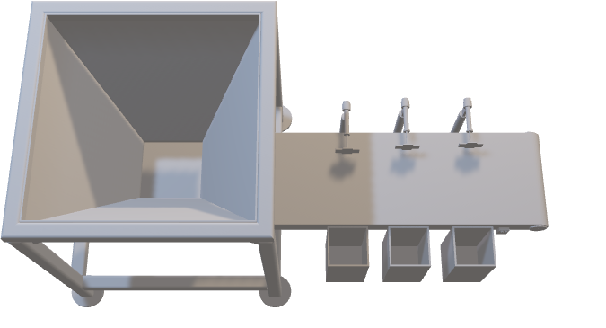
Calculations
Category | Details / Values
Conveyor Belt – Mechanical Specs
Belt speed | 0.2 m/s
Motor speed | 636.619 rpm
Shaft material | AISI 1045 steel
Shaft small diameter / Drum Diameter | 6 mm / 18 mm
Bearings | 6 mm bore, 20 mm OD
Bearing dynamic load rating (C10) | 781.83 N
Bearing life requirement | 19,000 hours
Conveyor – Load & Calculations
Total weight load | 6 kg → 58.86 N
Load per shaft | 29.43 N
Bending moment on shaft | 2.943 Nm
Corrected endurance limit | 223.8 MPa
Legs – Geometry & Loads
Number of legs | 4
Load per leg | 73.6 N
Leg radius used in calc | 5 mm
Contact area | ($A=7.85 x {10}^{−5} m^{2}$)
Contact pressure | 0.937 MPa
Max stress from FEA | 2 MPa

Slide 7
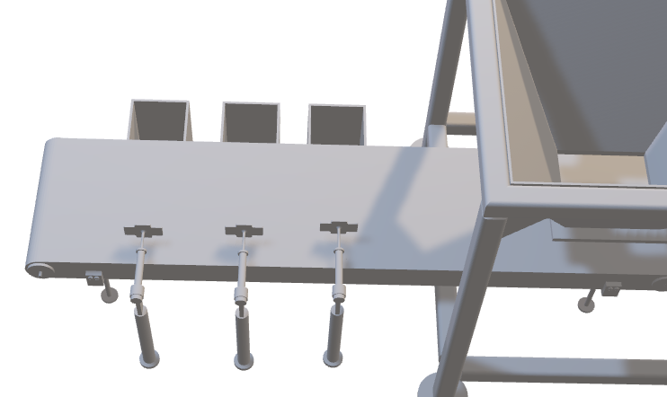
Pusher Mechanism
Function:
Each pusher activates based on the sensor output
Diverts the object into the correct bin
Operates at precise timing based on conveyor speed
Plastic
Ferrous
Non-Ferrous
Layout:
Pusher 1 → Ferrous metals
Pusher 2 → Non-ferrous metals
Pusher 3 → Plastics
Performance:
Mounted at calculated distances to match the 0.2 m/s belt speed
Activates only for a short stroke, minimizing energy use
Ensures clean separation with no collisions or misthrows
This creates a reliable, three-stage sorting process.

Slide 8
Cost
Item | Qty | Material / Type | Unit Cost ($) | Line Total ($)
Belt | 1 | Thermoplastic (industrial) | 300 | 300
Conveyor Frame | 1 | Steel (welded) | 900 | 900
Frame Legs (round tube) | 2 | Steel round tube | 50 | 100
Bolts + Nuts (group) | 16 | M4 steel hardware (combined, capped) | 30 | 30
Bearings (4×) | 4 | Deep-groove / industrial | 40 | 160
Soles | 4 | Rubber mounts | 5 | 20
Driver Shaft | 1 | Solid steel (machined) | 200 | 200
Driven Shaft | 1 | Solid steel (machined) | 200 | 200
Hopper Frame | 1 | Steel sheet & profiles | 200 | 200
Hopper | 1 | Sheet metal (fabricated) | 200 | 200
Actuation Package | 1 | Stands + cylinders + plungers (combined) | 500 | 500
Holding Box (wood) | 3 | Plywood / wooden box | 12 | 36
Camera (low-cost) | 1 | Basic industrial vision / webcam alternative | 50 | 50
Total Cost |  |  |  | 2,896

Slide 9
Thanks!

