Slide 1

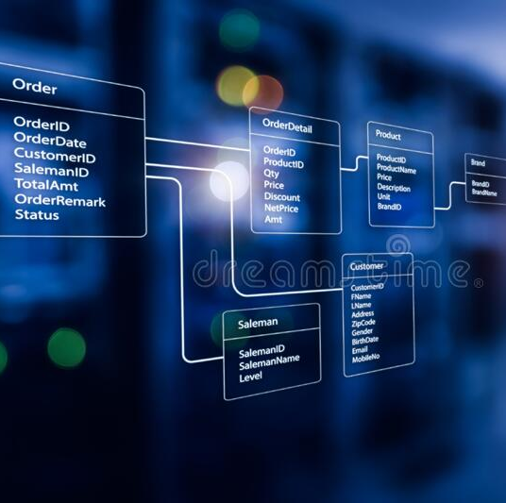
Final Project
Design a Normalized Relational Database for a cosmetics Company.

Slide 2


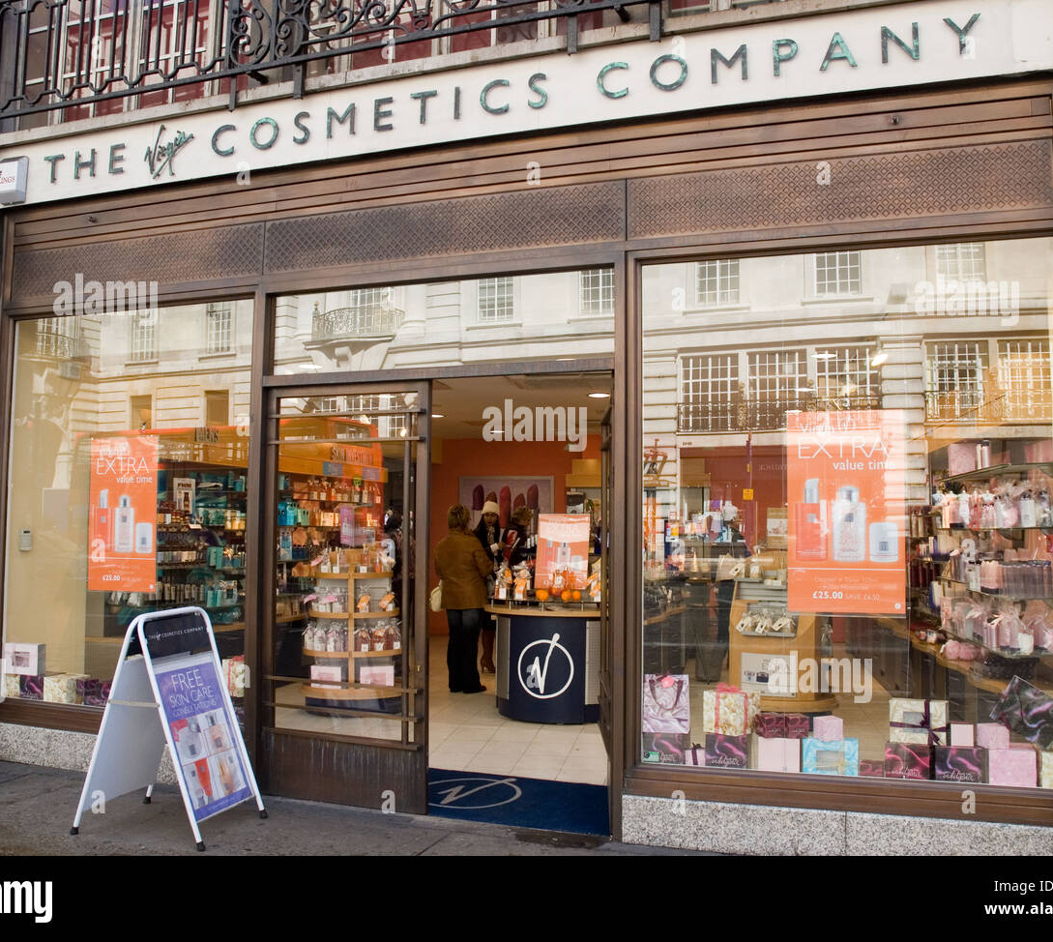

Business Background
A local cosmetic company has been very successful in recent years. They decided to expand their business outside the city. A database system for inner Management is crucial for the expansion of the business.

Slide 3
The Entity Relationship Model

Slide 4
The Entity Relation
The relationships
• An employee may serve one or more customers. A customer must be served by one and only one employee.
• An employee may supervise one or more employees. An employee can be supervised by one and only one employee.
• An order must be made by one and only one employee. An employee may make one or more orders.
• A customer may place one or more orders. An order must be placed by one and only one customer.
• A customer may be referred by one (zero or one) customer; and a customer may refer one or more (one or more) customers.
• An order might have one or more orderdetail. An orderdetail must have one and only one order.
• One category may have one or more products. A product belongs to one and only one category.
• A vendor can sell one or more products. A product can be sold by one or more vendors.

Slide 5

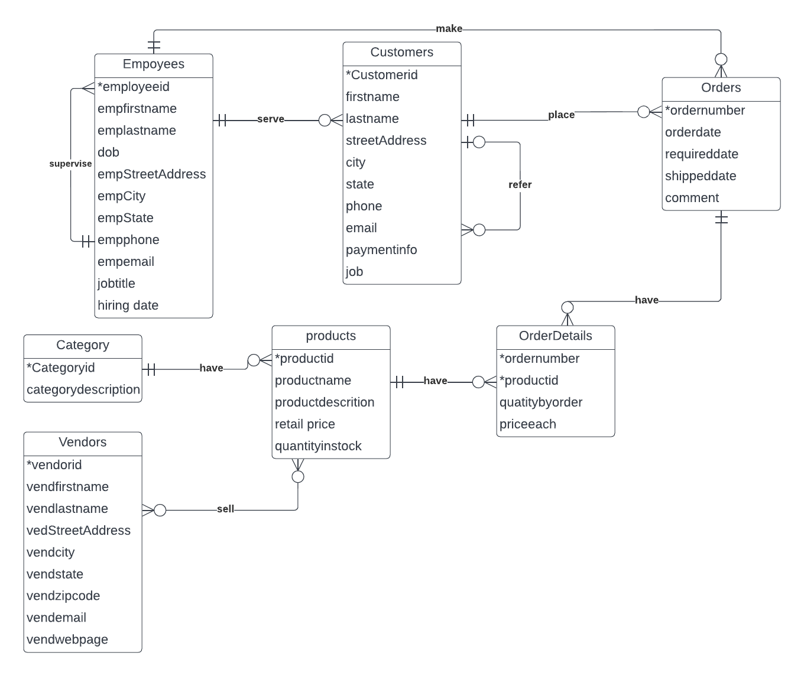

The Entity Relationship Diagram

Slide 6
Convert the ERD to RM

Slide 7
The Functional Dependencies

Slide 8
The Functional Dependencies

Slide 9
Normalize The Rational Model to 3NF

Slide 10
Normalize The Rational Model to 3NF

