Slide 1
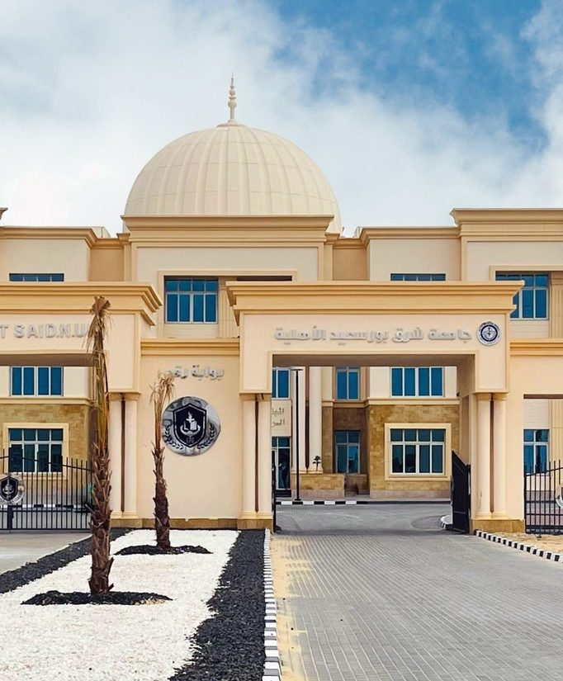
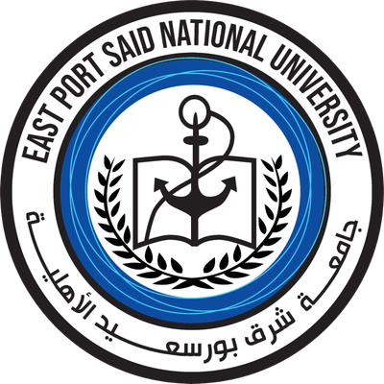
We Live the Future Today
East Port Said National University
Building International Bridges from the Suez Canal
International Profile | 2026
Notes:
Good morning, and welcome. It is a pleasure to host you. East Port Said National University is a non-profit national university in Sinai, created under Egypt's higher-education development strategy and aligned with Egypt Vision 2030. Our slogan is "We Live the Future Today", and one of our four stated pillars is global openness: international partnerships and exchange opportunities. That pillar is the reason we are speaking with you. In the next few minutes we will show you who we are, who leads us, what we teach, and the international relationships we are building, with candor about where we are today and where we would like to go together.
CAVEATS:
- "Fourth-generation university" is the university's own description of itself.
LIKELY QUESTION: When was the university founded?
ANSWER: The founding date is not published on our official website, so I would rather not quote a figure from memory. We would be glad to confirm it in writing after this meeting.
Sources (briefing): S1, S3, S5, S24

Slide 2
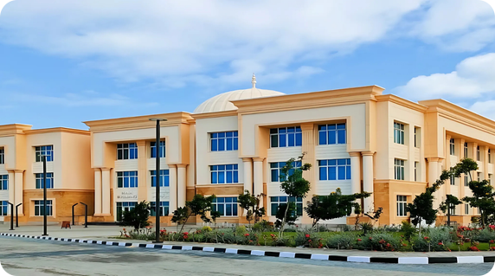



EPNU at a Glance
A non-profit national university in Sinai, created under Egypt Vision 2030
7
13+
5,200+
80+
Faculties
Academic programs
Students
International publications
Non-profit national (Ahliya) university
Part of Egypt's new generation of national universities
East Port Said, Sinai
A 44-feddan campus on the Suez Canal corridor, driving regional development
Aligned with Egypt Vision 2030
A "fourth-generation" university focused on research and innovation
Notes:
Here is EPNU at a glance. We have seven faculties, more than thirteen academic programs, and a student body that our website puts at over 5,200. English is our official language of instruction, with English textbooks, exercises and exams, which matters for international colleagues. We are based in East Port Said, in Sinai, on a 44-feddan campus, and the university is described as a driver of development there. Our mission is simple: provide distinguished academic programs, strengthen scientific research and community service, and discover and develop students' talents to help build a better future. We describe ourselves as a fourth-generation university, focused on excellence in education and research.
CAVEATS:
- "5,200+" is a website counter, not an audited figure; say "over 5,200 according to our website".
- Say "13+ programs"; the Programs page lists 13 but faculty pages show extra tracks.
- The founding date is not published.
- The campus figures (including the 44 feddans) come from a Ministry of Higher Education report shared on the university's Facebook page (S51); the campus is in an early construction phase.
LIKELY QUESTION: Is the 5,200 student figure official?
ANSWER: It is the figure shown on our website, not an audited number, so please treat it as an approximate indication of scale.
Sources (briefing): S1, S3, S5, S7, S24, S51

Slide 3




Why Partner with EPNU
A new-generation university building its international partnerships
Strategic location
Global academic standards
East Port Said on the Suez Canal, where Africa meets Asia, at the heart of Sinai's development.
English-medium instruction, a credit-hour system with ECTS equivalence, and bilingual graduation certificates.
Future-focused programs
Strong national backing
Artificial intelligence across faculties, a Huawei ICT Academy, and modern health sciences and clinical pharmacy.
A Board chaired by a former Prime Minister, and a national mandate to expand global partnerships.
Notes:
Why partner with EPNU? First, our setting: we are in East Port Said, on the Suez Canal side of Egypt, which is a natural meeting point for regional cooperation. Second, international academic habits are already part of daily life here: English-medium teaching, a credit-hour system, and ECTS-based Medicine. Third, our programs look to the future, with strong emphasis on artificial intelligence and health. Fourth, we have strong national backing: we are one of the national universities created under Egypt's higher-education strategy, and our Board is chaired by a former Prime Minister of Egypt. These are the foundations on which international partners can build with confidence.
CAVEATS:
- "Strategic location" and "gateway university" are our analysis, not website claims; present them as an opinion.
- Do not imply the national backing means any international agreement beyond what is documented.
LIKELY QUESTION: What does national backing mean in practice?
ANSWER: We are part of Egypt's national-university system, and our Board includes a former Prime Minister, former governors, senior academics and business leaders. The Minister has also publicly asked national universities to expand international cooperation.
Sources (briefing): S1, S3, S4, S7, S11, S21

Slide 4
Leadership & Governance
01
Experienced leadership with national reach and a global outlook
Notes:
Let us now turn to the people who guide the university. We will meet our President, whose career spans several countries, and then the Board of Trustees, which brings together government, academia and industry in one room.
LIKELY QUESTION: Who makes the strategic decisions?
ANSWER: The Board of Trustees, which meets regularly, sets the broad direction. Its 10th meeting was held on 17 March 2026.
Sources (briefing): S4, S23

Slide 5
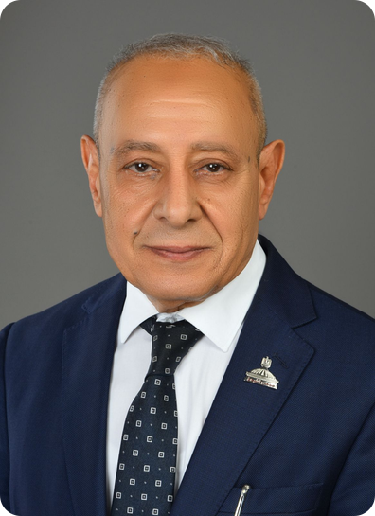




Leadership with a Global Outlook
Prof. Dr. Atef Alam El-Din, President of East Port Said National University
Internationally educated
PhD in Engineering, Leningrad University (former Soviet Union); BSc and MSc, Menoufia University
Egyptian-Japanese Education Initiative 2025
Member of the initiative's Steering Committee; has organized several international scientific conferences
National policy experience
Has served on the Egyptian Senate's Committee on Education, Scientific Research & ICT
Academic leadership and quality
Former Acting President of Port Said University; certified NAQAAE quality reviewer; about 40 research papers
Notes:
Our President, Professor Atef Alam El-Din, brings a genuinely international profile. He earned his PhD in Engineering at Leningrad University, in the former Soviet Union, after his bachelor's and master's degrees at Menoufia University in Egypt. He sits on the Steering Committee of the Egyptian-Japanese Education Initiative 2025 and has organized several specialized international scientific conferences. He has served as Acting President of Port Said University and Vice President of Suez Canal University's Port Said branch, and is a certified quality reviewer for Egypt's national accreditation authority, NAQAAE. He has published about forty research papers. His experience gives us credibility on both sides of any partnership.
CAVEATS:
- The website is inconsistent on the Senate role: the President's page lists it as current, while the Board page and March 2026 news say "former". Say "has served on Senate committees".
- The Egyptian-Japanese Initiative is a role held by the President, not a signed university agreement with Japan.
- The NAQAAE reviewer status is a national quality-authority credential.
LIKELY QUESTION: Does the President's Japan role mean EPNU has a Japanese partner?
ANSWER: Not yet. It is a steering-committee role in an education initiative, and we see it as a door to Japanese cooperation rather than an existing agreement.
Sources (briefing): S3, S4

Slide 6



A Board Bridging Government, Academia & Industry
The Board of Trustees supports the university's strategy and institutional partnerships
Academia & medicine
Prof. Dr. Atef Alam El-Din, University President
Prof. Dr. Sherif Youssef Saleh, President of Port Said University
Prof. Dr. Mohamed Hassan El-Kenawy, former President of Mansoura University
Prof. Dr. El-Sayed Hussein Hegazy
Prof. Dr. Mamdouh Radwan El-Nahas, President, Egyptian Society of Diabetes and Lipidology
Chairman
Eng. Ibrahim Mahlab
Former Prime Minister of Egypt
Government & public service
Industry & trade
Members bring together government, universities, medicine, and trade and industry.
Maj. Gen. Ahmed Abdullah, former Governor of the Red Sea and Port Said
Maj. Gen. Ibrahim Abu Limoun, Governor of Port Said
Eng. Lotfy Hassan El-Badrawy, KAPCI Coatings
Mr. Mohamed El-Said Saada, Port Said Chamber of Commerce
Dr. Hassan Hassanein Khalil Hassan, pharmaceutical sector
Notes:
Our Board of Trustees is chaired by Engineer Ibrahim Mahlab, a former Prime Minister of Egypt. Around him sit former governors, including of Port Said, the President of Port Said University, former and current university leaders, a medical society president, the head of the Port Said Chamber of Commerce, and business leaders in industry and pharmaceuticals. This mix of government, academia and trade is a useful base for partnerships, which is our own reading rather than a formal statement. The Board has met on our campus and at Port Said University, and it has discussed practical matters such as student residences and scholarship rules.
CAVEATS:
- The Board page says it has 12 members but lists 11.
- The Vice Chairman is named differently across pages (Maj. Gen. Ahmed Abdullah on the homepage; Prof. Mohamed El-Kenawy in news); avoid naming one.
- Maj. Gen. Ibrahim Abu Limoun is listed as former Governor of Menoufia but described elsewhere as Governor of Port Said; Prof. Hegazy is described as both a pediatrics pioneer and an engineering professor. Do not give individual details for these two.
- "Bridging government, academia and industry" is our analysis.
LIKELY QUESTION: Who is the Vice Chairman of the Board?
ANSWER: Our website names different people on different pages, so I would prefer to confirm this with the Board secretariat rather than give you an uncertain answer.
Sources (briefing): S1, S4, S23, S24

Slide 7








Academic Leadership
Program directors and university offices leading teaching, quality and international relations
Engineering
Computer Science & IT
Medicine
University Offices
Assoc. Prof. Mohamed El-Sakka
Mechatronics & Automation
Assoc. Prof. Asmaa Rady
AI & Machine Learning · Construction
Prof. Osama El-Baksawy
Director of the Faculty's Programs
Assoc. Prof. Sherine El-Khouly
Medicine and Surgery
International Relations Office
Assoc. Prof. Mohamed El-Sakka
Quality Assurance Center
Prof. Osama El-Baksawy
Pharmacy
Applied Health Sciences
Business Sciences
Training & Professional Development
Assoc. Prof. Asmaa Rady
Assoc. Prof. Mohamed Yasser
Clinical Pharmacy (PharmD)
Dr. Salma Khairallah
Director of the Faculty's Programs
Dr. Ali Gomaa
Accounting & Software Applications
Secretary-General
Ms. Ghada Shazly
Notes:
Behind every program is a named person you can speak to. Engineering is led by Dr. Mohamed El-Sakka for Mechatronics and Automation, and Dr. Asmaa Rady for AI and Machine Learning and Construction. Computer Science and IT, Medicine, Pharmacy, Applied Health Sciences and Business Sciences each have a director too. Beyond the faculties, our university offices carry institutional responsibility: Quality Assurance, Training and Professional Development, and the Secretary-General. For partners, the key point is simple. The International Relations Office, directed by Dr. Mohamed El-Sakka, is your point of contact. It is where partnership conversations begin, and where they are followed through.
CAVEATS:
- Titles are shown as "Dr." because our sources mix ranks (Dr., Associate Professor, Assistant Professor); do not add rank titles from memory.
- The Faculty of Arts program directors are not yet announced; say so plainly if asked.
- The names come from the university's official Facebook page (S51), where post dates are hidden, so we cannot say exactly when each appointment took effect.
- Several people hold more than one role (for example Dr. Mohamed El-Sakka, Dr. Osama El-Baksawy and Dr. Asmaa Rady); this is as shown on the slide.
LIKELY QUESTION: Who is the right person to contact about a partnership?
ANSWER: The International Relations Office, directed by Dr. Mohamed El-Sakka. He takes part in our agreement signings, so he can connect you with the right faculty or program director.
Sources (briefing): S51

Slide 8
Academics
02
Seven faculties with programs designed for tomorrow's labor market
Notes:
Now to the academic heart of EPNU. We will look at our seven faculties and their programs, and then at the international standards that already shape how we teach and administer studies.
LIKELY QUESTION: What language are programs taught in?
ANSWER: English is the official language of instruction, with textbooks, exercises and exams in English.
Sources (briefing): S7

Slide 9

Seven Faculties, Future-Ready Programs
13+ bachelor's programs, with artificial intelligence across engineering, computing and the arts
Engineering
Medicine
Pharmacy
Computer Science & IT
Mechatronics & Automation
AI & Machine Learning
Construction
Energy & Electrical Power
Medicine and Surgery: 5 years plus a 2-year internship (ECTS)
Clinical Pharmacy (PharmD)
Computer Science
Artificial Intelligence
Data Science
Biomedical Informatics
Applied Health Sciences
Business Sciences
Arts
Medical Laboratory Technology
Medical Imaging & Radiologic Technology
Accounting & Software Applications
Digital Marketing & E-Management
English Language & Translation
Geomatics & Artificial Intelligence
Notes:
We have seven faculties. Engineering offers mechatronics and automation, AI and machine learning, and energy and electrical power. Medicine is a five-year program plus a two-year internship, ECTS-based and taught in English. Pharmacy offers clinical pharmacy. Computer Science and IT covers computer science, artificial intelligence, data science and biomedical informatics. Applied Health Sciences focuses on laboratory technology and medical imaging. Business Sciences and Arts complete the picture. For international relations, one program stands out: English Language and Translation in the Faculty of Arts, covering interpreting, intercultural communication, and career paths in cultural and diplomatic institutions.
CAVEATS:
- The Programs page lists 13 programs; faculty pages show extra tracks (Energy and Electrical Power, Medical Imaging). Say "13+".
- The Arabic page for Applied Health Sciences lists six specialties, more than the English page.
- Do not quote student numbers per faculty; none are published.
LIKELY QUESTION: Which programs are most suited to joint activity?
ANSWER: Based on what we publish, AI and health are our strongest areas, and the Clinical Pharmacy program already leads our first international agreement. English Language and Translation is also a natural fit for cultural and diplomatic cooperation.
Sources (briefing): S3, S5, S9, S10, S21, S38, S39

Slide 10
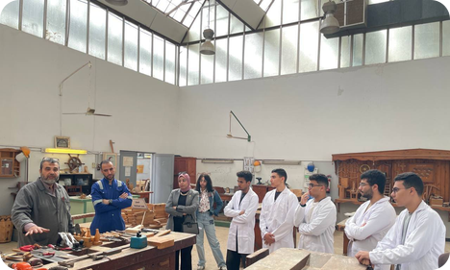





Faculty of Engineering
A shared preparatory year, then three future-focused specializations
Hands-on from day one
Robotics projects, from line-following robots to 4- and 6-axis industrial robot models
Program Directors
Assoc. Prof. Mohamed El-Sakka
Mechatronics & Automation · Engineering Programs · IR Office
PhD, University of Sheffield (UK); wind-energy and CFD research at Port Said University.
Huawei ICT Academy
AI students train in cloud, IoT and networking through Huawei's academy at EPNU
Industry training
Workshops at the Suez Canal Authority Training Center; a signed protocol with BEDO for factory training and applied research
Programs
Assoc. Prof. Asmaa Rady
AI & Machine Learning · Construction · Training Center
PhD, University of Exeter (UK; Newton-Mosharafa scholar); research fellow, Politecnico di Torino.
Mechatronics & Automation Engineering
AI & Machine Learning Engineering
Construction Engineering
Energy & Electrical Power Engineering
Competing nationally
Teams at ITC-Egypt 2026 and the ICIAAI 2026 AI Hackathon
Notes:
The Faculty of Engineering gives every student a shared preparatory year, then three specializations: mechatronics and automation, AI and machine learning, and energy and electrical power, with construction engineering also on offer. Learning is hands-on from the start, with robotics projects and training at the Suez Canal Authority Training Center. Our AI students also train through the Huawei ICT Academy hosted at EPNU. The programs are led by two directors with UK doctorates. Dr. El-Sakka, who also heads our International Relations Office, has published widely on wind energy, including highly cited work on vertical-axis turbines. Dr. Rady, a Newton-Mosharafa scholar, works on solar and thermal management of photovoltaics.
CAVEATS:
- El-Sakka's Sheffield PhD is a probable match only: it rests on an OpenAlex/ORCID profile for "Mohamed M. Elsakka" at Port Said University. The middle name "Metwally" appears on no academic profile. Say "reported" or "according to public records", not "verified".
- Dr. Rady's identity is better supported (PSU staff page, Google Scholar and the EPNU Engineering page agree on the Exeter PhD).
- Some EPNU news posts give directors' titles as Assistant Professor; the slide uses the titles the university confirmed, so do not improvise a different rank aloud.
- Program duration and credit hours are not published consistently: a 165 credit-hour figure appears on the site but the study plan is marked "to be updated soon". Do not quote it.
- The Energy & Electrical Power specialization has no named director on the slide; do not name one.
LIKELY QUESTION: How many credit hours and years is the engineering degree?
ANSWER: The program follows a preparatory year plus a specialization, but the final study plan and credit-hour total are still being updated on our website. We will send you the approved regulations in writing.
Sources (briefing): D:\AI\EPNU\research\faculty_engineering.json, D:\AI\EPNU\research\bio_el_sakka.json, D:\AI\EPNU\research\bio_asmaa_rady.json, D:\AI\EPNU\research\BRIEF.md, D:\AI\EPNU\data\text\en_rendered\pages\1058.txt, https://epnu.edu.eg/en/faculty-of-engineering/

Slide 11
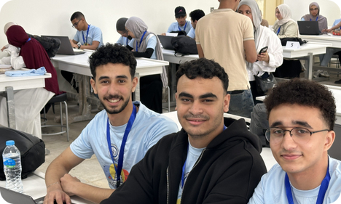


Faculty of Computer Science & IT
Four-year programs built around AI, data and digital health
AI at the core
Machine learning, intelligent systems and decision support across the programs
Program Director
Prof. Osama El-Baksawy
Director of the Faculty's Programs · Quality Assurance Center
Faculty member in Electrical Power & Machines Engineering at Port Said University. His research covers renewable energy, fractional-order control and metaheuristic optimization, with 24 indexed papers and 780+ citations (h-index 15, OpenAlex).
Computing meets medicine
Biomedical Informatics builds systems on clinical data, biometrics and medical imaging
Competitive programmers
Qualified for the Egyptian Collegiate Programming Contest (ECPC) 2026; ICPC-style community contests on campus
Programs
Computer Science
Artificial Intelligence
Data Science in Information Systems
Biomedical Informatics
Skills partners
Cooperation talks with ITI and Creativa Port Said on digital-skills training
Notes:
The Faculty of Computer Science and IT offers four-year programs in computer science, artificial intelligence, data science in information systems, and biomedical informatics. The last one is distinctive: it applies computing to clinical data, biometrics and medical imaging. Our students are active in competitive programming and qualified for the Egyptian Collegiate Programming Contest in 2026. The faculty is led by Professor Osama El-Baksawy, who also directs our Quality Assurance Center. His own research is in renewable energy and fractional-order control, and one of his IEEE Access papers has more than a hundred citations. We have also begun cooperation talks with ITI on digital-skills training.
CAVEATS:
- El-Baksawy's rank is inconsistent in EPNU sources: the Arabic faculty heading says Professor, but his own biography text and several news posts say Assistant Professor. The slide uses the title the university confirmed; verify before printing it on formal documents.
- His PhD institution and year were not found, so do not mention his doctorate. His field is electrical power engineering, adjacent to rather than inside computer science.
- His metrics (24 papers, about 780 citations, h-index 15) are auto-generated by OpenAlex and may be incomplete. One 2023 paper lists a different affiliation, which is unresolved.
- ITI and Creativa are described as cooperation talks only. No signed agreement was found.
- Credit hours for all four programs are not published ("to be updated soon").
LIKELY QUESTION: Do you have a formal agreement with ITI?
ANSWER: We have held cooperation meetings on digital-skills training, and we are happy to say more once there is a signed document. At this stage we describe it as talks.
Sources (briefing): D:\AI\EPNU\research\faculty_cs.json, D:\AI\EPNU\research\bio_el_baksawy.json, D:\AI\EPNU\research\BRIEF.md, D:\AI\EPNU\data\text\en_rendered\pages\3154.txt, D:\AI\EPNU\data\text\en_rendered\posts\4503.txt, https://epnu.edu.eg/en/faculty-of-computer-sciences/

Slide 12
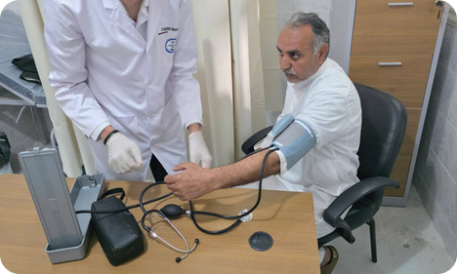



Faculty of Medicine
An integrated, English-medium MBBCh with early clinical exposure
Integrated curriculum
Basic sciences, clinical training and community service taught together
Program Director
Assoc. Prof. Sherine El-Khouly
Program Director, Medicine & Surgery
Leads the alignment of medical training and learning outcomes with Egypt's healthcare needs. She supervises student research, clinical training and community medical convoys, and holds a professional diploma (grade: Excellent) from GAHAR, Egypt's healthcare accreditation authority.
Community medicine in Sinai
Students train with medical convoys at primary-care units in North Sinai
Student research
Medical students present papers at national conferences, including Ain Shams and Suez Canal universities
Programs
Bachelor of Medicine & Surgery (MBBCh)
5 years (10 semesters) + 2-year internship
ECTS credit system, taught in English
Clinical partners
Port Said University's new university hospital; a signed protocol with Ahl Masr Hospital; MoU with 57357
Notes:
Our Faculty of Medicine offers an integrated, English-medium MBBCh: five years over ten semesters, followed by a two-year internship. Basic sciences, clinical training and community service are taught together, and the ECTS credit system makes it familiar to European partners. Students join medical convoys to primary-care units in North Sinai, and they present research at national conferences. The program director, Dr. Sherine El-Khouly, holds a GAHAR professional diploma with an Excellent grade, from the first cohort of Egypt's healthcare accreditation authority. Clinical training runs through partner hospitals, including Port Said University's new hospital, Ahl Masr Hospital and the 57357 children's cancer hospital.
CAVEATS:
- Internal only: Egyptian media in August to October 2026 reported a dispute over the size of the Medicine intake. See extra_findings.md section A1. Figures vary by source and the official reasons were not published. Do not raise it unprompted; if asked, use the neutral line below.
- Do not promise Medicine places, exchange numbers or a teaching-hospital opening date. Clinical training is through partner hospitals; no EPNU teaching hospital details are public.
- Dr. El-Khouly's home institution, specialty and publication record were not found, so avoid describing her specialty. Her rank appears as Assistant Professor in some Arabic posts; the slide follows the confirmed title.
- The credit-hour total is not published; only the ECTS system is named.
- The 57357 item is an MoU and Ahl Masr a signed protocol; do not upgrade either to a joint program.
LIKELY QUESTION: How many Medicine students do you admit each year?
ANSWER: Medicine intake follows the capacity limits set by the Supreme Council of Private Universities and the readiness of our clinical-training sites. We would rather confirm the current figure in writing than quote a number from memory.
Sources (briefing): D:\AI\EPNU\research\faculty_medicine.json, D:\AI\EPNU\research\bio_el_khouly.json, D:\AI\EPNU\research\extra_findings.md, D:\AI\EPNU\data\text\en_rendered\pages\3155.txt, https://epnu.edu.eg/en/faculty-of-medicine/

Slide 13
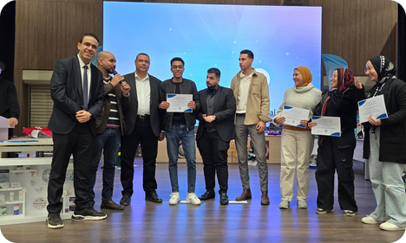




Faculty of Pharmacy
Clinical Pharmacy (PharmD) with a strong research and industry base
Modern labs
HPLC and UV-Vis instruments, plus clinical simulation rooms for dose calculation
Program Director
Assoc. Prof. Mohamed Yasser
Program Director, Clinical Pharmacy · Entrepreneurship Club
Faculty member in the Department of Pharmaceutics, Faculty of Pharmacy, Port Said University. His interests include pharmaceutical and cosmetic formulation, and he champions entrepreneurship and innovation among EPNU's pharmacy students.
Industry partners
EIPICO, EVA Pharma, Lavender Life and Royal Cosmetics
First international partner
Leads the Universiti Putra Malaysia partnership and joint webinars
Programs
Bachelor of Pharmacy: PharmD (Clinical Pharmacy)
10 semesters, taught in English
Research-active
Pharmacy and medicinal chemistry account for most of EPNU's international papers
Notes:
The Faculty of Pharmacy offers a Bachelor of Pharmacy, PharmD in Clinical Pharmacy, over ten semesters in English. Students use HPLC and UV-Vis instruments, and clinical simulation rooms where they practice dose calculation. The faculty has industry partners including EIPICO, EVA Pharma, Lavender Life and Royal Cosmetics. It is also where our first international partnership began, with Universiti Putra Malaysia, including joint webinars. Pharmacy and medicinal chemistry produce most of our international publications; our most-cited papers are on triazole-based anticancer candidates. The program is directed by Dr. Mohamed Yasser, who also runs the Entrepreneurship Club and lectures on innovation in pharmaceutical and cosmetic formulation.
CAVEATS:
- Dr. Yasser's rank: some EPNU posts say Assistant Professor (for example post 2751); the slide uses the confirmed title Associate Professor.
- No publication profile was found for him (OpenAlex, Scholar, ORCID). The research credit belongs to the faculty's staff generally, not to him personally.
- The UPM relationship is the only foreign MoU found; do not describe it as a joint degree or exchange program.
- The list of six scientific departments is marked provisional on the website. Credit hours and internship length are not published.
- The research claim ("most of our international papers") is based on automatic field labels and affiliation matching; see the research slide notes.
LIKELY QUESTION: Is the PharmD accredited, and is there an internship year?
ANSWER: The program is approved within Egypt's national-university framework. We have not published accreditation details or an internship structure online, so we will send you the official study plan once it is final.
Sources (briefing): D:\AI\EPNU\research\faculty_pharmacy.json, D:\AI\EPNU\research\bio_mohamed_yasser.json, D:\AI\EPNU\research\publications_summary.md, D:\AI\EPNU\research\extra_findings.md, D:\AI\EPNU\data\text\en_rendered\pages\3156.txt, https://epnu.edu.eg/en/faculty-of-pharmacy/

Slide 14
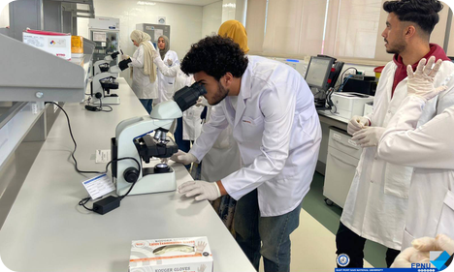



Faculty of Applied Health Sciences Technology
Training the technologists behind modern diagnostics
Diagnostic labs
Hematology, biochemistry, microbiology and microscopy labs
Program Director
Dr. Salma Khairallah
Director of the Faculty's Programs
Directs both the Medical Laboratory and Medical Imaging programs. She holds a PhD in Biochemistry from Port Said University's Faculty of Science, where she previously directed the Biochemistry & Microbiology program.
Imaging training
Training on X-ray, CT and MRI equipment, with radiation protection and quality standards
Hospital training network
Port Said University Hospital, Saudi German Hospital Cairo, Ahl Masr Hospital and 57357
Programs
Medical Laboratory Technology
Medical Imaging & Radiologic Technology
Taught in English (131 credit hours)
57357 MoU
A signed MoU with the 57357 Group covers practical training and research
Notes:
The Faculty of Applied Health Sciences Technology trains the technologists behind modern diagnostics, in two programs: Medical Laboratory Technology and Medical Imaging and Radiologic Technology. Teaching is in English, with 131 credit hours. Students work in hematology, biochemistry, microbiology and microscopy labs, and train on X-ray, CT and MRI equipment with an emphasis on radiation protection and quality. Practical training takes place across a hospital network: Port Said University Hospital, Saudi German Hospital in Cairo, Ahl Masr Hospital and the 57357 Group, with which we have signed an MoU. The faculty is directed by Dr. Salma Khairallah, a biochemist who holds her PhD from Port Said University.
CAVEATS:
- The 131 credit hours is stated on the faculty page but is not confirmed as specific to each program; say "about 131" if challenged.
- Dr. Khairallah is titled Prof. Dr. on the faculty page but Dr. in news posts; use Dr. as instructed. Her specialty is biochemistry, not radiology, so do not present her as an imaging expert.
- No publication record was found for her, and her current permanent post is not independently verified.
- Program durations are not published. The clinical-training partners also include Bahia Hospital and a plasma donation center, but those are not on the slide.
LIKELY QUESTION: Do graduates receive any international recognition?
ANSWER: We have not yet published any international recognition for these programs. What we can offer today is hospital-based training with named partners, and we would welcome discussion of joint curriculum or exchange.
Sources (briefing): D:\AI\EPNU\research\faculty_ahs.json, D:\AI\EPNU\research\bio_salma_khairallah.json, D:\AI\EPNU\data\text\en_rendered\pages\1047.txt, https://epnu.edu.eg/en/faculty-of-applied-health-sciences/

Slide 15
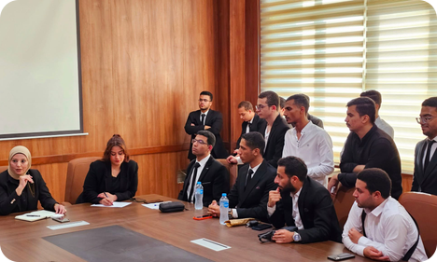




Faculty of Business Sciences
Accounting and marketing for a digital economy
Digital accounting
Accounting information systems, financial software and financial analysis
Program Director
Dr. Ali Gomaa
Program Director, Accounting & Software Applications
Leads the Accounting & Software Applications program, which prepares students for accounting, auditing, financial analysis, taxation and financial-software careers.
Digital marketing
Campaigns, e-commerce, platform management and consumer analytics
First cohort
The faculty welcomed its first cohort with a dedicated orientation day
Programs
Accounting & Software Applications
Digital Marketing & E-Management
Career-ready
Pathways to accounting, auditing, taxation, banking, marketing and e-commerce roles
Notes:
The Faculty of Business Sciences prepares graduates for a digital economy through two programs: Accounting and Software Applications, and Digital Marketing and E-Management. On the accounting side, students work with accounting information systems, financial software and financial analysis. On the marketing side, they learn campaigns, e-commerce, platform management and consumer analytics. This is one of our newest faculties, and it welcomed its first cohort with a dedicated orientation day. Dr. Ali Gomaa leads the Accounting program, which points graduates to careers in accounting, auditing, taxation, banking and financial software. We see good scope for exchange and joint teaching in digital business.
CAVEATS:
- Dr. Gomaa's role at EPNU rests on a single Facebook post (the first-cohort orientation); it is not on the website. His home institution, qualifications and research could not be verified. Do not say where he previously worked or what his doctorate is in.
- He is not the former Grand Mufti of the same name; avoid any confusion.
- The Digital Marketing program has no named director on the slide.
- Duration, credit hours and vision/mission statements are not published for this faculty.
- Some EPNU news posts give directors' titles as Assistant Professor; the slide uses the titles the university confirmed, so do not improvise a different rank aloud.
LIKELY QUESTION: What are Dr. Gomaa's qualifications?
ANSWER: I do not have his full academic profile in front of me, so I would rather not guess. We will send you a short biography from the faculty after this meeting.
Sources (briefing): D:\AI\EPNU\research\faculty_business.json, D:\AI\EPNU\research\bio_ali_gomaa.json, D:\AI\EPNU\data\text\en_rendered\pages\4176.txt, https://epnu.edu.eg/en/faculty-of-business-sciences/

Slide 16
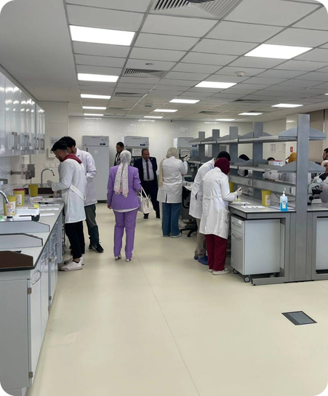





Built on International Academic Standards
Rules and standards that support credit transfer, exchange and joint programs
English-medium instruction
English is the official language of teaching, textbooks and exams
Credit hours ≈ ECTS
One semester's load ≈ 30 ECTS (750 hours of student workload)
Bilingual certificates
Graduation certificates issued in Arabic and English
Mobility-ready rules
Non-degree and auditor registration; transfer with course equivalency
International entry routes
Admission rules accept IGCSE, the Nile International Certificate and foreign certificates
Huawei ICT Academy
Training in AI, cloud, networks, IoT and modern communications
Notes:
Many partners ask whether we are ready to work internationally. Our regulations already contain the building blocks. Teaching is in English. We use credit hours, where a semester's workload of 750 hours is about 30 ECTS credits, and Medicine follows ECTS. Our rules allow non-degree registration, auditor registration, and transfer with course equivalency. Graduation certificates are issued in Arabic and English. Admission rules recognize routes including British IGCSE, the Nile International Certificate and recognized foreign certificates, and accept a passport as ID. We also host a Huawei ICT Academy, linked to our AI and machine learning program.
CAVEATS:
- The 2026-27 intake call lists only Egyptian Thanaweya Amma, Al-Azhar, STEM and Nile Schools certificates, and says the university does not deal with agents. Do not promise international intake this year.
- Mobility-ready rules exist on paper; no exchange or credit transfer with a foreign university has been reported.
- Non-native speakers of Arabic must show Arabic proficiency; no minimum English score is published.
- Do not describe the Huawei Academy as a signed agreement; the briefing only describes training offered.
LIKELY QUESTION: Can international students apply this year?
ANSWER: Our admission rules provide for foreign certificates, but the 2026-27 intake call lists only Egyptian-type certificates, so an international admissions track is something we would like to develop with partners.
Sources (briefing): S7, S8, S9, S21, S47, S48

Slide 17

Research with International Reach
A young university already publishing with leading international publishers
80+
Publications per year
Top-tier publishers
98% with international publishers: Elsevier, Springer Nature, the Royal Society of Chemistry and Wiley
peer-reviewed international publications
carry the EPNU affiliation, 2024 to October 2026, well beyond the 50+ milestone
Co-authors in 15 countries
Nearly two-thirds of papers are internationally co-authored: Saudi Arabia, Jordan, the US, the UK, China, Japan, Malaysia and others
Research strengths
Medicinal chemistry and pharmacy, medicine, and renewable-energy engineering
Notes:
Research is where a young university can show momentum. Since 2024, more than eighty peer-reviewed papers and chapters carry the EPNU affiliation: seven in 2024, thirty-eight in 2025, and thirty-six so far in 2026. Ninety-eight percent appear with international publishers, led by Elsevier with twenty-seven papers and Springer Nature with twenty. About two-thirds have co-authors abroad, from fifteen countries, mostly in the Arab region. The strongest areas are medicinal chemistry and pharmacy, medicine, and renewable energy. Our most cited paper so far, nineteen citations, studies triazole compounds that target cancer pathways. We think the true total is higher than we can show today.
CAVEATS:
- The count is 81, found by matching raw affiliation text in OpenAlex, Crossref and Europe PMC. It is NOT verified as Scopus- or Web of Science-indexed, and OpenAlex has no institution record for EPNU. Say "81 publications identified in open databases", never "81 Scopus papers".
- A paper qualifies with any one EPNU-affiliated co-author, so many may be mainly Port Said University work with EPNU as a secondary affiliation. This could overstate the output.
- The count may also be too low (indexing lag, truncated or misspelled affiliations, staff who publish only under their home university).
- Roughly 100 affiliation strings for the separate East Port Said University of Technology were excluded; do not confuse the two institutions.
- The 15 countries and 63 percent international co-authorship are lower bounds. Most collaboration is with Arab-region institutions; Western partnerships are few, so do not imply otherwise.
- Publication counts do not mean the faculty directors authored these papers; only some directors have profiles.
- Independent cross-check: a PubMed affiliation search for 'East Port Said National University' returns 56 records (about 54 articles; biomedical only). The only figure the university itself has published is 23 pharmacy papers for 2024-25 (post 4806), so cite '80+' as our own bibliometric count, not as an official university statistic.
LIKELY QUESTION: Are these papers indexed in Scopus, and in which quartiles?
ANSWER: Most of the journals are from publishers such as Elsevier, Springer Nature, RSC and Wiley, which are widely indexed. We identified the papers through open databases and have not yet checked Scopus or quartile rankings, so we prefer not to claim them. We can share the full list.
Sources (briefing): D:\AI\EPNU\research\publications_summary.md, D:\AI\EPNU\research\publications.json, D:\AI\EPNU\presentation\content\research_slide.json, https://openalex.org, https://www.crossref.org, https://europepmc.org, D:/AI/EPNU/research/research_activity.md

Slide 18
International Relations
03
"Global Openness" is one of the university's four pillars
Notes:
We now come to the part most relevant to today's meeting: our international relations. We will begin with the national mandate, then our first partner, our wider network, and finally our students.
LIKELY QUESTION: Is there a dedicated International Relations Office?
ANSWER: Yes. The International Relations Office is directed by Dr. Mohamed El-Sakka, who takes part in our agreement signings. It is the point of contact for partners. It does not yet have its own page on our website.
Sources (briefing): S49, S51

Slide 19

Internationalization Is a National Priority
Egypt's national universities are being directed to go global, and EPNU is aligned
MARCH 2026
JUNE 2026
JULY 2026
EPNU Academic Affairs Council
Reviews the Minister's directives, including enhancing international cooperation and academic partnerships
National Universities Council
Priorities: international rankings, global partnerships, international publishing, joint and dual degrees, international students. The Council approves MoUs between national universities and international institutions
Port Said University Council
EPNU's President takes part as the council reviews efforts to expand international partnerships and attract international students
Our partnership goal: "opening pathways for scientific and research exchange with regional and international universities and institutions"
Notes:
Internationalization is not only our ambition; it is a national priority. In March 2026 our Academic Affairs Council reviewed the Minister's directives to national universities, including enhancing international cooperation and academic partnerships. On 30 June, the National Universities Council, chaired by Minister Abdel Aziz Konsowa, stressed international rankings, partnerships with global universities, international publishing, joint and dual degrees, and more international students. It approved several agreements between Egyptian national universities and international institutions. In July, the Port Said University Council discussed similar goals. Our own partnership goals include opening pathways for scientific and research exchange with regional and international universities.
CAVEATS:
- The July item is the Port Said University Council; the post does not say these are EPNU's own efforts.
- The agreements approved on 30 June were between Egyptian national universities and international institutions in general; do not say they were all EPNU's.
- "International cooperation" is a stated objective, not evidence of delivered agreements.
LIKELY QUESTION: Did EPNU sign agreements at the National Universities Council?
ANSWER: The Council approved several agreements across national universities. Our website says we are working along this vision, but it does not name EPNU agreements from that meeting.
Sources (briefing): S2, S11, S41, S42

Slide 20




First International Partner: Universiti Putra Malaysia
A signed partnership agreement that includes a framework for faculty and student exchange
01
02
03
04
05
Agreement signed
Partnership with UPM, including faculty and student exchange programs
International webinar
"Global Horizons: Cross-Border Innovations in Science and Management", hosted by UPM-Sarawak
Joint research meeting
First joint virtual scientific meeting: EPNU staff and students present research
2nd edition announced
EPNU announced it would host the next edition of the webinar
Next: exchange
Activating faculty and student mobility under the agreement
Recognized abroad
EPNU pharmacy students' engagement in the UPM webinar was praised by Malaysian press outlets. The partnership is led by the Clinical Pharmacy program.
Notes:
Our first documented international academic cooperation is with Universiti Putra Malaysia. A signed partnership agreement provides a framework that includes faculty and student exchange, and our Faculty of Pharmacy, through the Clinical Pharmacy program, leads it. The first activity was an international webinar, Global Horizons, hosted by UPM's Sarawak campus together with Port Said University and EPNU, followed by our first joint virtual scientific meeting where our students presented research. Malaysian press outlets praised our students' participation. We announced that we would host the second webinar edition on 29 April 2026. The next natural step is real exchange of faculty and students.
CAVEATS:
- No faculty or student exchange has actually taken place; the agreement provides a framework only.
- The 2nd webinar was announced for 29 April 2026; the website does not confirm it happened.
- UPM is the only international university partner documented publicly.
- Avoid exact dates for the "first cooperation" post; many posts share the batch upload date of 8 July 2026.
LIKELY QUESTION: Has any exchange with UPM happened yet?
ANSWER: Not yet. The agreement includes a framework for faculty and student exchange, and so far the activity has been the webinar and a joint virtual research meeting. Exchange is the next step we would like to activate.
Sources (briefing): S12, S13, S38

Slide 21
A Growing Global Network
International links through partners, forums, initiatives and internationally trained faculty
Malaysia
Universiti Putra Malaysia: signed partnership agreement
Russia & Arab World
5th Forum of the Union of Russian & Arab University Rectors
Japan
Egyptian-Japanese Education Initiative 2025
United Kingdom & Italy
Faculty expertise from Exeter (Newton-Mosharafa scholar) and Politecnico di Torino
European Union
Community invited to the Euro-Egyptian Innovation Partnership (Horizon Europe)
China & MENA
Huawei ICT Academy · Saudi German Hospital network
Notes:
This map shows the directions in which EPNU is reaching out, and each spoke represents a different depth of relationship, which I will be clear about. Malaysia is our signed agreement. With Japan, our President sits on an education initiative's steering committee. With Europe, we have invited our researchers to a Horizon Europe event. We took part in the Union of Russian and Arab University Rectors forum. Our faculty include a PhD from Exeter in the UK and a research fellowship at Politecnico di Torino in Italy. Students trained at Saudi German Hospital, a network across the Middle East and North Africa, and we host a Huawei ICT Academy.
CAVEATS:
- Only Malaysia (UPM) is a signed agreement; do not call the other spokes partnerships.
- Horizon Europe was an invitation to attend; the Rectors' forum was participation.
- UK and Italy reflect individual faculty credentials (Exeter, Newton-Mosharafa, Politecnico di Torino), not institutional agreements.
- The Italian Ambassador attended the Zohr School graduation that our President also attended; that was attendance only, not a partnership, and the school was created with other organizations.
- The 5th Rectors' forum and Horizon Europe items carry an 8 July 2026 posting date that may not be the event date.
LIKELY QUESTION: How many signed international agreements does EPNU have?
ANSWER: One is publicly documented, with Universiti Putra Malaysia. National policy is pushing universities to expand, and this meeting is part of our effort to do so.
Sources (briefing): S3, S9, S12, S13, S14, S15, S19, S43

Slide 22
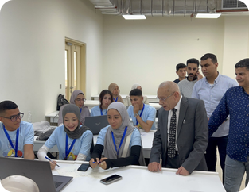
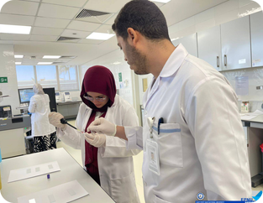
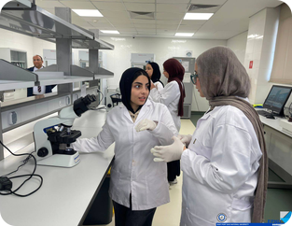
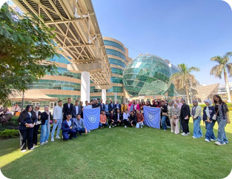
Partners with Regional & Global Reach
Industry and health partners that connect learning to international practice
Huawei ICT Academy
Saudi German Hospital, Cairo
Pharmaceutical industry
Children's Cancer Hospital 57357
Huawei ICT Academy at EPNU: training in AI, cloud computing, networks, IoT and modern communications
Clinical lab training (quality control, biosafety) with a hospital network operating in Saudi Arabia, the UAE, Egypt, Yemen and Morocco
Strategic partners include EIPICO, EVA Pharma, Lavender Life and Royal Cosmetics, supporting training, innovation and entrepreneurship
MoU signed with the 57357 Group: medical education, practical training, research and community service
Notes:
Beyond universities, we work with partners who add regional and global reach. Our Huawei ICT Academy offers training in artificial intelligence, cloud computing, networks, the Internet of Things and modern communications, and is managed by Dr. Asmaa Rady. Applied Health Sciences students trained in the laboratories of Saudi German Hospital in Cairo, part of a network operating across several countries in the region. Our Faculty of Pharmacy lists strategic partners from industry, including EIPICO and EVA Pharma, and has signed protocols supporting innovation and entrepreneurship. Most recently, we signed a memorandum of understanding with the Children's Cancer Hospital 57357, together with Prof. Sherif Abouelnaga, CEO of the 57357 Group. It covers medical education, practical training, research and community service.
CAVEATS:
- The 57357 MoU is signed, as reported on the university's official Facebook page (S51); it is not yet on the website. Describe its scope (education, training, research, community service) but do not promise specific programs or timelines.
- Pharmacy industry partners are listed strategic partners for training and entrepreneurship, not described as international agreements.
- Saudi German Hospital involvement is student training; do not call it a research agreement.
- The Huawei Academy description covers training only; no certification or agreement terms are published.
LIKELY QUESTION: Does the Huawei Academy offer official Huawei certification?
ANSWER: Our website describes training in AI, cloud, networks, IoT and communications, but it does not state certification details, so I would prefer to confirm that with the Faculty of Engineering.
Sources (briefing): S9, S10, S19, S32, S34, S38, S51

Slide 23
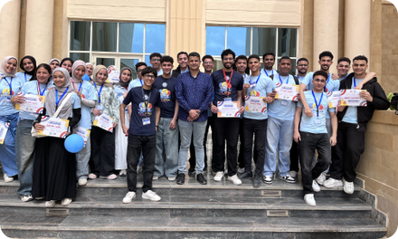

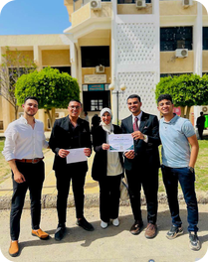
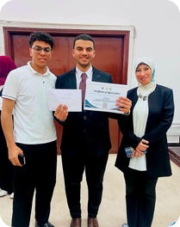

Our Students at International Events
Competing, publishing and presenting beyond the classroom
AI Hackathon, ICIAAI 2026
Engineering team qualified and competed at the 1st International Conference on Innovations & Applications of AI
ITC-Egypt 2026
Engineering team passed the 2nd judging stage at the 6th International Conference on Communications
11th International Pediatric Conference
Medical students attended, learning the latest advances in pediatric medicine
Research & programming
7 papers and 2nd place at Suez Canal University's student research conference; qualified for the Egyptian Collegiate Programming Contest (ECPC)
Notes:
Our students are already stepping onto the international stage, mostly through international-branded events in Egypt. An Engineering team qualified for and competed in the AI Hackathon at the first International Conference on Innovations and Applications of AI at Damietta University. Another team passed the second judging stage at ITC-Egypt 2026. Medical students attended the 11th International Pediatric Conference. Our computer science team qualified for the Egyptian Collegiate Programming Contest. At the Suez Canal University student research conference, we presented seven papers and placed second. Our pharmacy students also presented research alongside Malaysian counterparts.
CAVEATS:
- Most of these events were held in Egypt; do not imply travel abroad.
- Do not say the teams won the hackathon or ITC-Egypt; they qualified, competed or passed a stage. Second place applies to the student research conference.
- No student or staff mobility abroad has been reported.
LIKELY QUESTION: Have your students studied abroad?
ANSWER: No student mobility has been reported so far. Their international exposure has come through conferences, competitions and the Malaysian webinar, and exchange agreements are how we hope to extend it.
Sources (briefing): S2, S12, S13, S17, S18, S22, S44, S45, S46

Slide 24
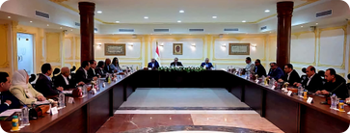


A Strong National Partnership Base
The foundation that supports international collaboration
23
Port Said University
Main academic partner; joint pharmacy research and shared academic events
ITI & Creativa Port Said
Cooperation talks on digital-skills training for CS students
research papers in 2024–2025
from pharmacy research cooperation with Port Said University, published in international journals including Q1–Q3 titles
Suez Canal Authority Training Center
Practical engineering workshops
Ahl Masr Hospital & BEDO
Signed protocols: clinical training; industrial training & joint applied research
Armed Forces College of Medicine
Visit to its anatomy hall and clinical simulation center
Port Said Governorate & Healthcare Authority
Community development and health training
Notes:
Our international ambitions rest on a strong national base. Our main academic partner is Port Said University. Their cooperation with our Pharmacy faculty produced 23 research papers in 2024-2025, with most published in reputable international journals, including Q1, Q2 and Q3 journals. We also work with ITI and Creativa on digital skills and with the Suez Canal Authority Training Center, which delivered a first practical program for our Engineering preparatory-year students. We have signed protocols with Ahl Masr Hospital, for clinical training, and with BEDO, for industrial training and joint applied research. We have also visited the Armed Forces College of Medicine, and we host visits from the Port Said Governorate, the General Authority for Healthcare, and the National Media Authority.
CAVEATS:
- The briefing gives 23 papers as the headline, but its breakdown (20 by faculty and 2 by students) adds to 22; quote only "23 papers" and do not go into the split.
- "Including Q1, Q2 and Q3" means some, not all, were in those quartiles.
- The Armed Forces College of Medicine and Healthcare Authority items are visits or talks, not signed agreements.
- The Ahl Masr Hospital and BEDO protocols are signed, per the university's official Facebook page (S51); describe their scope (training and joint applied research) without promising outcomes.
LIKELY QUESTION: Is Port Said University a formal partner?
ANSWER: Our website describes it as our main academic partner, with research cooperation and mutual honoring of Presidents. It does not describe a single named agreement in the material we have.
Sources (briefing): S2, S25, S26, S27, S28, S30, S31, S33, S35, S36, S37, S51

Slide 25



Partnership Opportunities
Where we invite international partners to build with us
Student & staff exchange
Joint & dual degrees
Joint research & EU funding
Semester exchange and short mobility on our credit-hour/ECTS framework
Co-designed programs in AI, health sciences, pharmacy and engineering
Research consortia, including Horizon Europe calls
Visiting professors
International student pathways
Sector hubs on the Suez Canal
Guest teaching, joint supervision and international webinars
Pathways for international students, building on foreign-certificate rules
AI, health and maritime/logistics collaboration in a strategic region
Notes:
Finally, here is where we would love to build together. These are opportunities we see, rather than commitments already made. First, activating student and staff exchange, beginning with our UPM framework and extending to Engineering, Computer Science and Business. Second, joint and dual degrees, which the Minister has named as a priority. Third, joint research and Horizon Europe consortia. Fourth, visiting-professor schemes. Fifth, pathways for international students, building on our existing foreign-certificate rules. Sixth, hubs in AI, health and maritime logistics, drawing on our Huawei Academy, hospital links and location. We would be delighted to hear which of these resonates with you.
CAVEATS:
- This slide is our analysis of gaps and opportunities, not a list of existing programs or promised commitments.
- Scholarships are currently domestic only, and recent academic vacancy calls required Egyptian nationality or secondment from Egyptian universities; do not suggest foreign scholarships or posts exist.
- Horizon Europe engagement to date is an invitation only.
LIKELY QUESTION: Do you offer scholarships for exchange students?
ANSWER: Our current scholarships are for domestic categories only. International and exchange scholarships are something we would like to design together with partners.
Sources (briefing): S6, S8, S11, S15, S48, S50

Slide 26
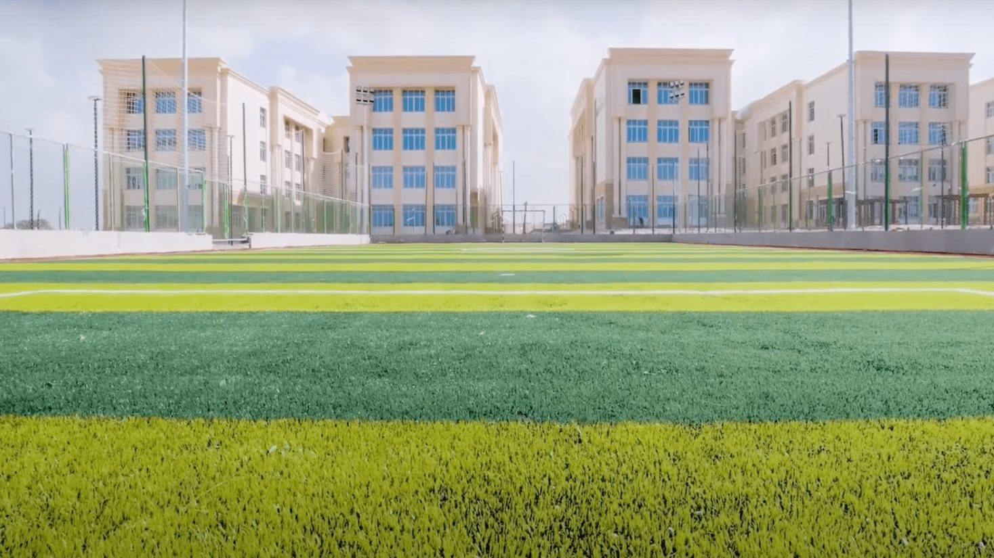
Let's Build the Future Together
East Port Said National University welcomes partners for exchange, joint programs and research.
epnu.edu.eg
International Relations Office | Director: Assoc. Prof. Mohamed El-Sakka
Notes:
Thank you for your time and your interest. EPNU is a young university with clear ambition, a solid national base, a first international partner, and a genuine wish to widen the circle. We believe the best partnerships begin with honest conversation about what each side can offer. Your point of contact is our International Relations Office, directed by Dr. Mohamed El-Sakka, and I would warmly invite you to speak with him or with me after the session, so that we can turn today's discussion into concrete next steps. Our website, epnu.edu.eg, also has a contact form with a partnerships and cooperation enquiry type. We Live the Future Today, and we would be honored to build it with you.
CAVEATS:
- The International Relations Office (Director: Dr. Mohamed El-Sakka) is confirmed by the university's Facebook page (S51); the website has no dedicated page for it yet.
- The contact form lists one email and a partnerships enquiry type; do not invent additional contact details for the office.
- Do not claim pending MoUs or exchanges as agreed.
LIKELY QUESTION: Who should we contact to follow up?
ANSWER: Please contact our International Relations Office, directed by Dr. Mohamed El-Sakka. The website's contact form, with its Partnerships and cooperation enquiry type, is also available, and we will share direct details during this visit.
Sources (briefing): S1, S2, S49, S51

