Slide 1
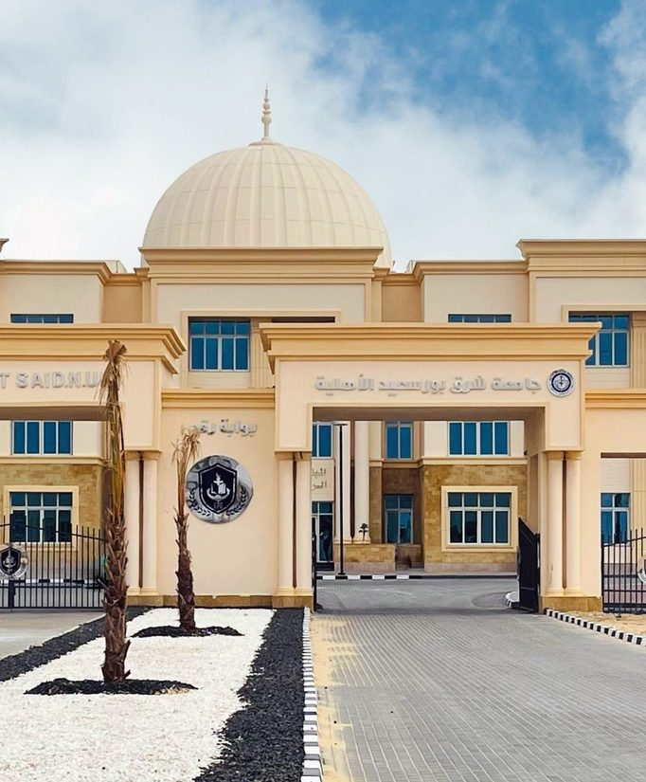

We Live the Future Today
East Port Said National University
Building International Bridges from the Suez Canal
International Profile | 2026

Slide 2
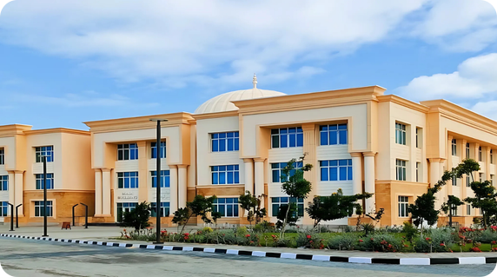



EPNU at a Glance
A non-profit national university in Sinai, created under Egypt Vision 2030
7
13+
5,200+
80+
Faculties
Academic programs
Students
International publications
Non-profit national (Ahliya) university
Part of Egypt's new generation of national universities
East Port Said, Sinai
A 44-feddan campus on the Suez Canal corridor, driving regional development
Aligned with Egypt Vision 2030
A "fourth-generation" university focused on research and innovation

Slide 3




Why Partner with EPNU
A new-generation university building its international partnerships
Strategic location
Global academic standards
East Port Said on the Suez Canal, where Africa meets Asia, at the heart of Sinai's development.
English-medium instruction, a credit-hour system with ECTS equivalence, and bilingual graduation certificates.
Future-focused programs
Strong national backing
Artificial intelligence across faculties, a Huawei ICT Academy, and modern health sciences and clinical pharmacy.
A Board chaired by a former Prime Minister, and a national mandate to expand global partnerships.

Slide 4
Leadership & Governance
01
Experienced leadership with national reach and a global outlook

Slide 5
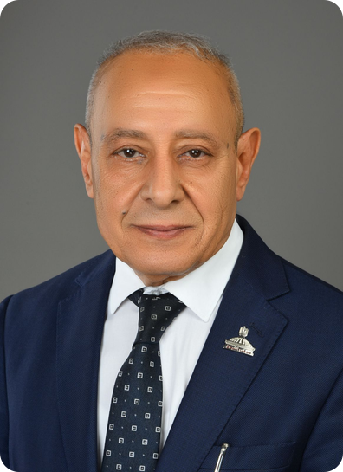




Leadership with a Global Outlook
Prof. Dr. Atef Alam El-Din, President of East Port Said National University
Internationally educated
PhD in Engineering, Leningrad University (former Soviet Union); BSc and MSc, Menoufia University
Egyptian-Japanese Education Initiative 2025
Member of the initiative's Steering Committee; has organized several international scientific conferences
National policy experience
Has served on the Egyptian Senate's Committee on Education, Scientific Research & ICT
Academic leadership and quality
Former Acting President of Port Said University; certified NAQAAE quality reviewer; about 40 research papers

Slide 6



A Board Bridging Government, Academia & Industry
The Board of Trustees supports the university's strategy and institutional partnerships
Academia & medicine
Prof. Dr. Atef Alam El-Din, University President
Prof. Dr. Sherif Youssef Saleh, President of Port Said University
Prof. Dr. Mohamed Hassan El-Kenawy, former President of Mansoura University
Prof. Dr. El-Sayed Hussein Hegazy
Prof. Dr. Mamdouh Radwan El-Nahas, President, Egyptian Society of Diabetes and Lipidology
Chairman
Eng. Ibrahim Mahlab
Former Prime Minister of Egypt
Government & public service
Industry & trade
Members bring together government, universities, medicine, and trade and industry.
Maj. Gen. Ahmed Abdullah, former Governor of the Red Sea and Port Said
Maj. Gen. Ibrahim Abu Limoun, Governor of Port Said
Eng. Lotfy Hassan El-Badrawy, KAPCI Coatings
Mr. Mohamed El-Said Saada, Port Said Chamber of Commerce
Dr. Hassan Hassanein Khalil Hassan, pharmaceutical sector

Slide 7








Academic Leadership
Program directors and university offices leading teaching, quality and international relations
Engineering
Computer Science & IT
Medicine
University Offices
Assoc. Prof. Mohamed El-Sakka
Mechatronics & Automation
Assoc. Prof. Asmaa Rady
AI & Machine Learning · Construction
Prof. Osama El-Baksawy
Director of the Faculty's Programs
Assoc. Prof. Sherine El-Khouly
Medicine and Surgery
International Relations Office
Assoc. Prof. Mohamed El-Sakka
Quality Assurance Center
Prof. Osama El-Baksawy
Pharmacy
Applied Health Sciences
Business Sciences
Training & Professional Development
Assoc. Prof. Asmaa Rady
Assoc. Prof. Mohamed Yasser
Clinical Pharmacy (PharmD)
Dr. Salma Khairallah
Director of the Faculty's Programs
Dr. Ali Gomaa
Accounting & Software Applications
Secretary-General
Ms. Ghada Shazly

Slide 8
Academics
02
Seven faculties with programs designed for tomorrow's labor market

Slide 9

Seven Faculties, Future-Ready Programs
13+ bachelor's programs, with artificial intelligence across engineering, computing and the arts
Engineering
Medicine
Pharmacy
Computer Science & IT
Mechatronics & Automation
AI & Machine Learning
Construction
Energy & Electrical Power
Medicine and Surgery: 5 years plus a 2-year internship (ECTS)
Clinical Pharmacy (PharmD)
Computer Science
Artificial Intelligence
Data Science
Biomedical Informatics
Applied Health Sciences
Business Sciences
Arts
Medical Laboratory Technology
Medical Imaging & Radiologic Technology
Accounting & Software Applications
Digital Marketing & E-Management
English Language & Translation
Geomatics & Artificial Intelligence

Slide 10
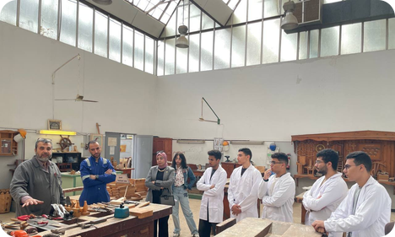





Faculty of Engineering
A shared preparatory year, then three future-focused specializations
Hands-on from day one
Robotics projects, from line-following robots to 4- and 6-axis industrial robot models
Program Directors
Assoc. Prof. Mohamed El-Sakka
Mechatronics & Automation · Engineering Programs · IR Office
PhD, University of Sheffield (UK); wind-energy and CFD research at Port Said University.
Huawei ICT Academy
AI students train in cloud, IoT and networking through Huawei's academy at EPNU
Industry training
Workshops at the Suez Canal Authority Training Center; a signed protocol with BEDO for factory training and applied research
Programs
Assoc. Prof. Asmaa Rady
AI & Machine Learning · Construction · Training Center
PhD, University of Exeter (UK; Newton-Mosharafa scholar); research fellow, Politecnico di Torino.
Mechatronics & Automation Engineering
AI & Machine Learning Engineering
Construction Engineering
Energy & Electrical Power Engineering
Competing nationally
Teams at ITC-Egypt 2026 and the ICIAAI 2026 AI Hackathon

Slide 11
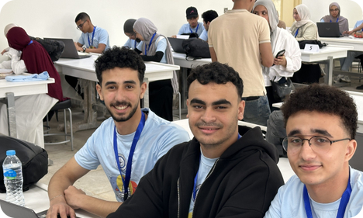


Faculty of Computer Science & IT
Four-year programs built around AI, data and digital health
AI at the core
Machine learning, intelligent systems and decision support across the programs
Program Director
Prof. Osama El-Baksawy
Director of the Faculty's Programs · Quality Assurance Center
Faculty member in Electrical Power & Machines Engineering at Port Said University. His research covers renewable energy, fractional-order control and metaheuristic optimization, with 24 indexed papers and 780+ citations (h-index 15, OpenAlex).
Computing meets medicine
Biomedical Informatics builds systems on clinical data, biometrics and medical imaging
Competitive programmers
Qualified for the Egyptian Collegiate Programming Contest (ECPC) 2026; ICPC-style community contests on campus
Programs
Computer Science
Artificial Intelligence
Data Science in Information Systems
Biomedical Informatics
Skills partners
Cooperation talks with ITI and Creativa Port Said on digital-skills training

Slide 12
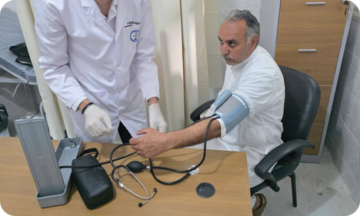



Faculty of Medicine
An integrated, English-medium MBBCh with early clinical exposure
Integrated curriculum
Basic sciences, clinical training and community service taught together
Program Director
Assoc. Prof. Sherine El-Khouly
Program Director, Medicine & Surgery
Leads the alignment of medical training and learning outcomes with Egypt's healthcare needs. She supervises student research, clinical training and community medical convoys, and holds a professional diploma (grade: Excellent) from GAHAR, Egypt's healthcare accreditation authority.
Community medicine in Sinai
Students train with medical convoys at primary-care units in North Sinai
Student research
Medical students present papers at national conferences, including Ain Shams and Suez Canal universities
Programs
Bachelor of Medicine & Surgery (MBBCh)
5 years (10 semesters) + 2-year internship
ECTS credit system, taught in English
Clinical partners
Port Said University's new university hospital; a signed protocol with Ahl Masr Hospital; MoU with 57357

Slide 13
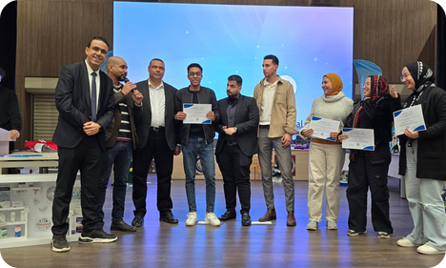




Faculty of Pharmacy
Clinical Pharmacy (PharmD) with a strong research and industry base
Modern labs
HPLC and UV-Vis instruments, plus clinical simulation rooms for dose calculation
Program Director
Assoc. Prof. Mohamed Yasser
Program Director, Clinical Pharmacy · Entrepreneurship Club
Faculty member in the Department of Pharmaceutics, Faculty of Pharmacy, Port Said University. His interests include pharmaceutical and cosmetic formulation, and he champions entrepreneurship and innovation among EPNU's pharmacy students.
Industry partners
EIPICO, EVA Pharma, Lavender Life and Royal Cosmetics
First international partner
Leads the Universiti Putra Malaysia partnership and joint webinars
Programs
Bachelor of Pharmacy: PharmD (Clinical Pharmacy)
10 semesters, taught in English
Research-active
Pharmacy and medicinal chemistry account for most of EPNU's international papers

Slide 14
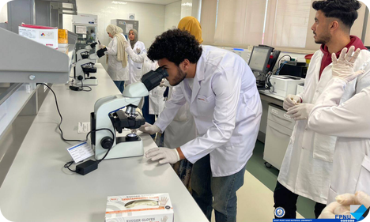



Faculty of Applied Health Sciences Technology
Training the technologists behind modern diagnostics
Diagnostic labs
Hematology, biochemistry, microbiology and microscopy labs
Program Director
Dr. Salma Khairallah
Director of the Faculty's Programs
Directs both the Medical Laboratory and Medical Imaging programs. She holds a PhD in Biochemistry from Port Said University's Faculty of Science, where she previously directed the Biochemistry & Microbiology program.
Imaging training
Training on X-ray, CT and MRI equipment, with radiation protection and quality standards
Hospital training network
Port Said University Hospital, Saudi German Hospital Cairo, Ahl Masr Hospital and 57357
Programs
Medical Laboratory Technology
Medical Imaging & Radiologic Technology
Taught in English (131 credit hours)
57357 MoU
A signed MoU with the 57357 Group covers practical training and research

Slide 15
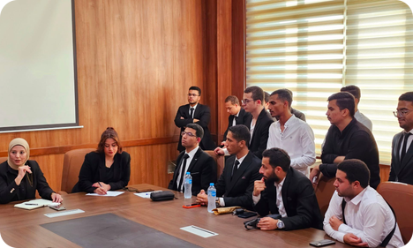




Faculty of Business Sciences
Accounting and marketing for a digital economy
Digital accounting
Accounting information systems, financial software and financial analysis
Program Director
Dr. Ali Gomaa
Program Director, Accounting & Software Applications
Leads the Accounting & Software Applications program, which prepares students for accounting, auditing, financial analysis, taxation and financial-software careers.
Digital marketing
Campaigns, e-commerce, platform management and consumer analytics
First cohort
The faculty welcomed its first cohort with a dedicated orientation day
Programs
Accounting & Software Applications
Digital Marketing & E-Management
Career-ready
Pathways to accounting, auditing, taxation, banking, marketing and e-commerce roles

Slide 16
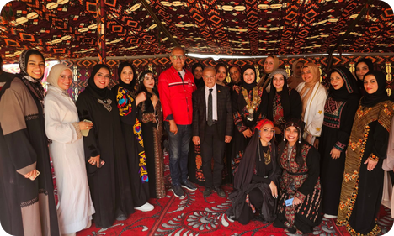



Faculty of Arts
Humanities connected to technology and global communication
Specialized translation
Written and interpreting translation: medical, legal, literary and audiovisual
Interdisciplinary by design
The Faculty of Arts pairs language and translation with geospatial technology and AI. That makes it a natural partner for joint programs in translation studies, digital humanities and smart-city research.
Geomatics & AI
GIS, remote sensing, digital surveying and AI-based spatial analysis
Smart-city careers
Graduates target GIS, urban planning, smart cities and telecoms
Programs
English Language & Translation
Geomatics & Artificial Intelligence
Intercultural skills
Applied linguistics and communication for media, tourism and diplomacy

Slide 17
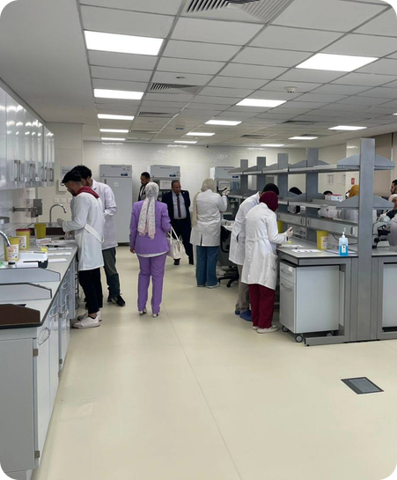





Built on International Academic Standards
Rules and standards that support credit transfer, exchange and joint programs
English-medium instruction
English is the official language of teaching, textbooks and exams
Credit hours ≈ ECTS
One semester's load ≈ 30 ECTS (750 hours of student workload)
Bilingual certificates
Graduation certificates issued in Arabic and English
Mobility-ready rules
Non-degree and auditor registration; transfer with course equivalency
International entry routes
Admission rules accept IGCSE, the Nile International Certificate and foreign certificates
Huawei ICT Academy
Training in AI, cloud, networks, IoT and modern communications

Slide 18

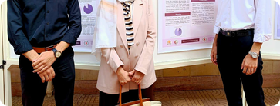
Research with International Reach
A young university already publishing with leading international publishers
80+
Publications per year
Top-tier publishers
98% with international publishers: Elsevier, Springer Nature, the Royal Society of Chemistry and Wiley
peer-reviewed international publications
carry the EPNU affiliation, 2024 to October 2026, well beyond the 50+ milestone
Co-authors in 15 countries
Nearly two-thirds of papers are internationally co-authored: Saudi Arabia, Jordan, the US, the UK, China, Japan, Malaysia and others
Research strengths
Medicinal chemistry and pharmacy, medicine, and renewable-energy engineering

Slide 19
International Relations
03
"Global Openness" is one of the university's four pillars

Slide 20

Internationalization Is a National Priority
Egypt's national universities are being directed to go global, and EPNU is aligned
MARCH 2026
JUNE 2026
JULY 2026
EPNU Academic Affairs Council
Reviews the Minister's directives, including enhancing international cooperation and academic partnerships
National Universities Council
Priorities: international rankings, global partnerships, international publishing, joint and dual degrees, international students. The Council approves MoUs between national universities and international institutions
Port Said University Council
EPNU's President takes part as the council reviews efforts to expand international partnerships and attract international students
Our partnership goal: "opening pathways for scientific and research exchange with regional and international universities and institutions"

Slide 21




First International Partner: Universiti Putra Malaysia
A signed partnership agreement that includes a framework for faculty and student exchange
01
02
03
04
05
Agreement signed
Partnership with UPM, including faculty and student exchange programs
International webinar
"Global Horizons: Cross-Border Innovations in Science and Management", hosted by UPM-Sarawak
Joint research meeting
First joint virtual scientific meeting: EPNU staff and students present research
2nd edition announced
EPNU announced it would host the next edition of the webinar
Next: exchange
Activating faculty and student mobility under the agreement
Recognized abroad
EPNU pharmacy students' engagement in the UPM webinar was praised by Malaysian press outlets. The partnership is led by the Clinical Pharmacy program.

Slide 22
A Growing Global Network
International links through partners, forums, initiatives and internationally trained faculty
Malaysia
Universiti Putra Malaysia: signed partnership agreement
Russia & Arab World
5th Forum of the Union of Russian & Arab University Rectors
Japan
Egyptian-Japanese Education Initiative 2025
United Kingdom & Italy
Faculty expertise from Exeter (Newton-Mosharafa scholar) and Politecnico di Torino
EPNU
European Union
Community invited to the Euro-Egyptian Innovation Partnership (Horizon Europe)
China & MENA
Huawei ICT Academy · Saudi German Hospital network

Slide 23
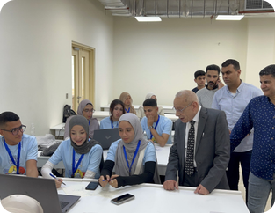
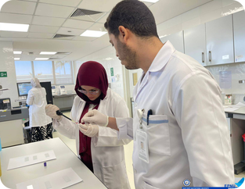
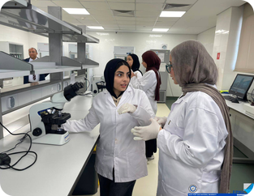
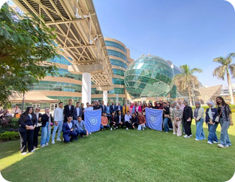
Partners with Regional & Global Reach
Industry and health partners that connect learning to international practice
Huawei ICT Academy
Saudi German Hospital, Cairo
Pharmaceutical industry
Children's Cancer Hospital 57357
Huawei ICT Academy at EPNU: training in AI, cloud computing, networks, IoT and modern communications
Clinical lab training (quality control, biosafety) with a hospital network operating in Saudi Arabia, the UAE, Egypt, Yemen and Morocco
Strategic partners include EIPICO, EVA Pharma, Lavender Life and Royal Cosmetics, supporting training, innovation and entrepreneurship
MoU signed with the 57357 Group: medical education, practical training, research and community service

Slide 24
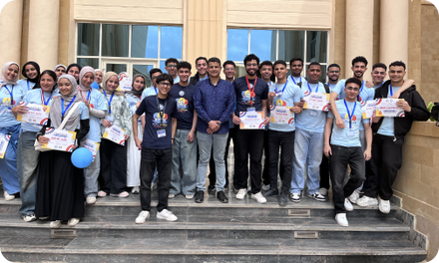

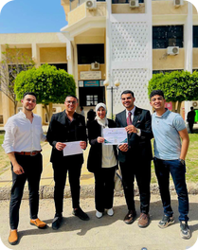
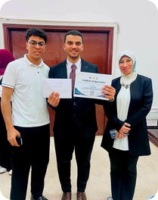

Our Students at International Events
Competing, publishing and presenting beyond the classroom
AI Hackathon, ICIAAI 2026
Engineering team qualified and competed at the 1st International Conference on Innovations & Applications of AI
ITC-Egypt 2026
Engineering team passed the 2nd judging stage at the 6th International Conference on Communications
11th International Pediatric Conference
Medical students attended, learning the latest advances in pediatric medicine
Research & programming
7 papers and 2nd place at Suez Canal University's student research conference; qualified for the Egyptian Collegiate Programming Contest (ECPC)

Slide 25
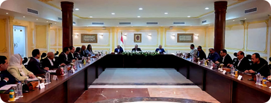

A Strong National Partnership Base
The foundation that supports international collaboration
23
Port Said University
Main academic partner; joint pharmacy research and shared academic events
ITI & Creativa Port Said
Cooperation talks on digital-skills training for CS students
research papers in 2024–2025
from pharmacy research cooperation with Port Said University, published in international journals including Q1–Q3 titles
Suez Canal Authority Training Center
Practical engineering workshops
Ahl Masr Hospital & BEDO
Signed protocols: clinical training; industrial training & joint applied research
Armed Forces College of Medicine
Visit to its anatomy hall and clinical simulation center
Port Said Governorate & Healthcare Authority
Community development and health training

Slide 26



Partnership Opportunities
Where we invite international partners to build with us
Student & staff exchange
Joint & dual degrees
Joint research & EU funding
Semester exchange and short mobility on our credit-hour/ECTS framework
Co-designed programs in AI, health sciences, pharmacy and engineering
Research consortia, including Horizon Europe calls
Visiting professors
International student pathways
Sector hubs on the Suez Canal
Guest teaching, joint supervision and international webinars
Pathways for international students, building on foreign-certificate rules
AI, health and maritime/logistics collaboration in a strategic region

Slide 27
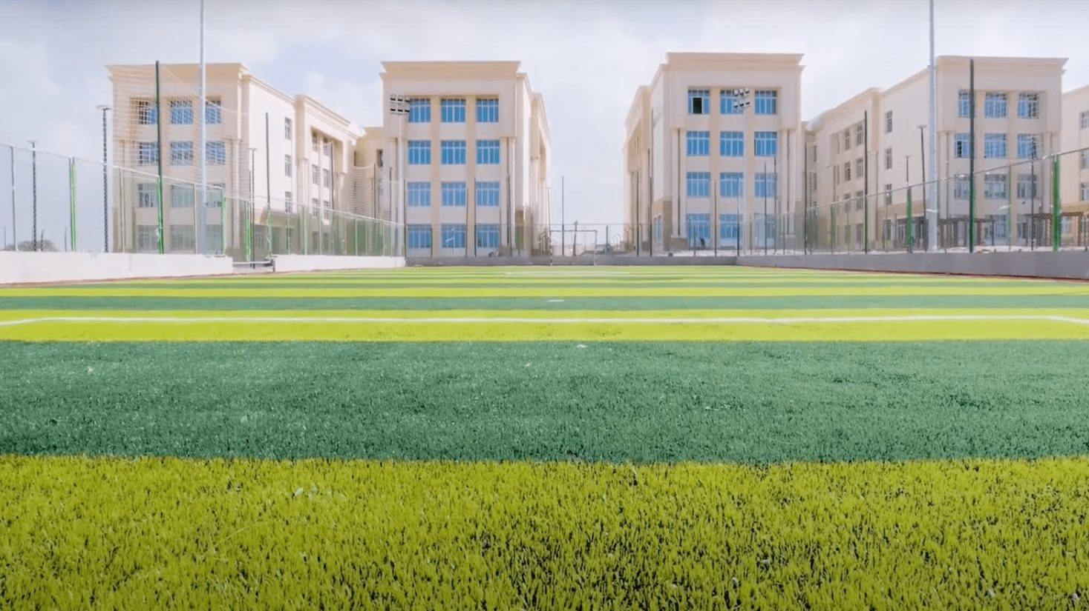
Let's Build the Future Together
East Port Said National University welcomes partners for exchange, joint programs and research.
epnu.edu.eg
International Relations Office | Director: Assoc. Prof. Mohamed El-Sakka

