Slide 1
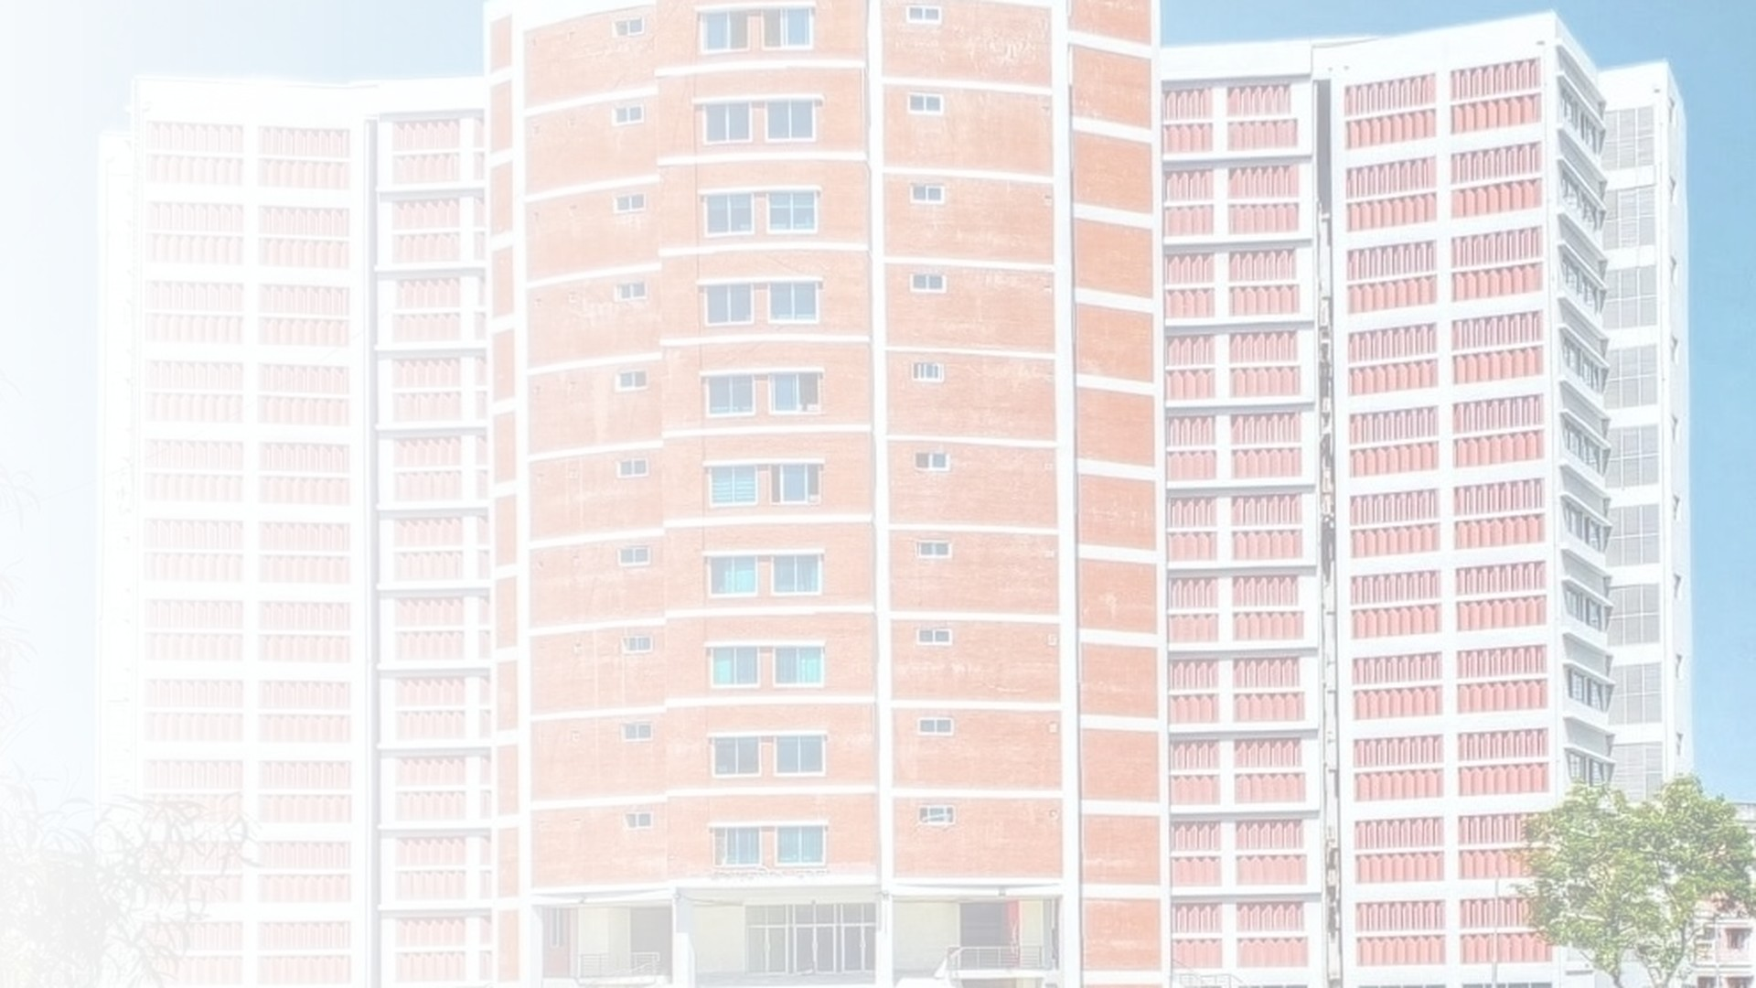


QUIC: A UDP-Based Secure and Multiplexed Transport Protocol
Submitted by
Supervised by
Md. Khalid Hasan
Dr. Nazrul Islam
ID: IT24013
Associate Professor
Department of ICT, MBSTU
Department of Information and Communication Technology
Mawlana Bhashani Science and Technology University (MBSTU), Tangail, Bangladesh
Notes:
Assalamu alaikum, and good morning, respected Sir and everyone.
My name is Md. Khalid Hasan, ID IT24013, from the Department of ICT, MBSTU. Today, under the supervision of Dr. Nazrul Islam, I will present a topic called QUIC.
QUIC is a modern internet transport protocol, and you may already be using it every day when you open Google or watch YouTube. In the next few minutes, I will explain why QUIC was needed, how it works, and why it matters.

Slide 2

Presentation Outline
01
Why do we need QUIC?
QUIC
02
What is QUIC?
03
QUIC in the protocol stack
Fast • Encrypted • Multiplexed
04
Fast handshake: 1-RTT and 0-RTT
Transport protocol for HTTP/3,
built on top of UDP
05
Streams, migration and loss recovery
06
Security, adoption and conclusion
QUIC: A UDP-Based Secure Transport Protocol
ID: IT24013
02
Notes:
This is the outline of my presentation.
First, I will explain why we need QUIC, that means the problems of the old protocol, TCP. Second, I will explain what QUIC is. Third, I will show where QUIC sits in the protocol stack. Fourth, the fast handshake, called 1-RTT and 0-RTT. Fifth, the main features: independent streams, connection migration and loss recovery. And finally, security, adoption and the conclusion.
On the right side, you can see QUIC in one line: fast, encrypted and multiplexed. It is the transport protocol for HTTP/3, and it is built on top of UDP.

Slide 3
Why Do We Need QUIC?
TCP dates back to 1981 — today's web asks much more of it.
1
Slow connection setup
2
Head-of-line blocking
TCP and TLS handshakes run one after the other, costing several round trips before any data moves.
One lost packet stalls every request sharing the TCP connection, even if their data has already arrived.
3
Tied to the network path
4
Protocol ossification
A TCP connection is bound to IP addresses and ports, so switching from Wi-Fi to mobile data breaks it.
Middleboxes depend on TCP headers, which makes deploying improvements to TCP extremely slow.
QUIC: A UDP-Based Secure Transport Protocol
ID: IT24013
03
Notes:
Let us start with the question: why do we need QUIC?
TCP was designed in 1981, so it is more than forty years old. It served us very well, but today's web asks much more from it. There are four main problems.
Number one, slow connection setup. TCP does its own handshake first, and then TLS does another handshake for security. They happen one after another, so the user waits for several round trips before any data moves.
Number two, head-of-line blocking. When many requests share one TCP connection and one packet is lost, all the other requests also have to wait, even if their data has already arrived.
Number three, TCP is tied to the network path. A connection is fixed to an IP address and port, so when your phone switches from Wi-Fi to mobile data, the connection breaks.
Number four, protocol ossification. Routers and firewalls, called middleboxes, depend on TCP headers. So if we change TCP, they may block it, and that is why improving TCP takes many years.
QUIC was designed to solve all these four problems.

Slide 4
What Is QUIC?
A secure, multiplexed transport protocol that runs over UDP
2012–13
Google designs and trials QUIC in Chrome
Standardised by the IETF in RFC 9000 (May 2021)
Integrates TLS 1.3 encryption into the transport
Carries many independent streams in one connection
Runs in user space, so it can evolve quickly
2016
IETF forms the QUIC working group
May 2021
RFC 9000, 9001 and 9002 published
June 2022
HTTP/3 standardised as RFC 9114
QUIC: A UDP-Based Secure Transport Protocol
ID: IT24013
04
Notes:
So, what is QUIC? QUIC is a secure, multiplexed transport protocol that runs over UDP. Multiplexed means it can carry many independent streams inside one connection.
Look at the timeline on the right. QUIC started at Google in 2012 and 2013, as an experiment in the Chrome browser. In 2016, the IETF, the organisation that makes internet standards, formed a QUIC working group. In May 2021, the standard was published as RFC 9000, together with RFC 9001 and RFC 9002. And in June 2022, HTTP/3 was standardised as RFC 9114, which runs on top of QUIC.
On the left are three key points. First, QUIC integrates TLS 1.3 encryption inside the transport. Second, it carries many independent streams in one connection. Third, it runs in user space, not inside the operating system kernel, so it can be updated quickly, almost like updating an app.

Slide 5
QUIC in the Protocol Stack
Traditional: HTTP/2 over TCP
Modern: HTTP/3 over QUIC
HTTPS (application)
HTTPS (application)
HTTP/1.1 · HTTP/2
HTTP/3
TLS 1.2 / 1.3
QUIC (TLS 1.3 + streams + loss recovery)
TCP
UDP
IPv4 / IPv6
IPv4 / IPv6
QUIC replaces TLS + TCP with a single UDP-based layer
QUIC: A UDP-Based Secure Transport Protocol
ID: IT24013
05
Notes:
Now let us see where QUIC sits in the protocol stack.
On the left is the traditional web. At the top is the application, HTTPS. Under it is HTTP/1.1 or HTTP/2. Then TLS for security, then TCP for reliable delivery, and IP at the bottom.
On the right is the modern web. HTTP/3 runs on QUIC, QUIC runs on UDP, and UDP runs on IP.
The main point is the highlighted box. QUIC does the work of TLS and TCP together, in one single layer. You may ask, why UDP? Because UDP is simple and passes through almost all networks. QUIC uses UDP only as a thin carrier, and builds reliability and security on its own.

Slide 6
Faster Handshake: 1-RTT and 0-RTT
1-RTT
Transport and TLS 1.3 handshakes are combined into one exchange.
0-RTT
Resumed sessions send application data in the very first packet.
Why it matters
Fewer round trips cut page-load time, especially on high-latency mobile links.
QUIC: A UDP-Based Secure Transport Protocol
ID: IT24013
06
Notes:
This slide is about the faster handshake. RTT means round-trip time, that is, the time for a message to go to the server and come back.
The chart shows how many round trips are needed before application data can start. TCP with TLS 1.2 needs three. TCP with TLS 1.3 needs two. QUIC needs only one, because it combines the transport handshake and the TLS 1.3 handshake in a single exchange. This is called 1-RTT.
And when a client connects again to a server it has visited before, QUIC can use 0-RTT. The client sends application data in the very first packet, so there is no waiting at all.
Why does it matter? On slow or high-latency mobile networks, every round trip is costly. So fewer round trips mean faster page loading.

Slide 7
Independent Streams: No Head-of-Line Blocking
TCP: one ordered byte stream
QUIC: independent streams
Stream 1
Stream 1
Stream 2
X
Stream 2
X
Stream 3
Stream 3
One lost packet blocks every stream behind it.
Only the affected stream waits; the others keep flowing.
Delivered
Lost packet
Waiting
QUIC: A UDP-Based Secure Transport Protocol
ID: IT24013
07
Notes:
This slide shows how QUIC solves head-of-line blocking.
Each row is a stream, for example one web request. Blue squares are delivered packets, grey squares are waiting, and the red X is a lost packet.
On the left, TCP sends everything as one ordered byte stream. When one packet is lost in Stream 2, all the packets behind it must wait, even the packets of Stream 1 and Stream 3.
On the right, QUIC gives each request its own independent stream. When the packet is lost in Stream 2, only Stream 2 waits for the retransmission. Stream 1 and Stream 3 keep flowing.
So one lost packet does not stop everything. This is very useful on Wi-Fi and mobile networks, where packet loss is common.

Slide 8
Connection Migration and Loss Recovery
Connection migration
Loss recovery and congestion control
Wi-Fi
Mobile data
Packet numbers never repeat, so lost and delayed packets are easy to tell apart
ACK frames report received ranges, enabling fast loss detection
Probe timeouts (PTO) catch tail losses without long waits
Pluggable congestion control: NewReno, CUBIC or BBR
Same Connection ID → session continues
TCP
Bound to IP + port, so a network change resets the connection.
QUIC
Identified by Connection ID; new path is validated and the session goes on.
QUIC: A UDP-Based Secure Transport Protocol
ID: IT24013
08
Notes:
This slide has two features. On the left is connection migration.
In TCP, a connection is identified by IP addresses and ports. So when your phone moves from Wi-Fi to mobile data, the address changes, the connection breaks, and the app has to reconnect. In QUIC, a connection is identified by a Connection ID, not by the IP address. After the new path is validated, the same session simply continues. For example, a download or a video call does not have to restart.
On the right is loss recovery. QUIC never reuses packet numbers, so it can easily tell a lost packet from a delayed one. ACK frames report the received ranges, so loss is detected fast. Probe timeouts catch losses at the end of a transfer without long waiting. And QUIC allows pluggable congestion control, such as NewReno, CUBIC or BBR.

Slide 9

Security by Design
1
2
3
Encryption is mandatory
Protected headers
Attack resistance
TLS 1.3 is built into the handshake; QUIC has no unencrypted mode.
Payloads and most header fields are encrypted and authenticated, limiting tampering by middleboxes.
Address validation (Retry) and a 3× anti-amplification limit protect servers from spoofed traffic.
0-RTT trade-off: early data can be replayed by an attacker, so it should carry only idempotent requests (for example, GET).
QUIC: A UDP-Based Secure Transport Protocol
ID: IT24013
09
Notes:
Security is built into QUIC by design. There are three points.
First, encryption is mandatory. TLS 1.3 is part of the handshake, and QUIC has no unencrypted mode. In TCP, encryption is optional.
Second, protected headers. The payload and most header fields are encrypted and authenticated, so middleboxes cannot easily read or change them.
Third, attack resistance. QUIC uses address validation, called Retry, and an anti-amplification limit. Before the client address is verified, the server can send at most three times the data it has received. This protects servers from spoofed-address attacks.
At the bottom, there is one trade-off to remember. 0-RTT data can be replayed by an attacker, so it should carry only safe, idempotent requests, such as a simple GET request, not something like a payment.

Slide 10
Adoption and Challenges
Adoption
Challenges
Browsers
Chrome, Edge, Firefox and Safari support HTTP/3
UDP may be blocked or throttled, so clients fall back to HTTP/2 over TCP
Higher CPU cost from user-space processing and per-packet encryption
Encrypted headers reduce visibility for network monitoring tools
0-RTT early data needs replay protection
Services
Google, YouTube, Meta, Cloudflare, Akamai, Microsoft
Standard
HTTP/3 (RFC 9114) is HTTP carried over QUIC
QUIC: A UDP-Based Secure Transport Protocol
ID: IT24013
10
Notes:
Now, adoption and challenges.
QUIC is already widely used. Chrome, Edge, Firefox and Safari support HTTP/3. Large services such as Google, YouTube, Meta, Cloudflare, Akamai and Microsoft use it. And HTTP/3, RFC 9114, is simply HTTP carried over QUIC.
But QUIC has some challenges too. Some networks block or slow down UDP, so the client must fall back to HTTP/2 over TCP. QUIC can use more CPU, because it runs in user space and encrypts every packet. Encrypted headers reduce visibility for network monitoring tools. And 0-RTT needs replay protection. These are active areas of improvement.

Slide 11
Conclusion and References
01
QUIC is a secure, multiplexed transport built on UDP
Selected references
[1] J. Iyengar and M. Thomson, “QUIC: A UDP-Based Multiplexed and Secure Transport,” RFC 9000, IETF, 2021.
[2] M. Thomson and S. Turner, “Using TLS to Secure QUIC,” RFC 9001, IETF, 2021.
[3] J. Iyengar and I. Swett, “QUIC Loss Detection and Congestion Control,” RFC 9002, IETF, 2021.
[4] M. Bishop, “HTTP/3,” RFC 9114, IETF, 2022.
[5] A. Langley et al., “The QUIC Transport Protocol: Design and Internet-Scale Deployment,” ACM SIGCOMM, 2017.
02
Faster setup with 1-RTT handshakes and 0-RTT resumption
03
No cross-stream blocking and seamless connection migration
04
The foundation of HTTP/3, with growing adoption
QUIC: A UDP-Based Secure Transport Protocol
ID: IT24013
11
Notes:
To conclude, please remember four points.
One, QUIC is a secure, multiplexed transport built on UDP. Two, it gives faster setup, with 1-RTT handshakes and 0-RTT resumption. Three, it removes cross-stream blocking and supports seamless connection migration. Four, it is the foundation of HTTP/3, and its adoption is growing.
On the right are the main references I used, mostly the IETF RFCs, which are the official standards, and the paper by Google engineers in ACM SIGCOMM 2017.
In short, QUIC is a modern redesign of how the internet carries data.

Slide 12
Thank You
Thank you
Questions and Discussion
Md. Khalid Hasan
ID: IT24013 | Department of ICT, MBSTU
Supervised by Dr. Nazrul Islam, Associate Professor, ICT, MBSTU
QUIC: A UDP-Based Secure Transport Protocol
ID: IT24013
12
Notes:
Thank you very much, Sir and everyone, for listening patiently. I would be happy to answer any questions.

