Slide 1
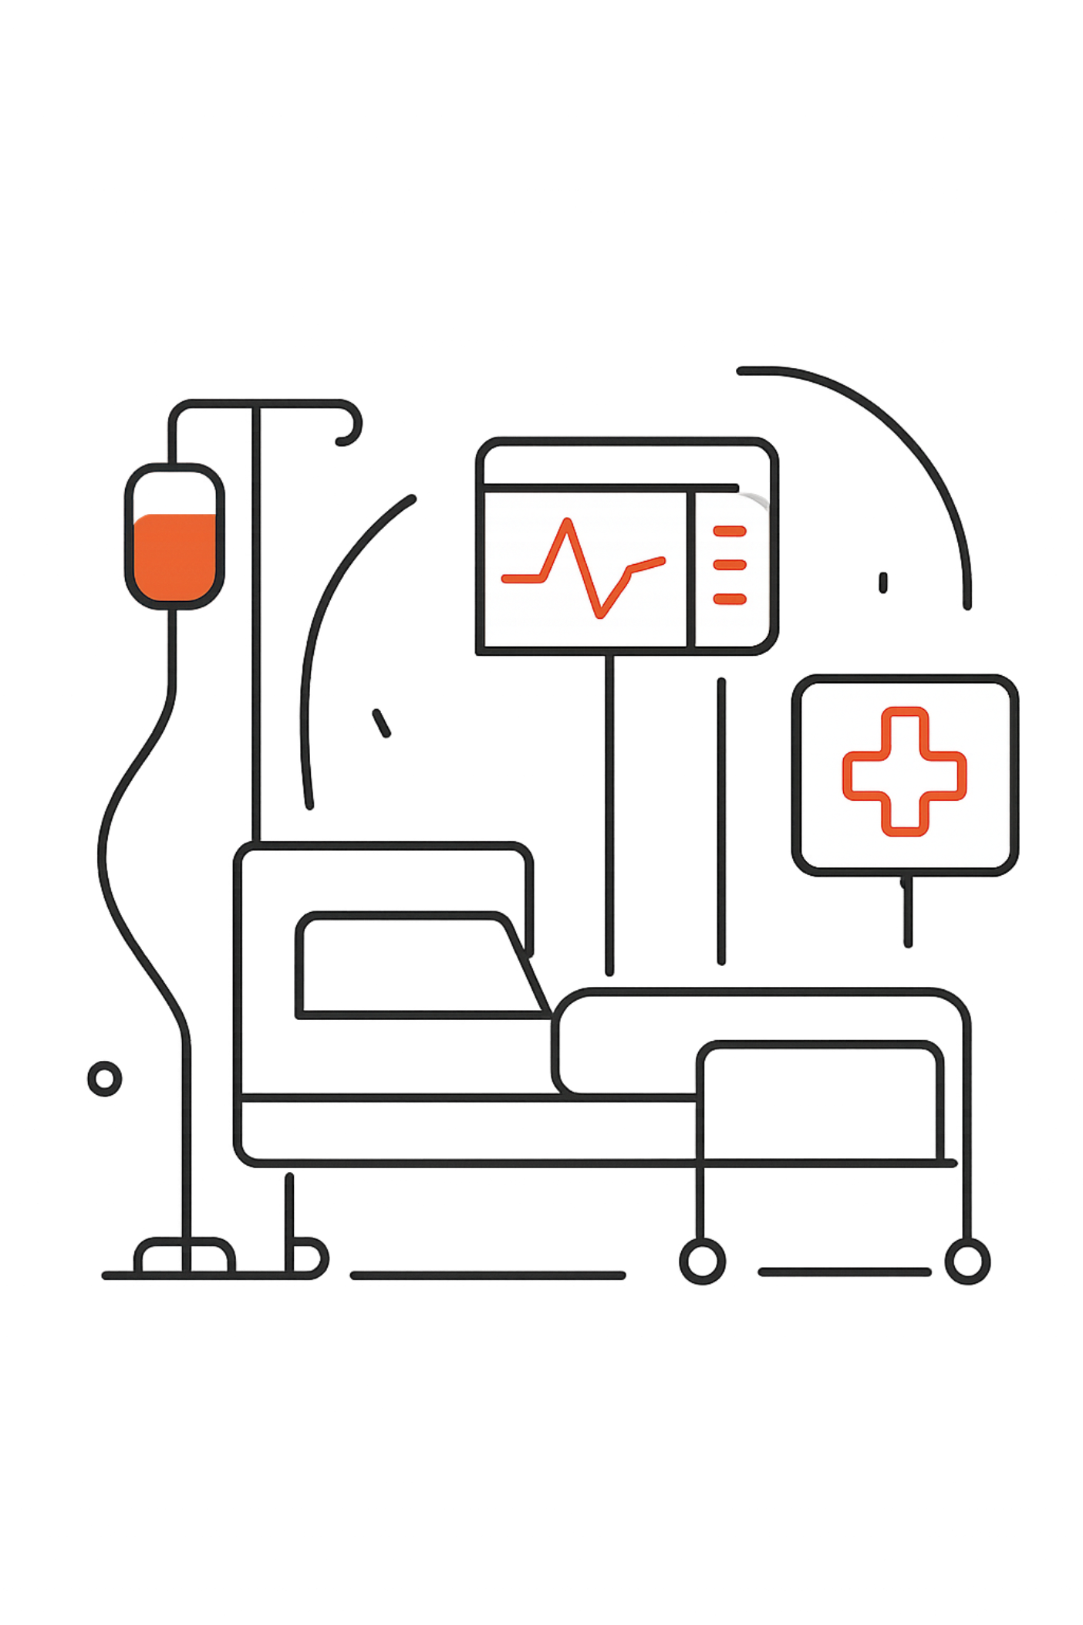
Autonomous Smart Dual Infusion & Patient Monitoring System Using ESP32
An intelligent ESP32-based IV infusion, syringe pump, and patient monitoring solution — designed for reliable, affordable bedside automation.
Team Members:
1. Md. Turjo Hasnat – 0112410067 2. Md. Khalid Hasan – 0112410009
3. Moieb Al Jawad – 0112410289 4. Swarup Deb Nath – 0112230150
5. Md Shakib - 0112410546

Slide 2

Problem Statement
Manual IV/syringe control causing variability and delays
Limited continuous patient monitoring — higher risk of adverse events
Nurse workload elevated by repetitive, time-critical tasks
Few low-cost, integrated smart solutions for resource-constrained hospitals
Project Objectives
Automatic IV flow control and syringe delivery
Continuous heart-rate monitoring (MAX30102)
Wireless real-time dashboard (ESP32 — ESP-NOW / Wi‑Fi)
Emergency alerts, LCD status, reduced nurse workload

Slide 3

System Architecture
LCD Display + Buzzer
Patient
Source of vital data
Local alarms & status
Syringe Pump Module
Bidirectional Monitoring & Control
MAX30102 HR Sensor
Stepper + lead screw drive
Heart-rate & SpO2 readings
IV Infusion Module
ESP32 Controller
Sensor fusion & control logic
IR sensor + servo actuation
Bi-directional controls and wireless telemetry enable remote monitoring and local alarms. Diagram shows sensors feeding ESP32, actuation chain for infusion and syringe, and dashboard for caregivers.

Slide 4
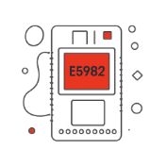



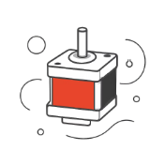
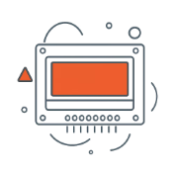
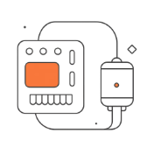


Hardware Components
ESP32 DevKit
MAX30102 HR Sensor
IR Drop Sensor
Servo Motor (IV control)
Stepper Motor + Lead Screw
LCD Display & Buzzer
Motor Driver & Power Supply
Rechargeable Battery & Wheels
Following Sensor / Camera

Slide 5
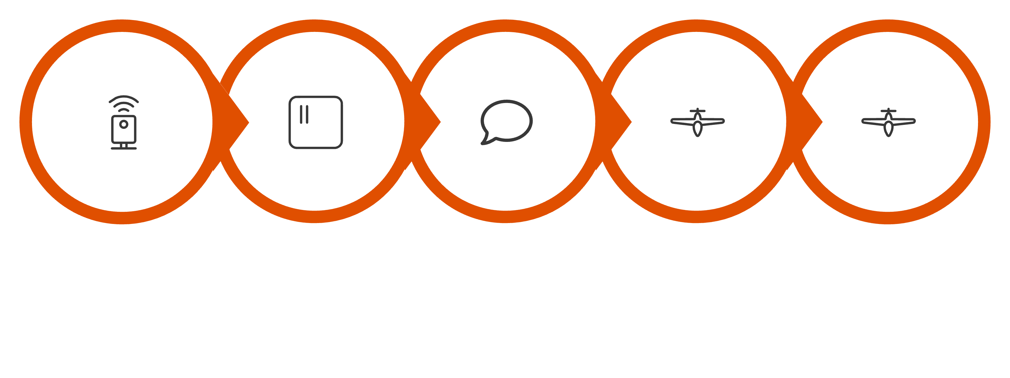
Working Principle
Stepper Syringe
Heart-rate
Drop Detect
ESP32 Logic
Servo Adjust
Continuous sensor feedback closes the control loop. ESP32 runs safety checks, triggers local alarms, and streams data for remote visualization and triage.

Slide 6
Key Features & Advantages
Advantages
Interface
Dual Infusion
Higher accuracy & consistent dosing
Reduced human error & nurse workload
Continuous patient monitoring and alarms
Low-cost, portable — suited for Bangladesh hospitals
Local LCD + buzzer for bedside alerts; web dashboard for clinicians.
Simultaneous control of two IV lines for parallel therapies.
Automatic IV & Syringe
Precision servo and stepper-based actuation with closed-loop feedback.
Heart Rate Monitoring
Continuous, non-invasive measurement and trend alerts.
ESP32 Wireless
Low-latency ESP‑NOW / Wi‑Fi telemetry to web dashboard.

Slide 7
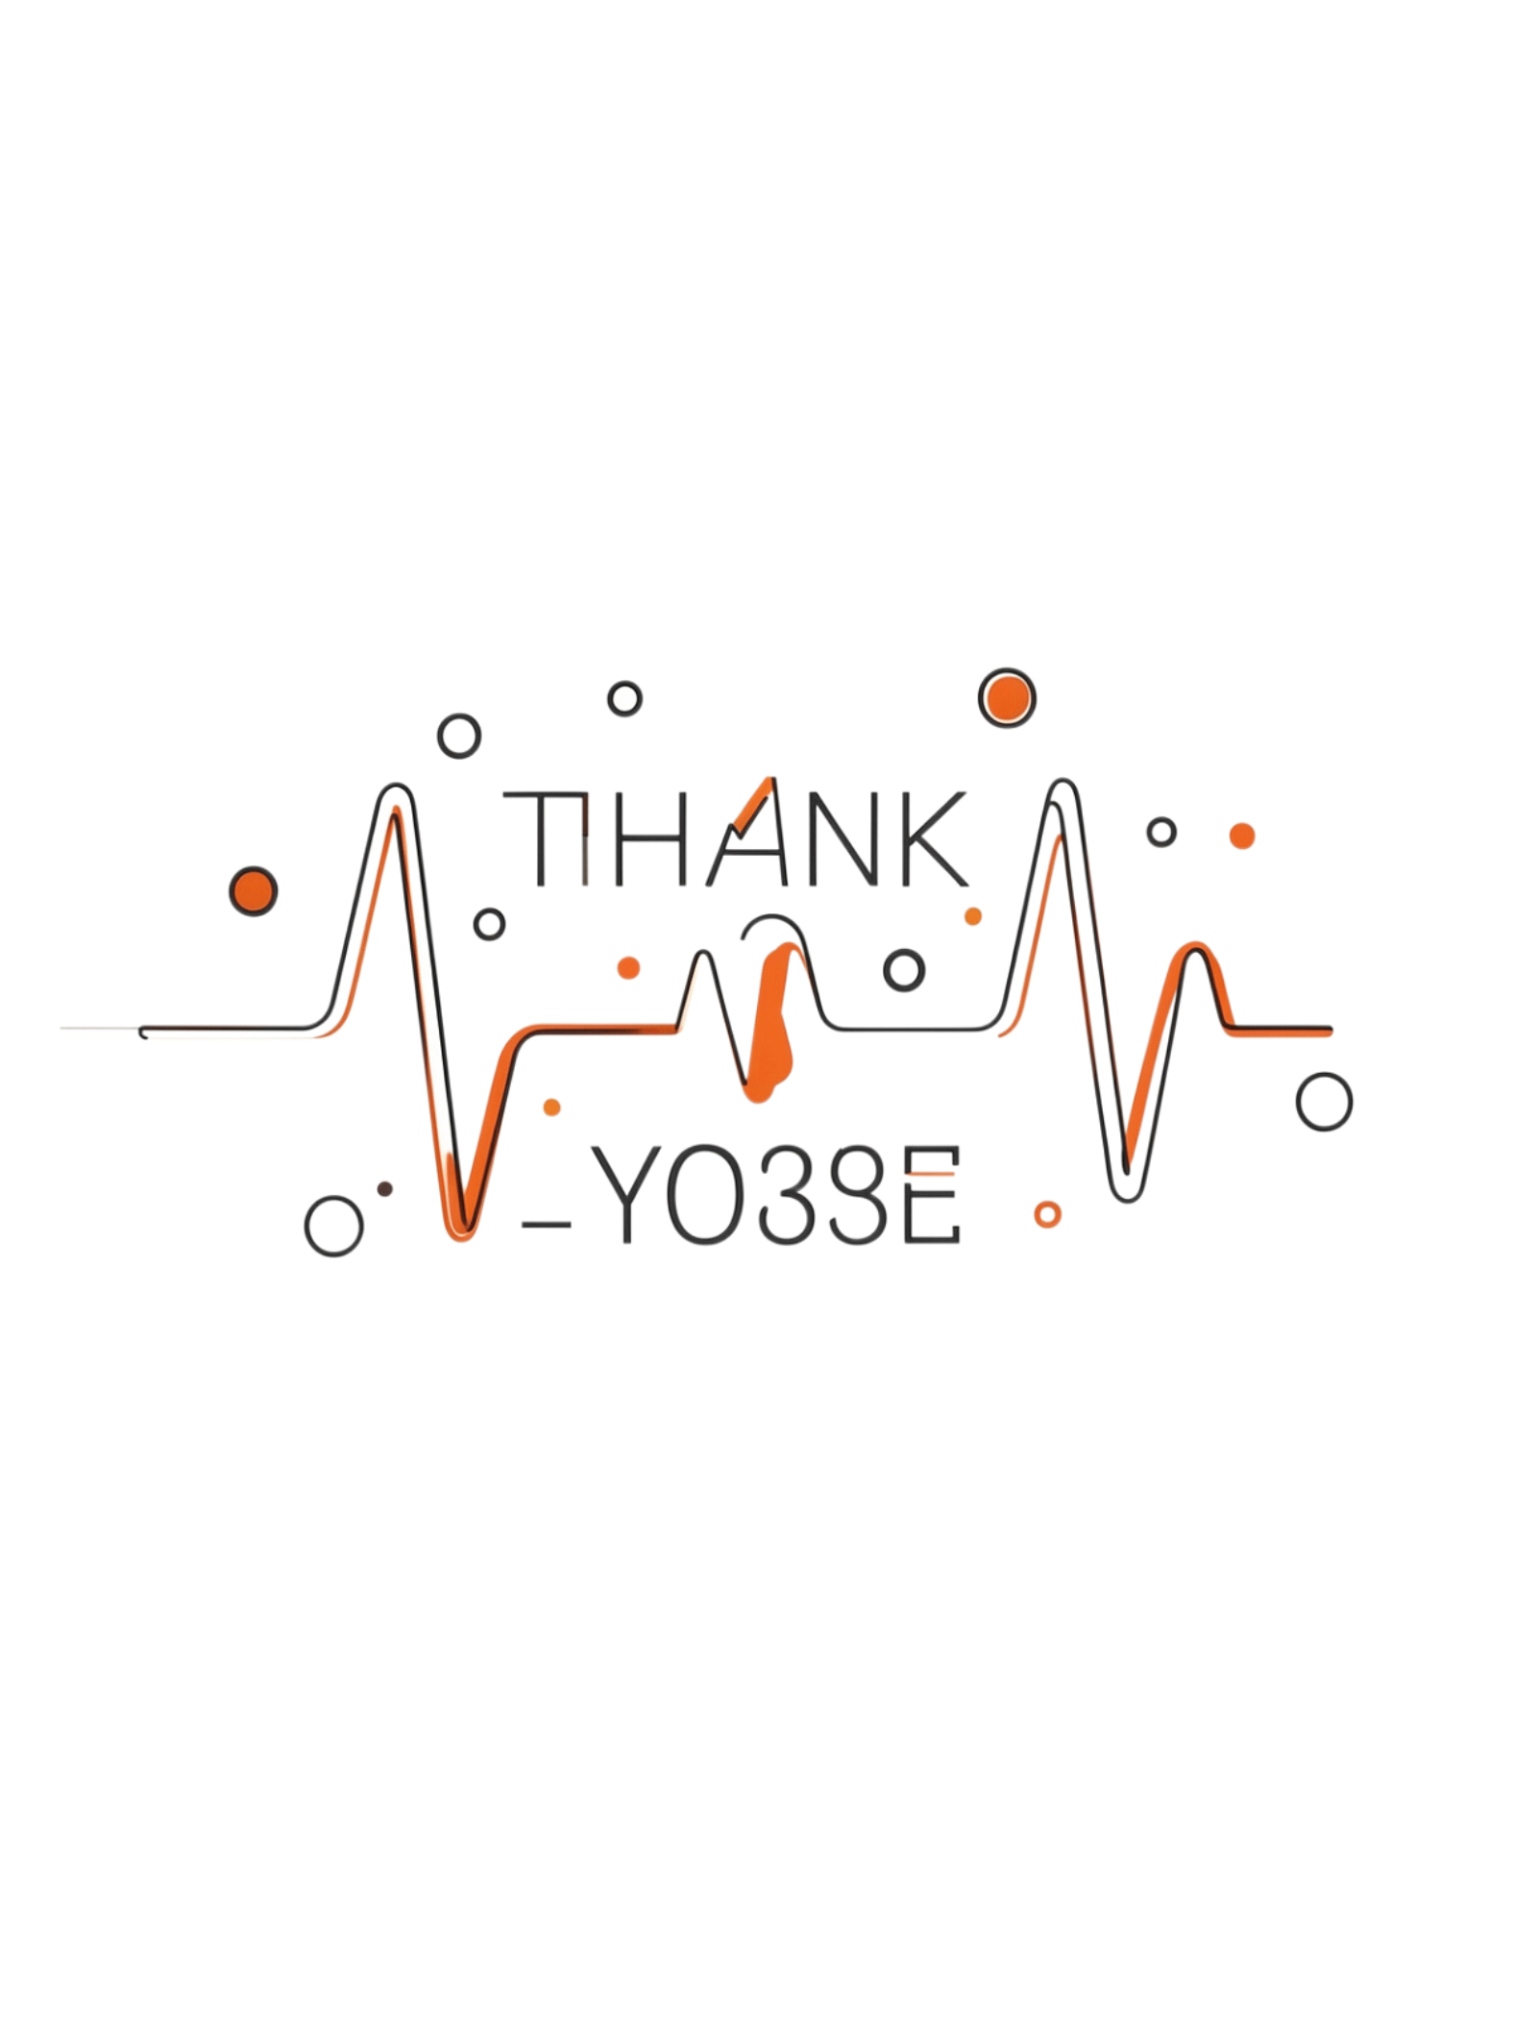
Conclusion & Future Scope
We integrated smart IV infusion, an intelligent syringe pump, and heart-rate monitoring on an ESP32 platform to deliver an affordable bedside automation system that improves patient safety and reduces staff workload.
Future Improvements
Contact
AI-based health prediction and anomaly detection
Additional sensors: BP, SpO2, ECG
Mobile app and cloud connectivity for longitudinal records
Thank you!

