Slide 1


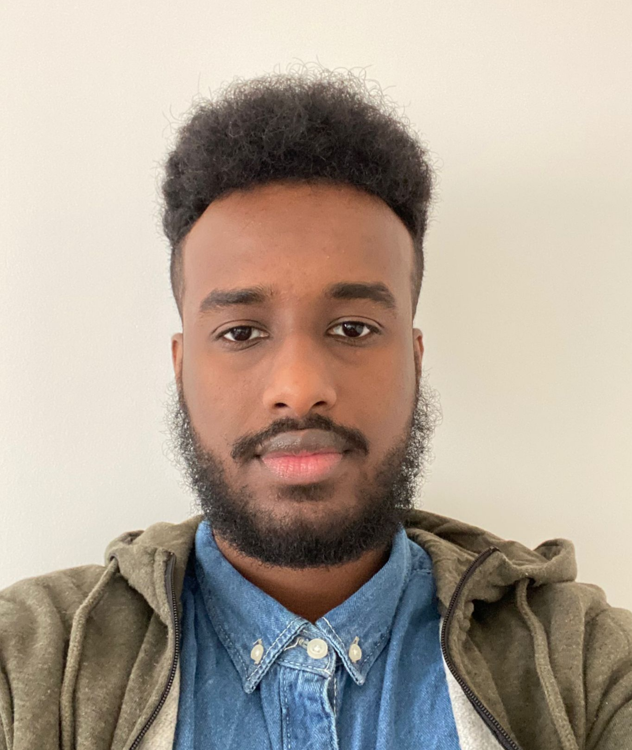
PROJECT OVERVIEW
https://github.com/khalidhersi/my-portfolio
Khalid
Hersi
Junior Full Stack Engineer
WORK EXPERIENCE
ABOUT ME
Security Guard, 2018 to Current
Deploy UK - London, England
Responded to alerts from security systems, taking action according to guidelines.
Triaged problems quickly and provided precise and clear information while working under minimum supervision.
Communicated with team members and building management via radio, telephones and computers.
Deterred criminal activity, vandalism and general misconduct by providing expert and highly visible security presence
I've always been around technology, as I grew I saw the growth of other technologies. From windows 98, XP, 7 to 10 I spent my life always fascinated on how computers worked. By 10 I taught myself basic html, using it to build simple websites to hold my old YouTube videos.
I started fixing the computers of close family members once I learnt more and felt more confident I tinkered with the insides of my own PC, this became a hobby and let me to build a number of Gaming rigs.
From these experiences I went on to study engineering at university thinking it would give me the same thrills. During my course I came across MATLAB; an engineering coding language, this brought the world of programming back into my eyes. In my free time I started learning C# to help me build games on unity; doing so I realized I wanted to spend my life making programs and solving problems using computer logic alone. This introduced me to the world of software development leading me to where I am today.
KEY COURSE SKILLS
HTML, CSS, SASS/SCSS, JavaScript, React, Jest, Cypress, React Testing Library, REST APIs, Test Driven Development, OOP, Java, C#, Spring, SQL and GCP.
EDUCATION
HOBBIES
Sept 2017 – Aug 2020, Brunel University, London, UK, BEng Civil Engineering
Combat martial arts including: boxing, taekwondo & kung fu
Coding games on unity
Spending time in the gym
Notes:
Once you have filled out your profile completely – export the document as a PDF.
Please do not move the _nology logo, ink drop or main layout of the document. The section sizes will differ person to person, but the overall layout must remain the same.

