Slide 1
Ecommerce Purchase Logs
Muhammad Khalid

Slide 2
Problem Statement
Overall overview of revenue of the business
Real time access to purchase history

Slide 3













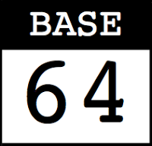





Slide 4
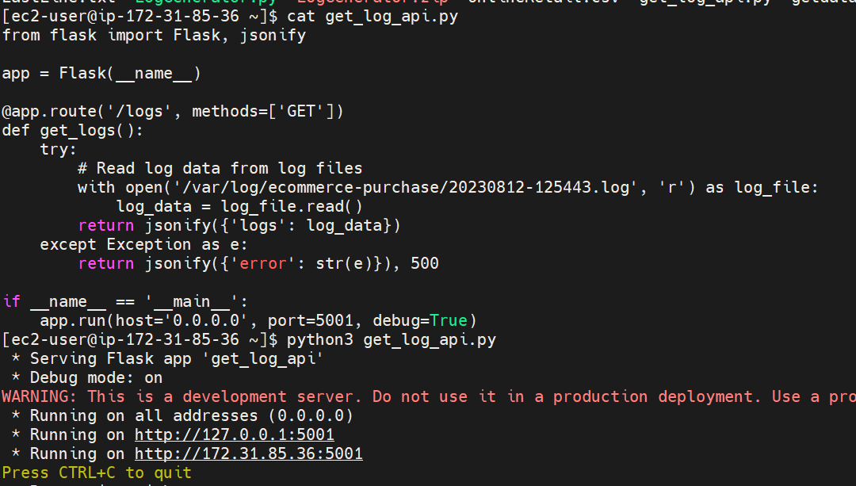

Slide 5
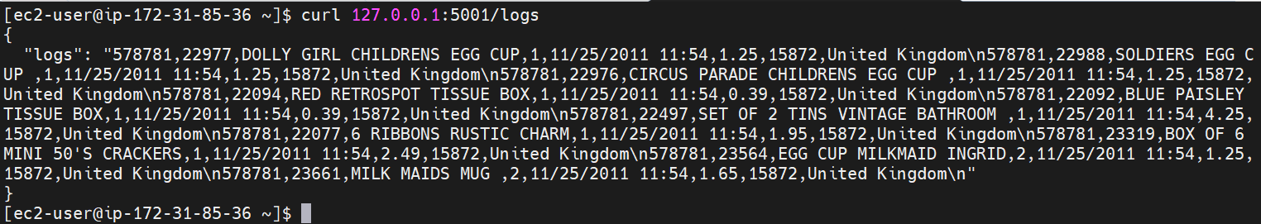

Slide 6
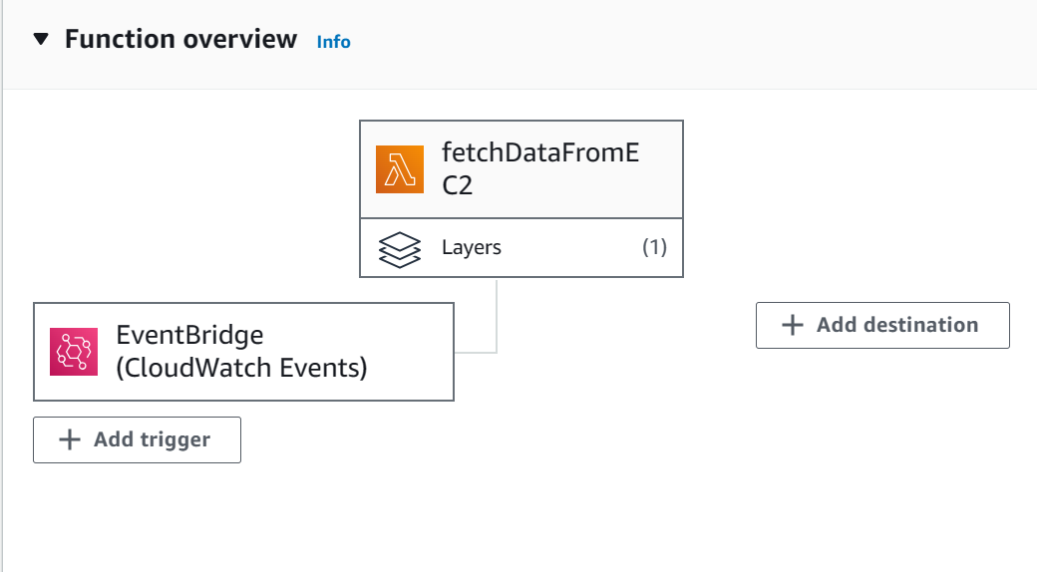

Slide 7
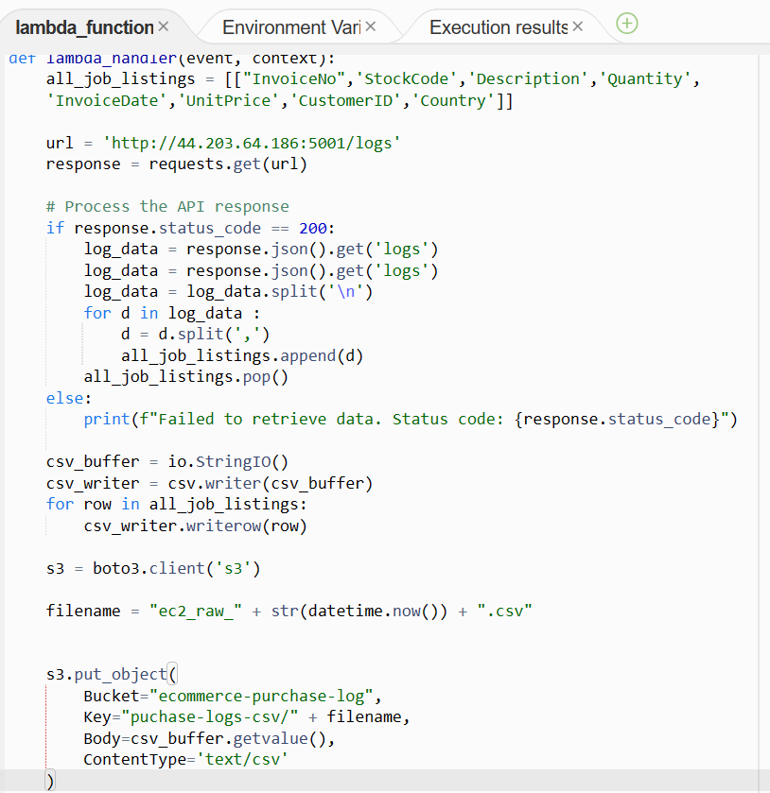

Slide 8
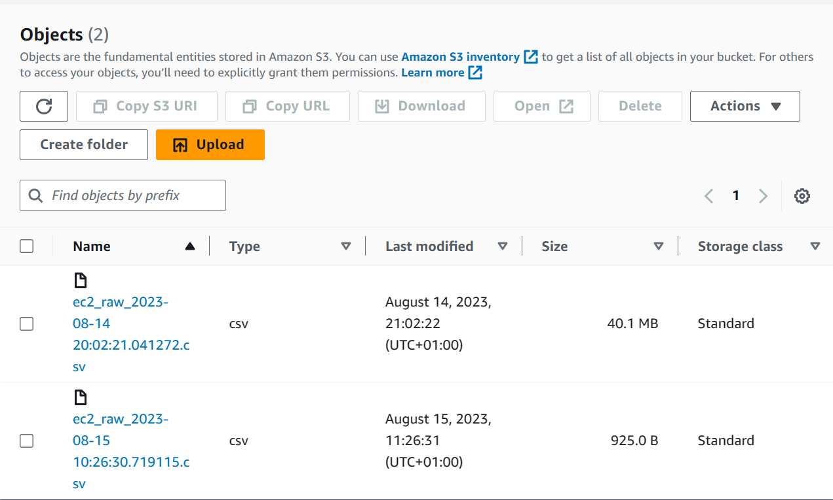

Slide 10
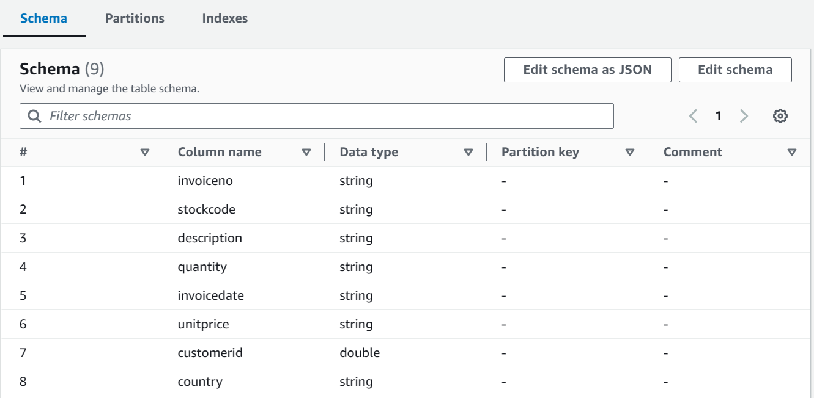

Slide 11
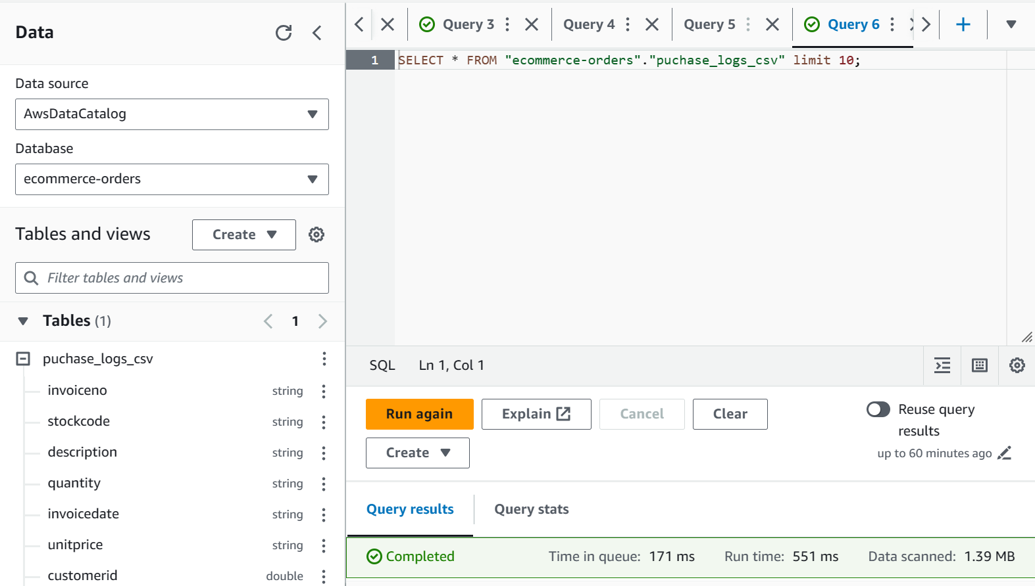

Slide 12
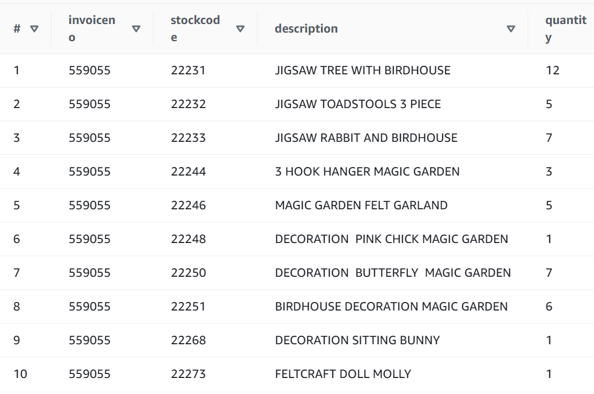

Slide 13
Thanks.
Any Question?

