Slide 1
Ecommerce User Behavior
Muhammad Khalid
04/08/2023
Big Data Developer– Information Tech Consultants

Slide 2
Business Nature
Sell product through an online platform
Physical product such as electronics, clothing and books.
Digital products such as software and e-books.

Slide 3
Problem Statement
Analyze the user behavior on the website to gain insights and make data-driven decisions
1
Understand user behavior patterns
2
Identify potential areas of improvement
3
Optimize the user experience to increase sales
4

Slide 4
Business Objectives
Increase Customer Engagement
Improve Customer Satisfaction
Boost Cross-Selling and Upselling
Enhance Customer Retention
Increase Conversion Rates

Slide 5









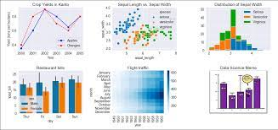




Batch Data Ingestion
End to end pipeline
Curated data
Curated data

Slide 6
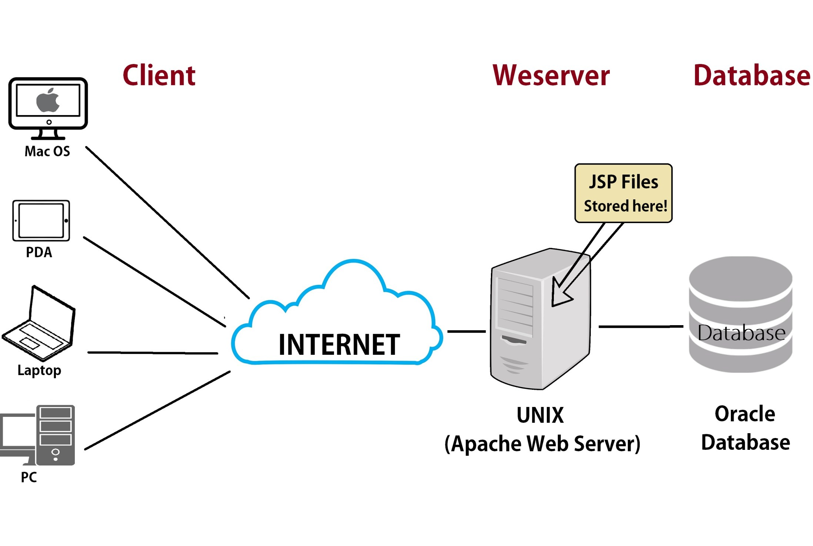






CI/CD Pipeline
Real Time Streaming
commit
postgresql
push
Event_logs
user/product
Webhooks
build

Slide 7
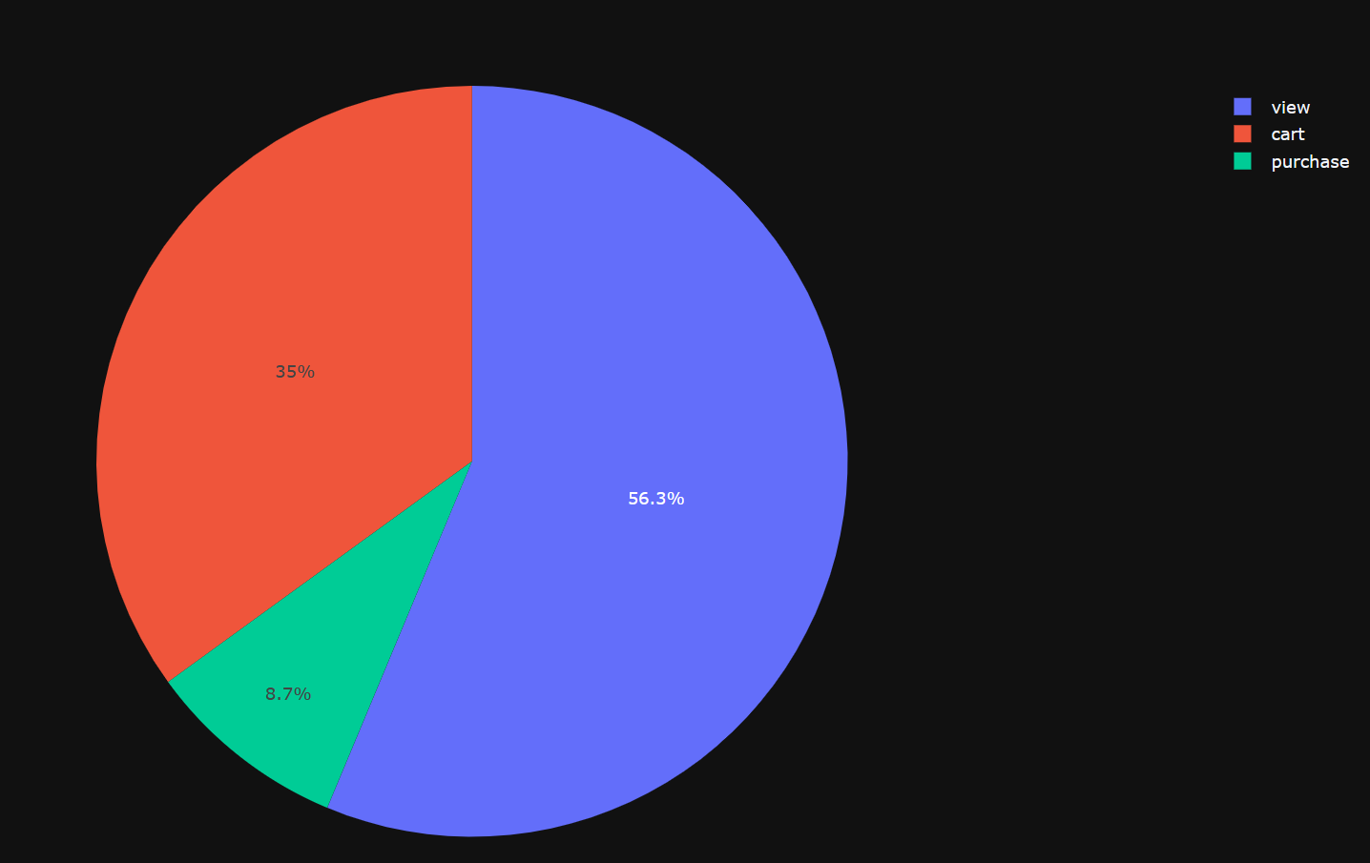

Slide 8
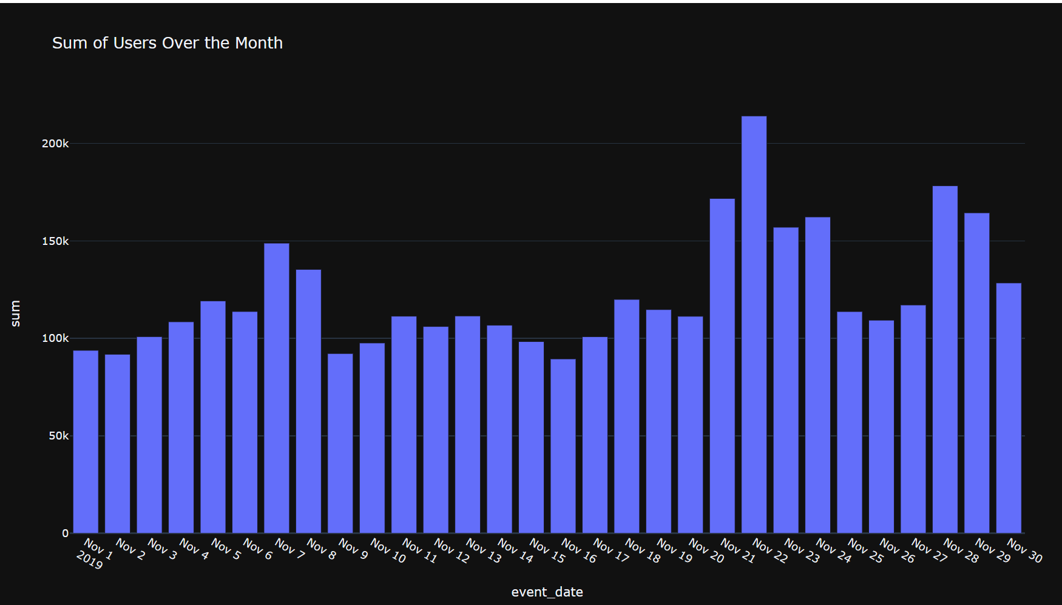

Slide 9
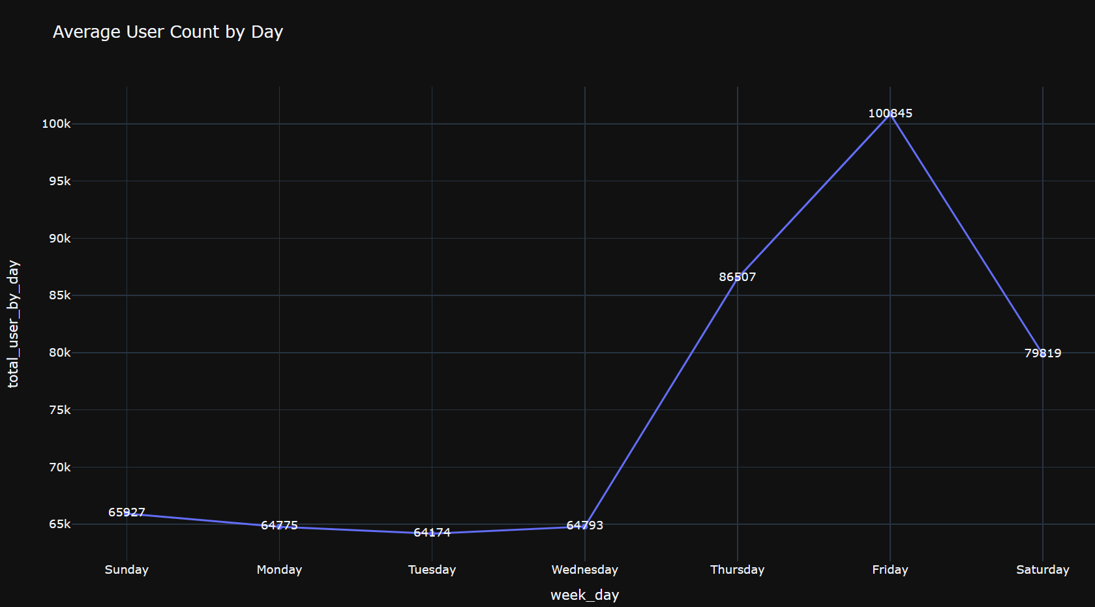

Slide 10
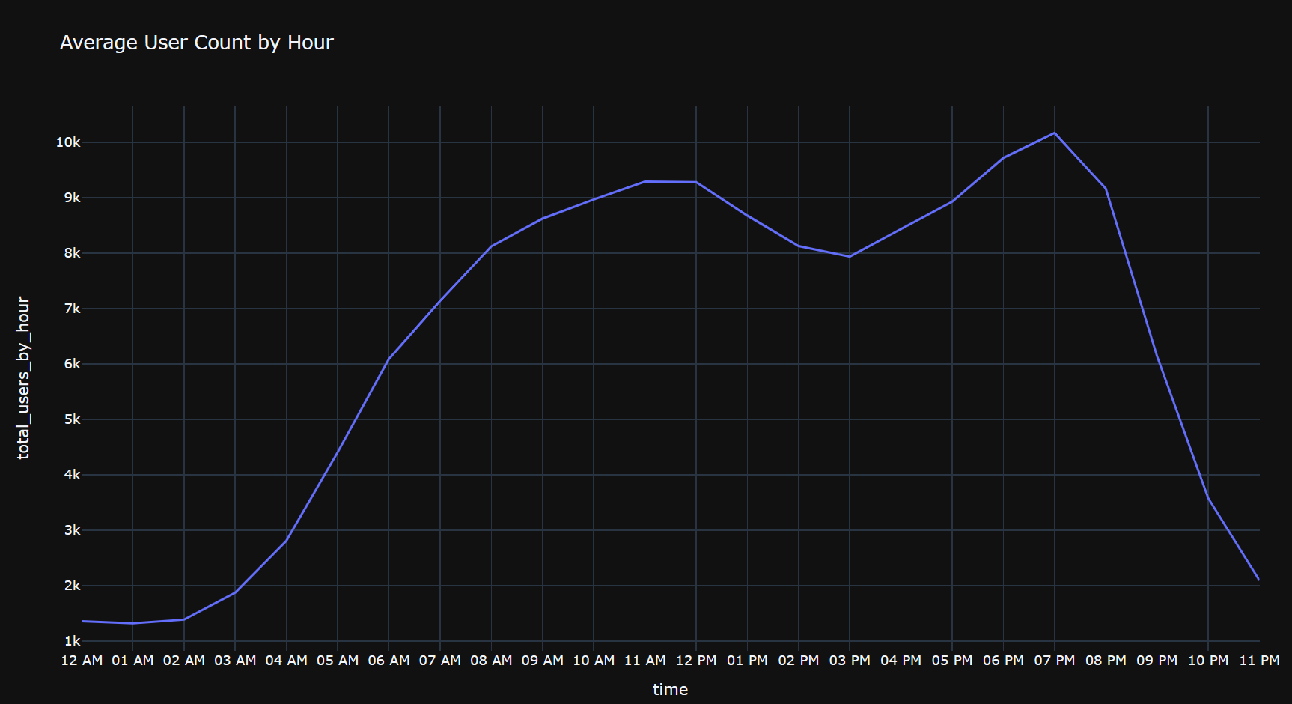

Slide 11
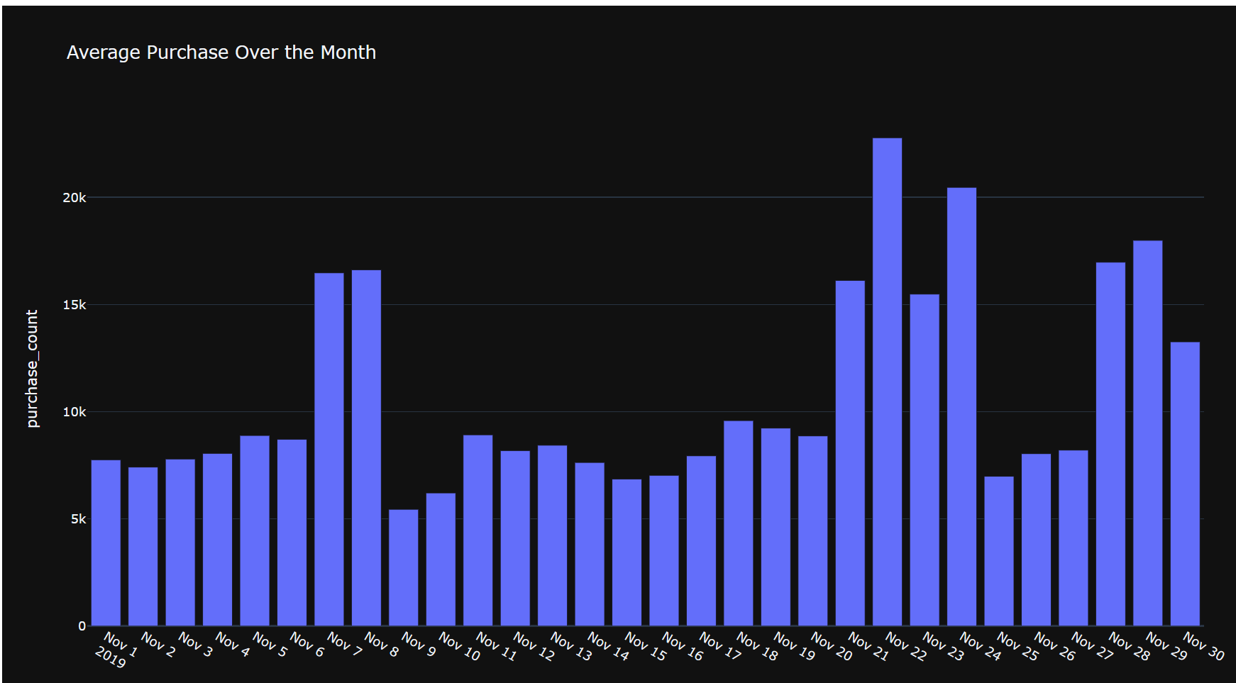

Slide 12
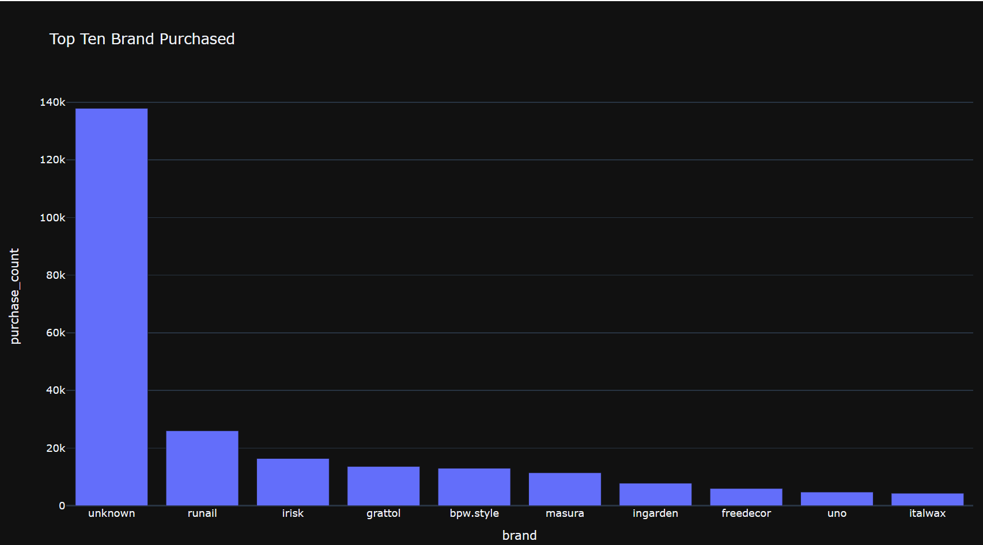

Slide 13
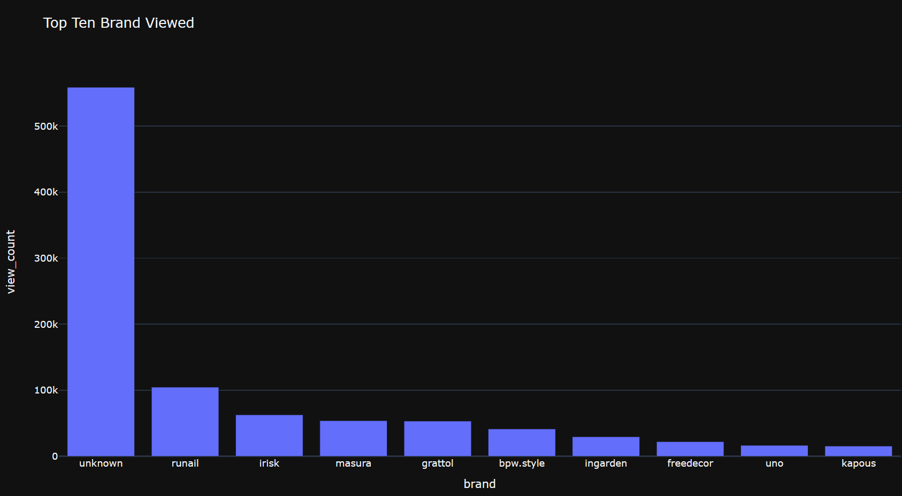

Slide 14
Further Enhancements
Personalized Email Marketing
Dynamic Pricing Strategy
Sentiment Analysis
Predictive Analytics
Social Media Integration

Slide 15

Thanks
Any Question

