Slide 1
Cassendra vs MongoDB
Muhammad khalid

Slide 2
The CAP theorem
The CAP theorem, also known as Brewer's theorem, is a fundamental principle in distributed systems and databases that outlines the trade-offs between three essential properties: Consistency, Availability, and Partition Tolerance. It was introduced by computer scientist Eric Brewer in 2000 and has since become a guiding principle in designing and understanding distributed systems.

Slide 3
Consistency
All nodes in a distributed system have the same data at any given point in time
Whenever a data item is updated, all subsequent requests for that item should return the updated value.
Achieving consistency ensures that the system maintains data integrity and avoids conflicting states.

Slide 4
Availability
Any client making a request for data gets a response
All working nodes in the distributed system return a valid response for any request, without exception

Slide 5
Partition tolerance
The cluster must continue to work despite any number of communication breakdowns between nodes in the system.

Slide 6
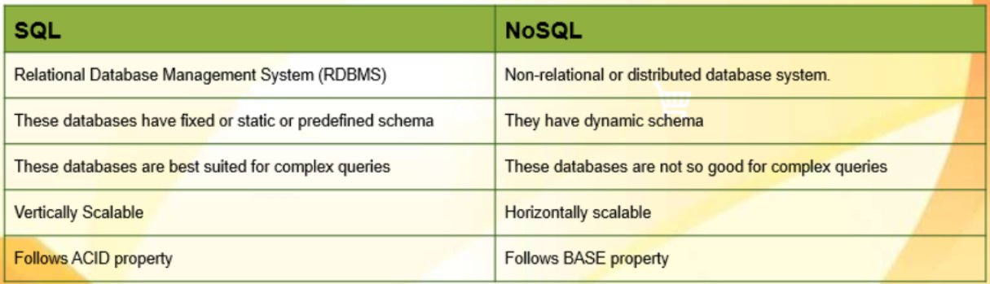
SQL vs NoSQL

Slide 7
Introduction to MongoDB
MongoDB is open-source NoSQL database
Document-Oriented: MongoDB stores data in flexible, JSON-like documents
Scalability: MongoDB is designed to scale horizontally by sharding data across multiple servers
High Performance: MongoDB provides fast read and write operations due to its in-memory processing and efficient data storage format
Replication: MongoDB supports automatic data replication across multiple servers
Aggregation Framework: MongoDB's aggregation framework allows you to perform complex data aggregation operations

Slide 8
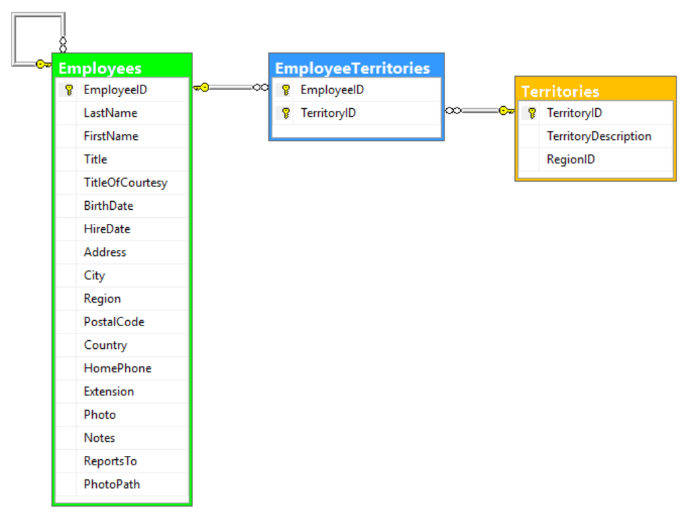

Slide 9
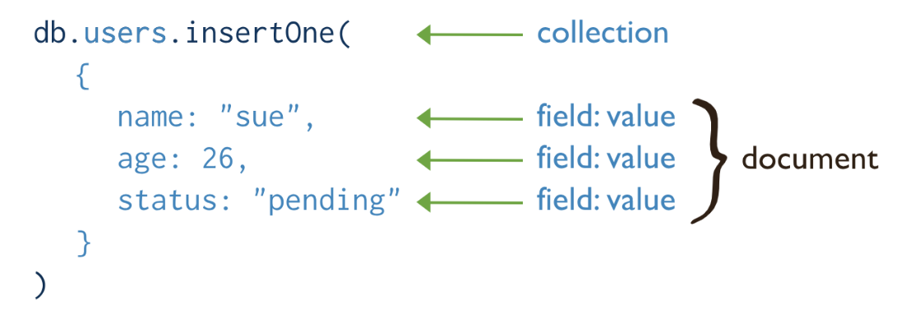
MongoDB uses name-value pairs or fields, which then make up documents, which make up collections

Slide 10
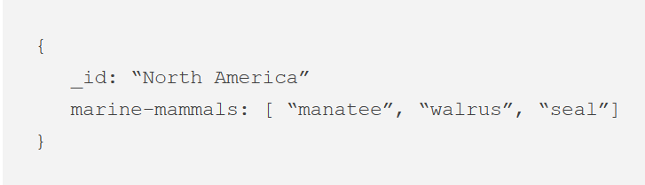
Arrays or List

Slide 11
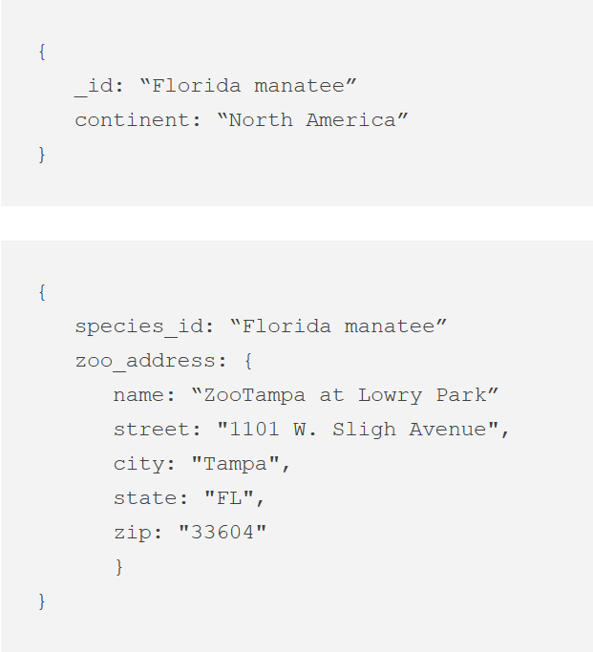
Embedded Documnet

Slide 12
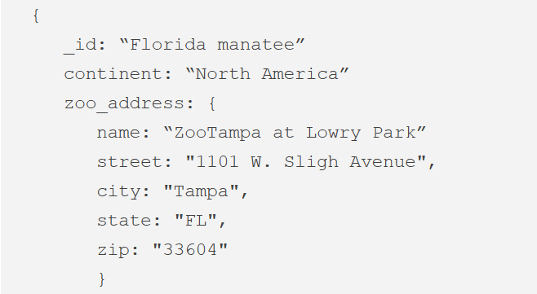

Slide 13
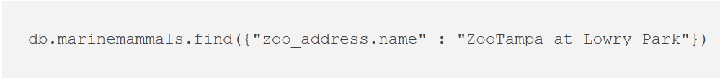
Dot Notation

Slide 14
What Is Database Scalability?
Scalability is the ability to expand or contract the capacity of system resources in order to support the changing usage of your application.

Slide 15
Challenges Database Server
The CPU and/or memory becomes overloaded
Database server runs out of storage
Network interface is overloaded

Slide 16
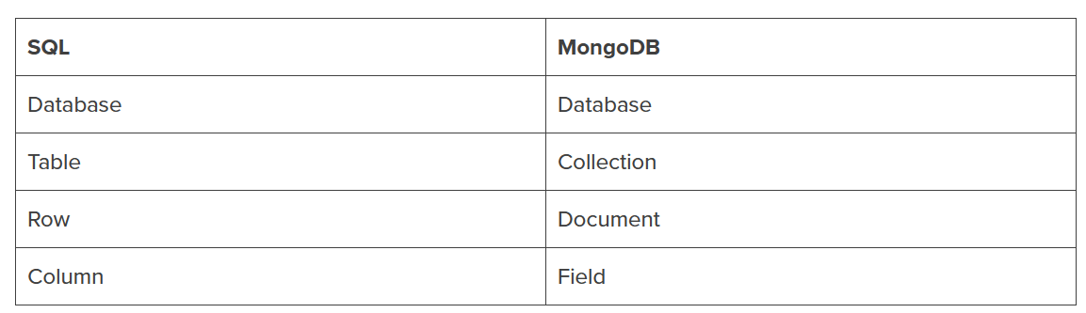

Slide 17
Data scaling
Horizontal scaling: Spreads out the load over multiple servers instead of relying on a single high-speed, high capacity server
High scalability: Distribute large volumes of data across multiple machines, and only add servers as needed.

Slide 18
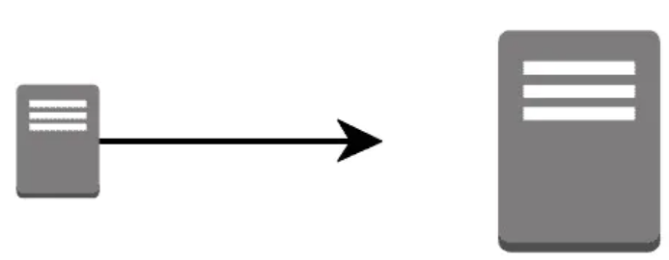
What is Vertical Scaling?
Vertical scaling refers to increasing the processing power of a single server or cluster

Slide 19
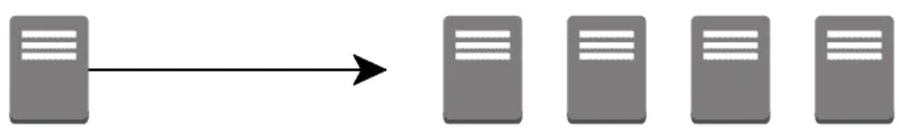
What is Horizontal Scaling?
Horizontal scaling, also known as scale-out, refers to bringing on additional nodes to share the load

Slide 20
MongoDB Scaling
Replication

Slide 21
Replication
Replication refers to creating copies of a database or database node
client requests can be spread across all the nodes in the cluster instead of overwhelming a single node
Replication increases neither the total storage capacity of the system nor its ability to handle write requests

Slide 22
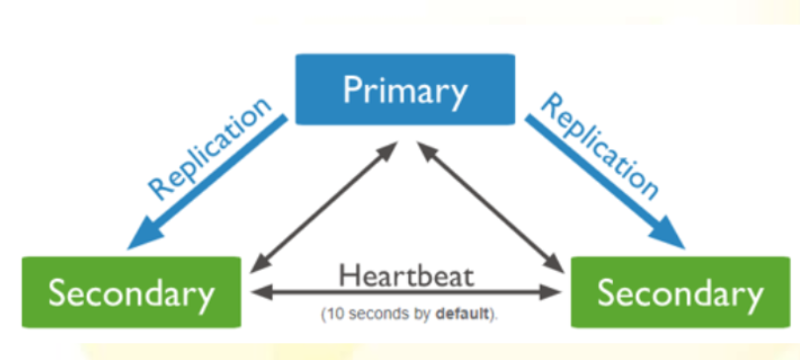
Replication

Slide 23
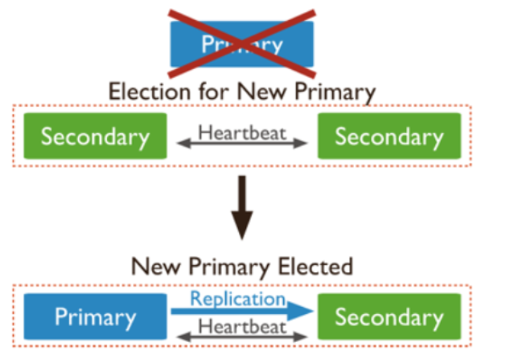
Availability

Slide 25
Partitioning (aka Sharding)
Partitioning distributes data across multiple nodes in a cluster
Each replica set (known in MongoDB as a shard) in a cluster only stores a portion of the data
Sharding key (sharding strategy), determines the distribution of the data
Each node is only responsible for processing the data it stores
Reads and writes could be done in parallel across multiple nodes.

Slide 26
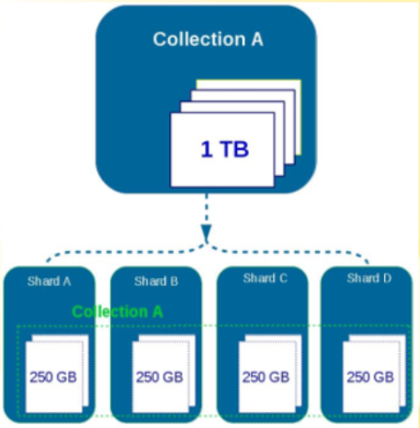
Sharding
Sharding is a method of distributing data across multiple machine
MongoDB uses sharding to support deployment with very large datasets and high throughput operation

Slide 27
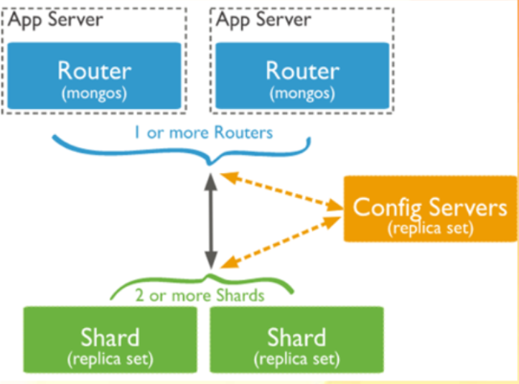
Sharding architecture
Shard is a mongodb instance to handle a subset of original data
Mongos is a query router to shard
Config server is mongo instance which store metadata information and configuration details of the cluster

Slide 28
Partitioning with Replication
Combine partitioning and replication to take advantage of both scalability and fault tolerance

Slide 29
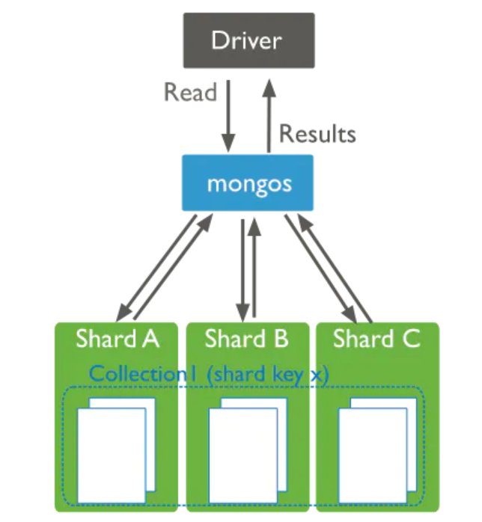
Partitioning with Replication

Slide 30
Aggregation Pipeline
An aggregation pipeline consists of one or more stages that process documents
Each stage performs an operation on the input documents
The documents that are output from a stage are passed to the next stage
An aggregation pipeline can return results for groups of documents. For example, return the total, average, maximum, and minimum values

Slide 31
db.orders.aggregate( [
// Stage 1: Filter pizza order documents by pizza size
{
$match: { size: "medium" }
},
// Stage 2: Group remaining documents by pizza name and calculate total quantity
{
$group: { _id: "$name", totalQuantity: { $sum: "$quantity" } }
}
] )

Slide 32
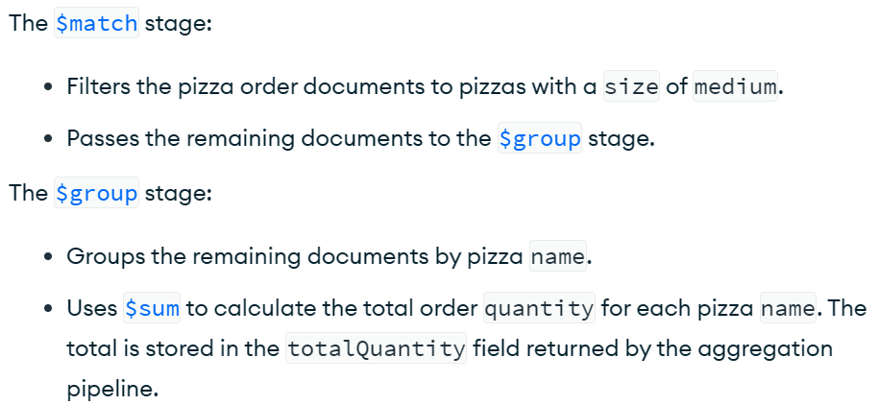

Slide 33
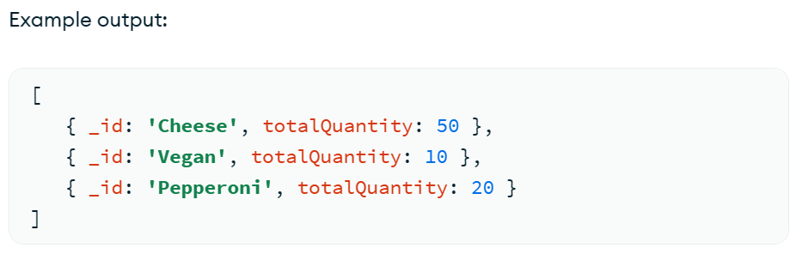

Slide 34
What is Apache Cassandra?
Cassandra is an open-source distributed NoSQL database management system
Cassandra is designed to handle large volumes of data across multiple servers
Cassandra has ability to handle write-heavy workloads
Cassandra is highly fault tolerant
Cassandra is originally developed by Facebook and later open-sourced as Apache Cassandra

Slide 35
Introduction
Apache Cassandra stores data in tables
Cassandra does not support relational data modeling intended for relational databases.
CQL (Cassandra Query Language) is used to query the data stored in tables

Slide 36
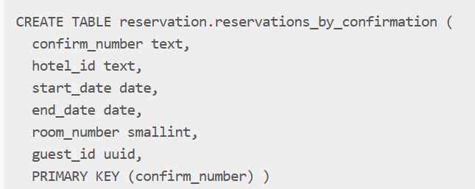

Slide 37
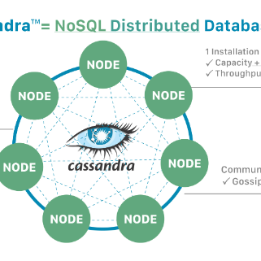
Key Features of Cassandra
Distributed Architecture: Cassandra is designed to be distributed across multiple nodes in a cluster
masterless architecture – any node in the database can provide the exact same functionality as any other node

Slide 38
Partitions
In Cassandra, the data itself is automatically distributed, with (positive) performance consequences.
Each node owns a particular set of tokens
The partition key is responsible for distributing data among nodes

Slide 39
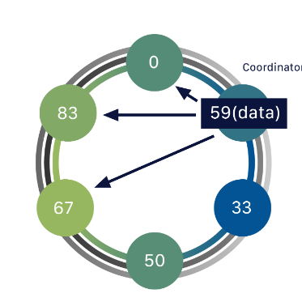
Key Features of Cassandra
Data Replication: Cassandra allows you to choose the replication factor

Slide 40
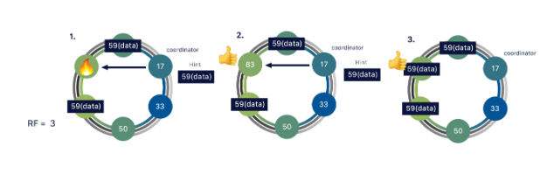
Key Features of Cassandra
No Single Point of Failure: Cassandra provides fault tolerance by replicating data across multiple nodes in the cluster

Slide 41
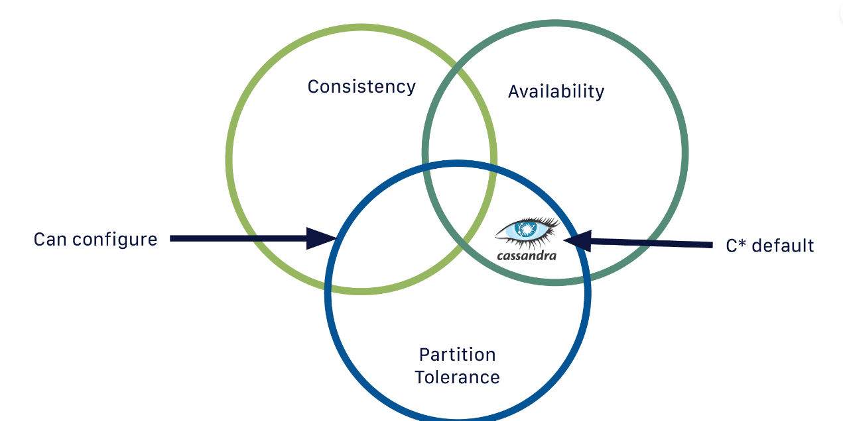
Cassandra is by default an AP (Available Partition-tolerant) database

Slide 42
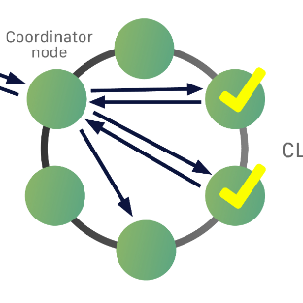
Quorum = RF/2 +1
Consistency can be configured on a per-query basis
Coordinator will need to get acknowledgement back from two of the replicas

Slide 43
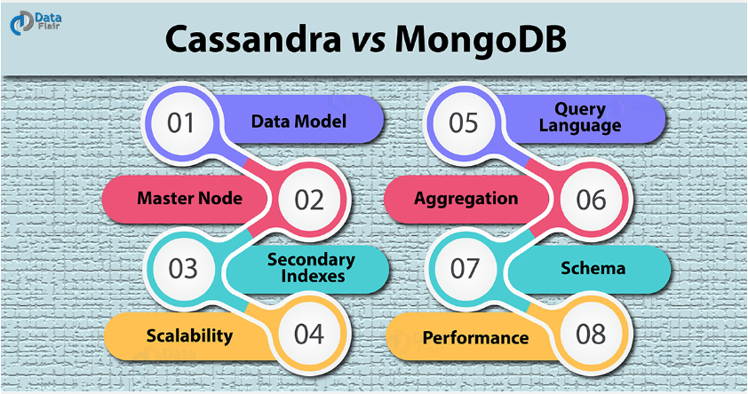

Slide 44
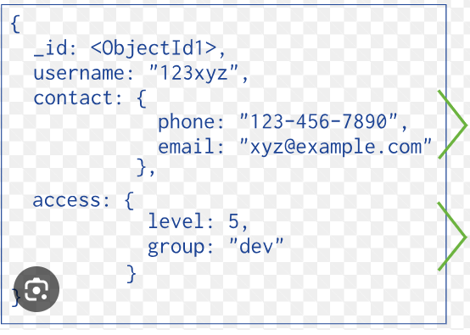
MongoDB Data Model
MongoDB has a rich and expressive data model. This data model is ‘object-oriented’ or ‘data-oriented

Slide 45
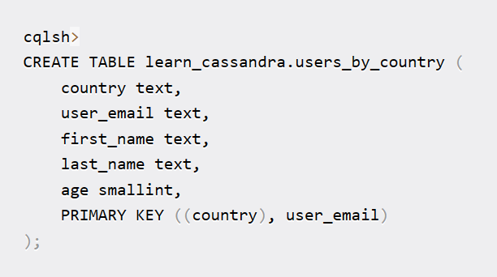
Cassendra Schema
In Cassandra, the data model is based on a wide-column store
Each row in a table has a defined set of columns
all rows in the table have the same column structure
Cassandra requires a schema to be defined before data can be inserted into a table

Slide 46
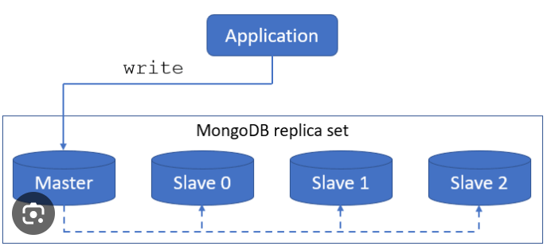
MongoDB Master Node
In MongoDB, there is only one master node in a cluster

Slide 47
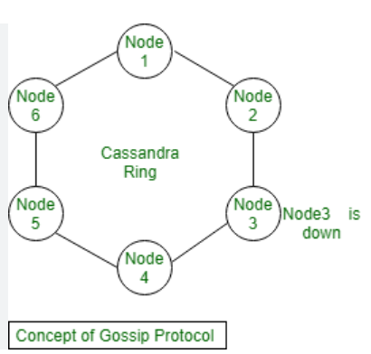
Cassendra Master Node
It has multiple master nodes in a cluster

Slide 48
MongoDB Secondary Indexes
Better query performance than Cassandra secondary indexes
Useful for equality queries, range queries, and sorting.

Slide 49
Cassendra Secondary Index
Querying using a secondary index might involve multiple read operations across multiple nodes, which can impact performance
Cassandra's secondary indexes are limited in functionality compared to primary keys.
They are efficient for equality queries but not well-suited for range queries

Slide 50
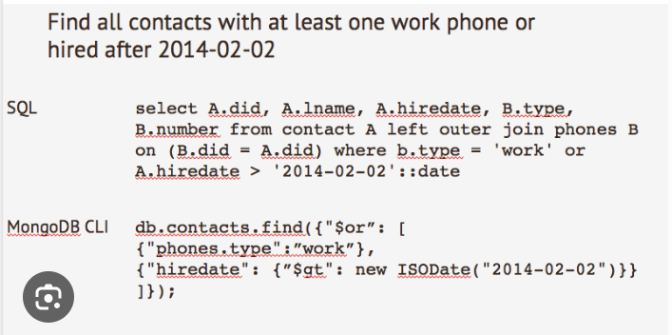
MongoDB Query Language
MongoDB uses a query language similar to JSON called MongoDB Query Language (MQL)
MQL is expressive and flexible, allowing for complex queries and easy manipulation of JSON-like documents
MongoDB supports a wide range of query operators

Slide 51
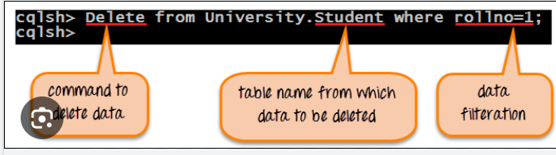
Cassendra Query Language
Cassandra uses Cassandra Query Language (CQL), which is similar to SQL in terms of syntax
CQL supports standard SQL-like operations for data manipulation
However, CQL lacks certain advanced querying features compared to MongoDB's MQL

Slide 52
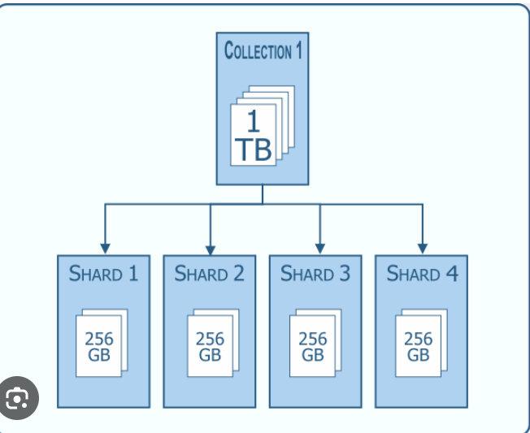
MongoDB Scalability
MongoDB uses a sharding architecture for horizontal scalability
Each shard can be deployed on a separate server

Slide 53
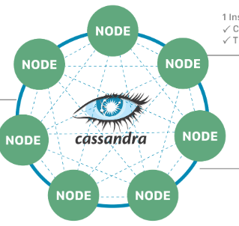
Cassendra Scalability
Cassandra uses a distributed architecture with a peer-to-peer design, where all nodes in the cluster are considered equal

Slide 54
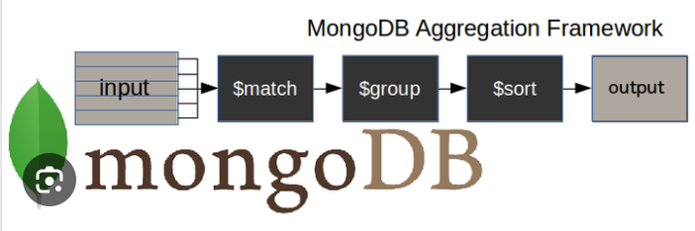
MongoDB Aggregation
MongoDB provides a powerful and flexible aggregation framework that allows you to perform complex data transformations and analytics on your data.
The MongoDB aggregation pipeline is a sequence of stages

Slide 55
Cassendra Aggregation
Cassandra does not have a built-in aggregation framework like MongoDB
Cassandra uses external tools like Apache Spark, Hadoop etc.
To perform aggregation in Cassandra, you typically need to denormalize your data

Slide 56
Performance
MongoDB uses a single-master architecture, where all writes are directed to the primary node, and reads can be performed from any replica set member
Cassandra uses a masterless architecture with no single point of failure, allowing it to provide seamless performance even in the face of node failures.
It uses a peer-to-peer approach, where all nodes are equal

Slide 57
Thanks You
Any Question

